Slide 1
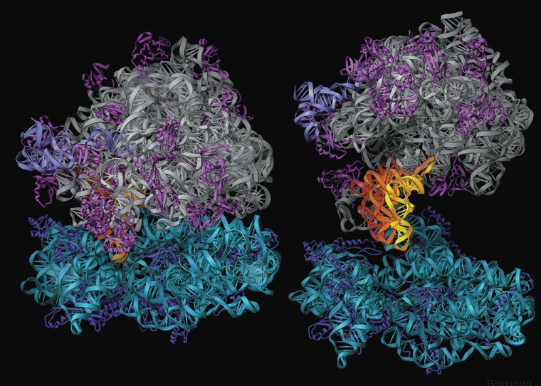
Protein Synthesis-
the ”Stuff of Life“
Translation- Making the Protein

Slide 2
Protein Synthesis: An Overview
2
Notes:
2

Slide 3
Translation Overview
Translation involves mRNA→Protein
Materials needed for translation
Ribosome
tRNA’s with the correct amino acid connected to it.
Mature mRNA
3
Notes:
3

Slide 4
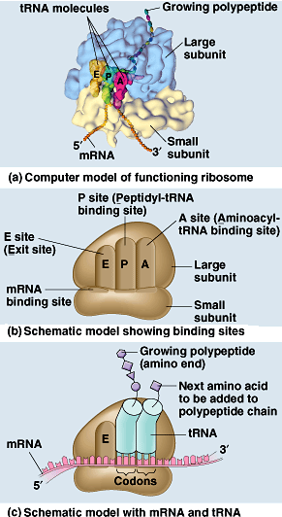
Ribosome Structure
1. Ribosomes-are made from proteins and rRNA. It has two subunits, a small subunit and a large subunit. There are three sites where the tRNA attaches.
The A site is where the tRNA arrives with the amino acid.
The P site has a tRNA that attaches to the tRNA at the A site.
The E site is where the tRNA exits without an amino acid.
Notes:
1. Ribosomes-are made from proteins and rRNA. It has two subunits, a small subunit and a large subunit. Only when the ribosome is translating are the subunits together. Several ribosomes (polyribosomes) can translate the same piece of mRNA. There are three sites where the tRNA attaches.
-The A site is where the tRNA arrives with the amino acid.
-The P site has a tRNA that attaches to the tRNA at the A site.
-The E site is where the tRNA exits without an amino acid.
While very similar in structure and function, prokaryotic and eukaryotic ribosomes have enough differences that certain antibiotic drugs (like tetracycline) can disable prokaryotic ribosomes without inhibiting eukaryotic ribosomes.

Slide 5
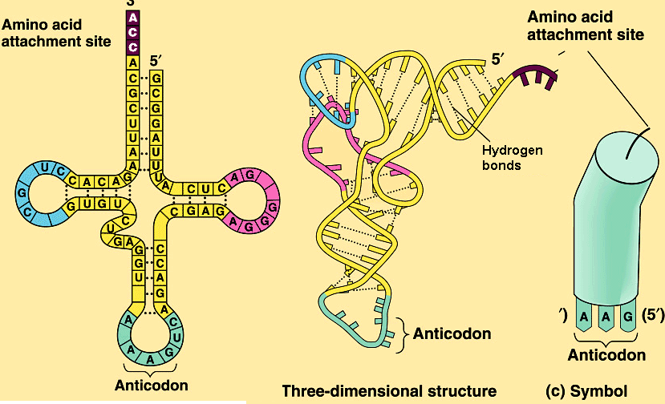
Structure of tRNA
2. tRNA brings the correct amino acid to the mRNA.
Notes:
2. tRNA-brings the correct amino acid to the mRNA. There is “self” base pairing that allows the tRNA to form a clover leaf shape. At the end of the tRNA there are three nucleotides that will base pair with the mRNA codons using complementary pairing (called the anticodon). So if the mRNA is AUG, the anticodon on the tRNA will be UAC. The amino acid attached to the 3’ end at the A-C-C position. Theoretically there should be 61 different types of tRNA because there are 61 anticodons (64-3 stop codons) but because there is often redundancy at position #3 on the mRNA codon, the base pairing rule is not as strict at position #3 as it is for first two. As a result, there are only 45 tRNA molecules. This is relaxing of the pairing between the third base of the codon and anticodon is called wobble.
At the wobble position, U on the anticodon can bind with A or G in the third position of a codon.
Some tRNA anticodons include a modified form of adenine, inosine, which can hydrogen bond with U, C, or A on the codon.

Slide 6
Notes:
2. tRNA-brings the correct amino acid to the mRNA. There is “self” base pairing that allows the tRNA to form a clover leaf shape. At the end of the tRNA there are three nucleotides that will base pair with the mRNA codons using complementary pairing (called the anticodon). So if the mRNA is AUG, the anticodon on the tRNA will be UAC. The amino acid attached to the 3’ end at the A-C-C position. Theoretically there should be 61 different types of tRNA because there are 61 anticodons (64-3 stop codons) but because there is often redundancy at position #3 on the mRNA codon, the base pairing rule is not as strict at position #3 as it is for first two. As a result, there are only 45 tRNA molecules. This is relaxing of the pairing between the third base of the codon and anticodon is called wobble.
At the wobble position, U on the anticodon can bind with A or G in the third position of a codon.
Some tRNA anticodons include a modified form of adenine, inosine, which can hydrogen bond with U, C, or A on the codon.

Slide 7
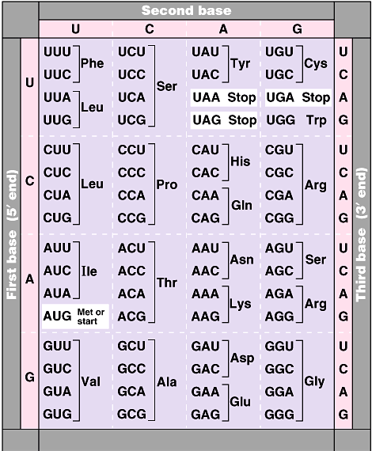
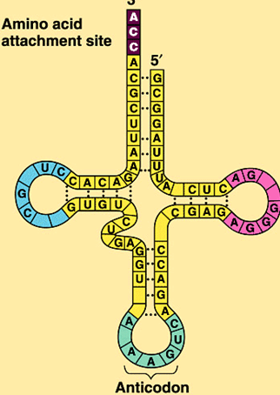
Structure of tRNA
Notes:
Example of the wobble effect.
UCA and UCG code for serine and if the tRNA anticodon is AGU and U will pair with either A or G, the tRNA will still bring amino acid serine.
GCA and GCG code for alanine and if the tRNA anticodon is CGU and U will pair with either A or G, the tRNA will still bring amino acid alanine.

Slide 8
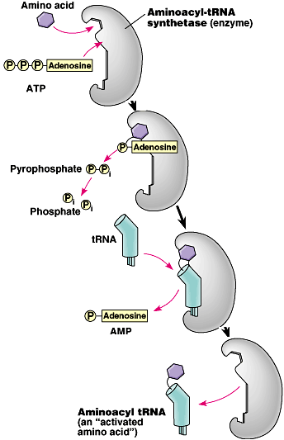
Attaching an Amino Acid to a tRNA
The tRNA must get its amino acid by combining with a charging enzyme (aminoacyl-tRNA synthetase). This enzyme will "put" the correct amino acid on to the tRNA according to its anticodon. ATP is also needed in this process.

Slide 9
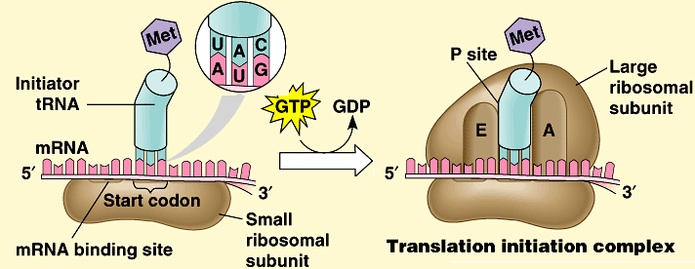
Initiation of Translation
The parts to translation are
Initiation 2. Elongation 3. Termination
1. Initiation- The small subunit attaches to the mRNA at AUG (start). Now the tRNA with the anticodon UAC will attach to the P site. Then the large subunit will attach to the small subunit.

Slide 10
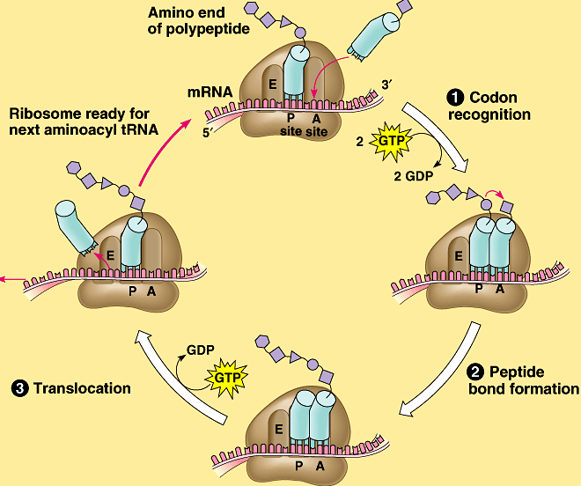
Elongation
2. Elongation- The second tRNA arrives and attaches at the A site, with the correct anticodon and the correct amino acid. A peptide bond is formed between the amino acids and water is removed.
Notes:
The mRNA will now move down one codon called translocation. The tRNA at the P site relocates and releases the amino acid stays on the growing polypeptide chain. The tRNA moves from the P site to the E site. The tRNA at the A site is now relocated to the P site and now a new tRNA will arrive starting the cycle all over again.
Notice that phosphorylation is involved and that two molecules of GTP are required. Once the tRNA exits leaving its amino acid behind, the tRNA is free to interact with aminoacyl-tRNA synthetase and combine with another amino acid.

Slide 11
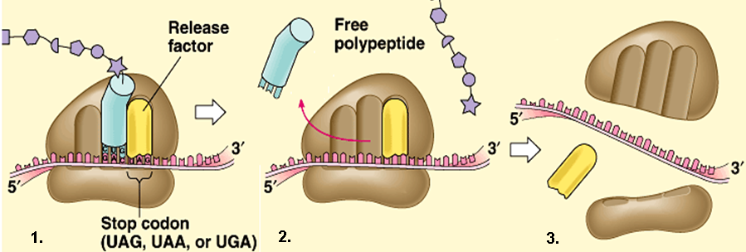
Termination
3. Termination- At the stop codon, a stop protein (release factor) will attach at the A site. This will cause the release of the last tRNA, the polypeptide chain and cause the ribosome to fall apart.

Slide 12
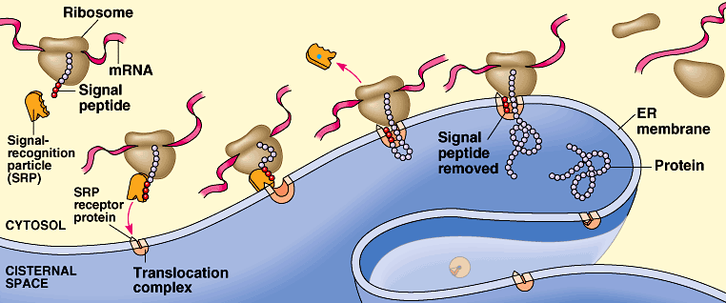
Exported Proteins
Exported proteins are tagged and interact with signal recognition particles (SRP). This SRP is responsible for threading the synthesized protein into the lumen of the E. R.
Notes:
Proteins will be exported have a signal tag that interacts with a signal recognition particle SRP “recognizes and attaches to”. The SRP is attracted to the protein pore on the E.R. The synthesized protein is threaded into the cisternae of the E.R. The ribosome detaches once the protein is made.

Slide 13
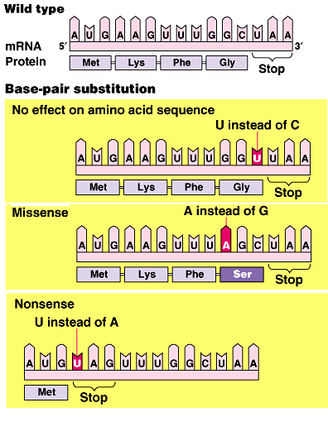
Base Pair Mutations and Effects on Proteins
There are three types of base pair mutations
No effect on proteins structure
Missense mutation- Change in one amino acid
Nonsense mutation- Shortening of the polypeptide chain
Notes:
This shows the result of a base pair substitution. The first example, the mutation results in no change in the amino acid sequence because of redundancy in the universal code.
The second example results in a change in one amino acid as GGC code for glycine but AGC codes for serine.
The last example results in nonsense because AAG code for lycine but UAG codes for stop resulting in nonsense mutation.
Examples of point mutation diseases
Cystic fibrosis is caused by a mutation in the gene for cystic fibrosis transmembrane gene . The most common mutation, is a deletion of three nucleotides that results in a loss of the amino acid phenylalanine (F) at the 508th position on the protein.
Sickle cell anemia involves a point mutation in which on the hemoglobin chain glutamic acid is substituted with valine. This makes the chain slightly less soluble in the cytosol.

Slide 14
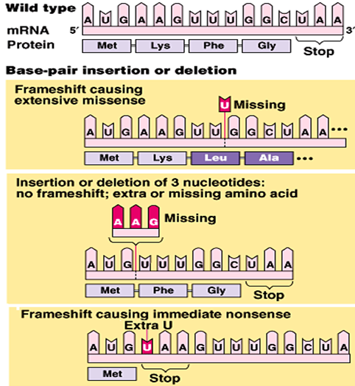
Frameshift Mutations the Effect on Proteins
Frameshift mutations result from either an insertion or a deletion of a nucleotide.
Missense mutation- Change in one amino acid sequence for the rest of the chain.
Three insertions or deletions will put the polypeptide chain back on track.
Nonsense mutation- Shortening of the polypeptide chain.
Notes:
This shows the result of a base pair insertion or deletion substitution. Results in frame shift mutation. The first one results in missense protein.
The second example results in an immediate stop codon resulting in immediate nonsense.
The last example results in three missing nucleotides which mean that the one amino acid is missing and no frameshift has been caused.
Example of a frameshift mutation
Tay-Sachs disease is an autosomal recessive disorder marked by degeneration of both mental and physical capabilities. At its worst, death usually occurs around the age of four, although there are juvenile and late-onset forms of the disease. It is caused by the build-up of a particular lipid in the brain that is normally broken down by hexosaminidase. Though different mutations in the same gene can lead to the disease, in most cases, a four base pair insertion in of the HEXA gene (chromosome 15) renders a premature stop codon, leading to a profound deficiency of one of the subunits of hexosaminidase protein.
It is important to note that not all frameshift and point mutations result in unstable, inactive proteins. Indeed, frameshift mutations can lead to new genes and novel proteins. After all, it is the ability to change DNA that leads to genetic adaptation and, ultimately, evolution of a species. It is important to relate this back to evolution.

Slide 15
Translation
Notes:
This shows the result of a base pair insertion or deletion substitution. Results in frame shift mutation. The first one results in missense protein.
The second example results in an immediate stop codon resulting in immediate nonsense.
The last example results in three missing nucleotides which means that the one amino acid is missing and no frameshift has been caused.
Example of a frameshift mutation
Tay-Sachs disease is an autosomal recessive disorder marked by degeneration of both mental and physical capabilities. At its worst, death usually occurs around the age of four, although there are juvenile and late-onset forms of the disease. It is caused by the build-up of a particular lipid in the brain, that is normally broken down by hexosaminidase. Though different mutations in the same gene can lead to the disease, in most cases, a 4 base pair insertion in of the HEXA gene (chromosome 15) renders a premature stop codon, leading to a profound deficiency of one of the subunits of hexosaminidase protein.
It is important to note that not all frameshift and point mutations result in unstable, inactive proteins. Indeed, frameshift mutations can lead to new genes and novel proteins. After all, it is the ability to change DNA that leads to genetic adaptation and, ultimately, evolution of a species. It is important to relate this back to evolution.

Slide 16
Protein Syntheis: A Review
Notes:
This shows the result of a base pair insertion or deletion substitution. Results in frame shift mutation. The first one results in missense protein.
The second example results in an immediate stop codon resulting in immediate nonsense.
The last example results in three missing nucleotides which means that the one amino acid is missing and no frameshift has been caused.
Example of a frameshift mutation
Tay-Sachs disease is an autosomal recessive disorder marked by degeneration of both mental and physical capabilities. At its worst, death usually occurs around the age of four, although there are juvenile and late-onset forms of the disease. It is caused by the build-up of a particular lipid in the brain, that is normally broken down by hexosaminidase. Though different mutations in the same gene can lead to the disease, in most cases, a 4 base pair insertion in of the HEXA gene (chromosome 15) renders a premature stop codon, leading to a profound deficiency of one of the subunits of hexosaminidase protein.
It is important to note that not all frameshift and point mutations result in unstable, inactive proteins. Indeed, frameshift mutations can lead to new genes and novel proteins. After all, it is the ability to change DNA that leads to genetic adaptation and, ultimately, evolution of a species. It is important to relate this back to evolution.

