Slide 1
2. Connective Tissue
Connective tissue is the most abundant and widely distributed type of tissue in the human body
They underlie the epithelium, support capillaries and always originate from mesenchyme

Slide 2
Roles of Connective Tissue
They wrap around and cushion/protects organs e.g. bones
Store nutrients e.g. the adipose tissue
Gives internal support for organs
Tendons and ligaments protect joints and attaches muscle to bone and to each other
They run through an organ capsule and in deep layers of skin giving strength
Binds together parts of the body

Slide 3
Components and Classification of Connective Tissue
..

Slide 4
2. Connective Tissue
Connective tissue is the most abundant and widely distributed type of tissue in the human body
The cells of connective tissue are more widely separated from each other than epithelial tissues and the intercellular substance (matrix) is present in larger amounts
Most types of connective tissue have a good blood supply

Slide 5
Characteristics of Connective Tissue
Connective tissues are highly vascularized (have a rich blood supply) except some e.g. tendons, ligaments and cartilages
They are made up of many specialized cells
They contain a large amount of non-living material called matrix composed of ground substance & fibers
Matrix is manufactured by the cells of the specific connective tissues

Slide 6
Functions of Connective Tissue
They wrap around and cushion/protects organs e.g. bones
Store nutrients e.g. the adipose tissue
Gives internal support for organs
Tendons and ligaments protect joints and attaches muscle to bone and to each other
They run through an organ capsule and in deep layers of skin giving strength
Binds together parts of the body

Slide 7
Cells in Connective Tissue
Connective tissue is found in all organs supporting the specialized tissue
The different types of cells involved include; fibroblasts, fat cells, macrophages, leukocytes and mast cells
Fibroblasts- are irregular processes. They manufacture collagen and elastic fibres and a matrix of extracellular material
Very fine collagen fibres called reticulin fibres are found in highly active tissues such as the liver and reticular tissue

Slide 8
Cells of Connective Tissue...
Fibroblasts are active in tissue repair (wound healing)
They bind together the cut surfaces of wounds or form granulation tissue following tissue destruction
Fat cells- also known as adipocytes
These cells occur singly or in groups in many types f connective tisse and are especially abundant in adipose tissue
They vary in size and shape according to the amount of fat they contain

Slide 9
Cells in Connective Tissue...
Macrophages- are large irregular-shaped cells with granules in the cytoplasm
Some are fixed i.e. attached to connective tissue fibres and others are motile
They are important part of the body’s defence mechanisms because they are phagocytic; engulfing and digesting cell debris, bacteria and other foreign bodies
Examples- macrophage defence systems e.g. monocytes in blood, kupffer cells in the liver sinusoids, sinus-lining cells in lymph nodes & spleen, microgial cells in the brain

Slide 10
Cells in Connective Tissue...
Leukocytes- white blood cells are normally found in small numbers in healthy connective tissue but neutrophils migrate in significant numbers during infections, when they play an important role in tissue defence
B-lymphocytes is a type of white blood cells, which synthesize nd secrete apecific defensive antibodies into the blood and tissues
Mast cells- are similar to basophil leukocytes found in loose connective tissue under the fibrous capsule of some organs e.g. liver, spleen and blood vessels

Slide 11
..
The cytoplasm of mast cells is packed with granules containing heparin, histamin and other substances which are released when the cells are damaged by disease or injury
Release of the granular contents is called degranulation
Histamin is involved in local & generalized inflammatory response, it stimulates secretion of gastric juice
It is also associated with development of allergies and hypersensitivity states
Heparin prevents coagulation of blood which help maintain blood flow through inflammed tissues
The blood flow helps to supply the inflammed cells with oxygen, glucose and bringing additional protective leukocytes to the area

Slide 12
Loose (Areolar) Connective Tissue
This is the most generalized type of connective tissue
The matrix is semi-solid with many fibroblasts and some fat cells (adipocytes), mast cells and macrophages
It is found in almost every part of the body, providing elasticity and tensile strength
It connects and support other tissues e.g.
  Under the skin
  Between muscles
  Supporting blood vessels & nerves
  In the alimentary canal
  In glands supportg secretory cells

Slide 13
Loose (Areolar) Connective Tissue...
Adipose tissue- consists of fat cell (adipocytes) containing large fat globules, in a matrix of areolar tissue
There are two types
White adipose tissue- makes upto 20-25% of body weight in adults with normal body mass index(BMI)
Adipose tissue secretes the hormone leptin (provide a feeling of fullness (satiety) after eating)
Adipose tissue is found in the kidneys, eyeballs, under the skin where it acts as a thermal insulator and energy store

Slide 14
Loose (Areolar) Connective Tissue...
Brown adipose tissue- is present in newborns. When metabolized, it produces less energy and more heat than other fat, contributing to the maintenance of body temperature
Reticular tissue- has a semi-solid matrix with fine branching reticulin fibres
It contains reticular cells and white blood cells (monocytes and lymphocytes)
It is found in lymph nodes, spleen and bone marrow

Slide 15
Dense Connective Tissue
They contain more fibres and fewer cells than loose connective tissue
Fibrous tissue- made up of closely packed bundles of collagen fibres with very little matrix
Fibrous tissue are found:
Forming ligaments which bind bones together
As an outer protective covering for bone called periosteum
As an outer protective covering of some organs e.g. kidneys, lymph nodes and brain
Forming muscle sheaths, called muscle fascia, which extend beyond the muscle to become the tendon that attaches the muscle to bone

Slide 16
Dense Connective Tissue...
Elastic tissue- is capable of considerable extension and recoil
They have few cells and matrix consists of masses of elastic fibres secreted by fibroblasts
It is found in organs where stretching or alteration of shape is required e.g. in walls large blood vessel, the trachea, bronchi, lungs
Blood- is a fluid connective tissue
It circulates constantly around the body allowing constant communication between tissues distant from each other

Slide 17
Functions of Blood
Carries/transports oxygen from the lungs to all body parts and carbon dioxide from all the body tissues to the lungs
Carries nutrients substances from the digestive system and hormones from the endocrine glands to all the tissues
Protects the body against diseases (immunological functions) done by white blood cells, antibodies and anti-toxins
Transports waste products from tissues to the kidney (urea, uric acid) for excretion

Slide 18
Functions of Blood…
Regulatory functions: Regulates body temperature.
    Regulates pH through buffer and electrolyte composition of intracellular fluid
    Has a coolant property of water
    Vasodilatation of surface vessels dampens heat
    Regulate water content of cells by interactions with dissolved ions and proteins

Slide 19
Functions of Blood
Thermal conductivity- typical heat generation is 3000kcal/day
Blood restricts fluid losses through damaged vessels
Platelets in the blood and clotting factors (proteins) minimize blood loss when a vessel is damaged

Slide 20
Dense Connective Tissue...
Blood is composed of a clear-straw coloured, watery fluid called plasma in which several different types of blood cells are suspended
Plasma constitutes 55% of the blood volume and the cells constitute 45%
Blood cells and plasm can be separated by centrifugation (spinning) or by gravity when blood is allowed to stand
The cells are heavier than plasma and sink to the bottom of the sample

Slide 21
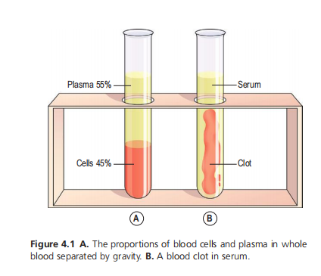
Proportion of Blood Cells & Plasma

Slide 22
Blood Cells
There are three types of blood cells
  Erythrocytes (red cells)
  Leukocytes (white cells)
  Platelets (thrombocytes)
Erythrocytes (red cells) are the most abundant cells constituting 99% of all the cells
They are biconcave discs with no nucleus
Their main function is in gas transport mainly oxygen but they a carry some carbon dioxide
Their shape (biconcave) increases the surface area for this function, then thinness of the central portion allows fast entry of gases

Slide 23
Blood Cells...
Leukocytes (white cells) they have important function in defence and immunity
They detect foreign or abnormal (antigenic) material and destroy it
Leukocytes are the largest blood cells but they account for only 1% of the blood volume
They contain nuclei and some have granules in their cytoplasm
They are two main types
  Granulocytes (polymorphonuclear leukocytes)- neutrophils, eosinophils and basophils
  Agranulocytes- monocytes and lymphocytes

Slide 24
Blood Cells....
Platelets (Thrombocytes)- are small discs 2-4μm in diameter derived from the cytoplasm of megakaryocytes in the red bone marrow
They have no nucleus, but their cytoplasm is packed with granules containing a variety of substances that promote blood clotting, which cause haemostasis (cessation of bleeding)
The hormone thrombopoietin from the liver stimulates platelet production

Slide 25
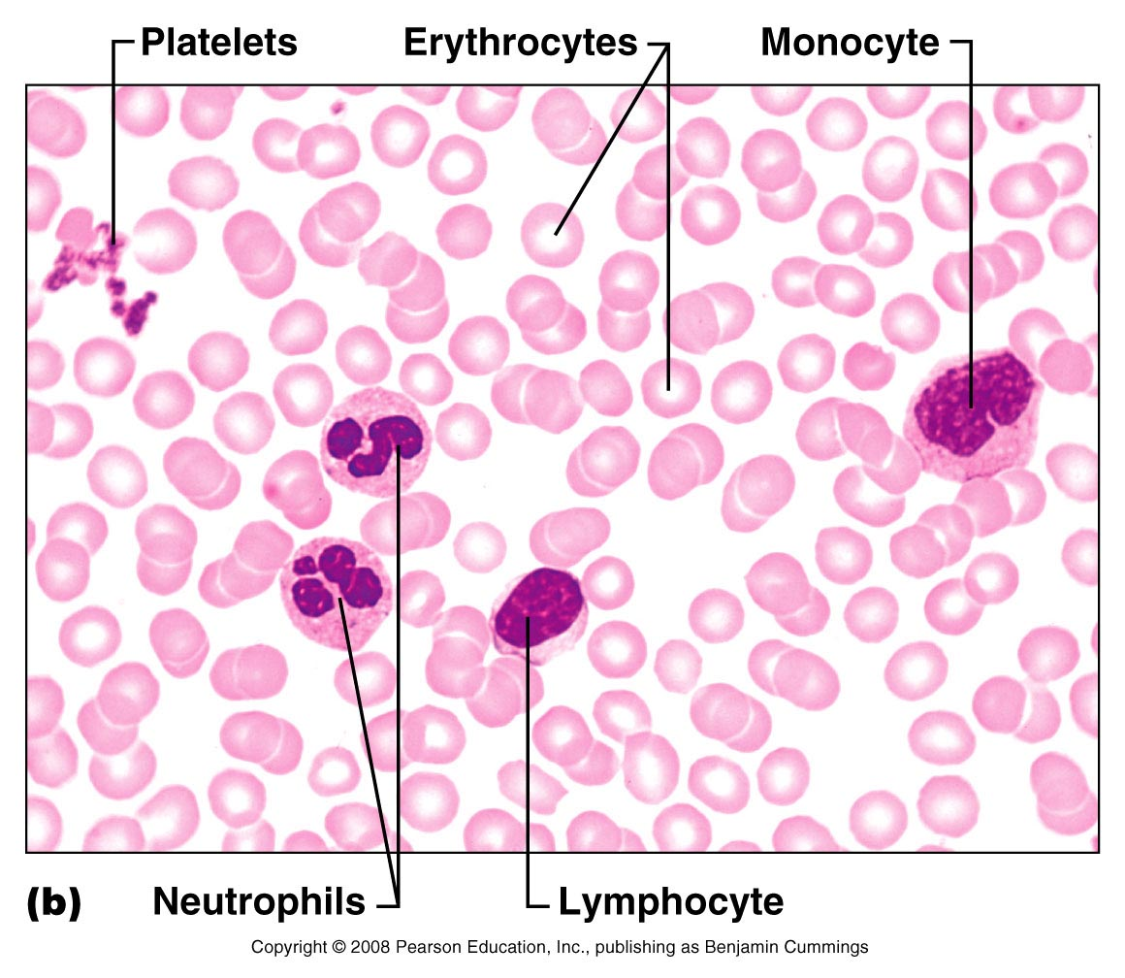

Slide 26
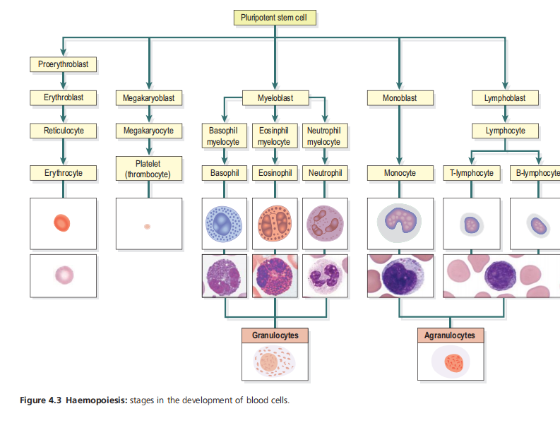
Haemopoiesis

Slide 27
Dense Connective Tissue...
Cartilage tissue- is firmer than other connective tissues
The cells (chondrocytes) are sparse and lie embedded in matrix reinforced by collagen and elastic fibres
There are three types of cartilage
  Hyaline cartilage
  Fibrocartilage
  Elastic cartilage

Slide 28
Dense Connective Tissue...
Hyaline cartilage- is smooth bluish-white tissue. The chondrocytes are arranged in small groups with cell nests
The matrix is solid & smooth
It provides strength with flexibility while resisting tear
One fundamental property of hyaline cartilage is that it is avascular
They provide smooth surfaces for movement at joints, cushions and absorbs shock whre bones meet e.g. joint capsules, also found in epiglottis, external ear (pinnae) larynx, epiphyseal growth plate

Slide 29
Dense Connective Tissue...
Cartilage tissue is found:
On the ends of long bones that form joints
Forming costal cartilage, which attach the ribs to the sternum
Forming part of the larynx, trachea, bronchi and foetal skeleton
Fibrocartilage- consists of dense masses of white collagen fibres in a matrix similar to that of hyaline cartilage with the cells widely dispersed

Slide 30
..
Fibrocartilage is tough, slightly flexible, supporting tissues found:
  As pads between the bodies of the vertebrae, intervertebral discs
  Between the articulating surfaces of the bones of the knee joint, called semilunar cartilage
  On the rim of bony sockets of the hip and shoulder joints, pubis symphysis
Elastic cartilage- is a flexible tissue, consists of yellow elastic fibres lying in a solid matrix with chondrocytes lying between the fibres
It provide support and maintains shape of pinna or lobe of the ear, the epiglottis and part of the tunica media of blood vessel walls

Slide 31
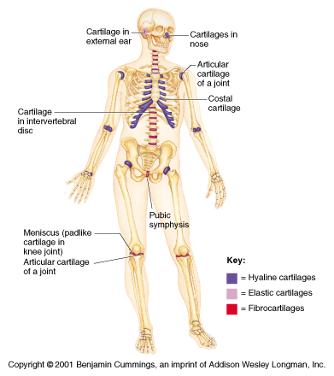

Slide 32
Dense Connective Tissue...
Bone (osseous) tissue- bone cells (osteocytes) are surrounded by a matrix of collagen fibres strengthened by inorganic salts (calcium & phosphate)
This provide bones with their characteristic strength and rigidity
Two types of bones can be identified by the naked eye
  Compact bone- solid or dense appearance
  Spongy/cancellous bone- “spongy” or fine honey comb appearance

Slide 33
Function of Bones
Provides framework and strength for the body
Allows movement
Mineral storage and homeostasis –calcium and phosphorous
Contains blood forming cells in the red bone marrow
Storage of energy – yellow bone marrow contains mostly adipose tissue

Slide 34
Functions…
Electrolyte balance- buffers blood against excessive pH changes by absorbing or releasing alkaline salt
Protective function- it protects vital organs e.g. brain, lungs, heart
Detoxification- removes heavy metals and other foreign elements from blood, thus reducing their effects on the nervous and other tissue

Slide 35
Bone Cells
Osteoblast the cells that form bone but do not have the ability to divide by mitosis
These bone-forming cells are responsible for the deposition of both inorganic salts and osteoid in bone tissue.
They are therefore present at sites where bone is growing, repairing or remodelling, e.g.:
  In the deeper layers of periosteum
  In the centres of ossification of immature bone
  At the ends of the diaphysis adjacent to the epiphyseal cartilages of long bones
  At the site of a fracture

Slide 36
Bone Cells...
Osteoprogenator (osteogenic) cells are precursors bone cells that undergo mitosis to become osteoblast. Found in the periosteum, endosteum and canals in bone that contains blood vessels
Osteocytes are mature bone cells derived from osteoblasts that have secreted bone tissue around themselves
They maintain healthy bone (bone matrix) and do not undergo mitosis

Slide 37
Bone Cells…
Osteoclasts functions in bone destruction (resorption) or bone lysis releasing calcium & phosphate which is important in the development, growth, maintenance and repair of bone
They are multicellular cells that secrete enzymes that breakdown bone.
Bone lining cells they line the bones and control the ions entering and leaving the bone.

