Slide 1
HMIS
Peter Kithuka, MSc(HSM)

Slide 2
Understanding the Health system
Definition:
All organizations, institutions and actions devoted to health
~ WHO

Slide 3
Who are the players?
Providers
Financiers
Citizens
Consumers

Slide 4
Components of a Health System
Service delivery
Health workforce
Health information
Financing
Medical products and technologies
Leadership/Stewardship/Governance

Slide 5
Intermediate goals
Ensure equity, quality and access to services
Promote efficiency and effectiveness
Entrenching ethics and rights in care
Ensure sustainability of programs

Slide 6
Ultimate goal of a Health System
Protect, maintain, and improve the health of the people evidenced by improved quality of life years and increased life expectancy

Slide 7
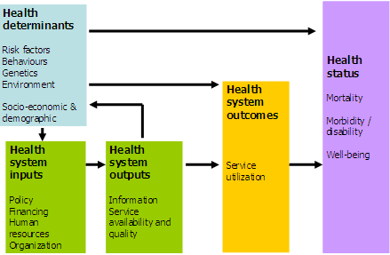
Health information domains
Source: WHO, 2006

Slide 8
Sources of Health information in Kenya
Census
Surveys
HIS(Health information system)
Surveillance systems
Vital registration
Note: These are all disintegrated

Slide 9
Systems thinking in Health
What is a system?
What is health?
What is information?
What is HIS?
What is HMIS?
Who benefits from HMIS?

Slide 10
Challenges of setting up HMIS in Kenya
Poor vital registration systems
Competing donor and program requirements
Human resource constraints
Poor data collection, storage and dissemination and feedback mechanisms
No ownership of data at the district/ county level
Note: Health Metrics Network has been established to address some of these challenges by building consensus on tools, indicators and policies

