Slide 1
Burn management

Slide 2
Introduction-1
One of the most devastating injuries
Affects the largest organ

Slide 3
Introduction-2
Commonly affects individuals with underdeveloped or impaired ability to avoid injury
Effects are:
Physical
Psychological

Slide 4
Epidemiology
Local study:
About 170 children admitted annually to PGH, Nakuru
mean age 2.6 years
M:F ratio 1.4:1
90.2% of the burns due to scalds
The mortality was 11.9%
American Burn Association
2.2 million people are burned in the US every year
5500 deaths result from burn injury
60,000 admitted for hospital care

Slide 5
Causes
Scalds
Flame
Contact
Electrical
Chemical
Cold burns
Flash
Friction
Radiation

Slide 6
Pathogenesis
Injured cells release inflammatory mediators
Mediators cause an inflammatory response with increased capillary permeability
Occurs in the first 3 days
Peak at 4-8hours
Loss of fluid containing electrolytes and proteins
SIRS or clinical capillary leak syndrome

Slide 7
Systemic effects of burn injury
Depend on
Extent of burn
Age
Depth
Delay in resuscitation

Slide 8
3 zones of injury
Described by Jackson in 1947
Central necrosis
Zone of stasis (at risk of necrosis)
Zone of hyperemia

Slide 9
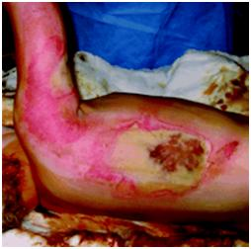
Zones of injury

Slide 10
Renal effects
Kidneys
In extensive burns- microalbuminuria
Albumin rich fluid results in kidney edema
Increased pressure in the glomeruli
Reduced filtration
ADH release
In extensive burns
Risk of fluid overload
Limit of 50% for fluid resuscitation

Slide 11
Pulmonary effects
Inhalation injury
Steam burns
Carbon monoxide poisoning
Chemical reaction with products of combustion
Circumferential eschar around the chest
May result in ARDS

Slide 12
Principles of burns management
Functions of the skin:
Protection
Sensation
Heat regulation:
Control of evaporation
Storage and synthesis: acts as a storage center for lipids and water
Vitamin D synthesis

Slide 13
Indications for admission
Extent
Depth
Burning agent
Site of burn
Suspected inhalation injury
Co morbid conditions
Extremes of age

Slide 14
Initial Burn Management
Follow ABCDs
Identify and treat associated injuries
Remove patient from source, protect rescuer,
Initial cooling with cold (not ice) water,
cover with sterile dressing, leave blisters
intact
Brush off any metal or powder, copious
irrigation for chemical burns
Singer et al. Circulation 2000:102

Slide 15
Burn assessment-1
Extent
Wallace’s rule of Nines
Lund and Browder charts

Slide 16
Lund and Browder chart

Slide 17
Burn assessment-2
Depth of injury
Epidermal (1st Degree)
Superficial partial thickness(superficial 2nd degree)
Deep partial thickness(deep 2nd degree)
Full thickness(3rd degree)

Slide 18
Burn assessment-3
Look for circumferential burns
Loss of distal pulses occurs late
Assess for warmth, sensation, motor, rigidity
Doppler exam helpful

Slide 19
Burn assessment-4
Identify signs of potential abuse in children
Well circumscribed, feet, ankles, buttocks
Stigmata of cigarette butts or other hot objects
Inconsistent history

Slide 20
Fluid replacement
Aim
Prevent the development of shock
Maintain adequate perfusion of blood to the tissues

Slide 21
Fluid replacement
Type of fluid-balanced fluid
Only ¼ remains in the circulation
Baxter in 1964: Parklands formula (4/kg/%burn)
Children have a higher fluid requirement and limited carbohydrate stores

Slide 22
Analgesia
Strong analgesics- intravenous opiates in extensive burns
Reduces pain, fear and anxiety
Occlusive dressing

Slide 23
Monitoring resuscitation-1
Pulse rate
Respiratory rate
Blood pressure
Urine output
ECG

Slide 24
Monitoring resuscitation-2
Hemogram/Hematocrit
Urea and electrolytes
Central Venous Pressure
Acid base and blood gases

Slide 25
Wound care
Sterile dressings to act as a physical barrier and maintain a moist environment
Conventional dressings
Biological dressings( allograft, xenograft, Transcyte)
Synthetic dressing
Topical agents
Silver sulfadiazine
Mafenamide acetate (sulfamylon)
Silver nitrate solution/Acticoat
Escharectomy
Skin grafting

Slide 26
Infection control
Strict hand washing
Aseptic techniques
Microbiological screening of wound during dressing change
Isolation and barrier nursing
Early nutritional support
Early excision of burn wound
Use of topical antimicrobials
Appropriate use of antibiotics

Slide 27
Inhalation injury
Skilled assessment and early nasotracheal intubation
High dose, humidified oxygen
Ventilation
Bronchoscopy and tracheobronchial toilet
Chest physiotherapy and postural drainage
Antibiotics

Slide 28
Nutrition
Metabolic rate higher due to
Evaporative heat loss
Overactive sympathetic nervous system
Secretion of adrenocortical steroids
Increased cellular activity

Slide 29
Nutritional support
Early enteral feeding
High calorie high protein diet
Nutritionist advice important

Slide 30
Rehabilitation
From admission to full recovery
Physiotherapy
Occupational therapy
Psychological support-coping mechanisms
Social support from family, friends and public

Slide 31
Complications-early 1
Fluid and electrolyte loss
Hypothermia
Compartment syndrome
Abdominal compartment syndrome
Hypoglycemia in children
Inhalation injury
Death

Slide 32
Complications-early 2
Toxic shock syndrome
Infection
Multi-organ failure
Deep vein thrombosis
Pulmonary embolism
Gastric ulcers

Slide 33
Complications -late
Tetanus
Stiffness of joints and contractures
Pruritus
Pigmentation problems
Hypertrophic scars and keloids
Marjolin’s ulcers
Psychological problems

Slide 34
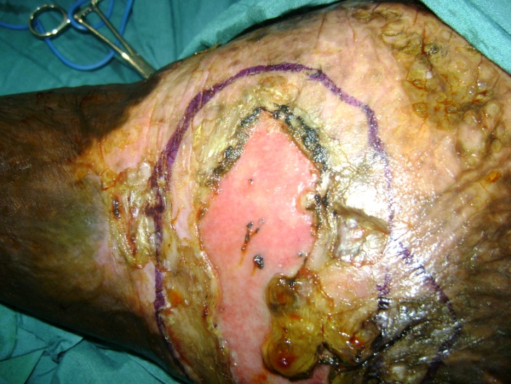
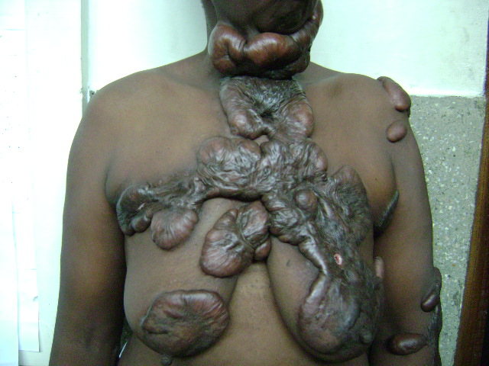
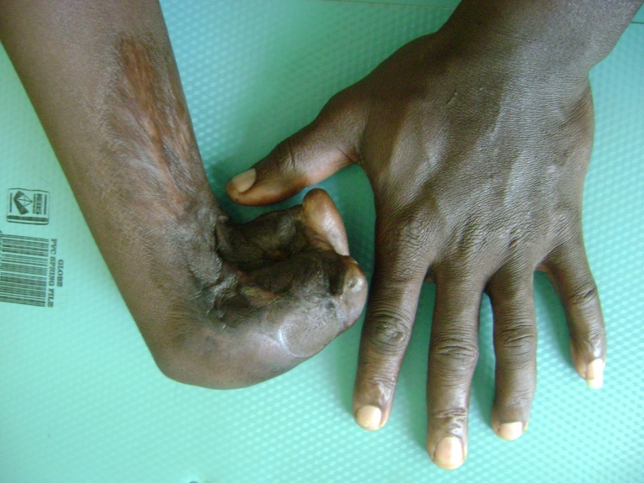

Slide 35
Electrical burns
Electrical injury is caused by the effect of electrical current flowing through the body
Current can be AC or DC

Slide 36
Low voltage(household): 120-440V
High voltage: 440-1000V
High tension voltage: >1000V
Lightning(DC): 2000-2 billion Volts with peak temperatures of 30,000⁰C

Slide 37
Effects of electrical injury
Determined by
Type of current
Amount of current
Pathway of the current
Duration of current
Area of contact
Resistance of the body

Slide 38
Causes of injury
Direct thermal injury
Arc and flash burns
Disruption of body’s normal activity
Nerve injury-numbness and tingling sensation
Brain- mass depolarization leads to loss of consciousness and amnesia
Spinal cord- transverse myelitis
Heart- dysrhythmias

Slide 39
Effects of AC and DC
High voltage AC:
Tetany and locked on phenomenon
Flexor muscles more affected
Effect on respiratory muscle results in asphyxia
High tension voltage/DC
Simple large muscular contraction
Throws the patient

Slide 40
Diagnosis
History:
Voltage and type of current
Length of exposure
Proximity of the energy transfer(direct strike, contact, arc and side flash)
Determine symptomatology after the injury
Pre-existing medical conditions

Slide 41
Examination
ABC
Disability- repeated neurological examination
Keep warm
Extremities-pulses, fractures, dislocation
Skin –burns
Wound- entry and exit

Slide 42
Treatment
Remove from injury site
Keep warm
Intravenous fluids
Surgical procedures

Slide 43
Mortality and morbidity
Low voltage injuries have very low morbidity and mortality
AC injuries have 3 times the morbidity and mortality rates as DC injuries
Pathways:
hand to hand (mortality is 60%)
Hand to foot (mortality is 20%)
Foot to foot (mortality >5%)

Slide 44
Chemical burns
Caused by strong acids and alkalis
Chemicals cause progressive damage unless deactivated
Not a common cause of burns

Slide 45
Etiology
Industrial chemicals
Chemical stored in households
Military injuries
Criminal assault

Slide 46
Chemical burns
Acid burns- coagulative necrosis
Alkali burns- liquefaction necrosis

Slide 47
Severity of chemical burns
Concentration
Quantity
Duration of contact
Penetration of agent
Mechanism of action

Slide 48
Treatment
Removal of offending agent from patient
Removal of clothing
Brush off powders/ solids
Wash off liquids
Copious irrigation

Slide 49
Management cont.
Fluid resuscitation depends on extent of burns
Analgesia
Management of the wound

