Slide 1






Early Hypoglycaemia
(First 72 hours of life)

Slide 2
Objectives
Introduction
Define hypoglycaemia
Define high risk patients
Discuss the prevention, early diagnosis and prompt treatment of hypoglycemia

Slide 3
Introduction

Slide 4
Introduction
Why do we worry about hypoglycaemia?
Associated with;
  Increased mortality
  Convulsions
  Permanent brain injury
The duration and number of hypoglycaemic episodes are associated with poor neurological outcomes
Some neonates are at high risk and they need to be recognized early
Notes:
Hypoglycemia is known to cause irreversible neuronal injury warranting prompt recognition and treatment.
Fuel for fetal metabolism is generated mostly by oxidation of glucose.
During intrauterine life, the neonate receives a. When this supply abruptly stops at birth, the neonate must adapt and stimulate its own glucose supply with the assistance of enteral feeds. The infant will also have to adapt to bolus feeds, after being used to a continuous supply of nutrients through the umbilical
cord.
At birth the stress produces several hormones (norepinephrine, cortisol)that help in initiation of breakdown of glycogen, fat and protein (glycogenolysis, lipolysis, proteolysis) generates substrate for endogenous production of glucose (gluconeogenesis). The hormones to facilitate theses process are low in neonates in the fisrt 1-3 days of life amd longer in preterm. Beside glycogen level are limited in preterms and SGAs
When there is an imbalance between glucose supply and utilisation, a low blood glucose level (BGL) may occur.
Foetal glucose consumption is higher (5‐7 mg/kg/min) than that of the newborn infant (4‐6 mg/kg/min) and the adult (2‐3 mg/kg/min). Under normal conditions, the foetus has no endogenous glucose production; instead, it is dependent on the glucose flux via the placenta.
The newborn's brain accounts for around 50% of the total glucose consumption. Glucose uptake to the brain is not insulin dependent, but is determined by a glucose concentration gradient with the help of specific glucose transport proteins. The levels of these proteins are low in the first week of life, but increase
thereafter

Slide 5
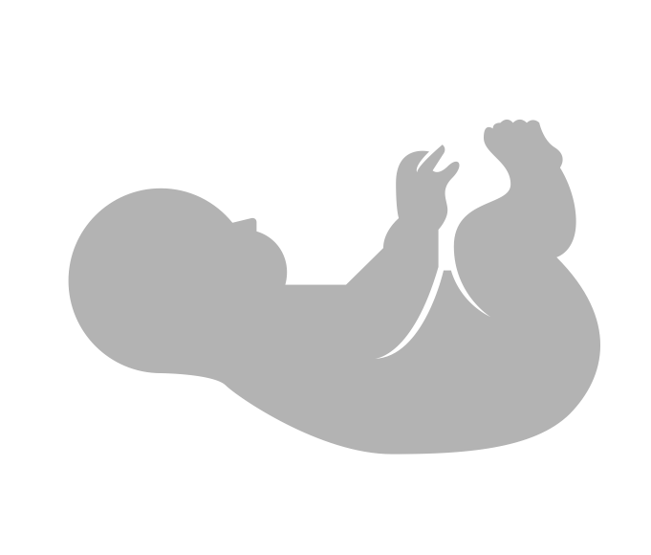
Neonatal Risk factors for hypoglycaemia
Introduction
Prematurity <37wks
SGA & IUGR
Perinatal asphyxia
Infection
Congenital heart disease
Cesarean delivery
Delayed start of breastfeeding
Infant of diabetic mother
Abramowski A, Hamdan AH. Neonatal Hypoglycemia. [Updated 2020 Jan 16]. In: StatPearls [Internet]. Treasure Island (FL): StatPearls Publishing; 2020 Jan-. Stomnaroska O, Petkovska E, Jancevska S, Danilovski D. Neonatal Hypoglycemia: Risk Factors and Outcomes. Pril (Makedon Akad Nauk Umet Odd Med Nauki).
Notes:
Maternal diabetes causing transient hyperinsulinism in the baby
Glucose infusions during labour
Maternal administration of B sympathomimetics used to suppress preterm labour may cause maternal hyperglycemia and associated fetal hyperinsulinism-

Slide 6
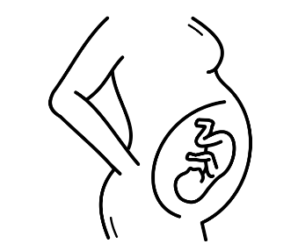
Maternal Risk factors for hypoglycaemia
Introduction
Maternal diabetes or obesity
Iatrogenic factors e.g.
Glucose infusions during labor/B agonists (salbutamol) used to suppress preterm labor
Family history of early onset DM
Sibling with history of sudden seizure/ collapse
Abramowski A, Hamdan AH. Neonatal Hypoglycemia. [Updated 2020 Jan 16]. In: StatPearls [Internet]. Treasure Island (FL): StatPearls Publishing; 2020 Jan-. Stomnaroska O, Petkovska E, Jancevska S, Danilovski D. Neonatal Hypoglycemia: Risk Factors and Outcomes. Pril (Makedon Akad Nauk Umet Odd Med Nauki).
Notes:
Maternal diabetes causing transient hyperinsulinism in the baby
Glucose infusions during labour
Maternal administration of B sympathomimetics used to suppress preterm labour may cause maternal hyperglycemia and associated fetal hyperinsulinism-

Slide 7
Postnatal Plasma glucose levels
Postnatal glucose levels
Fetal blood glucose
0.5 mmol/l lower than maternal level
In a well term neonate 1.4–1.7 mmol/L
Steadily rises to 3-3.3mmol/l and continues to rise to maintain plasma glucose of 3.9-5.9mmol/l
At 1 hr postnatal
At 2 hrs
Wackernagel et al, Swedisch national guidelines for prevention and treatment of neonatal hypoglycemia in new born infants with gestationl age ≥35 weeks, acta pediatrica, Wiley July 2019

Slide 8
Target blood glucose levels of neonates at risk at varying postnatal age
Target blood glucose levels
0- <3hrs | 1.4mmol/l
3 – 72 hours | ≥ 2.6 mmol/L
> 72 hours | ≥ 3.3 mmol/L
Postnatal age
Target blood sugar
Wackernagel et al, Swedisch national guidelines for prevention and treatment of neonatal hypoglycemia in new born infants with gestationl age ≥35 weeks, acta pediatrica, Wiley July 2019
Notes:
The 2.6mmol/l is after 3hrs postnatal life

Slide 9
Signs and symptoms of hypoglycemia
Signs and symptoms of hypoglycemia
Mild – Moderate
Severe
CNS – Jitteriness, Irritability, High pitched cry, Lethargy, Hypotonia, Tremors, Hypothermia
CVS – Tachycardia, Sweating
Respiratory - Tachypnoea
GIT - Poor Feeding, Vomiting
CNS – Seizures, Coma, Sudden Death
CVS – Pallor, Circulatory Collapse
Respiratory – Apnea, Cyanosis
Notes:
No studies could be identified that evaluated the reliability of specific symptoms and hypoglycaemia.- based on consensus recommendation
Mild-moderate – unlikely to lead to long term sequalae
Severe – likely to lead to long term impairement – treatment must be provided immediately

Slide 10
Prevention of hypoglycemia

Slide 11

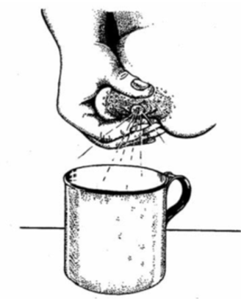

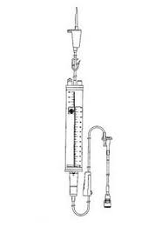
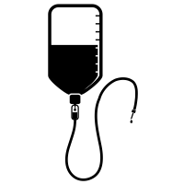
Prevention
Prevention of hypoglycemia
Breastfeeding immediately after birth
Neonates of mothers not available and for the unstable babies - to give breastmilk should receive supplementary feeding NO LATER than ONE HOUR after birth
Breastfeeding- Best option
EBM: Cup feed or NGT
Human donor milk/ formula feeds
IVF
Queensland Clinical Guidelines. Neonatal hypoglycaemia 2018; Wackernagel D, et al. Swedish national guideline for prevention and treatment of neonatal hypoglycaemia in newborn infants with gestational age ≥35 weeks. Acta Paediatr. 2020; 109: 31– 44

Slide 12
Prevention
Prevention of hypoglycemia
Maintain skin to skin contact
Keep warm – prevent hypothermia
Postpone the first bath by 6hrs and if acceptable up to 24 hours
After first feed, babies breastfed as per infants hunger cues/signal and at least every 2-3hrs
Queensland Clinical Guidelines. Neonatal hypoglycaemia 2018; Wackernagel D, et al. Swedish national guideline for prevention and treatment of neonatal hypoglycaemia in newborn infants with gestational age ≥35 weeks. Acta Paediatr. 2020; 109: 31– 44

Slide 13
Prevention
Monitor high risk infants for hypoglycaemia
Blood glucose should be measured at 2 hrs of age in all high risk ( NOT later than 3hrs after birth)
Measure blood sugar in all severely ill newborns at the point which diagnosis of ‘sick neonate’ is made
Measure blood sugar immediately in neonates with the signs/symptoms associated with hypoglycaemia

Slide 14
Prevention
Prevention of hypoglycemia
All well and not at risk neonates
All high risk neonates at birth
All sick neonates
BG at 2hrs of age
Immediate BG
No Hypoglycaemia
BG ≥ 2.6mmol/l
Keep warm.
Skin to skin contact
If able to BF, feed as per the cues, if not NGT or IVF continue feeding as per guidelines

Slide 15
Treatment of hypoglycemia

Slide 16
Treatment
Treating hypoglycaemia – Simplified
Symptomatic hypoglycaemia | Treat with iv 10% dextrose 2mls/kg then IV 10% Dextrose infusion Change to EBM when possible
Blood sugar below 1.8mmol | Treat with iv 10% dextrose 2mls/kg then IV 10% Dextrose infusion Change to EBM when possible
Asymptomatic blood sugar 1.8 - 2.5mmol/l | Immediate NGT feed with EBM
Give buccal 0.4ml/kg of 50% as you prepare the IV dextrose/EBM
Notes:
Asymptomatic infants : Dextrose gel may be an alternative to IV therapy for with a blood glucose <2.6 mmol/L and should be administered in conjunction with enteral supplementation.
In symptomatic infants, dextrose gel may be used as a temporizing measure to raise blood glucose while waiting to establish an IV dextrose bolus and infusion
Parents should be aware of the reasons for :
regular blood testing
and the symptoms that health care providers may be watching for, so that they can help with monitoring.
Because symptomatic hypoglycemia causes neuronal injury, urgent intervention to maintain glucose levels ≥2.6 mmol/L

Slide 17


Treatment
Why don’t we give IV dextrose for those asymptomatic patients glucose levels 1.8 mmol/L and 2.5 mmol/L
Lack of evidence for adverse effects of glucose levels between 1.8 mmol/L and 2.5 mmol/L in asymptomatic infants at several hours of age
No one form of supplementation shown to be superior over the other (breastfeeding, buccal glucose or IV dextrose).
A staged approach to screening and intervention is reasonable
Reasonable to continue feeding at-risk infants at regular intervals, while screening before feeds.
Levels should be rechecked after 30 mins to identify persistent hypoglycemia
Notes:
Hypoglycemia is known to cause irreversible neuronal injury warranting prompt recognition and treatment.
Fuel for fetal metabolism is generated mostly by oxidation of glucose.
During intrauterine life, the neonate receives a. When this supply abruptly stops at birth, the neonate must adapt and stimulate its own glucose supply with the assistance of enteral feeds. The infant will also have to adapt to bolus feeds, after being used to a continuous supply of nutrients through the umbilical
cord.
At birth the stress produces several hormones (norepinephrine, cortisol)that help in initiation of breakdown of glycogen, fat and protein (glycogenolysis, lipolysis, proteolysis) generates substrate for endogenous production of glucose (gluconeogenesis). The hormones to facilitate theses process are low in neonates in the fisrt 1-3 days of life amd longer in preterm. Beside glycogen level are limited in preterms and SGAs
When there is an imbalance between glucose supply and utilisation, a low blood glucose level (BGL) may occur.
Foetal glucose consumption is higher (5‐7 mg/kg/min) than that of the newborn infant (4‐6 mg/kg/min) and the adult (2‐3 mg/kg/min). Under normal conditions, the foetus has no endogenous glucose production; instead, it is dependent on the glucose flux via the placenta.
The newborn's brain accounts for around 50% of the total glucose consumption. Glucose uptake to the brain is not insulin dependent, but is determined by a glucose concentration gradient with the help of specific glucose transport proteins. The levels of these proteins are low in the first week of life, but increase
thereafter

Slide 18

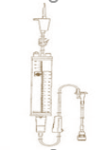
Treatment
Why is breastmilk the preferred option?
Breastmilk
10% Dextrose
Breastfeeding
EBM
IVF
Breastmilk contains 67 kcal / 100ml
Dextrose 10% (10g of glucose/100mls) contains 34kcal/100mls
Contains almost X2 energy as compared to 10% dextrose
Notes:
Hypoglycemia is known to cause irreversible neuronal injury warranting prompt recognition and treatment.
Fuel for fetal metabolism is generated mostly by oxidation of glucose.
During intrauterine life, the neonate receives a. When this supply abruptly stops at birth, the neonate must adapt and stimulate its own glucose supply with the assistance of enteral feeds. The infant will also have to adapt to bolus feeds, after being used to a continuous supply of nutrients through the umbilical
cord.
At birth the stress produces several hormones (norepinephrine, cortisol)that help in initiation of breakdown of glycogen, fat and protein (glycogenolysis, lipolysis, proteolysis) generates substrate for endogenous production of glucose (gluconeogenesis). The hormones to facilitate theses process are low in neonates in the fisrt 1-3 days of life amd longer in preterm. Beside glycogen level are limited in preterms and SGAs
When there is an imbalance between glucose supply and utilisation, a low blood glucose level (BGL) may occur.
Foetal glucose consumption is higher (5‐7 mg/kg/min) than that of the newborn infant (4‐6 mg/kg/min) and the adult (2‐3 mg/kg/min). Under normal conditions, the foetus has no endogenous glucose production; instead, it is dependent on the glucose flux via the placenta.
The newborn's brain accounts for around 50% of the total glucose consumption. Glucose uptake to the brain is not insulin dependent, but is determined by a glucose concentration gradient with the help of specific glucose transport proteins. The levels of these proteins are low in the first week of life, but increase
thereafter

Slide 19
Treatment
Correction of symptomatic hypoglycemia or blood sugar <1.8mmol/l
Give ‘mini-bolus’ of 10% dextrose 2mls/kg given over 3 mins. Use 0.4ml/kg of 50% glucose solution if available as you prepare to fix the IV line
Then immediately continue with the daily maintenance fluid ( Day 1 – 10% Dextrose, Day 2 onwards – Neonatal IV Fluid i.e. Dextrose with electrolytes)
If baby is able to take EBM via cup or NGT/OGT, wean off the IVF as you increase the EBM
Repeat blood sugar after 30minutes (after the bolus) then 3hourly. Target blood sugar ≥ 2.6mmol/l
Notes:
Treatment of hypoglycaemia is much less of a priority than taking care of the airway, initiating ventilation with a bag and mask and if required providing chest compressions in a sick newborn. This means unless there are at least 2 people for a resuscitation drugs like glucose cannot be given – you cannot stop ventilating to give drugs!
40% Glucose gel is recommended to oral treatment of hypoglycemia not associated with serous symptoms.
40% glucose gel is not readily available currently ( may at a later date!)
Demonstrate how to make 40% glucose solution from 50% dextrose
To apply on the buccal mucosa – dry the buccal mucosa – then massage 0.5ml’kg of the 40% glucose solution ( give X2 doses if required)
The maintained fluid should provide 4–7 mg/kg/min and titrating up as needed.

Slide 20
Treatment
Treatment of asymptomatic
Use 0.4ml/kg of 50% glucose solution as you prepare to obtain EBM and to fix the NGT
Give EBM the required 3 hourly feed immediately
Do blood sugar 1-2hrs.
If still below 2.6mmol/l repeat the 0.4ml/kg of 50% glucose
Ensure 3 hourly EBM (correct volume should be given). Do a blood sugar prior to each feed until 3 NORMAL readings are obtained.
Ensure neonate is kept warm.
If blood sugar remains low despite adequate feeds then use IVF as for the symptomatic neonate
Notes:
Do blood sugar 1-2hrs. 1 hrs if below 2mmol/l – 2 hrs if above 2 mmol/l

Slide 21
What happens after a dextrose bolus?
Treatment
10% Dextrose bolus
Blood Glucose(mmol/L)
Insulin
2.6
Time
Notes:
The blue line represents the blood sugar dropping into hypoglycaemia levels, the shaded area.
Here the black arrow represents the bolus of 10% dextrose
The blue dotted line represents what we hope will happen with the blood glucose level after the bolus
The pale orange bars represent what the insulin level is likely to be in response to a glucose bolus – note the lag time as insulin release is slow in response to a high glucose.

Slide 22
Rebound hypoglycaemia
Treatment
10% Dextrose bolus
Insulin
Blood Glucose(mmol/L)
Sugar level with maintenance
Sugar level without maintenance
2.6
Time
A plan must be made for continuous glucose supply after a bolus
Notes:
Here the black arrow represents the bolus of dextrose
The blue dotted represents what we hope will happen with the blood glucose level after the bolus
The pale orange bars represent what the insulin level is likely to be in response to a glucose bolus
The grey line represents what may happen to blood sugar levels after a bolus of glucose if the insulin level rises as predicted:
The glucose level falls again to very low levels because the only a bolus of glucose has been given, there is no continuous supply, and the insulin levels were increased in response to the bolus. The high insulin levels arrive at a time when the glucose level has fallen and is not being kept up by further glucose infusion.
This illustrates that only giving a bolus may result in problems at a later stage because of rebound.
Some continuous supply of glucose must be provided.

Slide 23
Treatment
Management of hypoglycemia
Do blood glucose for all high risk neonates and all sick neonates
Hypoglycemia Blood Sugar ≤2.5mmol/l
Asymptomatic
Symptomatic OR BG <1.8mmol/l
0.4ml/kg 50% oral glucose & NGT
0.4ml/kg 50% oral glucose & IV line
Immediate EBM via NGT at 3hrly feed volume and CT regular 3hrly feeds
10% Dextrose 2ml/kg mini-bolus over 3mins & immediate maintenance IVF. Start EBM as tolerated
BG after 1-2hrs then prior to the 3hrly feed
BG after 30minutes after the mini-bolus then 3hrly
If BG remains low

Slide 24
Administering Buccal glucose & Performing a heel prick

Slide 25
The Heel Prick
Diagnosis of hypoglycemia
Goal: To obtain blood for random blood sugar analysis
Observe hand hygiene
Manage pain – breastfeeding 2min before, during and after
Clean site with 70% alcohol; allow to dry for 30sec
Prick the heel with a disposable lancet to a depth of not more than 1mm
Wipe off the first drop and allow a large drop to collect.
Collect large drop using a capillary tube and place on point of diagnostic strip
Apply pressure on the site pricked to stop the bleeding.
Notes:
Take time to locate the best site for the heel prick .
Poor peripheral circulation does not permit capillary sampling.
Avoid the posterior aspect of the heel.
High risk sites are calcaneus (can cause osteomyelitis and osteochondritis) and posterior curvature
Talk to the mother (parents) about the procedure. Emphasis that though the procedure is causes some pain, the procedure is safe and the samples taken are needed to make the best clinical judgement for the baby’s treatment.
Pain Management;
1st option: Be breastfed at least 2 minutes before the procedure and continued throughout and after the procedure. The baby should also be skin-to-skin with the mother
2nd option: Those not able to breast feed should have 2mls of expressed breast milk (EBM) given into the mouth using a 2ml syringe 2 minutes before the procedure
3rd option: If no EBM available, 2mls of 10% dextrose or 0.4mls/kg of 50% dextrose should be given into the mouth 2 minutes before the procedure

Slide 26
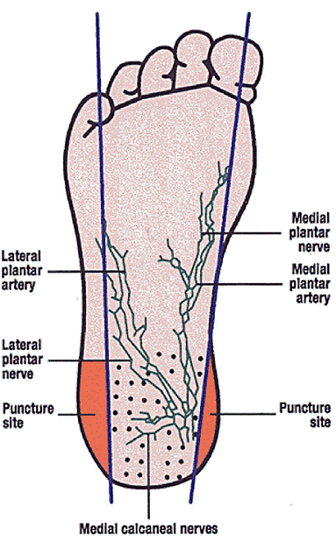
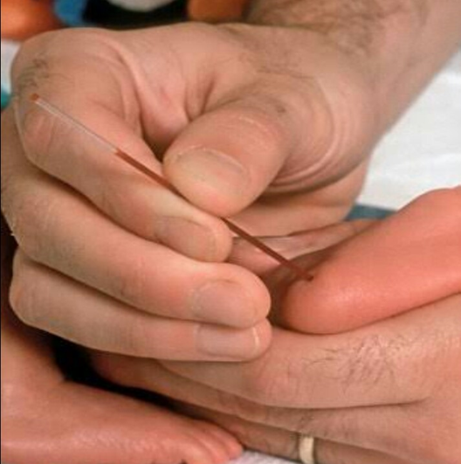
The Heel Prick
Diagnosis of hypoglycemia
Preferred site for heel prick
The lateral or medial side of the heel.
At these point the bone is further away from the outer surface compared to the toe or posterior heel.
Do not use toes or fingers
Notes:
Take time to locate the best site for the heel prick .
Poor peripheral circulation does not permit capillary sampling.
Avoid the posterior aspect of the heel.
High risk sites are calcaneus (can cause osteomyelitis and osteochondritis) and posterior curvature
Talk to the mother (parents) about the procedure. Emphasis that though the procedure is causes some pain, the procedure is safe and the samples taken are needed to make the best clinical judgement for the baby’s treatment.
Pain Management;
1st option: Be breastfed at least 2 minutes before the procedure and continued throughout and after the procedure. The baby should also be skin-to-skin with the mother
2nd option: Those not able to breast feed should have 2mls of expressed breast milk (EBM) given into the mouth using a 2ml syringe 2 minutes before the procedure
3rd option: If no EBM available, 2mls of 10% dextrose or 0.4mls/kg of 50% dextrose should be given into the mouth 2 minutes before the procedure

Slide 27

Taking a heel blood sample
Diagnosis of hypoglycemia

Slide 28
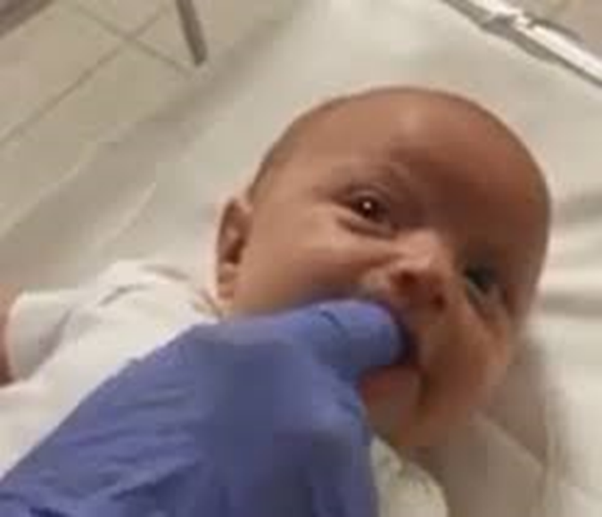
Administering the buccal glucose
Correction of hypoglycemia
Perform hand hygiene
Wear clean gloves
Prepare the 0.4mls/kg of 50% glucose in a syringe
Dry the baby’s gums and buccal surface using a gauze.
Apply a small amount of the prepared 50% glucose on one of your gloved finger
Gently apply and massage the 50% glucose into the baby’s left gum and buccal mucosa. Avoid squeezing the dextrose into the mouth
Repeat the same procedure on the right gum and buccal mucosa and vice versa until all the dextrose prepared is over.
Continue exploring other available means of correcting hypoglycemia.
Notes:
Talk to the mother (parents) about the procedure. Emphasis that the baby’s needs immediate glucose into the blood stream because the blood sugars are below the normal level .

Slide 29
Monitoring newborns at risk of hypoglycemia

Slide 30
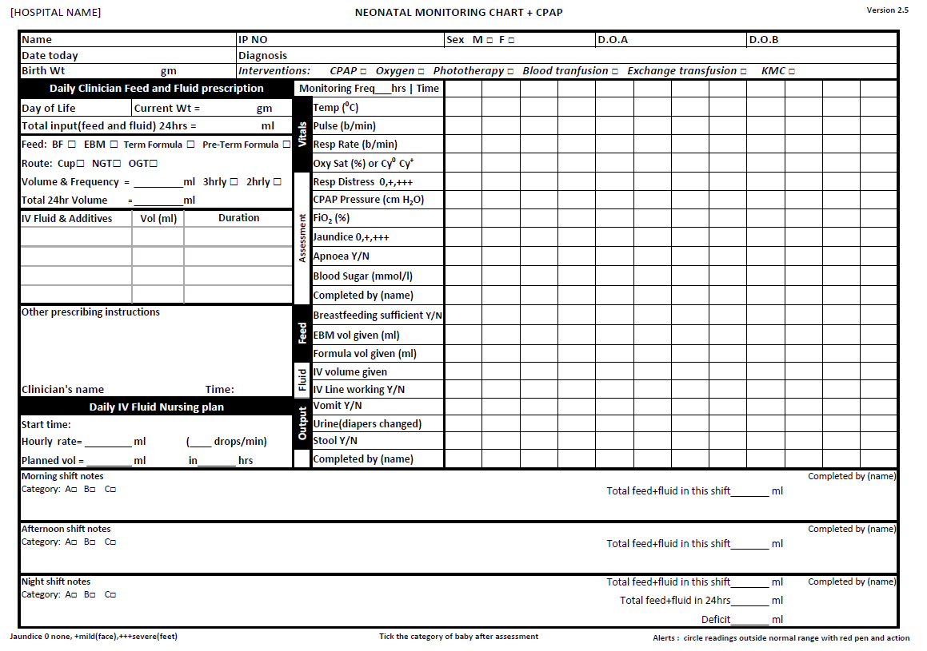
Monitoring
Monitoring High risk babies

Slide 31
Questions
Questions

Slide 32
Summary
Summary
Apply measures to prevent hypoglycemia
Recognize the neonates at risk of hypoglycemia
Check glucose - heel prick at the correct site
  Immediate BG in all seriously ill neonates
  All neonates at risk at 2hrs of age
  Regularly during treatment
Use 10% dextrose/EBM for treatment depending on severity. Show mums how to express breastmilk
Provide maintenance IVF with glucose or feed

