Slide 1
ATOPIC DERMATITIS (Eczema)

Slide 2
Introduction
Dermatitis is a group of diseases that result in inflammation of the skin. Dermatitis is characterized by itchiness, redness of the skin, and a rash.
The most common dermatitis presentations are allergic/contact dermatitis, atopic dermatitis, and seborrheic dermatitis.
Read about contact dermatitis

Slide 3
ATOPIC DERMATITIS (Eczema)
Atopic dermatitis is a type I immediate hypersensitivity disorder.
It is highest in infants and children. Mostly appears during infancy (typically by 3 months).
A family history is common. Other than genetic factors, epidermal barrier dysfunction, immunologic mechanisms and environmental factors also play a role.

Slide 4
Common environmental factors include
Food eg milk, eggs, soy, wheat, peanuts and fish
Airbone allergens eg molds, dander
Colonization of skin by Staph aureus
Sweating
Fabric
Cosmetics and harsh soaps etc
Extreme heat or cold
Exposure to tobacco smoke

Slide 5
Clinical features
Pruritus and hyperirritability of the skin are the most consistent features of atopic dermatitis
Excessive dryness of the skin and itching is related to changes in lipid content, sebaceous gland activity, and sweating.
In response to stroking of the skin, immediate redness appears on the skin and is followed in 15 to 30 seconds by pallor, which persists for 1 to 3 minutes

Slide 6
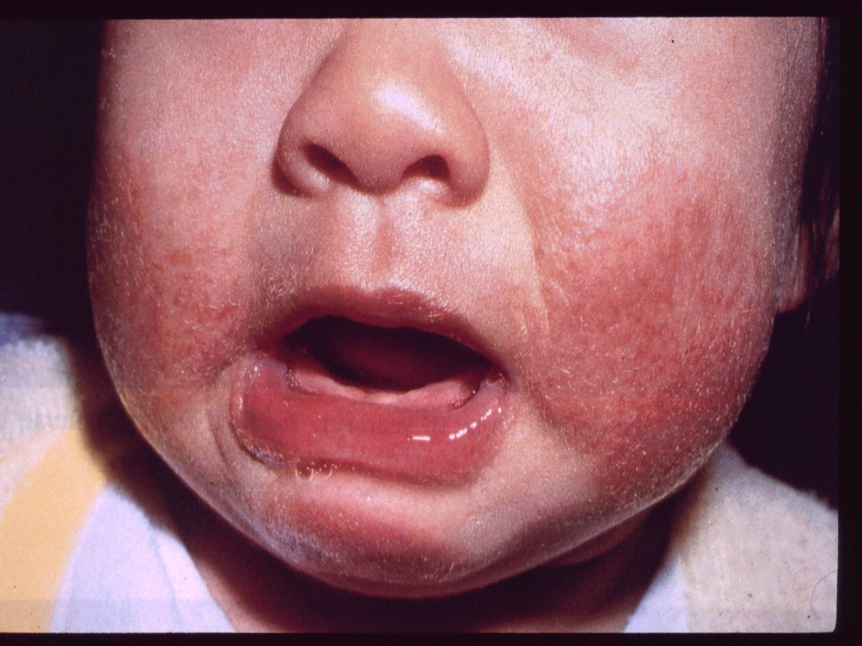
Lesions may appear due to scratching

Slide 8
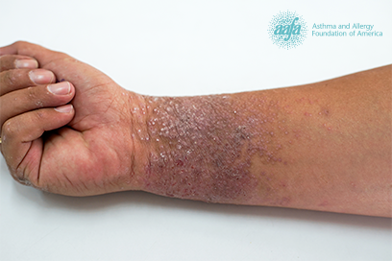
In adults there is lichenification (the skin appears thick and leathery as a result of constant scratching or rubbing) and excoriation (characterized by the repetitive and sometimes aggressive picking of one's own skin).

Slide 9
Management
Keeping the skin moisturized with daily baths followed by applying topical moisturizers. Petroleum-based moisturizer should be applied to the entire body within 3 minutes of bathing each day and applied twice daily if possible.
Topical corticosteroids may be used during flare-ups and to prevent inﬂammation
Decrease itching and scratching by wearing cotton fabrics, washing with a mild detergent, and maintaining room temperature at 20 to 22.2 degree Celsius.
Use of antihistamines in the case of excessive itching.

Slide 10
Topical tacrolimus for sensitive areas such as the face, skin folds, and perineum
Avoiding animals, dust, sprays, and perfumes.
Any infection is treated with antibiotics. Topical antibiotics for localized infections and oral antibiotics for extensive infection.
Avoid the food triggers such as eggs, nuts, peanut butter, chocolate, milk, seafood, and soy

Slide 11
Health education on:
Adherence to treatment
Moisturizing the skin. The moisturizing skin ointments should be applied on wet skin- apply immediately after bathing to help retain skin moisture and reduce itching.
Keep fingernails short to minimize skin damage and secondary infections due to excessive scratching

Slide 12
Bathing should be once daily
When drying the skin, it should be blotted or patted dry rather than rubbed. Dry skin folds well after bathing or swimming to prevent trapped moisture, which can cause increased irritation.
Keep the body well hydrated
Use of non-soap cleaners/mild soap, fragrance free and hypoallergenic soap, and lotions.
Avoid the triggering factors
Avoid foods that provoke allergic reactions
Avoid activities that cause excessive sweating.

