Slide 1
Genetics

Slide 2
Down Syndrome
Dr. John Langdon Down described the syndrome in 1866.
The chromosome abnormality was discovered in 1959.
Down syndrome is one of the first symptom complexes associated with mental retardation to be identified as a syndrome.

Slide 3
Epidemiology
Down syndrome is the most common autosomal abnormality.
The frequency is about 1 case in 800 live births.
Down syndrome accounts for about one third of all moderate and severe mental handicaps in school-aged children.

Slide 4

Down syndrome
Down syndrome is by far the most common and best known chromosomal disorder in humans and the most common cause of intellectual disability.

Slide 5
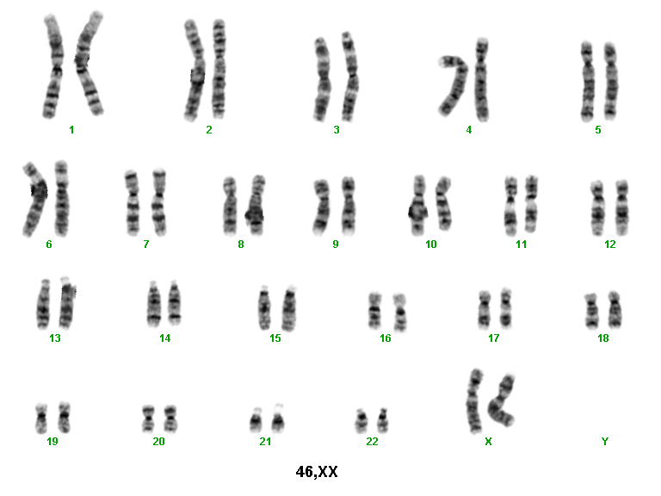
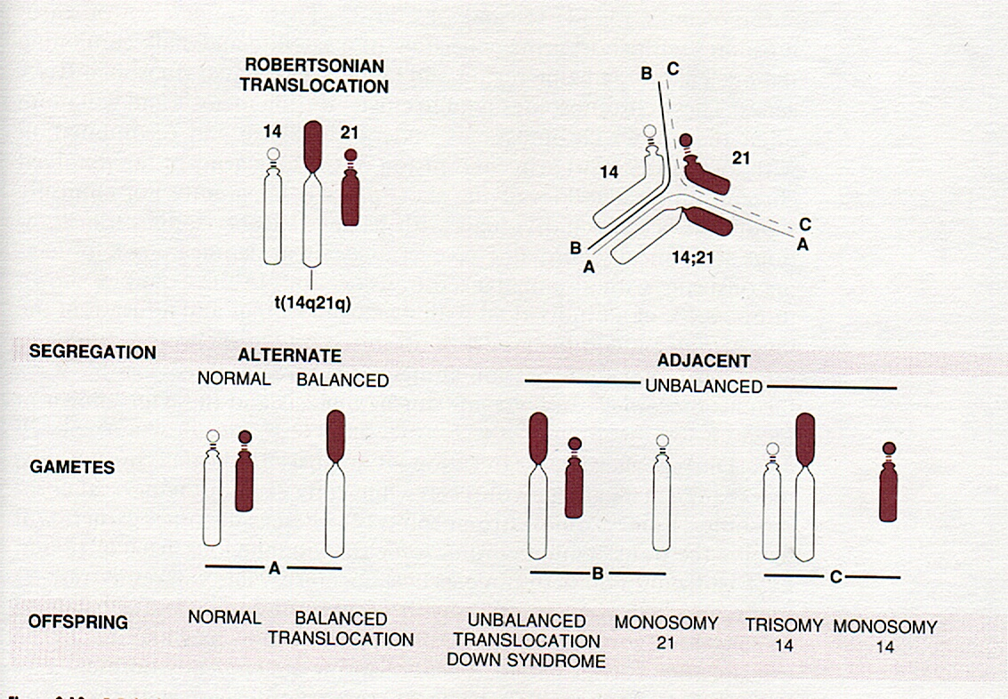
Etiology/ Genetic defect
95% people have three separate copies of chromosome 21
4% have the extra copy of chromosome 21 because of a Robertsonian translocation
Non-disjunction
1% have mosaicism with normal and trisomy 21 cell lines (and usually have much milder features because of the presence of the normal cells); - occurs postzygotically
Non-disjunction

Slide 6
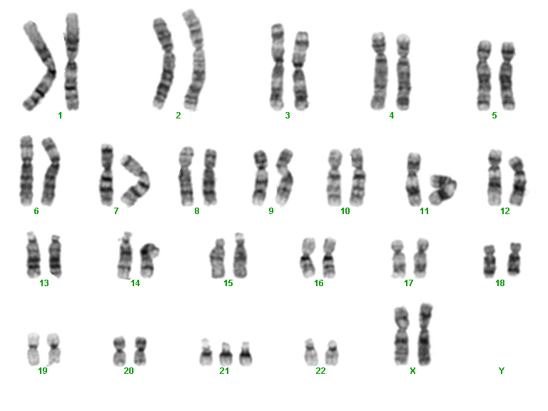
Trisomy 21: 47,XX,+21
three separate copies of chromosome 21

Slide 7
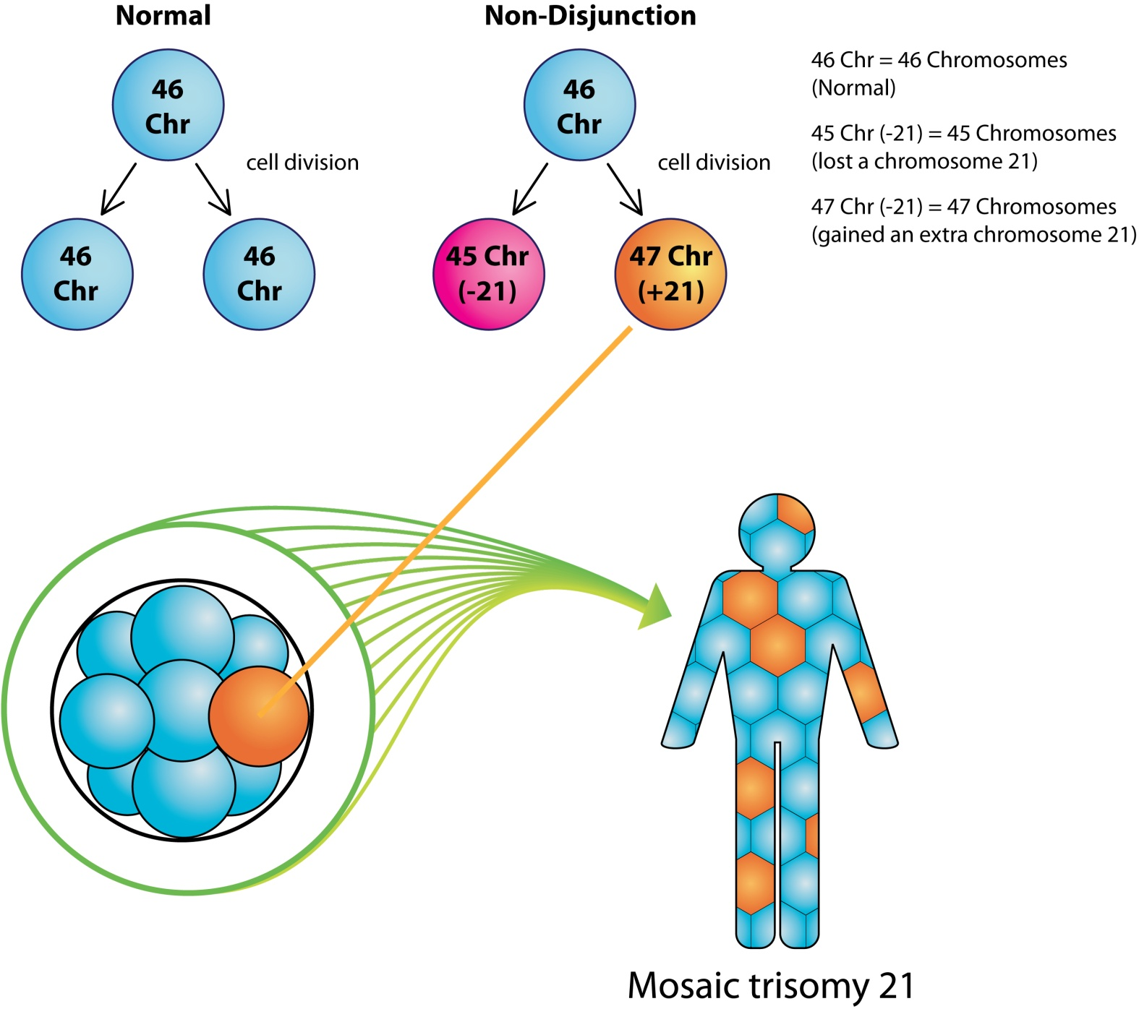

Slide 8
Meiotic
Non-disjunction
(Trisomy 21: 75% meiosis 1)
Trisomy
Monosomy (lethal)

Slide 9
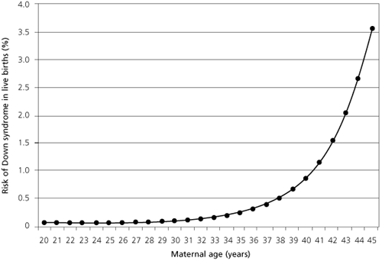

Slide 10

Clinical Features
Extra and loose neck skin
Single creases on the palms
Clinodactyly (curved fifth finger)
Broad space between the first and second toes
A deep plantar crease
The tongue often protrudes, more because of low muscle tone than true enlargement.

Slide 11

Clinical Features
Central hair whorl (cowlick)
Flat occiput (back of the head)
Upslanting eyes
Epicanthal folds (folds around the corner of the eye)
White spots in the iris of the eye (Brushfield spots)
Upturned nose

Slide 12

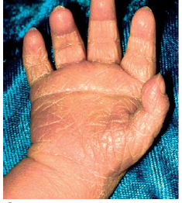

Slide 13
Related Conditions
Congenital Heart Disease
Seizures
Eye Anomalies
Hearing Loss
Genito-Urinary Tract Anomalies
Respiratory Disease
Obesity
Sleep Apnea
Developmental Delays
Blood Disease
Endocrine Disease
Blood Disorders
Alzheimer’s Disease

Slide 14
Heart Defects
40% of individuals with Down syndrome have some form of congenital heart defect
AV (atrioventricular) Septal defect
Ventricular Septal Defect (VSD)
Patent Ductus Arteriosus (PDA)
Atrial Septal Defect (ASD)
Tetralogy of Fallot
Aberrant Subclavian Artery
Pulmonary Hypertension
Adolescents and young adults can develop heart valve dysfunction even when they have had no history of congenital heart problems.
SBE prophylaxis may be necessary.
Notes:
The most common defects are Atrioventricular Septal Defect (formally called Endocardial Cushion Defect), Ventricular Septal Defect, Persistent Ductus Arteriosus and Tetralogy of Fallot.

Slide 15
Ophthalmologic Features
Brushfield spots (speckling of the iris)
Fine Lens Opacities
Nystagmus
Strabismus
Keratoconus
Ptosis
Cataracts
Astigmatism
Hyperopia (far sightedness)
Myopia (near sightedness)
Blepharitis
Tear Duct Obstruction

Slide 16
Hearing Loss
Can be conductive, sensorineural or both
Can be unilateral or bilateral
Often undiagnosed
  Change in learning or behavior-consider hearing screen
Etiology can be multifactorial
  Narrow posterior throat structures
  Subtle immune deficiency resulting in recurrent ear infections

Slide 17
Gastrointestinal Disease
Pyloric stenosis
Tracheo-esophageal fistula
Esophageal atresia (obstruction of the esophagus)
Duodenal atresia (obstruction of the duodenum).
Gastroesophageal Reflux (GERD)
Constipation
Hirschprung’s disease
Celiac disease
Imperforate Anus
Neonatal Liver Disease (rare)

Slide 18
Respiratory Disorders
Otitis media
Sinusitis
Pneumonia
Sleep apnea
Dysphagia/oromotor dysfunction
Aspiration
Pulmonary Hypertension

Slide 19
Dental Diseases
Microdontias
Missing Teeth/Fused Teeth
Delayed tooth eruption (1-2 years later than average)
Malocclusions
Periodontal disease
  Gingivitis leading to loss of Alveolar bone
Dental Caries occur with lower prevalence than in the general population

Slide 20
Genitourinary Tract Anomalies
Micropenis
Cryptoorchidism
Infertility
Cystitis/Urinary Tract Infections
Renal Anomalies
Wilm’s Tumor

Slide 21
Endocrine Disorders
Congenital hypothyroidism
Thyroid Disease
Diabetes
Failure to Thrive- in infancy and early childhood
Obesity
Short Stature
Lipid abnormalities
Notes:
Congenital hypothyroidism occurs in persons w/ Down syndrome at a rate about 28 times the normal population.
Diabetes occurs about 1 in 250 children with Down syndrome (about twice the usual prevalence)

Slide 22
Blood Disorders
Immune Dysfunction
Myeloid Proliferation
Leukemia
  1 in 150 in children with Down syndrome compared with 1 in 2800 in children at large
Platelet Disorders
White blood cell impairment
Erythrocytosis (secondary to chronic hypoxia)

Slide 23
Skin Conditions
Most related to Immune dysfunction/Inflammatory response
Atopic Dermatitis (eczema)
Seborrheic Dermatitis
Vitiligo
Chelitis
Ichthyosis
Xerosis
Alopecia Areata
Syringomas
Onychomycosis

Slide 24
The Neurology of Down Syndrome
The nervous system is always affected in Down syndrome.
Developmental Delays
Hypotonia
Atlantoaxial instability
  Symptomatic -vs- Asymptomatic
Seizures
Mental Health Disorders
Alzheimer’s Disease
Notes:
Five to 10% of individuals with Down syndrome have a seizure disorder.

Slide 25
Neurodevelopmental and behavior Impairments
Aggressive Behavior (7%)
ADHD (6%)
Conduct/Oppositional Disorder (5%)
Anxiety Disorders (5%)
Self Injurious Behavior ( 1%)
Autism (1%)

Slide 26
Mental Retardation
Almost all babies with Down’s syndrome have MR.
Mildly to moderately retarded.
Starts in the first year of life.
Average age of sitting and walking is twice the typical age.
First words at 18 months.
IQ declines through the first 10 years of age, reaching a plateau in adolescence that continues into adulthood.

Slide 27
Neurologic
Language Delays
  Receptive language tends to be better than expressive
Central Hypotonia
  Gross motor Delays
Oral motor dysfunction
  Poor oral motor coordination
  Decreased sensory awareness

Slide 28
Diagnosis
Prenatal screening
If no screening – It is recognized from the characteristic phenotypic features.
Confirmed by Karyotype.

Slide 29
Prenatal Screening
2 step screening combining:
T2 (15-20 weeks – ideally 15-17)
  Maternal serum markers
    AFP, uE3, hCG
Single risk assessment produced in second trimester

Slide 30
Quadruple/Triple Screening
First trimester (ideally 11 weeks)
  Nuchal translucency measurement
  Maternal serum marker
    PAPP-A (pregnancy-associated plasma protein)
Quad screening: Second trimester maternal serum screening
  15-20 weeks; 15-17 weeks optimal
  AFP, uE3, hCG, Inhibin-A
(high hCG and inhibin A, low AFP and uE3)
Triple screen: Same as Quad screening but without Inhibin-A

Slide 31
Prenatal Diagnostic Testing
Amniocentesis
  Performed from 15-20 weeks (15-17 ideal)
  Results available : 1-3 weeks later
  Highly accurate
  Risk of fetal loss 0.5-1%
CVS

Slide 32
Counseling
May begin when a prenatal diagnosis is made.
Discuss the wide range of variability in manifestation and prognosis.
Medical and educational treatments and interventions should be discussed.
Initial referrals for early intervention, informative publications, parent groups, and advocacy groups.

Slide 33
Recurrence risk
  For mothers who have had an infant with “classic” Down Syndrome, the generally quoted recurrence risk is 1% (but is higher if maternal age is greater than 40). The recurrence risk for mosaic Down Syndrome is 1-2%.
  For an unbalanced translocation, then recurrence risk will depend on the type of translocation.

Slide 34
Diagnosis
Cytogenetic studies
  The clinical diagnosis of trisomy 21 should be confirmed with cytogenetic studies. (Karyotyping)
Interphase fluorescence in situ hybridization
  Fluorescence in situ hybridization (FISH) may be used for rapid diagnosis of trisomy 21.

Slide 35
Prognosis
Approximately 75% of concepti with trisomy 21 die in embryonic or fetal life.
Approximately 25-30% of patients with Down syndrome die during the first year of life.
The most frequent causes of death are respiratory infections (bronchopneumonia) and congenital heart disease.
The median age at death is in the mid-50s.
Congenital heart disease is the major cause of morbidity and early mortality in patients with Down syndrome.

Slide 36
Genetic Counseling

Slide 37
Genetic counseling
Genetic counseling is the process of helping people understand and adapt to the medical, psychological and familial implications of genetic contributions to disease.

Slide 38
What is Genetic Counseling?
Communication process
    address individual concerns relating to development / transmission of hereditary disorder
Consultand
    individual who seeks genetic counseling

Slide 39
Genetic Counseling
Genetic counseling is a process of communication that deals with the human problems associated with the occurrence, or the risk of occurrence, of a genetic disorder in a family.
It is intended to provide such individuals and families with information about their condition, to explore the personal consequences of this information, and to aid families at risk to make informed reproductive decisions.

Slide 40
Goals of genetic counseling
Comprehend the medical facts including diagnosis, prognosis and management
Appreciate the way heredity contributes to the disorder and risk of recurrence
Understand the alternatives for dealing with these risks
Choose the course of action that seems appropriate for the individual or family being counseled
Make the best possible adjustment to the condition or the risk of its recurrence

Slide 41
Genetic counseling may be required for:
Genetic disorders:
    Chromosomal
    Single gene
    Multifactorial
    Mitochondrial
    Acquired somatic
Only single disorders follow a clearly defined pedigree pattern of inheritance “Mendelian Pattern”.
During genetic counseling it is essential to establish whether or not the disorder is Mendelian and to calculate the precise risk of recurrence.

Slide 42
Essential Components of
Genetic Counselling
Recurrence Risk
History and
pedigree
construction
Follow-up
Confirmatory
diagnosis
Clinical
Examination
Counselling
Calculation of
recurrence risk
- History findings
- Clinical examination findings
- Radiology findings
- Laboratory parameter results
- DNA studies results
- Others
Available
options
Notes:
5

Slide 43
ETHICAL PRINCIPLES
Beneficence
Fidelity
Veracity
Autonomy
Justice
Non-Maleficence

Slide 44
Indications for genetic counseling
  Presence of a genetic condition in the family
  Suspected genetic condition
  Birth defects
  Mental retardation or cognitive defects in the family
  A couple whose baby has been diagnosed with a genetic condition following routine newborn screening
  Advanced maternal age
  Cancer in family/ early cancer
  Recurrent pregnancy loss
  Consanguinity

Slide 45
What Information should be provided?
medical diagnosis and its implications in terms of prognosis and possible treatment
mode of inheritance of disorder and the risk of developing and/or transmitting it
choices or options available for dealing with the risks

Slide 46
Steps in Genetic Counseling
Diagnosis - based on history, examination and investigations
Risk assessment
Communication
Discussion of Options
Long-term contact and support

Slide 47
Discussing the Options
provide consultands with all information needed to arrive at their own informed decision
details of all the choices open to them - include a complete discussion of reproductive options
alternative approaches to conception - AID, donor ova
review of techniques, limitations and risks associated with methods available for prenatal diagnosis

Slide 48
Communication and Support
Communication - two way process
Counselor provides information
Receptive to fears and aspirations: expressed or unexpressed by consultand
Information - present in clear, sympathetic and appropriate manner

Slide 49
Process of genetic counseling
Nonjudgmental and not directive
Dealing with guilt, anger, frustration, and anxiety
Candor and honesty
Communication and information transfer
Social and other support services

