Slide 1
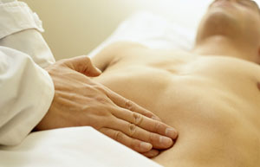
OESOPHAGUS AND THE GIT
..

Slide 2
THE OESOPHAGUS
.

Slide 3
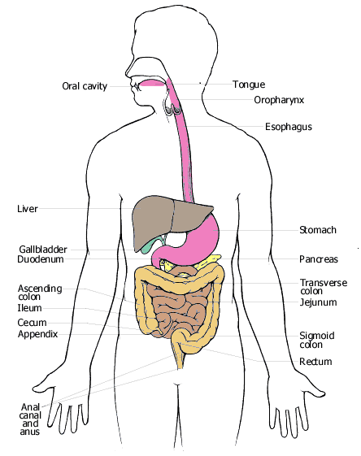

Slide 4
.
Oesophagus is a muscular tube starting from the pharynx and ends at the cardiac region of the stomach
Length is 25cm
Divided into 3 equal portions
  Upper third
  Middle third
  Lower third
Layers
  Serous coat
  Muscular coat
  Sub mucous coat
  Mucous coat
Lies more common to the right in the upper 1/3rd then moves to the left in the lower 1/3rd

Slide 5
Blood Supply
Upper third supplied by cervical blood supply from oesophageal branches of inferior thyroid arteries and right & left bronchial arteries
Middle third by aortic oesophageal arteries
Lower third by oesophageal branch of the left gastric artery
It has 3 constrictions
  Cricopharygeal constriction- 15cm measured from the upper incisor tooth
  Aortic and bronchial constriction- 25cm measured from the upper incisor tooth
  Lower constriction- lower oesophageal sphincter and diaphragm- 40cm from the upper incisor tooth

Slide 6
Physiology
The normal action of the oesophagus is swallowing
Normal act of swallowing is divided into oropharygeal (skeletal ms), and oesophageal (smooth ms) stages – voluntary and involuntary
Oropharyngeal
Involves the process of chewing and mixing the food with saliva so that the food is reduced in size sufficiently and lubricated to allow easy passage through the oral pharynx and oesophagus

Slide 7
.
With voluntary initiation of swallowing, the food bolus is propelled posteriorly by the tongue into the pharynx in a rapid series of carefully coordinated involuntary events, in which the soft palate of the larynx close to prevent regurgitation and aspiration of food
The upper oesophageal sphincter opens and a wave of pharyngeal peristalsis propels the food bolus into the upper oesophagus
This involuntary process of bolus transfer is controlled by the swallowing centre in the brain i.e. medulla oblongata
Respiration is inhibited centrally during the act of swallowing

Slide 8
.
Afferent input (towards the brain) to the swallowing centre is provided by cranial nerves – V, X, XI
Efferent input which do the motor function is provided by cranial nerves – V, VII, IX, XII
Once the food bolus has reached the upper oesophagus, the oesophageal phase takes place
A primary peristaltic wave propel the food bolus down the oesophagus into the stomach

Slide 9
Dysphagia
Dysphagia is difficulty in swallowing
Classification
i) Oropharygeal dysphagia
Also known as transfer dysphagia is produced by an abnormality in the preparation and transfer of food from the mouth to the oesophagus
May occur due to poor motor control
It involves the organs involved with chewing and rotation of food in the mouth i.e. tongue, jaw, other oral structures- teeth, gums, palate

Slide 10
Causes
a) Neurological disorders i.e. nerve supply impaired to these organs from CVA especially the one of brain stem, Alzheimer’s disease, Parkinson's disease (tremors), multiple sclerosis
b) Disease of myeneural junction- neuromuscular junction d’se- e.g. myasthenia gravis, Eaton-lumbert syndrome, botulism
c) Muscular disorders – myotonic dystrophy, oculopharygeal dystrophy, dermatomyetis, polymyetis, sarcoidosis (chronic inflammatory d’se)

Slide 11
Causes…
d) Metabolic myopathies- hyper & hypothyroidism, steroid induced myopathy
e) Structural abnormalities- oropharygeal neoplasms, post or radiational stenosis Infections- oropharygeal candidiasis, Herpes simplex, tonsillar enlargement, tonsillar abscess Caustic oesophagitis- due to strong acids and alkali burns- causes stricture during healing Oesophageal web Zenker’s diverticulum- a sack/pouch
f) Upper oesophageal sphincter dysfunction- cricopharygeal achalasia

Slide 12
Clinical features
Difficulty in initiating a swallow
Nasal regurgitation (food comes out from the nostrils)
Coughing during swallowing (food in the airway)

Slide 13
ii) Oesophageal dysphagia
Caused by mechanical or motor abnormality of the oesophagus
Patients are able to transfer food from the upper oesophagus but they experience a sensation of food hanging up after it has been swallowed.

Slide 14
Causes
a) Mechanical/structural cause – they impair the movement of the food bolus through the oesophangeal lumen. The cause may be in the lumen, on the wall or outside the wall.
In the lumen- foreign body, contrast media
On the wall- Ca. oesophagus, strictures form PUD, web, oesophageal diverticula
From external/outside the wall- cervical osteophytes (overgrowth of bones from the cervical bones), retrosternal goitre, enlarged mediastinal lymphnodes, aortic aneurysm, tumours from outside the lumen e.g.. gastric tumours, pharygeal compressions

Slide 15
causes……
b) Motility disorders- from;
Achalasia (failure of relaxation of the cardiac sphincter) leading to dilatation of the oesophagus,
Diffuse oesophageal spasms,
Chagga’s d’se- can affect the oesophagus and affect the nerve supply,
Progressive systemic sclerosis,
Severe GERD (gastro-esophageal reflux d’se)

Slide 16
Clinical features
Dysphagia to solid foods alone suggests structural or mechanical abnormality
Dysphagia to both solid and liquid suggests neuromuscular disturbances
Long hx of intermittent dysphagia to solids particularly steak or bread will suggest oesophageal ring or web which has not changed in size.
Long hx of progressive worsening dysphagia - strictures, neoplasms or achalasia

Slide 17
C/F……
History of associated symptoms of chest pains with intermittent dysphagia- diffuse oesophageal spasm or achalasia
Dysphagia in older patients who are wasting – oesophageal neoplasm especially alcoholics and cigarette smokers.
Regurgitation of undigested food while lying or history of recurrent pneumonia – achalasia
History of vomitus of undigested food after 48 hrs- Ca. stomach, Ca. oesophagus
Dysphagia with associated neck swelling-retrosternal goitre, pharyngeal pouch. It is associated with a gurgling sound following drinking.

Slide 18
Dysphagia in ISS patients
Oropharygeal candidiasis
Kaposi's sarcoma
Lymphomas- Non-Hodgkins lymphoma.
NB: Odynophagia ( pain on swallowing)
Oesophagitis
Tonsilar abscess
Ca. oesophagus
Achalasia
Oesophageal spasms

Slide 19
On Examination…
General examination- check weight/ask the patient about his/her previous weight and size
Ask about any problem with swallowing
Enquire about regurgitation or vomiting, content of the vomitus.
Ask about stool- the colour

Slide 20
Grading of Dysphagia
Grade the dysphagia with swallowing
1. Normal swallowing
2. Difficult to solids only
3. Dysphagia to semi-solids
4. Dysphagia to liquids
5. Total dysphagia

Slide 21
Investigations
FHG- WBCs total & differentials, ESR, RBCs
C-reactive proteins
Blood for U,E &C
TFTs- mass on the neck (retrosternal goitre)
Chest X-ray- Mediastinal fluid bubbles, stomach- gastric bubbles
Radiological studies- Barium swallow aka Barium oesophagography
Upper GIT endoscopy- to visualize the tract and take a biopsy (OGD)
Video pharyngeal Fluoroscopic swallowing study
Oesophageal Manometry- done if dysphagia is +ve and barium swallow does not show anything

Slide 22
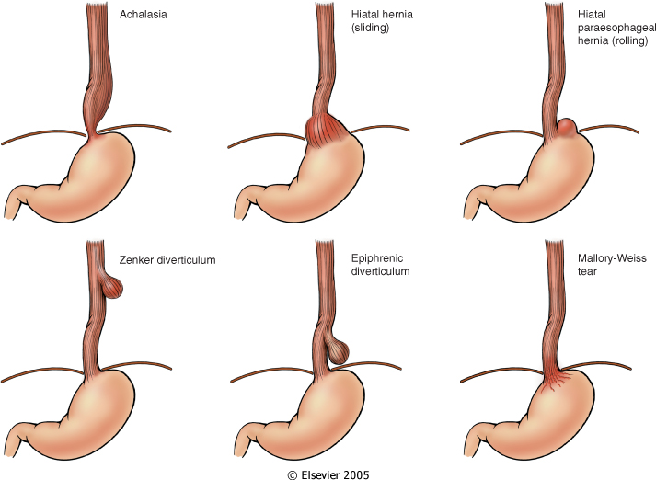

Slide 23
MOTOR DYSFUNCTION
1. Achalasia
a) “Failure to relax”
i) Aperistalsis
ii) Incomplete relaxation of LES with swallowing
iii) ↑ resting tone of LES
b) 1º - etiology poorly understood
TREAMENT
HELLERS MYOTOMY

Slide 24
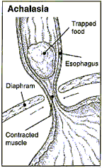
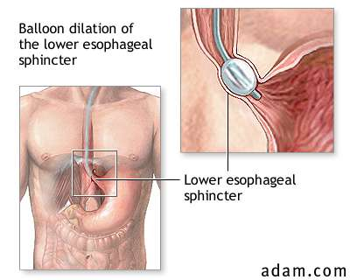

Slide 25
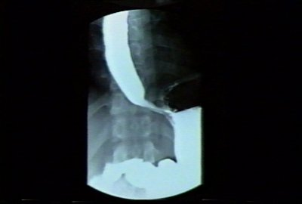
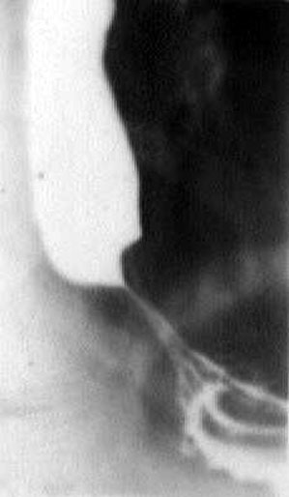

Slide 26
2. Hiatal Hernia
a) Sliding (~ 95% of cases)
i) Protrusion of stomach above
diaphragm → bell shaped dilation
ii) ~ 10% suffer from reflux
b) Paraesophageal
i) Separate portion of stomach
enters thorax
c) Etiology unknown
d) Clinical:
i) strangulation (b) ; ulceration

Slide 27
3. Diverticula
a) “Outpouching” of all visceral layers of oesophagus
i) False – only mucosa and sub - mucosa
b) types:
i) Zenker
- above UES
ii) Traction
- midpoint of esophagus
iii) Epiphrenic
- above LES

Slide 28
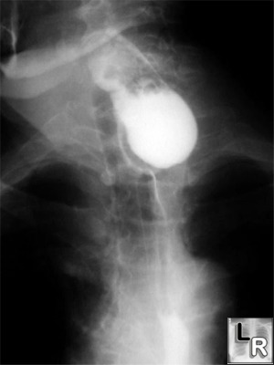
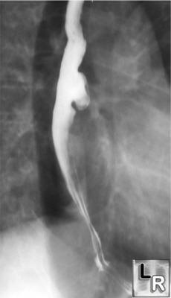
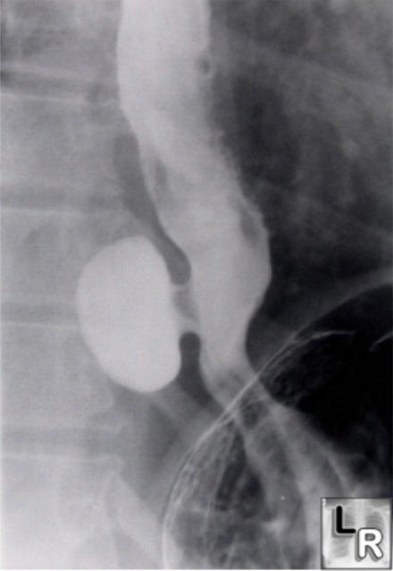

Slide 29
4. Lacerations (Mallory-Weiss
syndrome)
a) Longitudinal tears
i) Oesophagogastric junction
b) Severe retching and vomiting
i) Commonly seen in alcoholics
ii) Massive dilation with tearing
c) Underlying hiatal hernia is also known factor
d) 5-10 % of upper GI bleeds
i) Easily treated
ii) Rare rupture “Boerhaave”

Slide 30
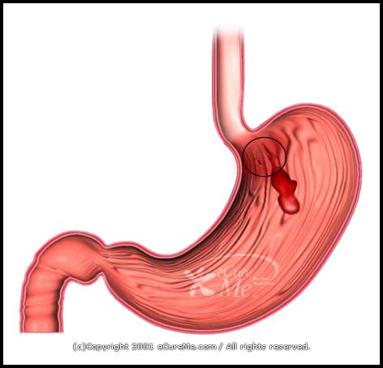

Slide 31
Esophageal Varices
Commonest cause is portal hypertension
a) Induces collateral circulation
wherever portal and caval systems
communicate
b) Seen in area of lower esophagus
i) ↑ Pressure in esophagus causing
- tortuous vessels called “varices”
c) Develop in ~ 90% of patients with cirrhosis (USA)
d) Worldwide main cause → schistosomiasis

Slide 32
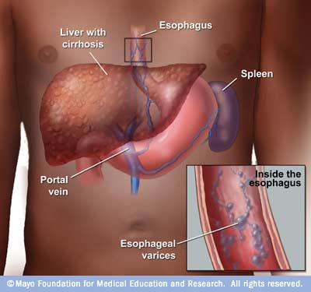

Slide 33
e) 40-50% of patients die with first bleeding episode
i) Does not stop spontaneously
Esophagitis
Inflammation of mucosa
a) ~ 5% in USA
b) GERD (gastroesophageal reflux disease) reflux of gastric contents is the most important cause of oesophagitis.

Slide 34
OESOPHAGEAL CANCER
.

Slide 35
Epidemiology
Most esophageal tumors are malignant, fewer than 1% are benign
Sex ratio- 25:1 M:F
Age average- peak is 50 years but can be seen in as young as 12 years and as old as 102 years
13,000 new patients in the United States each year, and almost matching that figure is the expected death rate of 12,000 patients

Slide 36
Types
Squamous cell carcinoma- commonest worldwide and 20% affects the upper 1/3rd of the oesophagus, 50% affects the middle 1/3rd and 30% affects the lower 1/3rd (Adenocarcinoma)
Adenocarcinoma – more common in western countries and affects the lower 1/3rd of the oesophagus
Oat cell carcinoma -rare

Slide 37
Squamous Cell Carcinoma
95% of esophageal cancer worldwide
Commonly 7th decade of life, 1.5-3 times more common in men
Thought to occur from prolonged exposure of esophageal mucosa to noxious stimuli in persons with a genetic predisposition to the disease.

Slide 38
Adenocarcinoma
Most common cell type of esophageal cancer in the United States.
Adenocarcinoma arises from the superficial and deep glands of the esophagus, mainly in the lower third of the esophagus, especially near the gastroesophageal junction.

Slide 39
Rare esophageal cancers
Anaplastic small cell (oat cell) carcinoma arise in the esophagus from same argyrophilic cells found in the lung.
Adenoid cystic esophageal carcinoma
Primary malignant melanoma of esophagus
Carcinosarcoma, features of SCC and malignant spindle cell sarcoma.

Slide 40
Risk Factors
Squamous cell still persists in patients with the usual risk factors for other aerodigestive tract carcinomas, specifically smoking (5-fold) and alcohol (5-fold) abuse.
Heavy smoking and heavy drinking combine to increase the risk 25- to 100-fold.

Slide 41
Risk Factors
CONSUMPTION OF:
  Tobacco, Alcohol, very hot drinks or foods, nitrogenous compounds e.g. found in smoked fish
UNDER-CONSUMPTION OF:
  Fruits, Fresh meat, Riboflavin, Beta-carotene,
  Vitamin C, Magnesium, Vegetables, Fresh fish, Niacin, Vitamin A, Vitamin B complex, Zinc
  Food without oxidants e.g. green vegetables inhibit the process of carcinogenesis

Slide 42
Risk Factors
PREDISPOSING CONDITIONS:
  Caustic injury, Esophageal webs, Achalasia (cardiac sphincter fails to relax during swallowing), Barrett's esophagus ( at the lower third of the oesophagus where the shape is altered in morphology), Esophageal diverticula, long-standing oesophageal stricture
OTHER EXPOSURE:
  Asbestos, Ionizing radiation, Exceptionally hot beverages (tea), obesity
  Location: Middle East, South Africa, Northern China, Southern Russia, India

Slide 43
Spread
a) Local or regional spread- occurs through sub-mucosal infiltration of the wall of oesophagus to the adjacent structures
It then involves regional lymphnodes and sometimes it may go to distant lymphnodes
b) Haematogenous spread- goes to distant places, but commonly to the liver, lungs then other organs

Slide 44
Clinical Findings
Dysphagia present in more than 90% of patients with esophageal cancer. Progressive dysphagia from solids, semi solids and finally to liquids (patient die from hunger and thirst)
Nonspecific retrosternal discomfort/epigastric pain
Indigestion
Weight loss- due to malnutrition (tumour wasting factor i.e. tumour cachexia)
Pain in advanced disease
Regurgitation
Respiratory symptoms- retrosternal chest (pain behind the sternum),hoarseness of voice (recurrent laryngeal nerve palsy), persistent nocturnal cough (PND)
Anaemia in advanced disease

Slide 45
Clinical Findings- percentag
Symptom Percen
p%
Dysphagia 87-95
Weight loss 42-71
Vomiting or regurgitation 29-45
Pain 20-46
Cough or hoarseness 7-26
Dyspnoea 5

Slide 46
Investigations
Oesophagogastroduodenoscopy (OGD) - allows direct visualization and biopsy of the tumour
Endoscopic ultrasonography (EUS)- is the gold standard investigation, most sensitive for T & N staging
Bronchoscopy –recommended for upper 1/3rd lesion to help exclude invasion of trachea or bronchi
Laparoscopy and Thoracoscopy for staging regional lymphnodes, to check transperitoneal cavity spread, liver metastasis

Slide 47
Invxs……
Barium swallow- very sensitive for detecting strictures and intraluminal masses (nowadays rarely used)
CT scan and MRI of the abdomen- used to locate the primary lesion and exclude any metastasis
Abdominal ultrasound- to exclude metastatic disease of the liver, differentiate tumour from the oedematous the surrounding which are found on CT
Chest X-ray- to exclude metastatic tumour in the lungs particularly pleural effusion, rule out fistula or paralysis of the diaphragm

Slide 48
TNM Staging
T: PRIMARY TUMOR
  Tis- Carcinoma in situ (high-grade dysplasia)
  T 1 -Tumor invading the lamina propria, muscularis mucosae, or submucosa but not breaching the boundary between submucosa and muscularis propria
  T 2- Tumor invading muscularis propria but not breaching the boundary between muscularis propria and periesophageal tissue
  T 3 -Tumor invading periesophageal tissue (adventitia) but not adjacent structures
  T 4 Tumor invading adjacent structures

Slide 49
TNM Staging……
N: REGIONAL LYMPH NODES
  N 0- No regional lymph node metastasis
  N 1- Regional lymph node metastasis, 1-2 regional lymphnodes involved
  N2- 3- 6 regional lymphnodes involved
  N3- more than 6 regional lymphnodes involved
M: DISTANT METASTASIS
  M 0- No distant metastasis
  M 1- Distant metastasis

Slide 50
Stage Grouping
Stage 0 T0 N 0
To N 0 M0
Stage I T 1 N 0 M0
Stage II IIA T 2 N0 M 0
T 3 N 0 M0
IIB T 1 N 1 M0
T 2 N 1 M0

Slide 51
Stage Grouping
Stage III T 3 N 1 M0
T 4 any N, M 0
Stage IV any T any N, M 1

Slide 52
Treatment Options
Palliative Treatment for unresectable lesions include:
  Dilatation
  Stenting
  Photodynamic therapy
  Radiation therapy
  Laser therapy
  Surgical palliation

Slide 53
Treatment Options
Curative resection
Mid esophagus approached from right
Distal esophagus from left
Ivor-Lewis combined right thoracic and abdominal incisions for mid esophagus
Neoadjuvant chemotherapy + radical subtotal oesophagotomy
To- endoscopic mucosal resection
T1, T2- chemotherapy without surgery

Slide 54
Contraindications to Sx
Patients with advanced nutritional debilitation
Patients with inadequate pulmonary reserve
Patients with wide spread metastasis
Involvement of the recurrent laryngeal nerve
Patients with fistulae

Slide 55
Cmxs of surgery
Patient may develop strictures
Leakage at the anastomosed site
Damage to the recurrent laryngeal nerve
Development of chylothorax
Development of DVT
Prognosis
Survival in patients with oesophageal cancer depends on the stage of the disease. Both SCC and ADC appear to have equivalent survival rates. Solid organs involvement e.g. liver, lungs and lymphnodes metastasis are associated with low survival rates.

Slide 56
TNM Stage | 5- Year survival rate (%)
o | 100
1 | 80
2A | 40
2B | 30
3 | 15
4 | 0

Slide 57
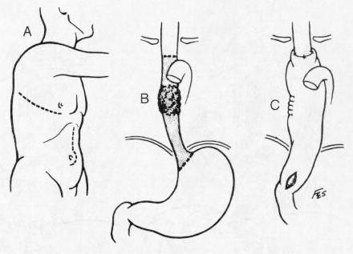
Mid-Esophageal Tumor

Slide 58
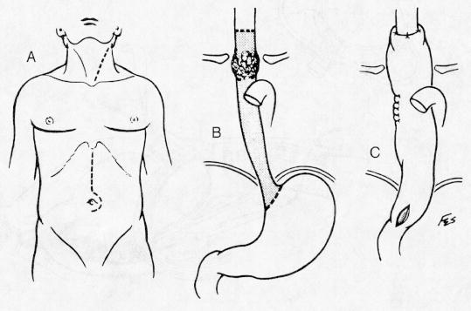
Upper Esophageal Tumor

Slide 59
.
THE STOMACH

Slide 60
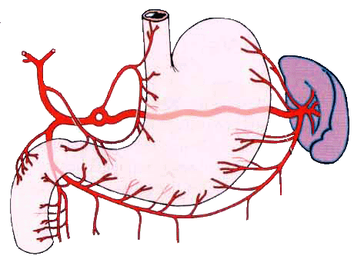
Celiac trunk
Left branch
Left gastric a.
Right branch
Short gastric a.
Common
hepatic a.
Cystic a.
Splenic a.
Right gastric a.
Proper hepatic a.
Gastroduodenal a.
Splemic branches
Left gastrioeploic a.
Right gastroepiploic a.
Superior pancreaticoduodenal a.

Slide 61
Introduction
Peptic ulcer disease (PUD) is a common disorder that affects millions of individuals worldwide
It is accounting for roughly 10% of medical costs for digestive diseases
Notes:
has a major impact on our health care system by

Slide 62
Definitions
Ulcer:
A lesion on an epithelial surface (skin or mucous membrane) caused by superficial loss of tissue
Erosion:
A lesion on an epithelial surface (skin or mucous membrane) caused by superficial loss of tissue, limited to the mucosa

Slide 63
.
DYSPEPSIA AND PEPTIC ULCERATION

Slide 64
Definitions
Peptic Ulcer
An ulcer of the alimentary tract mucosa, usually in the stomach or duodenum, & rarely in the lower esophagus, where the mucosa is exposed to the acid gastric secretion
It has to be deep enough to penetrate the muscularis mucosa

Slide 65
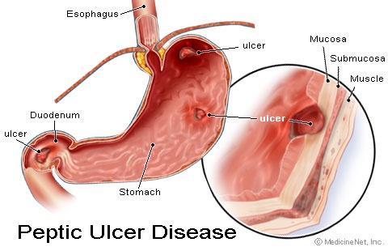
Peptic Ulcer Disease

Slide 66
Duodenal ulcer
Occurs mostly on the first part of the duodenum
Chronic ulcer penetrates the mucosa into the muscle coat, this leads to fibrosis, then fibrosis and finally to stenosis (pyloric stenosis)
When there is both anterior and posterior duodenal ulcers, they are called “kissing ulcer”
Anteriorly placed ulcers tend to perforate due to poor blood supply, posterior duodenal ulcer tend to bleed by eroding a large blood vessel e.g. gastroduodenal artery
Malignancy in the duodenum is uncommon i.e. 1- 5%

Slide 67
Gastric ulcer
Are independent of the gastric secretions
They can occur in Achlorhydric state (without Hcl acid)
May become malignant up to 15%
If fibrosis occurs, it may result to “hour-glass” contraction of the stomach
Chronic ulcers are more common in the lesser curvature especially in the incissura angularis (small anatomical notch on the stomach located on the lesser curvature of the stomach near the pyloric end)
Gastric ulcers may occur following enterostomy e.g. gastrojejunostomy

Slide 68
Etiology
The two most common causes of PUD are:
  Helicobacter pylori infection ( 70-80%)
  Non-steroidal anti-inflammatory drugs (NSAIDS)

Slide 69
Etiology
Other uncommon causes include:
  Gastrinoma (Gastrin secreting tumor)
  Stress ulceration (trauma, burns, critical illness)
  Viral infections
  Vascular insufficiency

Slide 70
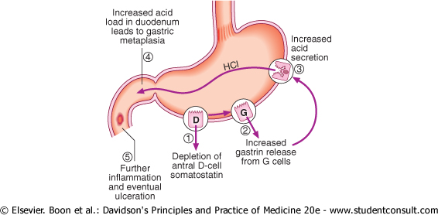
Pathogenesis of H. pylori infection
Effects of H. pylori on gastric Hormones

Slide 71
NSAIDS
Inhibits the production of prostaglandins precursor from membrane fatty acids resulting in:
1. Decrease mucus & HCO3 production
2. Decrease mucosal blood flow
3. Reduce cell renewal
The drugs also generate oxygen-free radicals & products of the lipoxygenase pathway that may contribute to ulceration

Slide 72
Recommendations for H.pylori Testing & Eradication in NSAID Users
1- Patients who have a history of ulcer complication should undergo H. pylori testing. H. pylori should be eradicated in all infected patients because it is not plausible to determine whether the ulcer complications were caused by NSAIDs or both

Slide 73
Clinical Presentation
Recurrent epigastric pain (the most common symptom)
  Burning, comes at certain times esp. at night
  Occurs 1-3 hours after meals
  Relieved by food → DU (milk)
  Precipitated by food → GU (beans, sukuma wiki etc)
  Relieved by antacids and worsened by NSAIDs
  Radiate to back (consider penetration)
  Pain may be absent or less characteristic in one-third of patients especially in elderly patients on NSAIDs

Slide 74
Clinical Presentation
Nausea, Vomiting
Dyspepsia, fatty food intolerance
Chest discomfort
Anorexia, weight loss especially in GU
Haematemesis or malaena resulting from gastrointestinal bleeding

Slide 75
Diagnosis of H. pylori
Non-invasive
Stool antigen test
H. pylori IgG titer (serology)
Invasive
Gastric mucosal biopsy
Rapid Urease test

Slide 76
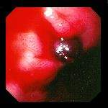
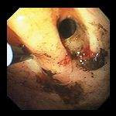
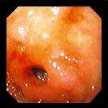
Complications of PUD on Endoscopy
Bleeding DU Perforated GU Duodenal stricture

Slide 77
General Strategy
Treat complications aggressively if present
Determine the etiology of ulcer
Discontinue NSAID use if possible
Eradicate H. pylori infection if present or strongly suspected, even if other risk factors (e.g., NSAID use) are also present;
Use antisecretory therapy to heal the ulcer if H. pylori infection is not present

Slide 78
Drugs Therapy
H2-Receptors antagonists e.g. Cimetidine, Ranitidine
Proton pump inhibitors e.g. Omeprazole, Lansoprazole
Cyto-protective agents e.g. Bismuth Salicylate, Sucralate
Prostaglandin agonists e.g. Misoprostol
Antacids e.g. Relcer gel .
Antibiotics for H. pylori eradication- Triple therapy – Amoxycillin, Clarithromycin & a PPI)

