Slide 1
INTRODUCTION TO AUTONOMIC PHARMACOLOGY
Dr Yuka

Slide 2
INTRODUCTION
The motor (efferent) portion of the nervous system is divided into autonomic and somatic subdivisions.
The autonomic nervous system (ANS) is largely independent and self regulating (autonomous) in that its activities are not under direct conscious control.
ANS is concerned primarily with visceral functions such as cardiac output, blood flow to various organs, and digestion and glands usually restricted to the two visceral efferent, peripheral components parasympathetic and sympathetic nervous systems.
The somatic subdivision is largely concerned with consciously controlled functions such as movement, respiration, and posture.

Slide 3
Autonomic Pharmacology
In the nervous system, chemical transmission takes place by the release of small amounts of transmitter substances from the nerve terminals into the synaptic cleft.
The transmitter diffuses across the cleft and activates or inhibits the postsynaptic cell by binding to a specialized receptor molecule.
In a few cases, retrograde transmission may occur from the postsynaptic cell to the presynaptic neuron terminal.
Autonomic pharmacology is the science of how drugs can be used to initiate various ANS functions.
Five key features of neurotransmitter function provide potential targets for pharmacologic therapy: synthesis, storage, release, and termination of action of the transmitter, and receptor effects.

Slide 4
Anatomy of the Autonomic Nervous System
Autonomic nervous system comprises three divisions:
Parasympathetic Division (craniosacral)
Sympathetic Division (thoracolumbar)
Enteric Nervous System Division

Slide 5
Parasympathetic system
Consists of pre-ganglionic and post-ganglionic fibres
Originate in nuclei within the CNS and give rise to preganglionic efferent fibers that exit from the brain stem or spinal cord and terminate in motor ganglia
The parasympathetic preganglionic fibers leave the CNS through
The cranial nerves (third, seventh, ninth, and tenth)
The third and fourth sacral spinal roots.
Parasympathetic ganglia lie close to or within the target organ and supply:
Cardiac & smooth muscle
Gland cells, and nerve terminals

Slide 6
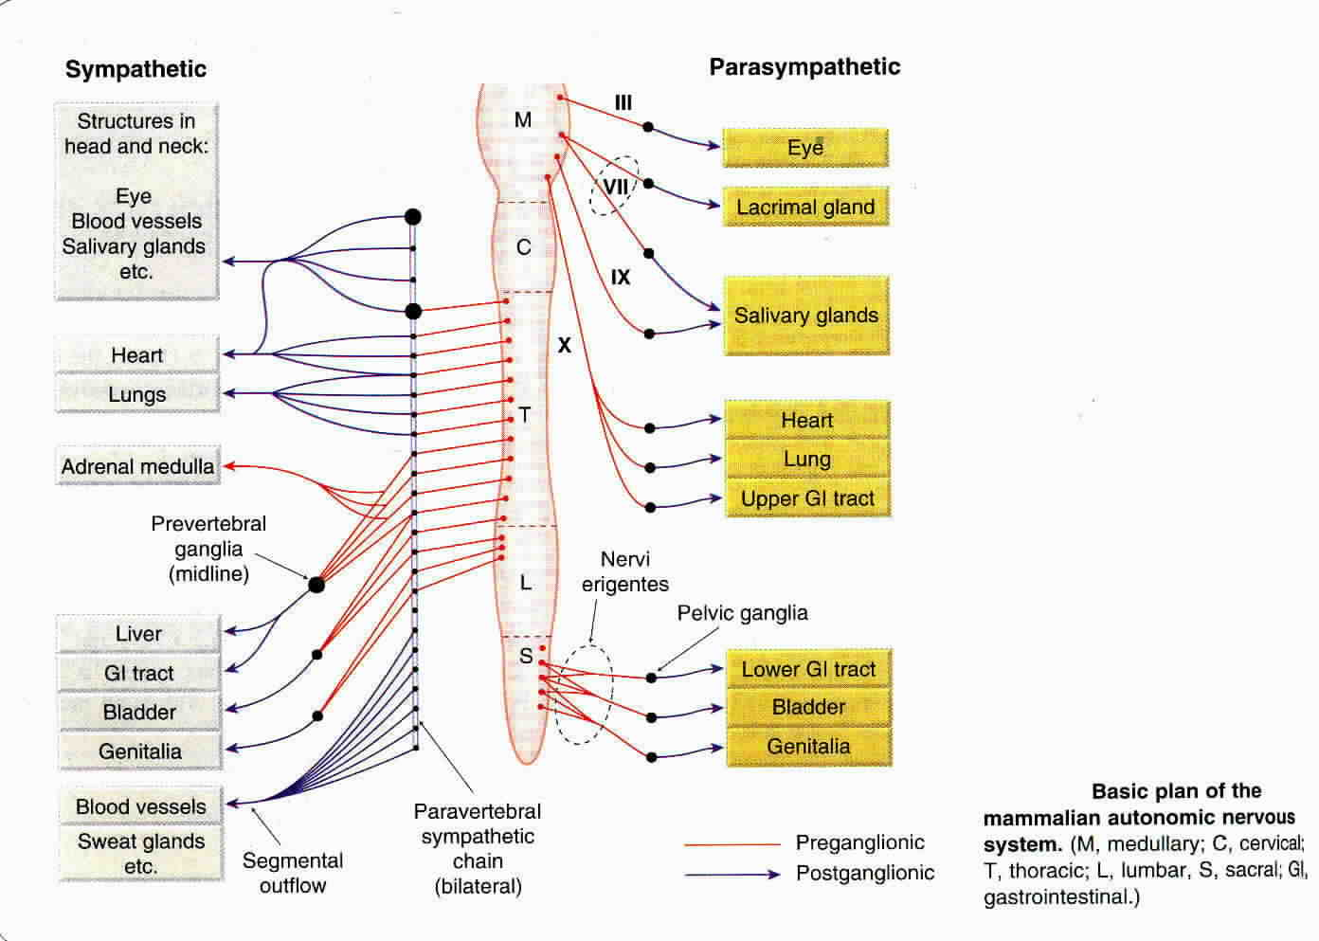

Slide 7
Sympathetic System
Consists of pre-ganglionic and post-ganglionic fibres
Sympathetic outflow leaves the CNS in the thoracic & lumbar spinal roots.
Sympathetic form two paravertebral chains plus some midline ganglia.
Originate in nuclei within the CNS and give rise to preganglionic efferent fibers that exit from the brain stem or spinal cord and terminate in motor ganglia
Supply:
Cardiac & smooth muscle
Gland cells, and nerve terminals
Renal vascular smooth muscle
Receptors: Nicotinic, muscarinic & Dopanergic

Slide 8
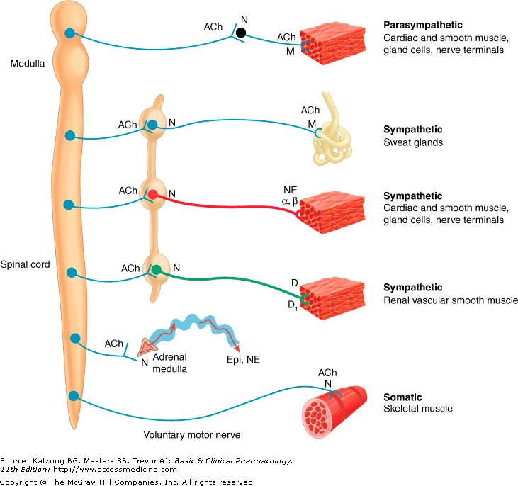
ACh, acetylcholine; D, dopamine; Epi, epinephrine;
M, muscarinic receptors; N, nicotinic receptors; NE, norepinephrine.

Slide 9
KEY:
Only the primary transmitter substances are shown. Parasympathetic ganglia are not shown because most are in or near the wall of the organ innervated.
Cholinergic nerves are shown in blue; noradrenergic in red; and dopaminergic in green.
Sympathetic postganglionic fibers release acetylcholine or dopamine.
The adrenal medulla, a modified sympathetic ganglion, receives sympathetic preganglionic fibers and releases epinephrine and norepinephrine into the blood.

Slide 10
The Enteric Nervous System
Found in the GI tract’s wall from the esophagus to the distal colon and is involved in both motor and secretory activities of the gut.
Includes the myenteric plexus (the plexus of Auerbach) and the submucous plexus (the plexus of Meissner).
Input from parasympathetic and from postganglionic sympathetic axons
Many transmitters & neuromodulators have been identified in the enteric nervous system

Slide 11
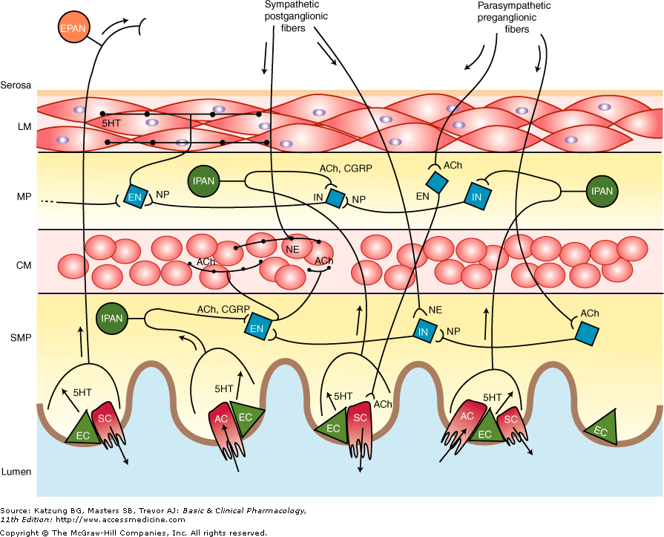
ACh, acetylcholine; AC, absorptive cell; CM, circular muscle layer;
EC,enterochromaffin cell; EN, excitatory neuron; EPAN, extrinsic primary afferent neuron; 5HT, serotonin; IN, inhibitory neuron; IPAN, intrinsic primary afferent neuron; LM, longitudinal muscle layer; MP, myenteric plexus; NE, norepinephrine;
NP, neuropeptides; SC, secretory cell; SMP, submucosal plexus.

Slide 12
Functions of the Autonomic Nervous System
The autonomic system controls smooth muscle (visceral & Vascular), exocrine (Endocrine
Parasympathetic & Sympathetic systems have opposing actions in control of heart rate & the GIT
Parasympathetic & Sympathetic have synergistic action on salivary gland & ciliary muscle.
Sympathetic activity increases in stress (fright –or- flight response.

