Slide 1
ADRENERGIC, CHOLINERGIC AND NANC NEUROTRANSMITTER SYSTEMS
Dr Yuka

Slide 2
NEUROTRANSMITTER CHEMISTRY OF THE AUTONOMIC NERVOUS SYSTEM
Based on the primary transmitter molecules released autonomic nerves can be classified as
Cholinergic
Release acetylcholine.
Almost all efferent fibers leaving the CNS are cholinergic
Include all preganglionic efferent autonomic fibers and the somatic (nonautonomic) motor fibers to skeletal muscle as well.
Most parasympathetic postganglionic and a few sympathetic postganglionic fibers
A significant number of parasympathetic postganglionic neurons utilize nitric oxide or peptides for transmission.
Noradrenergic (adrenergic)
Release norepinephrine and dopamine
Mostly postganglionic sympathetic fibers but a few sympathetic fibers release acetylcholine.
Adrenal medullary cells, which are embryologically analogous to postganglionic sympathetic neurons, release a mixture of epinephrine and norepinephrine.
Cotransmitter substances.
Released by most autonomic nerves.

Slide 3
Acetylcholine {and synthetic choline esters (pilocarpine, muscarine, arecoline) r muscarinic receptor agonists}
It is Cholinomimetic
It is the Autonomic neuroeffector junction; parasympathomimetic mediated via muscarinic receptor
Hydrolysed by Ach n plasma butyrylcholinesterase
Nicotine;stimulates autonomic ganglia and skeletal neuromuscular junction but not autonomic effector cells and also cause secretion of adrenaline
Signal mechanisms are distinct

Slide 4
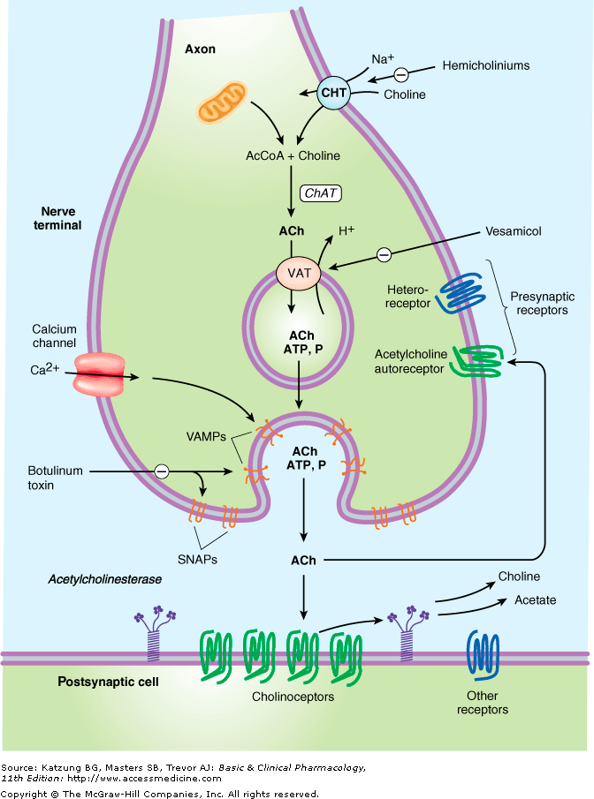
CHOLINERGIC JUNCTION
Choline is transported into the presynaptic nerve terminal by a sodiumdependent choline transporter (CHT). This transporter can be inhibited by hemicholinium drugs. In the cytoplasm, acetylcholine is synthesized from choline and acetyl Co-A (AcCoA) by the enzyme choline acetyltransferase (ChAT). Acetylcholine is then transported into the storage vesicle by a second carrier, the vesicle-associated transporter (VAT), which can be inhibited by vesamicol. Peptides (P), adenosine triphosphate (ATP), and proteoglycan are also stored in the vesicle. Release of transmitter occurs when voltage-sensitive calcium channels in the terminal membrane are opened, allowing an influx of calcium. The resulting increase in intracellular calcium causes fusion of vesicles with the surface membrane and exocytotic expulsion of acetylcholine and cotransmitters into the junctional cleft (see text). This step can be blocked by botulinum toxin. Acetylcholine's action is terminated by metabolism by the enzyme acetylcholinesterase. Receptors on the presynaptic nerve ending modulate transmitter release. SNAPs, synaptosome-associated proteins; VAMPs, vesicleassociated membrane proteins.

Slide 5
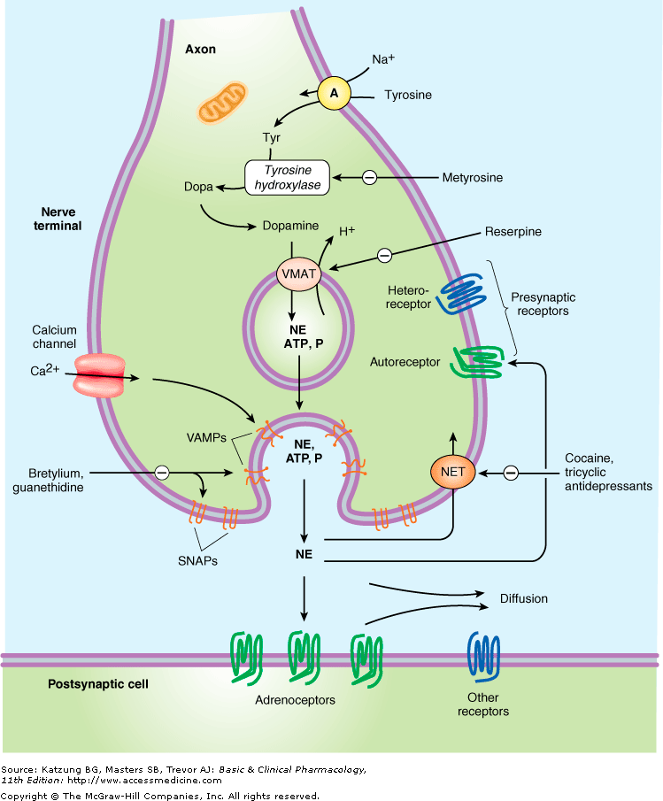
NORADRENERGIC JUNCTION
Tyrosine is transported into the noradrenergic ending or varicosity by a sodiumdependent carrier (A). Tyrosine is converted to dopamine (see Figure 6–5 for details), and transported into the vesicle by the vesicular monoamine transporter (VMAT), which can be blocked by reserpine. The same carrier transports norepinephrine (NE) and several other amines into these granules. Dopamine is converted to NE in the vesicle by dopamine- -hydroxylase. Physiologic release of transmitter occurs when an action potential opens voltagesensitive calcium channels and increases intracellular calcium. Fusion of vesicles with the surface membrane results in expulsion of norepinephrine, cotransmitters, and dopamine- -hydroxylase. Release can be blocked by drugs such as guanethidine and bretylium. After release, norepinephrine diffuses out of the cleft or is transported into the cytoplasm of the terminal by the norepinephrine transporter (NET), which can be blocked by cocaine and tricyclic antidepressants, or into postjunctional or perijunctional cells. Regulatory receptors are present on the presynaptic terminal. SNAPs, synaptosomeassociated proteins; VAMPs, vesicle-associated membrane proteins.

Slide 6
Cotransmitters in Cholinergic & Adrenergic Nerves
The vesicles of both cholinergic and adrenergic nerves contain other substances in addition to the primary transmitter.
They appear to play several roles in the function of nerves that release acetylcholine or norepinephrine.
They;
Can also be primary transmitters in the nonadrenergic, noncholinergic nerves.
Provide a faster or slower action to supplement
Modulate the effects of the primary transmitter.
Participate in feedback inhibition of the same and nearby nerve terminals.

Slide 7
AUTONOMIC RECEPTORS
Muscarinic and nicotinic receptors.- named after the alkaloids originally used in their identification
Adrenoceptor -Receptors associated with noradrenergic nerves, that respond to catecholamines such as norepinephrine.
The general class of adrenoceptors can be further subdivided into α -adrenoceptor, β -adrenoceptor, and dopamine-receptor types on the basis of both agonist and antagonist selectivity and on genomic grounds
Development of more selective blocking drugs has led to the naming of subclasses within these major types; for example, within the α –adrenoceptor class, α ₋1 and α-2 receptors differ in both agonist and antagonist selectivity.

Slide 8
Cholinoceptor denotes receptors (both muscarinic and nicotinic) that respond to acetylcholine.
G-protein linked; muscarinic
Ion channel mediated; nicotinic
These receptors regulate the production of second messengers and modulate ion channels via G-proteins
Receptors located in plasma membrane
Exhibits selectivity based on receptor subtypes and G-proteins
Adrenergic (or noradrenergic) receptors and cholinergic receptors are named after the nerves that innervate them.

Slide 9
Muscarinic Receptor Location
CNS
Organs and tissues innervated by parasympathetic nerves
Examples; endothelial cells, tissues innervated by somatic motor fibres and some CNS neurons
Nicotinic receptors
Transmembrane polypeptide
Act on cation-selective ion channelslocated on plasma m. of postganglionic cells in autonomic ganglia, somatic muscle fibres and some CNS neurons.

Slide 10
Selectivity
Receptor selectivity of muscarinic and nicotinic receptors
Pharmacokinetic selectivity; organ based

Slide 11
Cholinoceptors | Typical Locations | Result of Ligand Binding
Muscarinic M1 | CNS neurons, sympathetic postganglionic neurons, some presynaptic sites | Formation of IP3 and DAG, increased intracellular calcium
Muscarinic M2 | Myocardium, smooth muscle, some presynaptic sites; CNS neurons | Opening of potassium channels, inhibition of adenylyl cyclase
Muscarinic M3 | Exocrine glands, vessels (smooth muscle and endothelium); CNS neurons | Like M1 receptor-ligand binding
Muscarinic M4 | CNS neurons; possibly vagal nerve endings | Like M2 receptor-ligand binding
Muscarinic M5 | Vascular endothelium, especially cerebral vessels; CNS neurons | Like M1 receptor-ligand binding
Nicotinic NN | Postganglionic neurons, some presynaptic cholinergic terminals | Opening of Na+,K+ channels, depolarization
Nicotinic NM | Skeletal muscle neuromuscular end plates | Opening of Na+,K+ channels, depolarization

Slide 12
Dynamics of muscarinic receptors
Receptors are G-protein coupled and mediate effects via IP₃ and DAG which cascade release of calcium ions
Also increase cGMP intracellularly
There is flux of potassium ions
Inhibit adenylyl cyclase in some tissues (muscarinic receptors)

Slide 13
Dynamics of Nicotinic Receptors
Binds an ion channel causing conformational change that allows the flux of sodium and potassium ions across a concentration gradient and resultant depression of nerve or neuromuscular end plate

Slide 14
Muscarine acetylcholine receptors subtypes
M₁(neural) is located in the CNS: cortex, hippocampus & Glands: gastric, salivary etc.
Leads to increase IP3, DAG which leads to depolarisation & excitation increase K⁺ conductance.
Agonists are Ach, carbachol, oxtremorine
Antagonists: Atropine, ipratropium oxytropium & oxybutylin.

Slide 15
M₂ (cardiac) are located in the heart atria
Leads to decreased cAMP inhibition, decreased Ca⁺ conductance and increase K⁺ conductance.
Causing neural inhibition, central muscarinic effect i.e. tremor & hypothermia
M₃ glandular/smooth muscle GIT tract, eye, blood vessels: endothelium.
Leads to increase IP₃ & Ca ²⁺
Causing gastric, salivary secretion and smooth muscle contraction, ocular accommodation & vasodilatation.
Agonists: Ach, carbachol, oxotremorine.

Slide 16
Nicotinic Acetylcholine Receptors
Nicotic receptors are typical of ligand-gated ion channels.
Nicotinic receptors fall into three types: muscles, ganglionic & CNS types
Location of (α₁)₂ β₁ & E, is synapses of skeletal neuromuscular junction, mainly postsynaptic.
On the membrane response is excitatory. There is increased cationic permeability
Agonists: ACh, CCh & suxamethonium
Antagonists: Tubocurarine, pacronium, Hexamethonium, α-conotoxin.

Slide 17
(α3)₂ (β4)₃ are located at autonomic ganglia mainly at postsynaptic junctions.
Ganglionic receptors are responsible for transmission at sympathetic and parasympathetic ganglia
On the membrane response is excitatory. There is increased cationic permeability
Agonists are Ach, CCh, nicotine, Epibatide, DMPP
Antagonists: Micamylamine, trimetaphan,

Slide 18
CNS type (α4)₂(β2)₃ & (α7)₅ are located in many parts of the brain, pre- and postsynaptic junctions.
Agonists are nicotine, ephatidine Ach & cytosine for the (α4)₂ (β2)₃ and (α7)₅
Antagonists for the (α4)₂(β2)₃ are Mecamylamine, methylaconitine & α-conotoxin, while antagonists at (α7)₅ are Methylaconitine and α-Bungarotoxin.

Slide 19
Adrenoceptors | Typical Locations | Result of Ligand Binding
Alpha 1 | Postsynaptic effector cells, especially smooth muscle | Formation of IP3 and DAG, increased intracellular calcium
Alpha 2 | Presynaptic adrenergic nerve terminals, platelets, lipocytes, smooth muscle | Inhibition of adenylyl cyclase, decreased cAMP
Beta 1 | Postsynaptic effector cells, especially heart, lipocytes, brain; presynaptic adrenergic and cholinergic nerve terminals, juxtaglomerular apparatus of renal tubules, ciliary body epithelium | Stimulation of adenylyl cyclase and increased cAMP.
Beta 2 | Postsynaptic effector cells, especially smooth muscle and cardiac muscle | Stimulation of adenylyl cyclase and increased cAMP. Activates cardiac Gi under some conditions.
Beta 3 | Postsynaptic effector cells, especially lipocytes; heart | Stimulation of adenylyl cyclase and increased cAMP1

Slide 20
Dopamine Receptors | Typical Locations | Result of Ligand Binding
D1 (DA1), D5 | Brain; effector tissues, especially smooth muscle of the renal vascular bed | Stimulation of adenylyl cyclase and increased cAMP
D2 (DA2) | Brain; effector tissues, especially smooth muscle; presynaptic nerve terminals | Inhibition of adenylyl cyclase; increased potassium conductance D3
D3 | Brain | Inhibition of adenylyl cyclase D4
D4 | Brain, cardiovascular system | Inhibition of adenylyl cyclase

Slide 21
Direct acting cholinergic stimulants/ Choline esters
Acetycholine
Methacholine
Carbamic acid
Carbachol
Bethanechol

Slide 22
Direct acting cholinergic stimulants/alkaloids
Muscarinic alkaloids
Muscarine
Pilocarpine
Oxotremorine
Nicotinic alkaloids
Nicotine
lobeline
Dimethylphenylpipeazinium (DMPP)

Slide 23
INDIRECT ACTING CHOLINERGIC STIMULANTS Cholinesterase Inhibitors
Neostigmine Isofluorophate
Physostigmine Soman
Ambenonium Echothiophate
Carbamyl Parathion
Edrophonium Paraoxon
Malaoxon Malathion

Slide 24
Cholinergic Receptor Antagonists/Tertiary amines
Atropine
Scopolamine
Dicyclomine
Methixene
Oxyphencylimine
Thiphenamil

Slide 25
Cholinergic Receptor Antagonists/Quaternary amines
Anisotropine
Homatropine
Propantheline
Isopropanide
Methscopolamine
Clidinium
Glycopyrolate
Hexocylium
Mepenzolate
Methantheline
Oxyphenonium

