Slide 1


Syndromic Management of
Sexually Transmitted Infections
1

Slide 2
What is Syndromic Management?
Syndromic management refers to the approach of treating STI/RTI
symptoms responsible
and signs based on for each syndrome.
the organisms most A more definite or
commonly etiological
diagnosis may be possible in some settings with
sophisticated
laboratory facilities, but this is often problematic.
2
Notes:
Syndrome: a group of symptoms which consistently occur together, or a condition characterized by a set of associated symptoms.
STI: Sexually Transmitted Infections
RTI: Reproductive Tract Infections

Slide 3
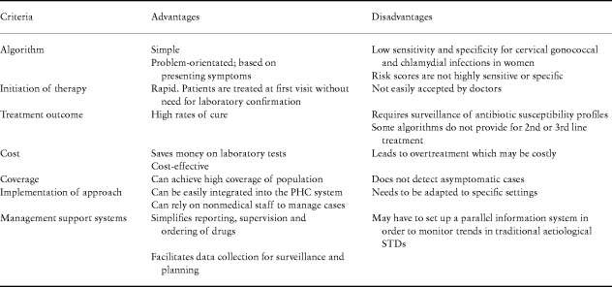
3

Slide 4

STI – Syndromic Case Management
REQUIREMENTS:
Adequate medical history
Good sexual history
Complete STI clinical examination
Management guidelines
Good supply of effective drugs
4

Slide 5
Essential Steps In STI Care Management*
Syndrome
Assessment
Contact tracing
(diagnostic tools)
Compliance
Diagnosis
Treatment
5Cs
Confidentiality
Condom use
(screening tests)
Counseling
Risk
Assessment
* Adapted from Holmes & Ryan
5

Slide 6
Syndromic Flow Charts for SCM
Urethral discharge
Vaginal discharge
Ophthalmia neonatorum
Pelvic Inflammatory Disease (PID)
Genital ulcer disease (M & F)
Scrotal swelling
Inguinal swelling
6
Notes:
SCM: Syndromic Case Management

Slide 7
URETHRAL DISCHARGE
7

Slide 8
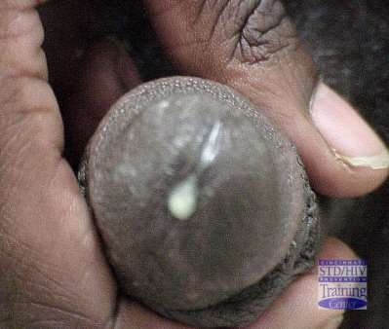
What is Urethral Discharge Syndrome?
Discharge coming from the urethral meatus
May be frank pus, mucopurulent, or serous (clear)
Occasionally discharge will be white in colour
Gonococcal urethral discharge
Photo: Cincinnati STD/HIV Training Ctr
8

Slide 9
COMPLAINT OF URETHRAL DISCHARGE
Take History including Risk Factors.
Retract foreskin. Milk urethra if necessary
Discharge seen
No discharge seen
Counsel. Treat for
Gonorrhoea and Chlamydia
Re-evaluate patient after holding his Urine for at least 4 hours
Follow-up 7 days after clinic visit if indicated
(e.g. if ceftriaxone for gonorrhoea was not prescribed)
Cured
Discharge persists. Treat for Trichomonas
Treatment regimen followed. REFER
Complete any remaining Treatments.
COUNSEL
Treatment regimen Not followed.
RE-TREAT
9

Slide 10
VAGINAL DISCHARGE

Slide 11
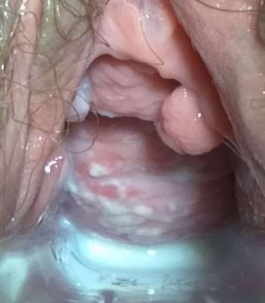
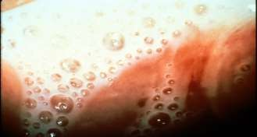
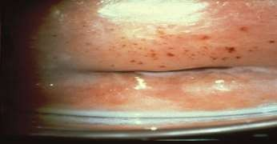
Causes of Abnormal Vaginal Discharge
Candidiasis
  Curdy white discharge.
  Common after antibiotic treatment.
Trichomoniasis
Greenish frothy discharge
Treatment of sex partner needed

Slide 12
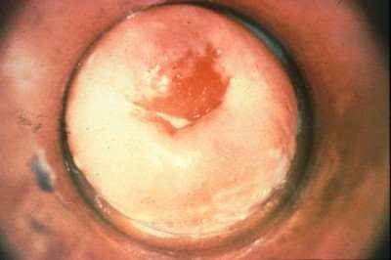
Cervicitis
Bacterial vaginosis
Overgrowth of anaerobic/facultative
Chlamydia
Gonorrhoea
Trichomonas
HSV
Limitations of syndromic management
  Use local prevalence data, if available
  Risk assessment
  Partner treatment
anaerobic flora
Associated with
increased risk of PID,
preterm labor, PROM
May enhance HIV
transmission
Adherent discharge
12
Notes:
Bacterial vaginosis (BV) is an abnormal vaginal condition that is characterized by vaginal discharge and results from an overgrowth of atypical bacteria in the vagina. It is not a true bacterial infection but rather an imbalance of the bacteria that are normally present in the vagina.

Slide 13

Complaint of Vaginal Discharge
Step 1
Take History (esp. sexual). Determine Risk Score
Step 2
Do Bimanual Pelvic Exam, Pass speculum
Step 3
Clean and Inspect Cervix
Step 4
Observe nature of Vaginal Discharge
Step 5
Give Prevention Messages

Slide 14
History
Menstrual history to rule out pregnancy
Nature and type of discharge
Itching
Burning micturition and increase in frequency of the same
Ulcer in the vulvar or inguinal region
Genital complaints in sexual partner
Low Backache

Slide 15

Complaint of Vaginal Discharge
Step 3
Clean and Inspect Cervix
Mucopus, Erosion or Friability: Treat for GC, CT & TV
No Mucopus etc., but Risk Score > 2:
Tx for GC, CT, TV
No Mucopus, Normal/No Discharge, Risk Score <2: No Tx but Counsel
Notes:
GC: Gonorrhea (Gonococcus )
CT: Chlamydia trachomatis
TV: Trichomonas vaginalis

Slide 16

Complaint of Vaginal Discharge
Step 4
Observe Nature
of Vaginal Discharge
Runny, profuse or malodorous: Treat for TV and BV.
White and curdlike: Treat fo Candida
Notes:
BV: Bacterial Vaginosis

Slide 17
Per speculum examination
Vaginits
o Trichomoniasis – Greenish Frothy
o Candidiasis – Curdy White
o Bacterial vaginosis - Adherent Discharge
o Mixed – Atypical discharge

Slide 18
Score 2
Vaginal Discharge: Risk Assessment
Risk Factor
Partner has urethral discharge
New partner in last 3 months
More than 1 partner last 3 months
Not living with steady partner 1
Age less than 21 years 1
1
1
[If risk score 2 and over, treat for cervicitis]
18

Slide 19
Treatment
Vaginitis Cervicitis (TV+BV+Candida) ( CT and NG)
Tab. Secnidazole 2gm orally one dose Tab. Cefixime 400mg orally one dose Tab. Tinidazole 500 mg orally bd for 5 days
Tab. Metochlorpromide to prevent gastric intolerance due Azithromycin 1gm an hour before lunch. If to secnidazole vomiting occurs give anti emetic and repeat
Candidiasis – Tab Fluconazole 150 mg oral single dose - vaginal pessary of clotrimazole once 500 mg
If both the conditions appear together, treat simultaneously
Avoid douching
Pregnancy, DM, HIV should be considered in recurrent infections
Regular follow up!
19

Slide 20
In Pregnancy!
T1
Clotrimazole – vaginal pessary/cream for Candidiasis. Fluconazole is CI in pregnancy.
Metronidazole pessaries or cream intravaginally if TV or BV is suspected
T2 and T3
Tab. Secnidazole or tinidazole
Metachlorpromide 30 mins before Metronidazole

Slide 21
LOWER ABDOMINAL PAIN

Slide 22
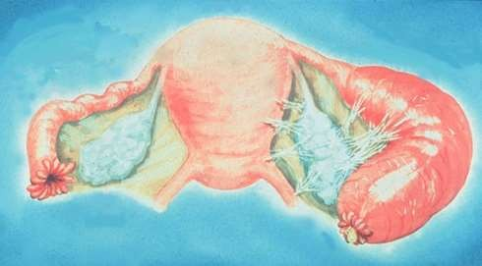
Pelvic Inflammatory Disease
Minimal criteria for diagnosis
Simple supporting signs
  Fever >38.3°C
  Abnormal discharge
In presence of HIV infection, PID may be more common and more severe
Acute Salpingitis
22
Notes:
Pelvic inflammatory disease (PID) is an infection of one or more of the upper reproductive organs, including the uterus, fallopian tubes and ovaries. Untreated PID can cause scar tissue and pockets of infected fluid (abscesses) to develop in the reproductive tract, which can cause permanent damage.
Salpingitis: inflammation of the fallopian tubes.

Slide 23


Complaint of Lower Abdominal Pain (LAP)
Take History and Assess Risk. Do Exam: Abdominal, pelvic, bimanual, speculum
Bowel or urinary symptoms?
Missed/overdue period; pregnant?
Recent childbirth or abortion?
Rebound tenderness; guarding?
Vaginal bleeding or pelvic mass?
Immediate Referral to Surgical or OBGYN
yes
to
any
no to all

Slide 24

Complaint of Lower Abdominal Pain (LAP)
Treat for PID. If IUD present:
Remove after 2-4 dys. Examine and treat partner(s).
[40% may be asymptomatic]. Counsel re 4 Cs.
Either:
Temperature > 38ºC
Dyspareunia or previous PID
Vaginal discharge
Mucopurulent cervicitis
Risk assessment positive With:
Pain on moving cervix/adnexa
Re-evaluate 3 days. Improved – complete Tx 10-14 days.
Not improved – refer hospital, (esp. if temperature elevated).
Notes:
IUD (intrauterine contraceptive device)

Slide 25
Treatment
Mild or Moderate PID, OPD treatment can be given. Therapy is required to cover NG, CT, & Anaerobes.
Tab. Cefixime + metronidazole 400mg Orally twice daily for 7 & 14 days respectively. Tab. Doxycycline 100mg Orally twice a day for two weeks.
Tab. Ibuprofen 400mg Orally thrice a day for 3-5 days.
Tab Ranitidine 150mg Orally to prevent gastritis.
OBSERVE THE PATIENT FOR THREE DAYS!! IF THERE IS NO IMPROVEMENT, THEN ADMIT HIM IN HOSPITAL, IN SITUATIONS WHEN,
The diagnosis is uncertain
Surgical emergencies (appendicitis). Pelvic abscess is suspected.
Pregnancy
Failed OPD therapy
Notes:
OPD: Outpatient Department

Slide 26
GENITAL ULCERS

Slide 27
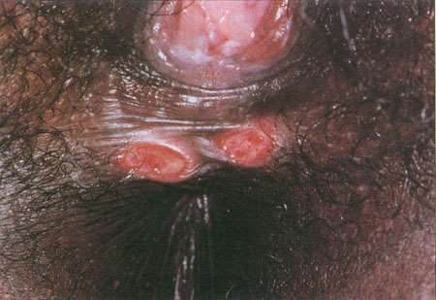
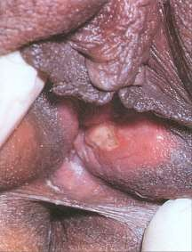
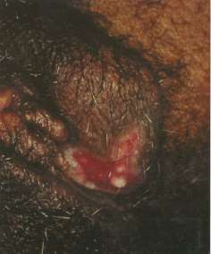
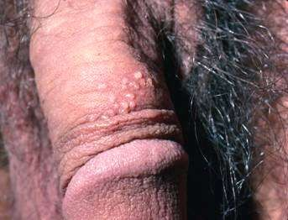
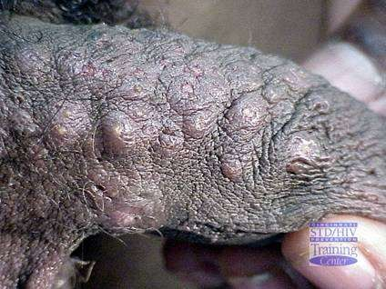
Genital Ulcer Disease
Syphilis
Chancroid
Herpes Simplex

Slide 28
Genital Ulcer Disease
Other Causes
  Lymphogranuloma venereum
  Granuloma inguinale (Donovanosis)
  Neoplasm
There are many published studies on HIV transmission and GUD including HSV.
Notes:
Lymphogranuloma venereum (LGV) is an ulcerative disease of the genital area. Its cause is the gram-negative bacteria Chlamydia trachomatis. It is an uncommon, sexually transmitted infection. It is transmittable by vaginal, oral or anal sex.
Granuloma inguinale is a genital ulcerative disease caused by the intracellular gram-negative bacterium Klebsiella granulomatis (formerly known as Calymmatobacterium granulomatis).

Slide 29
GENITAL ULCER SYNDROME
History, Risk Assessment, Examination.
Determine Number of Ulcers
Solitary Lesion
Multiple lesions
Recurrent at same site or with vesicles?
No Yes
Treat for Syphilis & Chancroid
Treat for Chancroid & Syphilis
Treat for Herpes
Review in 7 days
Review in 7 days
Ulcer Persists
Cured
Ulcer Persists
Cured
Refer
Refer

Slide 30
Treatment
Vesicles or multiple Painful ulcers are present, Treat for HERPES with Tab. Acyclovir 400mg thrice a day for 7 days
Only Ulcer is seen treat for syphilis and chancroid
  Syphilis by Inj. Benzathine Penicillin 2.4MU IM + Tab azithromycin 1gm oral single dose. Treatment should be extended beyond 7 days if ulcers have not epithelialized. Refer to higher centre if not responding to treatment or has recurrent lesions or is HIV positive.

Slide 31
SCROTAL SWELLING

Slide 32
Scrotal Swelling
Common STI causes of scrotal swelling are
  Neisseria gonorrhea
  Chlamydia trachomatis
Exclude non-STI causes of scrotal swelling:
  TB
  Inguinal hernia
  Testicular torsion, etc

Slide 33
Scrotal Swelling
Patient complains of
scrotal swelling or pain
Take history, examine, offer HIV test
No
No
Reassure patient, educate, counsel, provide condoms. Review if symptoms persist
Scrotal swelling or pain present?
Signs of other STI present?
Yes
Yes
Treat according to
appropriate flowchart
History of trauma or testis elevated or rotated?
or
Diagnosis in doubt?
No
Treat for chlamydia and gonorrhea.
Review in 7 days
Yes
Complete treatment course, reinforce education and counseling Review if symptoms persist
Refer patient to hospital
Patient has improved?
No
Yes

Slide 34
Lab Diagnosis:
Gram Stain of urethral smear to differentiate from gonococcal and non gonococcal.

Slide 35
Scrotal Swelling Recommended Therapy
Ciprofloxacin 500mg PO stat,
or
Spectinomycin 2gm IM stat
plus
Doxycycline 100mg PO BID for 7 days, or
Tetracycline 500mg BID for 7 days
If the partner is pregnant, then depending on the findings, drugs are prescribed. Doxycycline is contraindicated, where as ERYTHROMYCIN or AMOXICILLIN can be used.

Slide 36
INGUINAL BUBO

Slide 37
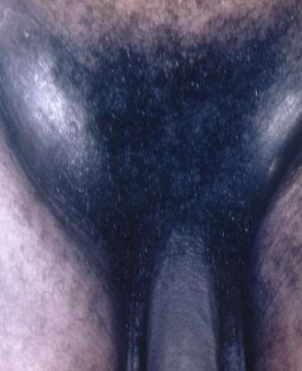
Inguinal Bubo
Swelling of inguinal lymph nodes as a result of STIs (or other causes)
Common causes:
  Treponema pallidum (syphilis)
  Chlamydia trachomatis (Lymphogranuloma venereum (LGV)
  Hemophylus ducreyi (chancroid)
  Calymatobacterium granulomatis (granuloma inguinale)
DD
  TB
  Malignancy

Slide 38
Inguinal Bubo
Patient complaining of inguinal swelling
Take history and examine
No
Educate
Counsel
Offer VCT
Promote and provide condoms
No
Inguinal/femoral bubo present?
Any other STI present
Yes
Yes
Use appropriate flow chart
Yes
Ulcers present
Use genital ulcer flow chart
No
Treat for LGV, GI and chancroid
Aspirate if fluctuant
Educate on treatment compliance
Counsel on risk reduction
Promote and provide condoms
Partner management
Offer VCT if available
Advise to return in 07 days
Refer if no improvement
38
Notes:
GI: granuloma inguinale

Slide 39
Inguinal Bubo
Recommended treatment:
  Ciprofloxacin 500mg PO BID for 14 days, and
  Erythromycin 500mg PO QID for 14 to 21 days

Slide 40
In Pregnancy!!!
Quinolones, Sulfonamides, Doxycycline are CI in pregnancy. Inj. Benzathine Penicillin 2.4MU IM one dose (after a test dose) Tab. Erythromycin 500mg orally four times a day for 15 days.
All pregnant women must be asked for history of genital herpes.
Women without symptoms of genital herpes can deliver vaginally. Genital Herpes must be treated with Acyclovir orally.
Metronidazole is generally not recommended in pregnancy. But it can be used in severly acute PID

Slide 41
Neonatal Conjunctivitis
Neonate presents with eye discharge
Take history and examine child
Purulent conjunctivitis present?
Yes No
Treat baby for gonococcal and chlamydial opthalmia
AND
Treat mother and partner for gonorrhoea and chlamydia
Educate and counsel Review baby in 7 days or sooner
if symptoms worsen
Review in 7 days
Signs of other illness present?
Reassure mother, educate parents
Review if symptoms persist
No
Yes
Treat appropriately
Complete treatment course, reinforce education and counseling Review if necessary
Eye infection cleared?
No
Yes
Refer for specialist opinion
and management

Slide 42
Prevention Messages
Treat the partner
Comply with Medication
Counsel Risk Reduction
Condom use
Confidentiality (assurance)
Treat all partners in past 3months
Treat males for SYPHILIS AND CHANCROID

Slide 43
THANK YOU!

