Slide 1
DIFFUSE PARENCHYMAL LUNG DISEASES
PRESENTER : DR. BAGHA
FACILITATOR : DR. MECHA
Respiratory Block 2008-2009
Notes:
1

Slide 2
Objectives
Describe the normal interstitium and the changes in lung architecture and cells that may occur in interstitial lung disease.
Review the differences between idiopathic and secondary interstitial lung disease.
List environmental conditions that are related to interstitial lung disease.
Review the signs and symptoms of interstitial pneumonia.
List the diagnostic procedures used for interstitial lung disease.
List the chest x-ray and CT features of interstitial lung disease.
Compare the structural and radiologic changes in the interstitial pneumonias and recall the treatment of Idiopathic Interstitial Pneumonia.
Notes:
2

Slide 3
Interstitial Lung Disease Introduction
Confusing
Confusing group of disorders, confusing and overlapping classifications, confusing terminology
Interstitial lung disease (ILD) = diffuse parenchymal lung disease (DPLD)
Diverse group of disorders considered together because of similar clinical, radiologic, physiologic, pathologic manifestations
COPD, asthma, pulmonary vascular disease are not included
The term “interstitial” is itself misleading because most of these diseases affect the airways, the lung parenchyma and often the pleura as well
Having said that, the major abnormalities in all of these disorders are located in the distal lung parenchyma
[Respiratory Block Interstitial Lung Disease Mark A. Smith]
Notes:
3

Slide 4
Interstitial Lung Disease Normal Interstitium
Pulmonary interstitium is made up of two compartments
The alveolar wall or septae, lined by the alveolar epithelial cell and the capillary endothelial cell
The loose binding connective tissue, peribronchovascular sheaths, interlobular septa, visceral pleura
The interstitium contains the lungs’ connective tissue elements (collagen, elastin and reticulin fibrils); extracellular matrix of glycosaminoglycans and non-collagenous proteins (fibronectin and laminin)
There are small numbers of cells found in the interstitium: macrophages, mast cells, plasma cells, fibroblasts and myofibroblasts
[Respiratory Block Interstitial Lung Disease Mark A. Smith]
Notes:
4

Slide 5
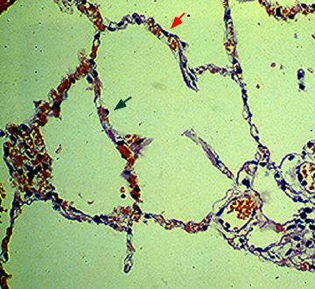
Interstitial Lung Disease Normal Interstitium
[Respiratory Block Interstitial Lung Disease Mark A. Smith]
Notes:
5

Slide 6
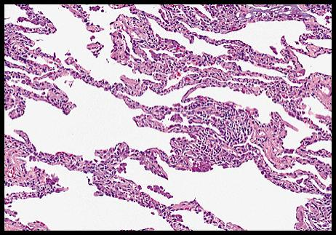
Interstitial Lung disease Pathology
[Respiratory Block Interstitial Lung Disease Mark A. Smith]
Notes:
6

Slide 7
Interstitial Lung Disease Pathogenesis
In ILD the inciting event is probably an injury to the alveolar epithelial cell
Inflammation and the lungs attempt to repair the damage likely result in the disease manifestations
The injury could be caused by inhalation such as inorganic (pneumoconiosis) or organic material (hypersensitivity pneumonitis)
The injury could occur via the circulation which is probably the case with connective tissue diseases and drug induced lung disease
In ILD a variety of cells may be found in larger than normal numbers in the interstitium. A variety of inflammatory cells, regenerating Type II alveolar cells, fibroblasts producing large amounts of extracellular material
In ILD either the injury continues or the repair process fails to be turned off and lung damage occurs
[Respiratory Block Interstitial Lung Disease Mark A. Smith]
Notes:
7

Slide 8
Pathogenesis of ILD
Collagen Vascular Disease,
Immunologic Disease, Drug,
Sensitivity to Antigen,
Mineral Fibers and dust
Lung injury / inflammatory response
Proteolytic enzymes, toxic O2 radicals
Cytokines (Propagation)
Initiation
Endothelial or
Alveolar epithelium
injury
Scarring
Fibrosis
Repair
Structural changes
Physiologic changes
Symptoms

Slide 9
Interstitial Lung Disease Pathogenesis
Realize that ILD’s are a diverse group of disorders and do not share a common etiology or pathogenesis
In Lymphangioleiomyomatosis, the interstitium is infiltrated with abnormal smooth muscle cells, in amyloidosis with amyloid, in lymphangitic carcinomatosis with malignant cells
To make things worse some diseases classified as ILD’s are actually alveolar filling diseases such as desquamative interstitial pneumonitis (DIP), eosinophilic pneumonia, pulmonary alveolar proteinosis
[Respiratory Block Interstitial Lung Disease Mark A. Smith]
Notes:
9

Slide 10
Interstitial Lung Diseases Classification
Raghu, Clin Chest Med 2004;25:409-419

Slide 11
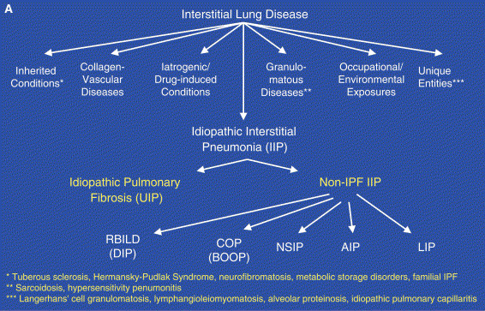

Slide 12
Classification of Idiopathic Interstitial Pneumonias
Clinical diagnosis Pathology
Idiopathic Pulmonary Fibrosis(IPF) Usual Interstitial Pneumonitis(UIP)
[Cryptogenic Fibrosing Alveolitis (CFA)]
Desquamative Interstitial Pneumonitis(DIP) DIP
Respiratory Bronchiolitis Interstitial RBILD
Lung Disease (RBILD)
Acute Interstitial Pneumonia(AIP) Diffuse Alveolar Damage (DAD)
Hamman Rich Syndrome
Nonspecific Interstitial Pneumonia(NSIP) NSIP
Cryptogenic Organizing Pneumonia(COP) Organizing Pneumonia
Lymphoid Interstitial Pneumonia(LIP) LIP
Notes:
12

Slide 13
Making Sense of the Alphabet Soup?!?
UIP COP NSIP
AIP RBILD
DIP BOOP LIP
IPF

Slide 15
Idiopathic Interstitial Pneumonias
 | IPF | NSIP | COP | AIP | DIP, RB-ILD | LIP
Duration | Chronic >12 mo | Subacute to chronic | Subacute < 3mo | abrupt | Subacute *smoker | Chronic *women
Frequency of Dx | 47-64% | 14-36% | 4-12% | rare | 10-17% | rare
HRCT Histo | Peripheral,subpleural,basal Reticulation Honeycomb Focal GGO bronchiectasis UIP | Peripheral,subpleural,basal GGO Subpleural sparing NSIP | Patchy consolidation Nodules Organizing PNA | Diffuse, bilateral GGO w/lobular sparing DAD | DIP: GGO in mid-lower zones RBILD: Bronchial wall thickening, GGO, nodules (centrilobular) DIP-RBILD | Diffuse Nodules GGO Cysts LIP
Rx | poor | + CS | +CS | ?? | Quit smoking,+CS | +CS
Prognosis | 50% in 5yr | 10% in 5yr | Death rare | 60% in 6mo | 5% in 5yr | ??

Slide 16
Collagen Vascular Diseases Associated with Interstitial Lung Disease
Many collagen vascular diseases can be associated with many types of lung diseases and are associated with interstitial lung diseases of varying histologies. Most common histologic pattern associated with each disease are listed first.
Rheumatoid arthritis UIP, NSIP, LIP, DIP, Mixed morphology, BOOP
Polymyositis/Dermatomyositis NSIP, UIP, DAD, BOOP
Sjogren’s Syndrome NSIP, LIP, BOOP
Systemic Sclerosis NSIP
Systemic Lupus NSIP, UIP, LIP
Mixed Connective Tissue Disease NSIP
[Respiratory Block Interstitial Lung Disease Mark A. Smith]
Notes:
16

Slide 17
Interstitial Lung Disease Inhalational Injury
Occupational and environmental exposures associated with interstitial lung disease
Inhaled inorganic dust
Silicates
Silica ("silicosis")
Asbestos ("asbestosis")
Talc (hydrated Mg silicates; "talcosis")
Kaolin or "china clay" (hydrated aluminum silicate)
Diatomaceous earth (Fuller's earth, aluminum silicate with Fe and Mg)
Nepheline (hard rock containing mixed silicates)
Aluminum silicates (sericite, sillimanite, zeolite)
Portland cement
Mica (principally K and Mg aluminum silicates)
Beryllium ("berylliosis“)
Notes:
17

Slide 18
Interstitial Lung Disease Inhalational Injury
Occupational and environmental exposures associated with interstitial lung disease
Inhaled inorganic dust
Carbon
Coal dust ("coal worker's pneumoconiosis")
Graphite ("carbon pneumoconiosis“)
Metals
Tin ("stannosis")
Aluminum: Powdered aluminum, Bauxite (aluminum oxide)
Hard metal dusts: Cadmium, Titanium oxide, Tungsten, Hafnium, Niobium, Cobalt, Vanadium carbides
Iron ("siderosis", "arc welder's lung") Barium (powder of baryte or BaSO4; "baritosis")
Antimony (oxides and alloys)
Hematite (mixed dusts of iron oxide, silica and silicates; "siderosilicosis")
Mixed dusts of silver and iron oxide ("argyrosiderosis")
CuSO4 neutralized with hydrated lime (Bordeaux mixture; "vineyard sprayer's lung“)
Notes:
18

Slide 19
Interstitial Lung Disease Inhalational Injury
Occupational and environmental exposures associated with interstitial lung disease
Inhaled organic dusts (hypersensitivity pneumonitis) (Partial list)
Thermophilic fungi (e.g. Macropolyspora faeni, Thermactinomyces vulgaris, T. sacchari)
Farmer's lung
Grain handler's lung
Humidifier or air conditioner lung
Bacteria (e.g. Bacillus subtilis, B. cereus)
Humidifier lung
True fungi (e.g. Aspergillus, Cryptostroma corticale, Aureobasidium pullulans, Penicillium species)
Maple-bark stripper’s lung
Malt worker’s lung
Paprika splitter’s lung
Sequoiosis
Cheese worker’s lung
Animal proteins
Bird fancier's disease
Rodent handler’s lung
Notes:
19

Slide 20
Interstitial Lung Disease Inhalational Injury
Occupational and environmental exposures associated with interstitial lung disease
Inhaled agents other than inorganic or organic dusts
Chemical sources
Synthetic - fiber lung (Orlon, polyesters, nylon, acrylic)
Bakelite worker's lung
Vinyl chloride, polyvinyl chloride powder
Gases
Oxygen
Oxides of nitrogen
Sulfur dioxide
Chlorine gas
Methyl isocyanate
[Respiratory Block Interstitial Lung Disease Mark A. Smith]
Notes:
20

Slide 21
Interstitial Lung Disease Inhalational Injury
Occupational and environmental exposures associated with interstitial lung disease
Inhaled agents other than organic or inorganic dusts
Fumes
Oxides of zinc, copper, manganese, cadmium, iron, magnesium, nickel, brass, selenium, tin, and antimony
Diphenylmethane diisocyanate
Trimellitic anhydride toxicity
Vapors
Hydrocarbons
Thermosetting resins (rubber tire workers)
Toluene diisocyanate (TDI - asthmatic reactions prominent)
Mercury
Aerosols
Oils, Fats
Pyrethrum (a natural insecticide)
Notes:
21

Slide 22
Drugs Associated with Interstitial Lung disease
Many drugs can cause many types of lung disease
Some can cause interstitial lung disease
Drug induced lung disease could be classified by the class of drug; others by the type of lung injury (clinical, radiologic or pathologic)
Antibiotics (nitrofurantoin, sulpha, minocycline), cancer chemotherapy (bleomycin, busulfan, chlorambucil, cyclophosphamide, methotrexate, mitomycin, nitrosureas), amiodarone, NSAIDS, gold, radiation
Patterns include hypersensitivity pneumonitis (methotrexate), pulmonary infiltrates and eosinophilia (NSAIDS) , organizing pneumonia (amiodarone), pulmonary fibrosis (nitrofuratoin), transient pulmonary infiltrates (hydrochlorothiazide), pulmonary edema (ASA), pulmonary hemorrhage (hydralazine)
Definitive diagnosis based on five criteria: history of drug use, drug should be known to cause the clinical/radiologic/pathologic condition, exclude other causes, condition should get better with drug withdrawal, condition should recur on re-challenge
Notes:
22

Slide 23
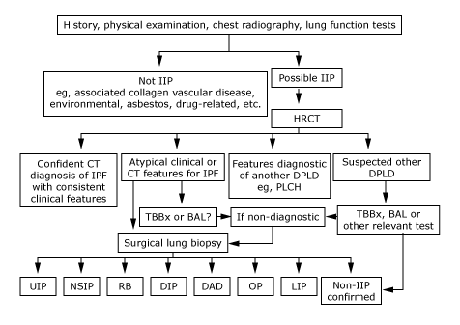
Approach to Interstitial Lung Disease
Notes:
23

Slide 24
Interstitial Lung Disease History
Reason for Assessment: Most common chief complaint is dyspnea worse with exertion. May also be seen because of chest x-ray abnormality, exposure or occupational history, pulmonary symptoms associated with another illness known to cause ILD (scleroderma), restrictive physiology discovered on spirometry done for another reason
General Identification: Age, sex, occupation
History of Present Illness: Age, sex, duration of symptoms (acute, subacute, chronic), associated symptoms (cough, hemoptysis, wheeze, chest pain), fever, chills, sweats, weight loss
Past Medical History: GERD, connective tissue disease, cardiac disease (risk factors for CHF), tuberculosis, malignancy, HIV
Medications: Past and present as thorough as possible
Family History
Social History: Occupational history past and present, smoking, exposures (pets, humidifiers, hot tubs), HIV risk factors
Review of Systems: GERD, connective tissue disease
[Respiratory Block Interstitial Lung Disease Mark A. Smith]
Notes:
24

Slide 25
Interstitial Lung Disease Physical Examination
Vital Signs: tachypnea, tachycardia, hypoxemia, fever
Respiratory Examination: “dry”, “velcro” crackles, inspiratory squeak or wheeze, clubbing, cyanosis
Cardiac Examination: right sided failure or pulmonary hypertension (loud P2, elevated JVP, peripheral edema, parasternal heave), left sided failure mimicking ILD
Extrapulmonary examination: joints, skin rashes
[Respiratory Block Interstitial Lung Disease Mark A. Smith]
Notes:
25

Slide 26
Interstitial Lung Disease Laboratory Studies
Blood: CBC, INR, creatinine, electrolytes, hepatocellular enzymes, LDH, CK, maybe serum ACE, ANA, ANCA, anti-GBM, serum precipitins
Arterial Blood Gas: might be normal, might see hypoxemia and respiratory alkalosis
Urinalysis: might see hematuria or proteinuria if there is vasculitis
EKG and maybe an echocardiogram
Pulmonary Function Testing: usually expect a restrictive pattern but some ILD’s can cause an obstructive or a mixed obstructive and restrictive picture (sarcoidosis, hypersensitivity pneumonitis, lymphangioleiomyomatosis (LAM), COPD with associated ILD). Typically the DLCO will be reduced; the reduction maybe less severe in sarcoidosis and maybe more severe in LAM, eosinophilic granuloma (PLCH) or ILD complicated with pulmonary hypertension
Exercise Testing:
Chest X-Ray: maybe normal, maybe reticular or nodular pattern, maybe airspace disease, there maybe an upper lobe or lower lobe predominance, there maybe adenopathy or pleural effusions
[Respiratory Block Interstitial Lung Disease Mark A. Smith]
Notes:
26

Slide 27
Interstitial Lung Disease Laboratory Studies
High Resolution Chest CT: allows similar classification of the disease as the CXR but shows the disease in much better detail which allows the disease to be shown in relation to the secondary pulmonary lobule. This helps with differential diagnosis.
Bronchoalveolar Lavage: useful for ruling out (or in) infectious etiologies or malignancy. Differential cell counts may be useful with differential diagnosis. For example a BAL lymphocytosis maybe seen with hypersensitivity pneumonitis, a BAL eosinophilia maybe seen in chronic eosinophilic pneumonia.
Lung Biopsy: transbronchial, VATS, open (surgical). Transbronchial biopsies are helpful for ruling in or ruling out malignancy or infection but are less helpful in making other diagnoses. However, they are useful in suspected sarcoidosis, perhaps hypersensitivity pneumonitis and sometimes bronchiolitis obliterans organizing pneumonia. Transbronchial biopsies are not helpful in diagnosing specific idiopathic interstitial pneumonias. Correctly classifying one of the idiopathic interstitial pneumonias requires a VATS or open lung biopsy.
[Respiratory Block Interstitial Lung Disease Mark A. Smith]
Notes:
27

Slide 28
CXR Patterns in Interstitial Lung Disease
Normal
Hypersensitivity pneumonitis (common in population studies, rare in isolated chronic cases)
Sarcoidosis
Connective tissue disease
Bronchiolitis obliterans
IPF (especially early "cellular" stage)
Asbestosis
Lymphangioleiomyomatosis
Reticular or linear opacities
Peripheral lung zone predominance
Bronchiolitis obliterans with organizing pneumonia
Eosinophilic pneumonia
[Respiratory Block Interstitial Lung Disease Mark A. Smith]
Notes:
28

Slide 29
CXR Patterns Interstitial Lung Disease
Reticular or Linear Opacities
Upper zone predominance
Granulomatous disease : Sarcoidosis, Berylliosis, Pulmonary Langerhans cell histiocytosis, Chronic hypersensitivity pneumonitis , Chronic infectious diseases (eg, tuberculosis, histoplasmosis)
Pneumoconiosis: Silicosis, Coal miners' pneumoconiosis
Ankylosing spondylitis
Radiation fibrosis
Drug-induced (amiodarone, gold)
Lower zone predominance
Idiopathic pulmonary fibrosis
Rheumatoid arthritis (associated with usual interstitial pneumonia)
Asbestosis
[Respiratory Block Interstitial Lung Disease Mark A. Smith]
Notes:
29

Slide 30
CXR Patterns in Interstitial Lung Disease
End-stage or honeycomb lung
Upper zone predominance
Sarcoidosis
Pulmonary Langerhans cell histiocytosis
Chronic hypersensitivity pneumonitis
Lymphangioleiomyomatosis
Lower zone predominance
Idiopathic pulmonary fibrosis
Rheumatoid arthritis (associated with usual interstitial pneumonia)
Asbestosis
Notes:
30

Slide 31
CXR Patterns in Interstitial Lung Disease
Increased lung volumes
Lymphangioleiomyomatosis
Tuberous sclerosis
Sarcoidosis (stage 3)
Pulmonary Langerhans cell histiocytosis (chronic, with cyst formation)
Neurofibromatosis
Chronic hypersensitivity pneumonitis
Pleural involvement
Asbestosis
Connective tissue disorders: Systemic lupus erythematosus, Rheumatoid arthritis, Scleroderma, Mixed connective tissue disease
Lymphangitic carcinomatosis
Lymphangioleiomyomatosis (chylous effusion)
Drug-induced (nitrofurantoin)
Sarcoidosis (lymphocytic effusion)
Radiation pneumonitis (chronic with mediastinal lymphatic obstruction)
Notes:
31

Slide 32
CXR Patterns in Interstitial Lung Disease
Hilar or mediastinal lymphadenopathy
Sarcoidosis (maybe calcified)
Lymphoma
Kaposi's sarcoma
Methotrexate-induced lung disease
Lymphangitic carcinomatosis
Berylliosis
Amyloidosis
Gaucher's disease
Acute disseminated histoplasmosis
Acute disseminated coccidioidomycosis
Silicosis (maybe calcified)
[Respiratory Block Interstitial Lung Disease Mark A. Smith]
Notes:
32

Slide 33
CXR Patterns in Interstitial Lung Disease
Miliary pattern (Nodular)
Sarcoidosis
Silicosis
Hypersensitivity pneumonitis
Bronchiolitis obliterans
Infectious granulomatous disease (tuberculosis, histoplasmosis, coccidioidomycosis)
Metastatic malignant disease: renal cell, adenocarcinoma of breast, melanoma, thyroid
Associated with Kerley B lines
Lymphangitic carcinomatosis
Chronic left ventricular failure, Mitral valve disease
Lymphoma
Lymphangioleiomyomatosis
Amyloidosis
[Respiratory Block Interstitial Lung Disease Mark A. Smith]
Notes:
33

Slide 34
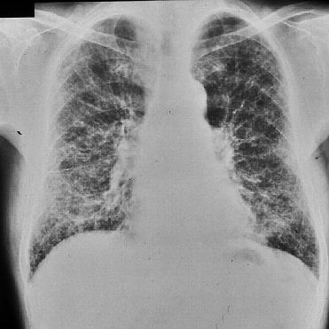
CXR Patterns Interstitial Lung Disease Reticular Opacities
[Respiratory Block Interstitial Lung Disease Mark A. Smith]
Notes:
34

Slide 35
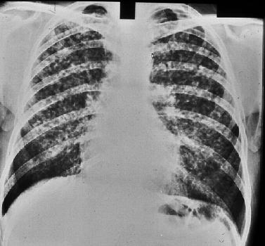
CXR Patterns in Interstitial Lung Disease Nodules
[Respiratory Block Interstitial Lung Disease Mark A. Smith]
Notes:
35

Slide 36
HRCT Patterns in Interstitial Lung Disease
Distribution of disease within the lung
Peripheral lung zone
Idiopathic pulmonary fibrosis
Asbestosis
Connective tissue disease
Eosinophilic pneumonia
Central disease (bronchovascular thickening)
Sarcoidosis
Lymphangitic carcinoma
Upper zone predominance
Granulomatous disease : Sarcoidosis, Pulmonary Langerhans cell histiocytosis X, Chronic hypersensitivity pneumonitis , Chronic infectious diseases (eg, tuberculosis, histoplasmosis)
Pneumoconiosis: Silicosis, Berylliosis, Coal miners' pneumoconiosis
Lower zone predominance
Idiopathic pulmonary fibrosis
Rheumatoid arthritis (associated with usual interstitial pneumonia)
Asbestosis
Notes:
36

Slide 37
HRCT Patterns Interstitial Lung Disease
Reticular opacities
Idiopathic pulmonary fibrosis
Asbestosis
Connective tissue disease
Chronic Hypersensitivity pneumonitis
Nodules
Hypersensitivity pneumonitis
Respiratory bronchiolitis-associated interstitial lung disease
Sarcoidosis
Pulmonary histiocytosis X
Silicosis
Coal workers' pneumoconiosis
Metastatic cancer
Infection (fungus, TB)
[Respiratory Block Interstitial Lung Disease Mark A. Smith]
Notes:
37

Slide 38
HRCT Patterns Interstitial Lung Disease
Airspace opacities
Haze or ground glass attenuation
Acute hypersensitivity pneumonitis
Desquamative interstitial pneumonia
Respiratory bronchiolitis-associated interstitial lung disease
Drug toxicity
Pulmonary hemorrhage
Lung consolidation
Chronic or acute eosinophilic pneumonia
Bronchiolitis obliterans with organizing pneumonia
Aspiration (lipoid pneumonia)
Alveolar carcinoma
Lymphoma
Alveolar proteinosis
[Respiratory Block Interstitial Lung Disease Mark A. Smith]
Notes:
38

Slide 39
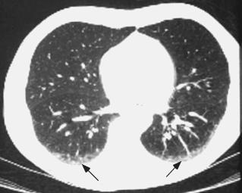
HRCT Patterns Interstitial Lung Disease Normal High Resolution CT
Notes:
39

Slide 40
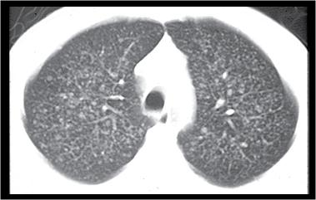
HRCT Patterns in Interstitial Lung Disease Metastatic Nodules
[Respiratory Block Interstitial Lung Disease Mark A. Smith]
Notes:
40

Slide 41
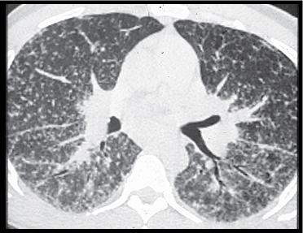
HRCT Patterns in Interstitial Lung Disease Stage II Sarcoidosis
[Respiratory Block Interstitial Lung Disease Mark A. Smith]
Notes:
41

Slide 42
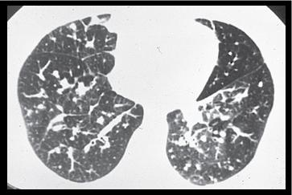
HRCT Patterns Interstitial Lung Disease Lymphangitic Carcinomatosis
[Respiratory Block Interstitial Lung Disease Mark A. Smith]
Notes:
42

Slide 43
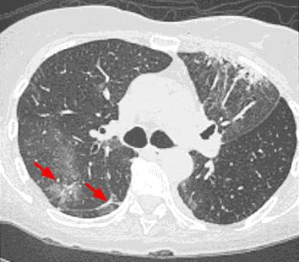
HRCT Patterns Interstitial Lung disease BOOP/COP
[Respiratory Block Interstitial Lung Disease Mark A. Smith]
Notes:
43

Slide 44
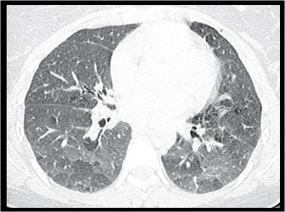
HRCT Patterns Interstitial Lung Disease Acute HSP
[Respiratory Block Interstitial Lung Disease Mark A. Smith]
Notes:
44

Slide 45
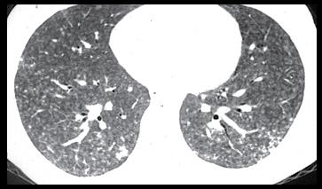
HRCT Patterns in Interstitial Lung Disease Subacute HSP
[Respiratory Block Interstitial Lung Disease Mark A. Smith]
Notes:
45

Slide 46
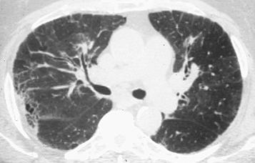
HRCT Patterns Interstitial Lung Disease Chronic HSP
[Respiratory Block Interstitial Lung Disease Mark A. Smith]
Notes:
46

Slide 47
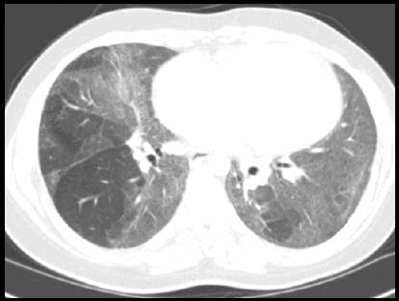
HRCT Patterns Interstitial Lung Disease DIP
[Respiratory Block Interstitial Lung Disease Mark A, Smith]
Notes:
47

Slide 48
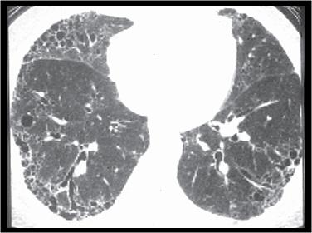
HRCT Patterns Interstitial Lung Disease Honeycomb IPF/UIP
Notes:
48

Slide 49
Idiopathic Interstitial Pneumonias Summary Radiographic Patterns
IPF – CXR – basal-predominant, reticular, volume loss, HRCT – peripheral, subpleural, basal, reticular, honeycomb cysts, traction bronchiectasis, architectural distortion, focal ground glass
NSIP – CXR – ground glass, reticular opacity, HRCT – peripheral, subpleural, basal, symmetric, ground glass, irregular lines, consolidation
COP – CXR – patchy bilateral consolidation, HRCT- subpleural, peribronchial, patchy consolidation and/or nodules
AIP – CXR – diffuse ground glass density/consolidation, HRCT- consolidation and ground glass opacity
DIP – CXR – ground glass opacity, HRCT – lower zone, peripheral, groundglass, reticular
RBILD – CXR – bronchial wall thickening, ground glass, HRCT – diffuse, bronchial wall thickening, centrilobular nodules, ground glass
LIP – CXR – reticular opacities and nodules, HRCT – diffuse, centrilobular nodules, groundglass, septal and bronchovascular thickening, thin-walled cysts
[Respiratory Block Interstitial Lung Disease Mark A. Smith]
Notes:
49

Slide 50
Interstitial Lung Disease Treatment
Depends on the cause
Treat infectious causes or malignant causes with specific treatment
If the cause is inhalational then the offending agent needs to be avoided
Some ILD’s will respond to glucocorticoids (sarcoidosis, hypersensitivity pneumonitis)
Connective tissue associated ILD’s may respond to gluccocorticoids or immunosuppression with azathioprine or cyclophosphamide
Some idiopathic interstitial pneumonias (DIP, RBILD) are strongly associated with cigarette smoking and may respond to smoking cessation
DIP, RBILD, NSIP and COP are more likely to respond to gluccocorticoids than IPF
IPF has no proven therapy and tends to be relentlessly progessive with most patients dying from respiratory failure. Early referral for lung transplant should be considered for patients that are potential candidates
[Respiratory Block Interstitial Lung Disease Mark A. Smith]
Notes:
50

Slide 51
Interstitial Lung Disease Take Home Messages
History, including occupational and avocational is absolutely crucial in correctly diagnosing ILD’s.
Always consider and rule out infectious causes.
Sometimes the CXR will suggest congestive heart failure - rule it out.
HRCT is the most useful non-invasive investigation for evaluating ILD’s.
ILD’s are a diverse group of disorders and eventual diagnosis will require correlation of clinical, radiologic and sometimes pathological information.
[Respiratory Block Interstitial Lung Disease Mark A. Smith]
Notes:
51

