Slide 1
SYMPATHOMIMETICS

Slide 2
SYMPATHOMIMETICS
Sympathetic stimulation is mediated by;
Norepinephrine (NE) from nerve terminals
Epinephrine (E) from adrenal medulla
Sympathomimetics are drugs that mimic NE and E actions

Slide 3
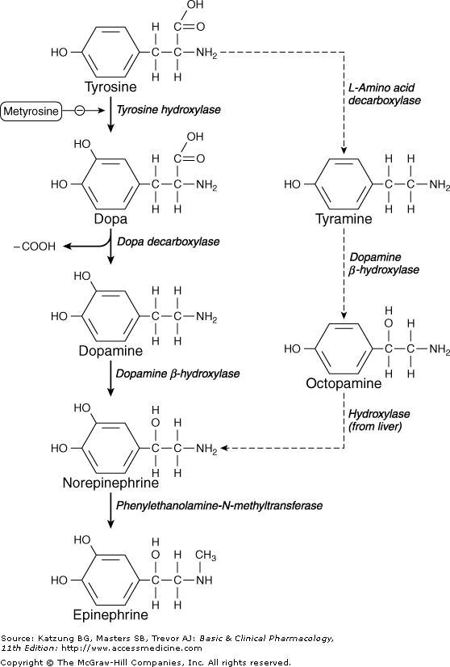
SYNTHESIS OF NE AND E
Tyrosine Dopa Dopamine Norepinephrine Epinephrine

Slide 4
Mechanism of Action
Direct acting sympathomimetics
Interact directly and activate receptors
Indirect acting
Dependent on the release of endogenous catecholamines
Mixed acting sympathomimetics
Activate receptors and release NE

Slide 5
Indirect
Have 3 mechanisms;
Displacement of stored catecholamines (Amphetamine and Tyramine)
Inhibition of catecholamine re-uptake (Coccaine, Tricyclic antidepressants)
Block NE metabolising enzyme (MAC and COMT)

Slide 6
Adrenoreceptors
α – adrenoreceptors; α₁ and α₂
β-receptors; β₁ and β₂
Dopamine receptors (precursors of NE and NT in the brain); D₁D₂D₃D₄ and D₅
Drugs can display selectivity for adrenoreceptors
Selectivity is relative
Clonidine; α₂ > α₁ >>>β: α₂ agonist
Albaterol; β₂ > β₁ >>>α: β₂ agonist
Adrenoreceptors are G protein coupled receptors
G proteins are classified according to the α sub unit Gs, Gi and Gq
Gs; The stimulatory G protein is adenyl cyclase
Gi; The inhibitory G protein of adenyl cyclase
Gq; The protein coupling and receptors to phospholipase C

Slide 7
α₁ adrenoreceptors
Diacylglycerol
Phosphoinosinate IP₃
DAG activates protein kinase C
Activate
Nitrogen activated protein kinase
Phosphoinositol 3-kinase
These modulate various signaling pathways
Phospholipase C
Release of Stored Calcium

Slide 8
α₂ adrenoreceptors
Inhibit adenylyl cyclase hence reduction of cAMP
Regulates ion channel activity
Regulates activity of other enzymes
Cause platelet aggregation

Slide 9
β-Adrenoreceptors
All activate adenylyl cyclase
ATP causes increase in cAMP
May activate voltage sensitive calcium ion channels
Dopamine Adrenoreceptors
D₁; stimulates adenylyl cyclase
D₂; inhibits adenylyl cyclase, opens potassium channels and this results in reduced calcium influx

Slide 10
SYMPATHOMIMETICS
1. Catecholamines
Epinephrine
Norepinephrine
Dopamine
Isoprenuline, Dobutamine, Dopexamine

Slide 11
2. Non selective beta adrenergic agonists
Iso proterenol
3. Selective beta 1 adrenergic agonists
Dobutamine
Prenaterol

Slide 12
4. Selective beta 2 adrenergic agonists
Procaterol
Salmeterol
Metaproterenol
Isoethanine
Ritodrine
Terbutaline
Albuterol (Salbutamol)
Pributerol
Biltoterol
Fenoterol
Formoterol

Slide 13
5. Non selective alpha agonists
Phenylephrine
6. Selective alpha-1 adrenergic agonists
Methoxamine
Midodrine
7. Selective α-2 adrenergic agonists
Glonidine Guanfacine Methyldopa Brimonidine Oxymetazoline | Apraclonidine Guanabenz Tizinidine Xylometazolin Modcifonil

Slide 14
8. Dopamine agonists
Levodopa
Fenoldopam (D1)
Bromocriptine (D2)
Quinagolide (D2)
Cabergolide (D2)
Pergolide (D1, D2)
Pramipexole (D3)
Ropinirole(D2)
Rotigotine

Slide 15
9. Indirect acting adrenergic agonists
Releasing agents Amphetamine Methamphetamine Phonemetrazine Methylphenylate Modafinil Tyramine Pemoline | Uptake inhibitors Cocaine Automoxetine RepBoxetine Sibutramine Duloxetine
Monoamine oxidase inhibitors
Selegiline
Catechol-O-methyl transferase inhibitors
Entacapone

Slide 16
Organ System Effects
1. CVS
Blood vessels
Alpha 1 and 2; contraction (skin, skeletal muscle)
Beta 2; relaxation (skeletal muscle)
D₁; relaxation of renal blood vessels
Heart;
Inceased force and rate of contraction i.e
Positively ionotropic
Positively chronotropic
Increased blood pressure by alpha agonists

Slide 17
2. Eye
Alpha agonists;
Contract radial papillary dilator muscle; myoriasis
Increased outflow of aqueous humor
Beta agonists;
Relax cilliary muscles
3. Respiratory System
Alpha agonist; bronchial smooth muscle relaxation
4. GIT
Alpha and beta agonists; smooth muscle relaxation
Alpha 2 agonists; decrease salt and water flux into intestinal lumen

Slide 18
5. GUT
Alpha agonists; promote urinary continuence
Alpha agonists; promote ejaculation
Beta 2 agonists; relax the bladder wall
Beta agonists; relax uterine smooth muscles
6. Sweat glands
Increase sweating
7. Metabolic Processes
Beta agonists increase lipolysis
Alpha agonists inhibit lipolysis
Beta agonists increase glycogenolysis
High doses of catecholamines cause metabolic acidosis
Beta agonists decrease K⁺ extracellularly

Slide 19
8. Endocrine
Beta agonists increase insulin release
Beta 1 agonists increase rennin increase
Alpha agonists decrease insulin decrease
Alpha 2 agonists decrease rennin release
9. Blood
Leucocytosis
10. CNS
D₂; modulate NT release

Slide 20
Pharmacokinetics of Catecholamines
EPINEPHRINE
Unstable in alkaline solutions
When exposed to light or air its odour changes to pink and later to brown
Administration is by SC, IM, IV and inhalation
Absorption after SC administration is slow because of local vasoconstriction
IV is used for emergencies
Metabolized in the liver and kidney by MAO and COMT (Catechol-O-Methyl Transferase)

Slide 21
MAO found in intestinal mucosa and nerve endings
Catechols usually ineffective when given orally because of MAO (2 min half life)
Excretion is via urine
Note the concentration of the solutions
1:100 is suitable for inhalation
1:1000 is suitable for IV administration
If the 1:100 is used for IV administration inadvently it can be fatal

Slide 22
Adverse Effects
Restlessness, throbbing headache, tremors and palpitations
Cerebral hemorrhage; large doses of rapid IV
Arrhythmias
May induce angina in patients with coronary artery disease
Contraindications
Patients receiving non-selective beta blockers
Unopposed alpha 1 receptor stimulation may lead to severe hypotension and cerebral hemorrhage

Slide 23
Synthetic non-catecholamines
Can be given orally
More resistant to enzymatic degradation
Longer half life
Salbutamol with a 4 hours half life

Slide 24
Cocaine
Local anaesthetic
Inhibits reuptake of NE
CNS inhibits dopamine reuptake
Tyramine
Found in cheese
Metabolized by MAO
Releases stored NE
Tyramine containing foods include;
Chicken liver Fermented sausage (salami, pepperoni) | Smoked or pickled fish Red wine Yeast

Slide 25
Therapeutic Uses
Hypotensive emergencies
NE
Phenylephrine
Methoxamine
Chronic orthostatic (postural) hypotension
Ephedrine
Midodrine (prodrug)
Cardiogenic shock
Dopamine
Dobutamine

Slide 26
Reduction of blood flow
Epinephrine (nasal packs, gingival strings)
Cocaine
Mucous membrane decongestion
Phenylophrine (topical, oral)
Ephedrine (oral)
Xylometazoline
Oxymetazoline
Cardiac arrest and complete heart block
Epinephrine
Isoprotenerol

Slide 27
Asthma
Albuterol
Terbutaline
Anaphylaxis
Epinephrine
Ophthalmic uses
Mydriasis (Phenylephrine)
Allergic hyperemia (Phenylephrine)
Glaucoma (Apraclonidine, Brimonidine)
GUT
Suppresses premature labor; Ritodrine, Terbutaline
Urinary inconsistency; Ephedrine, pseudoephedrine

Slide 28
CNS
Narcolepsy; modafinil
Attention deficit hyperactivity disorder (ADHD); methylphonidate, clonidine
Others
Hypertension; clonidine
Diarrhea in diabetes; clonidine
Reduce craving for abused substances; clonidine
Post menopausal hot flushes; clonidine
Sedation in ICU; dexmedetomidine

Slide 29
Adverse Effects
Can be deduced from psychologic effects
Precipitate CCF and cardiac ischemia
Tachycardia, arythmias
Amphetamines; restlessness, paranoid state
Cocaine; convulsion, myocardial infarction

