Slide 1
REPRODUCTIVE SYSTEM
MR. G. K. NGUUTU

Slide 2
CONTENTS
Review structures
Functions of reproductive structures
Role of reproductive hormones in males and females
Menstrual cycle
Menopause
Andropause

Slide 3
Female reproductive system
The female reproductive organs/ genitalia
Breast
Ovary
Uterine tube
Uterus
Vagina

Slide 4
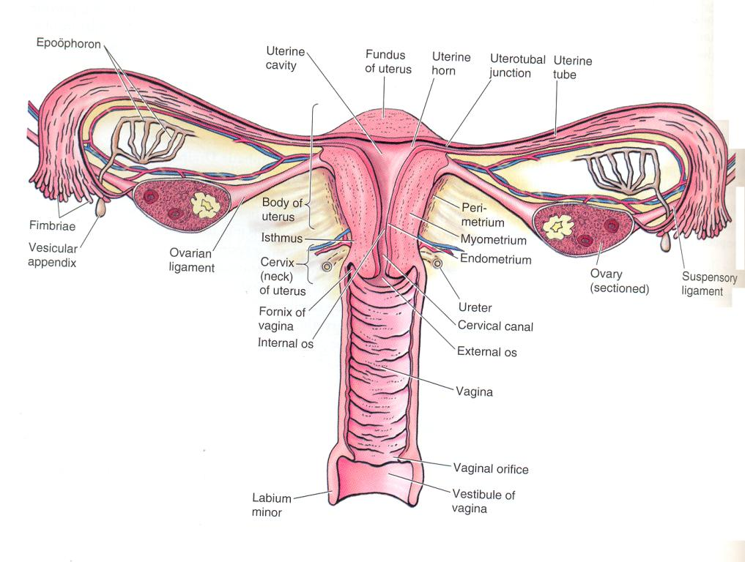

Slide 5
The functions of the female reproductive
• formation of ova
• reception of spermatozoa
• provision of suitable environments for fertilisation and fetal development
• parturition (childbirth)
• lactation, the production of breast milk.

Slide 6
External genitalia (vulva)
Consists:-
labia majora
labia minora,
the clitoris,
the vaginal orifice,
the vestibule,
the hymen
vestibular glands (Bartholin’s glands).

Slide 7
External genitalia
mons pubis
阴阜
Clitotis
阴蒂
Labium majus
大阴唇
Labium minus
小阴唇
Urethral orifice
尿道口
Vaginal orifice
阴道口
Vaginal vestibule
阴道前庭
Fossa navicularis
舟状窝
Perineal body
会阴体
Anus
肛门

Slide 8
Labia majora
Two large folds forming the boundary of the vulva.
Composed of skin, fibrous tissue and fat and contain large numbers of sebaceous and eccrine sweat glands.
Labia minora
Two smaller folds of skin between the labia majora, containing numerous sebaceous and eccrine sweat glands.

Slide 9
Vestibule
The cleft between the labia minora.
The vagina, urethra and ducts of the greater vestibular glands open into the vestibule.

Slide 10
Clitoris
Corresponds to the penis in the male and contains sensory nerve endings and erectile tissue.
Vestibular glands
The vestibular glands (Bartholin’s glands) are situated one on each side near the vaginal opening.
Their ducts open into the vestibule immediately lateral to the attachment of the hymen.
They secrete mucus that keeps the vulva moist.

Slide 11
Hymen.
Is a thin layer of mucous membrane that partially occludes the opening of the vagina.
It is normally incomplete to allow for passage of menstrual flow and is stretched or completely torn away by sexual intercourse.

Slide 12
Imperforate Hymen

Slide 13
Perineum
Roughly triangular area extending from the base of the labia minora to the anal canal.
It consists of connective tissue, muscle and fat.
It gives attachment to the muscles of the pelvic floor

Slide 14
Internal genitalia
Consist of:-
the vagina,
uterus,
two uterine tubes
two ovaries.

Slide 15
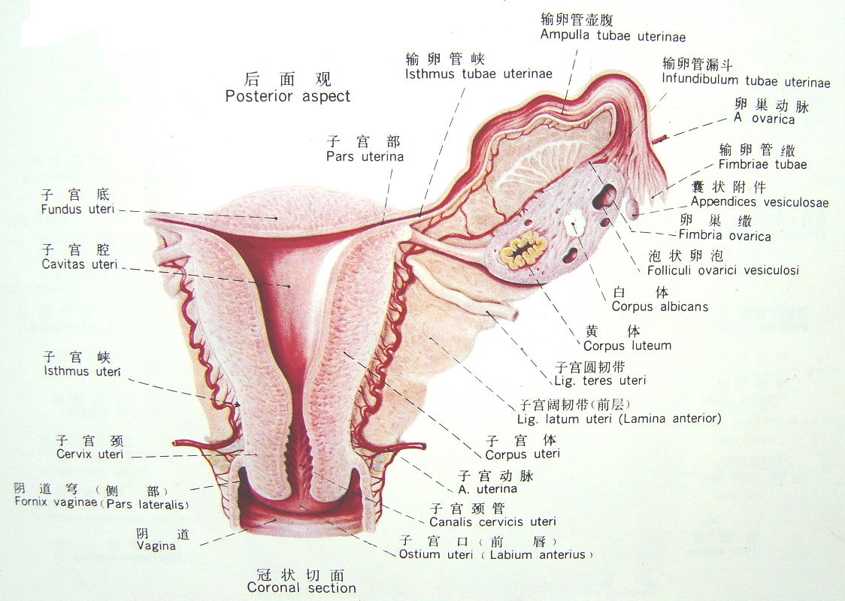
Internal genitalia

Slide 16
VAGINA
strong canal of muscle
Is a fibromuscular tube lined with stratified squamous epithelium that forms ridges or rugae
It runs obliquely upwards and backwards at an angle of about 45° between the bladder in front and rectum and anus behind.

Slide 17
In adult, anterior wall is about 7.5 cm long and posterior wall about 9 cm long.
Extends from the cervix of uterus to the vestibule (cleft between 2 labia minora).
Superior end sorrounds cervix (forming fornices)
Vagina passes through the pelvic floor.

Slide 18
It has Lactobacillus acidophilus bacteria(normal flora), that secrete lactic acid, maintaining the pH 4.9 - 3.5.
The acidity inhibits growth of most other micro-organisms that may enter the vagina from the perineum or during sexual intercourse.

Slide 19
Functions of vagina
Excretory pathway for menstrual fluid.
Forms inferior part of pelvic canal /passage for childbirth.
Receives penis and ejaculate during sexual intercourse (coitus).
Relations.
Anterior- base of bladder and urethra.
Laterally- levator ani, visceral pelvic fascia, ureters.
Posteriorly- anal canal, rectum, recto-uterine pouch.

Slide 20
Blood & nerve supply to vagina
Arterial supply- uterine and vaginal arteries- branches of the internal iliac arteries.
Venous drainage- internal iliac veins.
Lymph drainage- deep and superficial iliac glands
Nerve supply - pudendal nerves.

Slide 21
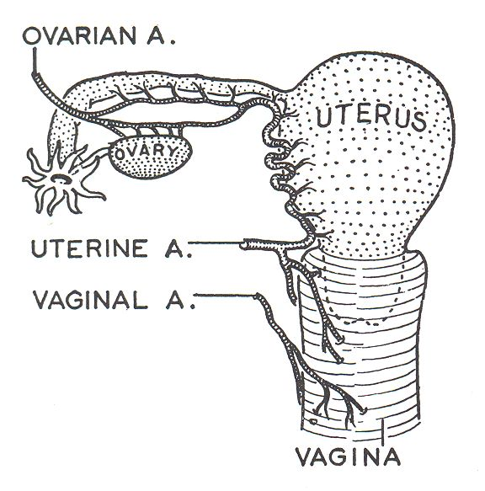

Slide 22
UTERUS
Thick walled, pear-shaped, hollow, muscular organ.
Lies in the pelvic cavity between the urinary bladder and the rectum.
In most women, it leans forward (anteversion), and is bent forward (anteflexion) almost at right angles to the vagina

Slide 23
Anterior wall rests against the bladder, forming the vesicouterine pouch
Posteriorly folds back on to the rectum forming rectouterine pouch (pouch of Douglas).

Slide 24
It is about 7.5 cm long, 5 cm wide and its walls are about 2.5 cm thick.
parts of the uterus:- fundus, body and cervix
Non gravid uterus- in the true pelvis.
Gravid uterus- Rises into false pelvis and abdomen.

Slide 25
Walls of uterus
composed of three layers:-
Perimetrium – Serous coat ( Peritoneum) supported by thin layer of connective tissue.
Myometrium- smooth muscle layer.
Endometrium – inner mucous coat shed off during menses.

Slide 27
Uterine tubes.
Extends from uterine horns and open into the peritoneal cavity near ovaries.
The uterine (Fallopian) tubes are about 10 cm long.
The end of each tube has fingerlike projections called fimbriae.
lined with ciliated epithelium
Parts.
Infundibulum- opens into peritoneal cavity.
- Bears fimbriae
Ampulla – widest, longest
Isthmus – thick walled, narrowest.
Uterine – Intramural segment.

Slide 28
Functions
The uterine tubes propel the ovum from the ovary to the uterus by peristalsis and ciliary movement.
Fertilisation of the ovum
zygote is propelled into the uterus for implantation.

Slide 29
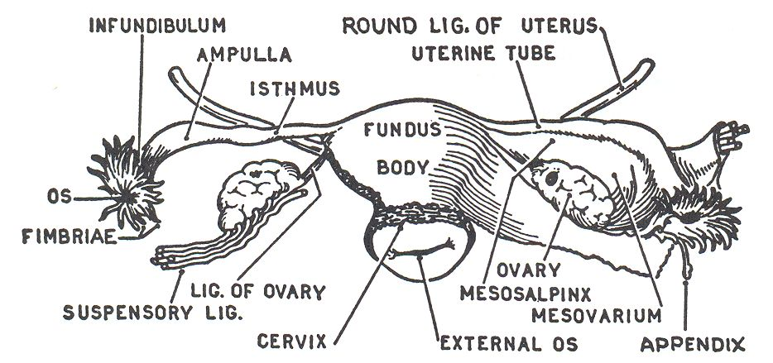

Slide 30
Functions of the uterus
Regular monthly cycle (menstrual cycle)
Receive, nourish and protect a fertilised ovum.
Accommodate the developing baby (embryo)
Placenta attachment

Slide 31
Functions of placenta
The placenta- attach the fetus to the wall of the uterus by the umbilical cord
provides route by which the growing baby receives oxygen and nutrients, and gets rid of its wastes.
The placenta - secretes high levels of progesterone

Slide 32
Ovaries
Produce sex hormones and the ova
It contains ovarian follicles in various stages of maturity, each of which contains an ovum.
Before puberty the ovaries are inactive it contains immature (primordial) follicles.

Slide 33
During the childbearing years, about every 28 days, one or more ovarian follicle matures (Graafian follicle), ruptures and releases its ovum (ovulation)
Ruptured follicle develops into corpus luteum which in turn will leave a scar of fibrous tissue called the corpus albicans

Slide 34
Functions
Female gametes are stored and develop prior to ovulation.
Releases hormones essential to the physiological changes during the reproductive cycle - oestrogen, progesterone and inhibin
Oestrogen during the 1st half then after ovulation, the corpus luteum secretes primarily progesterone, with some oestrogen and inhibin

Slide 35
Puberty in the female
Puberty- age at which the internal reproductive organs reach maturity (between the ages of 12-14yrs) (menarche),
marks the beginning of the childbearing period.
The ovaries are stimulated by the gonadotrophins from the anterior pituitary:- FSH & LH

Slide 36
Physical and psychological changes at puberty:
• the uterus, the uterine tubes and the ovaries reach maturity
• the menstrual cycle and ovulation begin (menarche)
• the breasts develop and enlarge
• pubic and axillary hair begins to grow
• increase in height and widening of the pelvis
• increased fat deposited in the subcutaneous tissue, especially at the hips and breasts.

Slide 37
DEFINITIONS
Gamete: egg or sperm
Gametogenesis: production of eggs or sperm
Oogenesis: production of eggs
Spermatogenesis: production of sperm
Spermiogenesis: differentiation of sperm morphology
Follicle: where eggs mature in the ovary
Ovulation: release of egg from follicle
Polar body: nonfunctional product of meiotic
divisions in oogenesis
Zygote: Fertilized egg

Slide 38
MENSTRUAL CYCLE

Slide 39
DEFINITIONS
1. Menstrual Cycle:
Rhythmical series of physiological changes that occur in fertile women resulting in the release of a mature ovum for fertilization which if fails to occur vaginal bleeding occurs.
Average length: 28 days, but typically varies, with shorter and longer cycles (21-35 days)
2. Menstruation:
Is a vaginal bleeding that occurs monthly in adolescent girls and premenopausal women.

Slide 40
3. Menarche: a woman's first menstruation
typically occurs around age 12
4. Menopause: end of a woman's reproductive phase, commonly occurs between ages 45 and 55
age of menopause is largely the result of genetics
5. Follicular Phase: Begins on Day 1 of mestrual cycle - ovulation of your menstrual cycle.
6. Ovulation: The release of a mature ovum when a follicle in the ovary bursts.
7. Luteal Phase: Begins on Day 14, after ovulation occurs and ends on Day 1 of the next period

Slide 41
Hormones produced by the pituitary gland
1. FSH (follicle stimulating hormone)
· Stimulates the development of a follicle in the ovary, and within the follicle the egg matures and ripens.
· Stimulates the ovaries to produce hormones such as oestrogen.
2. LH (luteinising hormone)
· Stimulates the release of egg from the ovary in the middle of the menstrual cycle
· Stimulates the ovary to produce progesterone to keep the uterus lining in place.

Slide 42
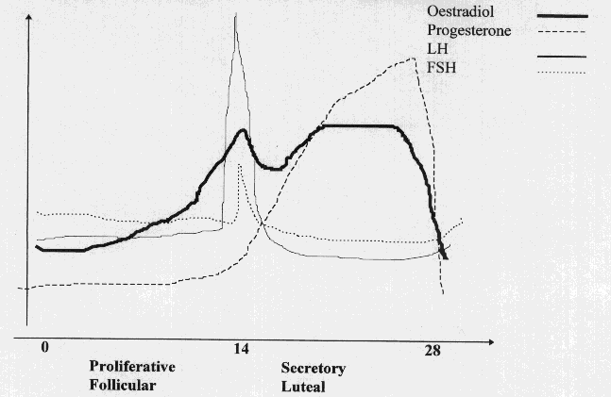
Pituitary Hormones

Slide 43
Hormones produced by the ovaries
1. Oestrogen
· Stimulates the lining of the uterus to build up in preparation for pregnancy.
· Affect the pituitary gland.
Ø As the oestrogen levels rises, the production of FSH falls gradually and this would have caused the oestrogen level to fall also but paradoxically doesn’t.
Ø The rise in the oestrogen level initially supresses the production of LH until mid cycle when it gives a positive feedback resulting in LH surge. When LH reaches its peak in the middle of the menstrual cycle, it stimulates the release of the ripe egg from the ovary.

Slide 44
2. Progesterone
· Maintains the thick lining of the uterus
· Stimulates the growth of blood vessels in the lining to prepare for pregnancy.
· Helps to maintain pregnancy if a fertilised ovum arrives in the uterus.

Slide 45
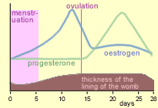
Ovarian Hormones

Slide 46
PHASES OF THE MENSTRUAL CYCLE

Slide 47
DEFINITION
Physiological changes during menstrual cycle can be observed at three different levels:
neuroendocrine level
ovaries
uterus
These changes are what define the phases
Menstrual cycle can be divided into 3 phases:
menstrual phase
proliferative / follicular (estrogen) phase
secretory / luteal phase (progesterone) phase

Slide 48
Phase | Average start and end day (assuming a 28-day cycle)
Menstrual phase | 1-4
Proliferative phase | 5-13
Ovulation | 13-16
Secretory phase | 16-28

Slide 49
MENSTRUAL PHASE
Menstruation
Menstrual bleeding, menses, period
Discharge of bloody fluid containing endometrial cells, glandular secretions and blood cells, lasts 3 -5 days
Due to strong vasoconstriction and proteolytic activity, endometrial tissue dies and is discharged during menstrual bleeding
Endometrium becomes very thin, but due to low estrogen levels, hypophysis secretes more FSH
FSH stimulates secretion of estrogen →serves as proliferation signal to the endometrial basal layer

Slide 50
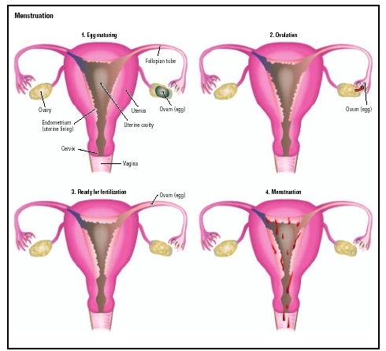
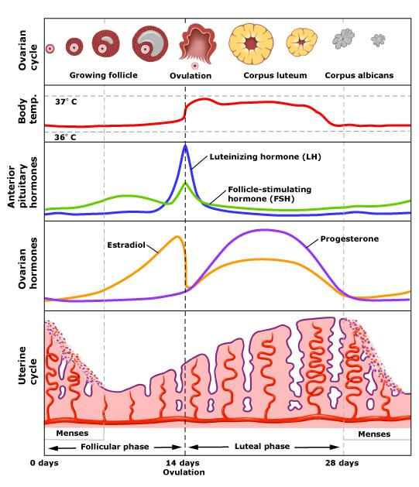

Slide 51
FOLLICULAR PHASE
The main hormones in the follicular phase are:
Pituitary – FSH
Ovarian - Oestrogen
Due to the rise of follicle stimulating hormone (FSH) during the first days of the cycle, several ovarian follicles are stimulated
Follicles compete with each other for dominance
The follicle that reaches maturity is called a Graafian follicle

Slide 52
As they mature, the follicles secrete increasing amounts of estrogen, which thickens the new functional layer of endometrium in the uterus
Estrogen also stimulates crypts in the cervix to produce fertile cervical mucus
At the end of this phase ovulation occurs

Slide 53
Days 1-14

Slide 55
OVULATION
During the follicular phase, estrogen suppresses production of luteinizing hormone (LH) from the pituitary gland
When the ovum has nearly matured, levels of estrogen reach a threshold above which they stimulate production of LH (positive feedback loop)
The release of LH matures the ovum and weakens the wall of the follicle in the ovary, causing the fully developed follicle to release its secondary oocyte
After being released from the ovary, the ovum is swept into the fallopian tube

Slide 56
LUTEAL PHASE
Corpus luteum: solid body formed in an ovary after the ovum has been released into the fallopian tube
Produces significant amounts of progesterone, which plays a vital role in making the endometrium receptive to implantation of the blastocyst
Falling levels of progesterone trigger menstruation and the beginning of the next cycle

Slide 57
Days 14 - 28

Slide 58
Menopause
The menopause (climacteric) usually occurs between the ages of 45 and 55 years, marking the end of the childbearing period
Caused by a progressive reduction in oestrogen levels, as the number of functional follicles in the ovaries declines with age.
The ovaries gradually become less responsive to FSH and LH.
ovulation and the menstrual cycle become irregular, eventually ceasing.

Slide 59
Presentation of menopause
Early /Stage 1:
Changes in menstrual cycle
Shorter cycles resulting from shorter follicular phase
Hot flushes – Vasomotor changes/vasodilation.
Sweating
palpitations
Insomnia
Depression
behaviour changes e.g. irritability, mood changes

Slide 60
Intermediate
Urogenital atrophy- atrophy of the sex organs
shrinkage of the breasts
axillary and pubic hair become sparse
Dyspareunia
Dysuria
Stress incontinence
Skin changes- thinning

Slide 61
Late
Osteoporosis- loss of bone mass
Cardiovascular disease - Increase in blood cholesterol levels.

Slide 62
Breasts
Also known as mammary glands
Are accessory glands of female reproductive system. They exist also in the male.
Structure - draw the diagram of the breast

Slide 63
The Mammary gland
Structures
Contains skin, mammary glands and adipose tissue
Consists of 15 to 20 Lobes of mammary gland that radiate outward from the nipple
lactiferous duct
lactiferous sinuse
Suspensory ligaments of breast (cooper’s ligaments): connective tissue septa that extend from the skin to the deep fascia

Slide 64
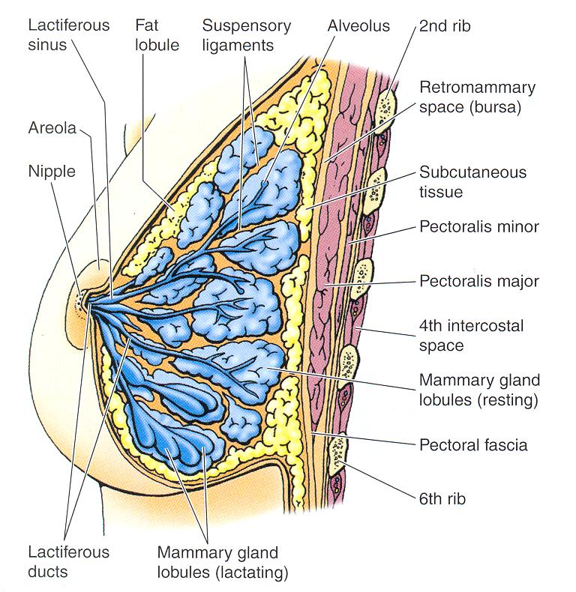

Slide 65
Each breast contains about 20 lobes
each lobe contains a number of glandular structures called lobules, where milk is produced.
Lobules open into tiny lactiferous ducts, which drain milk towards the nipple.
The nipple- small conical eminence at the centre of the breast surrounded by a pigmented area(areola).

Slide 66
On the surface of the areola are numerous sebaceous glands (Montgomery’s tubercles), which lubricate the nipple during lactation.
supported by fatty and fibrous connective tissue that anchor the breast to the chest wall.

Slide 67
After delivery prolactin hormone from AP stimulates milk production.
oxytocin from PP stimulates the release of milk (milk ejection) in response to the stimulation of the nipple by the sucking baby

Slide 68
Male reproductive system
The functions of the male reproductive organs are:
• production, maturation and storage of spermatozoa
• delivery of spermatozoa in semen into the female reproductive tract.
DRAW THE STRUCTURE
Male reproductive organs,
The testis

Slide 69
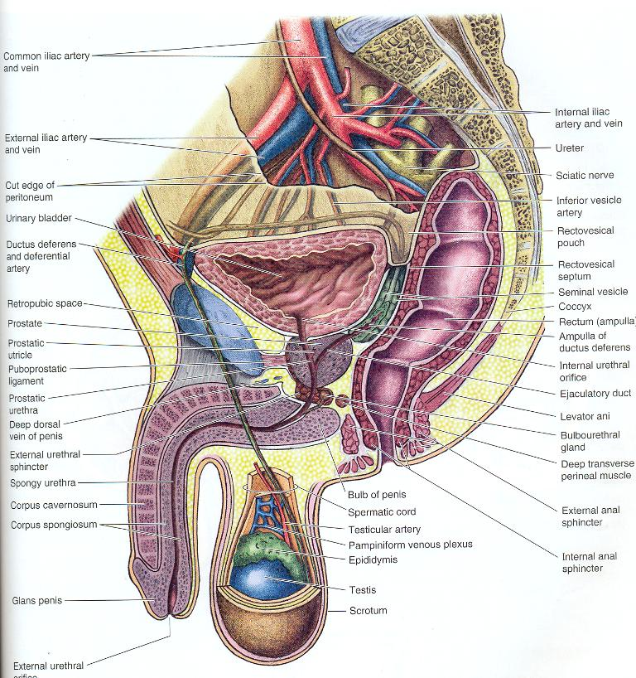

Slide 70
Scrotum
The scrotum is a pouch of pigmented skin, fibrous and connective tissue and smooth muscle.
It is divided into two compartments, each of which contains one testis, one epididymis and the testicular end of a spermatic cord.

Slide 71
Testes
The testes are the male reproductive glands and are the equivalent of the ovaries in the female.
They are about 4.5 cm long, 2.5 cm wide and 3 cm thick and are suspended in the scrotum by the spermatic cords.
During early fetal life, the testes develop in the lumbar region of the abdominal cavity just below the kidneys.

Slide 72
They then descend into the scrotum, taking with them coverings of peritoneum, blood and lymph vessels, nerves and the deferent duct.
Descent of the testes into the scrotum should be complete by the 8th month of fetal life.

Slide 73
They are surrounded by three layers of tissue.
Tunica vaginalis - double membrane, forming the outer covering of the testes
2. Tunica albuginea - a fibrous covering beneath the tunica vaginalis.
3. Tunica vasculosa. This consists of a network of capillaries supported by delicate connective tissue.

Slide 74
Structure of testis
Each testis has 200–300 lobules, and within each lobule are 1–4 convoluted loops of germinal epithelial cells, called seminiferous tubules= Spermatozoa (sperm) production .
FSH from AP stimulates sperm production
Between the tubules are groups of interstitial cells (Leydig cells) that secrete the hormone testosterone.
At the upper pole of the testis the tubules combine to form a single tubule. This tubule is repeatedly folded and tightly packed into a mass called the epididymis = Maturation and storage of sperms .
It leaves the scrotum as the deferent duct (vas deferens) in the spermatic cord.

Slide 75
SPERMATOZOA
A mature sperm has a head, a body, and a long whip-like tail used for motility.
The head is almost completely filled by the nucleus, containing its DNA.
It also contains the enzymes required to penetrate the outer layers of the ovum to reach and fuse with its nucleus.
The body of the sperm is packed with mitochondria for energy , to fuel the propelling action of the tail that powers the sperm along the female reproductive tract.

Slide 76
Successful spermatogenesis takes place at a temperature about 3°C below normal body temperature.
The testes are cooled by their position outside the abdominal cavity, and the thin outer covering of the scrotum has very little insulating fat.
sperm production in males begins at puberty and continues throughout life, often into old age, under the influence of testosterone.
Unlike females, who produce no new gametes after birth.

Slide 77
Spermatic cords
The spermatic cords suspend the testes in the scrotum.
Each cord contains a testicular artery, testicular veins, lymphatics, a deferent duct and testicular nerves.

Slide 78
Prostate gland
The prostate gland lies in the pelvic cavity in front of the rectum and behind the symphysis pubis, completely surrounding the urethra as it emerges from the bladder.
It has an outer fibrous covering, enclosing glandular tissue wrapped in smooth muscle.
The gland weighs about 8 g in youth, but progressively enlarges (hypertrophies) with age and is likely to weigh about 40 g by the age of 50.

Slide 79
Functions
The prostate gland secretes a thin, milky fluid that makes up about 30% of the volume of semen, and gives it its milky appearance.
It contains a clotting enzyme, which thickens the semen in the vagina, increasing the likelihood of semen being retained close to the cervix.

Slide 80
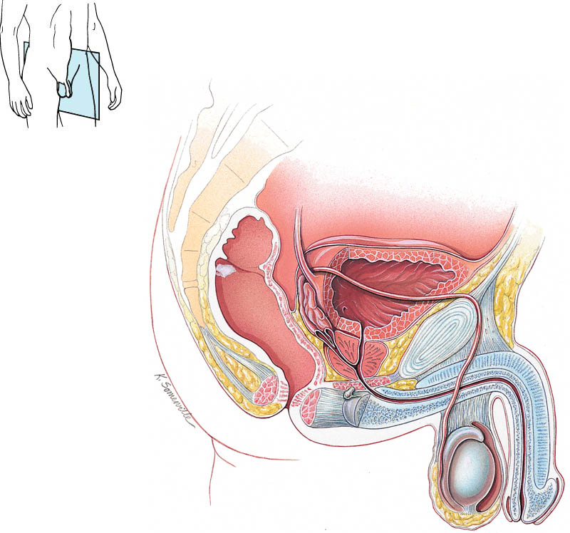
Male Glands
Prostate
Secretes 30% of milky, slightly acidic seminal fluid with an antibiotic to kill bacteria
Seminal Vesicles
Secrete 60% of clear, alkaline seminal fluid, with fructose sugar, ATP and prostaglandins for normal sperm nutrition & function
Chemicals for coagulation of semen
Cowper’s Glands
Secrete clear, alkaline
mucus to buffer and lubricate urethra

Slide 81
Penis
It is formed by three cylindrical masses of erectile tissue and smooth muscle.
The two lateral columns are called the corpora cavernosa and the column between them, containing the urethra, is the corpus spongiosum.

Slide 82
At its tip it is expanded into a triangular structure known as the glans penis.
Just above the glans the skin is folded to form a movable double layer, the foreskin /prepuce.
Arterial blood is supplied by internal pudendal arteries.
veins drain blood to the internal pudendal and internal iliac veins.

Slide 83
Sperm comprise only 10% of the final ejaculate, seminal fluid (50–60%) and prostatic fluid (20–30%)
Between 2 - 5 mL of semen are produced in a normal ejaculate, and contain between 40 and 100 million spermatozoa per mL.
If not ejaculated, sperm gradually lose their fertility after several months and are reabsorbed by the epididymis.

Slide 84
Puberty in the male
Occurs between the ages of 10 and 14.
LH from AP stimulates the interstitial cells of the testes to increase the production of testosterone.

Slide 85
Physical changes at puberty
• marked increase in height and weight
• enlargement of the larynx and deepening of the voice
• growth of hair on the face, axillae, chest, abdomen and pubis
• enlargement of the penis, scrotum and prostate gland
• maturation of the seminiferous tubules and production of spermatozoa
• the skin thickens and becomes oilier.

Slide 86
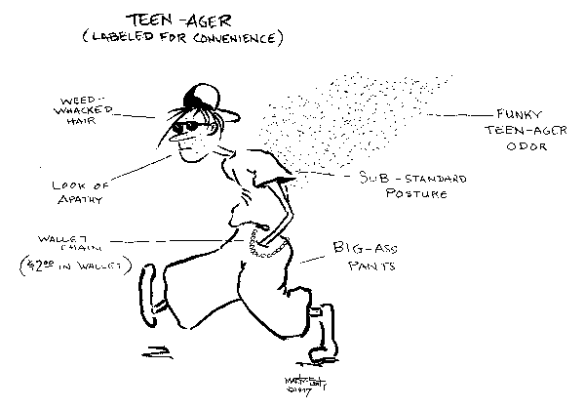
Thank You

