Slide 1
INTRODUCTION TO TRAUMATOLOGY 1
Dr. Moggy

Slide 2
Broad Objective
Objectives
By the end of the unit, the student/learner will be able to describe the historical background, trends and terminologies used in traumatology

Slide 3
Specific Objectives;
By the end of each lesson, the student will be able to;
Discuss the Historical Background and present trends of Traumatology
Define Terminologies used in traumatology
Explain the mechanism of injury
Outline the process of Fracture Healing

Slide 4
Introduction
Traumatology is a branch of medicine that deals with the study of wounds and injuries caused by accidents or violence to a person, and the surgical therapy and repair of the damage.
The term traumatology comes from two Greek words; ‘trauma’, meaning injury or wound and ‘logos’ meaning science or study.

Slide 5
Historical Background
Assignment (Group Work)
Q: Discuss the Historical Background and present trends in Traumatology

Slide 6
Branches of Traumatology
Medical traumatology; study of specializing in the treatment of wounds and injuries caused by violence or general accidents.
Focuses on the surgical procedures and future physical therapy patients need to repair the damage and recover properly.
Psychological traumatology; damage to one's mind due to a distressing event or as a result of overwhelming amounts of stress in one's life.
Usually involves some type of physical trauma that poses as a threat to one's sense of security and survival.
Often leaves people feeling overwhelmed, anxious, and threatened.

Slide 7
Current Trends in Traumatology
(Assignment) – find out the current trends
In addition………take note that;
Road Traffic Accidents (RTA) are major causes of long term morbidity and mortality in developing nations, Kenya inclusive.
NB: These includes motorcycle accidents.
WHO predicts that by the year 2020, Road Traffic Accidents (RTA) will be second leading cause of loss of life for world’s population

Slide 8
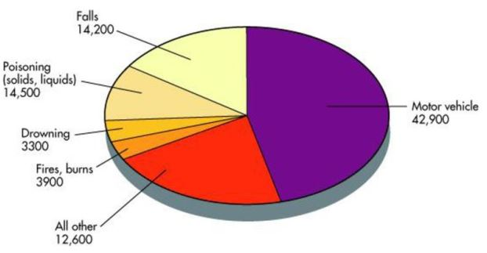

Slide 9
Injury: Scale of the Global Problem
5.8 million deaths/year
10% of worlds deaths
32% more deaths than HIV, TB and Malaria combined
Source: Global Burden of Disease, WHO, 2004
Notes:
WHO

Slide 10
Trauma Terminologies
Trauma can be defined as any form of physical or psychological injury to adult or child sustained due to direct force of externally applied energy or stress leading to loss of function (e.g. fractures sustained from road traffic accidents or birth trauma) or anxiety due to stress

Slide 11
Penetrating trauma is an injury that occurs when an object pierces the skin and enters a tissue of the body, creating an open wound.
Blunt trauma (non-penetrating trauma) is any physical trauma to a body part, either by impact, injury or physical attack.
The skin is not necessarily broken and the damage may not be visible externally but injury may extend deep inside body tissues
Psychological trauma is a type of damage to the mind that occurs as a result of a distressing event (may lead to PTSD)
Post-Traumatic Stress Disorder (PTSD) is a psychological disorder that can develop in response to prolonged, repeated experience of interpersonal trauma.

Slide 12
Major trauma is any injury that has the potential to cause prolonged disability or death
Polytrauma; condition of a person who has been subjected to multiple traumatic injuries not necessarily blast related e.g. a serious head injury in addition to a serious burn.
Defined via an Injury Severity Score (ISS) ≥ 16
Advanced Trauma Life support (ATLS) is a training program for medical providers in the management of acute trauma cases
Secondary trauma; stress amongst individuals who conduct therapy with trauma victims.
Workers who have had a history of trauma are more likely to develop secondary trauma syndrome.

Slide 13
Trauma surgery is a surgical specialty that utilizes both operative and non-operative management to treat traumatic injuries, typically in an acute setting. It is a sub-specialty of orthopaedic surgery.
Trauma Centre is a hospital equipped and staffed to provide specialized trauma care for patients suffering from major traumatic injuries such as falls, motor vehicle collisions or gunshot wounds.

Slide 14
Mechanism of Injury
Introduction to Mechanisms of Injury
Biomechanics of road traffic collision injuries - diagnosing and managing injured patients
Physical Principles and Physics;
Kinetic Energy (what does it say?)
Newton’s First Law of Motion (what is it?)
Law of Conservation of Energy (mention it)

Slide 15
Mechanism of Injury Cont’…
Factors affecting type of injury
Ability of body to disperse energy delivered
Force and energy (Size of object, Velocity, Acceleration or Deceleration, Affected body area
Duration and direction
The larger the area of force dissipation, the more pressure is reduced to a specific spot.
Position of victim
The impact resistance of body parts has a bearing on types of tissue disruption.
Organs that have gas inside are easily compressed.
Liquid-containing organs are less compressible.

Slide 16
Cont’…
Different forms of energy produce different kinds of trauma;
Mechanical e.g. road-traffic accidents
Thermal e.g. burns/frost bite (dry heat/extreme cold)
Electrical i.e. electrocution
Electromagnetic or nuclear (ionizing radiations) e.g.
excludes poisoning or toxic ingestion
Mechanical injury (RTA + Falls) accounts for majority of trauma cases (63%)

Slide 17
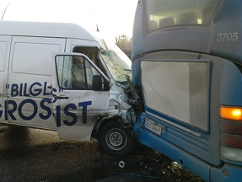
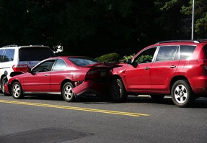
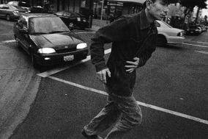
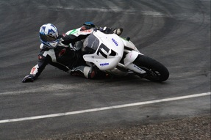
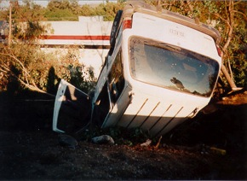
Mechanism of Injury
Frontal Impact Collisions
Lateral Impact Collisions (T bone)
Rear-end Impact Collisions
Roll-over Mechanism
Rotational Impact
Open Vehicle or Motorcycle/Moped
Pedestrian Vs. Car
Falls from Height
Objects falling on Victim
Penetrating Injury/Trauma (Guns vs. Knives)
Blunt Trauma
Nico.se (flickr)
Vincent J Brown (flickr)
Juicyrai (flickr)
Knockhill (flickr)
Nxtiak (flickr)
Notes:
Frontal Impact Collisions – A vehicle traveling at a higher rate of speed hits another vehicle that is moving at a slower rate of speed or is not moving at all and the vehicles are oriented with the passengers towards each other
The occupants of the vehicle traveling faster will continue to move forward even after the car has been stopped by the collision until they have impacted against another structure (steering wheel, windshield etc.)
Lateral Impact Collisions
Rear Impact Collisions
Off-Center or Rotational Collisions
Rollover
Occupant Protection
Open Vehicles

Slide 18
Head on Collision (Frontal Impact)
Forward motion stops abruptly;
A vehicle traveling at a higher rate of speed hits another vehicle that is moving at a slower rate of speed or is not moving at all and the vehicles are oriented with the passengers towards each other
Occupant usually travels in pathways relative to the dashboard, down and under or up and over the pathway;
Occupants of the vehicle traveling faster will continue to move forward even after the car has been stopped by the collision until they have impacted against another structure (steering wheel, windshield etc.)

Slide 19
Lateral Impact Collisions;
Impart energy to the near-side occupant
Seat belts offer little protection.
The body is pushed in one direction, while the head moves toward the impacting object.
Rear-end Impact;
Vehicle struck from behind and rapidly accelerates or auto-moves forward under occupant
Roll-over Mechanism;
Vehicle struck from side. Patient may be ejected or struck hard against interior of the vehicle.
Injury pattern differ if vehicle remains in place or moves away from part of impact
Rotational Impact;
Off-centre portion of vehicle strikes on immovable object or one that is moving more slowly and in the opposite direction

Slide 20
6. Open Vehicles or Motorcycle/Moped
7. Pedestrian Injuries;
Three predominant mechanism of injury in pedestrians;
First impact: auto strikes body with its bumpers.
Second impact: adult is thrown on hood and/or grille of vehicle.
Third impact: body strikes the ground or some other object.

Slide 21
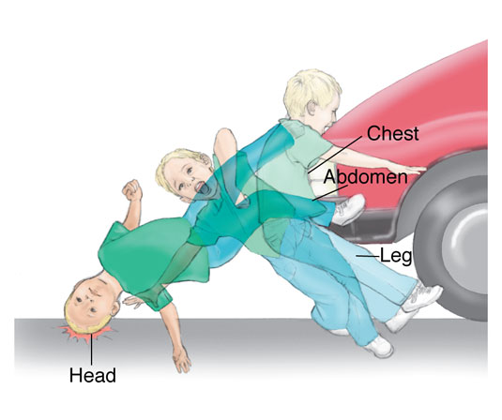
Waddell’s triad: Pattern of injuries in children and people of short stature
Bumper impact; bumper hits pelvis and femur (lower limb injury e.g. fracture femur)
Hood impact; body hits hood leading to chest and abdominal injuries
Ground impact; Head hits vehicle or ground; leads to head and cervical spine injuries

Slide 22
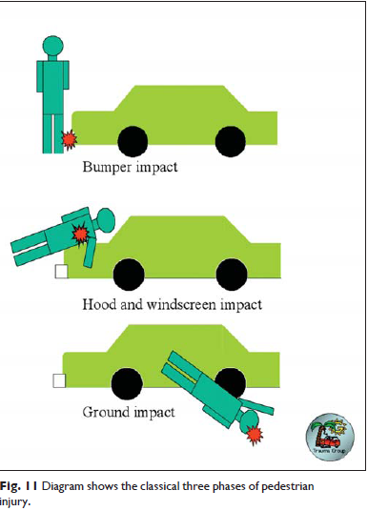
Child
Faces oncoming vehicle
Waddell’s Triad
Bumper Femur fracture
Hood Chest and Abdominopelvic injuries
Ground Head injuries

Slide 23
Adult
Turns from oncoming vehicle
O’Donohue’s Triad
Bumper Tib-fib fracture, Knee ligament tears
Hood Femur/pelvic fractures

Slide 24
8. Falls from a Height
Severity of injuries impacted by:
Height
Position
Don Juan syndrome or lover’s leap
Surface
Physical condition
Injury follows path of energy through body
Fall onto buttocks; pelvic fracture, coccygeal fracture, or lumbar compression fracture
Fall onto feet; “Don Juan Syndrome”
Bilateral heel fractures
Compression fractures of vertebrae
Bilateral Colles’ fractures

Slide 25
9. Penetrating Injury/Trauma (Fire arms/Stab wounds)
Involves disruption of skin and tissues in a focused area
Low velocity: Caused by sharp edges
Medium and high velocity: Object might flatten out, tumble, or ricochet
Stab wound severity depends on:
Anatomic area involved
Depth of penetration
Blade length
Angle of penetration

Slide 26
Gun-shot wounds severity depends on:
Type of firearm: hand gun, short gun, rifle…
Velocity of projectile; creates a permanent cavity
Physical design/size of projectile;
Distance of victim from muzzle;
Type of tissue struck

Slide 27
Fracture/Bone Healing
Fracture healing occurs by the formation of new bone tissue, rather than formation of non-specialized fibrous scar tissue.
New bone is formed by activation of osteoclasts & osteoblasts.

Slide 28
Factors enhancing fracture healing:
Adequate nutrition
Adequate blood supply
Absence of infection
Immobilization of fracture fragments
Exercise: weight bearing for long bones
Hormones: growth hormone calcitonin, vitamin D,

Slide 29
Factors hindering fracture healing:
Presence of infective organisms e.g. streptococci
Fat embolism in medullary canal
Excessive bone tissue fragments
Deficient blood supply
Continued mobility (lack of proper reduction and immobilization)
Age - old age due to slowing
Metabolic bone disease (e.g. Paget’s disease)

Slide 30
NB:
Factors influencing fracture healing can be categorized as local and systemic factors (Assignment)
The process of fracture healing can be supported by various treatment options with immobilization a mainstay;
Inappropriate treatment may result in a variety of complications.
Depending on the fracture site, normal healing in adults may take 3-12 weeks and involve five main stages.

Slide 31
Fracture Healing Process/Stages
Haematoma formation.
Fibrocartilage formation.
Callus formation.
Ossification.
Consolidation and remodeling

Slide 32
Stages in Bone Healing Process
Stage 1: Haematoma Formation (Inflammation)
Occurs within 24hrs;
Cells move to the site
Blood clot forms (haematoma); a loose delicate mesh of fibrins forms around the # site.
New cells (fibroblasts) develop in the area and fresh capillaries are formed around the broken ends of bone. This protectively encloses the damaged bone, acting as a scaffold of the capillary buds & fibroblasts.
Stage 2: Fibrocartilage Formation/Cellular Proliferation
Takes place at the # site where torn ends of the periosteum, endosteum & bone marrow supply the cells that proliferate & differentiate into fibrocartilage, hyaline cartilage & fibrous connective tissues.

Slide 33
Stages in Bone Healing Process cont’d…
Stage 3: Callus formation (Reparative Phase)
Occurs 6-10days after injury,
Gradual lay down of bone by osteoblasts to join broken ends of bones
Granulation tissues changes & a provisional callus (a large loosely woven mass of bone & cartillage) forms.
Stage 4: Ossification
A permanent callus of true, rigid bone forms by the deposition of calcium salts which knit the fractured bone ends together (external to internal).
During the 3rd to 10th week of healing.
Callus converts into bone. This firmly binds the fractured ends & completes healing.

Slide 34
Stages in Bone Healing Process cont’d…
Stage 5: Consolidation and Remodeling
Fracture calcifies in several months.
The callus is remodeled by osteoblasts and osteoblastic activity.
Remodeling is governed by the stress, function and strain imposed on it by the muscles & weight bearing.

Slide 35
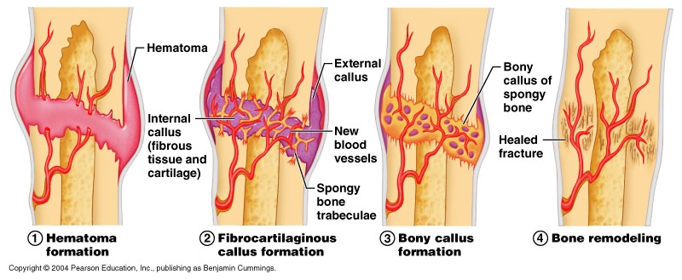
Bone healing process

Slide 36
Bone Healing

Slide 37
ANY QUESTIONS SO FAR?

Slide 38
References/ Further Readings
David, L., Hamblen, A., Hamish, R. and Simpson, W. (2007.) Adam’s Outline of Fractures, 12th Ed. Churchill Livingstone, Elsevier.
Dandy, D. and Edwards, D. (2009). Essential Orthopaedics and Trauma. 5th Ed. Churchill Livingstone, Edinburgh
Kenneth, A, et al (2010). Handbook of Fractures. 4th Ed. Wolters Kluwer, Philadelphia
McRae, S. and Esser, M. (2008). Practical Fracture Management. 5th Ed. Elsevier Churchill Livingstone, Edinburg
Sherry, E. and Bokor, D. (1997). Sports Medicine – Problems and Practical Management. Greenwich Medical Media, London
Louis, S., David, W. and Selvadurai, G. (2010). Apley’s System of Orthopaedics and Fractures, 8th Ed.

Slide 39
There is Hope of a bright future…all is not lost;
Let’s all cooperate to control Covid-19:
Stay Safe…Stay at home.
Let‘s Practice the guidelines recommended by WHO, CDC and GOK...
…and…
…above all…
PRAY !!!
Jer. 29:11, 2 Chr.7:12-16, Phil. 4:6-7, Heb. 13:6-7, Joel 2:32, Acts 10:21, Rom. 3:13

Slide 40
Doctor MOGGY
What will happen when zero will be greater than zero ?

