Slide 1
PROFESSIONALISM
By;P.Geke

Slide 2
Module content
Professionalism and the nurse
History of nursing/trends in nursing
Factors influencing nursing education
The practice and scope of nursing
Code of ethics
Nurses act Cap 257 of laws of Kenya and its relevance to Nursing practice
Medico-legal issues

Slide 3
Module content cont.
Varies nurses bodies and associations
Elements of professionalism as related to nursing practice
Adaptation to innovations in the nursing profession

Slide 4
Euthanasia – An easy death or mercy killing in care for the terminally ill when death is inevitable and life saving measures are of questionable benefit

Slide 5
NURSING HISTORY
The origin of the profession can be traced back from the beginning of history with the simplest nursing prompted by love and sympathy
- It is a sister profession founded by Florence nightingale in the 19th century

Slide 6
Before the birth of Christ, there was no organized records of nursing services- Religion was reflected in the care of the sick and women deaconesses used to care for the sick in the church thus the church became close to the sick

Slide 7
Modern nursing
Modern nursing was founded by Florence nightingale who was lived between 1820-1910. she was born on 12th may 1820 in Italy where her English parents were visiting, she grew up in England and visited Europe with her parents. Her birthday is celebrated by nurses globally on 12th may every year as NURSES WEEK.

Slide 8
As a child she loved to care for the sick at the age of 17 and saw it as a way of serving God in a special way
She wanted to be a nurse but her parents especially the father was not in favor of her being a nurse
During the Crimean war between Russia and Turkey Florence Nightingale took care of the wounded soldiers in the barracks

Slide 9
During that time, conditions were poor, no lights, poor sanitation but Florence tried her best to give services to the sick
In lighting. Florence used a candle to more from patients to patient thus was nicknamed the lady of the lamp. Remembered in NURSES Ceremony of candle lighting during the graduation
Her work beared fruits as the first training school was started where her advice was sort in England at St. Thomas Hospital in 1860

Slide 10
In the nursing models or theories, Florence Nightingale is remembered for she believed in manipulating the environment for patients recovery( Environmental Theory)
Natural law
Nursing is a calling
Nursing is both art and science
Nursing is achieved through alteration of the environment
Nursing requires a distinct educational base
Nursing is distinct and separate from medicine

Slide 11
Major cannons of Nightingale
Light
Ventilation and warming
Noise
Clean rooms
Clean beds and beddings
Nutrition/food
Personal cleanliness
Chatterity hopes and advices

Slide 12
Florence Nightingale died in 1910 having lived and seen her achievement of starting a nursing training school
Historical trends of nursing in Kenya
Historically the nursing practice in Kenya just like anywhere else in the world was performed on tradition that sick people received care from female family members. Therefore the family is the oldest and the most used

Slide 13
Health care delivery services in the world currently this approach is known as “family nursing” Nursing exists to serve the society and as social conditions and health care needs change, the nurses roles and nursing practices continue to alter in response to these changes

Slide 14
Western medicine in Kenya was introduced with the arrival of missionaries in 1895 doctors and nurses were brought from Britain and Europe. They trained dressers and assistants on the job later on they began to conduct basic training in missionary hospitals

Slide 15
In 1949 nurses, midwives and health visitors council was formed by an ordinance
In 1950 formal nursing training at enrolled and diploma level was started .The practice of nursing followed a medical model when the patient was nursed as fragments of diseased body parts using task allocation.
Politically, independence was attained in 1963.The KANU manifesto declared its intention to fight what it saw as the 3 greatest enemies of development,poverty,illiteracy and disease THIS LED TO INTRODUCTION OF Kenya enrolled community health nursing in 1966 in Kisumu

Slide 16
The first training for registered nurses in Kenya started at king George Hospital now KNH in 1952
Advancing of Nursing started at Nairobi University in 1988
Bachelors of Nursing was started at University of Nairobi in 1992
Community health nursing started in 1967 where the shift was to provide preventive and promotive healthcare service delivery

Slide 17
TASK ALLOCATION
This method of dividing duties based on the industrial concept of division of labour
The patient was fragmented into a services of Jobs assigned to different nurses of different grades. Thus a hierarchy of tasks and care was created for patient which resulted

Slide 18
In a fragmentation and lack of continuity of care with patients subordinated to the system rather than being control to it

Slide 19
THE PATIENT
Is a person who is feeling unwell or ill either physically, emotionally socially, mentally or spiritually
This is the most important person in a health facility who should be listened and understood

Slide 20
Patients come from various ethnic groups and have different cultures, the nurse acts as an interpreter to the hospital
The nurse should explain the treatment, purpose and value to gain co-operation from the patient

Slide 21
The nurses should be tolerant sincere, understanding ,empathetic and have love for people

Slide 22
PROFESSION
Profession – is a calling that requires special knowledge, skill and preparation.
A career with ethical components , that is devoted to the promotion of human & social welfare.

Slide 23
A profession is “ a calling requiring advanced training and experience in some specific or specialized body of knowledge which provides service to society in that special field.”

Slide 24
Differentiate between profession & occupation
In Occupation Training may occur on job while in Profession Education takes place in College and university
Length of training varies in occupation while in Profession Education is definite and prolonged
Value, beliefs and Ethics are not Prominent features of preparation in occupation while it is in profession
People unlikely to change jobs in occupation while in profession Peoples often change Jobs

Slide 25
Works are autonomous in occupation while in profession Works are supervised
In occupation Accountability rests with individual while in profession Accountability rests with employees
In occupation Commitment & personal identification are strong while in profession Commitment & personal Identification vary

Slide 26
Characteristics of a profession
A profession has a theoretical body of knowledge and skills
Encourages fulltime commitment to service
Establish high standards of practice which are maintained by all members
Exercise self-discipline (members)
Members should be responsible for advancement of the profession
Has code of ethics

Slide 27
Coordinates and evaluates nursing services in cooperation with members of other health services (collaboration and networking)
Is not overly concerned with the materialistic aspects of nursing
Expects to find satisfaction and spiritual values in their work

Slide 28
Feels responsible for the status of nursing and tries to advance and never retard it
Has inner resources to which she/he can turn to for renewal of faith and courage when weary and discouraged
Is proud of his/her profession and considers it to be at par with other professions like medicine or law or any or her vocation practiced

Slide 29
Personal Attributes
Personal attributes that help a nurse to display professionalism include:
Good personal appearance with a voice that does not scare patients
A ready smile gentle hand ,orderly in thought and action

Slide 30
ii) Emotionally mature compassionate dignified, friendly, sympathetic and interested in other people
All characteristics are advantageous to the creation of a friendly and conducive environment for the patients recovery

Slide 31
Remember a professional nurse all times should display integrity
Should display intelligence, good judgment and handle emergencies well
Personal grooming
Personal grooming is very important to nurses since every patient has a mental picture or image of how the nurse should be. The nurses appearance provides security and hope to a patient.

Slide 32
Nurses uniform
nurses uniform should not be tight or very loose to hinder free movement during an emergency
- It must be very clean to prevent cross infection
It must be well pressed
The dress or skirt should be below the knees cap to give allowance for bending

Slide 33
The material should not be a see-through
Female nurses should avoid bright inner wear especially if their uniform is white
Uniform should be well maintained that is fallen buttons or torn zippers should be replaced, rips and tears mended and stains removed

Slide 34
Long hair should tied back neatly as hair is source of micro-organisms, male nurses should have their beards and moustaches neatly shaven
Shoes should be low-healed and soft to avoid making excessive noise which may disturb patients.

Slide 35
The nurses should maintain daily care of shoes, socks or stockings in order to prevent cross infection
Nails should be trimmed and coloured nail polish avoided

Slide 36
Remember
The patient has a right to identify the nurse who is providing his care. It is advisable to wear identification tag at all times showing full names and qualifications

Slide 37
Nursing as a profession
NURSING is a disciplined involved in the delivery of health care to the society.
Is a helping profession
Is service-oriented to maintain health and wellbeing of people.
Is an art and a science.
NURSE – originated from a Latin word NUTRIX, to nourish.

Slide 38
Nursing is caring.
Nursing involves close personal contact with the recipient of care.
Nursing is concerned with services that take humans into account as physiological, psychological, and sociological organisms.
Nursing is committed to promoting individual, family, community, and national health goals in its best manner possible.

Slide 39
Nursing is committed to personalized services for all persons without regard to color, creed, social or economic status.
Nursing is committed to involvement in ethical, legal, and political issues in the delivery of health care.

Slide 40
PROFESSIONALISM
Professionalism is the adherence to a set of values comprising stature or statutory law( written law) of professional obligations formally agreed codes of conduct and the expectations of patients and colleagues or professionalism is the conduct/qualities that characterize or mark a profession or professional person

Slide 41
What is nursing?
Virginia Henderson defined nursing in functional terms: "The unique function of the nurse is to assist the individual, sick or well, in the performance of those activities contributing to health or its recovery (or to a peaceful death) that he would perform unaided if he had the necessary strength, will or knowledge. And to do this in such a way as to help him gain independence as rapidly as possible."

Slide 42
Who is a nurse?
A nurse is a person who satisfactorily completed a prescribed program of nursing education and basic training in nursing provided for by a teaching institution approved by the Nursing Council of Kenya and is qualified, registered/enrolled/licensed by the council to provide nursing services. Or it a person formally educated and trained to care for the sick. To nurse means to minister or give service to the sick

Slide 43
Note
Nursing is a service people seek and nurses provide. It’s a discipline that has philosophy and values
It is a profession not an occupation because it has the characteristics of a profession

Slide 44
Philosophy of nursing
Nursing is viewed as both an art and a science, reflecting upon the concepts of the nursing.
Nursing is an applied discipline which expresses itself in practice, and has its foundation rooted in scientific/empirical knowledge, theory, and research. Nursing is also expressed as a caring, therapeutic and teaching discipline.

Slide 45
FACTORS INFLUENCING NURSING EDUCATION
Education is a process of acquiring or imparting knowledge, skill and attitude which leads to relative change in behavior of an individual.
Transformations taking place in nursing and nursing education have been driven by major socio-economic factors as well as developments in health care delivery and professional issues unique to nursing.

Slide 46
1) Changing demographics and increasing diversity
Nursing practice and education should embrace and respond to changing demographics as well as the physical and psychosocial health of the population for efficient and effective continuing care due to greater life expectancy of individual with chronic and acute conditions challenging health care systems.

Slide 47
2) Technology explosion
Nurses of the 21st century need to be skilled in the use of computer technology.
Distance learning modalities link students and facility from different locals embracing continuing professional development.

Slide 48
3) Globalization of the world’s economy and society.
Nursing science needs to address emerging ( SARS, ebola, ZIKA virus) and re-emerging (TB, cholera) infections that result from globalization.

Slide 49
4) The era of the educated consumer alternative therapies and palliative care.
Today’s patient is a well informed consumer who expects to participate in decision affecting personal and family health care.

Slide 50
5) Shift to population based care and increasing complexity of patient care
Patients in inpatient setting are increasing and expanded life expectancy has led to increases the number, severity and duration of chronic conditions thus increasing the complexity of care.
The community has largely become the setting for chronic disease management and prevention.

Slide 51
6) The cost of health care and the challenge of managed care
Nursing education programs must prepare students at all levels for case management and managed care environment.

Slide 52
7) Growing need for interdisciplinary education and collaborative practice.
The health care delivery system of the future will rely on team of nurses, physicians, dentists, social workers, pharmacists and other providers to work together for coordinated care.

Slide 53
8)Teaching methods that incorporate opportunities for inter disciplinary education and collaborative practice.
9) The current nursing shortage/opportunities for life long learning and workforce development.

Slide 54
Nursing shortages have a negative impact on patient care and costly to the health care industry and poor student supervision.
Schools of nursing should have resources needed to deliver continuing professional education and can provide appropriate courses efficiently and effectively.

Slide 55
10) Significant advances to nursing science and research
Nursing research provides a scientific basis for patient care and should regularly be used by nurses.

Slide 56
Scope of practice for KRCHN
The scope of practice for a nurse encompasses how far a nurse can go in his/her professional practices
The KRCHN is professional who has successfully completed the prescribed nursing education program in an accredited institution and is qualified

Slide 57
And authorized to practices as a nurse under the nurses act cap 257 of the laws of Kenya .
A Kenya registered community nurse on completion of the programme is prepared in clinical practice, management, clinical teaching, counseling and research. S/he is a registered nurse who functions at operational and managerial level.

Slide 58
Roles and responsibilities of registered community health nurses
caregiver/care provider
Educator
Counsellor
Change agent
Client advocate
Manager
Researcher
Nurse practitioner

Slide 59
iv) Community health nursing
Provides holistic care to the individual, family & community
v) Operating theatre nurse
vi) Nurses entrepreneur – A nurse who manages health related business

Slide 60
General Scope of Practice for Nursing in Kenya
Nursing encompasses autonomous and collaborative care of individuals of all ages, families, groups and communities, sick or well or in all settings.
The scope of practice for all nurses shall entail the following:
-Diagnosing treating, evaluating and managing acute and chronic illnesses and diseases.
-Obtaining medical histories and conducting physical examinations.
-Prescribing drugs for acute and chronic illnesses.
-Providing information to include all aspects of sexual and reproductive health.

Slide 61
-Ensuring infection prevention and control while carrying out nursing procedures.
-Providing care for patients in an emergency care setting.
-Promoting of exercise, rest and sleep in a view to healthy and rehabilitation of patients.
-Providing prenatal care and family planning services.
-Providing well child care including screening and immunization.
-Performing and assisting in minor surgeries and procedures.
-Counseling, educating patients on healthy behaviors, self care skills and treatment options.
-Promoting and maintaining of nutrition of a patient

Slide 62
  -Managing and assuring quality of nursing commodities.
  -Facilitation of communication by and with a patient and others involved in patient care.
  -Promoting and maintaining of an environment which assures the physical and mental wellbeing of a patient.
  -Documenting and maintaining accurate and relevant information regarding patient care.
  -Advocating for the patient to obtain optimum and quality health care.
  -Developing appropriate health messages for clients in different settings.
  -Participating in the clinical teaching and learning of nurses including mentorship programmes and lifelong learning.

Slide 63
-Utilizing research findings to improve health care.
-Applying ICT and other technologies for improvement of nursing care.
-Caring for the dying patient and the care of recently of a recently deceased patient in conformity with nursing standards.
-Responding and participating in emergency and disaster situations.
-Providing all the necessary information to the consumer of nursing services to gain full benefits from goods and services of reasonable quality.

Slide 64
NURSING CODE OF ETHICS
The practice of professional nursing involves adherence to the code of ethics
Ethics is defined as
A system of morals, values,beliefs,norms or principles that direct actions as being right or wrong
Code is a set of principles accepted by society or a group of people
Code of conduct is a list of written statements describing an ideal moral behavior

Slide 65
- Code of ethics is written statements describing morals, values,beliefs,norms or principles that direct actions as being right or wrong. Principles provides guide for carrying out nursing responsibilities that provide quality nursing care
- The ethical concepts guide one’s practice as they interact with other people, the society co-workers and the profession.

Slide 66
Remember
The patient is be at the centre of your practice, patients have the right to contribute to their own care as you provide care, always remember to respect the beliefs, values and customs of the patient

Slide 67
As a professional nurse, you are expected to uphold and abide by the code of ethics

Slide 68
Guidelines on expected code of ethics
Nurses should always hold personal information in confidence and use discretion in sharing information
- Nurses should remember that it is their responsibility to keep abreast with the current trends in nursing profession so as to maintain competence in nursing practice through continuing education

Slide 69
Always maintain the highest standards of nursing care possible within the given reality of a specific situation
When accepting any responsibilities delegated to you ensure that you are competent to carry out the assignment
Maintain professional standards of personal conduct that reflect credit upon the profession at all time

Slide 70
Share with other citizens the responsibility for initiating the supporting action to meet the health and social needs of the public during your practice
Sustain co-operating relationship with co-workers in nursing and other fields

Slide 71
Take appropriate action to safeguard the individual when a co-worker or any person endangers their care
Determining and implementing desirable standards of nursing practices and nursing education
Be active in developing a care of professional organization to participate in establishing and maintaining equitable social and economic working conditions in nursing

Slide 72
INTERNATIONAL COUNCIL OF NURSES CODE OF ETHICS
The international council of nurses (ICN) code of ethics was adopted in Mexico city in 1973
It states that the fundamental responsibility of the nurse is to promote health, prevent illness, restore health and alleviate suffering

Slide 73
The need for nursing is universal Inherent in nursing is respect for life, dignity and the right of man
Nurses are to provide care to individuals regardless of nationality race, creed,colour, age sex, politics or social status
They provide care to the individual, family and the community

Slide 74
Ethical concepts applied in nursing (ICN)
The fundamental responsibility of the nurse is four fold
To promote health
To prevent illness
To restore health and to
Alleviate suffering

Slide 75
The need for nursing is universal
Dignity and right of man
It is unrestricted by considerations of nationality, race, creed, color, age, sex, polities or social status
Nurses render health services to the individuals, the family and the community and coordinate their services with those of related groups

Slide 76
ELEMENTS OF THE CODE
Nurses and people
The nurse’s primary professional responsibility is to those people who requiring nursing care
In providing care the nurses promotes an environment in which the values, customs and spiritual beliefs of the individual are respected

Slide 77
The nurse ensures that the individual receives sufficient information in which the base consent for care and related treatment
The nurse holds in confidence personal information and uses judgment in sharing this information

Slide 78
The nurse shares with society the responsibility for initiating and supporting action to meet the health and social needs of the public in particular those valuable populations
The nurse also shares responsibility to sustain and protect the natural environment from deterioration, pollution, degradation and destruction

Slide 79
2) Nurses and practice
The nurse carries personal responsibility and accountability for nurse practice and for maintaining competence by continuous education
The nurse maintains standards of nursing care possible within the reality of a specific situation

Slide 80
The nurses at all times maintains standards of personal conduct which reflect well on the profession and enhance public confidence
The nurse in providing care ensures that use of technology and scientific advances are compatible with the safety, dignity and right of people

Slide 81
3) Nurses and the profession
The nurse plays the major role in determining and implementing desirable standards of nursing practice and nursing education
The nurse is active in developing a core of professional knowledge

Slide 82
The nurse, acting through the professional organization participates in creating and maintaining equitable social and economic working conditions in nursing

Slide 83
4) Nurses and co-workers
The nurse sustains a cooperative relationship with co-workers in nursing and other fields
The nursing takes appropriate action to safeguard individuals when their care is endangered by a co-worker or any other person

Slide 84
NURSES ACT – CHAPTER 257
This is an act of parliament to make provision for training registration, enrolment, licensing of nurses to regulate the nursing profession. Its cited as the nurses act.

Slide 85
PROVISION: UNDER THE ACT
Persons entiled to be registered
Every person shall be entitled to registration on the appropriate register who satisfies the council that he is of good character and has paid the prescribed registration fee and who

Slide 86
Has undergone a prescribed course of instruction and has passed the appropriate examination conducted or prescribed by the course or:
Has undergone a course of training and passed an examination elsewhere than in Kenya which the council recognizes as equivalent to the training and instruction required in the case of persons trained in Kenya and as equivalent to the qualification by examination under this act

Slide 87
PRIVATE PRACTICES
1) No person shall engage in private practice as a nurse unless such person.
Is a citizen of Kenya
Is registered, enrolled or licensed as a under this act
Has served as a nurse for a period of not less than three years

Slide 88
d) Is a holder of an annual licenses known as a practicing certificate for that year
e) Is a holder of such other qualification as may be prescribed

Slide 89
2) A person who is not a citizen of Kenya may be licensed to practice as a nurse if he satisfies the council that-
He is of a good character
He has paid the prescribed fees
He has undergone a course of training and passed an examination.

Slide 90
DISCPLINARY PROVISIONS
Professional misconduct
1) A registered nurse shall be culpable of professional misconduct if such nurse
a) Allows any person to practice in his name as a registered nurse unless such person is the holder of a practicing certificate and is in partnership with him or employed by him.

Slide 91
b) Enters for the purpose of or in the course of practicing with a person who does not hold a practicing certificate or secures any professional business through services of such person or by means not open to a registered nurse.
c) Solicits clients or professional work or advertise professional attainments or services by use of means which contravenes the guidelines published by the council

Slide 92
d) Discloses information acquired in the course of professional engagement to any person other than a client without consent of the client or otherwise required by law
e) Is guilty of gross negligence in the conduct of his professional duties

Slide 93
f) Expresses an opinion on any matter with which he is concerned in a professional capacity without obtaining sufficient information on which to base the opinion
g) Fails to keep the funds of a client in a separate banking account or ….. Any such funds for purposes for which they are intended

Slide 94
h) Includes in any statement, return form to be submitted to the council any particular knowing it to be false
i)Is convicted of crime under the anti-corruption and economic crimes act 2003 (no. 3 of 2003)
j) Fails to declare a conflict of interest in relation to any particular matter or acts in a matter not with standing the pressure of an undisclosed conflict of interest

Slide 95
These disciplinary provisions applies in equal respects to all categories of nurses whether registered, enrolled or licensed under this act.

Slide 96
LEGAL AND ETHICAL ISSUES IN NURSING
Nurses are constantly faced with the challenge of making difficult decisions regarding life and death and this is where ethical theories, principles and care values can be used to make decisions

Slide 97
Common causes of legal issues
or offences a nurse can sued of
Lack of informed consent from a pt/client
Lack of confidentiality and privacy
Right to refuse medication (Not respecting)
Termination of pregnancy – assisting or procuring abortion

Slide 98
Advanced directives-lack of dignity and respect to patient wishes
Any intention of preventing a child to be born a live
Administering over powering drugs with bad interventions
Testify or giving false medical evidence
Obtaining license by fraud or allowing others use your license

Slide 99
Misconduct – stealing drugs or hospital property
Impropriety – conducting yourself unprofessionally while on duty will have discredited or shamed the nursing profession and will therefore be liable to be charged with impropriety e.g. fighting on duty or even in bar or anywhere.
Giving narcotics without prescription
Providing patients care under the influence of alcohol – refer for more in the code of ethics
Negligence-not providing care according to expected standards
Malpractice-performing procedures outside scope of practice &giving substandard care

Slide 100
Six elements for a code of nursing
malpractices to be proven
i) Duty
The person must be on duty assigned or not assigned clients for care but who need help
ii) Breach of duty
There must be a standard of care expected in specific situation but the nurse did not observe

Slide 101
iii) Foreseeability
A link must be exist between the nurse act and the injury suffered
iv) Causation
It must be proved that the harm occurred as a result of the nurses failure to follow the standard of care and the nurse would have known that failure to follow the standard of care could result in such harm

Slide 102
v) Harm or injury
The client must demonstrate some type of harm or injury (physical, financial or emotional)
vi) Damages
If malpractice caused injury, the nurses is hold liable for damages that may be compensated

Slide 103
Avoiding liability
Know scope of nursing practices
Know code of ethics
When performing procedure follow procedure manual guidelines
Respond to clients promptly
Document carefully
Supervise care, follow up and evaluate

Slide 104
- Comply with standards of care
Maintain a good interpersonal relationship with seniors, client and family

Slide 105
ETHICAL PRINCIPLES
Ethical decisions can be based on six ethical principles that form a foundation for ethical practice
Beneficence
Means doing good or dating for another's benefit
For health care providers is doing what is in the best interest to the patient

Slide 106
2) Non malice
Means doing no harm or avoiding an action that deliberately harms a person
3) Autonomy
Refers to a persons right to make his or her own choices without intimidation or influence
He must be provided with relevant information including treatment options in order to make decisions and decisions must be respected

Slide 107
Dilemma – what about if the choices or decisions of the client pose more risk that potential benefit
4) Veracity
The duty to be honest and avoid deceiving or misleading the patient/client
Conflict arises
when the truth have a negative impact on client/patient

Slide 108
However a voiding the truth is never justified
5) Fidelity
Means being faithfully to work related commitments and obligations
6) Justice
- Clients/patients should be treated equally without discrimination regardless of age, gender, race, religion, political

Slide 109
Or social economic status
Everyone should have equal distribution of goods and services
Note
When goods services cannot be allocated equally decisions are based on need merit and condition (most critically ill person)

Slide 110
CORE VALUES IN NURSING
values are ideas or concepts that are important in nursing
Caring
- A nurse is a caring person in response to human suffering and should promote healing and give hope to patients

Slide 111
2) Integrity
A nurse should respect morals and dignity of enemy person. Be honest and transparent
3) Embrace social justice
- Defending and advocating for patients rights and welfare

Slide 112
4) Diversity
Should recognize uniqueness and differences among individuals regarding ideas and values.
5) Leadership
- Should be effective nurse managers who are value driven, patient focused, model, caring and embrace integrity in all interactions.

Slide 113
ELEMENTS OF PROFESSIONALISM AS RELATED TO NURSING PRACTICE
Application of best practices and evidence- based practice
Promotion of nurse – patient healing relationship
Fostering teamwork of care
Work with family members and clients in giving holistic, safe and quality care

Slide 114
CUSTOMERS RIGHTS
Customers are all Kenya citizens, all visitors within Kenyan borders and health care personnel who seek healthcare services
The patient's bill of rights
Health care is a right to every individual in the country (Right to access care)

Slide 115
Patients have a right to considerate and respectful care
Right to obtain complete information concerning their treatment progress of the disease/condition. In certain situations where the patient may not be in a reasonable condition to understand or it may be medically inadvisable to give particular information an appropriate person should be given information on their behalf

Slide 116
Right to know by name a person caring for them
Refuse treatment to the extent permitted by law but must be informed of the medical consequences of their action
Right for privacy concerning their care. Those persons not directly involved in their care must get permission from the patient in order to be present

Slide 117
Right to confidentiality with regard to all communication and records pertaining to their care.
Be advised if the hospital proposes to engage in or perform human experimentation affecting their care or treatment. Patient harm the right to refuse to participate in such research

Slide 118
Question and receive an explanation of their bill regardless of source of payment
Know what hospital rules and regulations apply to his/her conduct as a patient
Right for choice of care provider
Right for safe and healing environment

Slide 119
Right to be involved in planning their care and treatment
Right to high quality care by qualified and skilled health care providers
Right for referral and continuity of care
Right to dignified and peaceful death
Right to informed consent

Slide 120
NURSES BILL OF RIGHTS
Right to a safe environment
Adequate working tools and supplies
Right to risk allowance
Right to professional autonomy
Right to opportunities for further education, promotion and career development

Slide 121
NURSING CARE DELIVERY MODALITIES
The goal of the nursing team who care for patient/client directly is to help the patients maintain or regain health.
The modalities are as a result of the nurse leaders worldwide who became dissatisfied with the task allocation method of organizing patient care in fragmented elements

Slide 122
Therefore in the 1980s nurses started moving away from tasks to individualized nursing
This lead to introduction of nursing process that provide a systematic methods for individualized nursing
Nursing modalities are ways care is organized and delivered to patients.

Slide 123
It depends on the philosophy stating and client population
- The most important goal is meeting patients needs and continuity of care

Slide 124
Team nursing
Pattern in which nursing personnel divide clients into groups or teams and complete their care together
It is organized and directed by a team leader the leader may assist with but usually assigns and supervised the care that other team members provide.

Slide 125
All team members report the outcome of the care to the team leader
The team leader is responsible for evaluating whether the goals of client care is met
2) Functional nursing – task oriented or task allocation
- Nurses are assigned different tasks i.e medication, dressing ,admission etc.

Slide 126
3) Primary nursing
-The admitting nurse assumes responsibility for planning care and evaluating the client progress

Slide 127
The primary nurse may delegate the clients care to someone else in his/her absence but is consulted when new problems develop or the plan of care requires modification
The primary nurse remains responsible and accountable for specific clients until they are discharged

Slide 128
4) Total patient care or case method
It is where one nurse is assigned to one client or 2 and provides all care
It is client centered methods
Nurses assess needs of patients implements and evaluates care and gives feedback during the shift

Slide 129
5) Differentiated practice
Nurse is allocated responsibility to care for the patient according to job description, experience and educational background
This model seeks to provide quality care and is cost effective

Slide 130
6) Case management
- Involves multidisciplinary team and assumes a collaborating responsibility of assessing planning implementing and evaluating clients progress

Slide 131
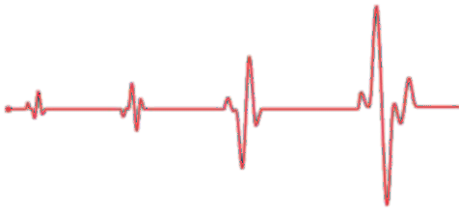


Euthanasia

Slide 132
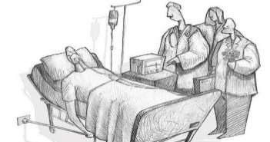
Euthanasia comes from the Greek words: Eu (good) and Thanatosis (death) and it means "Good Death, "Gentle and Easy Death." This word has come to be used for "mercy killing.
It is the act or practice of ending a life of a person either by a lethal injection or suspension of medical treatment.
The word "euthanasia" was first used in a medical context by Francis Bacon in the 17th century, to refer to an easy, painless, happy death, during which it was a "physician's responsibility to alleviate the 'physical sufferings' of the body

Slide 133






Types of euthanasia:
Passive
Indirect
Active
Assisted
Voluntary
Involuntary

Slide 134
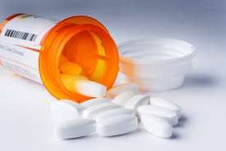
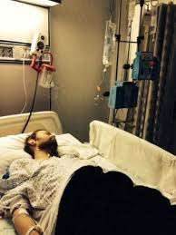
Active euthanasia:
-It is when death is brought by an act for example taking a high dose of drugs
-To end a person’s life by the use of drugs, either by oneself or by the aid of a physician.
Passive euthanasia:
-When death is brought by an omission eg: When someone lets the person die, this can be done by withdrawing or withholding treatment.
Withdrawing treatment: For example switching off a machine that keeps the person alive.
Withholding treatment: For example not carrying out a surgery that will extend life of the patient for a short time.

Slide 135
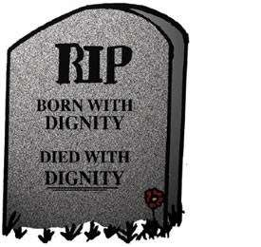
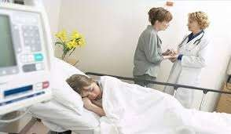
Voluntary euthanasia is committed with the willing or autonomous cooperation of the subject. This means that the subject is free from direct or indirect pressure from others.
Non voluntary euthanasia occurs when the patient is unconscious or unable to make a meaningful choice between living and dying, and an appropriate person takes that decision for him/her.
This is usually called murder, but it is possible to imagine cases where the killing would count as a favor for the patient.

Slide 136
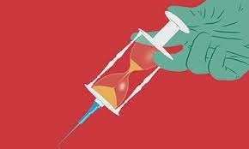
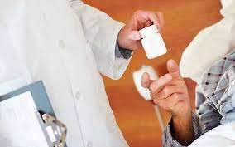
Indirect euthanasia:
This means providing treatments -mainly to reduce pain- that has a side effect of shortening the patient’s life.
Since the primary intent wasn’t to kill, it is morally accepted by some people.
  Assisted suicide:
This usually refers to cases where the persons who are going to die need help to kill themselves and ask for it.
-It may be something as simple as getting drugs for the person, and putting those drugs within their reach.

Slide 137
THE STAGES OF DYING ACCORDING TO DR ELISABETH KUBLER ROSS
Stages typical response typical comments
First stage : DENIAL No “Not me “ the patient may think there has been a mistake
Second stage: ANGER “Why me” the patients hospitality may be directed towards
Family members friends or health workers

Slide 138
Third stage : BARGAINING Yes me but “ the
bargaining may be a promise to go if the patient is a religions person in exchange for more time or a person may say he will do anything in exchange for such experiences as seeing a child graduate from school enjoying his next birthday

Slide 139
Fourth stage : DEPRESSION : why me the patient feels sadness and often cries as though mourning their own death
Fifth stage :ACCEPTANCE: I'm ready A positive feeling and readiness characterized the comment for death. This stage is usually peaceful and tranquil( calm) .

Slide 140
KENYAN NURSES PLEDGE
I do solemnly swear before Almighty God and in the presence of this assembly to observe the Nurses code of ethics and conduct
I shall faithfully practice my profession in accordance with the laid down laws and regulations as provided for in the Nurses ACT CAP 257 of the laws of Kenya

Slide 141
Cont---
I shall abstain from whatever is deleterious and mischievous and shall not take or knowingly administer harmful drugs.
I shall do all in power to maintain and elevate the standard of my profession
I shall hold in confidence all personal matters committed to me and all family affairs coming to my knowledge in the practice of my calling

Slide 142
Cont--
I shall endeavor to work in collaboration with other team members in the provision of health care and devote myself to the welfare of those committed to my care. So help me God.
Note, the pledge is in harmony with the code of Ethics and should not be violated in the course of duty

Slide 143
PROFESSIONAL ORGANIZATIONS
Nurses in Kenya just like any other countries in the world are members of professional organizations at national and global level

Slide 144
The professional nursing organization include :
National nurses association of Kenya (NNAK)
East central southern Africa college of nursing (ECSACON)
International council of nurses (ICN)

Slide 145
Note
In Kenya the professional nursing organization that has both regional and international recognition is the national nurses association of Kenya (NNAK)

Slide 146
THE NATIONAL NURSES ASSOCIATION OF KENYA.
The National Nurses Association Of Kenya [NNAK]is a professional association for nurses which is registered by the registrar for societies as a welfare association .It has branches in all counties.

Slide 147
MEMBERSHIP
Membership of NNAK is open to all nurses who are either registered or enrolled by the nursing council of Kenya .Student nurses can join as associate members .The headquarters of NNAK is in Nairobi.

Slide 148
NNAK is a member of a regional body known as the East Central Southern Africa College of nursery [ECSACON] situated in Arusha ,Tanzania , the association of professional societies of East Africa [APSEA] and the international council of nurses [ICN] situated in Geneva.

Slide 149
Additionally NNAK collaborates with other professional bodies such as the Royal collage of nurses , Royal collage of medicines , Canadian Nurses association , American nurses association ,Kenya medical association [KMA] and the Association of Kenya obstetrical & Gynecologist

Slide 150
FUNCTIONS OF NNAK.
1) Promoting nursing and maintaining the honor , interest and practice of all aspects of the profession as a whole.
2) Promoting and maintaining high standards of nursing education .
3) Stimulating and encouraging nursing research

Slide 151
4) Promoting co-operation between this organization and other national and international professional bodies .
5) Promoting good understanding between the association , central and local governments and all communities .
6) Acting as a local representing body of the nursing profession

Slide 152
7) Supporting a high standard of nursing ethnics , conduct and practice which is organized and function unrestricted consideration of nationality , race ,creed ,politics ,sex or social status .
8) Assisting whenever possible members who by reason of advertising or ill health and in need of help .

Slide 153
9) Arranging and holding periodic meetings of the association for professional , educational and social purposes .
10) Maintaining an up to date list of all members.

Slide 154
Chapters
The chapters of NNAK include:
Midwives
Education
Theatre Nurses
Mental Health and Psychiatric Nurses
General Nurses
Private Nurse Practitioners
Pediatrics Nurses
Critical care

Slide 155
THE EAST CENTRAL SOUTHERN AFRICA COLLEGE OF NURSING [ECSACON]
ECSACON is a professional agency of health Commonwealth Regional Health Community [CRHC] .
It’s main objective is to promote and reinforce professional excellence through the development of programs .

Slide 156
The aim is to strengthen nursing and midwifing practices, education , research, leadership and management to improve service delivery and uplift the quality of health of the communities in the east central southern Africa region

Slide 157
- ECSACON is a corporate body of nurses and midwives of member state composing Botswana Lesotho, Kenya Malawi, Mauritius, Mozambique, Namibia, Seychelles, South Africa, Swaziland, Tanzania, Uganda, Zambia, Zimbabwe

Slide 158
The membership of the college consists of individual nurses/midwives and professional organizations
An individual can be become a member once registered by the nurses/midwife in any of the member states

Slide 159
BENEFITS OF MEMBERSHIP TO ESCACON
i) Benefit of knowledge
The knowledge is obtained through the many activities ESCACON conducts such as quadrennial conference where nurses from member countries meet and share research fending on topics of national interest in health

Slide 160
They exchange information on various topical issues of nursing, midwifery and health mapping the way forward for excellence in nursing/midwifery, education and practices
ii) Interacting with nurse from the region
iii) Provision of reading materials through NCK

Slide 161
Membership rights and privileges
Voting and speaking at ECSACON meeting
Nominating candidates for ECSACON elections and standing committees.
Participating in ESCACON conferences, workshops, seminars and other professional activities as appropriately promoted by ECSACON

Slide 162
Nominating candidates for ECSACON fellowships and awards
Receiving from or through ECSACON documents and periodic information about actives and new ideas a about nursing worldwide

Slide 163
INTERNATIONAL COUNCIL OF NURSES (ICN)
The international council of nurses is a federation of nurses association in 122 countries
It was found in 1899
ICN is the first health professional organizations to be formed and remains the longest among international organization relating to the provision of health care it is operated by nurses for nurses

Slide 164
The secretariat of the ICN is based in Geneva consists of a president a chief executive members
ICN works to ensure quality nursing and sound health policies for all
It strive for the advancement of nursing knowledge and the presence of worldwide respected nursing profession and competent satisfied nursing workforce

Slide 165
GOALS AND CORE VALUES
Goals
To influence health and nursing globally
To strengthen national nurses associations
Values
To encourage visionary leadership, inclusiveness, flexibility and partnership among all member states and the achievement of excellence in nursing/ midwifery education and practices

Slide 166
GOALS AND CORE VALUES
Goals
To influence health and nursing globally
To strengthen national nurses associations
Values
To encourage visionary leadership, inclusiveness, flexibility and partnership among all member states and the achievement of excellence in nursing/ midwifery education and practices

Slide 167
Vision
Unites all nurses within the ICN to speak with one voice as advocates of all that ICN serves
To acknowledge that a human being has the right to preventable and curative care
To spearhead the health care progress and shape health policy around the world through, their numbers alignment of their efforts and collaboration with the public and other health professionals

Slide 168
Mission
Lead societies to benefit health and promote healthy lifestyles, workplace
To support strategies which alternate poverty, population and other causes of illness while incorporating science and advanced of compassionate and ethical caring
To shape nursing education in accordance with values, polices standards and conditions that free nurses to practice to the full extent of their education and abilities with mult-discpinary health teams

Slide 169
Mission
Lead societies to benefit health and promote healthy lifestyles, workplace
To support strategies which alternate poverty, population and other causes of illness while incorporating science and advanced of compassionate and ethical caring
To shape nursing education in accordance with values, polices standards and conditions that free nurses to practice to the full extent of their education and abilities with mult-discpinary health teams

Slide 170
Mission
Lead societies to benefit health and promote healthy lifestyles, workplace
To support strategies which alternate poverty, population and other causes of illness while incorporating science and advanced of compassionate and ethical caring
To shape nursing education in accordance with values, polices standards and conditions that free nurses to practice to the full extent of their education and abilities with mult-discpinary health teams

Slide 171
Philosophy
Entails commitment to caring advocating on benefit of patients and helping people help themselves
ICN ensures that the nursing profession is highly valued appropriately utilized, recognized, rewarded and represented throughout the healthcare system.

Slide 172
THE NURSING COUNCIL OF KENYA (NCK)
The nursing council of Kenya was established by the nurses Act, chapter 257 of the laws of Kenya
The council is a corporate body having perpetual succession and a common seal with power to sue and be sued and to purchase hold, manage and disposal land and other property and to enter into such contracts as it may consider necessary

Slide 173
Members of the council
The director of medical services and the chief nursing officer
One person responsible for education
Two person representing, religious organizations providing health services in Kenya

Slide 174
Two person representing nursing association one from NNAK and one from KEPNA
Four persons nomited by outgoing council to represent General nursing, midwifery and community health nursing
Eleven elected members who may be involved in clinical practices nursing education and administration . they must be register nurses as follows: three registered nurses three midwives, three community health nurses and this psychiatric nurses

Slide 175
FUNCTIONS OF NCK
1) Establishing and improving of all branches of nursing profession in all aspects and to safeguards the interest
2) Establishing and improving the standards of professional nursing and of health care within community

Slide 176
3) Prescribing and conducting examinations for persons seeking registration on environment under the act.
4) Regarding the conduct of person registered, licensed or enrolled under the act and to take such disciplinary measures as may be necessary to maintain a proper standard of conduct among such persons

Slide 177
5) Prescribing badges, insignia or uniforms to be worn by persons registered, licensed or enrolled under the act.
6) Directing and supervising the compilation and maintenance of registers required under the act.

Slide 178
7) Advising the cabinet secretary on matters concerning all aspects of nursing.
8) Indexes students aspiring to be nurses.
9) Makes provision for training registration ,enrollment and licensing of nurses.

Slide 179
THE FULL COUNCIL
The functions of the nursing council are carried out through committees.
The council is composed of 22 members and meets every 3 months.

Slide 180
COMMITTEES
1) The education standing committee
2) The standards and ethics committee
3) Registration and licensing standing committee
4) Investigations standing committee
5) Financial standing committee
6) Disciplinary committee.

Slide 181
The Education Standing Committee
Deals with all issues that relate to nursing education such as:
Designing nursing programmes, syllabuses and national curriculum according to the health needs of the community.

Slide 182
Scrutiny of institutions curriculum whether they meet the minimum standards for producing a safe practitioner.
Formulating training materials like educational policies guidelines and procedures, log books for recording clinical practice learning

Slide 183
Dealing with examinations – setting and packaging and dispatch to training institutions, making moderation and presenting results to various committees and full council and finally release to individual candidates and training institutions.
Monitoring of students during training e.g discontinuations, readmissions and discipline cases.

Slide 184
Approving training institutions and monitoring the institutions to ensure standards of nursing education are maintained. Areas monitored include:
  Facilities in the school and clinical area
  Approved teacher/student ratio of 1:10
  Adequate clinical area staff
  Facilitating continuing education for nurses.

Slide 185
2) The Standard and Ethics Committee
Initiation of maintenance of standards of nursing education and nursing practice.
Coordinates council visits to health institutions for the purpose of monitoring the quality of nursing education or quality of care being offered to patients and clients respectively.
Coordinates research sub-committee meetings which facilitate research and surveys related to nursing practice and nursing education.

Slide 186
3) Investigations Standing Committee
This committee investigates all cases of professional misconduct, negligence, malpractice and impropriety. This is to establish whether the alleged crime has been committed and whether the nurse has a case to answer or not.

Slide 187
4) Finance Standing Committee
This committee deals with financial issues of the council in relation to income and expenditure

Slide 188
5) Disciplinary Committee
Deals with disciplinary cases recommended by the investigations standing committee.
It is independent of the full council,
Members are drawn from experienced nurses practicing general nursing, midwifery, community health nursing, mental health and psychiatry nursing, the legal advisor and representative of the chief nursing officer. The registrar is the secretary.

Slide 189
5) Disciplinary Committee
Deals with disciplinary cases recommended by the investigations standing committee.
It is independent of the full council,
Members are drawn from experienced nurses practicing general nursing, midwifery, community health nursing, mental health and psychiatry nursing, the legal advisor and representative of the chief nursing officer. The registrar is the secretary.

Slide 190
Registration and Licensing Standing Committee
The registration and licensing standing committee meets every month.
It deals with the registration and licensing of nurses for nursing practice. This is applicable for those trained in Kenya and those outside Kenya.
The committee also licenses nurses for private practice and retention of nurses in the registers, rolls and records.

Slide 191
The Nursing Council Secretariat
All activities of the Nursing Council are coordinated by the Secretariat. The Nursing
Council Secretariat conducts the day to day activities of the Council.
The Secretariat is composed of council officers and council staff.

Slide 192
The council officers who are the registrar, education officers, examination officers, registration officers and standards and ethics officers are currently employees of the Ministry of Health deployed to work at the council.
They coordinate various Standing Committees and Subcommittees as discussed earlier. As a practicing nurse you may be familiar with the offences under the 257 Act.

Slide 193
The council staff
includes the accountant, accounts assistant, secretaries, copy typists, records clerk, driver and supportive staff who are employees of the Council.

Slide 194
Nursing Council Elections
The Nursing Council of Kenya conducts elections of council members every three years.
All registered nurses are eligible to vie for representation of various disciplines for example general nurses, midwives, community health nurses and mental health and psychiatric nurses.

Slide 195
The nurses may be practicing either in clinical practice, nursing education or leadership and management.
The procedures to be followed are at the back pages of the Nurses Act.

Slide 196
OTHER LAWS RELATING TO NURSING PRACTICE
1) The Public Health Act (Cap 242)
Describes the health delivery in the country
2) The Pharmacy and Poisons Act (cap 244)
Deals with drug prescription and administration.

Slide 197
3) Medical practitioners and Dentists Act (Cap 253)
Deals with diagnosis and treatment (nurses diagnosis and treat minor ailments)
4) Narcotic drugs and psychiatric substances (control) (Act 1994)
While dealing with the dangerous drugs be familiar with the law.
Also applies to dealing with drug misuse and abuse.

Slide 198
5) Mental Health Act (Cap 248)
A nurse deals mental health and psychiatric nursing.
6) Medical Laboratory Technicians And Technologists Act (1999)
Deals with body specimens from patients and clients.

Slide 199
7) Clinical medicine act
Diagnosing and treating minor ailments related to medical practitioners and dentists Board
8) Food, drugs and chemical act.
Nutritional status of the patient and nurses are one of food handlers in the hospital.

Slide 200
9) Children’s and young persons act
Interacting with bodies for children adolescents and teenagers. This may be in wards, departments, clinics, maternity, school health and the community.

Slide 201
Workman’s compensation Act which outlines what one should do in cases of accidents, injuries, acquiring disease during practice with a specific focus on how to go about applying for compensation of damages caused as a result of accidents, injuries of disease incurred during practice.

Slide 202

INNOVATIONS IN
NURSING

Slide 203
INTRODUCTION
The only constant feature in this world is change. While all the change may not lead to progress, there can be no progress without change. This is true for the individual, institution, organization or the country. Civilization owes its existence to change.
The success or even survival of an institution or organization on depends on making necessary changes.
World wide nurses are engaged in innovative activities on a daily basis to improve patient care outcomes and to reduce cost to health care system

Slide 204

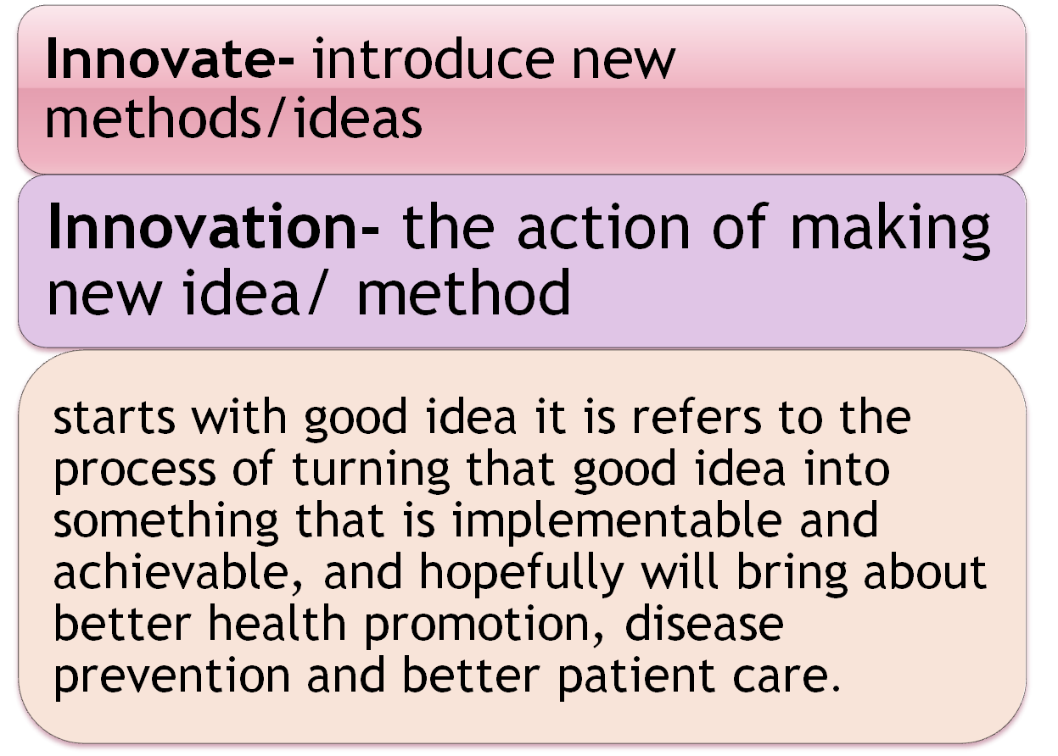

Slide 205


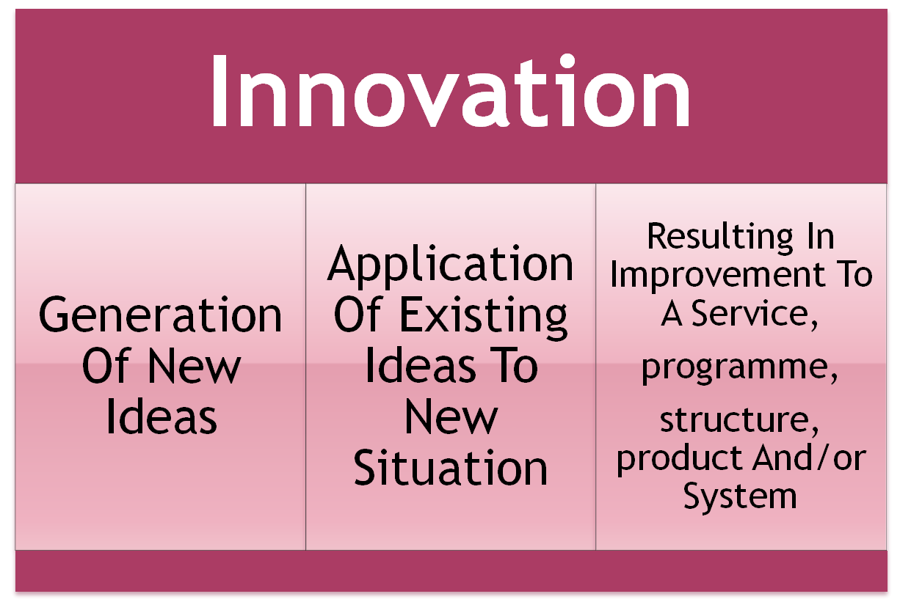

Slide 206

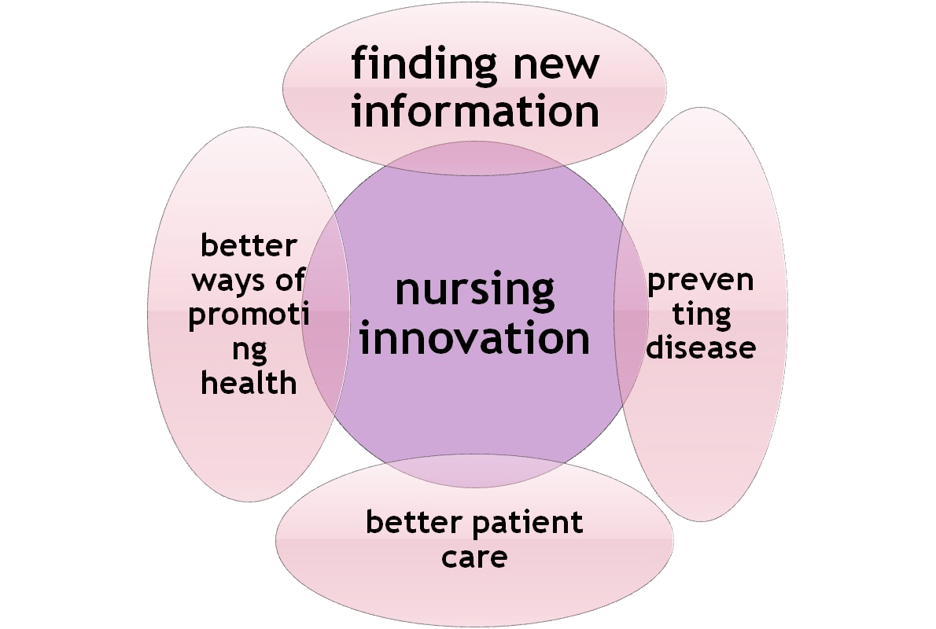

Slide 207
NEED OF INNOVATION
Maintenance of quality health services and improving quality of care
Growing demands in health services
Global workforce shortage
Emerging clinical/ nursing specialities.
To conform to the regulation
To find new information

Slide 208
PRINCIPLES
Innovation is to analyze the opportunities or sources
Innovation is both conceptual and perceptual
It should be simple and focused
Effective innovation start small and they aim to do
one specific thing
Successful innovation aim at being the best from the very beginning

Slide 209
Innovation in Nursing
Innovation in nursing practices
Innovation in nursing education
Innovation in nursing care
Innovation in nursing management

Slide 210

·
Innovation in the clinical practice occur across the continuum of care. Clinical practice demanding new skills and techniques as well as the new ways of working. Similarly changes in the availability and effectiveness of drug-based treatments have also brought about significant shifts in the clinical practice.

Slide 211
Varies innovations are there in clinical practice:
·
○Computer Assistance
○Wireless Technology
○Evidence Based Practice
○Procedure Manual
○Emergency Medical Services
○ Job Description
○Management and Leadership
○Infection control
○ Triage
○Ethics
○ Forensic Nursing Speciality
○Community Based Nursing Role

Slide 212

Development of computer-assisted thinking: in order to enhance students active thinking, faculty members at international University Of Health and Welfare developed the CAT( Computer Assisted Thinking) program. The CAT program is different from CAI (Computer Assisted Instruction),which mainly ask the users to choose correct answer.

Slide 213

HANDHELD COMPUTERS IN NURSING EDUCATION
·
First personal digital assistant in 1996
According to ANA (2001) all nurses need to use nursing informatics
VIDEOCONFERENCING AND WEB BASED CONFERENCING
Connects students and educators across distance
Connects diverse student groups
·

Slide 214

E-LEARNING
·
Adaptation of different distance learning technologies
Self directed, active learning
Refocusing from educator to the subject

Slide 215
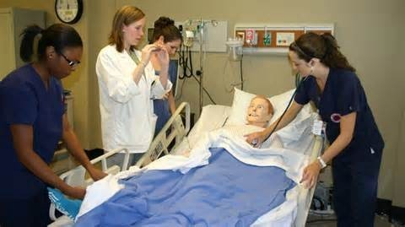
SERVICE-LEARNING
·
Structured learning experience that combines community service with preparation and reflection
Achieves a balance between service and learning objectiv
HIGH FIDELITY PATIENT SIMULATOR
Help student practice decision making and problem solving skill and to develop human interaction
Simulation is the third leg in the stool of education and science

Slide 216
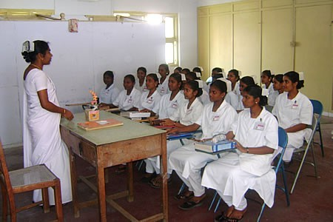
TELE TEACHING
·
Online model of education-learner directly interacts with tutor
Learner oriented learning
Promotes discovery learning
MICRO TEACHING
Miniature classroom teaching
Small duration
Paying full attention to a particular unit and skill
Content reduced to one unit with a single concept

Slide 217
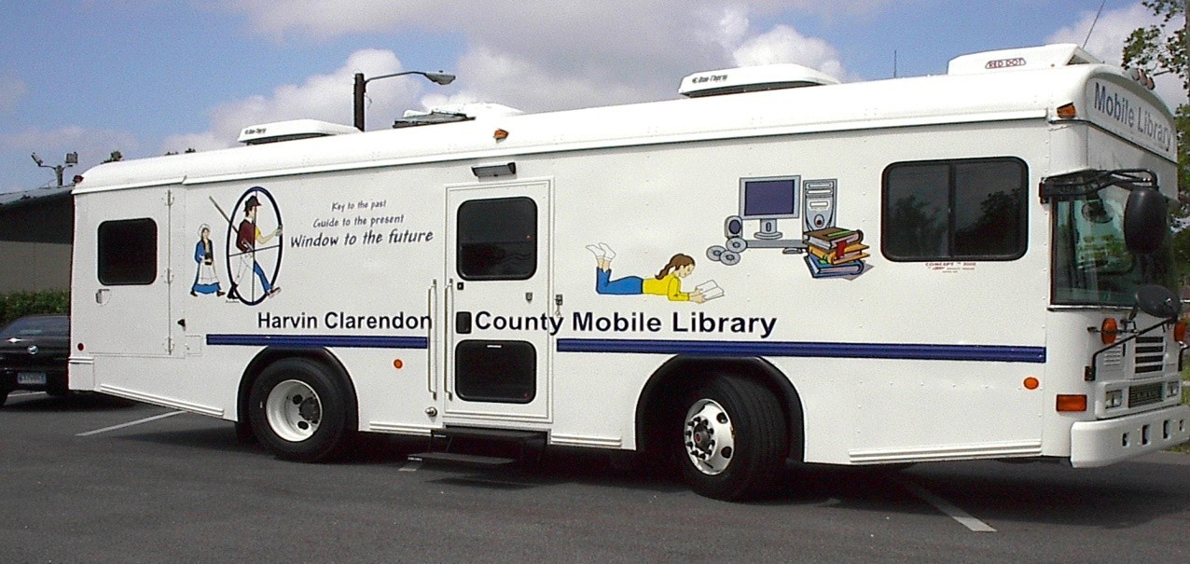
NURSING MOBILE LIBRARY
Access to health care information for nurses working in remote area
To reduce the gap between the desperate need for nursing information and its availability

Slide 218

Innovation in nursing care
·
·
·
Health care systems are increasingly being opposed with chronic patients who need complex interventions tailored to their individual needs.

Slide 219
·
However today’shealth care professionals,organizations and budgets are not sufficiently prepared to provide this kind of care.as a results ,health care policy reduce the health care cost and the improve the quality of care.
·
Care is provided by health personnel at the lowest cost level, giving advance nursing practice,hospital-at-home care and integrated care.eg…DOTS therapy

Slide 220

4th
·
·
USE OF COMPUTER
○ Computerized physician order entry (CPOE)
○ Clinical decision support system (CDSS)
ELECTRONIC MEDICAL RECORDS
Affordable & integrated.
For improving patient care.
Powerful practice management system for practices of any size.

Slide 221
○ Fast, flexible, Easy to use schedule for increasing productivity.
Clinical desktop for improving enterprise work flow.
Integrated, Internet – based solution that securely connects clinics and patients.
Electronic document management system for eliminating paper charts.
·
LEADERSHIP FOR CHANGE
○ It is an action learning programme to develop nurses as effective leaders and managers
·
OUTSOURCING
○ outsourcing is subcontracting a process to a third party company

Slide 222
CAUSES FOR NOT ATTEMPTING INNOVATION
Afraid of failures; of opposition; of the unknown.
Lacking adequate and correct information.
Reluctant to experiment.
Bound by custom & tradition.
Unaware of our strengths for achievement.

Slide 223
CONCLUSION
CONCLUSION
Every nurse can play a role in ensuring that innovations are effectively implemented and adopted. Through their professional conduct and relationship with colleagues, nurses can play in creating a working environment.
In their leadership positions, nurses are well placed to disseminate information about innovations.
In leadership roles, is encouraged and supported among peers and more junior staff. Everyday nurse are developing new and innovative approaches to improve healthcare services and healthcare outcome for local people.
Nursing innovation are key to improvement and progress in health systems worldwide.
We must teach students how to think, how to access, interpret and use knowledge, how to be leaders and how to defend their ideas. These skills require each faculty be
engaged in those activities themselves…across settings.

