Slide 1
Family Centered Care

Slide 2
Objectives
Introduction
Define Family Centered Care (FCC)
Describe the partners in FCC and their roles
Discuss the components and goals of FCC
Outline the outcomes and benefits of FCC
Describe Pain Management

Slide 3
Definition
Introduction
Family Centered Care (FCC) is an approach to care delivery that promotes a mutually beneficial partnership among parents, families and health-care providers to support health-care planning, delivery and evaluation
FCC is working with babies and their families, rather than just doing “to” and “for” them.
Notes:
Family members, especially parents, are natural advocates for the neonatal patient for whom the emotional, social, and developmental needs are serious and urgent.

Slide 4
Partners in FCC
Partners in FCC
Families
Include Mother, Father, Mother in Law, Grandmother, Siblings, Relatives
Staff
Include nurses, clinicians, nutritionists, psychologists/counsellors, rehabilitation therapists, social workers and chaplains
The Facility/Unit System (building blocks)
Includes the other staff, stuff, space and supporting system

Slide 5
Partners in FCC - Roles
Partners in FCC
Families should;
Be aware of their rights during admission
Communicate their needs, preferences, choices & plans
Supported to cope with their baby’s admission/death
Staff Should;
Know and proficiently implement the components of respectful FCC
Be effective communicators
Support families going through loss and grief
Create forums to offer parents education as well as peer to peer support.
The Facility/Unit System should have;
Enough staff, stuff, space to support respectful FCC
A culture that encourages respectful & dignified FCC
Notes:
Creating a family-centered environment encompasses making the NBU a place where the whole family feels welcome and valued as important contributors to the infant’s well-being and where the needs of the family unit are supported.

Slide 6
Components of FCC
Components of FCC
Participation, Involvement & Collaboration
Respect & Dignity
Empowerment
Information Sharing
These components should be implemented as a bundle
Notes:
All the components of FCC should be implemented as a bundle (together)
Participation, involvement & collaboration
Encouraging families to be part of the care team. Parents should be involved and supported in caregiving and decision-making to the extent they choose.
How can the family be allowed to participate in the care team?
How do you involve the family in the care of their baby in your unit?
How do you collaborate with a family whose baby is on CPAP?
Information sharing
Sharing information on the condition of the baby, likely treatment and outcomes can afford the parents time to accept the news, gather more information and discuss potential decisions they might make
How do you share information about the baby’s condition, treatments and likely outcomes in your unit?
Respect & dignity
Listening to and honoring the parents perspectives and choices. The parents knowledge, values, beliefs and cultural backgrounds are incorporated into the planning and delivery of care.
How do you listen and honour families perspectives?
Empowerment
Educating the parents so they become stronger and more confident in the care of their baby both in the unit and at home. Also involves enlightening the parents so they are in more control of their baby’s care within their charter rights.
How do you prepare families for the baby’s discharge?

Slide 7
The effect of FCC
The effect of FCC
Immediate Result
Outcomes
Benefits
Humane and dignified interactions
Efficient Sharing of information
Collaboration as equal partners
Participation in care team based on each partners ability and choice
Decisions made together
Better care during bereavement
Adherence to treatments plans
Improved pain management
Less anxiety and stress
Reduced length of stay
Improved satisfaction
Improved communication
Enhanced learning environment
Improved quality of care
Reduced unnecessary diagnostic tests and referrals
Decreased medical errors and infection rates
Fewer readmissions
Decreased lengths of stay
More efficient and effective use of professional time and healthcare resources
Decreased complaints
Notes:
American Academy of Paediatrics, 2003; Boudreaux, Francis & Loyacano, 2002; Cooper et al., 2007; Coulter &
Ellins, 2007; Davidson et al., 2007; Dunst, Trivette & Hamby, 2007; Dunst & Trivette, 2009; Frampton & Charmel,
2008; Fumagalli et al., 2006; Mitchell et al., 2009; Meyer, 2011; Wagner et al., 2005

Slide 8
Pain Management
Notes:
How do you know a newborn is in pain?
How often do you assess for pain?

Slide 9
Why do Neonates feel more pain than adults?
Assessing Pain
The number and types of peripheral pain receptors is similar to adults by 20 – 24 weeks gestation. Neonates have a greater density per area of skin
Neonates have a slower conduction rate due to incomplete myelination but they have a shorter length of pain receptor pathway
Adaptive mechanisms that can modulate painful stimuli do not develop until 32 – 36 weeks of post conceptional age
Lundeberg S, Lundeberg T. Pain in infants and children – physiological background and clinical aspects. Acupuncture and related therapies 2013 Oct 1: 1(4):46-9

Slide 10
Pain Assessment
Assessing Pain
Cry/Irritability – high pitched, high intensity, long duration, inconsolable
Upper and lower limb movements – finger splaying, saluting, sitting on air, arms and legs flexion/extension, swiping motions of the unaffected lower limb as if to remove painful stimulus
Activity – awake, active
Facial expression (next slide)

Slide 11
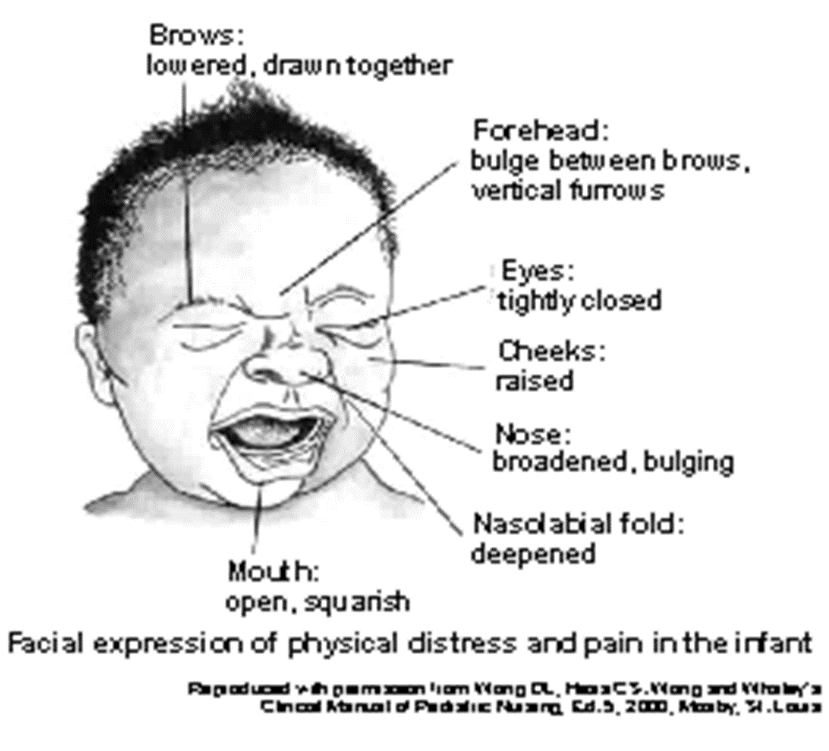
Pain Assessment
Assessing Pain
Notes:
American Academy of Paediatrics, 2003; Boudreaux, Francis & Loyacano, 2002; Cooper et al., 2007; Coulter &
Ellins, 2007; Davidson et al., 2007; Dunst, Trivette & Hamby, 2007; Dunst & Trivette, 2009; Frampton & Charmel,
2008; Fumagalli et al., 2006; Mitchell et al., 2009; Meyer, 2011; Wagner et al., 2005

Slide 12
Managing Acute Pain in Newborns
Current Kenya Pain Management Guidelines
Breast feed at least 2 minutes before the procedure and continue throughout and after the procedure. The baby should also be skin-to-skin with the mother
Those not able to breast feed should have 2mls of expressed breast milk (EBM) given into the mouth using a 2ml syringe at least 2 minutes before the procedure
If no EBM available, 2mls of 10% dextrose or 0.4mls/kg of 50% dextrose should be given into the mouth at least 2 minutes before the procedure

Slide 13
Questions
Questions

Slide 14
Summary
Summary
The family, staff and system need to partner to implement FCC
The components of FCC should be implemented as a bundle
Always assess and manage pain by breastfeeding

