Slide 1
Newborn Transition to postnatal life

Slide 2
Objectives
Introduction
Outline transition from intrauterine life to extrauterine life with a focus on;
Phases of transition
Important aspects of lung development and adaption
Neonatal thermoregulation
Hemoglobin changes
Physiological Jaundice
Newborn glucose and feeding needs

Slide 3
Newborn Transition
Transition
How long should it take a newly born to transition from intrauterine life to extra-uterine life?
1 - 2 hours
2 - 3 hours
3 - 6 hours
6 - 12 hours

Slide 4
Newborn Transition
Transition
Transition period can last 3 - 6 hours
Three phases of transition
Phase One: “Period of Reactivity”
Phase Two: “Sleep Period”
Phase Three: “Second Period of Reactivity”
1 - 2 Hours
1 - 4 Hours
2 - 8 Hours

Slide 5
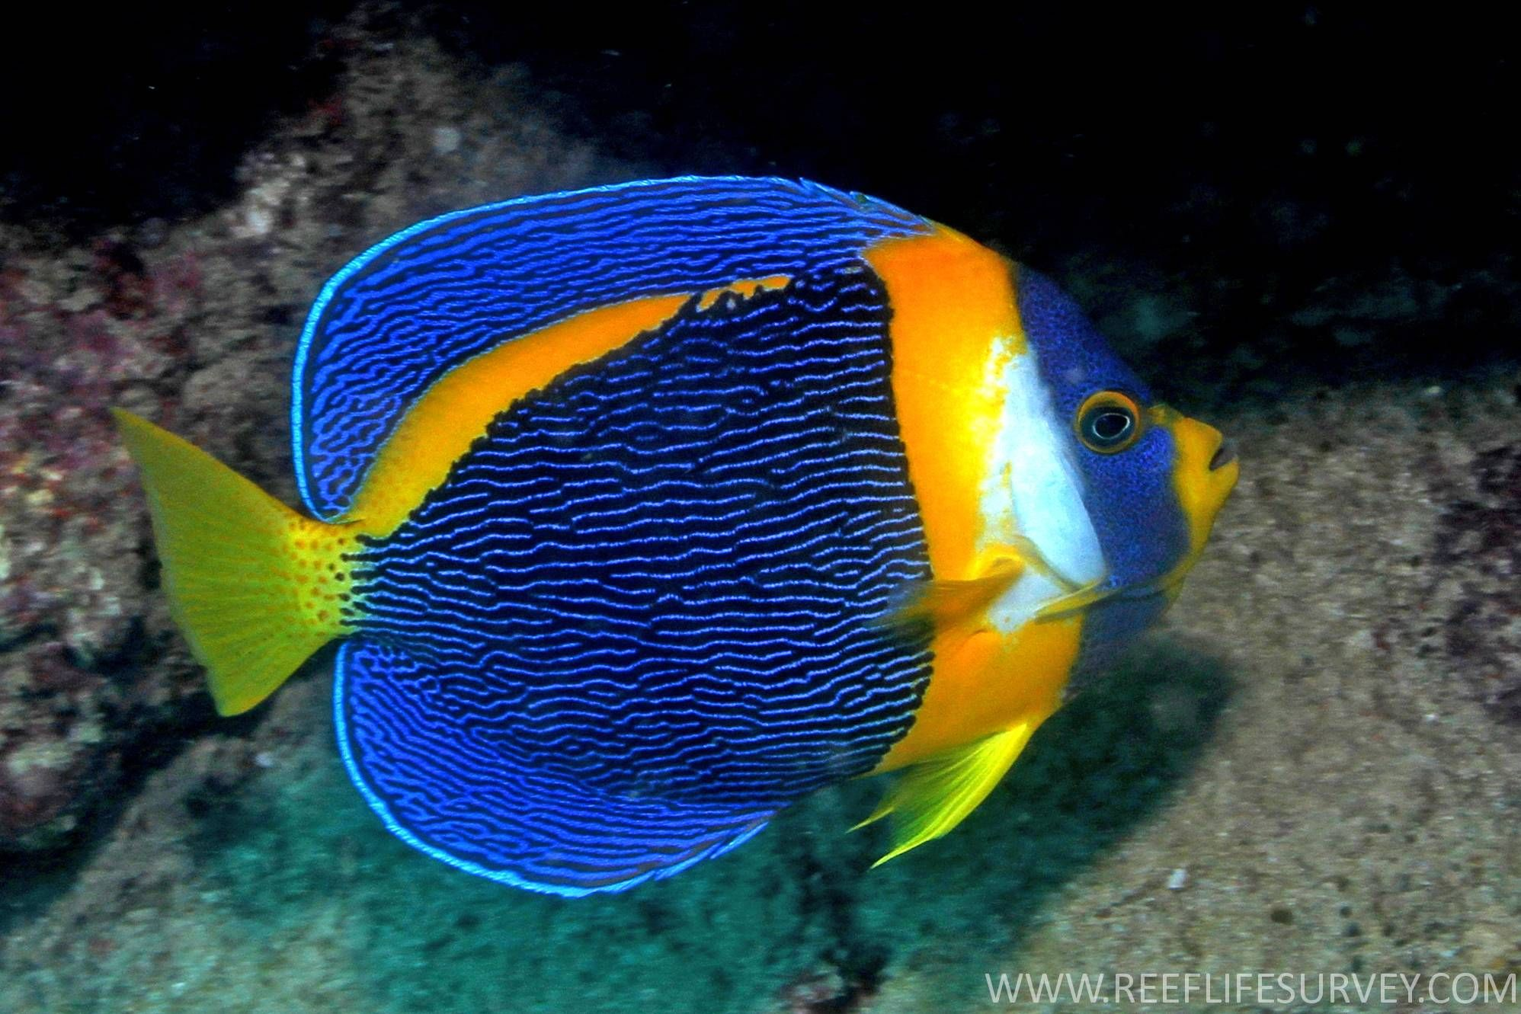
Newborn Transition
Transition

Slide 6
Lung Transition
Transition
Fluid filled alveoli in utero.
Lungs hyperextended, critical for stimulating lung development
Air filled alveoli in after birth
Labor - stimulates surfactant production - Birth
Placental gas exchange.
Pulmonary respiration.
Immediately after birth the respiratory epithelium role changes from fluid secretion to fluid absorption linked to trans-pulmonary pressures generated during inspiration

Slide 7
Clearance of Fluid in the Fetal Lungs
Lung adaptation
Clearance of fluid in the fetus lungs begins before birth, enhanced by labor & completed by 2hrs of age.
During labor and immediately after birth - the respiratory epithelium changes
Active fluid secretion
Active fluid absorption
Birth
Cortisol
Preterm babies have delayed clearance of foetal lung fluid
Infants with TTN have delayed clearance of foetal lung fluid

Slide 8
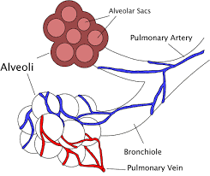
Lung Adaptation
Lung adaptation
Requires the coordinated activities
Clearance of fetal lung fluid
Surfactant secretion
Onset of consistent breathing

Slide 9
Lung Adaptation
Lung adaptation
Fetal breathing starts at 10 weeks gestation
Fetal breathing movements help with lung development & prevents lung hypoplasia
Lung development
2nd trimester – Gas exchanging portions of the airway are formed
24 weeks – Alveolar ductal development
36 weeks – Septation of the air sacs

Slide 10
Surfactant Production
Lung adaptation
Production begins at 24 weeks - mature levels at 34 week
Surfactant secretion into the fetal lungs further stimulated by labour and by the stretch of the alveolar by initiation of ventilation
Surfactant lowers surface tension in the lungs, allowing for inflation at lower pressures increasing the functional residual capacity (FRC)

Slide 11
First Postnatal Breathe
Lung adaptation
First postnatal breath/initiation of ventilation of results in increased oxygen exposure
This leads to a decrease in pulmonary resistance with increase pulmonary blood flow and well oxygenated blood to the left side of the heart.
As ventilation is initiated – the inspiratory volume is higher than the expiratory volume resulting in a functional residue capacity (FRC)

Slide 12
First Postnatal Breathe
Lung adaptation
Preterm infants with lower amounts of surfactant have a lower baseline FRC
Continuous positive airway pressure (CPAP) can help preterm infants adapt by triggering production and secretion of surfactant.

Slide 13
Thermoregulation
Thermoregulation
Normal range 36.5⁰C- 37.5⁰C
In utero - Thermostability
At birth, infants emerge covered in liquid, resulting in potential heat loss via evaporation.
Heat can also be lost by; Convection/Conduction/Radiation
Neonates are at high risk of hypothermia because of;
Higher body surface area compared to children
Limited capacity to generate heat via shivering
Decreased subcutaneous fat for insulation

Slide 14
Thermoregulation
Thermoregulation
Newborns can generate heat and prevent heat loss by;
Brown adipose tissue lipolysis triggered by norepinephrine. This brown adipose tissue however, develops at 34 weeks gestation
Peripheral vasoconstriction
Surge of thyroid hormone
Neonatal thermoregulation – requires increased oxygen consumption and use of glucose

Slide 15
Thermoregulation
Thermoregulation
Evidence suggest an increased risk of mortality by at least 28% for each 1° below 36.5⁰C body temperature at admission and dose-dependent effect size.
Preterm babies have a large surface area–to–volume ratio and increased evaporative fluid losses from the skin.
Strategies introduced to minimize heat loss include use of;
Occlusive wrapping
Exothermic warming mattresses
Warmed humidified resuscitation gases
Caps/Hats
Increased delivery room temperature

Slide 16
Thermoregulation
Thermoregulation
Hyperthermia (temperature greater than 37.5°C) also increases the risk for neonatal mortality and morbidity in both term and preterm infants.

Slide 17
Fetal Hb Vs Adult Hb
Hemoglobin Adaptions
Intrauterine environment
Relatively hypoxic
Fetal Hb has enhance oxygen binding capacity
High Hb (19 - 21g/dl)
Extrauterine environment
High oxygen concertation
Lower Hb
Increase in adult Hb
Birth
Preterms have;
Less Iron stores because transfer from maternal store takes place in late 3rd trimester
An immature hemopoietic system
Lower erythropoietin levels

Slide 18
Physiological Jaundice
Physiological Jaundice
Neonates have high RBC mass and shortened life span
Unconjugated bilirubin bound to albumin is transported to the liver.
Binding is low in ill neonates
Low activity of the conjugating enzyme in neonates
Increased Breakdown of RBC and haemoglobin
Unconjugated bilirubin
Conjugated bilirubin
Lipid soluble;
Can cross the blood brain barrier
Water soluble;
Eliminated via urine & faeces
Unconjugated bilirubin - predominant form, usually less than 255mmo/l
Bilirubin level 290 - 305mmol/l may be accepted as normal in term health newborn

Slide 19
Glucose Needs & Feeding
Glucose Needs
Delivery stress causes conversion of fats and glycogen to glucose for energy
At 1 - 2 hours of age, glucose levels fall and baseline glucose is achieved at 30 mins -1hour of age
A newborn’s brain relies on glucose to fuel development.
Low blood glucose levels (hypoglycemia) at birth have been associated with brain injury and intellectual and developmental disabilities.
Higher blood glucose level may be protective.
Protective target glucose not yet defined

Slide 20
Questions
Questions

Slide 21
Summary
Summary
Most babies transit well to the extra uterine life
A few babies don’t and will require to be supported in;
Breathing
Keeping warm
Maintaining blood sugars

