Slide 1
The Genetic Code
بسم الله الرحمن الرحيم
By:
Dr. Ali Malik Osman

Slide 2
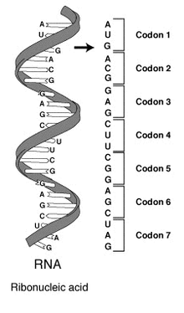
Definition:
The genetic code is collection of codons.
The codon in mRNA is comprised from 3 letters of either A, G, U, or C.
Each codon codes for specific aminoacid.
So , The genetic code is the series of codons in the transcribed mRNA that specify the aminoacid sequence of the encoded protein.

Slide 3
mRNA Processing:
Generally, genetic information flows as follows:
In prokaryotes the gene is transcribed into mRNA which is translated - without processing - into the polypeptide product (=protein).
In higher eukaryotes the large mRNA precursors (hnRNA) contain coding regions (exons) and long intervening noncoding sequences (introns) that separate the exons.
DNA
mRNA
Protein
Transcription
Translation
Ex1 Intron Ex2 Intron Ex3 Intron Ex4
5‵ 3‵
hnRNA

Slide 4
The hnRNA is processed within the nucleus, and the introns, which often make up much more of this RNA than the exons, are removed.
Exons are spliced together to form mature mRNA, which is transported to the cytoplasm, where it is translated into protein.
Ex1 Ex2 Ex3 Ex4
5‵ 3‵
Mature mRNA

Slide 5
Why the codon is triplet?
20 amino acids are required for protein synthesis; thus,
There must be at least 20 distinct codons that make up the genetic code.
Since there are only 4 different nucleotides in mRNA, each codon must consist of more than a single purine or pyrimidine nucleotide.
If the codon consists of:
  2 nucleotides, only 16 (4²) codons can be formed,
  3 nucleotides, 64 (4³) codons can be formed,
  4 nucleotides, 256 (4⁴) codons can be formed, much more than needed.

Slide 6
Why studying of the Genetic Code is important?
It was impossible to understand protein synthesis—or to explain mutations—before the genetic code was elucidated.
It is used to explain the way in which protein defects may cause genetic disease.
Pathogenesis of viruses is related to their ability to disrupt host cell protein synthesis.
Many antibacterial agents are effective because they selectively disrupt protein synthesis in the invading bacterial cell but do not affect protein synthesis in eukaryotic cells.

Slide 7
The Genetic Code
(in mammaliam mRNA)
The terms first, second, and third nucleotide refer to the individual nucleotides of a triplet codon.
Term, chain terminator(stop) codon.
AUG, which codes for Met, serves as the initiator codon in mammalian cells and encodes for internal methionines in a protein.
In mammalian mitochondria, AUA codes for Met and UGA for Trp, and AGA and AGG serve as chain terminators rather than Arg.
First Nucleotide | Second Nucleotide |  |  |  | Third Nucleotide
 | U | C | A | G
U | Phe Phe Leu Leu | Ser Ser Ser Ser | Tyr Tyr Term Term | Cys Cys Term Trp | U C A G
C | Leu Leu Leu Leu | Pro Pro Pro Pro | His His Gln Gln | Arg Arg Arg Arg | U C A G
A | Ile Ile Ile Met | Thr Thr Thr Thr | Asn Asn Lys Lys | Ser Ser Arg Arg | U C A G
G | Val Val Val Val | Ala Ala Ala Ala | Asp Asp Glu Glu | Gly Gly Gly Gly | U C A G

Slide 8
Features of the Genetic Code
Degenerate
Unambiguous
Nonoverlapping
Not punctuated, &
Universal.

Slide 9
Degenerate
  Degeneracy = Some A.As are encoded by several codons; e.g, 6 different codons specify Ser,
  Exp:
    This is because 61 codons code for 20 amino acids, & the 3rd nucleotide in a codon is less important than the first two in determining the specific amino acid to be incorporated.
    Also, by “Wobble” base-pairing.
  N.B: Some A.As like Met & Trp, have a single codon.
Unambiguous
  Each codon encodes only ONE amino acid.
  Exp: Since each tRNA molecule recognizes only one codon in mRNA by its anticodon arm & can be charged with only one specific A.A, each codon therefore specifies only one amino acid.

Slide 10
Nonoverlapping
  The reading of the genetic code during the process of protein synthesis does not involve any overlap of codons.
  Exp: The ribosome moves by 1 codon distance along the mRNA during translation.
Not punctuated
  Once the reading is commenced at a specific codon, there is no punctuation between codons, and the message is read in a continuing sequence of nucleotide triplets until a translation stop codon is reached.
Universal
  With few exceptions, the genetic code is universal.

Slide 11
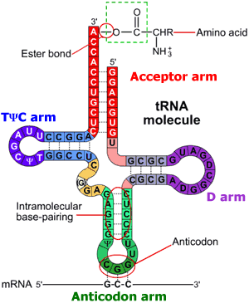
Role of tRNA in Genetic Code reading (Structure):
Each tRNA is made of a single RNA chain that base pairs with itself in its secondary structure becoming like the “ Cloverleaf ”.
It contains 4 main arms:
The acceptor arm terminates in the nucleotides CpCpAOH.
  These 3 nucleotides are added post -transcriptionally.
  The tRNA-appropriate amino acid is attached to the 3′-OH group of the A moiety of the acceptor arm.
The D, TΨC (=thymidine-pseudouridine-cytidine), and extra arms help define a specific tRNA.
TΨC arm is involved in binding of the aminoacyl- tRNA to the ribosomal surface at the site of protein synthesis.
The D arm is used for the recognition of tRNA by its aminoacyl-tRNA synthetase.
The anticodon arm consists of 7 nucleotides, and it recognizes the three-letter codon in mRNA.

Slide 12
Role of tRNA in Genetic Code reading (Function):
tRNA serves as adapter for the translation of information reside in the mRNA sequence of nucleotides into specific amino acids.
The adapter function of the tRNA molecules requires the charging of each specific tRNA with its specific amino acid.
There is no affinity of nucleic acids for specific functional groups of amino acids.
So, this recognition must be carried out by a protein molecule capable of recognizing both a specific tRNA molecule and a specific amino acid.
These proteins/enzymes are termed aminoacyl-tRNA synthetases.
The process of recognition and attachment (charging) proceeds in 2 steps :
  There is a formation of an activated intermediate of aminoacyl-AMP-enzyme complex:
      A.As + Enz + ATP → Aminoacyl-AMP-enzyme complex
  Then the specific aminoacyl-AMP-enzyme complex recognizes a specific tRNA to which it attaches the aminoacyl moiety at the 3′-hydroxyl adenosyl terminal.
      Aminoacyl-AMP-enzyme complex + tRNA → Aminoacyl-tRNA + AMP + Enz

Slide 13
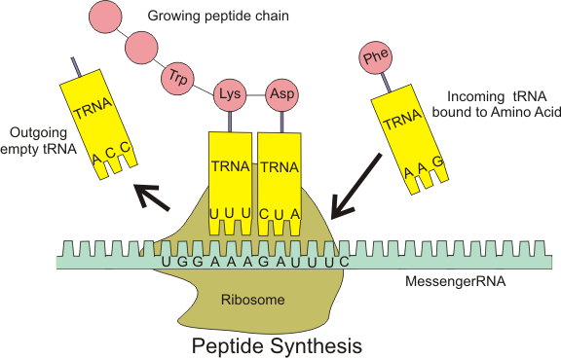

Slide 14
Summary:
The Genetic Code is the series of codons in the mRNA that specify amino acids sequence in the translated protein.
Decipher of the genetic code explains protein synthesis, mutations, genetic diseases, viral pathogenesis; & used for synthesis of many antibacterials.
The flow of genetic information follows the sequence: DNA → RNA → protein.
The transcribed premature mRNA (= hnRNA) is processed by removing introns & splicing exons in eukaryotes to form the mature mRNA.
The Genetic Code is: degenerate, unambiguous, nonoverlaping, not punctuated & universal.
tRNA is the adaptor for translation of mRNA into specific amino acids sequence of protein.
The tRNA is charged with its specific amino acid via aminoacyl tRNA synthetase enzyme.

Slide 15
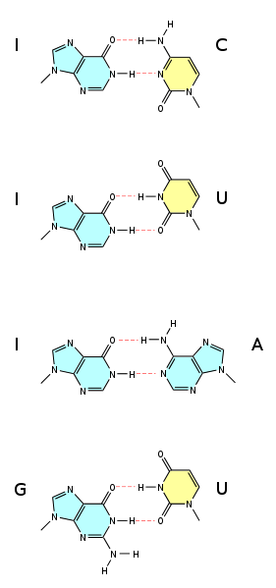
Wobble Hypothesis
Proposed by Francis Crick in 1966.
It is a non-Watson-Crick base pairing between mRNA codon & tRNA anticodon.
Since tRNAs are fewer than 45, some tRNAs must pair with more than one codon.
The 5' base on the anticodon, which binds to the 3' base on the mRNA, have non-standard base pairing.
Exm: In yeast, tRNA^{Phe} has the anticodon 5'-GmAA-3' & can recognize the codons 5'-UUC-3' and 5'-UUU-3'.

Slide 16
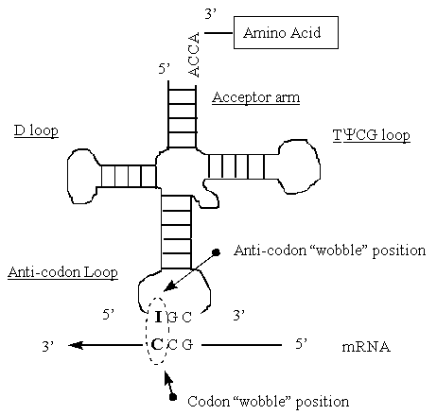

Slide 17
Thank U very much

