Slide 1
Pharmacodynamics
Structure-activity relationship, Dose-response relationship: drug potency, efficacy and therapeutic index

Slide 2
Learning objectives …
Show how the knowledge of the chemical structure of a drug is useful
Explain the terms:
Potency
Therapeutic efficacy
Therapeutic index

Slide 3
Structure activity relationship
Pharmacodynamics

Slide 4
Structure activity relationship
The activity of a drug is intimately related to its chemical structure.
Knowledge about the chemical structure of a drug is useful for:
Synthesis of new compounds with more specific actions and fewer adverse reactions
Synthesis of competitive antagonists
Understanding the mechanism of drug action

Slide 5
Structure activity relationship …
Synthesis of new compounds, for the following purposes:
To increase or decrease the duration of action of the original drug or to get a more potent compound. E.g.
Procaine –When given intravenously reduces the rate and excitability of the myocardium, but is very rapidly hydrolyzed in plasma hence cardiac action is too transient.
Procainamide, is structurally similar to procaine but resistant to hydrolysis, and is a valuable antiarrythmic drug.

Slide 6
Structure activity relationship …
Synthesis of new compounds :
To restrict drug action to a particular system of the body. E.g.
Chlorpromazine has antihistaminic, anticholinergic, hypotensive and tranquillizing actions.
By structural modification of chlorpromazine molecule, trifluoperazine was produced and has more potent tranquillizing effect but negligible antihistaminic and hypotensive properties.

Slide 7
Structure activity relationship …
Synthesis of new compounds …
To reduce the adverse reactions, toxicity and other disadvantages associated with the available drugs
E.g.
New penicillins have been synthesized which are not inactivated by gastric acid, and hence can be taken by mouth.
Penicillins that destroy staphylococci resistant to benzyl penicillin have been synthesized – cloxacillin, flucloxacillin.

Slide 8
Structure activity relationship …
Synthesis of competitive antagonists:
Para-amino benzoic acid (PABA) is an essential growth factor for several micro-organisms
Sulphonamides are structural analogues of PABA. They act by competing with PABA for uptake by bacteria in the synthesis of folic acid. This arrests folic acid formation and bacterial multiplication stops.

Slide 9
Structure activity relationship …
Understanding the mechanism of drug action:
Understanding the basic chemical groups responsible for drug action gives some idea about their mechanism of action.
E.g. Chlorpromazine is a tranquillizer. Structurally related Imipramine, on the other hand, is an antidepressant due to slight alteration in chemical group in the formula.

Slide 10
Dose-response relationship
Pharmacodynamics

Slide 11
Dose-response relationship
When a drug is administered systemically, the dose-response relationship has two components:
Dose-plasma concentration relationship and
Plasma concentration-response relationship.
Generally, the intensity of response increases with increase in dose.

Slide 12
DOSE-RESPONSE CURVE
The measured dose (usually in milligrams, micrograms) is generally plotted on the X axis and the response is plotted on the Y axis.
The curve produced is the dose-response curve.

Slide 13
Drug potency and efficacy
Potency
Drug potency refers to the amount of drug needed to produce a certain response.
A dose-response curve positioned rightward indicates lower potency
If 10mg of morphine = 100mg of pethidine, morphine is 10 times more potent than pethidine.

Slide 14
Potency …
If weight for weight, drug A has a greater effect than drug B, then drug A is more potent than drug B, but the maximum therapeutic effect obtainable may be similar with both drugs.
The diuretic effect of Bumetanide 1mg is equivalent to Frusemide 50mg, thus bumetanide is more potent than Frusemide but both drugs achieve about the same maximum effect.

Slide 15
Efficacy
Drug efficacy refers to the maximal response that can be elicited by the drug
If drug A can produce a therapeutic effect that cannot be obtained by drug B however much of drug B is given, then drug A has the higher therapeutic efficacy. e.g. morphine produces a degree of analgesia not obtainable by any dose of aspirin. So morphine is more efficacious than aspirin.

Slide 16
Efficacy …
Efficacy is a more decisive factor in the choice of a drug.
The slope of the DRC is important in that, a steep slope indicates that a moderate increase in dose will markedly increase the response, while a flat one implies that little increase in response will occur over a wide dose range (standard dose can be given to most patients)

Slide 17
Therapeutic index
The therapeutic index (TI) (also referred to as therapeutic window or safety window or sometimes as therapeutic ratio) is a comparison of the amount of a therapeutic agent that causes the therapeutic effect to the amount that causes toxicity

Slide 18
TI
The concept of therapeutic index refers to the relationship between toxic and therapeutic dose.
This pharmacodynamic parameter is relevant to clinical practice because it determines how safe (or toxic) a drug is.

Slide 19
Therapeutic Index
TI is therefore an approximate assessment of the safety of the drug.
It is the gap between the therapeutic effect DRC and the adverse effect DRC.
In experimental animals, it is expressed as the ratio of the median lethal dose to the median effective dose.

Slide 20
Therapeutic Index …
For animal studies, ‘the median lethal dose’ or LD50 is the dose (mg/kg) that results in death of 50% of the study population.
‘the median effective dose’ or ED50 is the dose (mg/kg) which produces a desirable response in 50% of the test population.
Therapeutic index (TI) = LD50
ED50

Slide 21
TI in human trials
Classically, in an established clinical indication setting of an approved drug, Therapeutic Index refers to the ratio of the dose of drug that causes adverse effects (toxic dose) at a severity not compatible with the targeted indication, in 50% of subjects, TD₅₀ to the dose that leads to the desired pharmacological effect (efficacious dose) in 50% of subjects, ED₅₀.

Slide 22
TI
The dose required to cause a therapeutic effect (positive response) in 50% of a population is the ED₅₀.
The dose required to produce a toxic effect in 50% of the studied population is the TD₅₀.

Slide 23
TI

Slide 24
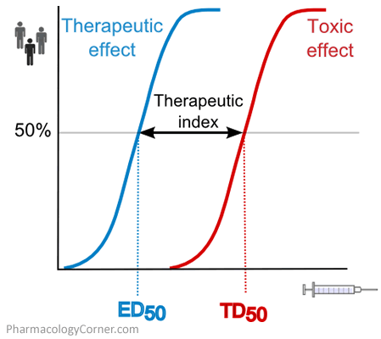
THERAPEUTIC INDEX

Slide 25
Therapeutic Index
The larger the TI the safer is the drug
For safe therapeutic application of a compound, its TI must be more than one.
Penicillin and sulphonamides have high Therapeutic indices.
Digitalis preparations have much smaller Therapeutic indices.

Slide 26
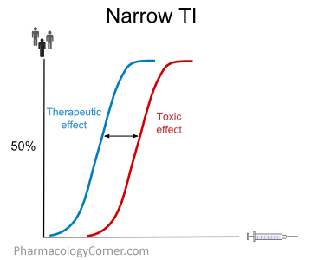
Narrow therapeutic index drugs
The list below shows some examples of narrow therapeutic index drugs:
Warfarin
Lithium
Digoxin
Phenytoin
Gentamycin
Amphotericin B
5-fluorouracil

Slide 27
The end.
Thanks.

