Slide 1
BACILLUS

Slide 2
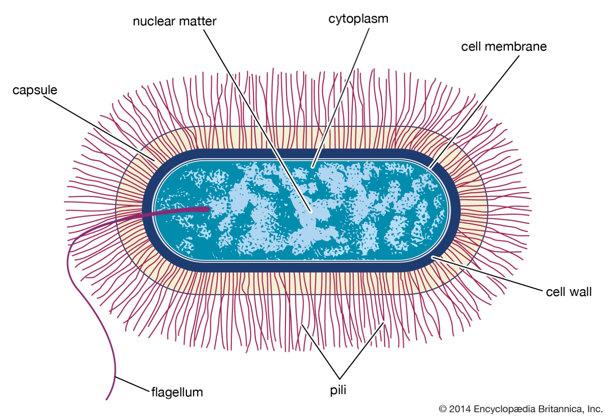
Structure

Slide 3
A tad history
In 1877 German botanist Ferdinand Cohn provided an authoritative description of two different forms of hay bacillus (now known as Bacillus subtilis): one that could be killed upon exposure to heat and one that was resistant to heat.
He called the heat-resistant forms “spores” (endospores) and discovered that these dormant forms could be converted to a vegetative, or actively growing, state.

Slide 4
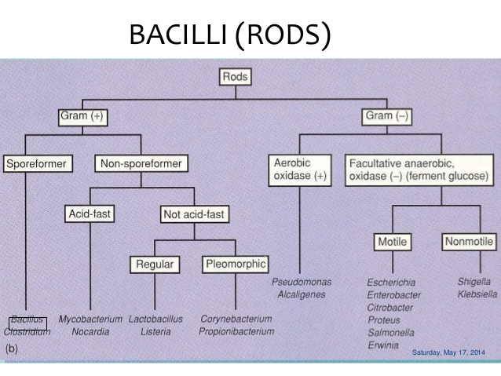
Classification of Bacillus

Slide 5
Spore-forming Bacilli
Genus Bacillus
Genus Clostridium

Slide 6
Medically Important Gram-Positive Bacilli
Three general groups: (import)
  Endospore-formers
    Bacillus, Clostridium
  Non-endospore-formers
    Listeria, Erysipelothrix
  Irregular shaped and staining properties
    Corynebacterium, Proprionibacterium, Mycobacterium, Actinomyces, Nocardia

Slide 7
Clostridium (c. tetanii)
Tetanus and Clostridium Tetani
Clinical Manifestations
Tetanus is characterized by twitching of muscles around a wound, pain in neck and jaw muscles (trismus), and around the wound. Patients have no fever, but sweat profusely and exhibit muscle rigidity and spasms.

Slide 8
Structure of c. tetanii
These organisms are bacilli with terminal spores.

Slide 9
Classification and Antigenic Types of tetanii
C tetani is the only species. There are no serotypes.

Slide 10
pathogenesis
Pathogenesis
The infection is initiated as a result of contamination of a wound with C tetani. The anaerobic tissue environment facilitates C tetani replication and secretion of exotoxins. A spasmogenic toxin, tetanospasmin, fixes to inhibitory neurons and blocks the release of neurotransmitters.

Slide 11
Diagnosis
Diagnosis is primarily by the clinical symptoms (above). The wound may not be obvious. Furthermore, C tetani is recovered from only one-third of all implicated wounds.

Slide 12
control
The administration of tetanus toxoid is a preventive measure. C tetani infection is treated with antimicrobial agents (metronidazole or penicillin) and by local wound debridement. Other measures include tetanus immunoglobulin and supportive therapy.

Slide 13
Bacillus, (genus Bacillus), any of a group of rod-shaped, gram-positive, aerobic or (under some conditions) anaerobic bacteria widely found in soil and water.
The term bacillus has been applied in a general sense to all cylindrical or rodlike bacteria.

Slide 14
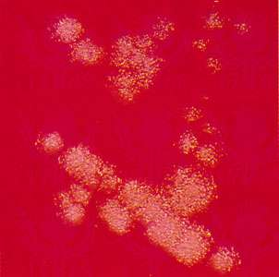
A Bacillus subtilis bacterial colony

Slide 15
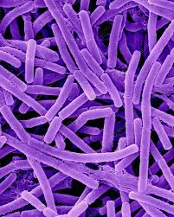
Bacillus anthracis

Slide 16
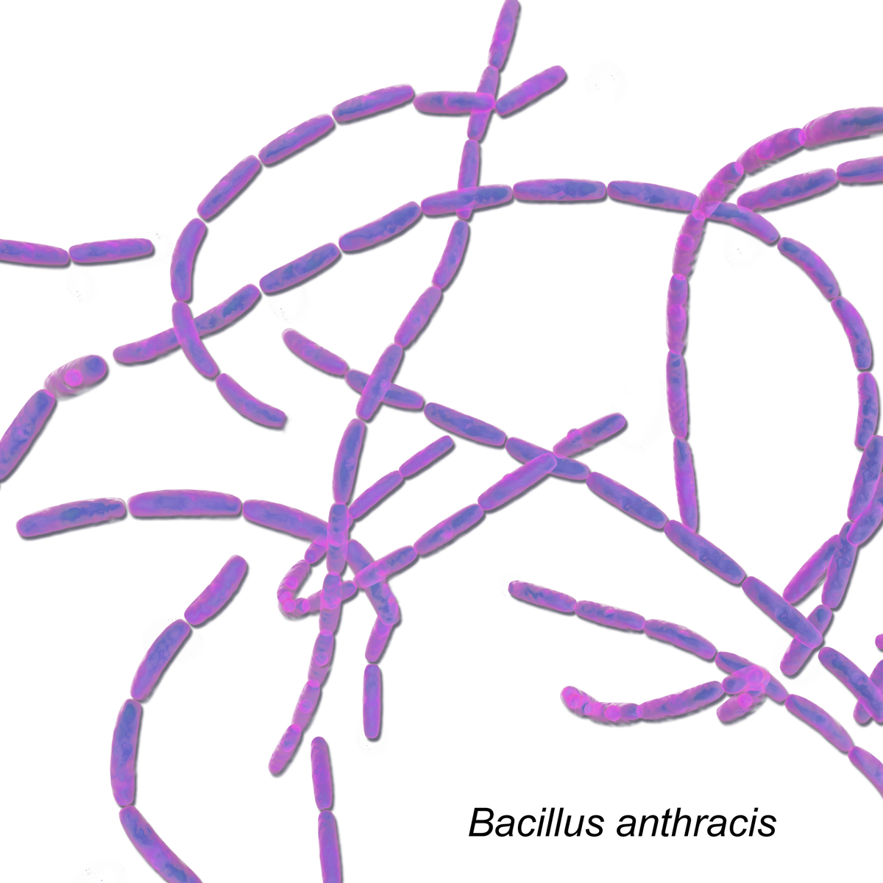

Slide 17
Characteristics of bacilli
Strictly aerobic
facultatively anaerobic
Spore-forming
medium-to-large rods
Most motile
many Gram variable
Major pathogen is B. anthracis

Slide 18
Diagnosis of bacilli
Laboratory identification of Bacillus spp includes certain biochemical and physiological properties.
Ability to grow anaerobically
Growth at temperatures above 50°C
Growth in 7% sodium chloride
Motility
Catalase production (Catalase is a very common enzyme that is present in almost all organisms that are exposed to oxygen. The purpose of catalase in living cells is to protect them from oxidative damage, which can occur when cells or other molecules in the body come into contact with oxidative compounds.)

Slide 19
Bacilli of clinical importance
There are around 260 species of the genus Bacillus, prevalent worldwide showing both molecular and physiological diversity. Among this group of bacteria, there are certain members responsible for accidental and opportunistic human infections !! Eg Bacillus anthracis

Slide 20
Importance of bacilli
Bacillus spp are widely recognized for their utility as biological controls in clinical microbiology laboratories where the spores of Bacillus stearothermophilus are used to determine the efficacy of sterilization by autoclave and hot air oven.
There are a few antibiotics which are extracted from Bacillus spp eg Bacitracin

Slide 21
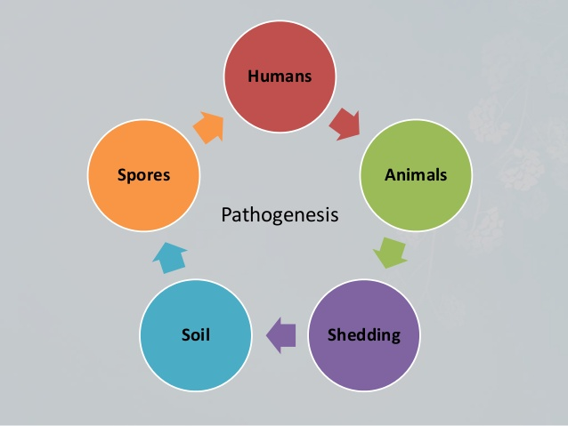
Bacilli transmission cycle

Slide 22
End of 1

