Slide 1






Neonatal Feeds and Fluids Management
Notes:
Prevent hypoglycemia and appropriate weight gain

Slide 2
Objectives
Introduction
Describe feeding regimes for the stable and unstable newborns
Describe the breast milk expression and use of cup feeding and nasal gastric feeding
Discuss gastric residual monitoring
Describe monitoring of newborn feeds and fluids

Slide 3
Introduction
Notes:
Ask how do we feed a newly born?

Slide 4
Modes of Feeding
Introduction
Before feeding any baby determine;
Safety/Risk
If the baby is stable or unstable
Measurement – Correct volume
Frequency – How often
Hunger ques
Breast feed
Cup feeding
NG Tube feeding
Intravenous Fluids
Notes:
Inverted triangle
Before feeding ask yourself 3 questions:
1.Ability to breast feed
2. Is the baby stable or unstable: Characteristics of an unstable baby
3. Weight of the baby
Discuss this in the next slides

Slide 5
Neonatal Feeding Recommendations
Introduction
Can breastfeed?
Yes
Breastfeed
No
Is newborn stable?
Yes
Expressed Breast Milk
No
Day 1: 10% Dextrose
Day 2 : Start EBM(30mls/kg/day), reduce IVF
Characteristics of unstable newborns
Convulsions, Unconscious, Severe respiratory distress evidenced by severe drawing, Absent bowel sounds
EBM/Fluid volume on Day 1 of life based on weight:
Less than 1500gms - 80mls/kg/day
More than or Equal to 1500gms – 60mls/kg/day
Notes:
Three considerations to ask
1, Ability to breastfeed ?
2. Is the baby stable ? If stable and cannot breastfed then NGT EBM; if unstable IVF
3. If EBM or IVF – volume to be based on weight
All unstable infants start on IVF only on day I
If a baby doesn’t have these characteristics of unstable new born does not need IVF ,IVF not substitute to breastmilk
How did we arrive at 80mls/kg/d- neonates less than 1500g have increased body S.A to weight ratio thus have more insensible water loss

Slide 6
Effects of Early Vs Delayed feeds on GIT
Early Vs Delayed Feeding
Early Feeding
Enhanced GIT absorption
Stimulates vital processes
Improves digestive tolerance
Enhances Growth
Early discharge
Reduced risk for NEC
Delayed Feeding
GIT mucosal atrophy
Reduced intestinal size
Slow maturation of GIT enzymes
Bacterial overgrowth
Inadequate growth
Risks of prolonged IV’s
Risks of long hospital stay
24-48hrs
We do not have iv nutrition –
10% dextrose has < 50% the calories of EBM
Breastfeeding, A Guide for the Medical Profession, 8th EDITION by Ruth A. Lawrence & Robert M. Lawrence & Jochum F, et al., ESPGHAN/ESPEN/ESPR guidelines on pediatric parenteral nutrition: Fluid and electrolytes, Clinical Nutrition (2018) & Journal of Pediatric Gastroenterology and Nutrition 38:237–238 © March 2004 Lippincott Williams & Wilkins, Inc., Philadelphia
Notes:
Qn 1 Ability to breastfeed
When should a newly born be feed?
Recommended immediately
Delayed feeding after 48hrs of birth
Some benefits of breast milk include components preventing infection and inflammation and encouraging good microbio growth(e.g.IgA, lactoferrin),

Slide 7
What are trophic feeds?
Small volume, hypo-caloric feeding for gut priming or minimal enteral feeding to acclimate the immature gut of enteral fasting preterm neonates.
Expressed breast milk. NEVER FORMULA
1–2 mL/kg/dose or 10-15ml/kg/day
Early trophic feeds are given within 24 hours of birth.
The volume is not subtracted from the total daily intake
Benefits:
  More energy intake, improved feeding tolerance, greater and faster weight gain and head growth, less sepsis, significantly fewer days of parenteral nutrition and oxygen supplementation, and consequently earlier discharge.
Kebede DA, Tafere Y, Eshete T, Abebaw E, Adimasu M, Endalew B (2022) The time to initiate trophic feeding and its predictors among preterm neonate admitted to neonatal intensive care unit, Multicenter study, Northwest Ethiopia. PLoS ONE 17(8): e0272571. https://doi.org/10.1371/journal.pone.0272571
Notes:
Concept of trophic feed on D1.
Remember the benefits of early enteral feeding?
In the NBU you’ll notice the clinicians and nurses talking to mother and encouraging them to express breastmilk and the little expressed is just applied on the lips or fed via NGT

Slide 8
Feeding regimes for the Stable Newborn
Notes:
How do we feed a stable newborn?
Breastfeeding
Cup
NGT

Slide 9
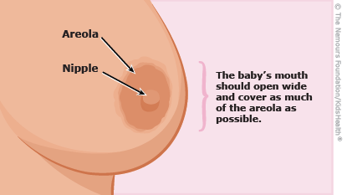
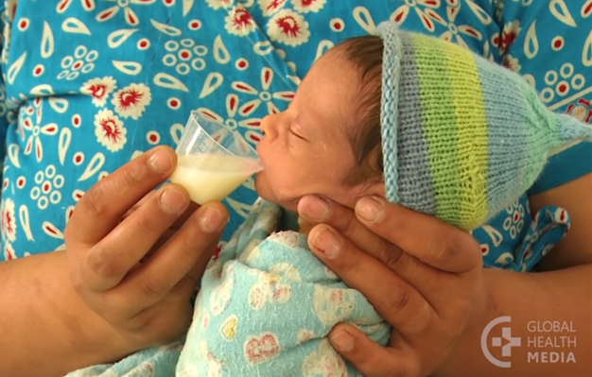
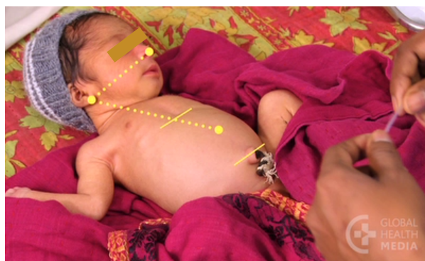
Feeding the Stable newborn
Feeding Regimes – Stable Newborn
>1500 grams
<1500 grams
Notes:
>1500g have a swallow reflex is well developed
Called a nasogastric tube because its from the nose to tragus and the tragus to midpoint xiphisternum to umbilicus

Slide 10
Feeding the Stable newborn
Which Feed?
Best Option: Breast Milk
  Colostrum – low fat, high protein and minerals.
  Breast milk lowers the risk of Necrotizing enterocolitis (NEC) – whenever possible fresh breast milk
2nd option: Donor milk if available
3rd option: Preterm formula milk
If full oral feeds not possible use parenteral feeds
Not recommended: Oral glucose solutions (can cause diarrhea) or cow’s milk (low nutritional value)
Notes:
Colostrum was designed as first feeding food for babies – if god wanted babies to have 10% dextrose that is what breasts would produce!
10% dextrose has less than half the energy of breast milk volume for volume but giving oral glucose to babies may suppress their appetite and stop them sucking – preventing breast feeding being established early.
Glucose powders mixed with water may have very high concentrations of glucose that can cause diarrhoea and rebound hypoglycaemia and they are usually made with water that is not sterile.
Fewer than 30% of mothers breast feed exclusively until 6 weeks of age yet it is likely that exclusive breast feeding alone would save 1.3 million newborn lives a year (see Darmstadt, 2005a).
Health workers should not be promoting glucose drinks for newborn babies – get them breast feeding.
Limited glucose infusion rates to what is required to maintain normal blood glucose.
The rate of glucose production by the neonate’s liver during fasting, which is defined as 3 to 4 hours after birth without feeding or 8 to 9 hours after last feed, is estimated to be 4 to 6 mg/kg/min. This is higher than the adult rate of 2 mg/kg/min because of the higher metabolic rate and brain body weight ratio. The preterm may require additional 2-3 mg/kg/min and sick neonates require even slightly more. The maximal oxidative capacity in the neonate is 12mg/kg/day so the rate of infusion should not exceed that. 10% dextrose administered at 100mls/kg/day is estimated to provide approximately 7mg/kg/min of glucose (10,000/24hr/60min). The rate and/or concentration can be reduced in the setting of hyperglycemia. Glucose restriction can however result in catabolism and growth restriction so if hyperglycemia persists and enteral feeds are contraindicated insulin therapy should be initiated alongside the dextrose infusion

Slide 11

Stable Neonate
Stable Neonate
Birthweight less than 1500grams
Notes:
What was the other qn?
Weight of the newborn
80mls/kg/d because increase body S.A to weight ratio thus have more insensible water loss

Slide 12
Calculating Feed Volume
Stable Neonate
Stable newborn birth weight – 1.3kg
Day | Total fluid required/day | Three hourly feeds
Day 1 | 80 X 1.3 = 104ml | 13
Day 2 | 100 X 1.3 = 130ml | 16
Day 3 | 120 X 1.3 = 156ml | 20
Day 4 | 140 X 1.3 = 182ml | 23
Day 5 | 160 X1.3 = 208 ml | 26
Start at 80ml/kg/day volume of feeds. Increase by 20ml/kg/day to full feeds (150ml/kg); maximum 180ml/kg/day
Notes:
Calculate for D1 And D4
The goal for nutrition of the preterm infant should be to achieve a postnatal growth rate approximating that of the normal fetus of the same gestational age.
Emphasize that increase by 30mls/kg of EBM per day while retaining the total daily requirement
Max IVF is 150ml/kg
Max EBM is 180mls/kg/d

Slide 13
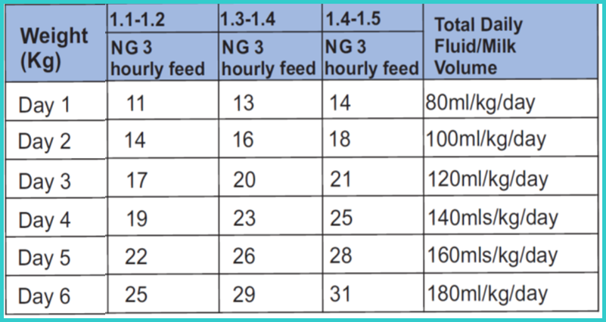
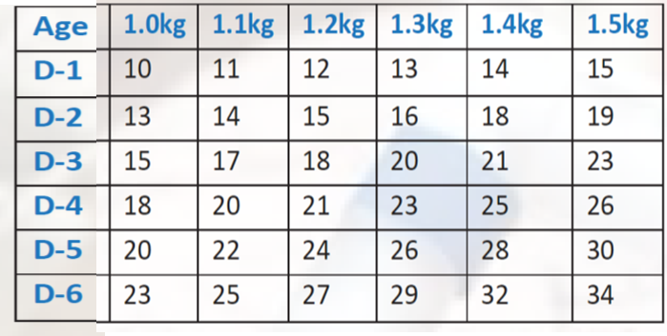
Feeding of the Stable Newborn
Stable Neonate
Notes:
BPP page 61
Comprehensive Newborn 21

Slide 14
Feeding regimes for the Unstable Newborn
Notes:
Characteristics of unstable newborn:
Convulsions
Unconciousness
Severe respiratory distress evidenced by severe LCWI
Absent bowel sounds

Slide 15
Increasing EBM - Unstable Newborns < 1500grams
Unstable Neonate
Day | Feed/Fluid | Weight <1500grams
Day 1 | 10% D Trophic feeds | 80ml/kg/day
Day 2 | EBM 30ml/kg/day | 30mls/kg/day ( ÷ into 3hrly feeds)
 | IVF | 100ml/kg – 30mls/kg = IVF volume
Day 3 | EBM 60ml/kg/day | 60mls/kg/day ( ÷ into 3hrly feeds)
 | IVF | 120ml/kg – 60mls/kg = IVF volume
Increase daily total fluid requirement by 20mls/kg/day until maximum
On Day 2 start EBM at 30ml/kg/day then increase by 30ml/kg/day until maximum
Withhold oral feeds if abdominal obstruction or ileus is suspected
Notes:
Emphasize that increase by 30mls of EBM per day while retaining the total daily requirement
Max IVF is 150ml/kg
Example with 1.3 kg

Slide 16
Calculating Feed Volume
Unstable Neonate
Unstable newborn birth weight – 1.3kg
Day | Total fluid required/day | 3 Hourly EBM Feeds | 1 Hourly IVF
Day 1 | 80 X 1.3 = 104mls |  | 4.3mls
Day 2 | 100 X 1.3 = 130mls | 4.9mls | 3.7mls
Day 3 | 120 X 1.3 = 156mls | 10mls | 3.3mls
Day 4 | 140 X 1.3 = 182mls | 14.6mls | 2.7mls
Day 5 | 150 X1.3 = 195 mls | 19.5mls | 1.6mls
Start at 80ml/kg/day volume of feeds. Increase by 20ml/kg/day to full feeds (180ml/kg/day if on enteral feeds and 150mls/kg/day if on IVF)
Notes:
D1 and D4
The goal for nutrition of the preterm infant should be to achieve a postnatal growth rate approximating that of the normal fetus of the same gestational age.
Emphasize that increase by 30mls of EBM per day while retaining the total daily requirement
Max IVF is 150ml/kg
Max EBM is 200ml-240/kg/day
Aspirates feedback
Some EVLBW may not tolerate 180ml/kg/day – individualize the max feeds.
Reaching full feeds within a week is achievable—in an RCT on VLBWI, the median time to reach 170 mL/kg/day was 7 days after fast advancement of enteral feeding, with no increase in apneas, feed interruptions, and intolerance

Slide 17
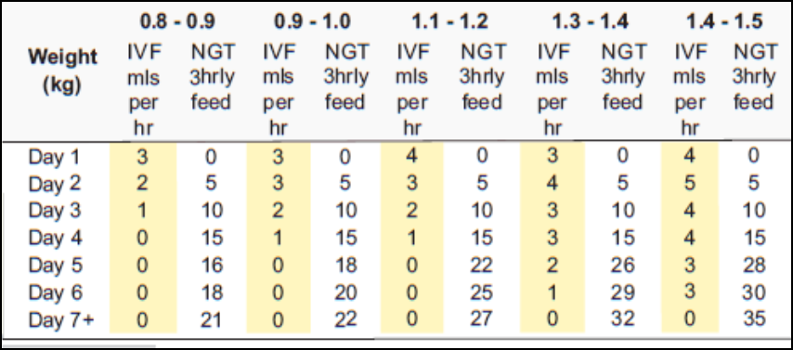
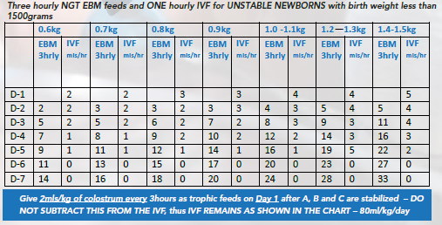
Feeding the Unstable Newborn
Unstable Neonate
Notes:
BPP page 62
Comprehensive page 23

Slide 18
Increasing EBM - Unstable Newborns > 1500grams
Unstable Neonate
Day | Feed/Fluid | Weight ≥1500grams
Day 1 | 10% D Trophic feeds | 60ml/kg/day
Day 2 | EBM 30ml/kg/day | 30mls/kg/day ( ÷ into 3hrly feeds)
 | IVF | 80ml/kg – 30mls/kg = IVF volume
Day 3 | EBM 60ml/kg/day | 60mls/kg/day ( ÷ into 3hrly feeds)
 | IVF | 100ml/kg – 60mls/kg = IVF volume
Increase daily total fluid requirement by 20mls/kg/day until maximum
On Day 2 start EBM at 30ml/kg/day then increase by 30ml/kg/day until maximum
Withhold oral feeds if abdominal obstruction or ileus is suspected

Slide 19
Class Exercise
Feeding Regimes
Outline the one week feeding plan for a;
Stable newly born whose birth weight is 1.4kg
Newly born with severe birth asphyxia. Birth weight 1.8kg
Newly born with severe chest wall indrawing. Birth weight 1.2kg
Stable newly born whose birth weight is 1.6kg and not able to breastfeed
Notes:
This is an exercise I would like people to pass through - I will break you into small groups and we go through this.
Please calculate these so that you have answers you have 5 minutes
Qn1- what 3 qns to ask,Stable-Can they breast feed,No-Cup or NGT so NGT <1400g D1 1.4*80=112mls=14mls D2 18mls BPP page 61
Qn2 stable-Severe BA=Multiple convulsions.D1 IVF 60mls/kg*1.8=108mls/24mls=4.5mls/hr,D2 TDF=80mls/kg EBM=30mls/kg *1.8mls=54mls/8=6.75mls=7mls. IVF 80-30mls=50*1.8=90mls/24=3.75mls/hr=4mls BPP pg 60
Qn 3-Stable or unstable=Unstable Bwt=<1.5kgs=80mls/kg/d D1=80*1.2=96/24=4mls/hr D2
Qn 4= Stable or Unstable/=Stable breastfeed or not.They cant breastfeed but which other mode of feeding is cup.This newborn feed according t the hunger ques.
Engage the class on the effect of missing an oral feed eg because mum late to express milk – not allowed in the NBU
Also effect of line tissuing – fixed in the morning – baby receives no IVF fluid for 6hours
For baby number 4, feed on demand via cup based on hunger cues

Slide 20
Expressing Breast Milk
Notes:
Who to feed?How to feed?
Remember the triangle-best is the Bf
Now we need to know how to express the breast milk
introductory look at the anatomy
Hormones for lactation

Slide 21
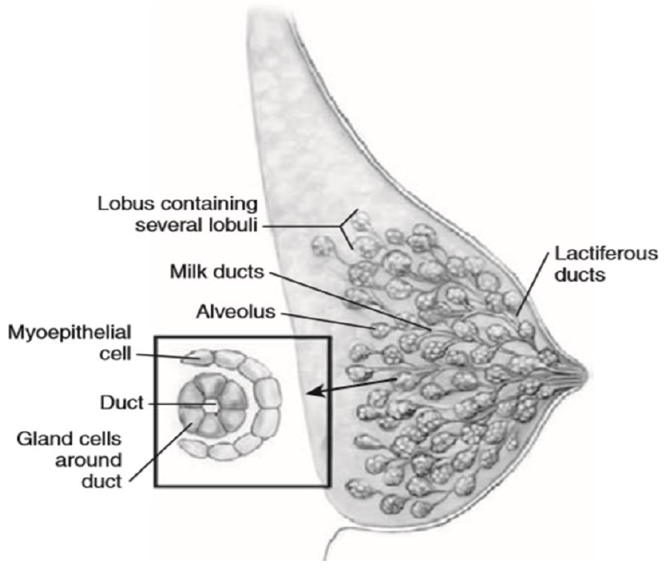
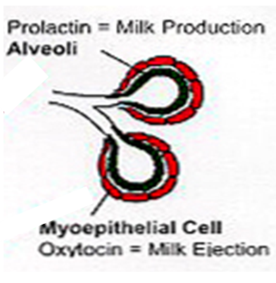
The Lactating Breast
Anatomy of the lactating breast
Temporary Milk Containers
Notes:
The lobules are drained by a lactiferous duct. Lactiferous ducts converge towards the nipple and open on it. Each duct has a dilation near its termination– ampullae- that serves as temporary milk containers.
Oxytocin makes the myoepithelial cells around the alveoli contract.
Each nipple contains 15 to 25 lactiferous ducts end as small orifices near the tip of the nipple
Significant elevations of maternal oxytocin levels occur at 15, 30 and 45 minutes after delivery when the baby is put skin to skin
These timings correspond with placenta expulsion and the baby’s initial reactive phase (alert, active, explorative, sucking reflex strongest)
Levels return to normal after 60 minutes if the baby is put on the breast
This is why the first 1 hour of birth is crucial

Slide 22

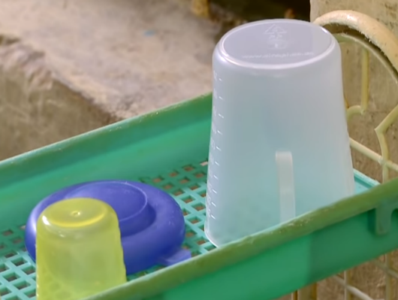

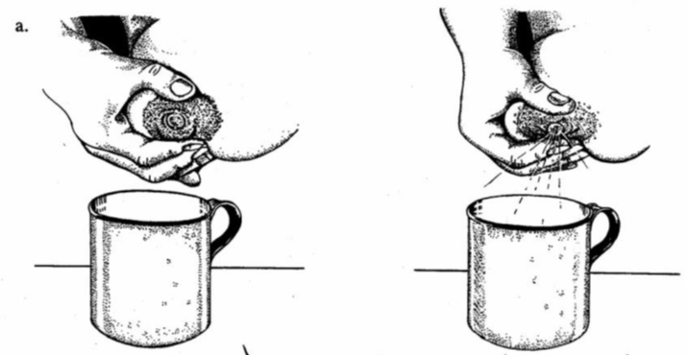
Hand expression of breastmilk
Breast Milk expression
Hold the breast using ‘C grip’
Push breast back towards the chest wall
Press the thumb and the supporting fingers together and then release.
Repeat this step until breast is empty by rotating to all areas of the breast.
Notes:
Steps to Expression;
Step 1 – Wash hands with soap and running water. Air dry or dry with disposable towel
Step 2 – Prepare a container that is clean and has a wide rounded opening. Also prepare the containers you will store the milk in so when you are done you immediately keep the milk safe waiting for use.
Step 3 - The mum should relax. She can look at her baby as sight can stimulate milk. She can also smell baby’s clothes. Stimulating her breast by massage can also help.
Step 4 – Mum should hold breast the breast with the thumb two fingers away from the top areola and the rest of the fingers supporting the lower part of the breast. She should use the other hand to hold the container she will use to collect the milk
Step 5 – Mum should lift the breast and push it backwards on to the chest wall
Step 6 - Mum should bring the thumb toward the areolar, compressing the areolar between the thumb and supporting fingers. and release. Repeat this until the breast is soft meaning its fully emptied by rotating to all areas of the breast. Hold the cup securely.
This compression and pressure stimulate milking action
Avoid rubbing or sliding her fingers along the skin; , it is the thumb only that moves towards the areolar.
Avoid squeezing or pinching the nipple itself.

Slide 23
Expression Demonstration
Notes:
Demo
Then read in the compressive protocol
Then next slide in summary

Slide 24
Using Expressed Breast Milk (EBM) - Cup & Nasogastric tube Feeding
Notes:
Now have EBM how do you give it?
Remember baby >1.5kg stable,exercise 1.6 kgs not feed 3 hourly but according to feeding cues

Slide 25
Hunger Cues
Hunger Cues
Early stage of readiness to feed
Mid stage of readiness to feed
Late stage of readiness to feed
Wiggling
Moving arms or legs
Rooting
Fingers to mouth
Fussing
Squeaky noises
Restless
Crying intermittently
Full cry
Aversive screaming pitch
Color turns red
Do Not wait for crying to feed!
Feed as soon as early cues are present!
Notes:
Remember in the exercise the 1.6kg stable newly born,nt feed 3 hourly but according to the hunger cues
Do you know any hunger ques?
Remember when you were small and wanted a pen?remember throwing tantrums

Slide 26

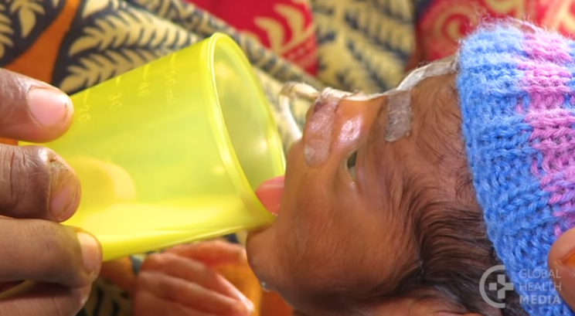


Cup Feeding Technique
Using Expressed Breast Milk
Observe for hunger cues
Prepare and put appropriate volume of milk in a cup
Sit the baby at 90⁰ supporting the baby’s head, neck and back.
Place the cup on the lower lip and tilt the cup so the milk reaches the baby lips
Let the baby lick the milk using the tongue
Continue tilting the cup as the baby continues to lick the milk.
When baby has taken enough, he will start closing his mouth and even fall asleep
Do not feed baby when lying down
Do not pour milk into the mouth
Do not feed a sleeping baby
Notes:
Cup feeding can be used for babies who are able to swallow but cannot (yet) suckle well enough to feed themselves fully from the breast due to poor attachment.
Mother should maintain hand hygiene before feeding the baby.
3. Using a Cgrip ear to ear
Cup on the lower lip and baby licks the milk
Let the baby rest and let the cup rest-Don’t remove the cup

Slide 27
Cup Feeding Demonstration

Slide 28
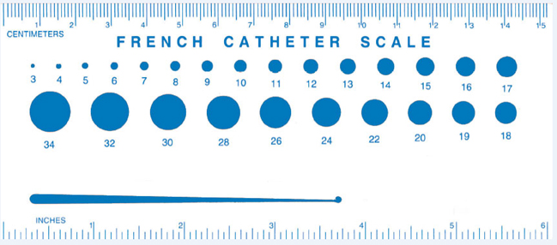
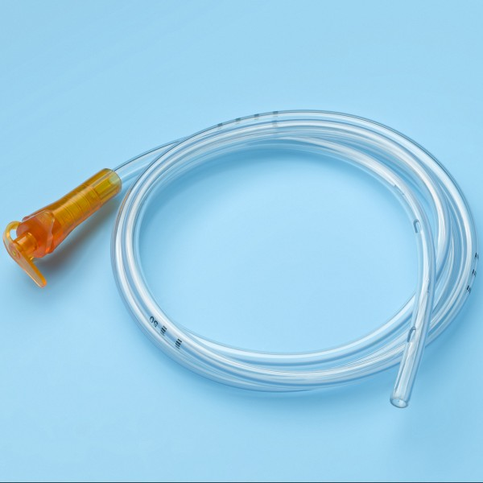


Nasal Gastric Tube Sizes
Inserting a nasal gastric tube
Baby’s Weight | Recommended Size
Less than 1500gm | Fr Gauge 5 - 6
More than or equal to 1500gm | Fr Gauge 6 - 8
SUH 2007 and NICCU Clinical Guidelines 2006
Notes:
Stable but cant breastfeed? Use

Slide 29
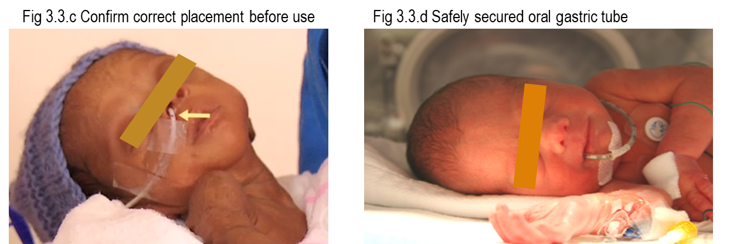
Inserting a nasal/oral gastric tube
Nasal vs Oral Gastric Tube
Nasal gastric tubes (NGT) preferred over Oral gastric tubes (OGT)
Use Oral gastric tubes when the baby has;
Nasal prongs on for CPAP or conventional oxygen therapy
Nasal trauma
Choanal atresia
Cranio-facial anomalies
Notes:
In the newborn unit do we use more nasal gastric or orogastric?
Nasogastric-Correct.Thank you

Slide 30
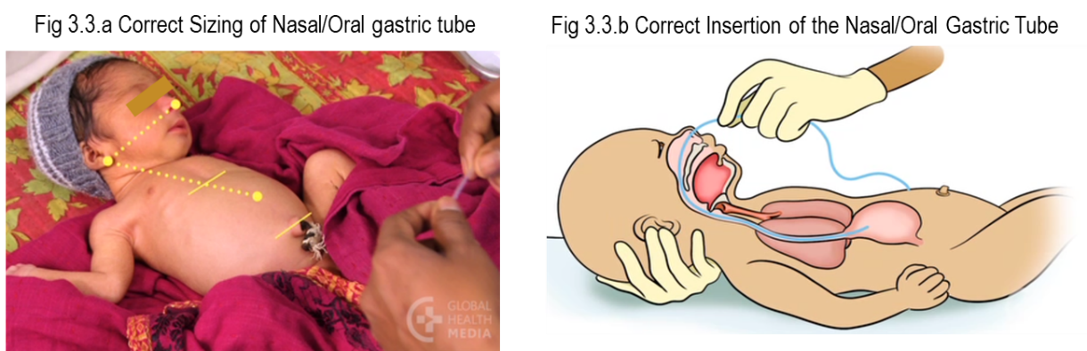
Nasal Gastric Tube Insertion
Inserting a nasal gastric tube
Sizing the NGT
Measure the distance from the side of nose to the tragus, then to the midpoint between xiphisternum (epigastrium) and umbilicus.
Mark the tube at this point
Inserting
Lubricate the tip of the NGT with breast milk
Insert until the measured distance is reached. Ensure the mark is visible
Secure the tube on the cheek using a clear medical adhesive
Notes:
Mother should maintain hand hygiene before feeding the baby.
Reason for tragus not ear lobe is because babies with congenital anomalies like down syndrome have low set ears..

Slide 31
Nasal Gastric Tube Insertion
Inserting a nasal gastric tube
Confirming and Securing position
Aspirate using a 1-2ml syringe and check that the aspirate turns blue litmus paper pink.
If no aspirate is obtained, inject air down the tube and listen for a ‘whoosh’ over the abdomen with a stethoscope
Before feeding always confirm correct tube placement
Notes:
Before feeding always confirm correct tube placement why tubes get displaced and neonates aspirate

Slide 32

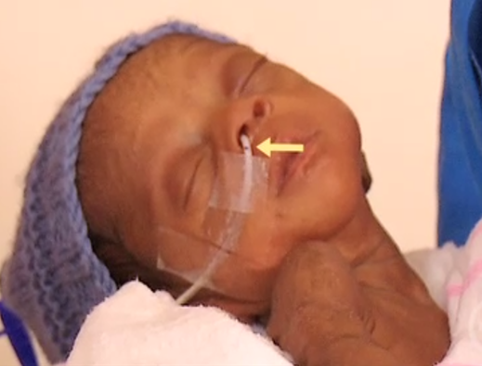

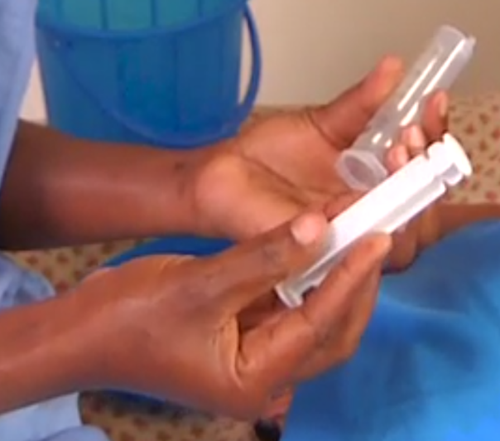
Nasal Gastric Tube Feeding
NGT feeding
a)
b)
Confirm the correct volume to feed
Hand hygiene
c)
d)
e)
Check correct tube placement
Pour volume of EBM needed in a cup
Remove the syringe burrel
Notes:
Preparation to feed using the NG tube
Confirm the correct volume to feed. Adjust the volume if on 10% dextrose or breastfeeding
Observe hand hygiene
Express breast milk/prepare feed
Put baby on the breast to help the baby learn how to breast feeding and increase milk production
Check the correct tube placement mark is visible at the edge of the nose. See a)
Draw volume of milk needed and place in a cup. See b)
Remove the burrel from a 10 – 20 cc syringe. See c)
Hold baby in breastfeeding position and skin to skin

Slide 33


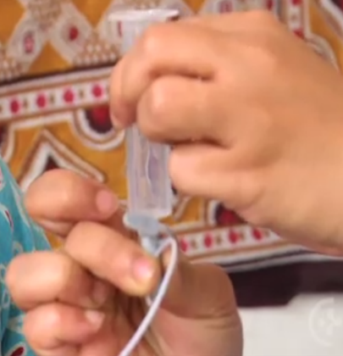
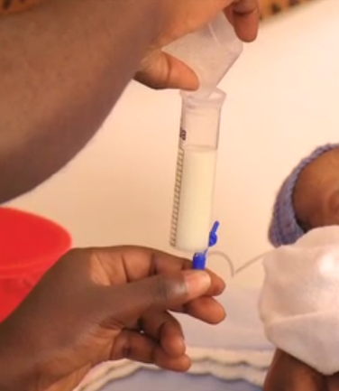


Nasal/Oral Gastric Tube Feeding
NGT feeding
a)
b)
c)
d)
Pinch the tube
Open the end of the tube
Attach the empty syringe
Pour milk into the syringe
e)
f)
Remove the pinch & hold the tube above the baby
Let the milk flow slowly by gravity
Notes:
Let the milk flow slowly for 15minutes

Slide 34
Nasal Gastric Tube Feeding
NGT feeding
Caution
If the milk doesn’t flow using gravity, DO NOT push the milk using a syringe
Always observe the baby for spitting, vomiting and choking
Before NGT feeds, always check if the baby is able to cup feed or breast feed
All containers used for NGT feeding should always be cleaned and air dried after use
Replace the NG tube after 72 hours
Notes:
Replace the NG tube after 72 hours-Remember NGT is a foreign object inserted into the neonate and can be a source of infection

Slide 35
Gastric Aspirates Monitoring

Slide 36
Effects of Gastric Aspiration
Gastric aspirates monitoring
Disadvantages:
Delays time to establish full enteral feeds
Delays time to regain birth weight
Significant increase in the episodes of feed interruption
Significant increase in the number of Total Parenteral Nutrition and its complications
Damages gastric mucosa by negative pressure
NO EFFECTS in incidence of:
Necrotizing Enterocolitis
Invasive infection
Kaur A, et. al. Journal of Paediatric Gastroenterology and Nutrition 2015; 60(2):259-63..
Li YF, et. al. Pediatrics and Neonatology 2014;55(5):335-40
Notes:
Research has shown that there are more disadvantages of gastic monitoring,you know aspirating after before a feed
3.Seen in NBU aspirate then tell mum to skip this feed and feed the next one
4.Keep aspirating neonate maintained NPO then introduced on TPN which have adverse electrolyte imbalance

Slide 37
Recommendations for gastric residual monitoring in preterms
Gastric aspirates monitoring
Do not check for gastric residuals routinely
Only monitor if signs are suggestive of NEC or feeding intolerance
Withhold feeds in case of haemorrhagic residuals, as haemorrhagic residuals are significant.
Vomiting bile may indicate an intestinal obstruction or ileus
Isolated green or yellow residuals are unimportant.
Dutta S, et al. Guidelines for feeding very low birth weight infants. Nutrients. 2015 Jan 8;7(1):423-42
Notes:
Remember;Optimal nutrition improves growth and neurological outcomes, and reduces the incidence of sepsis and possibly even retinopathy of prematurity.

Slide 38
Feeds & Fluids Monitoring

Slide 39
Is the baby getting enough feeds?
Monitoring
Weight monitoring
  Percentage weight loss
  (less than 1 – 2% per day up to 5 days of life)
  Weight gain in grams/kg/day
  (10 -15gms/kg/day)
Number of wet diapers (4 per day after 72 hours)
Notes:
Monitor if baby feeding well by monitoring their weight.
This is done thru:
In our unit we monitor babies every alternate day

Slide 40
Is the baby getting enough feeds?
Monitoring
Weight Loss Calculation (%)
Day 1 = 1.3kg
Day 3 = 1.2kg
= (Day 1 – Day 3)/Day 1 × 100
= (1.3kg – 1.2kg)/1.3kg × 100
= 0.1/1.3 × 100
= 7.7% ( divide by 2 days =3.85% per day)
Weight Gain Calculation (gms/kg/day)
Day 8 – 1.25kg
Day 10 – 1.3kg
= {Day 10(grams) – Day 8(grams)} ÷ Day 10(Kg)
= (1300gms – 1250gm) ÷ 1.3kg
= 38.5gms/kg in 2 days
= 19.2gms/kg/day
Notes:
To calculate weight loss, you get the weight difference divided by the original weight times 100; So, if today is day 3 of life as shown in this example with a weight of 1.2kg and child had a wwight of 1.3kg on day 1 - so the weight difference will be 1.3-1.2 which is 1.1 – this divided by the original wwight which is 1.3 – this times 100. and result gives is 7.7% divided by 2 to get 3.85% so is this patient receiving adequate feeds or not? No because recommended weight loss is less than 1-2%/day
And as for weight gain calculation
You get the weight difference in grams, then divide this by the current weight in kilograms, then divided by the number of days – giving us the weight gain in gms/kg/day. So for this child, to calculate the weight gain from day 8 to day 10 of life, increased from 1.25kg on day 8 to 1.3kg on day 10 of life; the difference in grams is 1300 minus 1250 giving us 50gms, then we divide this by the current weight in kilograms, so 50 divided by 1.3, and this gives us 38.5gms/kg gained in 2 days and to get the gms/kg gained per day we divided this by 2 and we have 19.2gm/kg/day, so is this patient receiving adequate feeds or not? Yes why weigh gain is 10-15g/kg/d

Slide 41
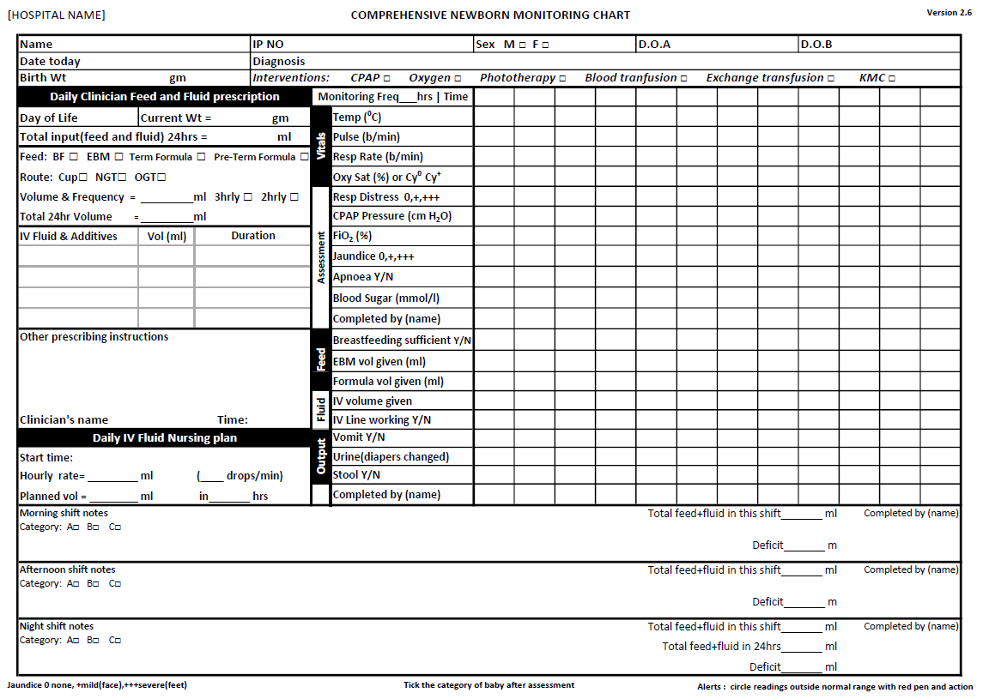

Monitoring Feeds & Fluids
Notes:
How do we monitor feeds and fluids this by using the Comprehensive newborn monitoring chart

Slide 42
Questions
Questions

Slide 43
Summary
Summary
Breastfeeding is the best option
Use the correct volumes of feeds and fluids
Gastric residual monitoring is not recommended
Use the comprehensive newborn monitoring chart to monitor newborn feeds and fluids

