Slide 1
Counselling
For
KRCHN(B)
By
Mr. Njagi

Slide 2
Definition
It is a two-way, face to face communication process in which one person tries to help another to understand a problem and identify a solution to that problem
Counseling is a person-to-person interaction in which the counselor provides adequate information to enable the client to make an informed choice about the course of action that is best for him/her.

Slide 3
Why do people need counseling?
Help them understand the problems they are experiencing
Give them information they are lacking to solve problems
Assist them to understand alternative approaches to solving the problems facing them

Slide 4
Cont
Help them to explore the problems and clarify conflicting issues
Assist them to adjust to the problem or find better ways of coping/living with the problem
NB
Counseling is one of the most important tasks of a nurse; You counsel your patients/clients, relatives and even colleagues

Slide 5
NB
Counseling can be described as formal or informal
Formal ;
Done by professionals trained in counseling e.g. professional counselors, psychologists and psychiatrists
Informal;
Provided by people and other professionals not trained in counseling e.g. doctors,nurses,teachers, lawyers and parents

Slide 6
Cont
Whether counseling is done formally or informally, the purpose is to help the individual to understand his problem and find solutions and coping mechanisms

Slide 7
Types of counselling
Individual counselling;
when a counselor is working with only one person e.g. nurse and one patient
Group counseling;
Recommended for people facing the same problem to support each other to change their behavior e.g. people living with Hiv/Aids(PLWHAs),drug addicts.

Slide 8
Examples;
Marital counseling; -The counselor assists the couple to understand their problems and to find solutions
Family counseling; -It focuses on family issues and is conducted when all the family members concerned are present

Slide 9
Cont
Special group counseling; - Any group of people who require counselling to enable them to adjust better in their life
Examples ;HIV/AIDs infected and affected people, terminally ill people, handicapped persons, drug $ substance abusers
NB; Counselling is a supportive relationship

Slide 10
Qualities of a good counselor
Patience; Don’t hurry the client or show impatience, the client feels accepted and is encouraged to open up even more
Warmth; -Smile and show concern and acceptance to the client

Slide 11
Cont
Confidentiality; Keeping all the information given by the client secret
Honesty; -Act of telling the truth to the client. -This makes the client regard you as a dependable and trustworthy counselor

Slide 12
Cont
Empathy; -Ability to imagine oneself in the position of another person, and thus, share and understand that person’s feelings
This allows you give objective responses to assist the client to select the right choices or to make the right decisions

Slide 13
Cont
Observance;
Be observant as you listen to your client talking
Observe facial expression and interpret all the non-verbal communications
Observe mood swings and it’s relevance to the conversation

Slide 14
Active listening
Allow client to express himself/ herself
Concentrate on what client is saying
Allow client to control conversation
Accept client’s opinion as valid for himself/herself

Slide 15
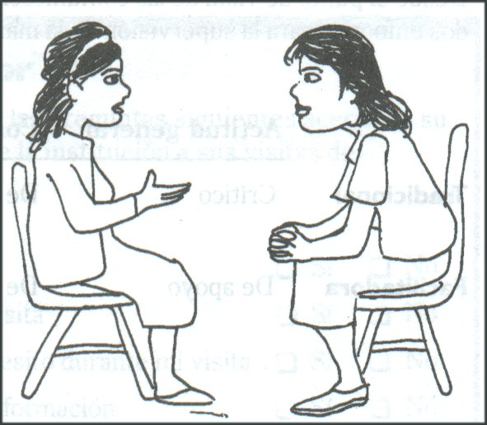
What is Active Listening?
Listening to another person in a way that communicates understanding, empathy and interest
It is different from hearing
Requires energy, skill and commitment
Makes the client feel important, acknowledged and empowered

Slide 16
Active Listening;Don’t;s
Do other things (e.g., look through papers) when the client is talking.
Daydream or get distracted by surrounding events
Interrupt/Finish the clients sentences
Ask questions that change the subject.
Ignore the emotional context.

Slide 17
Positive Body Language
Body language includes:
Body posture
Position of body parts(arms, legs, eyes)
Gestures
Space
Seating
Active listeners use body language to indicate respect, interest and empathy
Body language may have different meanings in different communities or cultures; Any idea?

Slide 18
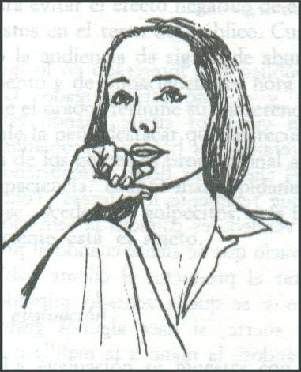
What impressions do these body languages suggest to the client?

Slide 19
What impressions do these body languages suggest to the client?

Slide 20
Cont
Being non- judgmental; -Avoid criticizing the client even if he is wrong
Avoiding Embarrassment; -Hold counseling sessions in a private room -Avoid sensitive probing questions which make the client develop feelings of guilt

Slide 21
Cont
Relevant discussion; -Confine counseling session to the topic -The counselor assists the client to keep to the main points that will help to solve the problem

Slide 22
Cont
Respect of client’s opinion; -The counseling relationship improves when the client becomes aware his views are respected

Slide 23
Process of counselling
Establish a good interpersonal relationship with the client during the interview
This enables the client to voluntarily give information facing him without any fears

Slide 24
Cont
In counseling, interviews are conducted to gather information to help clients to resolve some problems(this interview is called therapeutic interview)
Probing and open -ended questions are recommended for interview because the client’s response is unlimited

Slide 25
Appropriate Questioning Techniques: Examples
Closed questions:
“Did you solve the problem of the stock out of the pill?”
“Did you organize that training course?”
Open-Ended questions
“What has been done about the stock out of pill?”
“How are you going to organize the training course?”

Slide 26
Preparation for interview
Interview should be conducted in a private quiet room
The room should be spacious for both to sit comfortably
The room should have adequate ventilation and furniture(table and chairs)

Slide 27
Cont
Environment should be free from noise and there should be no distracting equipment, pictures on the wall
The room should be clean and tidy and well lit
The counselor and client should sit facing each other

Slide 28
Steps in the counseling process
G ATHER;
Greet the client and welcome him
Ask client about self and the family. Ask the help he require from you
Tell the client what you can/cannot do to resolve the problem. Tell him about your commitment to help solve the problem

Slide 29
Cont
Help the client to formulate course of action and identify resources to resolve the problem
Explain available services and where they are located. Explain the cost of services
Return appointment. Make the next appointment with the client to enable you review his/her progress

Slide 30
Counseling phases
Entry phase
This is the initial contact with the client.
The counselor should communicate effectively
This is the phase which start building a helping relationship(sets the climate for counseling)
It’s to win the client’s confidence of your ability to help

Slide 31
Working phase
Starts when the client is convinced that the counselor can help
The sessions should take about 45-60 minutes
Has 5 stages;
Social stage -setting the climate
Problem exploration Ask for needs/problems

Slide 32
Cont
3) Interacting with the client; Probing more about the problem, how it started, it's progress, and any aggravating factors to the problem(diagnosis)
4) Setting the goals; You agree with the client the number of sessions to hold, the length of each and the number of problems to solve in each and time to report

Slide 33
Cont
5)Closure/terminating the session;
Summarizing the important points discussed during the session
Both agree on the return date
Client is given time to ask questions and clarifications

Slide 34
Termination of counseling
Ending the counseling relationships
It is decided by the counselor when the client shows signs of improvement and ability to solve his problems
Prepare the client to be ready for termination

Slide 35
Techniques of termination
Counselor introduces the idea of termination and encourages the client to rely on self
Both agree to reduce the number of sessions and to complete all pending issues
NB; Encourage gradual termination

Slide 36
Stages of separation
Denial;
Experienced when the client is informed of termination
The client refuses to belief the counselor can really stop the counseling sessions
Convince the client that he is doing well

Slide 37
Cont
Anger;
Encourage the client to continue expressing the feelings and accept termination
Client may even refuse to eat

Slide 38
Cont
Bargaining stage;
The client wishes the counselor could change his mind about termination
Listen his arguments/complaints and emphasize on achievements

Slide 39
Cont
Depression stage;
Occurs when the client realizes the counselor is serious and will definitely terminate the relationship
He has a feeling of hopelessness and despair
May withdraw from friends
May have anorexia and insomnia

Slide 40
Cont
Acceptance;
Results when the client accepts the reality of termination
He starts planning on how to cope without the help of the counselor
He gains confidence that he has the ability to manage his own affairs independently

Slide 41
Barriers to effective Counseling
Age differences E.g. counselor almost the age of the client’s child; youths open up to counselors of the same gender
Language differences
Education levels
Values/beliefs relating to culture/Gender biasness
Lack of privacy/ confidentiality
Inappropriate non verbal behaviors e.g. showing signs of boredom,disgust,disapproval with the client
Judgmental attitude
Religious differences
Interviewing room;noisy,dirty,congested,distracting pictures on the wall

Slide 42
Questions??

