Slide 1
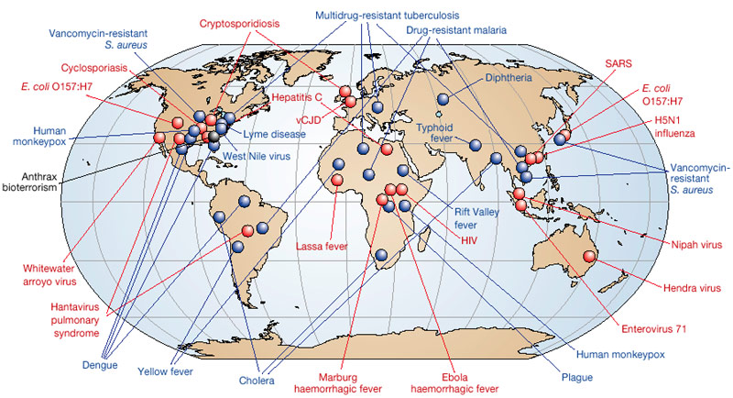
EMERGING AND RE-EMERGING INFECTIOUS DISEASES

Slide 2
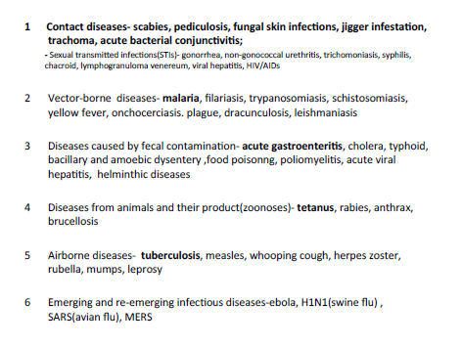
Classification of CD

Slide 3
Definition of terms: Emerging, re-emerging, endemic, pandemic
Emerging: diseases
that have not occurred
in humans before
or that occurred only
in small numbers
in isolated places.
Re-emerging: diseases that once were major health problems globally or in a particular country, and then declined dramatically, but are again becoming health problems for a significant proportion of the population.
Diseases thought to be adequately controlled making a “comeback” are “re-emerging”
Endemic: a long-term problem. Never significantly declining
Eg. pneumonia
Pandemic: (Panic and epidemic) is a global disease outbreak
Notes:
Emerging infectious disease: Newly identified & previously unknown infectious agents that cause public health problems either locally or internationally
Re-emerging infectious disease: Infectious agents that have been known for some time, had fallen to such low levels that they were no longer considered public health problems & are now showing upward trends in incidence or prevalence worldwide

Slide 4
New Diseases - Emerge
Emerging diseases = new infections that arise from changes in existing organisms
or
known infections that spread to new geographic areas or populations
Emerging disease hot spots’
Regions where new emerging infectious diseases are most likely to originate.
Usually tropical – developing countries
Ill equipped to cope

Slide 5
Old Diseases Re-Emerge
1. EVOLUTION OF THE INFECTIOUS AGENT
Mutations in bacterial genes that confer resistance to antibiotics – 20%
Multidrug-resistant & extremely drug-resistant TB
Multi drug resistant P.falciparum
2. REDUCED HUMAN IMMUNITY
Immunization failure (breakdowns in public health measures)➔ a greater proportion of susceptible individuals in a population and an increased reservoir of the infectious agent.
Increased number of immunocompromised hosts - due to the stress of famine, war, or disease

Slide 6
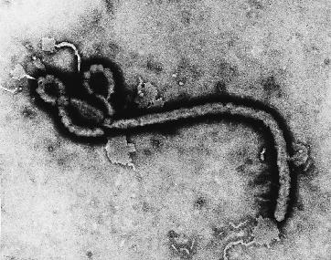
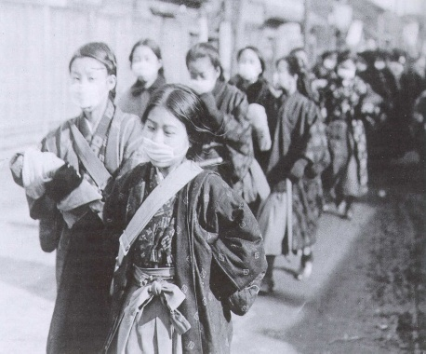
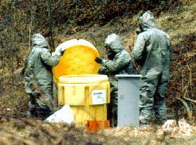
Emerging/epidemic disease
at the beginning of the 21st. Century:
emergence of new or newly recognized pathogens (e.g. Highly Pathogenic Avian Influenza [H5N1], SARS, Nipah, pandemic influenza [H1N1], novel coronavirus ……)
resurgence of well characterized outbreak-prone diseases (e.g. dengue, measles, yellow fever, chickungunya - also cholera, TB, meningitis, shigellosis)
Human-made "bio-risk" also increasing: accidental and deliberate release of infectious agents as smallpox, SARS, Ebola, anthrax, tularaemia, etc.
Notes:
6

Slide 7
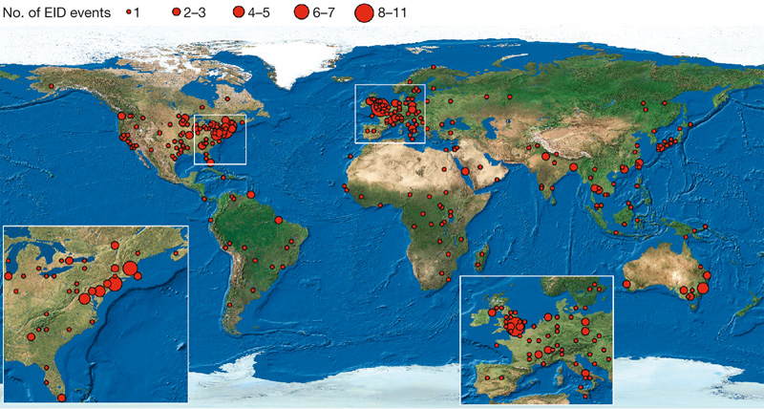
Map of geographic origins of EID events, 1940-2004
(Jones et al, Nature 2008)

Slide 8
FACTORS PREDISPOSING TO EMERGENCE
Introduction of an infection for the first time into the
human population
ZOONOSES
In most cases (60%) that’s an infection that’s already out there in nature – may be a virus that’s naturally infecting some other species.
Ecological changes - puts humans in contact with the virus. Usually due to human activities

Slide 9
Factors Contributing To Emergence
AGENT
Evolution of pathogenic infectious agents
(microbial adaptation & change)
Development of resistance to drugs
Resistance of vectors to pesticides
HOST
Human demographic change (inhabiting new areas)
Human behaviour (sexual & drug use)
Human susceptibility to infection (Immunosuppression)
Poverty & social inequality
ENVIRONMENT
Climate & changing ecosystems
Economic development & Land use (urbanization, deforestation)
Technology & industry (food processing & handling)
International travel & commerce
Breakdown of public health measure (war, unrest, overcrowding)
Deterioration in surveillance systems (lack of political will)

Slide 10
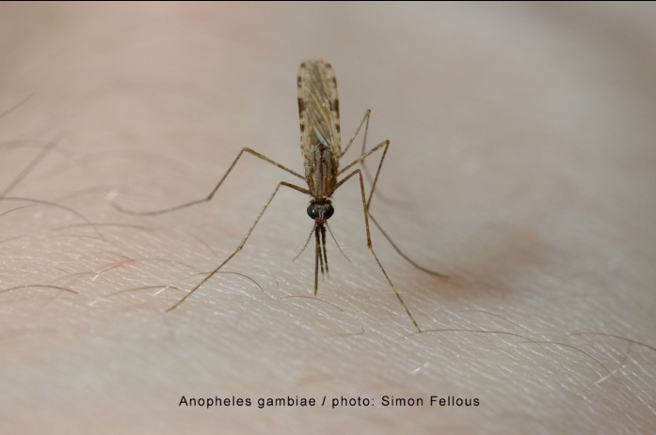
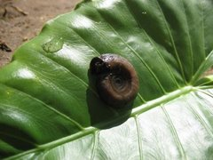
Global Warming
A temperature change of several degrees may make temperate zones more hospitable to vectors of tropical diseases
Malaria, Dengue - mosquitoes
Schistosomiasis – snails
At the same time, tropical areas may become less hospitable to some of the same diseases.

Slide 11
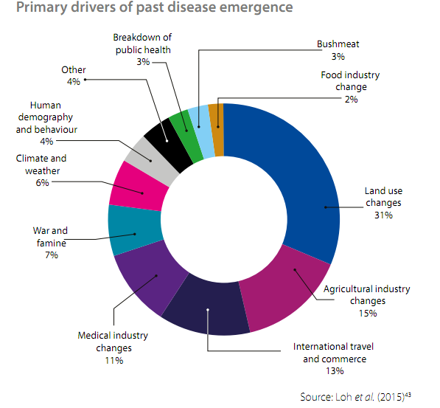

Slide 12
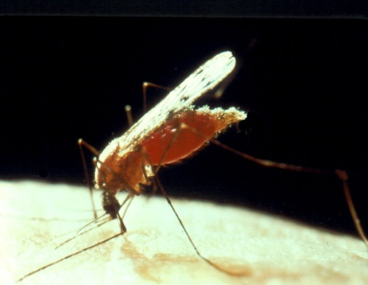
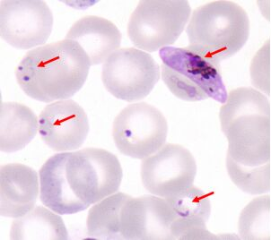
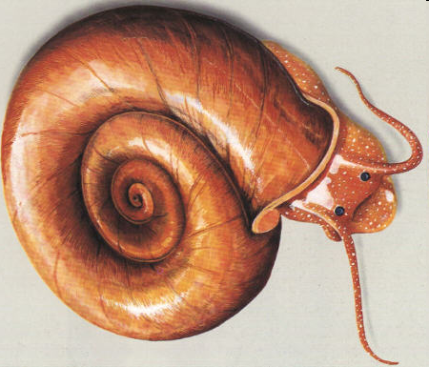
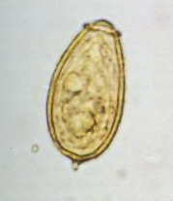
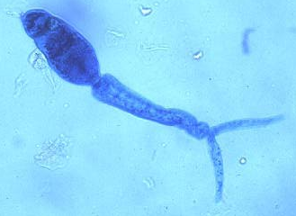
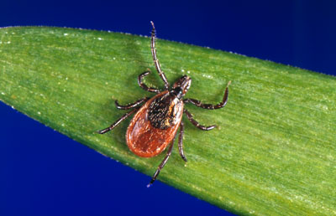
Globally important Emerging &
Re-emerging Infectious Diseases
EMERGING
AIDS
cholera
Ebola hemorrhagic fever
influenza
Legionnaire disease Lyme disease
RE-EMERGING
tuberculosis
malaria
schistosomiasis

Slide 13
Examples of recent emerging diseases
Source: NATURE; Vol 430; July 2004; www.nature.com/nature

Slide 14

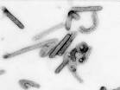

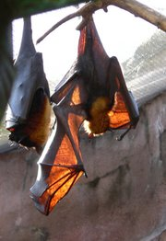
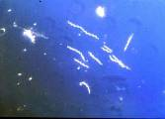


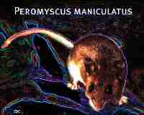
Emerging Zoonoses: Human-animal interface
Avian influenza virus
Bats: Nipah virus
Ebola virus
Marburg virus
Borrelia burgdorferi: Lyme
Deer tick (Ixodes scapularis)
Mostomys rodent: Lassa fever
Hantavirus Pulmonary Syndrome

Slide 15
Emerging infectious diseases
  Avian influenza
  SARS-CoV

Slide 16
AVIAN INFLUENZA(AI)
Highly lethal, contagious viral disease of birds, less commonly - pigs and occasionally - humans.
  In humans: asymptomatic to severe respiratory disease.
Cause
  Influenza A viruses.
    Strains that have caused diseases in humans are of subtypes
      H5N1,
      H7N7,
      H9N2.
      H1N1(Swine flu)

Slide 17
Transmission
Birds to humans:
  Close contact
    handling infected poultry, poultry products
    contaminated surfaces.
Person to person
  Through droplets produced when an infected person coughs, sneezes or talks

Slide 18
Clinical signs and symptoms
Asymptomatic to severe respiratory distress (dyspnoea).
Incubation period 2 – 8 days.
Initial symptoms :
  cough, sore throat, runny nose, high fever (>38 degrees C), muscle aches, headache,
  Rare symptoms: watery diarrhea, abdominal pains and vomiting.
Later (5 days):
  Shortness of breath which progresses into clinical pneumonia
  Acute respiratory distress syndrome due to viral pneumonia that culminates in death.
    Cause of death is progressive respiratory failure.
    Death 9 to 10 days after onset of illness.
CFR over 50 percent

Slide 19
Diagnosis
Clinically
  Acute onset of fever (temp >38 °C) and one or more of the following:
    Cough ; Sore throat; Shortness of breath.
  Plus positive exposure history in the last 7 days prior to onset of illness e.g. contact with birds that later died of an illness
Laboratory
  Samples: nasopharyngeal aspirate, naso-pharyngeal swab, throat swabs, nasal swabs, trans-tracheal aspirate, blood or tissues
    Viral isolation of an avian influenza virus
    A positive PCR result for avian influenza virus

Slide 20
Management
Infection prevention & control measures
  Isolate patient
  Put surgical mask on patient (if tolerated)
  When being in close contact with the patient
    Wear a surgical mask, gloves, gown etc.
    Wash your hands frequently.
  Educate patient and family about risks of transmission.
Supportive measures
  Pulmonary support with oxygen and mechanical ventilation for respiratory failure.
  Antibiotics for secondary bacterial infections.
Antiviral drugs
  Oseltamivir phosphate 75 mg twice x 5days (adults)
  Children: 30 mg twice x 5days (Age 1 year or older as adjusted doses)
Report.

Slide 21
Prevention and Control of Avian Influenza
Infection control measures
  Isolation
  Education
  Use of PPE by health workers
  Hand hygiene
  Chemoprophylaxis (Oseltamivir) for high risk groups

Slide 22
1. Highly Pathogenic Avian Influenza (H5N1)
Started in Nov 2003, avian influenza H5N1 in birds affected 60 countries across Asia, Europe, Middle-East & Africa
>220 million birds killed by AI virus or culled to prevent further spread
Majority of human H5N1 infection due to direct contact with birds infected with virus
Notes:
Avian influenza (“bird flu”) is an infectious disease of birds caused by type A strains of the influenza virus. The infection can cause a wide spectrum of symptoms in birds, ranging from mild illness, which may pass unnoticed, to a rapidly fatal disease that can cause severe epidemics.
Avian influenza viruses do not normally infect humans. However, there have been instances of certain highly pathogenic strains causing severe respiratory disease in humans. In most cases, the people infected had been in close contact with infected poultry or with objects contaminated by their faeces. Nevertheless, there is concern that the virus could mutate to become more easily transmissible between humans, raising the possibility of an influenza pandemic.

Slide 23
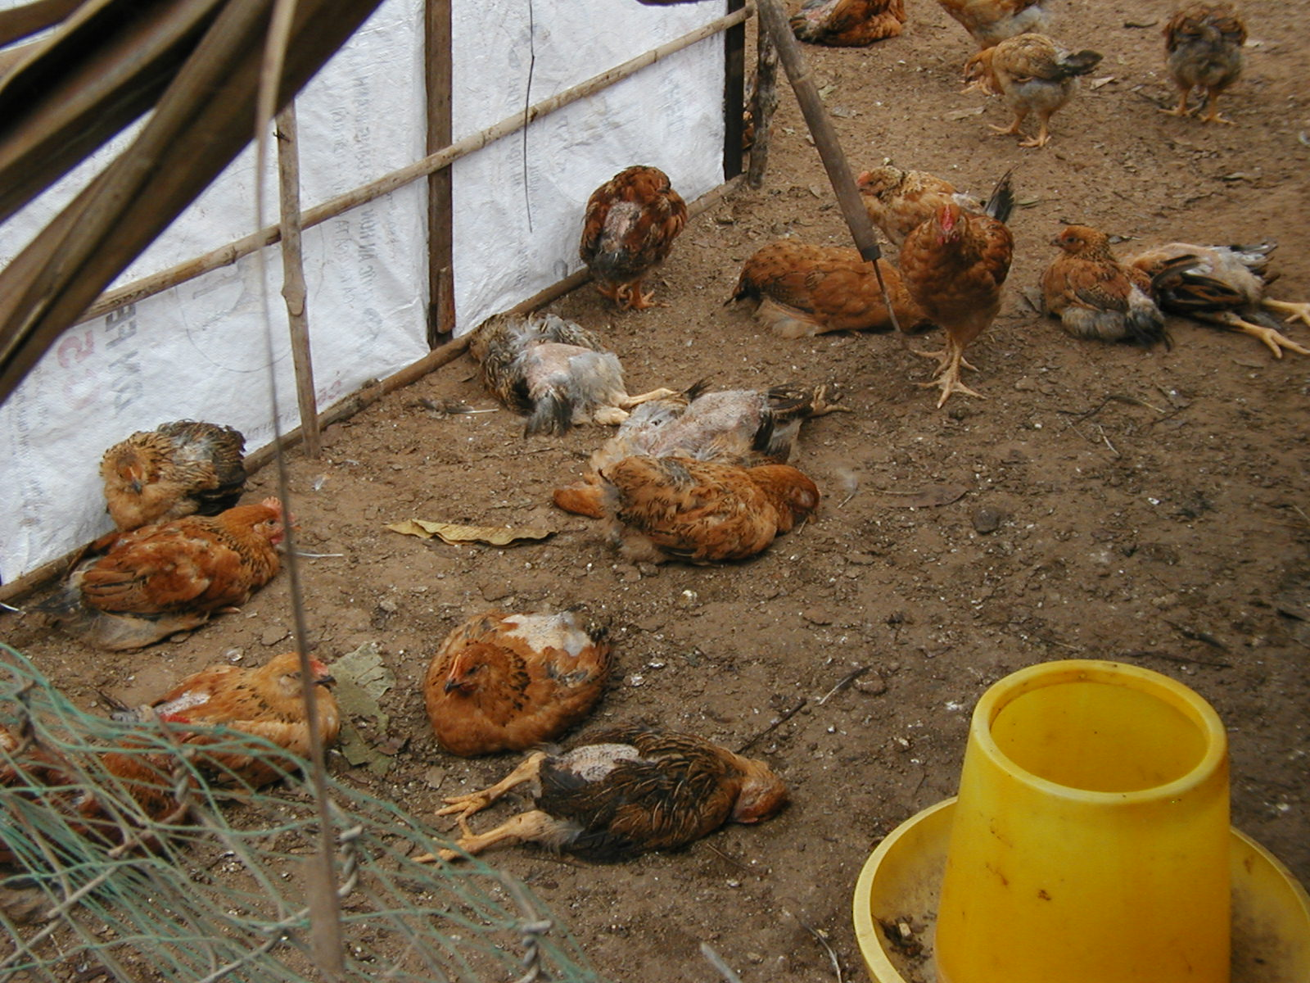
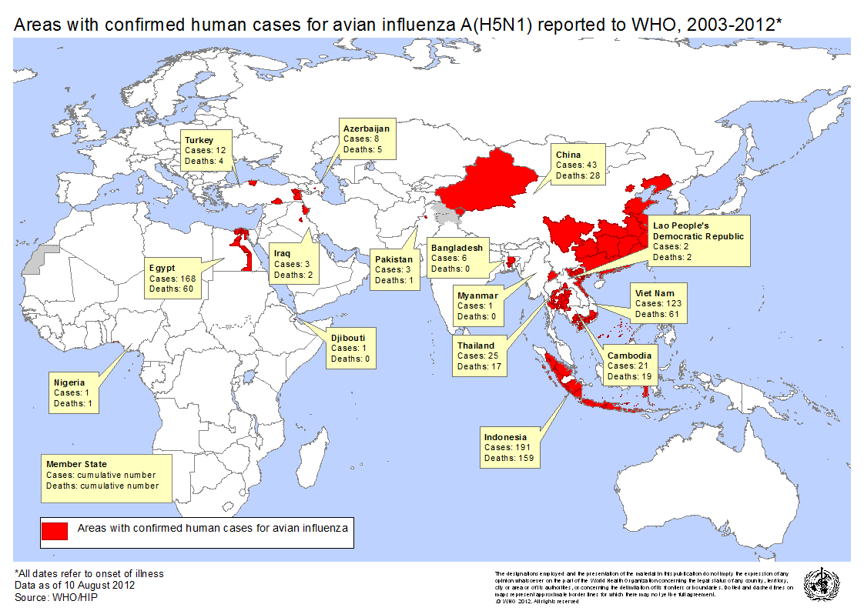
H5N1 Avian Influenza
December 2003 – August 2012
608 cases
including 359 deaths
in 15 countries

Slide 24
Characteristics of H5N1 Avian Influenza
Highly infectious and pathogenic for domestic poultry
Wild fowl, ducks asymptomatic reservoir
Now endemic in poultry in Southeast Asia
Proportion of humans with subclinical infection unknown
Case fatality in humans is >50%

Slide 25
Intervention Strategies (H5N1)
Culling (killing of infected flocks)
Innovative surveillance strategies
  Identification and analysis of human to human clusters
  Characterization of strains
    Necessity for vaccine development (Science 304:968-9, 5/2004)
Vaccination of bird handlers (vaccine developed)
Vaccination of commercial bird flocks

Slide 26
Barriers to H5N1 Control
Reservoir in wild birds and ducks
Economic impact of culling of poultry stocks
Resistance to antivirals and vaccines

Slide 27
2. Novel Swine origin Influenza A (H1N1)
Swine flu causes respiratory disease in pigs – high level of illness, low death rates
Pigs can get infected by human, avian and swine influenza virus
Occasional human swine infection reported
Notes:
Swine flu was first recognised in the 1919 pandemic and still circulates as a seasonal flu virus. Swine flu is caused by the H1N1 virus strain, which started in pigs.

Slide 28
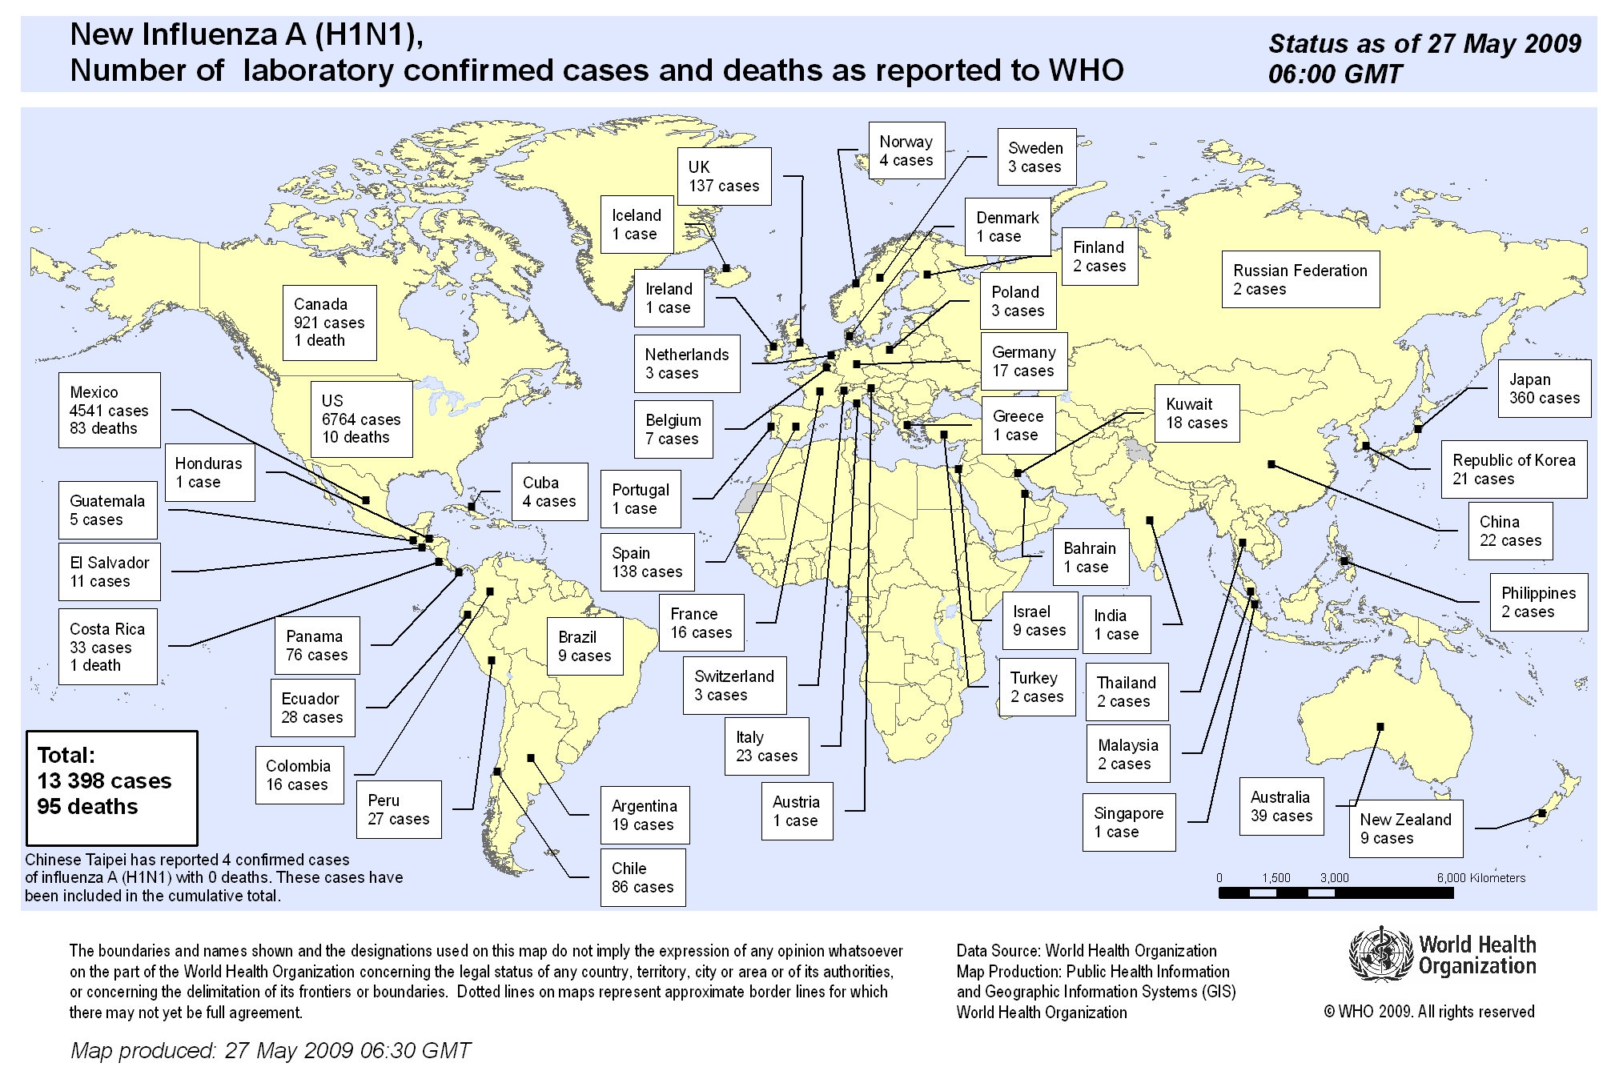
Pandemic HINI (Swine flu)
Worldwide: 162,380 cases➔ 1154 deaths
28

Slide 29
SEVERE ACUTE RESPIRATORY SYNDROME (SARS)
Severe respiratory viral infection
Cause: SARS corona virus (SARS- CoV)
  Similar to animal corona viruses.
  Stable in faeces and urine at room temperature for at least 1-2 days and for up to 4 in stools from patient with diarrhoea.
  Virus loses infectivity after exposure to disinfectants.
  Destroyed by heat above 56 degrees C.

Slide 30
Epidemiology.
  SARS CoV identified on 27 March 2003
  Highly mutable
  Reservoir unknown
  8,098 cases with 774 deaths (CFR% 9.5, age related)
  1,707 HCWs affected (21%)
  27 countries affected with 92% of cases in mainland China, Hong Kong SAR, and Taiwan, China
  Age range – 0-97 years; most cases 30-45 years
  Almost exceeded surge capacity of acute care facilities and public health services

Slide 31
Transmission
Droplets and fomites
  Close contact
  Direct contact with infected respiratory secretions or body fluids.
Health workers are at greatest risk
  They carryout pulmonary procedures like intubation.

Slide 32
Signs and Symptoms
Initially
  Influenza-like symptoms → Sudden onset of fever (temp. > 38°C), malaise, headache and rigors.
Week later
  Cough (initially dry),
  Dyspnoea and
  Diarrhea.
Severe cases
  Respiratory distress
  Watery diarrhea (70%).

Slide 33
Diagnosis
Clinical
  History of fever (> 38°C) and one or more of the following:
    Cough; Difficulty in breathing, Shortness of breath.
  Plus history of positive exposure:
    Close contact with a suspected case
    Travel to an area with recent local transmission of SARS
    Residing in area with recent local transmission of SARS
Laboratory
  PCR positive for SARS - CoV
  Seroconversion by Elisa.
  Virus isolation in cell culture of SARS -CoV.

Slide 34
Management
No proven treatment
Isolate.
Put surgical mask on patient (if tolerated).
Use PPE when handling patient
Wash hands frequently.
Administer antiviral Rivabirin
Antibiotics for secondary bacterial infections.
Supportive measures→ pulmonary support with oxygen and mechanical ventilation for respiratory failure.
Educate on risks of transmission.
Complete epidemic clinical case form and notify

Slide 35
Prevention & control
Identify and quarantine close contacts.
Investigation the source of infection
Massive public health awareness and education

Slide 36
The current pandemic
SARS-CoV-2 is one of seven types of coronavirus, including the Middle East respiratory syndrome (MERS) and sudden acute respiratory syndrome (SARS)
The other coronaviruses cause most of the colds but aren’t a serious threat for healthy people

Slide 37
Severe acute respiratory syndrome coronavirus 2 (SARS-CoV-2) is a new strain of coronavirus that has not been previously identified in humans.

Slide 38
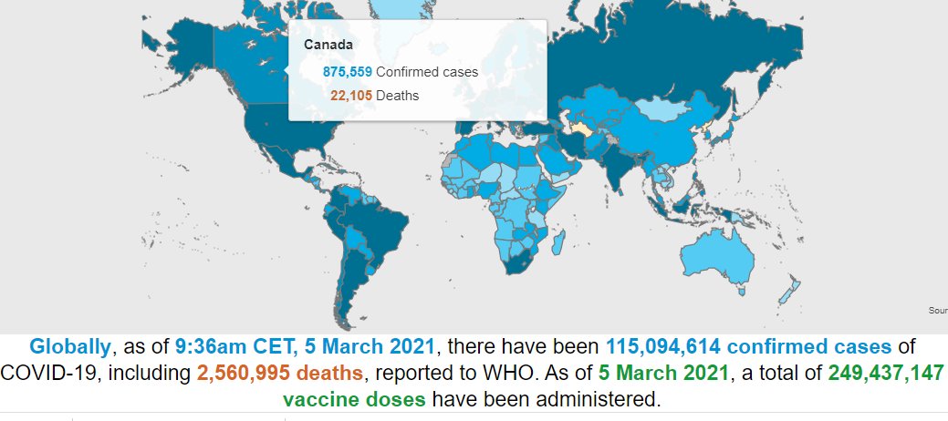
Notes:
As of today, 4 million deaths; 186 conformed cases.
3.42B doses given; 940 million fully vaccinated; 12.1% of the population globally fully vaccinated.
Kenya; 1.53 M doses given, 505k people fully vaccinated – rep 1% of the population. In US, almost 50% of pop fully vaccinated.

Slide 39
Coronaviruses are a large family of viruses, some cause illness in humans, and others cause illness in animals, such as bats, camels, and civets.
Human coronaviruses cause mild illness, such as the common cold

Slide 40
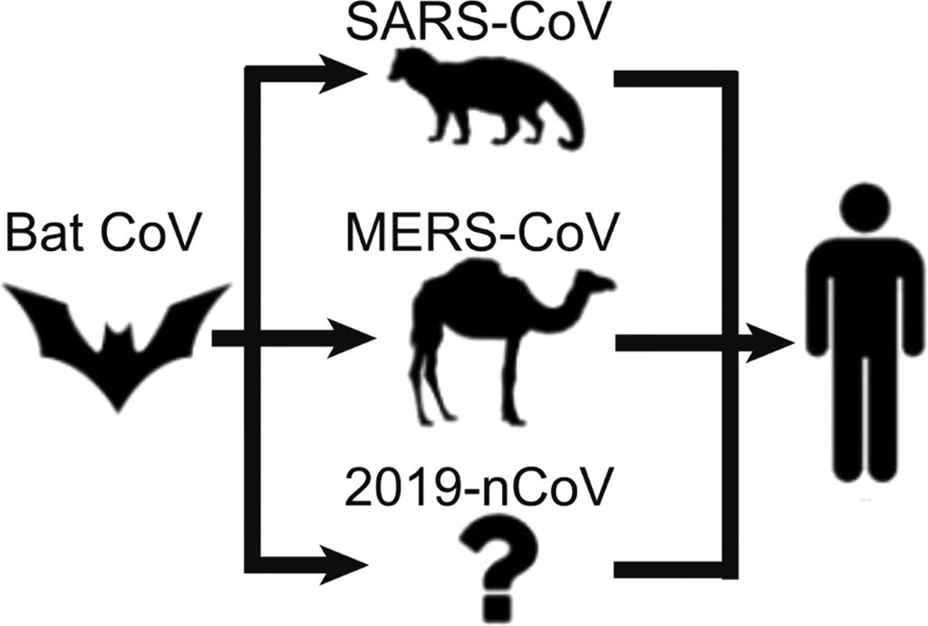
The most likely ecological reservoirs for coronaviruses are bats, but it is believed that the virus jumped the species barrier to humans from another intermediate animal host.
This intermediate animal host could be a domestic food animal, a wild animal, or a domesticated wild animal which has not yet been identified.

Slide 41
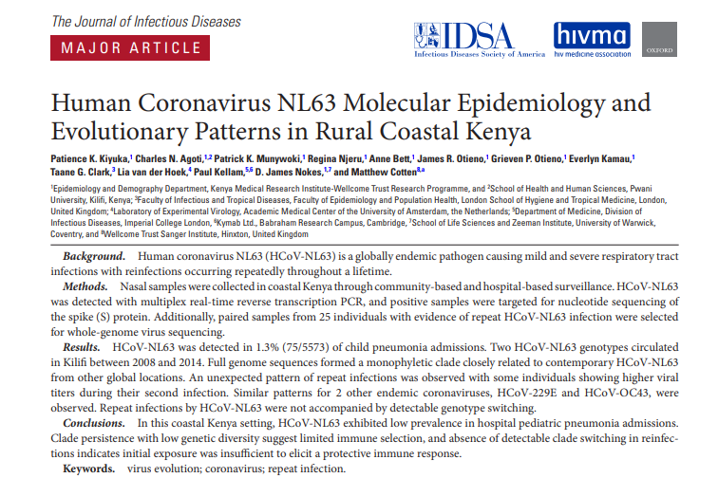

Slide 42
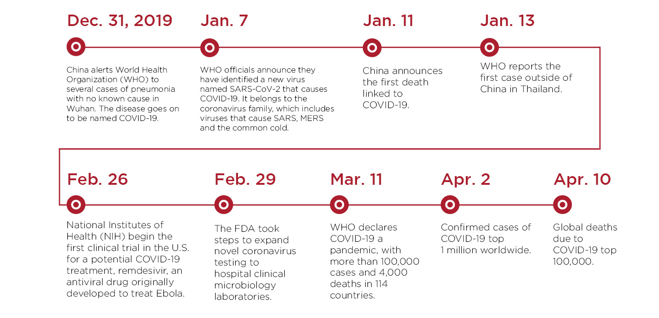
Pandemic timeline

Slide 43
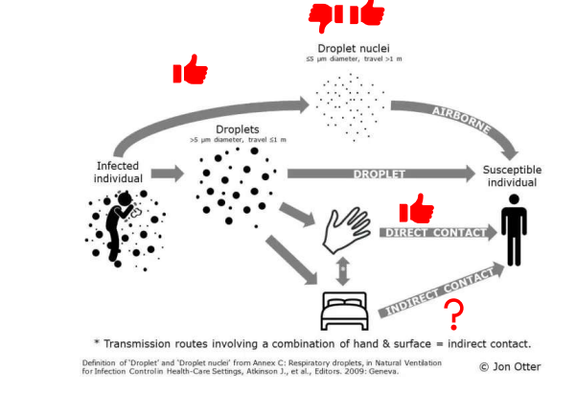

Slide 44
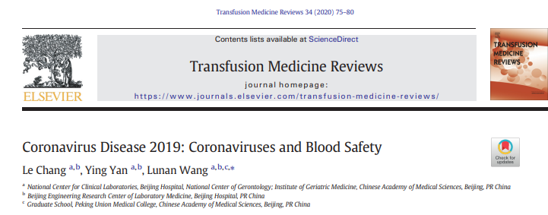

Slide 45
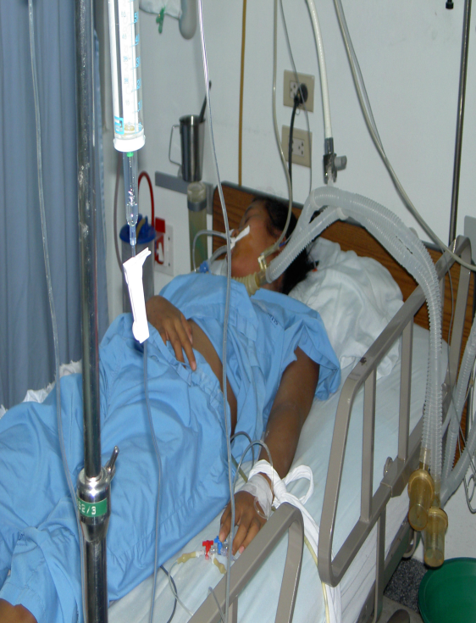
SARS-CoV: Final thoughts
The First Emerging Infectious Disease Of The 21st Century
Lessons:
  An infectious disease in one country is a threat to all
  Important role of air travel in international spread
  Tremendous negative economic impact on trade, travel and tourism, estimated loss of $ 30 to $150 billion
  High level commitment is crucial for rapid containment
  WHO can play a critical role in catalyzing international cooperation and support
  Global partnerships & rapid sharing of data/information enhances preparedness and response

Slide 46
Re-Emerging Infectious Diseases
  Diphtheria
  Cholera
  Human plague
  Dengue (DHF)

Slide 47
Examples of Re-Emerging Infectious Diseases
Diphtheria- Early 1990s epidemic in Eastern Europe(1980- 1% cases; 1994- 90% cases)
Cholera- 100% increase worldwide in 1998 (new strain eltor, 0139)
Human Plague- India (1994) after 15-30 years absence.
Dengue/ DHF- Over past 40 years, 20-fold increase to nearly 0.5 million (between 1990-98)
Notes:
In India, plague reemerged in August 1994, when it was detected in the Beed district of Maharashtra. This was followed by pneumonic plague in Surat in Gujarat state, resulting in over 50 deaths and inducing a mass exodus of people. Eventually plague was reported from 12 Indian states.

Slide 48
Nurses are uniquely positioned to identify events of potential public health significance……
Any outbreak of disease
Any uncommon illness of potential public health significance
Any infectious or infectious-like syndrome considered unusual by HCWs, based on:
    Frequency e.g., a sudden, unexplained, significant increase in the number of patients, especially when it occurs outside the normal season
    Circumstances of occurrence e.g., many patients coming from the same location or participating in similar activities
    Clinical presentation e.g., a patient’s health rapidly deteriorating out of proportion to the presenting symptoms and diagnosis
    Severity e.g., a number of patients failing to respond to treatments

Slide 49
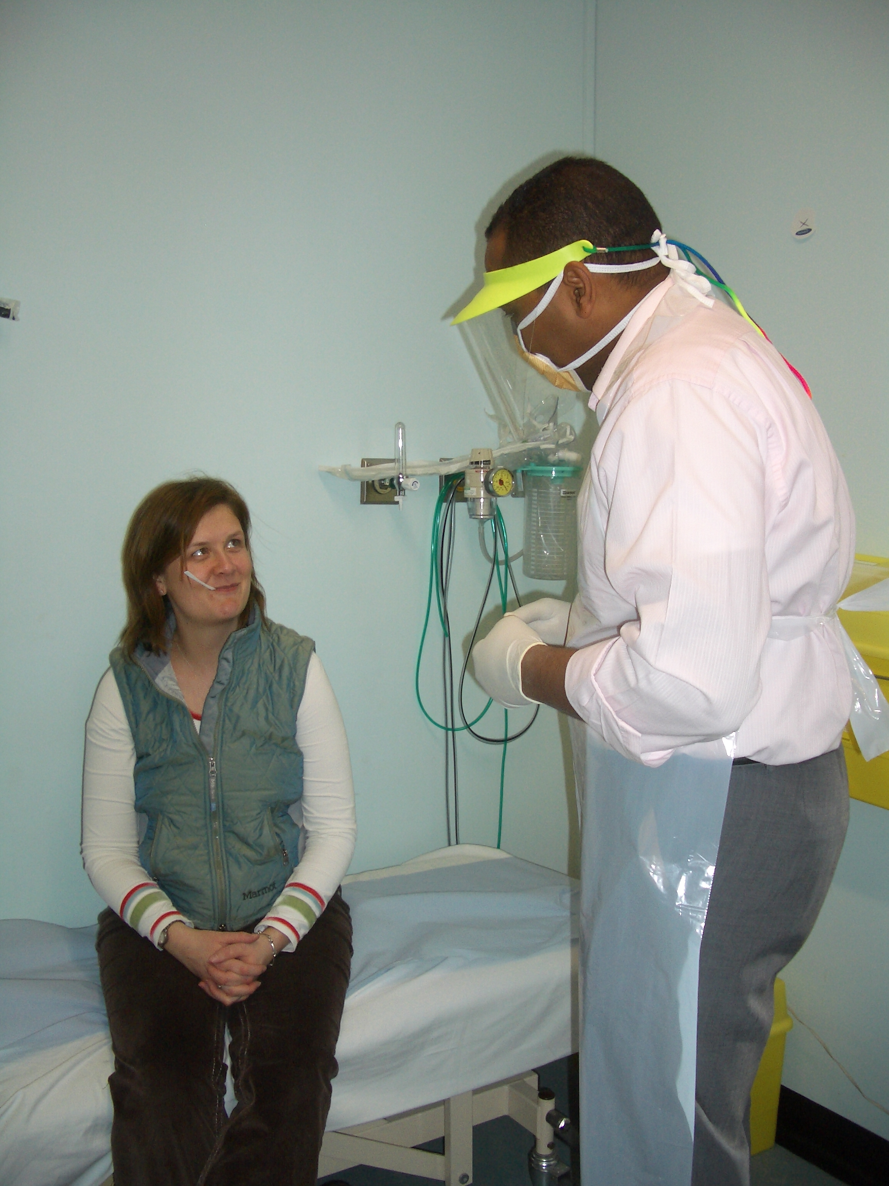
Questions during
Patient triage
Thorough travel history
History of fever within 21/7 of travel to an at-risk country, check temperature
Fever and bleeding/bruising after a tick bite from an at-risk area or after killing livestock/abattoir work
Exposure history
Clinical history & vital signs
Airline flight numbers and stop over/transit
documented.
Illness during the journey.
Illness during any stopover/s
Malaria test

Slide 50

Nurses and Infection Control
HCWs may be the canaries!
21 % of the SARS probable cases were HCWs !
Pneumonic Plague, Peru 2010
They may be the first cluster of cases
that triggers an alarm bell that there is
something seriously wrong.

Slide 51
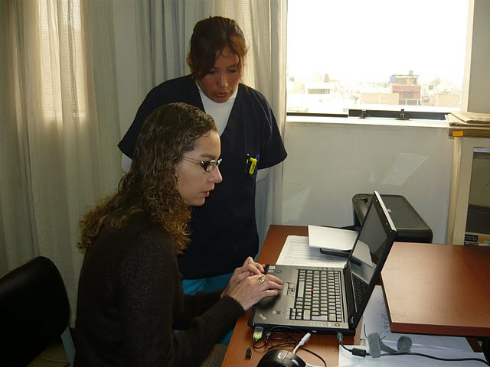
Nurses and EID detection
“In remaining vigilant for the presence of a new disease, the individual nurse functions as a mini-surveillance system.”

Slide 52
STRATEGIES TO REDUCE THREATS (1)
Use of vaccines
  Increase coverage and acceptability (e.g. oral)
  New strategies for delivery (e.g. nasal spray administration)
  Develop new vaccines
  Decrease cost
  Decrease dependency on “cold chain”
New drug development

Slide 53
STRATEGIES TO REDUCE THREATS (2)
Decrease inappropriate drug use
  Improve education of clinicians and public
  Decrease antimicrobial use in agriculture and food production
Improve vector and zoonotic control
  Develop new safe insecticides
  Develop more non-chemical strategies e.g. organic strategies
Better and more widespread health education
  (e.g., west Nile virus; bed nets, mosquito repellent)

Slide 54
STRATEGIES TO REDUCE THREATS (3)
Development of predictive models based on:
Epidemiologic data
Climate change surveillance
Human behavior
Establish priorities
  The risk of disease
  The magnitude of disease burden
    Morbidity/disability
    Mortality
    Economic cost
Reduce potential for rapid spread
Develop more feasible control strategies

Slide 55
Modeling EID events: Relative risk of an EID
Hot Spots: global distribution of relative risk of an EID event caused by zoonotic pathogens from wildlife, (Jones et al, Nature, 2008).

Slide 56
Key Tasks in Dealing with Emerging Diseases
Surveillance at national, regional, global level
  epidemiological,
  laboratory
  ecological
  Anthropological
Investigation and early control measures
Implement prevention measures
  behavioural, political, environmental
Monitoring, evaluation

