Slide 1
LEISHMANIASIS
KIMAIGA H.O
MBChB (University of Nairobi)

Slide 2
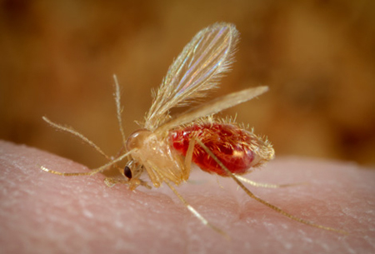
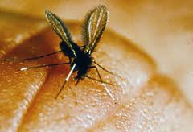
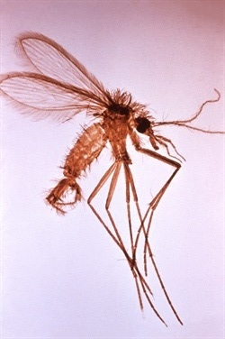
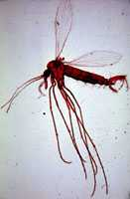
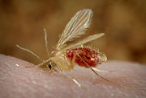
Causal Agent
Leishmaniasis is a vector-borne disease that is transmitted by infected female Phlebotomus sand fly and caused by obligate intracellular protozoa of the genus Leishmania.

Slide 3
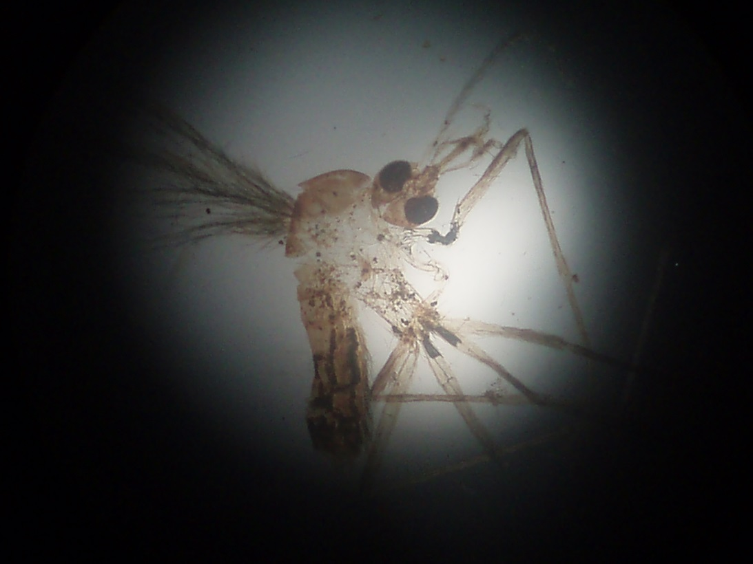
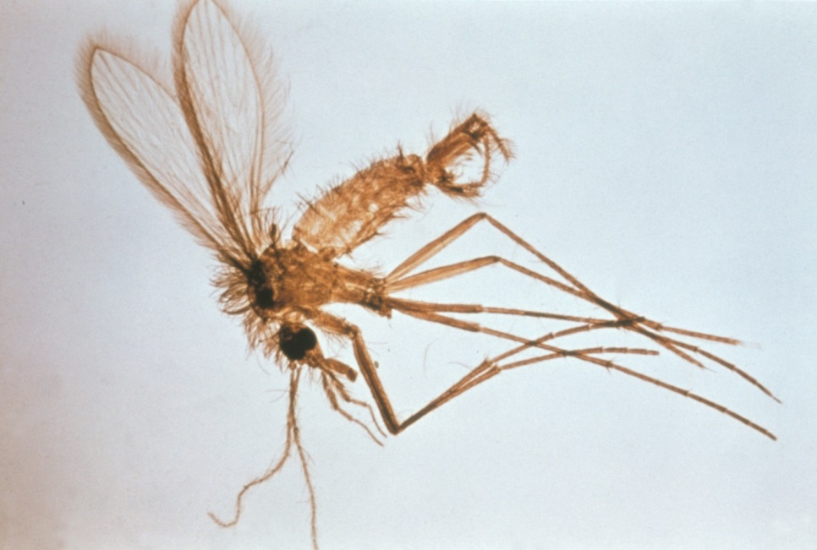
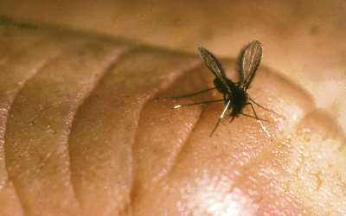
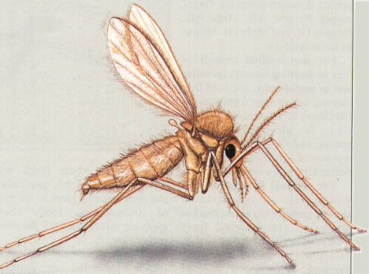
Phlebotomus (sand fly):
Hairy body
Long legs
Wings are erect and V-shaped

Slide 4
Neglected tropical diseases
The neglected diseases are a group of tropical infections which are especially endemic in low-income populations in developing regions of Africa, Asia, and the Americas.
Some of these diseases have known preventive measures or acute medical treatments which are available in the developed world but which are not universally available in poorer areas even in some cases where the treatments are relatively inexpensive
Examples include helminths, Schistosomiasis, Elephantiasis,Trachoma,Onchocerciasis),Leishmaniasis, Trypanosomiasis, Leprosy,Buruli ulcer, elephantiasis, rabies and others.

Slide 5
  The L. donovani complex with 3 species (L. donovani, L. infantum, and L. chagasi);
  The L. mexicana complex with 3 main species (L. mexicana, L. amazonensis, and L. venezuelensis);
  L. tropica; L. major; L. aethiopica;
  The subgenus Viannia with 4 main species (L. (V.) braziliensis, L. (V.) guyanensis, L. (V.) panamensis, and L. (V.) peruviana).
  The different species are morphologically indistinguishable, but they can be differentiated by isoenzyme analysis, molecular methods, or monoclonal antibodies

Slide 6
Human infection is caused by about 21 of 30 species that infect mammals.
These include
Species: Leishmania donovani complex:
Subspecies:
    L. d. donovani
    L. d. infantum
    L. d chagasi
    East African L. d. donovani
    Sudanese L. d. donovani
Species: Leishmania brazilliensis (Viannia) complex
Subspecies
  L. b. brazilliensis
  L.b. guyanensis
  L.b. panamensis
  L. b. peruviana
Species: Leishmania mexicana complex
Subspecies:
  L. m. mexicana
  L. m. amazonensis
  L. m. venezuelensis
Species:
  Leishmania major
  Leishmania tropica
  Leishmania aethopica

Slide 7
Geographic Distribution
Leishmaniasis is found in parts of about 88 countriesand affecting 12 million people worldwide.
Most of the affected countries are in the tropics and subtropics. The settings in which leishmaniasis is found range from rain forests in Central and South America to deserts in West Asia.
  90% of visceral leishmaniasis cases occur in parts of India, Bangladesh, Nepal, Sudan, Ethiopia and Brazil
  90% of cutaneous leishmaniasis cases occur in parts of Afghanistan, Algeria, Iran, Saudi Arabia, Syria, Brazil, Colombia, Peru and Bolivia
Leishmaniasis is found in Mexico, Central America, and South America—from northern Argentina to Texas (not in Uruguay, Chile, or Canada)
Southern Europe (leishmaniasis is not common in travelers to southern Europe), Asia (not Southeast Asia), the Middle East, and Africa (particularly East and North Africa).

Slide 8
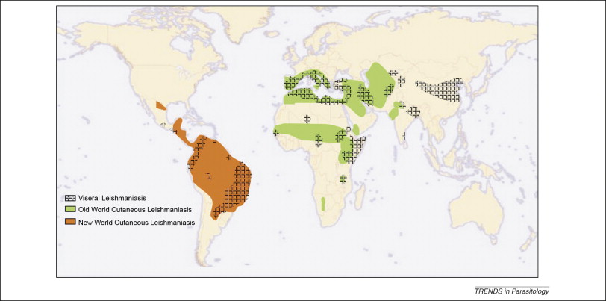

Slide 9
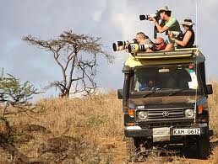

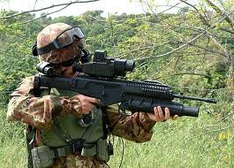
Risk factors
The major risk factor is being exposed to infected sand flies.
Infection is more common in adventure travelers, Corps workers, soldiers.

Slide 10
Prevalence in Kenya
The estimated average visceral leishmaniasis caseload per year is about 600, according to the Ministry of Health , though this in the epidemic years the caseload surpasses 1000.
The occurence of cutaneous leishmaniasis is rare compared to visceral leishmaniasis, and the 2 diseases do not tend to overlap geographically.
Visceral leishmaniasis is found predominantly in the arid low lying areas of the Rift Valley, Eastern and North Eastern Provinces. Cases have also been reported in the highlands. Baringo, Machakos, Kitui, Meru, Tharaka, Samburu, West Pokot, Nakuru
Cutaneous leishmaniasis occurs over a wide range of environmental conditions, from semi-arid lowlands to high plateaus in the Rift Valley, Eastern ,North Eastern, Central and Western provinces.

Slide 11
LIFE CYCLE OF LEISHMANIASIS
Leishmaniasis is transmitted by the bite of infected female phlebotomine sandflies.
The sandflies bite a person or animal and inject the infective stage (i.e promastigotes) from their proboscis during blood meals.
Flagella, sandfly saliva enhances infectivity
The promastigotes are phagocytized by macrophages

Slide 12
Progmastigotes transform in these cells into the tissue stage of the parasite (i.e., amastigotes) , which multiply by binary fusion and proceed to infect other mononuclear phagocytic cells
Parasite, host, and other factors affect whether the infection becomes symptomatic and whether cutaneous or visceral leishmaniasis results.
In cutaneous leishmaniasis promastigotes are aken by skin Reticuloendothelial cells, transform to amastigotes, multiply by binary fission, rupture, release & infection to other skin RE cells
Sandflies become infected by ingesting infected cells during blood meals.
In sandflies, amastigotes transform into promastigotes, develop in the gut and migrate to the proboscis

Slide 13
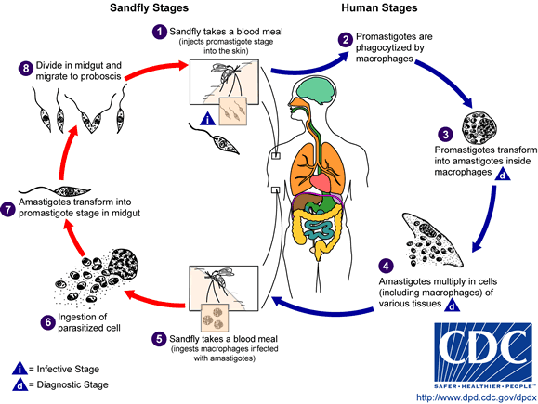

Slide 14
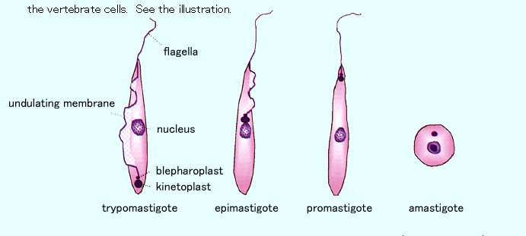
Different stages of Haemoflagellates

Slide 15
Types of Leishmanias Disease.
Four main forms of Leishmaniasis
  Visceral Leishmaniasis : Involving liver, spleen, and bone marrow
  Cutaneous Leishmaniasis : Affects the skin and mucus membranes. Skin sores usually start at the site of the sandfly bite.
  Mucocutaneous Leishmaniasis : involving mucous membranes of the mouth and nose after spread from a nearby cutaneous lesion (very rare)
  Disseminated Leshmaniasis

Slide 16
VISCERAL LEISHMANIASIS (VL)
Also known in Asia as ' black fever/ 'kala azar‘ and Dumdum fever. Kala-azar means dark pigmentation which is characteristic of cases of visceral
Caused by:
  L. donovani in East Africa and the Indian subcontinent
  L. infantum in Mediterrranean region-Europe, North Africa and Latin America
  L. chagasi. in South and Central America- Brazil, Peru and Paraguay

Slide 17
Disease in india subcontinent similar to East African disease
Disease in Mediterranean region similar to south & central ameriac
Visceral leishmaniasis – Baringo, machakos, kitui, meru, tharka, samburu, west pokot, nakuru.
It is purely a human disease. No animal reservoir.
Vector – sandfly called Phlebotomus fly in Mediterranean region. In America vector is lutzomyia sandfly.
1% other causes may be transmitted by:-
  Congenital – child infected in utero
  B/transfusion
  Accidental inoculation
  Sexual transmission

Slide 18
Morphology
Amastigotes (pathogenic stage/sometimes called leishmania donovani bodies)
  Spherical to ovoid and measure 1-5 µm long by 1-2 µm wide.
  They possess a large nucleus
  A prominent kinetoplast within the cytoplasm. (2 dots in the cytoplasm – nucleus & kinetoplast) and a short axoneme.
  They can be either intra/extracellular. Live in macrophages.
  The organisms reside in macrophages of the host and can be found throughout the body.
Promastigotes (infective stage)
  Oval
  Nucleus
  Kinetoplast
  Flagellum– since it’s found in blood = haemoflagellate

Slide 19
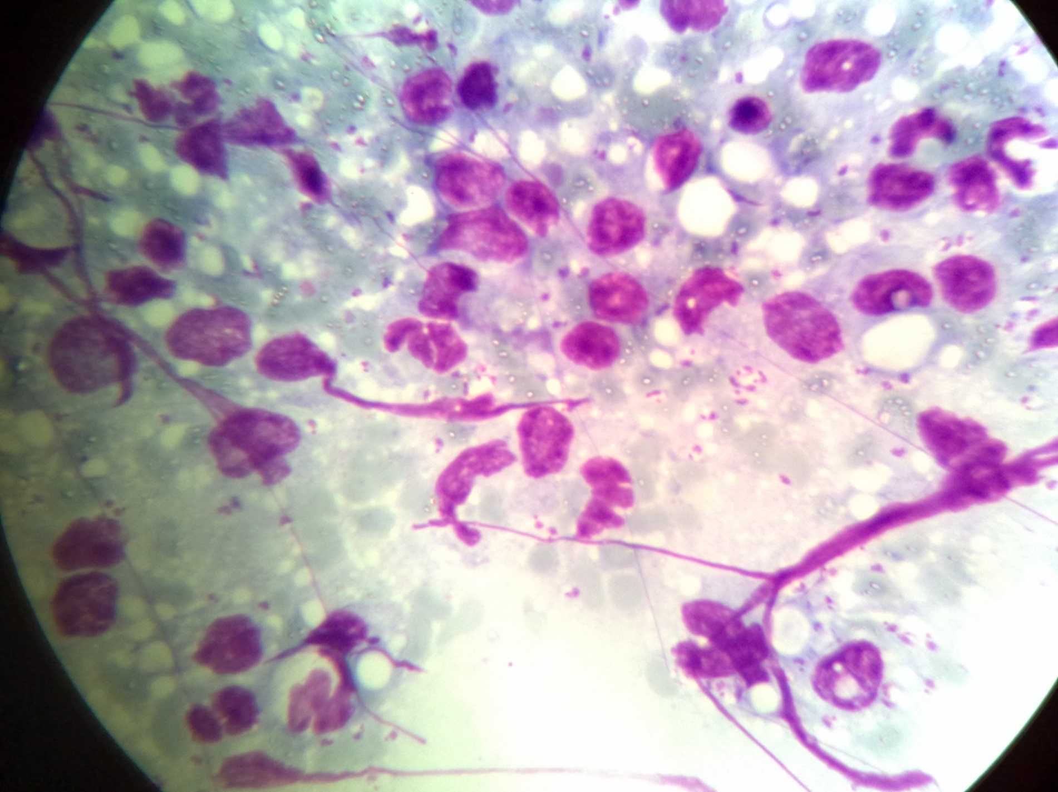

Slide 20
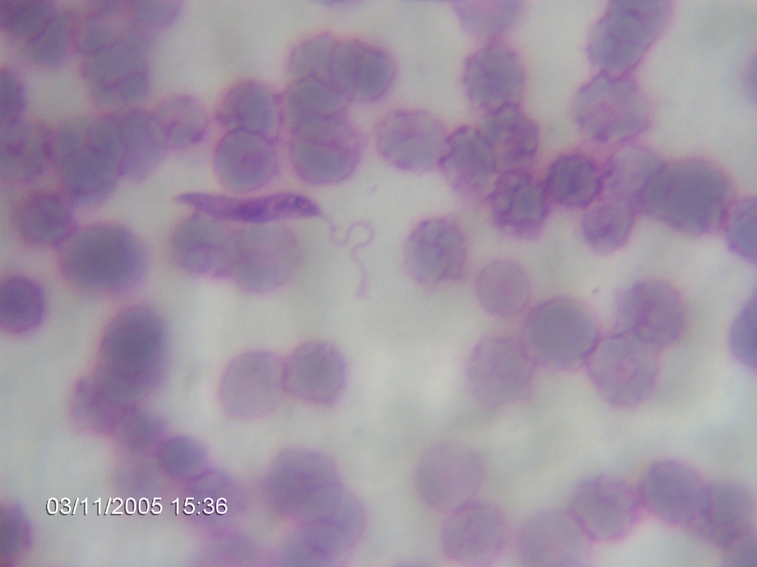

Slide 21
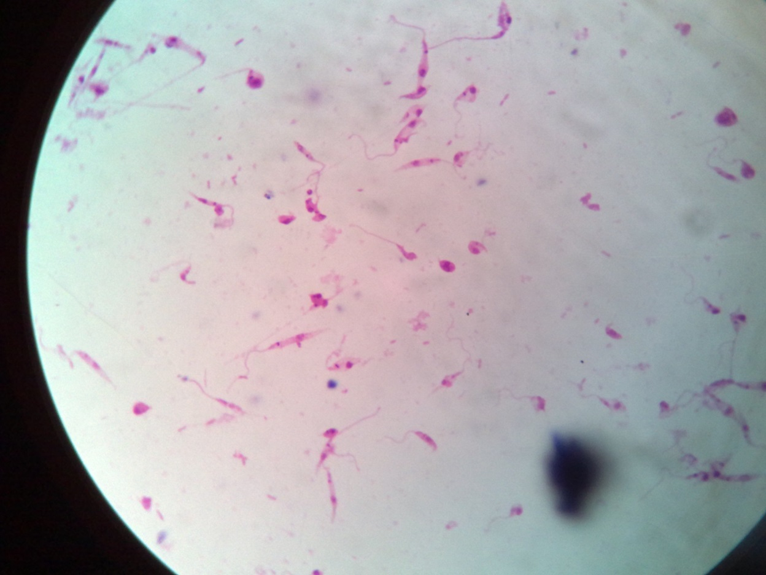
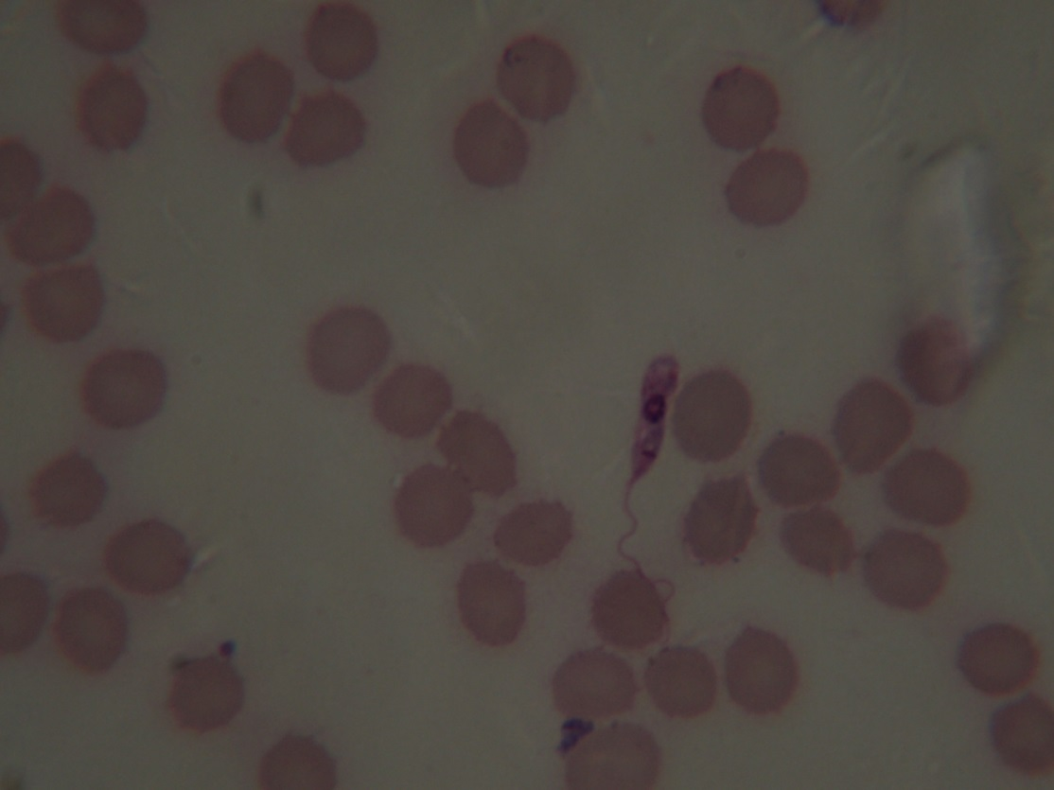
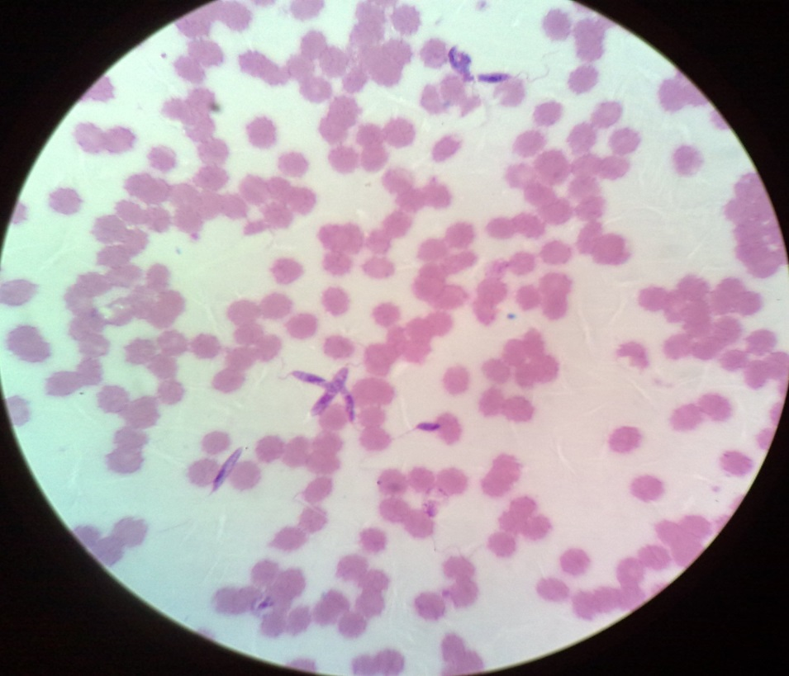
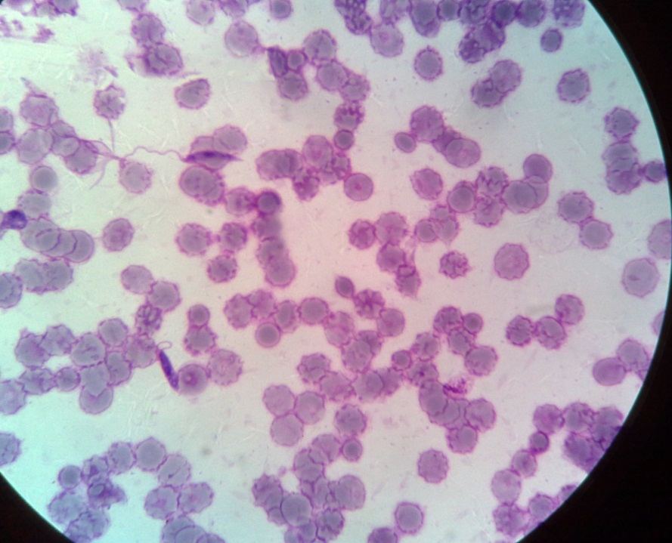
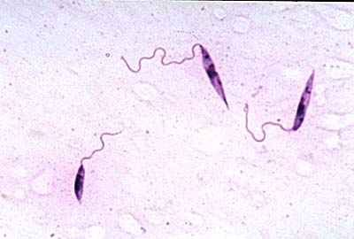
leishmania promastigotes
(form present in sandfly host)

Slide 22
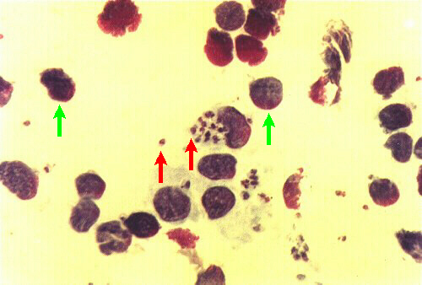

Slide 23
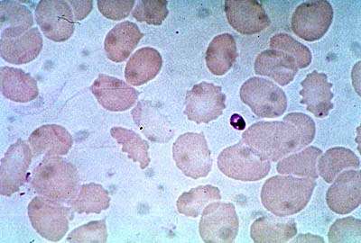
Leishmania donovani extracellular amastigote (form present in vertebrate host)

Slide 24
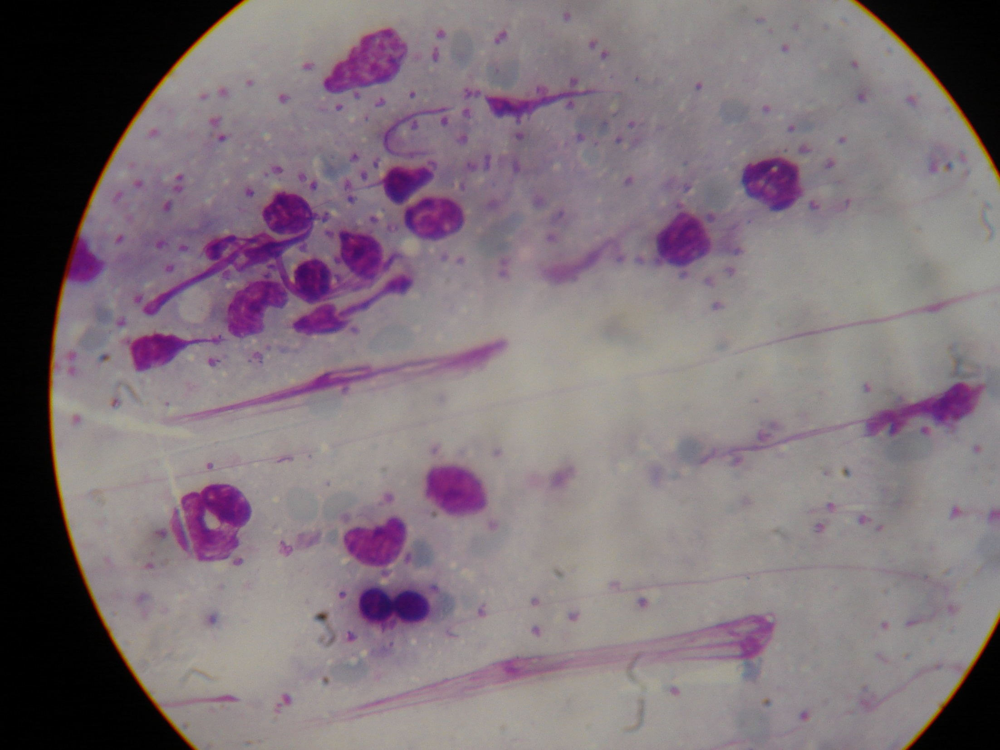
leshmania amastigotes

Slide 25
Clinical presentation of Visceral leishmaniasis
Affects several organs such as the spleen, the bone marrow, liver and lymph nodes.It can be life threatening. The illness develops months or years after the sand fly bite.
Leishmanioma at site of bite that heals by itself (ulcer at site of bite)
Irregular/Undulating fever,
Pallor (look pale), bleeding easily from nose (epistaxis), gums etc.
Recurrent infections – respiratory including TB, GIT. Coz the WBC numbers go down.
Opportunistic infection in AIDS patients

Slide 26
Splenomegaly, Hepatomegaly (usually the spleen is bigger than the liver), lymphadenopathy
Cough – usually dry. The amastigotes line the respiratory tract, thus the dry cough
Diarrhoea – may include dysentery
Anaemia, Malaise, Fatigue, Loss of weight,
Thrombocytopenia, Lecopenia
Hyper-pigmentation of the skin known as Kalazar
Peripheral oedema, ascites coz of fluid accumulation in the abd.
Body produces globulins in the expence of albumin – thus it interferes with electrolyte balance causing ascites

Slide 27
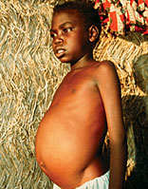
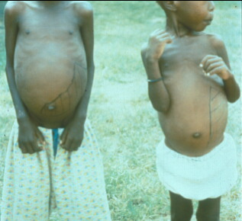

Slide 28
Diagnosis of Visceral Leishmaniasis
Take history of patient – clinical & geographical record coz it’s not worldwide distribution
Aspirate (splenic 1st , BM 2^{nd –} iliac crest, Liver, LN) don’t go for blood coz they are anemic – smear, stain with Giemsa, microscopy (for amastigotes forms called Leishman-donovan (L-D) bodies.)
Biopsy of the Bone marrow/ spleen and Culture – NNN (Nicole, Novey, McNeal), RPMI (Roose-Park Memorial Institute) or Schneider (for promastigotes)

Slide 29
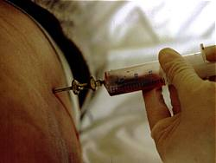
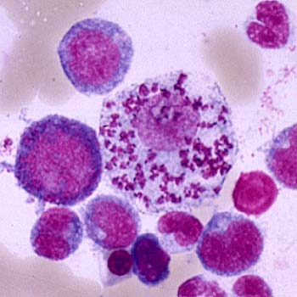
Bone marrow aspiration
Bone marrow amastigotes

Slide 30
Leishmanin skin test (Montenegro test) – it is –ve for visceral leishmaniasis coz of immunosuppression. It requires the body to mount a hypersensitivity rxn against antigen. It is done to test if patient is recorvering
Formal gel test – take serum & add 40% formaline, it should form a gel in 20 mins. This indicates +ve
Serology looking for immunoglobulins – ELISA, IHA (indirect heme agglutination), IFAT (indirect fluorescent assay test)
Haemogram – pancytopenia

Slide 31
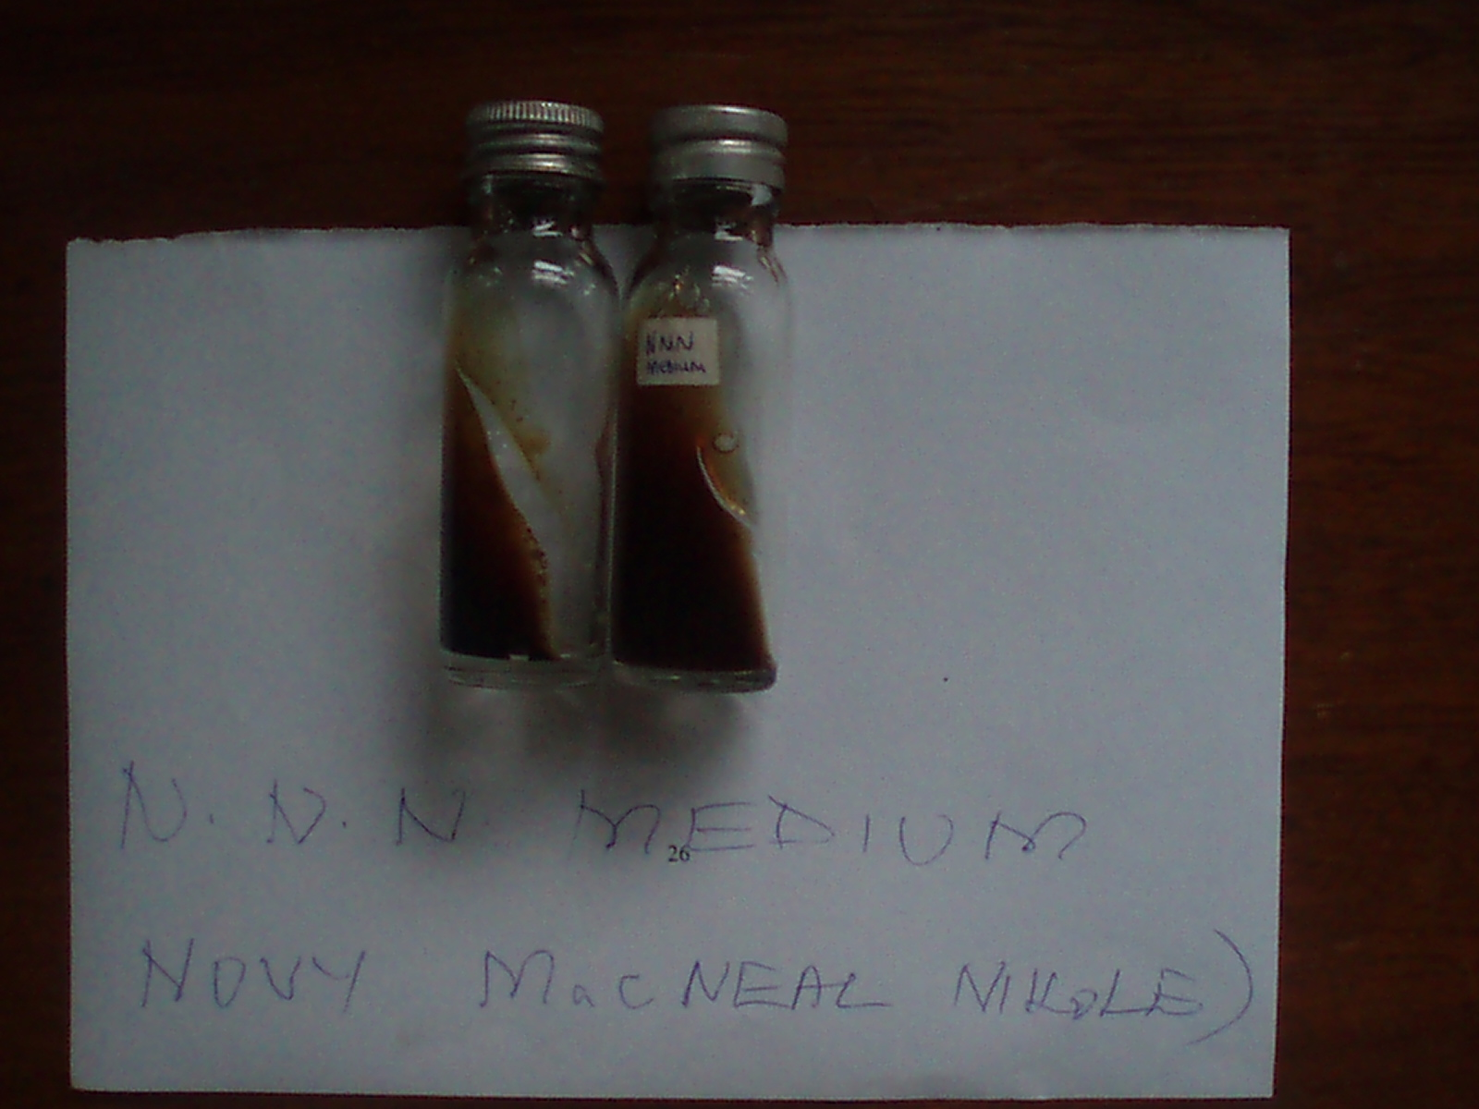

Slide 32
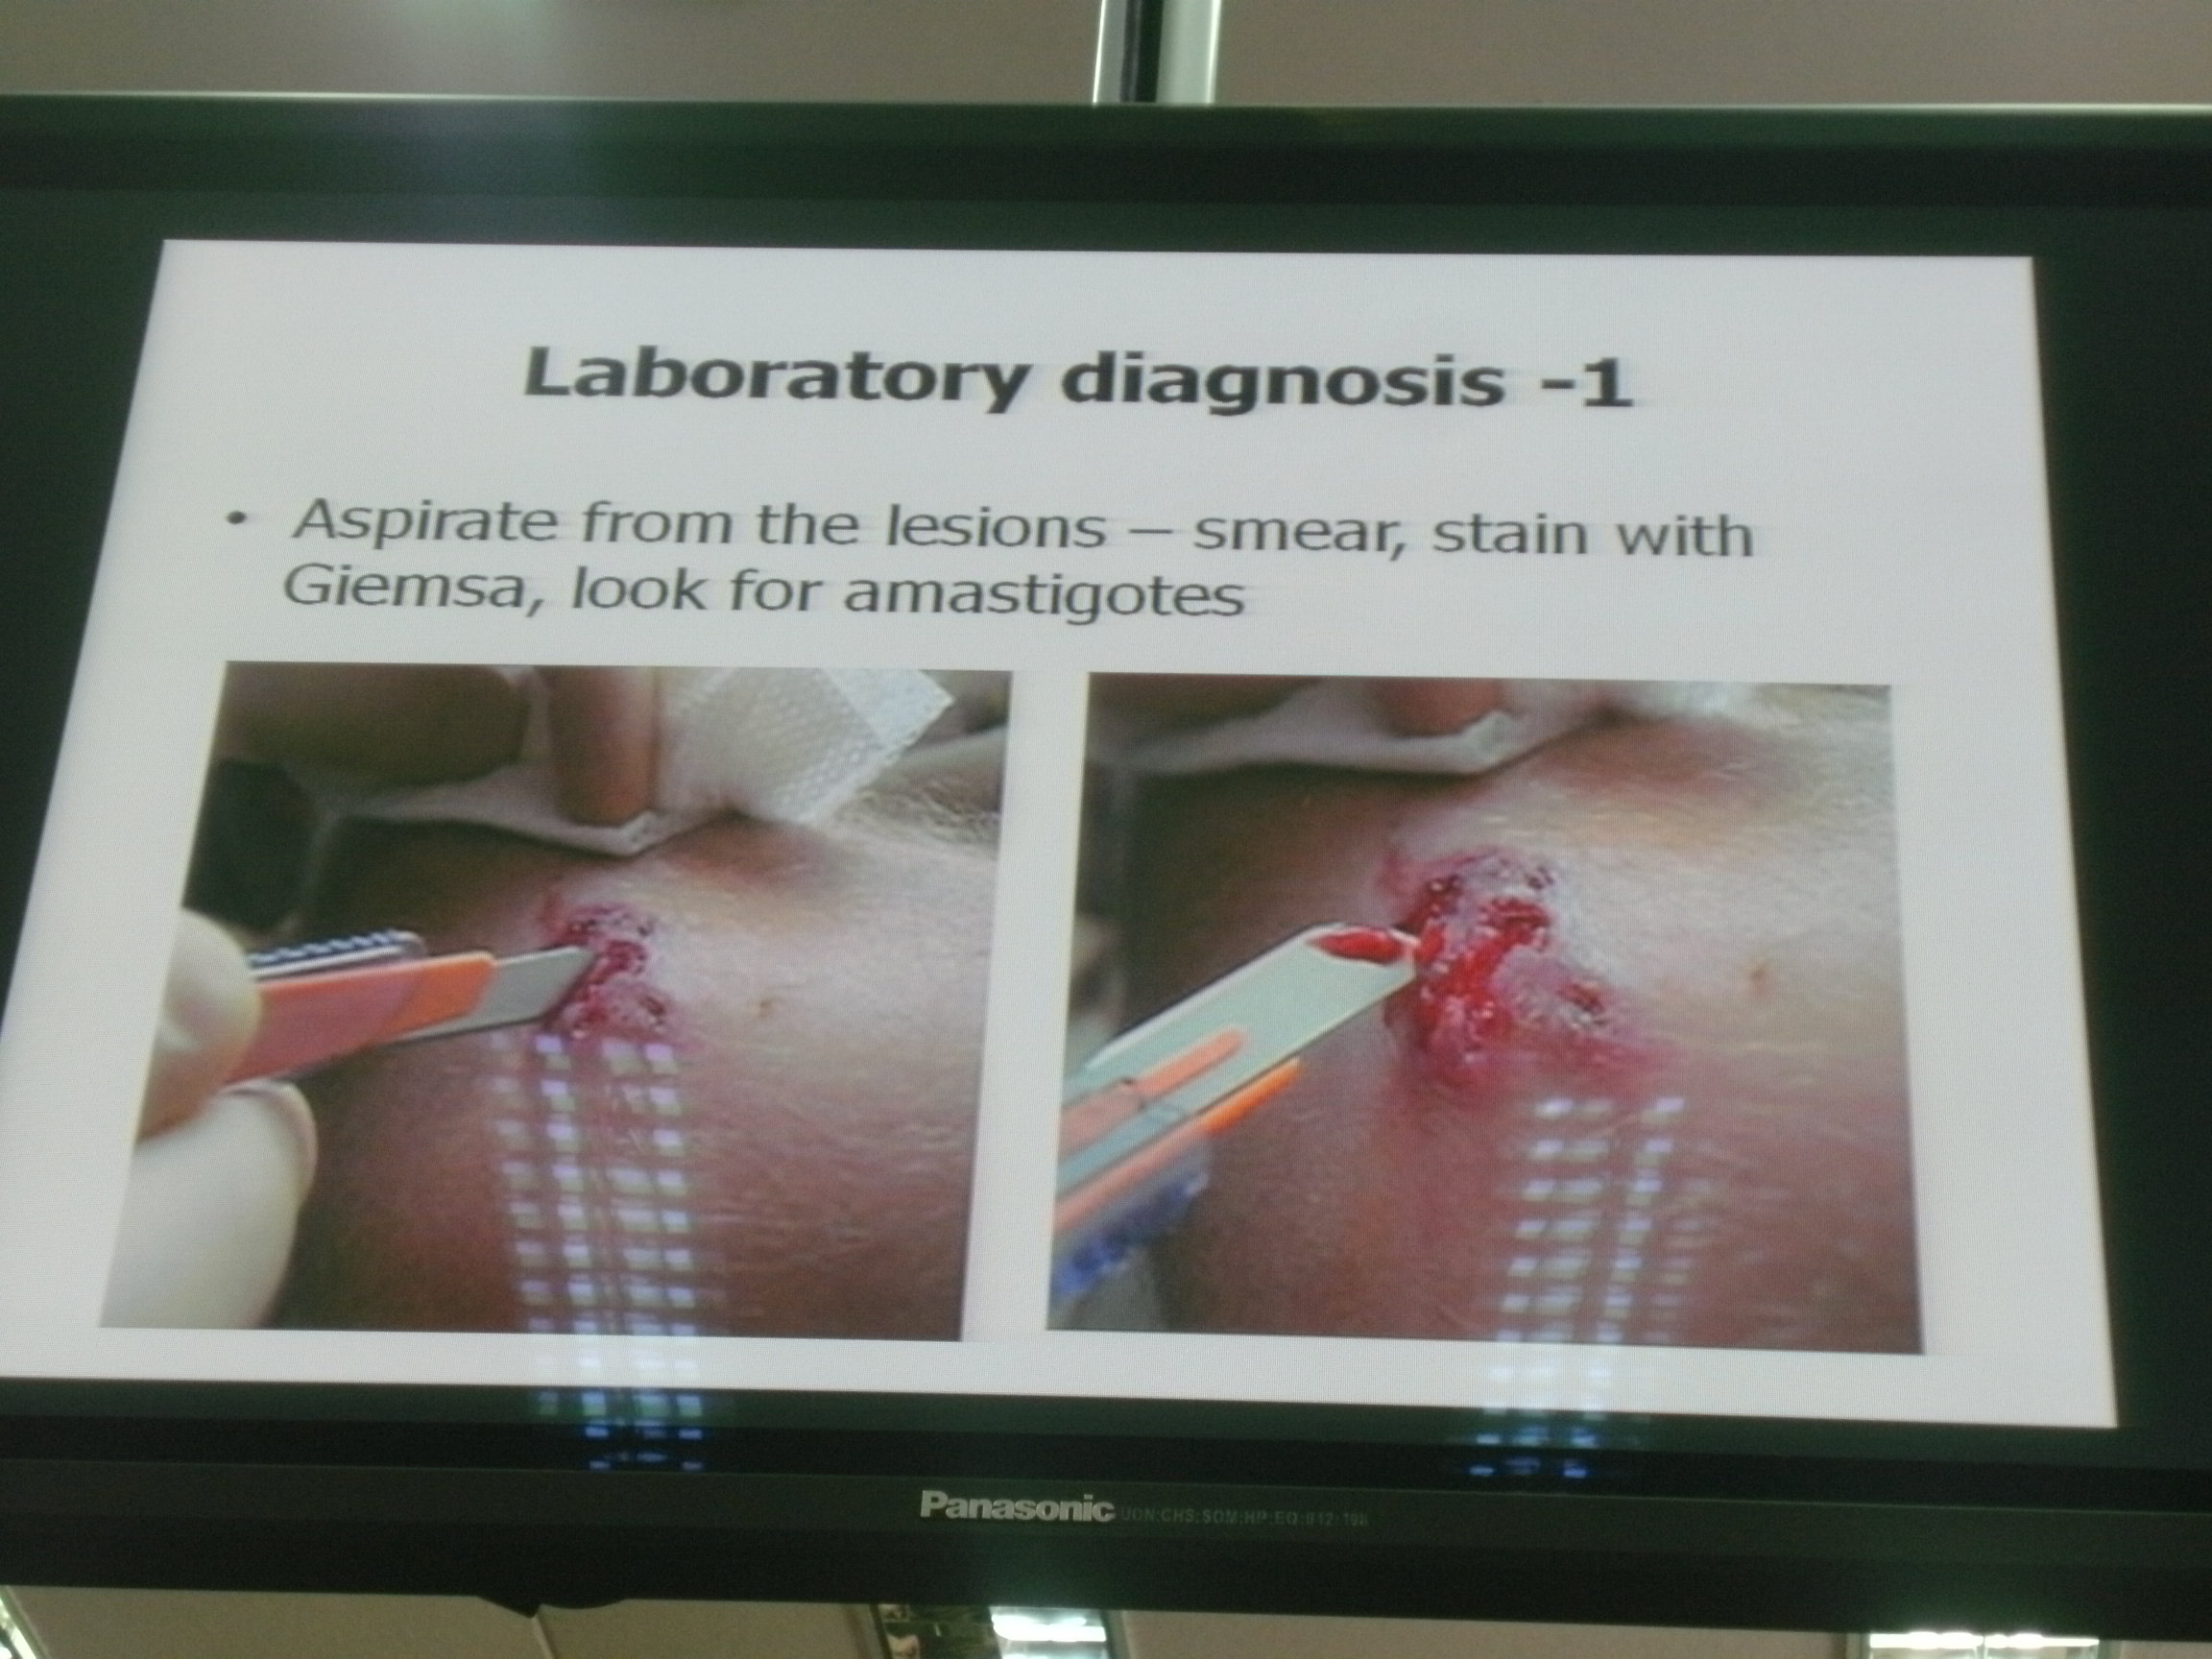

Slide 33
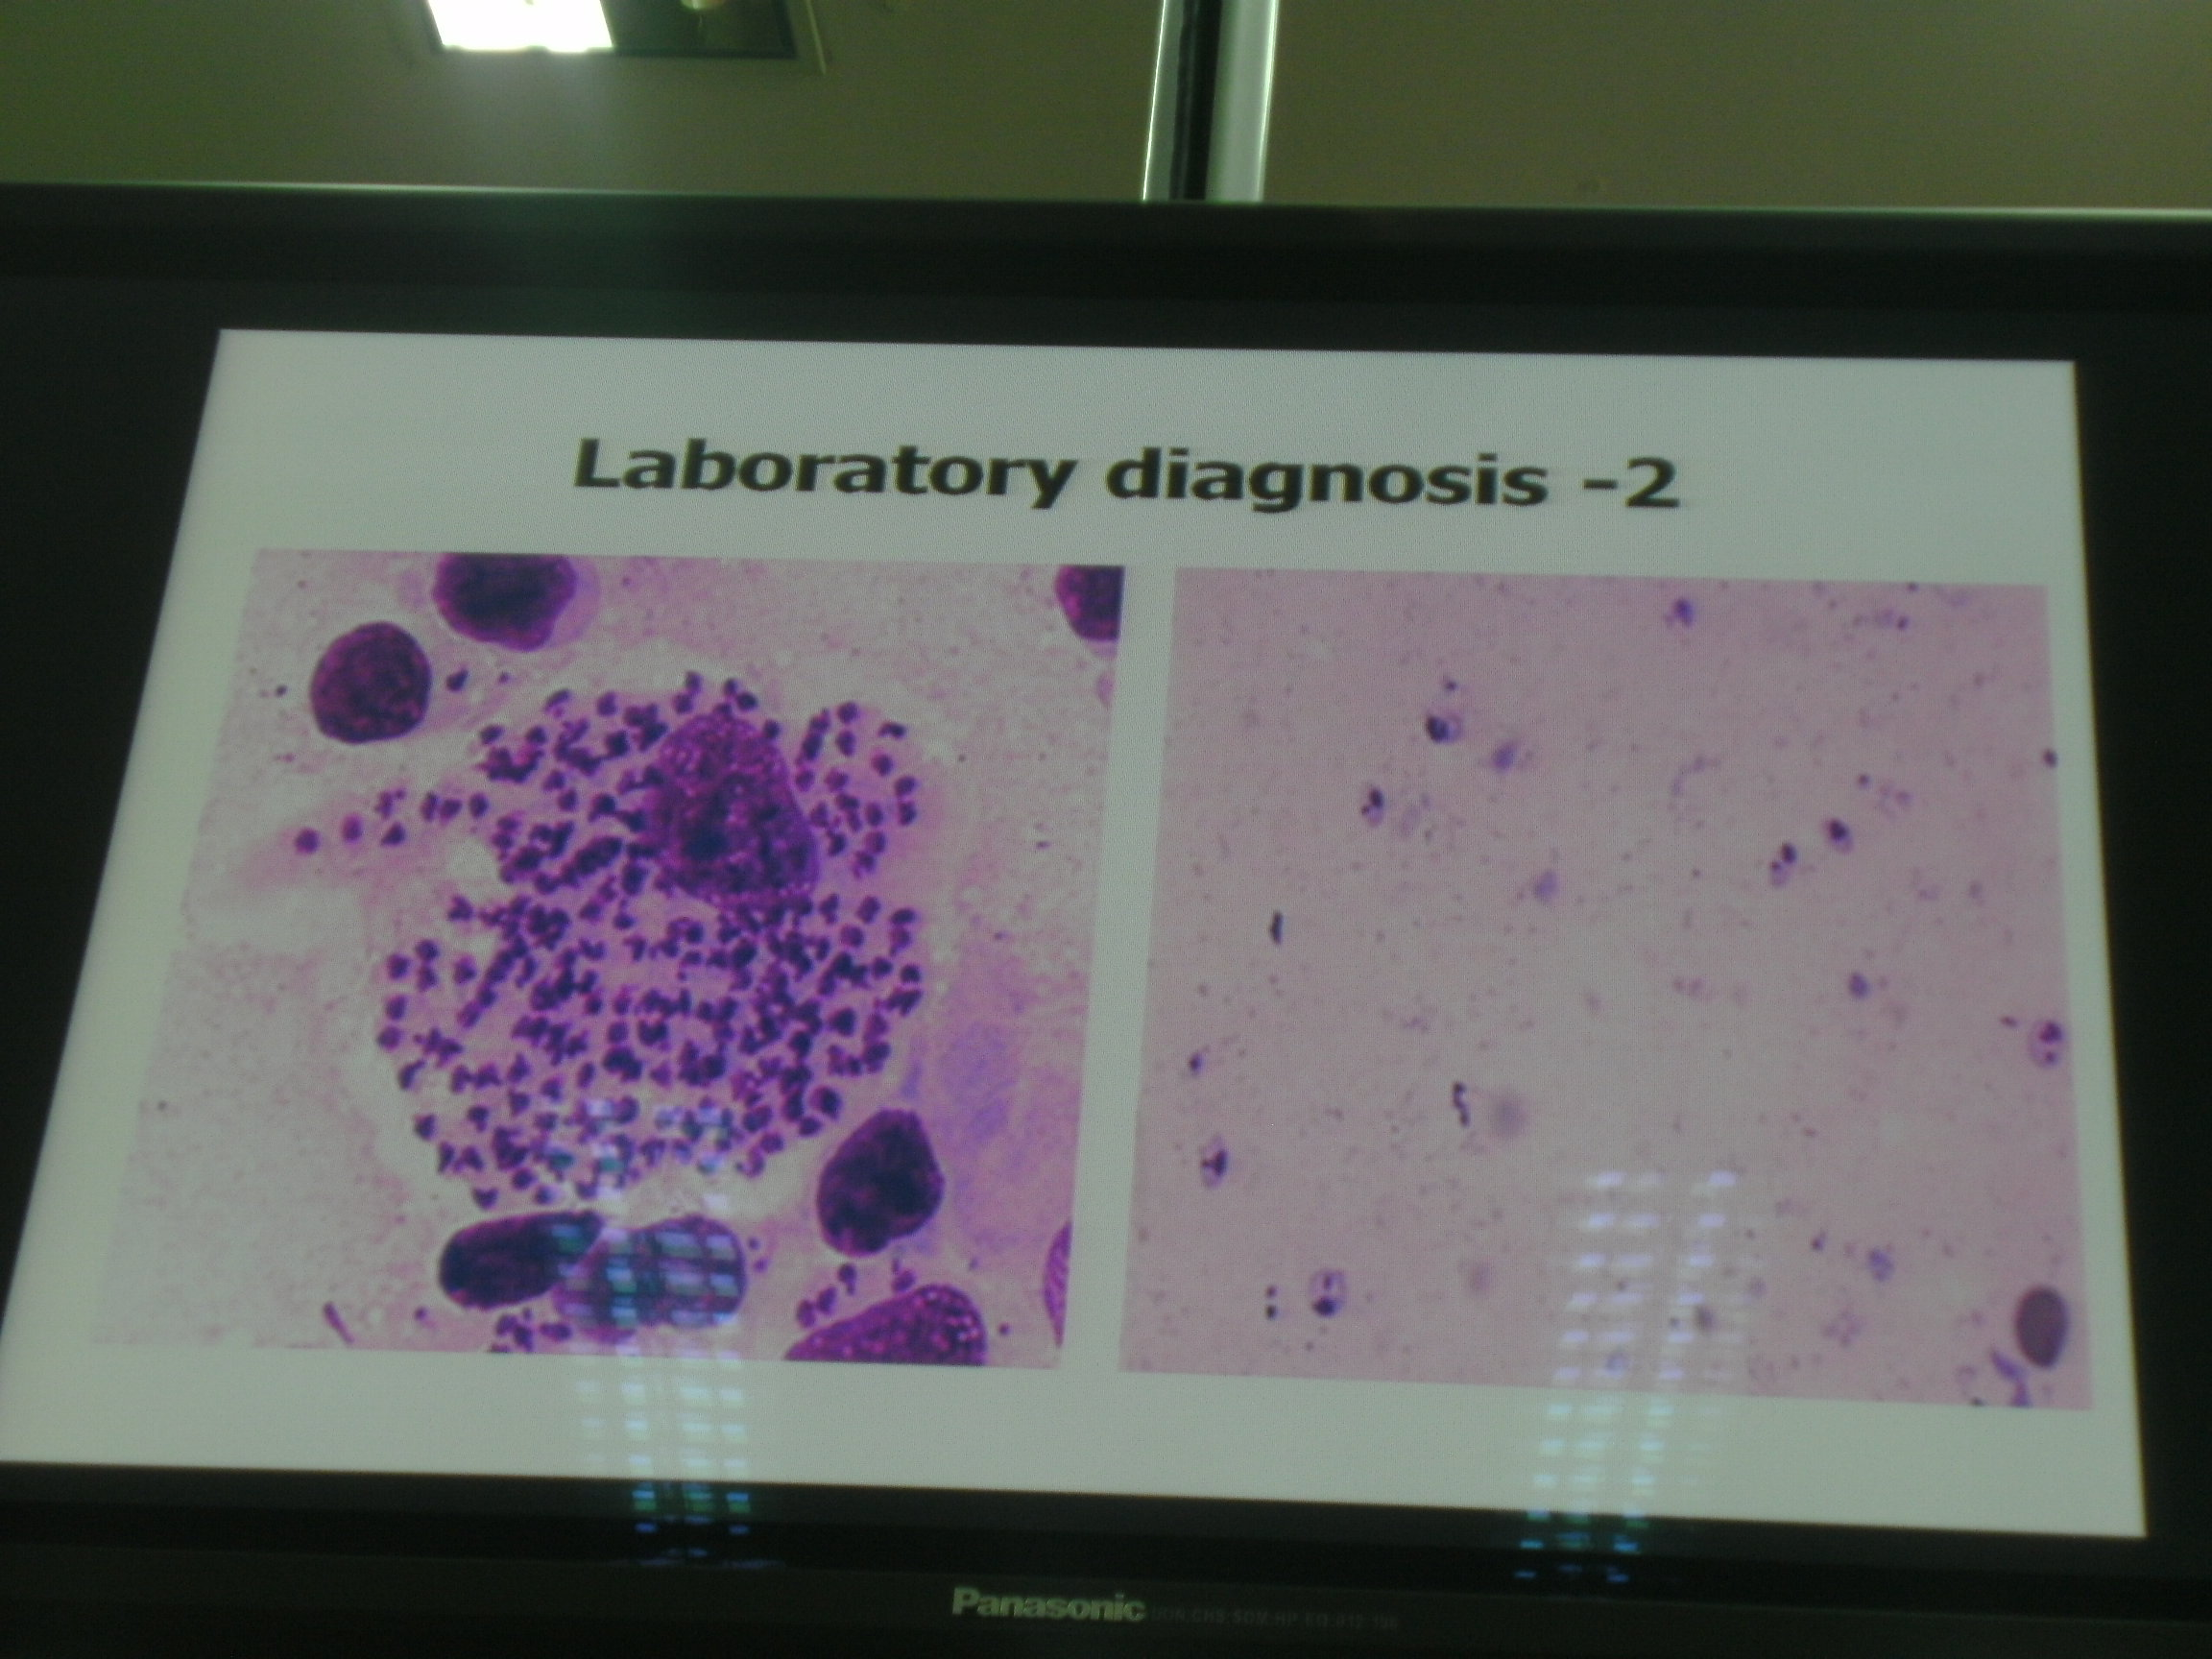

Slide 34
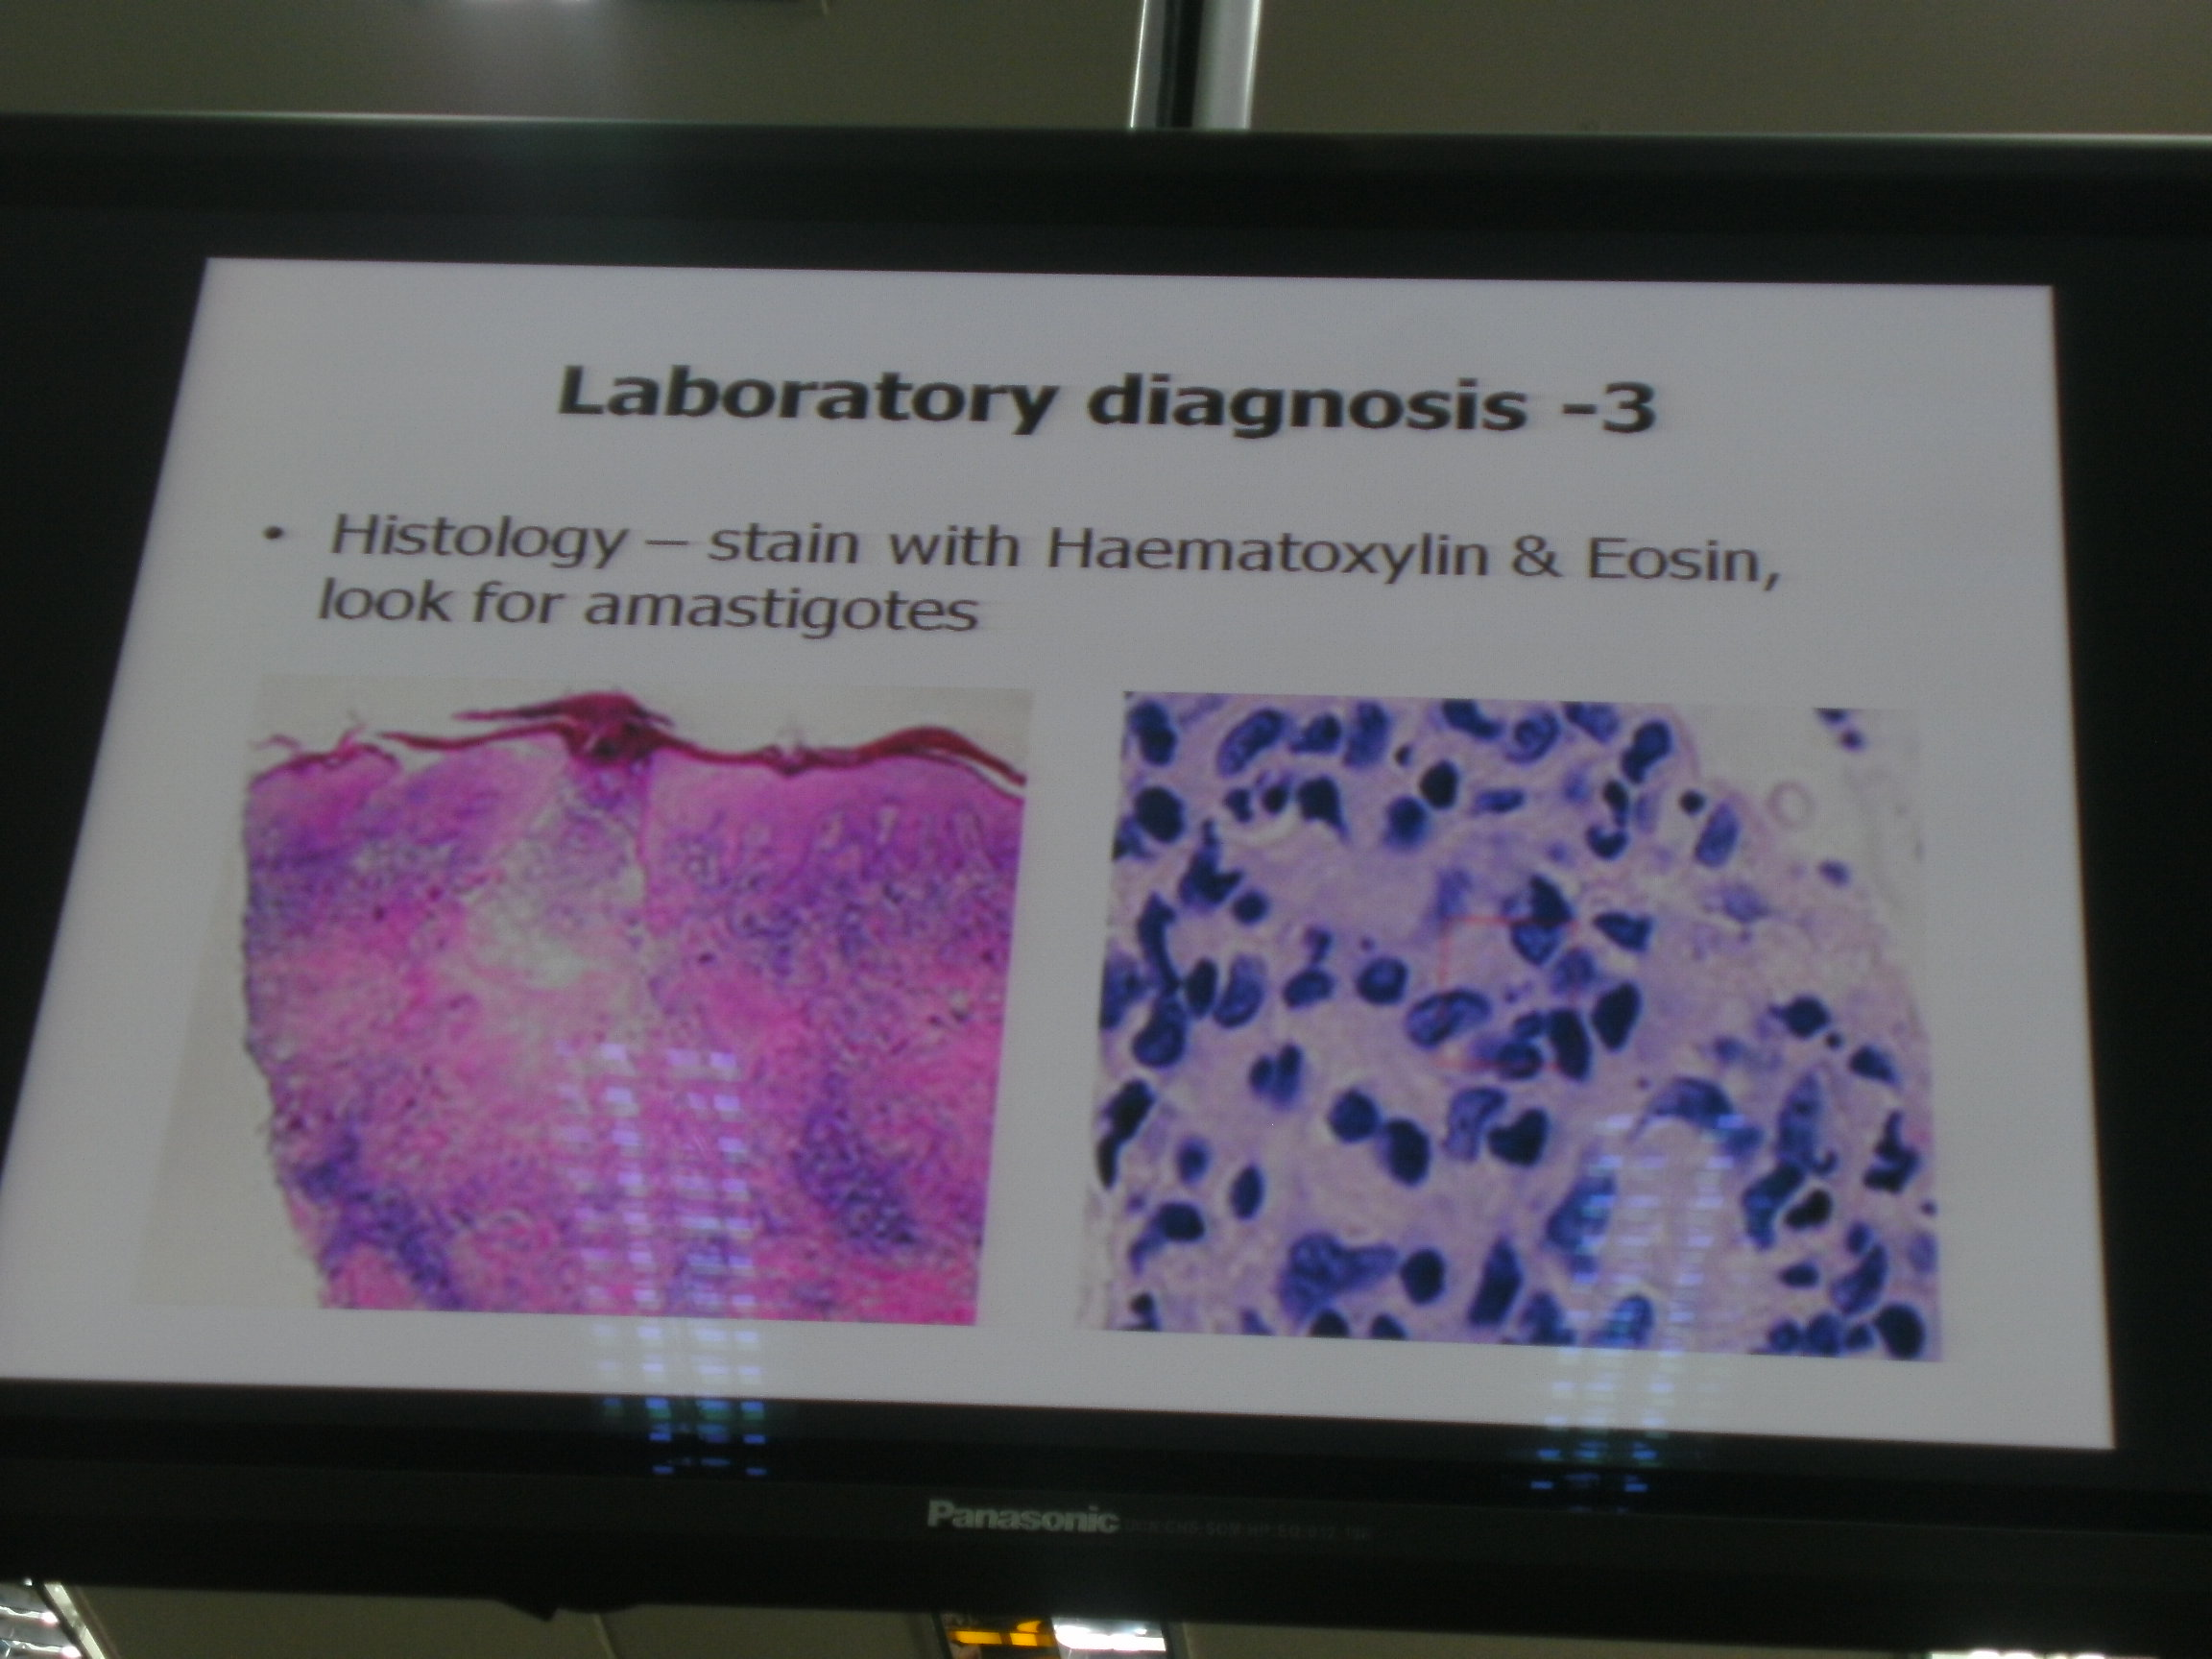

Slide 35
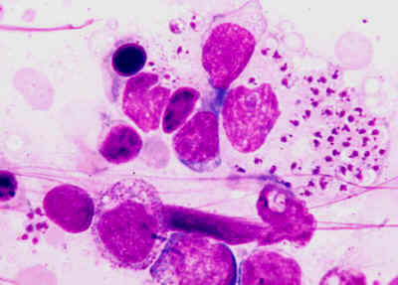
L. donovani bodies
L. donovani bodies may be demonstrated in buffy coat preparations of blood and bone marrow aspirate. Aspirates taken from enlarged lymph nodes show parasites in 60 percent of cases.

Slide 36
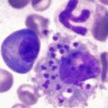
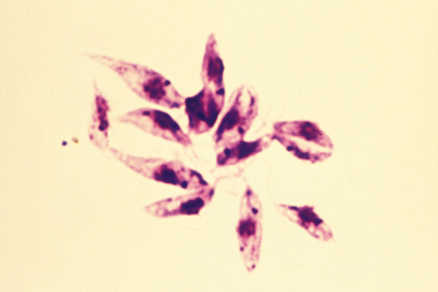
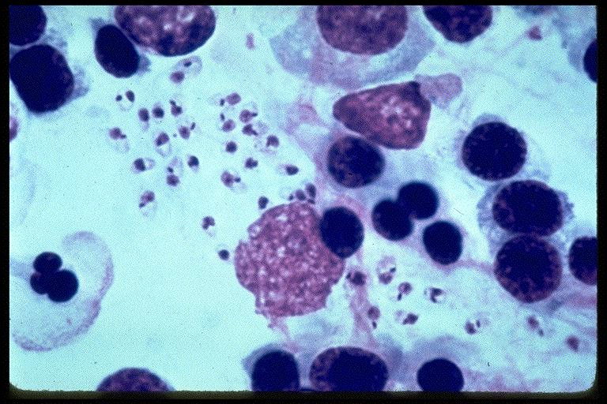
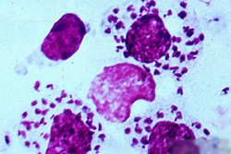
Leishmania amastigotes

Slide 38
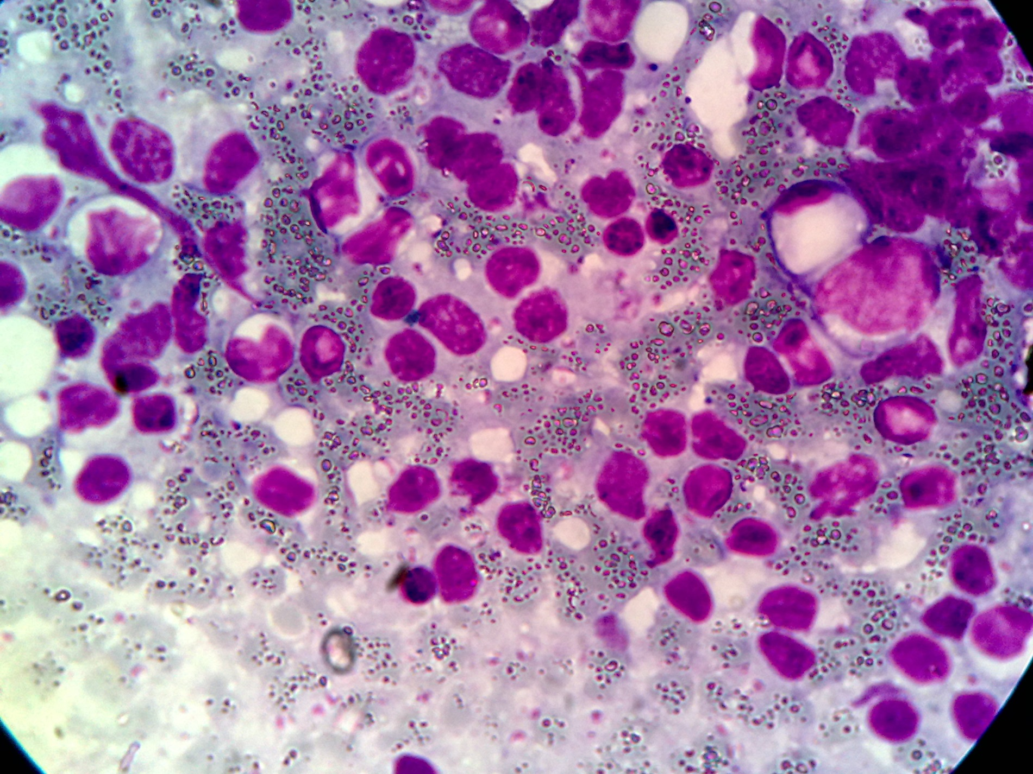

Slide 39
leishmania promastigotes

Slide 40
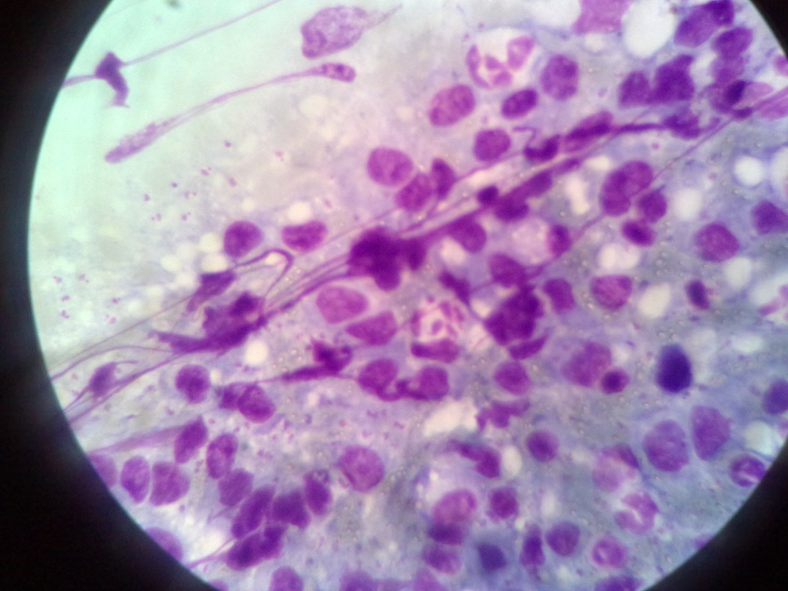
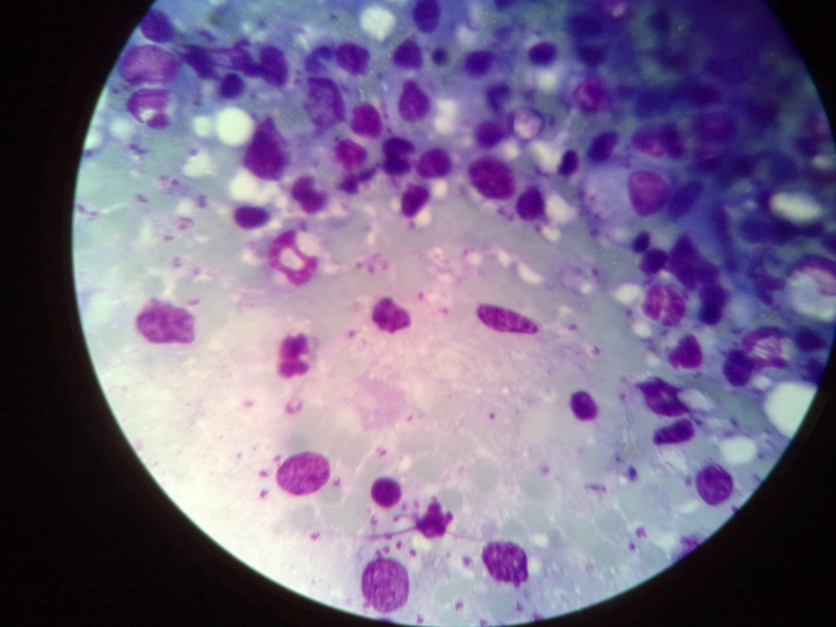
Amastigotes (L.D bodies)

Slide 41
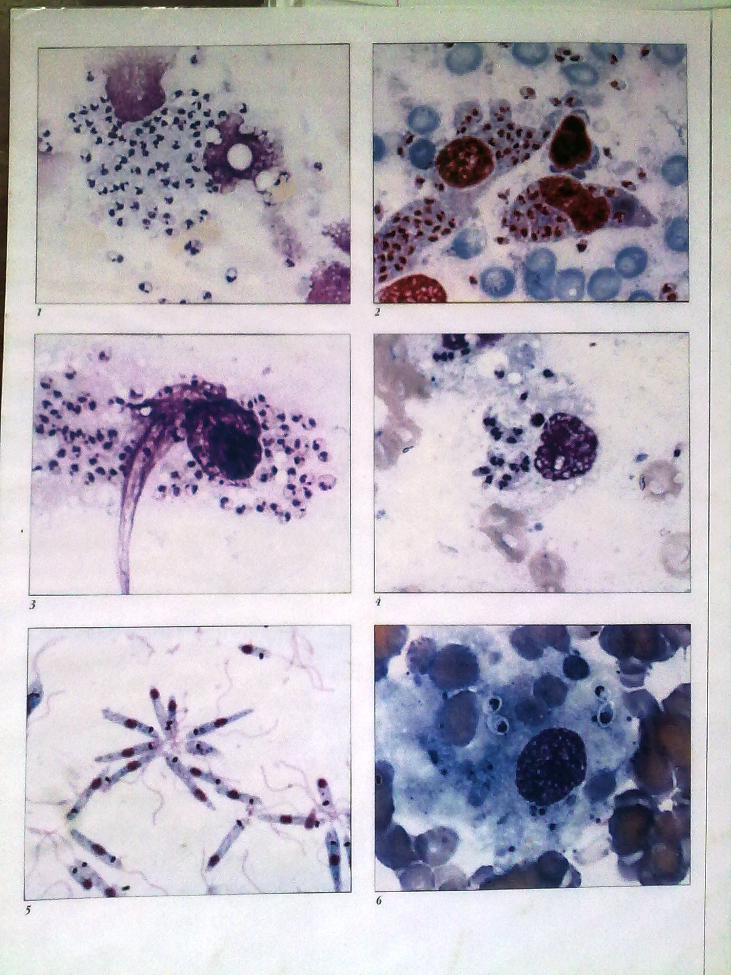
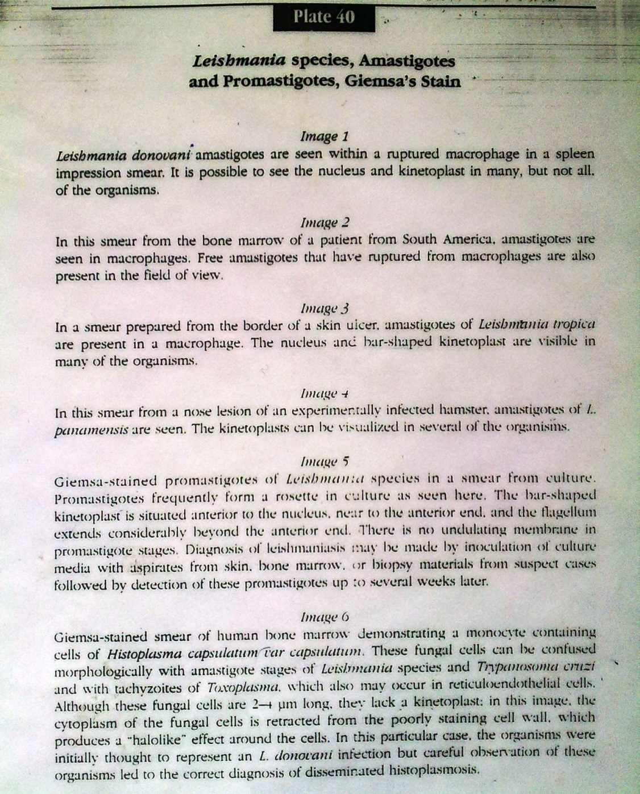

Slide 42
CUTANEOUS LEISHMANIASIS (CL)
Caused by L. major, L. tropica & L. mexicana.
This is the most common form of Leishmaniasis.
Worldwide distribution – 80 countries
200 Million at risk, 300,000 new infections annually
Americas, Europe, middle east, Asia, Afica
Occurs in 80 countries
Epidemics – non-immune popn into endemic areas (tourists, soldiers, new settlers, counstruvction or agricultural workers)
Social economic factors, popn growth, migration influence epidemiology of Cutaneous leishmaniasis

Slide 43
Leishmania, haemoflagellates, obligatory IC parasites
Old world – Cutanueous leishmaniasis –
  Leishmania major (rural, reservoir – rodents),
  L. tropica (urban, reservoir – dogs),
  L. ethiopica (reservoir – hyrax) – (Africa, Middle East, Europe, Asia)
New workd CL –
  L. Mexicana complex (L.M. Mexicana, L. m. amazonensis, L. m. venezuelensis),
  L. braziliensis complex (L.b. brazilliensis, L. b. peruviana, L. b. guyanensis, L. b. panamensis) – Central & South America

Slide 44
In Kenya
  L. tropica – Laikipia, Baringo, Nyandarua, Nakuru
  L. major – Laikipia, Baringo, Nyandarua, Nakuru, Kajiado
  L. ethiopica – reservoir – Rock hyrax, Kenya (Mt. Elgon region), Ethiopia highlands

Slide 45
Morphology
Amastigotes
Promastigotes

Slide 46
Clinical presentation of CL
Incubation period is few months (6) to years.
Temp sensitive promasitogotes
On the extremities
Characterized by one or more cutaneous lesions on areas where sandflies have fed. The volcano- like sores starts off as papules and nodules and may end up as ulcers.
Leishmanioma, papules – crusts – skin ulcers with raised edges – L. troika (single, dry), L. major (multiple, wet); secondary bacterial infection; self-limiting (slow healing) – L. major (1-2 yrs), L. troika (1/2 to 1 yr). Life-long immunity. L. major (both major & tropica), L. tropica (L. tropica only)

Slide 47
Nodules – L. ethiopica, not self-limiting, no immunity, diffuse cutaneous leishmaniasis
Skin ulcers may be covered by scab and crust.
The sores are usually painless but they can be painful. They take 2 to 3 weeks to appear. The sores heal in a few months to an year.
Some people have swollen glands near the sores (for example, in the armpit if the sores are on the arm or hand).

Slide 48
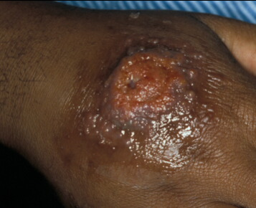
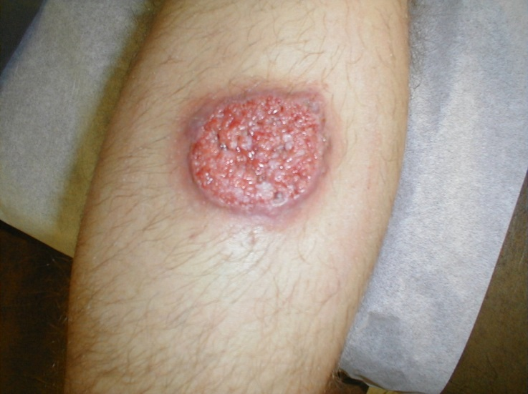
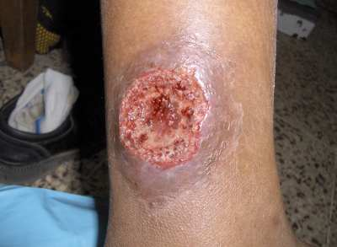
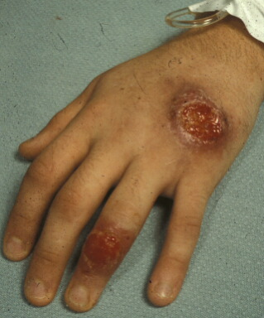
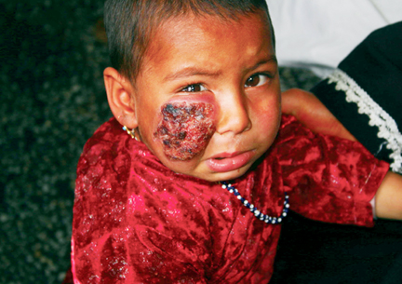
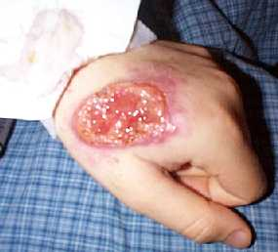
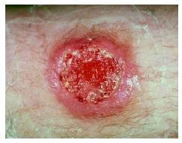

Slide 49
Lab diagnosis
Aspirate from the lesions – smear, stain with Giemsa, look for amastigotes!
  Some amastigotes will be intracellular, others are extracellular (when the macrophages rupture).
Biopsy: microscopy for LD bodies or culture in NNN medium for promastigotes

Slide 50
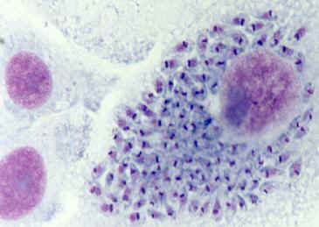

Slide 51
MUCOCUTANEOUS LEISHMANIASIS (ML)
Caused by L. braziliensis.
This infection is limited to the mucous membranes. It might be the consequence of infection with some of the species that causes cutaneous leishmaniasis.
Not treated cutaneous lesion on the face spreads to the nose or mouth causing sores in the mucous membranes of the throat, nose, palate or mouth.
Epistaxis
Months to years.
Lesions can be very disfiguring
Some people may have a silent infection without any symptoms.

Slide 52





Slide 53


POST KALA-AZAR DERMAL LEISHMANIASIS (PKDL)
DIFFUSE CUTANEOUS LEISHMANIASIS
PKDL occurs in 10% patient (India), 50% E. Africa
In New World PKDL is extremely rare (South America)
Usually after recovery from infection but may occur in those with no previous Kala azar

Slide 54
Begins with small hypopigmented macules, papules or nodules on face, gradually increase in size (rarely >1cm in D), nodules or facial erythema a macular especially in a patient who has recovered from VL and is otherwise well, then spread to upper trunk, arms, forearms, thighs, legs, abd, neck & back
Multiple lesions can join to form larger ones with gross enlargement of facial features similar to leprosy
May be confused with leprosy, nodular cutaneous leismaniasis, secondary syphillis, & sarcoidosis

Slide 55
Disease particularly severe if lesions spread to mucosal surfaces of nasal septum, hard & soft palate, larynx oropharynx, or eye lids & cornea leading to blindness
Potentially the lesions can appear on any part of body
Reports of lesions occurring on glans penis & genital mucosa, hence, there is possibility of PKDL being transmitted sexually

Slide 56
Sarcoidosis.
Lesions usually self-limiting, however those that do not heal within 6 months have to be treated
IM Na stibogluconate (20 mg/kg body wt) 4-5 Moles
+ ketoconazole (antifungal) & allopurinol (gout Rx)can improve response
For resistance cases use of Amp B is effective
Indian PKDL appears 1- yrs after apparent Kalazar cure, although up to 20-30 yrs been reported
African form usually appears with 6 months, but can occur during Rx (para kalaazar dermal leishmaniasis)

Slide 57
DISSEMINATED LEISHMANIASIS
This is a new and emerging form of leishmaniasis. It is characterised by a large number of acneform, ulcerated and papular lesions distributed in more than 2 noncontiguous parts of the body.
It mainly occurs in Brazil.
Mucosal involvement is detected in up to 44% of the cases.
The development of the disease involves a complex and poorly understood network involving the parasite, host immune response and the environment where brazeliensis is the main parasite.

Slide 58
Treatment of Leishmaniasis
Human beings have no promastigotes! Thus drugs are used to treat amastigotes
Antimony-containing compounds :
  Meglumine antimonate.
  Sodium stibogluconate.
Other drugs
  Pentamidine: CL
  Amphotericin B
  Aminosidine (Paromycin) - Add allopurinol in unresponsive cases
  Miltefosine
  Sitamaquine (Kalazaquine)

Slide 59

Miltefosine
  An alkyl phospholipid, approved for the treatment of VL.
  An oral daily dose of 50 mg (patient's body weight < 25 kg) to 100 mg (≥ 25 kg), or 2.5 mg/kg body weight for children, for 28 days cures over 90%.
  Side-effects include mild to moderate vomiting /diarrhoea/ rarely skin allergy or nephrotoxicity.
  Since it is a teratogenic drug, it cannot be used in pregnancy; female patients are advised not to become pregnant for the duration of treatment &another 2 months, because of its half-life of nearly 1 week.

Slide 60

Paromomycin
  An aminoglycoside, highly effective if given intramuscularly at 15 mg/kg body weight daily for 3 weeks.
  No significant auditory or renal toxicity is seen.

Slide 61
Surgery
  Cryosurgery – heat therapy = use of very low temps (freezing to kill amastigotes).(CL)
  Plastic surgery and skin (ML and ML).
  Splenectomy in drug-resistant (VL).
Oral (CL)
  Ketoconazole, Itraconazole, dapsone (used for leprosy), allopurinol, rifampicin. Rx is reserved for L. ethiopica. The others are not very intense.

Slide 62
PREVENTION AND CONTROL
Vector control (Indirect Active Transmission)
  Insecticide spraying
  Genetic control
  Biological control
  Chemical control
Public health measures to reduce the sandfly population and control of animal reservoirs e.g dogs
Personal protection

Slide 63
Personal protection
Preventing sand fly bites is the most immediate form of protection. You can prevent a bite by
Screening windows
Putting fine mesh netting around the bed and tuck it under your mattress
If possible, use a bed net that has been soaked in or sprayed with a pyrethroid-containing insecticide (permethrin or deltamethrin). The same treatment can be applied to screens, curtains, sheets, and clothing (clothing should be retreated after five washings)
Wearing insect repellent
Wearing protective clothing
There are no vaccines or drugs that prevent leishmaniasis

