Slide 1
The Cold Chain
Sr. Muhatia
KMTC Webuye

Slide 2
Broad objectives
The learner will manage cold chain effectively.
Specific objectives:
At the end of the session the learner will be expected to:
1. Explain concept of cold chain system.
2. List the cold chain equipment used in the country.
3. Demonstrate packing of vaccines in the cold chain equipment.
4. Describe basic principles of refrigeration.
5. Monitor cold chain temperature.
7. Be able to take equipment inventory.
8. Know common cold chain emergencies.

Slide 3
Definition
The "cold chain" is a system of storage and transport of vaccines at low temperature from the manufacturer to the actual vaccination site/target population to be immunized.
The cold chain system is necessary because vaccine failure may occur due to failure to store and transport under strict temperature controls.

Slide 4
It is a system of different elements: human, material and financial resources, certain norms and standards that ensure high-quality vaccine.
Cold chain consists of different levels called links, which deal with vaccine orders and supplies, their transportation, storage and distribution at low temperature from the manufacturer to the actual vaccination site/target population to be immunized.
The cold chain is an integral part of any immunization and as such, it should be seen within the entire EPI management framework (planning, monitoring and evaluation).

Slide 5
Cold chain options
The cold chain structure is based on two options: fast and slow cold chain
Fast cold chain
Is based on equipment that retain cold through pre-frozen icepacks for transporting vaccines (vaccine carriers and cold boxes) it does not generate cold. It has a hold over time of 8 hours.
Slow cold chain
Relies on cold-generating equipment , it uses ice-making equipment like refrigerators, freezers and cold rooms. Hold over time is 72 ours

Slide 6
Reverse Cold Chain
This is a special chain that involves transportation of specimens from people who show signs and symptoms of disease.
It starts from taking specimens, preserving and transporting them from patient to the laboratory.
The fast cold chain is the recommended option for the reverse cold chain

Slide 7
Cold Chain system of EPI
System that ensures
1.Potency
2.Quality
3.Safety
of Vaccines by maintaining the correct temperature from Manufacturer to
Children/Women

Slide 8
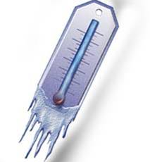
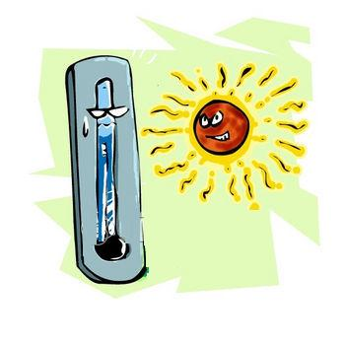
Why have the Cold Chain?
If vaccines are exposed to excessive
Heat
Cold
Light
they may lose their potency or effectiveness.
Notes:
8

Slide 9
How long is the cold chain?
♦ Manufacturer to airport; cold storage at airport
♦ Transport at the correct temperature from airport to storage in central, regional and district stores and in health centers
♦ Transported at the correct temperature to outreach sites
♦ Kept at correct temperature during immunization sessions.

Slide 10
The levels of cold chain

Slide 12
The components of the cold chain :
The equipment and tools:
vaccine carriers, ice packs, fridge books and thermometers
The procedures:
process/techniques e.g. vaccination, waste management ,injection safety
The health staff:
should be trained for controlling vaccines

Slide 13
Elements of an effective cold chain
Health worker trained in cold chain maintenance and vaccine handling
Adequate functional equipment: cold room, refrigerators, freezers, vaccine carriers and cold boxes, temperature monitors, refrigerator repair tools etc.
Vaccine supply and transport
EPI needs a well-established system of logistics to administer high quality and safe vaccines to women and children.
This include: needles, syringes and sharps disposal boxes.
Too often unsafe injections occur due to shortage of injection equipment.
Notes:
An efficient cold chain system requires trained and skilled staff, reliable equipment and adherence to set standards.

Slide 14
Cold Chain Equipment
The equipment used in maintaining cold chain must meet standards set by WHO and UNICEF for safe vaccine storage. They vary depending on the level of use.
Below is a list of the equipment currently used in Kenya.
Cold rooms and freezer rooms
Freezers and Ice-lined refrigerators
Gas electric refrigerators
Solar Refrigerators
Vaccine carriers
Cold boxes
Icepacks
Thermometers

Slide 15
Cold Rooms and Freezer Rooms
These are large rooms, specially constructed for storage of large quantities of vaccines.
They have two cooling units; one running while the other is standby, a 24-hour temperature monitoring system with an alarm, a recorder, and a backup generator that will turn on automatically when the regular power is interrupted.
Cold rooms are found at the national and regional levels while freezer rooms are only found at the national level.

Slide 16
The Cold/Freezer Room

Slide 17
Basic Principles Of Refrigeration
Terminologies
• Refrigeration - The process of removing heat from an insulated space to maintain cold temperature.
• Refrigerator - This is an airtight equipment connected to a power source which can either be
gas or electricity to achieve cooling.
• Refrigerant - A fluid with low boiling point which circulates in the refrigeration system to facilitate cooling.

Slide 18
Types of refrigeration systems used in EPI
• Compression system
• Absorption system
Compression type: This type of refrigeration system uses a compressor, which when connected to electricity pumps the refrigerant through the pipes.
The pipes connect the inside of the refrigerator to the outside.
As the refrigerant circulates, it absorbs heat from inside lowering the temperature inside the refrigerator.
The refrigerator hums when in operation.
An example of this refrigerator is TCW 1152

Slide 19
Absorption type:
This type of refrigerator has a heating unit, which uses either gas or electricity.
When the heating unit is supplied with a source of heat the refrigerant boils, evaporates and circulates through the coiled pipes where it loses heat changing into liquid as it enters the pipe inside the refrigerator.
Due to the low boiling properties of the refrigerant it evaporates again as it enters the inside pipes and this results into cooling.
Absorption refrigerator is quiet when in operation.
An example of absorption type of refrigerator is RCW 42 EG.

Slide 20
Freezers/ Ice-lined Refrigerators
Freezers and ice-lined refrigerators are used at Central, Regional& District stores
Freezer
Used for large storage of antigens and freezing of icepacks at the central, regional, district and sub district level
Ice-lined refrigerator
Used for large storage of antigens at the district and sub district level.
It can be converted into either a refrigerator or a freezer based on need.

Slide 21
Freezer MF314

Slide 22
Ice-lined refrigerator TCW3000AC

Slide 23
Gas Electric refrigerators
There are currently three major types of gas electric refrigerators used in the country; these are
Sibir 170GE, RCW42EG and RCW50EG.
Sibir170GE
Vaccines are placed in shelves in order of sensitivity with the most sensitive to heat (OPV) being on the first shelf below the evaporator.
TT and DPT+HepB –HiB being most sensitive to freezing are placed on the second last shelf from the bottom.

Slide 24
Vaccines are packed leaving space of about 5cm in between the packets for air circulation.
The upper cabinet is used for freezing of icepacks.
This fridge is used at the district vaccine store and at the immunizing facilities with high target population.

Slide 25
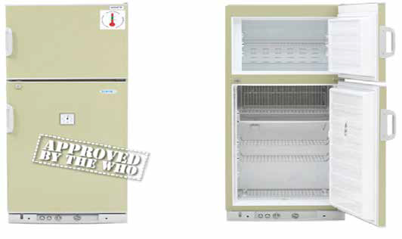
Sibir V170GE
Vaccines are packed upright refrigerator

Slide 26
Sibir 170 GE

Slide 27
RCW 42 EG
The refrigerator is designed for use at the service delivery point.
It is operated either on electricity or gas and has top opening door.
Trays of different colors are used to store each type of vaccine.
The most sensitive to heat being oral polio vaccine is kept in blue tray that is placed at the bottom most part of the fridge while the most sensitive to freezing being DPT+HepB-HiB is kept in the red tray which is the top tray.

Slide 28
A sticker is pasted on the front side of the refrigerator to guide on the vaccine arrangement and the arrangement order must be observed at all the times.

Slide 29
RCW42EG

Slide 30
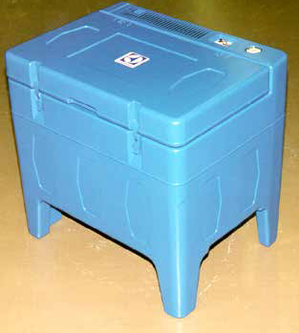
RCW 50 EG
This is similar to RCW42EG but has a double vaccine carrying capacity.
It is suitable for use at places with higher target population or sub district depots.
It also has higher fuel consumption.

Slide 31
Cold Box
Cold boxes are normally used for transportation of vaccines.
They can also be used for temporary storage when a refrigerator breaks down.
The cold life of a cold box varies depending on the type, the number of openings and the ambient temperature.

Slide 32
Packing ice packs in cold box

Slide 33
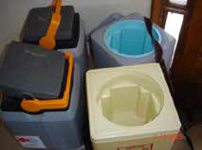
Vaccine Carrier
Vaccine carriers are used to transport vaccines from district stores to service delivery points (outreach / mobile) and during immunization sessions.
The cold life in a vaccine carrier is approximately 8hours.

Slide 34
Icepacks
Icepacks are flat rectangular plastic containers filled with water or gel and frozen.
They are used in vaccine carriers, cold boxes or refrigerators to maintain temperatures.
The required number in a particular cold box or vaccine carrier varies.
Always have at least an extra set of icepacks as a reserve while one set is in use.
Every health centre should have two sets of ice packs, one being frozen while the other is in use.
♦ Condition the ice packs before use

Slide 35
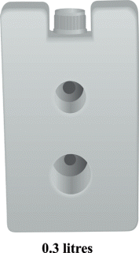
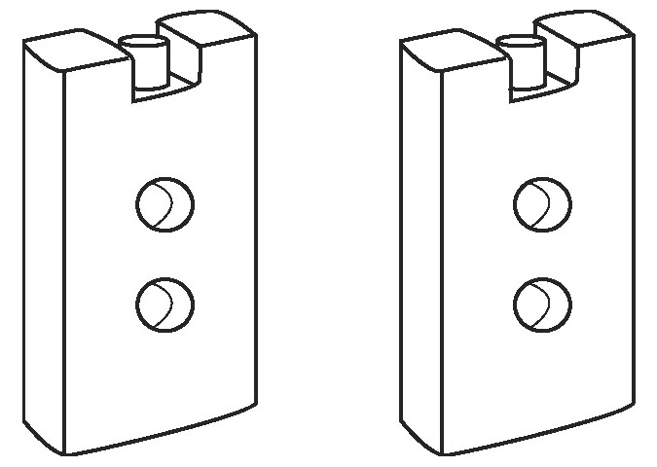
Ice packs
0.4 liters
0.6 liters

Slide 36
Thermometers
Different types of thermometers are used to monitor cold chain temperature.
These are the dial and alcohol thermometers as shown below.
They indicate the safe operating ranges of temperature of between +2OC to +8OC for refrigerators and –15OC to –25OC for freezers.

Slide 37
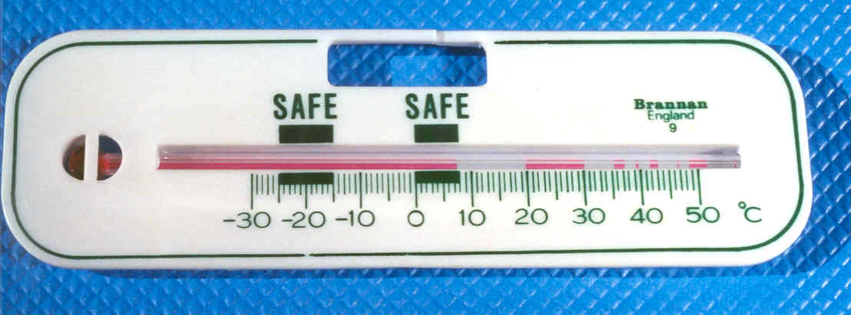
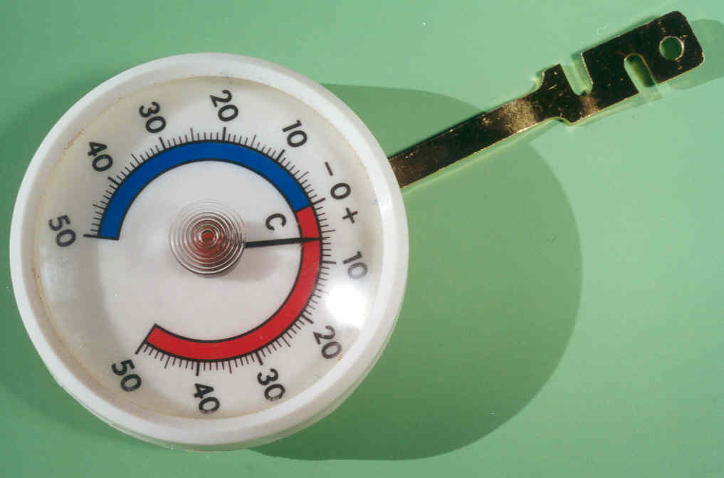
Type of Vaccine Thermometer

Slide 38
Type of Vaccine Thermometer
Dial type Thermometer

Slide 39
Type of Vaccine Thermometer
Bar type Thermometer
(read safety zone as 2⁰ to 8⁰ C & not as 0⁰ to 8⁰)

Slide 40
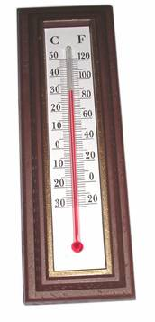

Slide 41
Monitoring Cold Chain Temperature
How to use the cold chain temperature-monitoring chart
Read and record the refrigerator temperature twice daily; morning and evening including weekends and public holidays.
Carefully record these temperature readings on the cold chain recording sheet.

Slide 42
You must enter:
• Name and type of refrigerator
• Name of the district
• Name of the health institution
• Power Source (Normally operating on)
• The date
• The number of icepacks frozen today
• The number of icepacks used today
• The number of hours of electricity failure
• Shortage of gas (Mark with X)
• Gas cylinder renewed (Mark with X)
• Plot the temperature morning and evening
• Report on faults and problems at the bottom off the chart

Slide 43
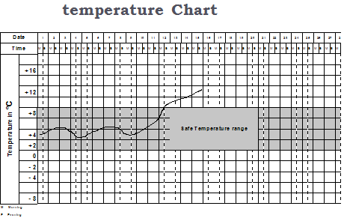
Note that the bold line is for start of the day which is mid night and the broken line mid day.
Charting should therefore be done at the centre of the bold and dotted line in the morning, and at the centre of the broken and bold line for the evening charting as shown below.

Slide 44
Preventive Maintenance Activities
Daily activities
Check temperature twice, in the morning and evening including public holidays and weekends and chart on the temperature-monitoring chart.
Ensure the temperature is between +2°C to +8°C.
Check that the refrigerator is operating and the burner flame is blue for gas refrigerator.
Make sure that there is enough gas in the cylinder.
Health worker should know how long a cylinder takes when running continuously.
Ensure that vaccines are well arranged in the refrigerator
DO NOT keep any other item in refrigerator apart from vaccines and diluents.
Keep a spare gas cylinder available and always replace the gas cylinder before it is completely empty.

Slide 45
Weekly activity
Check the ice formation on the evaporator.
If the ice is thicker than 6mm to 10mm defrost the refrigerator.
Check that the refrigerator is level.
Monthly activity
Check that the condenser and cooling unit are clean.
Remove any dirt or dust with a soft brush or cloth.

Slide 46
When necessary, clean inside and outside of the refrigerator with a damp cloth.
Clean door gasket and powder it with perfume free talcum.
Check the gas connections for leaks
Yealy activity –
done by the medical engineering technician
Clean the gas burner and gas jet
Clean the flue and baffle

Slide 47
What to do if the refrigerator is not working properly
The refrigerator is not working properly if any of the following happens:
The refrigerator is not cooling at all
The refrigerator is not cold enough above 8 degress centrigade
The refrigerator is too cold below 2 degrees centigrade

Slide 48
Ensure that Vaccines are transferred into a vaccine carrier or cold box before determining the fault.
Always start with the first possible fault.
Make sure that a fault does not exist before going on to the next one.
If, after checking all the possible faults, the refrigerator is still not working properly, start at the beginning and check everything again.
If, after checking all the possible faults twice, the refrigerator is not working properly, refer to the district for further action by a trained technician

Slide 49
Checking the door sealing
Place a thin paper (foolscap) strip in between the door and body of refrigerator
Close the door.
Pull the paper strip (Foolscap), if it moves easily or falls by itself, the door gasket is faulty, or the door hinges are loose or broken.
Take necessary action and if unable, refer for further action by a skilled technician.

Slide 50
Checking gas supply
• Always keep a spare gas supply tube.
• Use soapy water to check for any gas leakage
• If there is a leakage in the gas supply tube, replace it.
• Does not use the refrigerator on gas operation if there is leaking connections, which you cannot repair, refer to the district for further action by a skilled technician.
Checking the gas thermostat
Remove the capillary tube end from the evaporator.

Slide 51
Put the capillary tube end into a glass of ice cubes.
• Turn the thermostat control knob to “maximum” position.
• Watch the flame in the sight glass and slowly turn the thermostat control knob towards the “minimum” position.
If the flame gets smaller, the thermostat is working.
If the flame does not get smaller, the thermostat is faulty.
Replace the thermostat.

Slide 52
Adjusting the temperature, ensure a 48hr observation period
• After checking the inside temperature, the control knob can be turned towards a warmer or colder position if necessary.
• The control knob is usually marked “1” to “7”, MIN”, “MED” and “MAX” or with an arrow
indicating how to turn to colder temperature as shown below.
• No. “1” or “MIN” gives the warmest and No. “7” or “MAX” gives the coldest temperature.

Slide 53
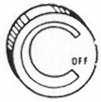
Types of control knobs

Slide 54
Checking the flame failure device
• Press the flame failure device button as far in as possible.
• Light the burner and wait for 15 to 20 seconds.
• Release the button and check the thermo-element.
If the flame is accidentally blown out, the flame failure device must shut off the gas supply within one minute.
• Blow out the flame. Wait for one minute.
• Try to light the burner without pressing the flame failure device button.
• If the burner lights, the flame failure device is faulty. Replace it.

Slide 55
Defrosting
It is quite normal for ice and frost to form on the evaporator.
A thin layer of frost does not affect the cooling performance but if the frost grows thick approximately (6 to 10m (1/4 –3/8”) or more), it must be removed by defrosting.

Slide 56
Defrosting Procedure
• Move the vaccine into another refrigerator or store it in a cold box with icepacks
• Turn off the gas supply (or remove plug from the wall socket if on electric operation).
• Open the door of the refrigerator and leave it open for the ice to melt normally or use warm water with a cloth to thaw the ice
• Do not use knives or other sharp instruments.
• Wipe the freezer compartment dry.
• Clean and dry the refrigerator.
• Light the burner (or plug in three pin top plug into the wall socket if on electric operation).
• Wait until the temperature stabilizes between +2°C to +8°C.
• Place the vaccine inside and close the door.

Slide 57
Cleaning the refrigerator
• Always clean the inside of the refrigerator when defrosting.
• Use warm water and soap.
• Never use scouring powder, steel wool or abrasive cleaners on any refrigerator with a metallic surface paint.

Slide 58
Clean the door gasket and put same talcum on it.
• Wipe all parts dry before starting the refrigerator.
• Clean the outside with a soft brush or a piece of cloth.
• Clean the condenser and cooling unit with soft brush.
• Light the burner (connect the power plug into the wal1 socket if on electric operation).
• Wait until the temperature stabilizes between +2°C to +8°C to return vaccines.

Slide 59
Cold Chain Emergencies
Emergencies can interrupt immunization services if not planned for.
Some of the common cold chain emergencies include:
• Equipment breakdown.
• Electric power failure.
• Shortage of gas.
• Shortage of spare parts.

Slide 60
There should be a warning system for identifying equipment failure and make arrangements in advance for moving vaccines to the nearest health facility or location that has appropriate substitute equipment.
The district should be notified as soon as possible of such failure.
Wash the gas jet carefully in alcohol, kerosene or petrol. Blow through it to dry (Do not use any sharp object to clear the jet.

Slide 61
• Check that the jet is completely clear by looking through it against the light.
• If the jet is damaged or badly blocked that cannot be cleared, fit a new one.
• Clean the gas burner with a soft brush and blow it free of dust.
• Replace the parts and Check for leaks.
• Light the burner and wait until the temperature inside has come down to +2°C to +8°C before replacing the vaccine.

Slide 62
Starting on electric operation
• If the refrigerator has been on gas operation, take the following action:
• Turn off the gas supply at the gas cylinder.
Wait until the burner flame goes out.
• Disconnect the gas supply regulator from the gas cylinder.
• Check that the power supply voltage is correct (220V – 240V).

Slide 63
Plug in the top plug into the wall socket.
Turn the thermometer control knob to medium or position 4, put a thermometer in the fridge and leave the refrigerator running for 3 to 4 hours.
If it does not start, ensure that the plug is wired correctly.
Read the temperature inside the refrigerator. It must be between +2oC to +8 oC.

Slide 64
Adjusting the temperature
After confirming that the refrigerator is working on electricity, it is important to check the temperature because the temperature setting for gas operation may give very low temperature for electric operation.
Monitor the refrigerator and adjust the thermostat control knob accordingly depending on the temperatures inside the refrigerator.
The temperature must stabilise between (+2oC to +8 oC).
If the refrigerator does not cool, follow the instructions below

Slide 65
Refrigerator not cooling at all on (electrical operation)

Slide 66
Stock management
Always keep in stock:
• One spare full gas cylinder.
• One spare gas supply pipe.
• One spare heater (for electric operation).
• Spare fuses or fuse wire for electric operation).

Slide 67
Equipment Inventory
It is important to keep records of equipments. A good equipment inventory will provide the information needed to track the location, maintenance schedule, replacement and evaluation of the adequacy of the equipment.
Records for each piece of equipment should include:
• Technical information (brand, model, serial number, date of entry into service and date of final removal from service)
• Specific location
• Current condition (working, in repair, un-repairable)

