Slide 1
GIT DISORDERS

Slide 2
Objectives
At the end of the block the student will be able to:-
1.Define terminologies used in GIT conditions
2.Recognize individuals with GIT conditions
3.Describe common GIT diseases
4.Demonstrate ability to care for individuals with GIT conditions

Slide 3
ASSIGNMENTS
Barrett’s oesophagus
Irritable bowel syndrome
Coeiliac disease
Sphincter of Oddi Dysfunction
Food allergies
Narcotic bowel Syndrome
Anal Fistulae

Slide 4
TERMS IN GIT
Constipation-fewer than three bowel movements a week, or hard, dry and small bowel movements that are painful and, or difficult to pass.
Obstruction-blockage within the G.I.T
Mal-absorption-inability of the small intestines to absorb certain essential substances

Slide 5
Odonophagia-pain on swallowing
Pyrosis-heartburn
Xerostomia –dry mouth
Stomatitis –inflammation of the oral cavity and lips mucosa
Dysphagia –difficulty in swallowing
Achlorhydria –lack of HCL in digestive secretions of the stomach
Stenosis –narrowing or tightening of an opening or passage in the body

Slide 6
COMMON TESTS
Liver enzyme tests
Stool tests
Gastric juice analysis
Endoscopies
Radiographics
CT scan
MRI
X-rays

Slide 7
DISORDERS OF THE ORAL CAVITY

Slide 8
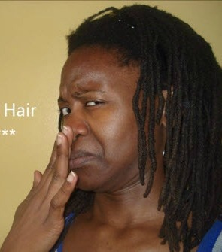
1. HALITOSIS

Slide 9
It is also known as bad breath or fetor oris. Halitosis can cause significant worry, embarrassment, and anxiety .
estimated to affect 1 in 4 people globally.
If particles of food are left in the mouth, their breakdown by bacteria produces sulfur compounds.
Keeping the mouth hydrated can reduce mouth odor. How to keep mouth hydrated?
The best treatment for bad breath is regular brushing

Slide 10
Causes
Tobacco: Tobacco products cause their own types of mouth odor. Additionally, they increase the chances of gum disease which can also cause bad breath.
Food: The breakdown of food particles stuck in the teeth can cause odors. Some foods such as onions and garlic can also cause bad breath. After they are digested, their breakdown products are carried in the blood to the lungs where they can affect the breath.

Slide 11
Dry mouth: Saliva naturally cleans the mouth. If the mouth is naturally dry or dry due to a specific disease, such as xerostomia, odors can build up.
Dental hygiene: particles of food build up and slowly break down, producing an odor. A film of bacteria (plaque) builds up if brushing is not regular. This plaque can irritate the gums and cause inflammation between the teeth and gums called periodontitis Dentures that are not cleaned regularly or properly can also harbor bacteria that cause halitosis.

Slide 12
Crash diets(a very restrictive meal plan that's unsustainable for the long term). Fasting and low-carbohydrate diet. This is due to the breakdown of reserve fats produces called ketones. that smell
Drugs: Examples include nitrates used to treat angina, some chemotherapy chemicals, and some tranquilizers, such as phenothiazines. Individuals who take vitamin supplements in large doses can also be prone to bad breath.

Slide 13
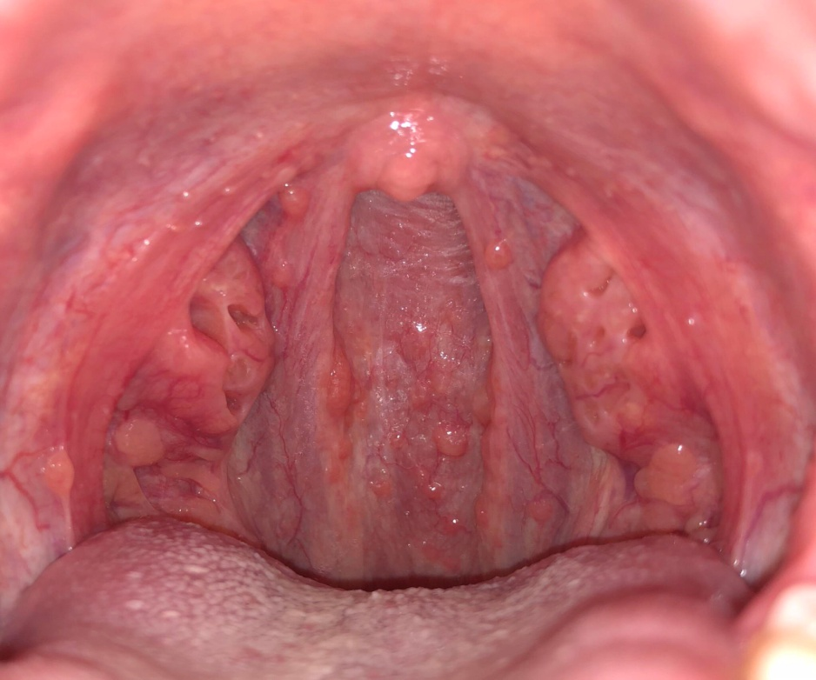
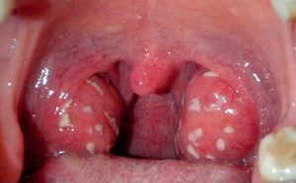
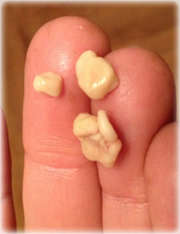
Mouth, nose, and throat conditions: Sometimes, small, bacteria-covered stones can form on the tonsils at the back of the throat and produce odor( tonsilolithiasis). Also, infections or inflammation in the nose, throat, or sinuses can cause halitosis.

Slide 14
Foreign body: Bad breath can be caused if they have a foreign body lodged in their nasal cavity, especially in children.
Diseases: Some cancers, liver failure, and other metabolic diseases can cause halitosis, due to the specific mixes of chemicals that they produce. Gastroesophageal reflux disease (GERD) can cause bad breath due to the regular reflux of stomach acids

Slide 15
HOME REMEDY FOR SMALL STONES
Cotton swab or finger. reach it with a finger or a cotton swab and scrape it off. Do this very carefully as it may cause additional infection if done aggressively or if the stone’s larger. Gargle with salt water immediately after you remove a tonsil stone this way. You shouldn’t do this unless the stone is easy to reach and small.
Coughing. Depending on the size of the stone, coughing could to dislodge a stone in some cases.

Slide 16
Apple cider vinegar or any vinegar. Dilute with water and gargle. Vinegar is supposed to be able to break down the stones because of its acidic content.
Garlic. Studies have shown that garlic has antibacterial, antifungal, and antiviral properties. It may combat bacterial growth and infection.

Slide 17
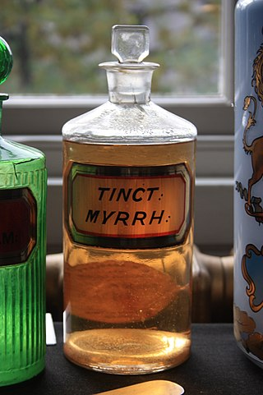
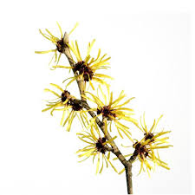
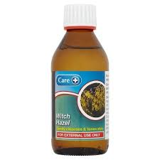
Essential oils. Some oils have anti-inflammatory or antibacterial properties. Examples are myrrh, thieves oil, and lemongrass. These may reduce or eliminate tonsil stones. Dilute the essential oil in a carrier oil and place one or two drops on a toothbrush before brushing the stones. Be sure to follow the directions for each specific oil. Because of the number of bacteria, it’s recommended that you don’t use this toothbrush afterwards

Slide 18
Thieves oil-History-bubonic plague
35 drops clove essential oil.
30 drops lemon essential oil.
15 drops cinnamon bark essential oil.
13 drops eucalyptus essential oil.
7 drops rosemary essential oil.
10 ounces witch hazel or water (optional)

Slide 19
Salt water. One study shows that rinsing with salt water is an effective treatment of oral wounds.
Yogurt. Eating yogurt that contains probiotics may be able to counteract the bacteria causing tonsil stones.

Slide 20
Apples. The acidic content of apples may help combat the bacteria in a tonsil stone.
Carrots. Chewing carrots helps increase saliva and the production of natural antibacterial processes. This may help reduce or eliminate your tonsil stones.
Onions. Onions are believed to contain strong antibacterial properties. Including them in your diet may help prevent or eliminate tonsil stones.

Slide 21
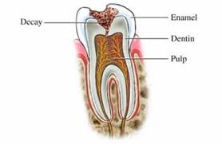
2. DENTAL CARIES
It is a local process manifesting with demineralization and progressive destruction of dental tissues with the formation of defect (cavity).
Affect enamel, dentin and pulp
decay
enamel
dentin
pulp

Slide 22
types
Carious: Have caries(cavities), etiology: bacterial action
Non carious: No caries(no cavities), no bacteria action, just lesions: etiology: erosion, abrasion,fluorosis

Slide 23
Carious lesions: pathophysiology
Tooth surfaces are normally colonized by many microorganisms.
Unless the surface is cleaned thoroughly and frequently, bacterial colonies of majorly streptococcus mutans form a soft mass known as dental plaque on the teeth surface or in a fissure (a break in the tooth’s enamel) or in an area that is hard to clean.

Slide 24
Food residues accumulate and bacterial action produces acid that erodes the enamel. If no action is taken, the enamel is penetrated through into the dentin.
In the dentin, decay progresses more rapidly because the dentin is softer than the enamel and in time reaches the pulp. When the blood, lymph vessels, and nerves are exposed, they become infected and an abscess may form, either within the tooth or at the tip of the root.

Slide 25
Factors enhancing bacterial action
Xerostomia (chronic dryness of the mouth from lack of saliva)
Normally, saliva neutralizes microbially produced acids in the mouth.
It contains bacteriostatic factors

Slide 26
High-carbohydrate diet-more acids while roughage in raw and unrefined foods cleanses the teeth and necessitates more mastication, which further contributes to cleansing of the teeth.
Soft and refined foods tend to stick to the teeth and also require less chewing.
Others:– general state of the organism, – genetic predisposition, – age, –

Slide 27
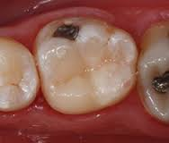
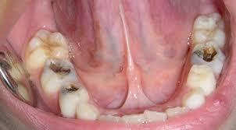
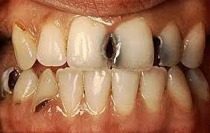

Slide 28
Non carious lesions etiology
Erosion
Mechanical abrasion
Fluoride (excess)
Fluoride(deficient)

Slide 29
Non carious lesions
Erosion – irreversible loss of tooth structure due to chemical dissolution by acids not of bacterial origin.
Acids of 5.0 -5.7pH from food greatly responsible
Gastric acid(regurgitation)
Work in production of inorganic acids e.g diamond, table salt (professional pathology).

Slide 30
abrasion
loss of tooth structure by mechanical forces from a foreign element.
Possible sources of this wearing of tooth are toothbrushes, toothpicks, floss, and any dental appliance frequently set in and removed from the mouth.

Slide 31
Fluoride: Deficient
Fluoride protects against dental caries by being incorporated into the crystal lattice structure of enamel, where it forms fluorapatite, which is less acid soluble than is the apatite of enamel. Fluoridation of drinking water leads to reductions in dental caries. Normal amount is 0.7-1.2 mg/l.

Slide 32
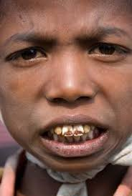
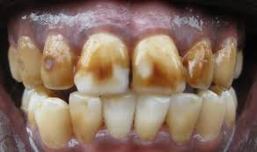
Fluoride: excess (fluorosis)
Dental fluorosis, aka. mottling of tooth enamel, is a developmental disturbance of dental enamel caused by excessive exposure to high concentrations of fluoride during tooth development.
Develops if fluoride concentration in food and water exceeds 2 mg/l
Critical period of exposure is between 1 and 4 years old, no longer at risk after 8 years of age.
Managed by microabrasion and bleaching.

Slide 33
Complications of dental caries
Destruction of enamel and dentin allows the bacteria to enter the pulp and extend into the bone at the tip of the tooth. Typical complications: •
Acute pulpitis: infection in the central cavity of the tooth. • Apical abscess: Bacteria extend from the pulp into the bone surrounding the root of the tooth. Pus may drain into the mouth along the lateral sides of the infected tooth.
Periapical granuloma: granulation tissue that develops inside the healing periapical abscess.
Radicular cyst: If the pus from an abscess is resorbed, a cavity remains. This initial pseudocyst (no epithelial lining) may be partially covered by ingrowths of gingival epithelium.

Slide 34
General Symptoms of dental caries
Toothache
Sensitivity
Holes at the surface of the tooth
Jaw swelling.
Diagnosis
Oral examination-rays

Slide 35
Management
Fillings
Extractions
Dental implants
Drugs( antibiotics, analgesics)
Fluoridation of water
Good oral hygiene

Slide 36
3. Dentoalveolar abscess
Dfn-collection of pus in the apical dental periosteum (fibrous membrane supporting the tooth structure) and the tissue surrounding the apex of the tooth.
Clinical manifestations
Dull, gnawing continuous pain
Cellulitis and edema of the surrounding tissues
Mobility of the affected tooth
Fever
Malaise

Slide 37
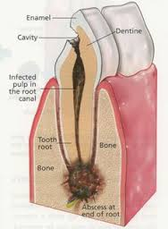
Management
Needle aspiration or drill an opening into the pulp cavity to relieve pressure and pain
Antibiotics
Later extraction or root canal of the affected tooth
Assess for bleeding
Gargle with saline
Giving of the antibiotics
Giving of analgesics
Giving of soft or liquid diet

Slide 38
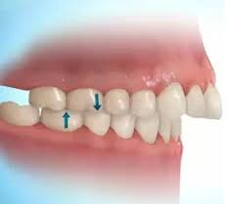
4. MALOCCLUSION
Dfn-misalignment of the teeth of the upper and lower dental arcs when the jaws are closed. It can be inherited or acquired( thumb sucking, trauma etc). Malocclusion makes the teeth difficult to clean and can lead to decay, gum disease, and excess wear
on supporting bone and gum tissues.
Management
Use of wires or braces-worn several hours in
a day for the alignment to occur
Oral hygiene

Slide 39
5. TEMPOROMANDIBULAR DISORDERS
They are classified as:-
Myofascial pain-discomfort of the jaw, neck and shoulder muscles
Internal derangement of the joint-dislocated jaw, displaced disc or injured condyle
Degenerative joint disease-rheumatoid arthritis or osteoarthritis

Slide 40
Clinical manifestations
Pain( dull to throbbing)
Restricted jaw motion
Jaw locking
Difficult in chewing and swallowing
Others( headache, earache, dizziness, hearing problem)

Slide 41
Diagnosis
Based on clinical signs and symptoms
X-ray studies
MRI
Management
Use of analgesics
Use of muscle relaxants
Use of mild antidepressants
Surgical management-insertion of metal plates and screws to stabilize the jaw

Slide 42
Nursing management
Liquid diet for the first month of surgery
Food high in calories and proteins
Mouth care
Assess for signs of infection
Health education

Slide 43
6. PAROTITIS
Dfn-inflammation of the parotid glands but can occur in other salivary glands.
Mumps( epidemic parotitis)-a communicable disease caused by a virus. It also affects the parotid glands and commonly in children.
Pathophysiology
Bacteria or virus in the mouth which travels through the salivary duct to the glands

Slide 44
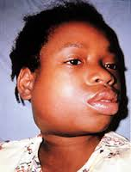
Clinical manifestations
Glands are swollen, tense and tender
Pain in the ear
Difficulty in swallowing
Fever
Irritability
Infant refuse to feed

Slide 45
Management
Antibiotics
Analgesics
Antipyretics
Maintaining adequate nutrition
Oral hygiene
Soft diet
Parotidectomy (surgical drainage of the glands)

Slide 46
7. Cancer of the oral cavity
Staging of cancers
Stage 0:carcinoma in situ( tissue of origin)
Stage I: cancers are localized to one part of the body.( Less than 2cm)
Stage II: cancers are locally advanced(no lymph node involvement)-2cm to 5 cm

Slide 47
Stage III: cancers are also locally advanced( further lymph nodes and structures)-more than 5 cm
Stage IV: cancers have often metastasized, or spread to other organs or throughout the body

Slide 48
Mouth cancer refers to cancer that develops in any of the parts that make up the mouth.
Mouth cancer can occur on the:
    Lips
    Gums
    Tongue
    Inside lining of the cheeks
    Roof of the mouth
    Floor of the mouth

Slide 49
Risk factors
Tobacco use of any kind, including cigarettes-has more than 400 carcinogens.
Heavy alcohol use (carcinogen-acetaldehyde )
Excessive sun exposure to lips
A sexually transmitted virus called human papillomavirus (HPV)
Family history
Exposure of radiation

Slide 50
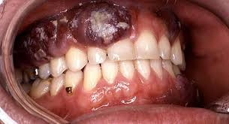
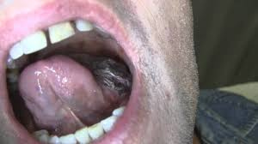
Types of oral cancers
Cancer that affects in the inside portion of the cheeks (buccal mucosa cancer)
Floor of mouth cancer
Gum cancer
Lip cancer
Roof of mouth (hard palate) cancer
Salivary gland cancer
Tongue cancer

Slide 51
Pathophysiology
Risk factor change in normal cell genetic factor abnormal cells forms a clone
Change occurs in surrounding tissues
Infiltration to other areas

Slide 52
Signs and symptoms
A sore that doesn't heal
A lump or thickening of the skin or lining of your mouth
A white or reddish patch on the inside of your mouth
Loose teeth
Poorly fitting dentures
Tongue pain
Jaw pain or stiffness
Difficult or painful chewing
Difficult or painful swallowing
Sore throat
Feeling of a mass in the throat

Slide 53
Diagnosis
Physical exam
Biopsy
Endoscopy
X-rays
CT scan
MRI

Slide 54
Treatment
Surgery to remove the tumor
Reconstructive surgery
Chemotherapy
Radiotherapy
Pain management
Antibiotics
Diet –soft, rich in both calories and proteins
Mouth care

Slide 55
Prevention
Stop tobacco use or don't start
Stop drinking alcohol
Eat a variety of fruits and vegetables –antioxidants
Avoid excessive sun exposure to lips.
See dentist regularly

Slide 56
8. GINGIVITIS
Dfn-inflammation of the gums.
Predisposing factors
Poor dental hygiene, trauma, infections, vitamin deficiency, hormonal effects, systemic diseases.
Etiology
Fusiform bacilli e.g boreliavincente

Slide 57
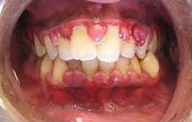
Signs &symptoms
Pain, bleeding, halitosis, fever, metallic taste, enlarged gum
Dx-physical exam
Management
Good oral hygiene
Antiseptic mouth wash
Analgesics
Antibiotics

Slide 58
9. Salivary calculus/ sialolithiasis
Dfn–calcified structure that may form inside a salivary gland or duct
Most affects the submandibular glands
Less common in the parotid and sublingual glands

Slide 59
Causes
Less saliva production
Thickened saliva
Pathophysiology
This is as a result of calcium crystals in the saliva when they clog ( calcium phosphate and calcium carbonate)

Slide 60
Risk factors
Dehydration –saliva concentration( statherins & proline rich proteins)
Reduced food intake –reduced saliva production
Medications e.g. antihistamines –reduced saliva production

Slide 61
Signs and symptoms
Pain in the face, mouth or neck-becomes worse just before or during meals
Tenderness and swelling around the cheeks
Redness in the affected area
Fever
Foul taste

Slide 62
Diagnosis
History taking
Physical exam
X-rays
Ultra sound
CT scan

Slide 63
Treatment
Hydration –increase saliva production
Apply heat and gently massage the affected area
Extracorporeal shock wave lithotripsy ( ESWL )
Antibiotics
Analgesics
Antipyretics
Soft/ blended food

Slide 64
PERIODONTITIS
Periodontitis is a chronic inflammatory disease of the gums resulting from an opportunistic infection of endogenous plaque biofilm. It usually manifests as a worsening of gingivitis and then, if untreated, with loosening and loss of teeth.

Slide 65
Pathophysiology
Develops when gingivitis has not been adequately treated. In periodontitis, the deep pockets can harbor anaerobic organisms that do more damage than those usually present in simple gingivitis. The organisms trigger chronic release of inflammatory mediators, including cytokines, prostaglandins, and enzymes from neutrophils and monocytes.
The resulting inflammation affects the periodontal ligament, gingiva, cementum, and alveolar bone. The gingiva progressively loses its attachment to the teeth, bone loss begins, and periodontal pockets deepen. With progressive bone loss, teeth may loosen, and gingiva recedes. Tooth migration is common in later stages, and tooth loss can occur.

Slide 66
Modifiable risk factors that contribute to periodontitis include
Plaque
Smoking
Obesity
Diabetes (especially type 1)
Emotional stress
Vitamin C deficiency(scurvy

Slide 67
Symptoms and Signs
Impaction of food in the pockets can cause pain at meals.
Abundant(hyperplasia) plaque along with redness, swelling, and exudate
Gums may be tender and bleed easily, and breath may be foul.
As teeth loosen, particularly when only one third of the root is in the bone, chewing becomes painful.
Diagnosis
Clinical evaluation
Sometimes dental x-rays

Slide 68
Inspection of the teeth and gingiva combined with probing of the pockets and measurement of their depth are usually sufficient for diagnosis. Pockets deeper than 4 mm indicate periodontitis.
Dental x-rays reveal alveolar bone loss adjacent to the periodontal pockets.
Treatment
Treatment of risk factors
Scaling and root planing
Sometimes oral antibiotics, antibiotic packs, or both
Surgery or extraction
Treatment of modifiable risk factors such as poor oral hygiene, diabetes, and smoking improves outcomes.

Slide 69
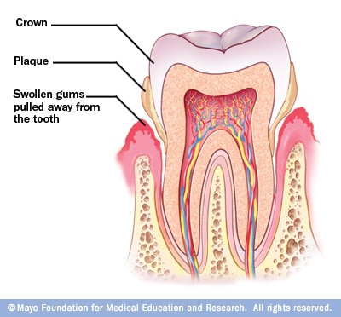

Slide 70
10. Sialadenitis
Dfn–chronic inflammation of one or more salivary gland( acute, chronic and recurrent)
-Occurs when the rate of saliva is slowed or stopped causing the growth of micro-organisms ( bacteria )
-occurs in all of the salivary glands

Slide 71
Risk factors
Poor oral hygiene
Viral infections e.g mumps, herpes
Decreased flow of saliva –dehydration, post operative drugs
Sialolithiasis
Immunosuppression
Malnutrition
Dental procedures

Slide 72
Clinical features
Painful swelling
Reddened skin
Slow grade fever
Malaise
Raised leucocytes and ESR
Purulent exudate from the duct
Diagnosis
Culture
History and physical exam

Slide 73
Treatment
Hydration
Gland massage
Culture and antibiotics
Analgesics –NSAIDS
Incision and drainage
Nutrition care
Mouth care

Slide 74
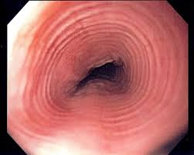
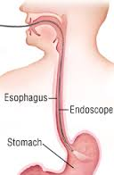
DISORDERS
OF THE
ESOPHAGUS

Slide 75
1. ACHALASIA
Dfn-absence or ineffective peristalsis of the distal esophagus. The esophageal sphincter fails to relax after swallowing.
-The etiology is not known
Various animal model suggests a central or peripheral vagal nerve dysfunction resulting in the development of achalasia
The classic triad of presenting symptoms include dysphagia, regurgitation and weight loss

Slide 76
Clinical manifestations
Difficulty in swallowing both liquids and solids
A feeling of food sticking in the lower portion of the esophagus
Regurgitation
Pyrosis (chest pain and heart burn)
Pulmonary complications from aspiration of gastric contents
Weight loss

Slide 77
Diagnosis
X-ray -shows esophageal dilatation above the narrowing at the gastro esophageal junction
Barium swallow
CT chest
Endoscopy
Manometer is used to measure the pressures in the esophagus
Management
Calcium channel blockers and nitrates-reduces the esophageal pressures
Botulinum toxin injection-inhibits the contraction of smooth muscles( given via endoscopy)

Slide 78
Surgical treatment
Forceful dilatation (balloon)
Esophagomyotomy-performed laparascopically with either LES myotomy or the muscles are separated to relieve the LES

Slide 79
Nursing management
Preoperative management
Postoperative management
Nurse patient in fowlers position
Nil by mouth
NG drainage
Iv fluids
Sunctioning
Infection prevention
Vital observation
Check for bowel sounds
Nutrition ( enteral /parenteral)

Slide 80
2. Diffuse esophageal spasm (DES)
It’s a motor disorder of the esophagus. It is a poorly understood hyper motility disorder. Results from repetitive high amplitude esophageal contractions
The etiology is unknown
These patients typically are anxious and complain of chest pain inconsistent to eating, exertion and position
The character of pain may mimic that of angina

Slide 81
Symptoms are greatest during periods of emotional stress
Patients may experience slow emptying of the esophagus and obstructive symptoms are uncommon
Diagnosis
Manometry; it measures the motility and pressure in the esophagus.
Barium swallow-shows areas of spasms

Slide 82
Management
Antispasmodics are occasionally helpful
Calcium channel blockers(nifedipine)-help reduce spasms
Small frequent feeds
Soft diet
Dilatation by use of bougienage (use of progressively sized flexible dilators).
If this doesn’t improve surgical management is the last result.
Esophagomyotomy-this is an open surgery

Slide 83
Post surgical management
Npo
IV fluids and parenteral feeds
Care of the wound
Antibiotics
Analgesics
Soft diet
Health education

Slide 84
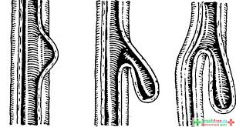
3. ESOPHAGEAL DIVERTICULA
A diverticulum is an outpouching of mucosa and submucosa that protrudes through a weak portion of the musculature. Almost all are acquired and occur predominantly in adulthood. They are classified according to their:
  a. Site of occurrence
    Pharyngoesophageal
    Midoesophangeal
    Epiphrenic

Slide 85
  Wall thickness
      True
      False
  Mechanism of formation
      Pulsion ( pressure from within)
      Traction (occurs from the pulling of adhesions)

Slide 86
PATHOPHYSIOLOGY
The pouch traps food. The stationary mass allow the lumen, interferes with the passage of food into the stomach and may exert pressure on the trachea. The trapped food then decomposes and may cause oesophangitis or ulceration in the mucosa.

Slide 87
Signs and symptoms
Difficulty or pain when swallowing
Belching
Regurgitation
Coughing
Foul breath odor
A gurgling sound on auscultation of the mid upper chest.

Slide 88
TYPES; Pharyngoesophageal diverticula (zenker)
Its the most common esophageal diverticulum. It occurs between the ages of 30-50 (believed to be acquired). It rises within the inferior pharyngeal constrictor, between the oblique fibers of the thyropharyngeus muscle and the cricopharyngeus muscle

Slide 89
Is a pulsiondiverticulum
Complaints are of cervical dysplasia, effortless regurgitation of food or pills sometimes consumed hours earlier
Sometimes a gurgling sensation in the neck after swallowing is felt

Slide 91
Diagnosis and treatment
Barium swallow establishes the diagnosis
Surgery is indicated in symptomatic patients regardless of the size
It is the degree of cricopharyngeal muscle dysfunction and not the size of the diverticulum that determines the relative severity of cervical dysphagia

Slide 92
Midesophageal (traction) diverticula
Are typically associated with mediastinal granulomatous disease (TB, histoplasmosis)
They are usually small with a blunt tapered tip that points upward
These are usually an incidental finding on barium swallow
They rarely cause symptoms or require treatment
Need to be differentiated from pulsiondiverticula which can also occur in this location (associated with neuromotor esophageal dysfunction)

Slide 93
Epiphrenic (supradiaphragmatic) diverticula
Generally occur within the distal 10cm of the thoracic esophagus
These are pulsiondiverticula that arise due to esophageal motor dysfunction or mechanical distal obstruction
Many patients are asymptomatic when diagnosed
Dysphagia and regurgitation are common symptoms

Slide 94
Diagnosis and treatment
Diagnosis is easily made with barium swallow
Esophageal function studies should also be performed to rule out any motor disturbances
Lesions < 3 cm often require no treatment
Extreme symptomatic patients sometimes require surgical repair

Slide 95
MANAGEMENT
For mild symptoms treatment is a bland, soft, semisoft or semiliquid diet to facilitate passage.
Small frequent meals is also recommended.
The more severe symptoms may require surgical excision of the diverticulum

Slide 96
Nursing management
Dietary modification
Oral hygiene
Pre and post op care in case of surgical management

Slide 97
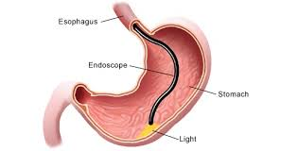
ESOPHAGOSCOPY
Indications include:
    Dysphagia -foreign body impaction
    Reflux –treatment
    Hematemesis –GERD
    Atypical chest pain
    Confirmation of diagnosis e.G oral candidiasis

Slide 98
ESOPHAGOSCOPY
Contraindications:
    Zenker hernia
    Bleeding

Slide 99
General considerations
The esophagoscopy should be performed after barium swallow
Bacteremia during upper GI endoscopy has been well documented therefore prophylactic antibiotic treatment should be administered
Patient should be in NPO for 6-8 hours

Slide 100
Complications
The minor ones:
Lacerations of the lips or tongue
Dislodgment or fracture of teeth and possible aspiration
Major complication
Esophageal perforation

Slide 101
4. HIATUS HERNIA
Protrusion of the upper part of the stomach into the esophagus.
Types
  Sliding; the junction of the stomach and esophagus and part of the stomach slide through the weakened portion of the diaphragm.
  Para esophageal/rolling; its an upward displacement of the fundus and greater curvatures of the stomach through the diaphragm.

Slide 102
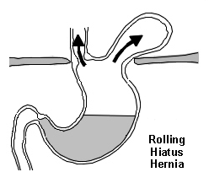
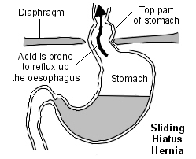

Slide 103
CAUSE
Any condition that will increase abdominal pressure e.g. Straneous coughing, pregnancy, obesity ,valsava maneuver.
Symptoms
Usually asymptomatic but one can have heartburn
Belching
Sub sternal or epigastric pressure
Pain after eating

Slide 104
diagnosis
Esophagoscopy
Barium meal

Slide 105
Management
Small feeds
Elevate head of bed during bed time
Medication(antacid, histamine receptors, proton pump inhibitors)
Surgical repair

Slide 106
5.Gastro-oesophangeal reflux Disease
Backflow of gastric or duodenal contents into the esophagus.
Symptoms
Pyrosis, dyspepsia, dysphagia, hypersalivation
Diagnosis
Barium swallow, endoscopy

Slide 107
Management
Health education
Diet
Medication(proton pump, histamine antagonists ,Prokinetic agents)
Surgical management
Nissen fundoplication

Slide 108
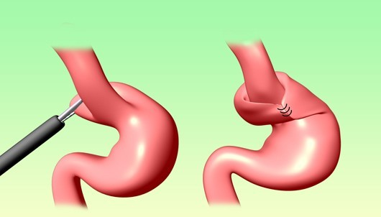
Nissen fundoplication

Slide 109
6. Cancer of the oesophagus
Occurs 3 times in men than in women
Associated with alcohol and tobacco use
Risk factors
Ingestion of hot foods
Poor oral hygiene

Slide 110
Ca esophagus contd….
Exposure to nitrosamines
Cigarette smoking
Chronic alcohol consumption
Pathophysiology
Starts as a small growth usually in the squamous layer. Tumor spreads rapidly due to lack of serosa layer. Spread is through lymphatic and the systemic circulation. Inner layer invasion causes ulceration, later the whole wall is invaded. There is hypertrophy of the affected cells

Slide 111
S/S
Diagnosis
Biopsy
CT chest
Endoscopic ultrasound
Management
-Surgical
-Pain
Dysphagia
Sensation of a mass in the throat
Sub sternal pain
Regurgitation of undigested food
Hiccups
Foul smell
Dyspnea
Hemorrhage

Slide 112
Post –op care
Complications
Aspiration pneumonia
Esophageal obstructions
Tracheo-esophageal fistulas
Observations
NBM
Intercostal drain management
Pain control
Antibiotics
IV fluids
Removal of stitches on the 10thday
Other nursing care per the patients needs

Slide 113
DISORDERS OF THE STOMACH

Slide 114
1. GASTRITIS
Inflammation of the stomach mucosal surface
Pathophysiology
Reduced mucus secretion reduced
Surface protection HCL
Destroys the epithelium

Slide 115
Predisposing factors
Nsaids
Excessive alcohol consumption
Food poisoning
Cigarette smoking
Cytotoxic drugs
Ingestion of corrosive poisons, acids and alkalis
Regurgitation of bile into the stomach
Helicobacter associated gastritis
Autoimmune causes

Slide 116
Clinical manifestations
Anorexia
Abdominal discomfort
Epigastric pain
Hemorrhage
Signs of anemia

Slide 117
Management
Restrict the patient from the irritants
-If it is persistence IV fluids
-dilute the alkaline(lemon juice or vinegar) or acids( aluminium hydrochloride).
-Lavage is indicated if the corrosion is extensive
-NG feeding
-Drugs (analgesics, antacids and sedatives)
-Surgery( gastric resection or gastrojejunostomy) if there is a gangrene or perforation.
-H.Pylori kit( clarithromycin,amoxyl and esomeprazole)
Assignment-morbid obesity, gastric cancer

Slide 118
2. PEPTIC ULCER DISEASE
Erosion of the mucosa and sub mucosal lining of the GIT tract. An “ulcer” is an open sore. The word “peptic” means that the cause of the problem is due to acid. Most of the time when a gastroenterologist is referring to an “ulcer” the doctor means a peptic ulcer.
Sites
    Duodenal ulcers
    Gastric ulcers
    Esophageal ulcer

Slide 119
Contrary to general belief, more peptic ulcers arise in the duodenum (first part of the small intestine, just after the stomach) than in the stomach.
Duodenal ulcers usually first occur between the ages of 30-50 years and are twice as common in men as in women.
Stomach (or gastric) ulcers usually occur in people older than 60 years and are more common in women.
Ulcers come when the defense mechanisms fail

Slide 120
Stomach defense mechanisms
Pre-epithelial factors:-mucus-bicarbonate-phospholipid barrier, HCL that makes environment unfriendly to most organisms
Epithelial:- layer of simple columnar cells that is hydrophobic and interconnected by tight joints with continuous, and well-coordinated cell renewal which maintains constant structural integrity of the mucosa,

Slide 121
Post-epithelial factors
continuous blood flow that delivers oxygen and nutrients with the simultaneous removal of toxic substances, an endothelial barrier that produces nitric oxide and prostacyclin to oppose the damaging effects of vasoconstrictors and inflammation in the microcirculation, and sensory innervation which helps regulate mucosal blood flow and gastric motility. These critical mechanisms exist under normal conditions to balance out injurious factors and prevent the development of ulcers and their complications.

Slide 122
Etiology
Increased gastric juices/intestinal juices
Erosion and inflammation of the mucosa
Causes
Helicobacter pylorii
Stress
Diet
Cigarette smoking
Alcohol
Nsaid
Pancreatic gastric secreting tumor

Slide 123
Pathophysiology
Whatever the etiologic factor is, the following happens:
Peptic ulcers are produced by an imbalance between the gastro-duodenal mucosal defense mechanisms and damaging forces of gastric acid and pepsin, combined with superimposed injury from environmental or immunologic agents.
The mucous membrane lining the digestive tract erodes and causes a gradual breakdown of tissue. This breakdown causes a gnawing or burning pain in the upper middle part of the belly (abdomen).

Slide 124
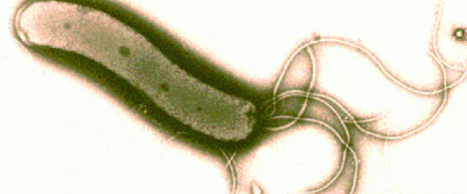
H. pylori
80% of ulcers are associated with Helicobacter pylori, a spiral-shaped bacterium that lives in the acidic stomach. Requires a little oxygen for survival
It is capable of forming biofilms and can convert from spiral to a possibly viable but nonculturable coccoid form, both likely to favor its survival and spread
Infection is usually contracted in childhood, perhaps through food, water, or close contact with an infected individual.
H. pylori associated with a 1-2% lifetime risk of stomach cancer and a less than 1% risk of gastric MALT lymphoma

Slide 125
Usually doesn't cause problems in childhood, if left untreated it can cause ulcers by:
-- infecting and inflaming the stomach and duodenal lining which weakens their defenses.
--Disturbing the mechanism which normally switches off acid and pepsin production after a meal has been digested so that more acid is produced on empty stomach

Slide 126
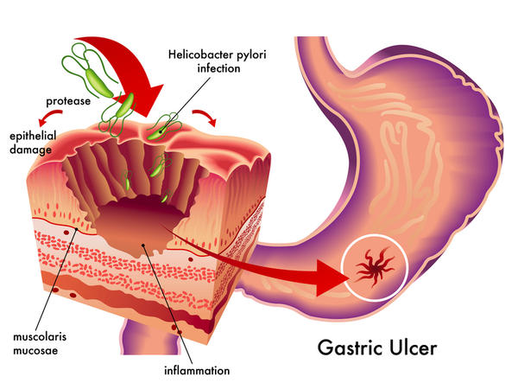

Slide 127
Stress
Stress related mechanisms: increased catecholamine release, vasoconstriction, and secretion of pro-inflammatory cytokines .
These effects are initially beneficial because they shift blood away from the GI tract and to critical organs such as the brain . However, when they persist they cause damage by breaking down gastric mucosal defenses, leading to injury and ulceration.

Slide 128
Decreased blood flow results in poor oxygen delivery and ischemic damage which have structural and chemical consequences.
Loss of the epithelial cell layer that separates the contents of the gastric lumen with the body’s interior milieu leads to increased permeability and back-diffusion of protons and pepsin which further damages the mucosa
Hypoperfusion also triggers the production of oxygen radicals and the decreased synthesis of gastro-protective prostaglandins which can lead to an aggressive inflammatory response

Slide 129
Interestingly, reperfusion injury also plays a significant role in the pathogenesis of stress ulcers. Once blood flow is restored to ischemic tissue, the sudden hyperemia brings in an influx of inflammatory cells and cytokines that result in even more cell death.
Both ischemia and reperfusion cause and worsen gastric dysmotility through the effect of cytokines on the enteric nervous system.
Poor motility aggravates the situation because the persistence of acidic material and other irritants increase the risk of ulcer formation and persistence

Slide 130
Therefore in management, we should aim at maintaining gastric motility, improving the hemodynamics, and the overall medical status of your patients to help prevent splanchnic hypoperfusion, as well as providing acid suppression, typically with a proton pump inhibitor

Slide 131
NSAIDS
Topical irritant effect on the epithelium,
Destroys the tight junctions
Suppression of gastric prostaglandin synthesis,
Reduction of gastric mucosal blood flow and interference with the repair of superficial injury.
NSAIDs acids contribute to ulcers pathogenesis and bleeding, by impairing the restitution process, interfering with hemostasis and inactivating several growth factors that are important in mucosal defense and repair.

Slide 132
Smoking
Smoking and chronic nicotine treatment stimulate gastric and HCL acid output which is more pronounced in the smokers having duodenal ulcer.
This increased gastric acid secretion is mediated through the stimulation of H2-receptor by histamine released after mast cell degranulation and due to the increase of the functional parietal cell volume or secretory capacity in smokers.
Nicotine stimulates pepsinogen secretion by increasing chief cell number or with an enhancement of their secretory capacity.

Slide 133
Long-term nicotine treatment in rats also significantly decreases total mucus neck cell population and neck-cell mucus volume.
Smoking also increases bile salt reflux rate and gastric bile salt concentration thereby increasing duodeno-gastric reflux that raises the risk of gastric ulcer in smokers.
Smoking and nicotine not only induce ulceration, but they also potentiate ulceration caused by H. pylori, alcohol, nonsteroidal anti-inflammatory drugs

Slide 134
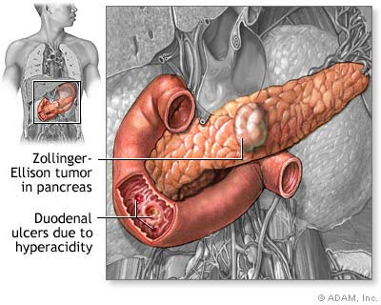
Gastrinomas (Zollinger Ellison syndrome), rare gastrin-secreting tumors, also cause multiple and difficult to heal ulcers.

Slide 135
Diet
Beverages and foods that contain caffeine can stimulate acid secretion in the stomach. This can aggravate an existing ulcer, but the stimulation of stomach acid can't be attributed solely to caffeine.

Slide 136
Alcohol(Chemical component is ethanol, a psychotropic drug)
Alcoholic beverages are typically divided into three classes—beers, wines, and spirits—and typically contain between 3% and 40% Alcohol by volume (ABV).
Beer (Alcohol content: 4%-6% ABV generally) and Wine (Alcohol content: 9%-16% ABV) are alcoholic beverages produced by fermentation.
Beer is generally composed of malted barley and/or wheat and wine is made using fermented grapes.
The above two have low alcohol content

Slide 137
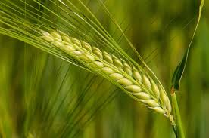
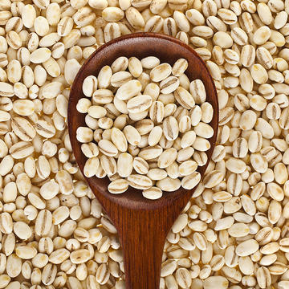
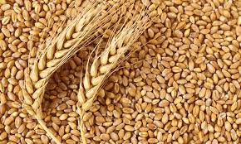
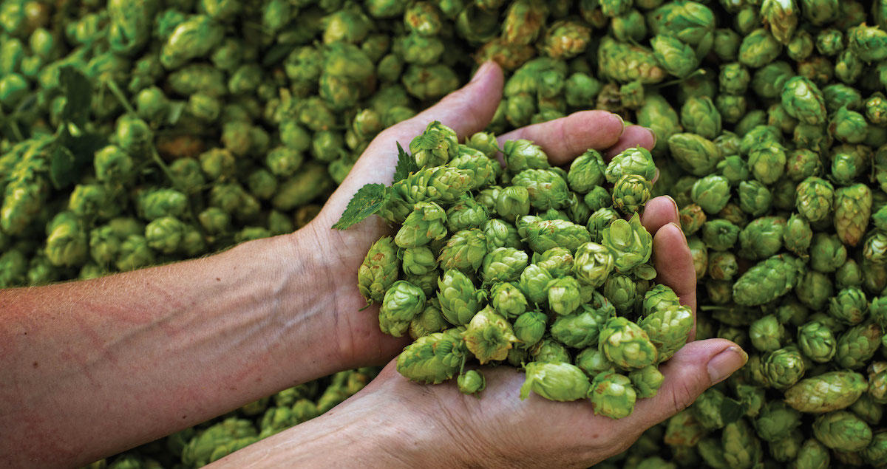
barley
wheat
hops

Slide 138
How do we end up with wheat in alcohol?
MALT is barley or other grain that has been steeped(soaked), germinated, and dried, used especially for brewing or distilling and vinegar-making
Germination makes the starch /sugars ready for fermenting
Malted barley is crushed and soaked in water. Crushing increases the surface area for sugar dissolving.
The extent of heating the barley plus the type of yeast determine the color and taste of beer
Yeast is added to ferment. Ethanol is produced

Slide 139
If more roasting is done and hops(another plant) added, alcohol is at 7 or 8% and beer labeled is strong (stout) “Export”
Lager or ale? Due to type of yeast used(Yeast is bacteria of fermenting) Lager starts fermenting beer at bottom, and spreads upwards while ale starts at top. Does better in lower temperatures910⁰c)
Lager produces better beer in terms of taste but takes longer to ferment.
Ale starts at top and spreads downwards and does better in cool temperatures

Slide 140
Champagne is just a specific variant of wine.
A sparkling(carbonated) wine produced from grapes grown in the Champagne region of France following rules of secondary fermentation of the wine in the bottle to create carbonation.
Whisky, Rum, Brandy, Vodka, Tequila are all what we call 'Spirits'.
Spirits (aka Liquor or Distilled beverage) are beverages prepared using distillation.
Distillation is further purification and removal of any diluting components like water.
This increases the alcohol content and that's why they are also known as 'Hard Liquor',
Distilled beverages like whisky may have up to 40% ABV.

Slide 141
Soda is nothing but carbonated water.
Carbonated water (also known as club soda, soda water, sparkling water, seltzer water, or fizzy water) is water into which carbon dioxide gas under pressure has been dissolved.
A cocktail is a mixed alcoholic drink/beverage that contains two or more ingredients (like a distilled spirit, soda, fruit juice, honey, herbs etc.) if at least one of them contains alcohol.
Mocktail contains fruit juices.

Slide 142
How much to take?
Normal drinking according to CDC
Women should consume no more than one drink per day, and men should stop at two drinks per day. For these recommendations, a drink is defined as:
12 ounces of beer (1 tablespoon=0.5ounce ,15-20mls)
8 ounces of malt liquor
5 ounces of wine
1.5 ounces of 80-proof liquor such as rum, gin, vodka, or whisky
All of these drinks contain slightly more than half an ounce of pure alcohol. Acts like nicotine for ulcer formation
Alcohol reduces the amount of digestive enzymes which the pancreas produces to help us to break down the fats and carbohydrates we eat

Slide 143
Classification of peptic ulcers
Ulcers are named for their location within the body. Sometimes ulcers can also be diagnosed by examining the mouth and tongue of the effected patient to detect and find the type of Ulcer.
Some other type of Ulcers however will take other method for diagnoses. There are also other types of ulcers which are relatively less common and among them are Stress Ulcers, Bleeding Ulcers, esophageal ulcers and Refractory Ulcers.

Slide 144
Peptic Ulcers
Strictly, pepsin exposed ulcers are called peptic ulcers, although the term is applied to mean all esophageal, gastro, duodenal ulcers. Peptic Ulcer is the most common type in the gastrointestinal tract area. Relieved by anti acids.
Found on stomach or duodenum wall.
Pepsin and HCL, when barrier is damaged, digest epithelium.

Slide 145
Duodenal Ulcers
In duodenum.
Duodenum ulcers are usually benign however doctors may take a biopsy to make sure that they are benign.
Usually patients feel a burning sensation and heartburn feelings .Duodenum ulcers will usually begin in the starting point of the small intestine and are this type of Ulcer is much common in western societies than any other.
Four less common types are following:

Slide 146
Esophageal Ulcer
Occurs in the lower end of esophagus.
H. pylori common etiology
Patients may feel a lot of pain if acid from stomach refluxes
Causes difficulty and pain in swallowing.

Slide 147
Bleeding Ulcer
Internal bleeding occurs if an ulcer is untreated.
Must be attended to fast
Refractory ulcers
Simple peptic ulcers that have not healed after at least 3 months of treatment are called refractory ulcers
Stress ulcers
consist of a group of lesions and usually found in the esophagus, the stomach or the duodenum.
Common in those with other illness or are critically ill and on ventilation.

Slide 148
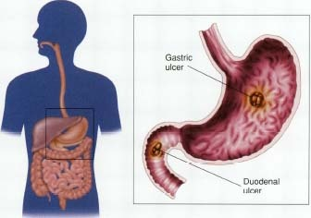
SYMPTOMS

Slide 149
Duodenal ulcers
-Age-30 to 60
-Male: female= 3:1
-Incidence-80%
-May have weight gain
-Pain-2 to 3 hrs after meals
-Nocturnal awakening
-Vomiting uncommon
-Hemorrhage less likely
-Perforation more likely
Gastric ulcers
-Usually 50 and over
-1:1
-15%
-May have weight loss
-1/2-1 hrs after meals
-No nocturnal awakening
-Vomiting common
-Hemorrhage more likely
-Perforation less likely

Slide 150
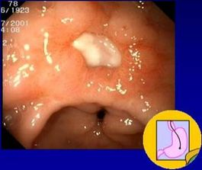
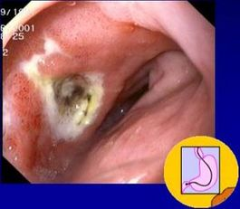
Endoscopy

Slide 151
Predisposing factors
Are age 60 or older (your stomach lining becomes more fragile with age).
Have had past experiences with ulcers and internal bleeding
Take steroid medications, such as prednisone.
Take blood thinners, such as warfarin.
Consume alcohol or use tobacco on a regular basis.
Experience certain side effects after taking NSAIDs, such as upset stomach and heartburn.
Take NSAIDs in amounts higher than

Slide 152
recommended or for long period
Stress doesn’t cause ulcers, but a contributing factor
Chronic disorders: liver disease, emphysema, R. arthritis may predispose one to ulcers
Improper diet, irregular or skipped meals
Type O blood (for duodenal ulcers)

Slide 153
COMPLICATIONS
GI bleeding is the most common complication. It occurs when the ulcer erodes one of the blood vessels.
Perforation Erosion of the gastro-intestinal wall by the ulcer leads to spillage of stomach or intestinal content into the abdominal cavity. The first sign is often sudden intense abdominal pain. Posterior wall perforation leads to pancreatitis; pain in this situation often radiates to the back.

Slide 154
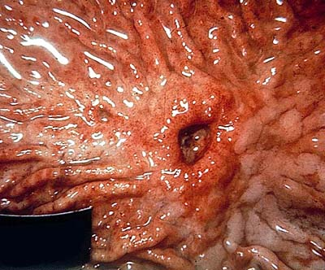

Slide 155
Penetration is when the ulcer continues into adjacent organs such as the liver and pancreas
Scar tissue Scarring and swelling due to ulcers causes narrowing in the duodenum and gastric outlet obstruction. Patient often presents with severe vomiting. Peptic ulcers can also produce scar tissue that can obstruct passage of food through the digestive tract, causing one to become full easily, to vomit and to lose weight.

Slide 156
WARNING SIGNS
vomit blood
sudden, severe pain
vomit food eaten hours or
days before
ongoing nausea or
repeated vomiting.
feel cold or clammy
feel unusually weak or
dizzy
blood in your stools
losing weight
pain doesn't go away
With medication

Slide 157
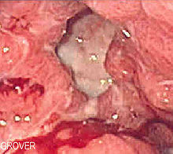
TESTS AND DIAGNOSIS CHART

Slide 158
Noninvasive
Urea Breath Test (UBT)
Blood test
Invasive
Histology
Biopsy Urease Test

Slide 159
Culture
Other tests
Stool antigen test
Endoscopy
Upper gastrointestinal (upper GI) X-ray

Slide 160
GOALS OF TREATMENT
Lowering the amount of acid that stomach makes,
Neutralizing the acid
protecting the injured area so it can heal
It's also very important to stop smoking and drinking alcohol
Prevent complications (bleeding, perforation, penetration, obstruction)
Minimize recurrences
Reduce financial costs

Slide 161
Antibiotic medications. Combinations of antibiotics to treat H. pylori because one antibiotic alone isn't always sufficient to kill the organism.
-amoxicillin (Amoxil), clarithromycin (Biaxin) and metronidazole (Flagyl). Combination drugs that include two antibiotics together with an acid suppressor or cytoprotective agent (Helidac, Prevpac) have been designed specifically for the treatment of H. pylori infection.

Slide 162
Acid blockers. Also called histamine (H-2) blockers — reduce the amount of HCL released into GI. This relieves ulcer pain and encourages healing.
MOA: keeping histamine from reaching histamine receptors.
NB: Histamine is a substance normally present in body. When it reacts with histamine receptors, the receptors signal acid-secreting cells in stomach to release hydrochloric acid. Available by prescription or over-the-counter (OTC), acid blockers include the medications ranitidine (Zantac), famotidine (Pepcid), cimetidine (Tagamet) and nizatidine (Axid).

Slide 163
Antacids. An antacid may be taken in addition to an acid blocker or in place of one. Instead of reducing acid secretion, antacids neutralize existing stomach acid and can provide rapid pain relief.

Slide 164
Proton pump inhibitors. Reduce acid by blocking the action of these tiny pumps. These drugs include the prescription and over-the-counter medications omeprazole (Prilosec), lansoprazole (Prevacid), rabeprazole (Aciphex) and esomeprazole (Nexium). They also inhibit H. pylori.

Slide 165
Cytoprotective agents. Protect the GI mucosa.
sucralfate (Carafate) and misoprostol (Cytotec). bismuth subsalicylate (Pepto-Bismol).

Slide 166
Bowel rest: Bed rest and clear fluids with no food at all for a few days. This gives the ulcer a chance to start healing without being irritated.
Nasogastric tube: Decompression
Urgent endoscopy or surgery if indicated: Damaged, bleeding blood vessels can usually be repaired with an endoscope. The endoscope has a small heating device on the end that is used to cauterize a small wound.

Slide 167
Surgery
Vagotomy
Antrectomy
Pyloroplasty
Tying off an
artery
Other modes
Of treatment
Acupuncture
Chiropracting
Homeopathy
Herbs
Notes:
Chiroprotractor deals with the disorders of the MS and Nervous systems. Manipultes for example spinal joints that have become hypomobile due to injury etc
Using irritants to cure the dsame condition

Slide 168
LIFE STYLE AND HOME REMEDIES

Slide 169
Use of Olive Oil
Don't smoke
Limit or avoid alcohol
Less
Coffee and
Carbonated
Beverages
Avoid nonsteroidal
anti-inflammatory
drugs (NSAIDs)
Exercise
Fruits and
Vegetables
Stress Relief

Slide 170
Read and make notes on pyloric stenosis

Slide 171
DISORDERS OF THE PANCREAS

Slide 172
1. PANCREATITIS
Acute
Chronic
Pancreatitis is the inflammation of the pancreas leading to the obstruction of the pancreatic juices.
Predisposing factors to acute
Gallstones
Alcohol
Viral infections e.g. Mumps
Abdominal trauma

Slide 173
Signs and symptoms
Investigations
Serum amylase
Full hemogram
Urinalysis
Serum calcium
Peritoneal tap
X-ray
Ultra sound
Abdominal pain
Unexplained abdominal mass
Vomiting
Fever
Jaundice
Respiratory distress

Slide 174
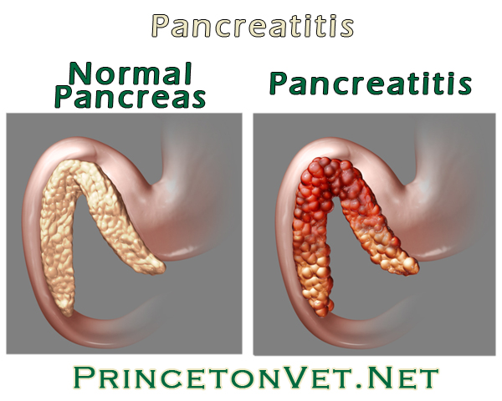

Slide 175
COMPLICATIONS
Pseudo cysts
Infected pancreatic necrosis
Systemic inflammatory syndrome; xterised by fever, tachypnea, tachycardia.

Slide 176
Patient is on NBM.
Parenteral feeding
Administer a free drainage
Cimetidine is given to reduce HCL
Pain management

Slide 177
Management
Pain relief
Insulin
Fluid/electrolyte balance
Gastric suction
Respiratory care
Pancreatectomy

Slide 178
Chronic pancreatitis
Inflammatory disorder characterized by progressive anatomic and functional destruction of the pancreas.
Risk factors
Chronic alcohol consumption

Slide 179
Symptoms
Investigations
OGTT
CT scan
MRI
X-ray of the abdomen
Endoscopy
Severe abdominal pains
Weight loss
Steatorrhoea

Slide 180
COMPLICATIONS
Diabetes
Jaundice
Pseudocyst
Cancer of the Pancreas

Slide 181
Management
Hypoglycemics and insulin
Pancreatic enzyme replacement
Diet low in proteins
Pancreaticojejunostomy
Health education

Slide 182
1. CANCER PANCREASE
Ca head of pancreas is the commonest 75%
Risk factors
Cigarette smoking -gender ( male )
Exposure to industrial chemicals
High fat diet
Race ( African/ American
Chronic pancreatitis

Slide 183
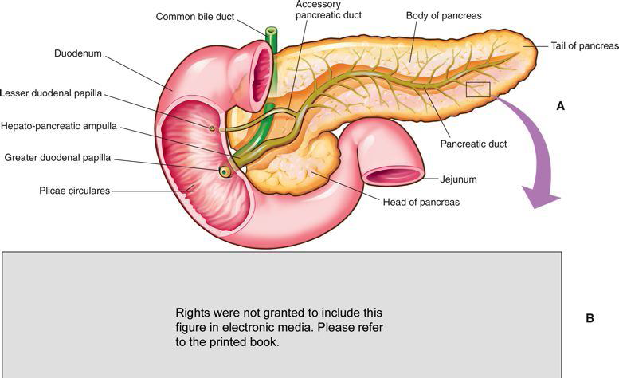
May develop in the head, body or tail of the pancrease.

Slide 184
Symptoms
Investigations
Ultrasound
CT scan
Percutaneous biopsy
Pain –steatorrhoea
Jaundice -nausea and vomiting
Weight loss -pale and gray tools
Signs of diabetes

Slide 185
Monitor for hyper and hypoglycemia
Diet( low proteins, carbohydrates and vitamins)
Pancreatic enzymes
Monitor weight
Fluid balance
Skin care
Inspect suture line
Infection control

Slide 186
DISORDERS OF THE LIVER

Slide 187
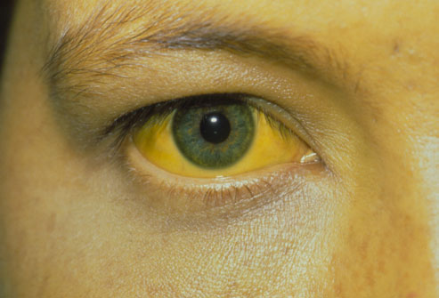
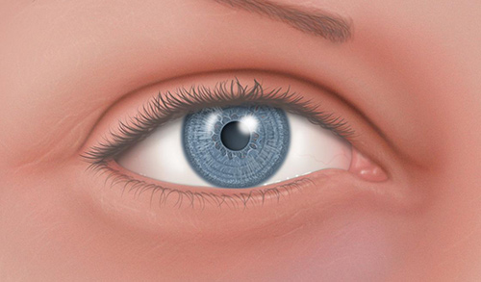
2. JAUNDICE
Yellowish coloration of the skin, sclera and mucous membrane. Different methods of classification:

Slide 188
Classification of jaundice
According to source in relation to the liver:
Pre hepatic: Hemolysis
Hepatic: Infection in the liver
Post hepatic: Block to bile flow from gall bladder

Slide 189
According to cause
Pathological: Infection e.g malaria
Physiologic: Neonatal RBC hemolysis
Obstructive: Gall bladder stones

Slide 190
Conjugation of bilirubin
Breakdown of RBC’S haem>biliverdin> bilirubin
in the Liver it is conjugated with glucoronic acid by enzyme glucuronyltransferase making it soluble in water. Much of it goes to the bile and out into the small intestine. The conjugated bilirubin is not absorbed and passes into the colon and gives the color of the stool

Slide 191
Causes
Breakdown of RBCS
Damage of the liver/muscles
Under absorption of bilirubin by GIT
Investigations
Bilirubin levels
LFTS
Complete blood count

Slide 192
LFTs Normal values

Slide 193
-Abdominal U/S
-Abdominal CT
-Percutaneous transhepatic cholangiogram
-Liver biopsy
-Cholesterol levels

Slide 194
Prothrombin time
Hepatitis A,B,C tests
Endoscopic retrograde cholangiopancreatography

Slide 195
Clinical manifestations
Yellowish coloration of the sclera, skin and mouth
Dark or brown coloured urine
Pale or clay coloured stools
Pruritus
Weight loss
Abdominal pain
Fever
Management
NB according to the cause

Slide 196
3. HEPATITIS
Inflammation of liver tissue
The most common types are viral. A,B,C
Many cases are asymptomatic and therefore remain undiagnosed.
Pathophysiology
The virus enters the liver cells causing degenerating
Changes. Inflammation process follows
Accompanied by exudates containing lymphocyte, plasma cells and granulocytes.

Slide 197
There is reactive hyperplasia of the macrophages in the sinusoids. Later there is necrosis of the liver cells and tissue. Macrophages tries to remove the necrotic materials causing the collapse of the lobules. Blood supply in the lobules is interfered with causing hypoxia and further liver damage.

Slide 198
HEPATITIS A
Caused by RNA virus
Spread through the oral faecal route
Clinical manifestations
Flu like symptoms
Low grade fever
Anorexia
Jaundice
Dark urine
Splenomegally

Slide 199
Management
Complete bed rest
IV fluids
Diet low in protein
Gradual mobilization
Health education
Other nursing care as per the patient needs

Slide 200
Prevention
Administration of hepatitis A vaccine

Slide 201
HEPATITIS B
Caused by DNA virus
Spread through blood, mucous membrane and skin
Also found in semen and vagina
Predisposed people
Health workers
Patients on hemodialysis
Homosexuals
IV drug abusers

Slide 202
Clinical manifestations
Fever
Rashes
Arthralgia
Anorexia
Dyspepsia
General malaise and weakness
Jaundice
Hepatomegally
Splenomegally

Slide 203
Management
Complete bed rest
Diet restricted in protein
Medication( antacids, antiemetics, antispasmoidals)
Ambulation
Involve family in care

Slide 204
Patients education
Nutrition
Ways of transmission
Avoid alcohol
Protected sex

Slide 205
Prevention
Control chain of transmission
Early screening
Vaccination
Contact tracing
Treatment of the affected
Health education

Slide 206
HEPATITIS C & D
Hepatitis C
Is associated with blood infusions
Clinical symptom and management are like for hepatitis B
Hepatitis D
Only people with hepatitis B contracts the disease because this virus needs the antigen surface for hepatitis B to attach.
Transmission-sexual intercourse with an infected person
Symptoms and management are like in hepatitis B
Assignment –hepatitis E

Slide 207
Hepatitis C
Affect both the RNA and DNA strands
Target is the liver mostly the b lymphocytes
CAUSES
Sexual intercourse
Sharing needles
Blood and blood products
Mother to child transmission
Signs and symptoms
Usually asymptomatic

Slide 208
4. PORTAL HYPERTENSION
Its an increase in pressures in the portal system above 5mm/hg.
Review of Portal circulation
The hepatic portal vein drains venous blood from the gastrointestinal tract, spleen, pancreas, and gallbladder to the sinusoids of the liver; from here, the blood is conveyed to the systemic venous system by the hepatic veins that drain directly to the inferior vena cava.

Slide 209
Causes
  Liver cirrhosis
  Blood clot in the portal vein
  Blockage of veins that carry blood from the liver to the heart
  Parasitic infections (schistosomiasis)

Slide 210
    Causes
    Pre hepatic
    Intra hepatic
    Post hepatic

Slide 211
Pathophysiology
Blockage of vessels high pressures in portal system varices, umbilical hernia. The portal vein drain blood from the stomach intestine, spleen and it is usually under low pressure five to ten mmhg. Any obstruction to blood flow may cause the blood to rise. Obstruction lead to esophageal, gastric and hemorrhoid varicose veins due to increased venous pressure and there is accumulation of fluid in the abdominal cavity; ascites.

Slide 212
Symptoms
GI bleeding dark stool
Splenomegaly
Ascites
Encephalopathy/confusion
Reduced platelets, reduced WBC cells
Liver biopsy
Hepatic venous wedge pressure
Abnormal LFTS

Slide 213
Investigations
MRIS
Ultrasound
Doppler ultrasound
Management
Endoscopic therapy
  Banding; block bld vessels with a rubber band
  Sclerotherapy; a blood clotting solution is injected into the bleeding varices to stop bleeding

Slide 214
Management
Medication
  Beta blockers e.g. propranolol
  Vasopressin
  Octreotide

Slide 215
5. LIVER CIRRHOSIS
Damage to the liver tissue and replacement of the normal tissue with scarred tissue. Scar tissue partially blocks the flow of blood through the liver and impairs the liver’s ability to:
control infections
remove bacteria and toxins from the blood
process nutrients, hormones, and drugs
make proteins that regulate blood clotting
produce bile to help absorb fats and fat-soluble vitamins

Slide 216
stages
Stage 1
The first stage of cirrhosis is characterized by the presence of inflammation, characterized by swelling, an influx of inflammatory-promoting immune cells and some destruction of liver tissue. Additionally, there may also be the growth of abnormal connective tissue. These two factors, inflammation and abnormal connective tissue, are confined to the portal area of the liver.

Slide 217
Stage 2
Also characterized by inflammation, but fibrosis is also beginning to occur. Fibrosis is the replacement of normal liver tissue with scar tissue.
No symptoms because the remaining normal liver tissue is able to compensate.
However, scar tissue will not become normal functioning liver tissue, meaning this transformation is permanent.

Slide 218
Stage 3
Damage is more severe.
Fibrosis forms “bridges,” and is called bridging fibrosis. These bridges develop abnormal connections between the hepatic artery, vein and other vessels that cause abnormal blood flow and Hepatic portal hypertension.

Slide 219
Stage 4 (End Stage Liver Disease)
Gross liver malfunction
Many symptoms, including bleeding in the digestive tract, jaundice -- yellow coloring of the eyes and skin, mental effects such as confusion, unusual sleepiness and slurring of speech, build-up of fluid in the body -- edema; and intense and unexplained skin itching.

Slide 220
Types of Cirrhosis(Also etiologic factors)
Alcoholic- involves the production of high levels of metabolites.
Post-necrotic- severe necrosis linked to viral or toxic damage most commonly as a result of hepatitis B or C.
Biliary Cirrhosis- Chronic autoimmune destruction of the inter-hepatic bile ducts.

Slide 221
Pathology
Liver cirrhosis is defined by two principal factors: Portal Hypertension and Hepatic Dysfunction. Portal hypertension is the result of restricted flow of blood through the liver to the hepatic veins and then to the inferior vena cava.
The resulting portal congestion increases portal pressures and decreases blood flow to the liver. With reduced blood flowing to the cirrhotic liver, the hepatocytes have minimal access to blood, severely hampering their capacity to detoxify harmful chemicals.

Slide 222
As a result, toxins become more concentrated in the blood producing damaging effects particularly the production of ammonia (from amino acid breakdown). Instead of being excreted, ammonia stays in the blood causing hepatic encephalopathy and a noticeable foul breath. Furthermore, the hepatocytes continue to die leading to a progressive deterioration of the liver’s regulatory capabilities resulting in hypocoagulation and hypoalbuminemia.

Slide 223
Congestion in the hepatic portal system causes blood to be diverted to the collateral vessels forcing them to accommodate larger volumes. This engorgement causes: a) the veins to bulge producing easily visible hemorrhoids.
b) dilation of the thin-walled esophagus causing esophageal varices which are subjected to trauma as food is swallowed and can rupture.
With prolonged bleeding time, esophageal varices is a very serious complication of liver cirrhosis.

Slide 224
Portal hypertension in liver cirrhosis also causes ascites (accumulation of fluid in the peritoneal cavity) and splenomegaly.
Ascites is caused by hampered albumin production, the osmotic pressure decreases reducing the return of fluid to the blood from the tissues. It results in a significant and pronounced abdominal distention, compressing the abdomen and compromising breathing.

Slide 225
Splenomegaly is the enlargement of the spleen as a result of the inability of the veins that drain the spleen to empty into a congested portal system.
The enlarged spleen increasingly takes up and hold formed elements of the blood causing thrombocytopenia and anemia.

Slide 226
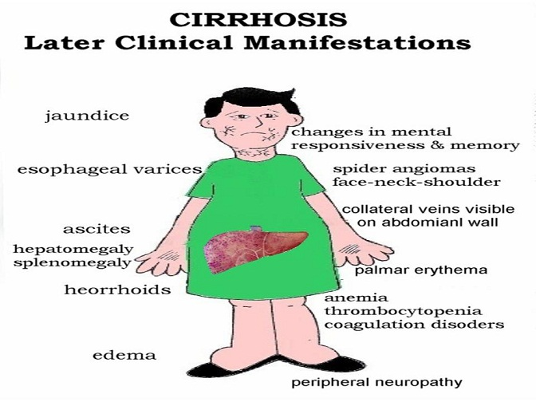

Slide 227
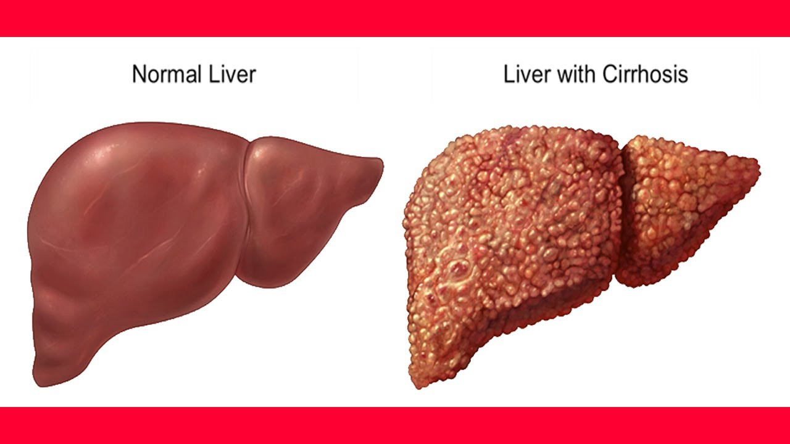

Slide 228
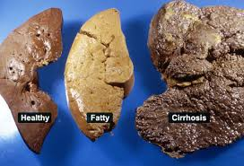

Slide 229
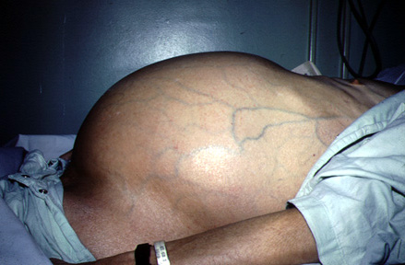
Ascites

Slide 230
S/S
Late
Foul breath
Jaundice
Fatigue
Pain
High Grade Fever
Loss of appetite
Edema
Anemia
Confusion
Early
generally feeling unwell and tired all the time
loss of appetite
loss of weight and muscle wasting
feeling sick (nausea) and vomiting
tenderness/pain on the RUQ
spider-like small blood capillaries on the skin above waist level (spider angiomas)
blotchy red palms
disturbed sleep pattern

Slide 231
Diagnosis
Blood tests
LFTs: should include SGOT (serum glutamic oxaloacetic transaminase ) aspartate transaminase (AST), alanine transaminase (ALT), alkaline phosphatase (ALP), bilirubin, gamma-glutamyltransferase (gamma-GT); AST and ALT are raised due to hepatocyte damage; gamma-GT is high in active alcoholics.
Albumin: there is hypoalbuminaemia in advanced cirrhosis.
FBC: occult bleeding may produce anaemia; hypersplenism may cause thrombocytopenia; macrocytosis can suggest alcohol abuse.

Slide 232
Renal function tests and electrolytes: hyponatraemia may be present (due to increased activity of antidiuretic hormone). Poor renal function may represent hepatorenal syndrome.
Red cell folate: alcohol abuse is often associated with a diet inadequate in folate.
Coagulation screen: abnormalities of coagulation are a sensitive test of liver function; prothrombin time is reduced in advanced cirrhosis.
Ferritin: low ferritin may indicate iron deficiency from diet or blood loss; ferritin is raised in haemochromatosis

Slide 233
Viral antibody screen for hepatitis
U/S
P/E
Chest x-ray will show a raised diaphragm

Slide 234
Management
Nothing can reverses the damaged liver cells state
Treatment aims at preventing the progression and providing symptomatic relief
Class brainstorming

Slide 235
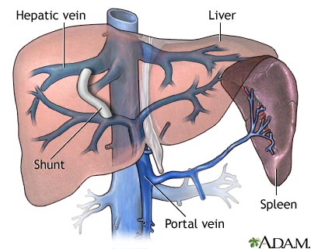
T.I.P.S
Transjugular intrahepatic Portosystemic shunt
The goal of TIPS placement is to divert portal blood flow into the hepatic vein, so as to reduce the pressure gradient between portal and systemic circulations

Slide 236
Complications
?????????

Slide 237
6. CA LIVER
NB: READ ON HCC
Causes
Hepatitis B virus
Hepatitis C virus
Cirrhosis
Smoking
Chemical agents

Slide 238
Clinical features
Diagnosis
Abdominal u/s
CT scan
Arterial partography
Liver biopsy
LFTS
Anorexia
Nausea and vomiting
Weakness and general malaise
Abdominal mass
Splenomegally
Hepatomegally
Ascites
Jaundice

Slide 239
Management
Surgical
Wedge resection
Lobectomyresection
Major liver resection
Total hepatoctomy and liver transplant
Cryotherapy
Chemotherapy
-Regional
Intra –arterial
Radiation

Slide 240
DISORDERS OF THE GALL BLADDER

Slide 241
1. CHOLECYSTITIS
Cholecystitis-inflammation of the gall bladder
Associated with sedentary life style. Obese persons are more predisposed
Incidences are high at the age of 50’s and 60’s

Slide 242
The Gallbladder
Hollow organ that beneath the liver.
In adults, measures approximately 8 cm (3.1 in) in length and 4 cm (1.6 in) in diameter when fully distended.
Divided into three parts: fundus, body and neck.
The neck tapers and connects to the biliary tree via the cystic duct which then joins the common hepatic duct to become the common bile duct.
At the neck of the gallbladder is a mucosal fold called Hartmann's pouch, where gallstones commonly get stuck.

Slide 243
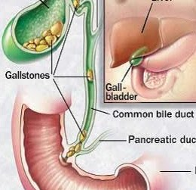

Slide 244
Cholecystitis is the inflammation of the gallbladder, usually resulting from a gallbladder stone blocking the cystic duct.
Lasts for long time and characterized by repeated attacks of pain (biliary colic).
It may become thick walled, scarred and small. The gallbladder usually contains sludge (a microscopic particles or materials similar to gallstones)
These block its opening into the cystic duct or reside in cystic duct itself.

Slide 245
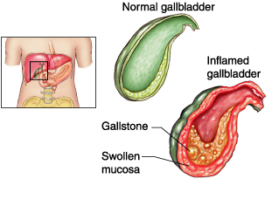

Slide 246

Notice thickness of gall bladder wall, abundant polyhedric stones
and small papillary tumor in the cystic duct.

Slide 247
Pathophysiology
Obstruction of the bile flow, more water absorption causing increased concentration of the bile and irritation of gall bladder
Bacteria and irritants are trapped thus further inflammation

Slide 248
Clinical features
Fever, tachycardia, and tenderness in the RUQ(right upper quadrant) or epigastric region, often with guarding or rebound.
The Murphy sign described as tenderness and an inspiratory pause elicited during palpation of the RUQ.
A palpable gallbladder or fullness of the RUQ .
Jaundice may be noted in approximately 15% of patients.
Patients with chronic cholecystitis frequently have a palpable RUQ mass secondary to fibrosis involving the gallbladder.

Slide 249
Pain : sharp, cramping, steady
Spread to the back or below the right shoulder blade
Other symptoms : clay-colored stools, fever, nausea or vomiting, yellowing of skin(jaundice)

Slide 250
Diagnostic
P/examination.
Ultrasonography is the best way to detect gallstones in the gallbladder or the thickening of its wall.

Slide 251
If possible, the patient should not eat for 6 or more hours before the test, which takes only about 15 minutes. During the procedure, the doctor can check the liver, bile ducts, and pancreas, and quickly scan the gallbladder wall for thickening (characteristic of cholecystitis.

Slide 252
…continue
Liver blood test are often normal unless the person has an obstructed bile duct. Other blood test can detect some complications such as high level of a pancreatic enzyme (lipase or amylase) in pancreatitis.
A high count of WBC suggest inflammation, an abscess, gangrene or a perforated gallbladder.

Slide 253
management
Surgical – removal of the gallbladder (cholecystectomy) is usually done by using a flexible tube called a laparoscope.
This surgery uses a smaller surgical cuts, which results in a faster recovery. Patients are often sent home from the hospital on the same day as surgery or the next morning. Open cholecystectomy requires larger cut in the upper-right part of the abdomen.
Gall stones may also be dissolved with medication taken by mouth. But may take 2 years or longer to work.

Slide 254
Complications
Pain after surgery : a few people have new or recurring episodes of pain that felt on gallbladder even thought the gallbladder and the stones have been removed.
It may be the malfunction of the sphincter of Oddi, the muscle that control the released of bile and pancreatic secretion.

Slide 255
Other possible complication
Cancer of gallbladder (rarely)
Jaundice
Pancreatitis
Worsening of the condition:
NB;The pancreas and liver drain into the same duct into the gut. When the pancrease becomes inflamed and swollen the outflow from the liver does not drain into the gut. The bile salts do not get into the gut and stay in the body leading to jaundice.

Slide 256
Management
The condition is not always preventable.
Eating less fatty food may relieve symptoms who have not had their gallbladder removed.

Slide 257
2. CHOLELITHIASIS
Dfn-collection or presence of stones in the gall bladder
Causes
Altered solubility of the bile content
High levels of blood and dietary cholesterol
Dm
Hemolytic diseases
Female gender
Obesity

Slide 258
Clinical manifestations
Intolerance to fatty foods
Nausea and vomiting
Flatulence
Fever
Right upper quadrant discomfort
Right upper quadrant pain
Jaundice
Clay colored stool
Dark colored urine

Slide 259
Diagnosis
A) cholecystitis
-High WBC
-High LFTs

Slide 260
B) cholelithiasis dx
X-ray
Cholecystogram
Cholangiogram
Ultrasonography

Slide 261
Management
Bed rest
Pain control
Antibiotics
Gallstone resolution therapy
Cholecystectomy
Cholecystotomy
Choledochostomy: into common bile duct
Choledocholithotomy: resection of common bile duct

Slide 262
Pre-op care
Restrict food or drinks
Skin preparation
Cleansing enema
Catheterization
Monitor prothrombin time
Administer vitamin k

Slide 263
Post-op care
Management of pain
Semi fowlers position
Splint incision site
Change dressing
Anti embolic stocking
Observe for bleeding
Vital signs
Other nursing care as per the patient’s needs
Health messages

Slide 264
Bowel diseases/disorders

Slide 265
INTESTINAL CONDITIONS
Inflammatory (IBD) Crohns, Ulcerative colitis
Obstructions
Diverticular
Other Inflammations
Infections

Slide 266
1. Ulcerative Colitis
Is an ulcero-inflammatory disease affecting the colon, which is limited to the mucosa and submucosa, except in the most severe cases.
It begins in the rectum and extends proximally in a continuous fashion sometimes involving the entire colon (Pancolitis).

Slide 267
Predisposing factors
Any age, but more rampant in between 15 and 30 ^{yrs}
older than 60 ^{yrs}
Positive Family history
Jewish descent-challenged
Causes
Heredity
Overactive immunity
Drugs: Antibiotics, corticosteroids, NSAIDs,
Stress may trigger

Slide 268


Slide 269
Clinical features
Bloody mucoid diarrhea
Cramps ( a painful & involuntary muscular contraction)
Tenesmus (painful spasm of the anal sphincter along with the urgent desire to defecate without the significant production of feces)
Colicky lower abdominal pain
Fever
Weight loss

Slide 270
Extra-intestinal symptoms
Migratory polyarthritis,
Sacroilitis,
Ankylosing spondilitis,
Uveitis,
Erythema nodosum and
Hepatic involvement (pericholangitis and
Primary sclerosing (cholangitis).

Slide 271


Slide 272
Diagnosis
Medical and family history
Physical exam: distended abdomen, increased bowel sounds, tenderness
Lab tests: Hb (low), occult blood, cell count
Endoscopies of the large intestine

Slide 273
Management
Aminosalicylates to reduce inflammation
corticosteroids
Immunomodulators to reduce inflammation e.g azathioprine, 6-mercaptopurine, or 6-MP
biologics, also called anti-TNF therapies E.G humira
Colectomy, complete

Slide 274
Complications:
Perforation,
Peritonitis,
Abscess
Toxic megacolon
Venous thrombosis
Carcinoma

Slide 275
2.CROHN’S DISEASE
Crohn's Disease causes inflammation of the bowel. It most commonly affects the lower small intestine (ileum) and the large intestine (colon), but may involve any part of the digestive tract from the mouth to the anus. The inflammation extends through the entire thickness of the bowel wall.

Slide 276
Pathophysiology
The immune system seems to overreact to substances and bacteria in the intestine. White blood cells invade the intestinal lining and produce inflammatory toxins causing chronic tissue swelling, injury and ulceration. The precise cause of this abnormal immune response is unknown.

Slide 277

Causes
Complications
Adhesions
Obstruction
Malnutrition from poor absorption
Anal fissures
Fistula
Abnormal immune response
Genetical
Diagnosis
Colonoscopy

Slide 278
Summary of Differences
Crohn’s disease
Inflammation may develop anywhere in the GIT
Common at the end of the small intestine
May appear in patches
May extend through entire thickness of bowel wall
About 67% of people in remission will have at least 1 relapse over the next 5 years
Ulcerative colitis
Limited to the large intestine (colon and rectum)
May involve a part of or the entire colon
Appears in a continuous pattern
Inflammation occurs in innermost lining of the intestine
About 30% of people in remission will experience a relapse in the following year

Slide 279


Slide 280
Indeterminate Colitis
Histopathologic and clinical overlap between ulcerative colitis and Crohn’s disease is common, and it is not possible to make a distinction in up to 10% of patients with IBD. In such cases, termed indeterminate colitis, the small bowel is not involved, and the continuous pattern of colonic disease typically would indicate ulcerative colitis.

Slide 281
Management
Physical and psychological rest
Nutrition ( high calories, minerals, Vitamins, low fats, high fibers)
Fluid and electrolyte balance
Drugs-corticosteroids
Surgery

Slide 282
3. DIVERTICULAR DISEASE
Dfn-small pouches of colonic mucosa that protrude into the peritoneal cavity through the circular muscle fibers of the colon
Diverticulitis-Inflammation of the outpouched mucosa
Diverticulosis-presence of the diverticuli
Diverticula–a pouch on a mucous lining of the body due to a defect or normally

Slide 283


Slide 284
Causes
Damaged collagen due to infection
Age: Collagen becomes weak
Increased intraluminal pressure from tonic and rhythmic contractions
Lack of fibre: binds water and salt in the colon, thus, bulkier and voluminous easy to pass. Without enough fiber, the stools are small and hard, colon contracts harder to expel them. That extra pressure on the wall of the narrow colon causes diverticulosis

Slide 285
Clinical manifestations
Pain at the left iliac fossa
Constipation
Vomiting
Tachycardia
Fever
Diarrhea
Abdominal distention
Obstruction
Diagnosis
CT Scan
Barium meal

Slide 286


Slide 287
Management
  Complications
  Chronic diverticular
  Diverticulitis
  Abscess
High fibre diet
Broad spectrum antibiotic
IV fluid replacement
Analgesics
Monitor vital signs
Colectomy
Patients education

Slide 288
4. INTESTINAL OBSTRUCTION

Slide 289
Obstruction
A mechanical blockage in small or large bowel arising from a structural abnormality that presents a physical barrier to the progression of gut contents.
Accounts for 5% of all acute surgical admissions
Patients are often extremely ill requiring prompt assessment, resuscitation and intensive monitoring

Slide 290
-Can be partial or complete.
Types/causes
A)mechanical( Dynamic)
B) Non mechanical (Adynamic)

Slide 291
Dynamic | Adynamic
Physical /mechanical obstruction. It may occur in an acute or chronic form. Strong peristalsis in trying to clear the obstruction | Peristalsis Absent
Obstruction lesion may be: Intraluminal (impacted feces, foreign bodies, gallstones) Intramural (malignant or inflammatory strictures) Extramural (intraperitoneal bands and adhesions, hernias, ca ovary, ca stomach, volvulus or intussusceptions.) | l ILEUS, esp. post surgical ¡ INFARCTION ¡ MOTILITY DISEASES, esp., HIRSCHSPRUNG DISEASE

Slide 292
DYNAMIC OBSTRUCTION (MECHANICAL)

Slide 293
Pathophysiology
As mechanical obstruction becomes established, the proximal bowel produces increasingly vigorous contractions in an effort to overcome the obstruction. This accounts for the abdominal colicky pain.
It also begins to dilate, initially due to accumulation of air and increased intestinal secretions. Stagnation of fluid encourages anaerobic bacterial overgrowth leading to fermentation and production of gas, manifesting as dilated bowel loops on plain abdominal radiography

Slide 294
The products of fermentation in the bowel lumen also increase the osmotic gradient causing intraluminal fluid and electrolyte shifts, which compounds the problem leading to abdominal distension. The bowel distal to the obstruction eventually evacuates its contents and collapses, accounting for eventual absence of flatus and feces (absolute constipation). Vomiting may occur as this process evolves. The timing of onset depends on the level of obstruction. The vomitus contains gastric contents initially, then becomes bile stained, and finally feculent.

Slide 295
With increased intraluminal pressure the tension in the bowel wall increases, which subsequently impairs venous drainage of the bowel, leading to capillary congestion and mural edema.
Arterial inflow becomes compromised leading to ischemia. This results in loss of the bowel's innate immunoprotective mechanism, predisposing to translocation of intraluminal bacteria into the circulation with associated signs of sepsis.
This process is more likely in a 'closed loop obstruction' whereby a closed loop is formed between the proximal and distal segments of the obstructed bowel.

Slide 296


Slide 297
Diagnosis
Physical exam
INSPECTION: Abdominal distention, scars, visible peristalsis.
PALPATION: has abdominal pain, vomiting, increased bowel sounds initially. Mass, tenderness, guarding
PERCUSSION: Tymphanic, dullness
AUSCULTATION: Bowel sound are high pitch and increase in frequency

Slide 298
Lab tests
Complete blood count (CBC): The portion of the blood sample made up of red blood cells.
Electrolyte levels
Urinalysis
Abdominal x-ray
Barium enema

Slide 299
Obstruction by adhesions
Peritoneal irritation→ local fibrin production→ produces adhesions between apposed surfaces
As early as 4 weeks post laparatomy. The majority of patients present between 1-5 years
    Colorectal Surgery 25%
    Gynaecological 20%
    Appendectomy 14%
Prevention: good surgical technique, washing of the peritoneal cavity with saline to remove clots, etc, minimizing contact w/ gauze, covering anastomosis & raw peritoneal surfaces

Slide 300

Management
adhesion
Surgery to release

Slide 301
Obstruction by hernias
Hernia is a general term used to describe a bulge or protrusion of an organ through the structure or muscle that usually contains it.

Slide 302


Slide 303
Accounts for 20% of SBO
Commonest 1. Femoral hernia
2. direct / indirect inguinal
3. Umbilical
4. Others: incisional (ventral)
Site of obstruction is the neck of hernia
The compromised viscus is within the sac.
Notes:
-volvulus: Intestinal volvulus is defined as a complete twisting of a loop of intestine around its mesenteric attachment site.
-incarceration: passage of a loop of intestine through a small orifice, e.g. inguinal canal, with resulting swelling, obstruction and occlusion of blood supply
-Obstruction:partial or complete blockage of the bowel that prevents the contents of the intestine from passing through
-intussusception: process in which there is telescoping of a proximal segment of intestine invaginates into the (distal) adjoining intestinal lumen

Slide 304


Slide 305
Terms in hernia
Reducible: A hernia that can be gently pushed back into place or that disappears when the person lies down.
Irreducible: Emergency
Incarcerated: That has mild symptoms does not exaggerate on coughing; reducible but has fecal content.
Strangulated:The intestine is blocked and the blood supply cut off. Emergency

Slide 306






Slide 307



Management
Conservative: pressure
Herniorrhaphy
Surgery: Herniotomy
Herniorraphy
Hernioplasty

Slide 308
Obstruction by a Volvulus
A twisting or axial rotation of a portion of bowel about its mesentery. When complete it forms a closed loop obstruction→ ischemia
SURGICAL EMERGENCY!!!!!!!!

Slide 309



Slide 310
Can be primary or secondary:
  1°: congenital malformation of the gut
    (e.g: volvulus neonatorum, cecal or sigmoid volvulus)
  2°: more common, due to rotation of a piece of bowel around an acquired adhesion or stoma
Commonest spontaneous type in adult is sigmoid, can be relieved by decompression per anal
Surgery is required to prevent or relieve ischemia

Slide 311
Surgical Management
Laparascopy
Laparatomy
Sigmoidoscopy

Slide 312
Acute intussusceptions
SURGICAL EMERGENCY!!!!
Occurs when one portion of the gut becomes invaginated within an immediately adjacent segment.
Common in 1st year of life or after a viral illness→ enlargement of Peyer’s patches(grp of lymph nodes)
Ileocolic is the commonest variety in child.
Colocolic intussusception commonest in adult

Slide 313
An intussusceptions is composed of three parts :
the entering or inner tube;
the returning or middle tube;
the sheath or outer tube (intussusceptions).

Slide 314


Slide 315

Red currant jelly stools

Slide 316

Signs.symptoms: child
Classically, a previously healthy infant presents with colicky pain and vomiting (milk then bile).
Between episodes the child initially appears well.
Later, they may pass a ‘red currant
jelly’ stool.

Slide 317
CARDINAL FEATURES:
Colicky pain
Vomiting
Abd distention
Constipation
OTHER FEATURES:
Dehydration
Hypokalaemia
Pyrexia
Abd tenderness

Slide 318
INVESTIGATIONS:
Lab:
    FBC (leukocytosis, anaemia, hematocrit, platelets)
    Clotting profile
    Arterial blood gasses
    U& Crt, Na, K, Amylase, LFT and glucose, LDH
    Group and save (x-match if needed)
    Optional (ESR, CRP, Hepatitis profile)

Slide 319
Radiological:
    Plain ABDOMINAL xrays
    USS ( free fluid, masses, mucosal folds, pattern of paristalsis, Doppler of mesenteric vasulature, solid organs)
    Other advanced studies (CT, MRI, Contrast studieS)

Slide 320
TREATMENT OF INTESTINAL OBSTRUCTION
Supportive
1. Resuscitation
2. Ryle tube free flow with 4 hourly aspiration
-Decompression of proximal to the obstruction, reduce subsequent aspiration during induction of anesthesia and post extubation.
3. IV drip normal saline / Hartmann
4. Broad spectrum antibiotic (not mandatory but need in all patient undergoing surgery.

Slide 321
Surgical
Ind: obstructed / strangulated external hernia, Internal intestinal strangulation and acute obstruction
Midline incision usually look on CECUM
Operative decompression
Look at viability of intestine
Large bowel obstruction: colostomy
Notes:
Immediate intervention:
Evidence of strangulation (hernia….etc)
Signs of peritonitis resulting from perforation or ischemia
In the next 24-48 hours
Clear indication of no resolution of obstruction ( Clinical, radiological).
Diagnosis is unclear in a virgin abdomen
Viable:
-dark color comes lighter, peristalsis, shiny peritoneum, maesentery bleeds if pricked, firm intestinal musculature, pressure ring may or may not disappear
Non viable:
-dark color remains, no peristalsis, dull and lusterless peritoneum, no bleeding if mesentery is pricked, flabby, thin, and friable intestinal musculature, pressure ring persist.
Resuscitation then opened abdomen through midline incision
Assess caecum : distension means large bowel involvement
Removable lesion found in caecum, ascending colon, or proximal transverse colon→ right hemicolectomy should be performed
Lesions is irremovable, a proximal stoma or ileo transverse bypass should be considered

Slide 322
INDICATIONS FOR SURGERY
Absolute
  Generalised peritonitis
  Localised peritonitis
  Visceral perforation
  Irreducible hernia
Relative
  Palpable mass lesion
  'Virgin' abdomen
  Failure to improve
Trial of conservatism
  Incomplete obstruction
  Previous surgery
  Advanced malignancy
  Diagnostic doubt - possible ileus

Slide 323
MANAGEMENT FOR LARGE BOWEL OBSTRUCTION
All patients require
  Adequate resuscitation
  Prophylactic antibiotics
  Consenting and marking for potential stoma formation
At operation
  Full laparotomy should be performed
  Liver should be palpated for metastases
  Colon inspected for synchronous tumors

Slide 324
Complications associated with intestinal obstruction repair
excessive bleeding
infection
formation of abscesses (pockets of pus)
leakage of stool from an anastomosis
adhesion formation
paralytic ileus (temporary paralysis of the intestines)
reoccurrence of the obstruction.

Slide 325
ADYNAMIC OBSTRUCTION

Slide 326
Adynamic can be due to:
neurological causes
Is a result of excessive sympathetic stimulation or lack of parasympathetic stimulation
( paralytic ileus )
vascular obstruction
Atheroma in the blood vessels
Embolism
Ileus 2º to mechanical obstruction

Slide 327
Neurological causes: 1. PARALYTIC ILEUS
  A state in which there is a failure of transmission of peristaltic waves 2° to neuromuscular failure ( in Auerbach’s and Meissner’s plexuses)
  Stasis → leads to accumulation of fluid and gas within bowel:-distension, vomiting, absence of bowel sound and absolute constipation
  Varieties factors: postoperative, infection, reflex ileus and metabolic
  Radiological: gas filled loops of intestines with multiple fluid levels
Notes:
Postoperative: only 24 to 72 hours. Prolonged in hypoproteinemia, and metabolic abnormality
Infection: intraabdominal sepsis
Metabolic: uremia and hypokalemia
Reflex ileus: spine, rib, retroperitoneal hemorrhage and application of plaster jacket

Slide 328
Management:
  Essence of treatment→ prevention with use of nasogastric suction and restriction of oral intake until bowel sound and passage of flatus return
  Maintain electrolyte balance
  Specific treatment:
    Remove primary cause
    Decompressed GI distension
    If prolong paralytic ileus , consider laparotomy→ exclude hidden cause and facilitate bowel decompression

Slide 329
2. Hirschsprung’s Disease
Hirschsprung disease is a developmental disorder characterized by absence of ganglia in the distal colon, resulting in a functional obstruction.
Diagnosed early in life and should be considered in any newborn who does not pass stool in the first 24-48 hrs of life
Surgical removal of the aganglionic portion is done

Slide 330

PSEUDO-OBSTRUCTION
Obstruction usually colon- occur in the absence of mechanical cause or acute intra-abdominal disease.
Associated with a variety of syndromes in which there is underlying neuropathy and/or a range of other factors

Slide 331
Small intestinal pseudo-obstruction
may be primary (i.e. idiopathic or associated with
familial visceral myopathy or secondary.
There’s recurrent subacute obstruction.
The diagnosis is made by the exclusion of a mechanical cause.
Treatment consists of
initial correction of any underlying disorder.
Metoclopramide and erythromycin may be of use.

Slide 332
Colonic pseudo-obstruction (Ogilvie’s syndrome )
Can be acute / chronic. Usually acute.
Radiographs :colonic obstruction, with marked cecal distension
Confirmation of absence of mechanical cause by colonoscopy or single contrast water soluble barium enema or CT should be done.
Treated by colonoscopic decompression

Slide 333
Vascular obstruction: Acute Mesenteric Occlusion
Acute ischemic of mesenteric vessel.
Causes: Atrial fibrillation(AF), Mural thrombosis, atheromatous plaque from aortic aneurysm and valve vegetation from endocarditis
Features:Sudden onset of severe abd. pain in pt with AF and atherosclerosis, Persistent vomiting and defecation, melena stools, Hypovolemic shock

Slide 334
Investigations: - Neutrophil leukocytosis
- Abd Xray: Absence of gas in thickened small intestines
Treatment: - Anti-coagulant
- Embolectomy
- Revascularization
- Colectomy

Slide 335
5. CANCER OF RECTUM AND COLON
Most prevalent intestinal cancer
Occurs both in male and female
Etiology
Associated with:
Diverticulosis
Ulcerative colitis
Low fibre diet
Excessive fat or protein

Slide 336
Pathophysiology
It is thought that the intestinal bacteria produce
Carcinogens from the dietary fat and from the bile steroids
Clinical manifestation
Rectal bleeding
Alternating constipation and diarrhea
Pain in the lower quadrant
Anemia-hypochromic
A lump in the iliac fossa
Abdominal distention
Weakness and general malaise
Diagnosis
Barium enema
Barium meal
Sigmoidoscopy
Fibre optic colonoscopy

Slide 337
Management
Surgical excision and creation of colostomy
Chemotherapy
Radiation
Pre-op management
Post-management
Care of colostomy

Slide 338
6. HAEMORRHOIDS
Etiology
Prolonged constipation
Straining when defecating
Pregnancy
Heavy lifting
Large pelvic tumors
Liver disease
Dilated veins at the anal area
Types
External-small dilated veins situated on the anal margin
Internal-found inside the bowel

Slide 339


Patients in lithotomy position with hemorrhoids

Slide 340
Clinical manifestations
Bleeding during defecation
Feels a mass in the rectum
Prolonged constipation
Pain of the prolapse

Slide 341
Management
Warm compressions or sitz births
Diet high in fibers
Drugs( laxatives, steroid suppositories hemorrhoids)
Sclerotherapy (quinine, polidocanol or zinc chloride)
Rubber band ligation (banding)
Hemorrhoidectomy-post op care

Slide 342
Post-op Complications
Pain in their anal region afterwards.
Bowel movements and sitting can hurt as a result.
Bleeding
wound infections, abscesses,
narrowing of the anus (anal stenosis), and – rarely
fecal incontinence.

Slide 343
7. PERITONITIS
Peritonitis is an inflammation of the peritoneum, the serous membrane that lines part of the abdominal cavity.
Localized or generalized, and may result from infection and from a non-infectious process.

Slide 344
Classification/types
1-Infected peritonitis (localized or generalized infected peritonitis) or none infected peritonitis
2 Primary or secondary peritonitis

Slide 345
Primary peritonitis is caused by the spread of an infection from the blood and lymph nodes to the peritoneum.
Secondary peritonitis is the more common type of peritonitis, happens when the infection comes into the peritoneum from the gastrointestinal or biliary tract

Slide 346
Risk factors
2⁰
Appendicitis (inflammation of the appendix)
Stomach ulcers, Twisted intestine, Pancreatitis
Inflammatory bowel disease, Injury caused by an operation.
Peritoneal dialysis, Trauma.
1º
Liver disease (cirrhosis)
Ascites
Weak immune system
PID

Slide 347
Infected peritonitis
pyogenic bacteria - E-coli
Aerobic and anaerobic streptococci staphylococci
Causative organisms

Slide 348
Perforation of the distal colon
perforation of the stomach as peptic ulcer, gastric carcinoma
perforation of the duodenum (peptic ulcer)
perforation of the remaining intestine (e.g., appendicitis, inflammatory bowel disease, intestinal infarction, intestinal strangulation, colorectal carcinoma.

Slide 349
Or perforation of the gall bladder (cholesystitis).
Other possible reasons for perforation include abdominal trauma, ingestion of a sharp forgin body, perforation by an endoscope or catheter.
Disruption of the peritoneum, even in the absence of perforation of a hollow viscus, may also cause infection by letting micro-organism into the peritoneal cavity. Examples include trauma, surgical wound, continuous ambulatory peritoneal dialysis, and intra-peritoneal chemotherapy.

Slide 350
Non-infected peritonitis
Leakage of sterile body fluids into the peritoneum, such as blood, gastric juice (e.g., peptic ulcer, gastric carcinoma), bile (e.g., liver), urine (pelvic trauma), pancreatic juice (pancreatitis).

Slide 351
Direct entry through an operative or traumatic wound.
Intra-peritoneal dialysis predisposes to peritoneal infection
Though blood spread in cases of septicemia and pyemia but is rare.
Systemic or localized infections (such as tuberculosis) may rarely have a peritoneal localization.

Slide 352
Note: While these body fluids are sterile at first, they frequently become infected once they leak out of their organ, leading to infectious peritonitis within 24 to 48 hours.
Sterile abdominal surgery under normal circumstances, causes localized or minimal generalized peritonitis through a foreign body reaction and/or fibrotic adhesions.

Slide 353
Pathophysiology
In normal conditions, the peritoneum appears greyish and glistening. It becomes dull 2–4 hours after the onset of peritonitis, initially with serous or slightly turbid fluid.
Peritonitis is caused by leakage of contents from abdominal organs into the abdominal cavity, usually as a result of inflammation, infection, ischemia, trauma, or tumor perforation.

Slide 354
Bacterial proliferation occurs.
Edema of the tissues results and exudation of fluid develops in a short time. This fluid in the peritoneal cavity becomes turbid with increasing amounts of protein, white blood cells, cellular debris, and blood. Immediate hypermotility of intestines develops followed by paralytic ileus with an accumulation of air and fluid in the bowel. Later on, the exudate becomes creamy and suppurative. It may spread to the whole peritoneum

Slide 355
Nursing process:
A-Assessment through:
Signs and symptoms of peritonitis:
Abdominal pain and tenderness. At first, a diffuse type of pain is felt. The pain tends to become constant, localized, and more intense near the site of the inflammation.

Slide 356
Diffuse abdominal rigidity, Swelling and tenderness in the abdomen with pain ranging from dull aches to severe, sharp pain is often present, especially in generalized peritonitis
Fever and chills, loss of appetite, thirst, nausea and vomiting.

Slide 357
Reduced urine output
Not being able to pass gas or stool
Sinus tachycardia
Paralytic ileus with nausea, vomiting, distension .
Auscultation reveals absent of bowel sound due to paralytic ileus
In neglected cases the patient will present by sunken eyes

Slide 358
Diagnostic parameters:
A diagnosis of peritonitis is based on the clinical manifestations.
Blood picture for leukocytosis.
hypokalemia, hypernatremia, and acidosis may be present, but they are not specific findings.
Abdominal X-rays may reveal dilated, edematous intestines,

Slide 359
Computed tomography may be useful in differentiating causes of abdominal pain.
Paracentesis.
Culture of the peritoneal fluid
B-Nursing diagnosis:
Abdominal pain.
Fluid volume deficit.
Alteration in tissue perfusion

Slide 360
C- Nursing intervention:
Monitor and document the severity, consistency, location and other characteristics of pain.
The patient is placed on the side with knees flexed; this position decreases tension on the abdominal organs and maximize comfort.

Slide 361
Accurate recording of all intake and output and central venous pressure assists in calculating fluid replacement.
Monitor the quantity and quality of output from nasogastric tube
Maintain intravenous therapy.
Monitor the patient for signs and symptoms of shock.

Slide 362
Monitor the patient's bowel sounds by assessing for flatus or bowel movement.
Monitor the patient's mental, cardiac, and pulmonary status.
Monitor Signs that indicate that peritonitis is subsiding include a decrease in temperature and pulse rate, softening of the abdomen, return of peristaltic sounds, passing of flatus, and bowel movements.
Increase fluid and food intake gradually and reduces parenteral fluids as prescribed.

Slide 363
Medical /Surgical Treatment of peritonitis:
General supportive measures such as intravenous rehydration and correction of electrolyte disturbances.
Antibiotics are usually administered intravenously, but they may also be infused directly into the peritoneum.
laparotomy is needed to perform a full exploration and lavage of the peritoneum.

Slide 364
Preoperative preparation:
A nasogastric tube is inserted to deflate the stomach and bowels and to prevent vomiting during induction of anesthesia.
Intravenous fluids as saline or ringer solution are administered to correct the hypovolemia.
Antibiotics: a combination of ampicillin, an aminoglycoside and metroniazol can cover all aerobic and anaerobic organisms.

Slide 365
Analgesics are given for pain relieve.
Foley catheter is inserted to check the urine output and the adequacy of fluid replacement.

Slide 366
Post operative care:
Continuous antibiotic treatment.
Drains are inserted during the surgical procedure, and the nurse must observe and record the character of the drainage postoperatively.
Care must be taken when moving and turning the patient to prevent the drains from being dislodged.
Prepare the patient and family for discharge by teaching him to care for the incision and drains if he will be sent home with the drains.

Slide 367
[10]- Complications
Sequestration of fluid and electrolytes, as revealed by decreased centeral venous pressure, may cause electrolytes disturbances.
hypovolemia, leading to shock and acute renal failure.

Slide 368
A peritoneal abscess.
sepsis may develop, so blood cultures should be obtained.
The fluid may push on the diaphragm, causing splinting and subsequent breathing difficulties.
Formation of fibrous tissue in the peritoneum
Adult respiratory distress syndrome.

Slide 369
8. ACUTE APPENDICITIS
Appendicitis = Inflammation of the appendix.
Mostly young people (age 10-20) but can present at any age
M>F (1.4:1)
Common – 7-9% lifetime risk

Slide 370
Appendix lumen may become obstructed by:-
Fecal material-
Foreign body-
Carcinoma of the cecum-
Stenosis-
Inflammation-
Kinking of the organ

Slide 371
Pathophysiology
Appendix fills and empties as the cecum. If obstruction from any of the above factors occurs, the appendix subsequently becomes filled with mucus and swells, increasing pressures within the lumen and the walls of the appendix, resulting in thrombosis and occlusion of the small vessels, and stasis of lymphatic flow.

Slide 372


Fecalith obstructing lumen
inflammation

Slide 373
“Typical” Presentation
Dull, crampy central abd pain
Malaise/vomiting/anorexia/low grade fevers
Pain worsens & localises to RIF with cough/movement tenderness
Systemic symptoms

Slide 374


Early Appendicitis
Pain:
  Location: Periumbilical
  Character: Dull
  Over time: Colicky
  Associated symptoms:
    Vomiting
    Anorexia
obstruction
distension
mucus

Slide 375
Later Appendicitis
Exam findings:
  “peritonism”
    Guarding
    rebound tenderness
    percussion tenderness
  Rovsing, Psoas, other signs
Pain:
  Location: R. Iliac Fossa
  Character: Localised
  Over time: Constant
  Aggravating: going over bumps, coughing, walking
  Relieving: hip flexion, staying still

Slide 376
Late Appendicitis
Pain:
  Location: lower abdominal/generalised
  Character: diffuse, severe
  Over time: constant
  Aggravating: movement, coughing, palpation, rebound
  Associated: Fever
Exam findings:
  Systemic features- fever, tachycardia, hypotension
  Abdominal – severe, generalised “peritonism”
  RIF mass (sometimes)

Slide 377

Special Clinical signs
Abdominal examination
Psoas Sign – pain on hip extension
Rovsing Sign – R. iliac fossa pain on palpating LIF
“The walk” – walk with R hip
flexed, bent over
Pain on coughing/unable to cough

Slide 378
Complications
Rupture and sepsis
Periappendiceal Abscess

Slide 379
Clinching the diagnosis
Appendicitis is usually a clinical diagnosis- ie history + examination.
However sometimes you’re just not sure! All those ovaries, fallopian tubes, ureters, atypical presentations…
…perhaps you could order some tests?

Slide 380
Pathology/Lab investigations
White cell count (WCC) – usually mildly elevated.
C. reactive protein (CRP) – also elevated
Urinalysis sometimes positive for blood, leuks; not very helpful in discriminating vs UTI
Electrolytes, renal function, haemoglobin, platelets, liver function, coagulation should all be normal unless profoundly unwell- if abnormal think of other things.

Slide 381
Imaging
CT
  Good for getting an overview of all the structures esp bowel
  Accurate- sensitive and specific >90%
  Less good at pelvic anatomy than abdominal anatomy
  Radiation exposure
Ultrasound(will rule out other conditions)

Slide 382
Diagnostic Laparoscopy
Safe
Useful for when diagnosis is unclear
Esp in females w/ suspected gynecological pathology e,g endometriosis/menstruating/ovulating)
Management
Supportive / symptomatic management
  Antibiotics/fluids/etc
Treatment of underlying cause
3. Appendectomy

Slide 383
Septic shock
Systemic inflammatory response- usual appropriate local responses make no sense when :-
  Generalised vasodilation (flushing), capillary leak- fluid leaves central circulation
  Hypotension, tachycardia- organs not perfused properly
  Either fever or hypothermia
  Other complications like coagulopathy/DIC/multiorgan failure present
  ARDS in severe sepsis- hypoxia ocuurs

Slide 384
Treatment of infection, sepsis
Antibiotics- in appendicitis cover gram negs (gentamicin/ceftriaxone), enterococcus (ampicillin/vancomycin), anaerobes (metronidazole)
Drain pus, remove infected material
Replace fluid that is lost peripherally – IV cannula, fluid resuscitation
Blood tests, imaging, other tests- find source
Correct other organ dysfunction
If necessary ICU and advanced life support

Slide 385


Appendectomy - Laparoscopic
“Keyhole” surgery
Lower complication rate, quicker recovery
Sometimes difficulty in mobilisation requiring open procedure

Slide 386

Appendicectomy - Open
Incision over McBurney’s point or point of maximal tenderness
Straightforward, good exposure, technically easier
Longer recovery, risk of hernia &
adhesions, can’t see pelvic structures as well

Slide 387
COLOSTOMY

Slide 388
An artificial opening for elimination of faecal matter
Indication
-Cancer
-Perforated diverticular
-Enteric fistula
-Intestinal obstruction
-Penetrating injuries

Slide 389
Types
-Ascending
-transverse ( loop and double barrel)
-Descending/ sigmoid
Pre op care
-Psychological care and counseling
-Involve the relatives in the care
-Health messages
-allay anxiety

Slide 390


Slide 391

Both ends of the bowel are brought through the abdomen to the skin surface as two separate sections.
Distal colon is not removed but bypassed.
The proximal stoma, diverts feces to the abdominal wall.
Distal stoma lets out mucus

Slide 392



Slide 393
Skin preparation
Apply adhesives to ascertain allergies
Correct any fluid electrolyte imbalance
Post op care
Observe stoma for color
Observe for drainage and rule out obstruction
Change colostomy bag appropriately
Dress the stoma as directed

Slide 394
Colostomy irrigation
-Patients education
Complications
-Infections
-Bowel prolapse
-Perforation
-Blockage

Slide 395
Patient to seek medical care if:-
Severe cramps lasting more than two or three hours
Unusual odor lasting more than a week
Unusual change in stoma size and appearance
Obstruction at the stoma and/or prolapse of the stoma
Excessive bleeding from the stoma opening, or a moderate amount in the pouch

Slide 396
Severe injury or cut to the stoma
Continuous bleeding at the junction between stoma and skin
Watery discharge lasting more than five or six hours
Chronic skin irritation
Stenosis of the stoma (narrowing)
Unable to wear the pouching system for 2-3 days without leakage

Slide 397
END

