Slide 1
ABNORMAL MIDWIFERY
By Gladys M.
Bsn, krchn

Slide 2
Learning objectives
Identify, manage and refer patient with obstetric and medical condition associated with pregnancy, labour and puerperium
Identify and appropriately manage patient with obstetrics emergencies

Slide 3
Pre- Eclampsia and Eclampsia
Preeclampsia is clinically defined by hypertension and proteinuria, with or without pathologic oedema.

Slide 4
Risk factors for pre-eclampsia and eclampsia
Pregnancy-associated risk factors
Hydatidiform mole
Multiple pregnancy
Urinary tract infection
Maternal-specific risk factors
Extremes of age (maternal age <20 and>35 yrs)
Black race: (In the United States, the incidence of preeclampsia is 1.8% among white women and 3% in African Americans).
Family history of preeclampsia
Nulliparity (more common in primigravidae)
Preeclampsia in a previous pregnancy
Diabetes
Obesity: Body weight is strongly correlated with progressively increased risk, ranging from 4.3% for women with a BMI <20 kg/m to 13.3% in those with a BMI >35 kg/m.
Chronic hypertension
Renal disease

Slide 5
Essential for diagnosis of Pre-Eclampsia:
Hypertension:
Hypertension is blood pressure (BP) of 140/90 mmHg or more on two occasions six hours apart OR
A diastolic blood pressure of 110 mmHg or more on a single occasion
Proteinuria:
Is a protein concentration of 0.3 g/I or more in at least two random urine specimens collected six hours apart OR
Urine dipstick finding of ‘trace’, ‘1+’, or more proteins
Normally protein is not supposed to be present in urine.
Oedema:
Gradual or sudden swelling of the face, hands and legs.

Slide 6
Eclampsia
It is characterized by convulsions -fits (in the absence of other medical conditions predisposing to convulsions) in a woman with pre-eclampsia.
Impending Eclampsia:
Impending eclampsia means that eclamptic fits are likely to occur very soon, usually in a woman with severe pre-eclampsia. Symptoms and Signs of impending eclampsia include:
Severe headache
Drowsiness
Mental confusion
Visual disturbance (e.g. blurred vision, flashes of flight)
Epigastric pain
Nausea / vomiting
A sharp rise in blood pressure
Decreased urinary output
Increased proteinuria
Hyper-reflexia

Slide 7
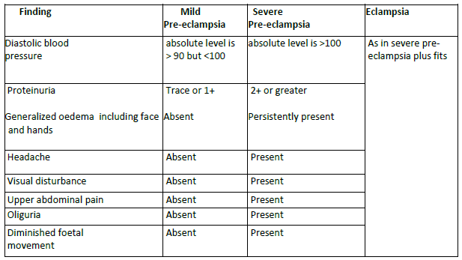
Classification of pre-eclampsia/ eclampsia

Slide 8
Characteristics of Eclamptic fits:
Convulsions may occur regardless of the severity of hypertension, are difficult to predict and typically occur in the absence of hyper-reflexia, headache or visual changes.
Convulsions are tonic-clonic and resemble grand-mal seizures of epilepsy
Seizures may recur in rapid sequence as in status epilepticus, and end in death.
Convulsion may be followed by coma that lasts minutes or hours, depending on the frequency of seizures.
25% of eclamptic fits occur after delivery of the baby.

Slide 9
Stages of eclamptic fit
A) Premonitory stage
This lasts 10-20 seconds, during which:
The eyes roll or stare
The face and hand muscle may twitch
There is a loss of consciousness
B) Tonic stage
This stage lasts 10-20 seconds, during which:
The muscles go stiff or rigid
The colour of the skin becomes blue or dusky (cyanosis)
The back may be arched
The teeth are clenched
The eyes bulge

Slide 10
Cont…
C) Clonic Stage
This stage lasts 1- 2 minutes and is marked by:
Violent contraction and relaxation of the muscles occur
Increased saliva causes "foaming" at the mouth
Deep noisy breathing
Inhalation of mucous or saliva
The face looks congested (filled with blood) and swollen
Tongue is bitten by violent action of the jaws
D) Coma stage
This may last minutes or hours. During this time
There is a deep state of unconsciousness
Breathing is noisy and rapid
Cyanosis fades, but the face remains congested and swollen
Further fits may occur before the woman regains consciousness

Slide 11
Diagnosis of Preeclampsia /Eclampsia
History: Mild-to-moderate preeclampsia may be asymptomatic. Many cases are detected through routine prenatal screening.
Physical Examination
Increased BP compared with the patient's baseline or greater than 140/90 mm Hg
Altered mental status
Decreased vision or scotomas
Hyperreflexia or clonus: Although deep tendon reflexes are more useful in assessing magnesium toxicity, the presence of clonus may indicate an increased risk of convulsions.
Seizures

Slide 12
Cont…
Investigations:
Laboratory Studies
CBC count and peripheral smear
Liver function tests
Serum creatinine level
Urinalysis - Proteinuria suggestive of preeclampsia is greater than or equal to 1+ protein on urine dipstick or 300 mg/L or more on urine dipstick.

Slide 13
Cont…
Ultrasonography:
This is used to assess the status of the foetus as well as to evaluate for growth restriction (typically asymmetrical IUGR). Aside from transabdominal ultrasonography, umbilical artery Doppler ultrasonography should be performed to assess blood flow.

Slide 14
Management of patients with pre-eclampsia /eclampsia.
General principles:
BP control
Control of seizures
Fluid management

Slide 15
Cont…
Medication
Anticonvulsants:
Magnesium sulphate:
Phenytoin:
Antihypertensives
Hydralazine (Apresoline)
Labetalol
Nifedipine

Slide 16
Magnesium sulphate dosage
Loading dose: IV 4g 20% solution slowly over 15 mins10 g 50% IM(5g in each buttock with 1 ml 2% lignocaine
Then maintainance dose: 5g IM 4 hourly
NB- IV maintainance dose of 1g 20% per hour in 24 hours should only be applied if IV pump is available to avoid toxicity and complications

Slide 17
Cont…
If unable to give loading dose can give loading dose IM only
If convulsion recurs give additional 2-4g IV over 10-15 minutes( give lower dose{2g} if woman is small and/or weigh less than 70kgs)
NB- If dilution required for i.v route use normal saline NOT LIGNOCAINE
Monitor vital signs
Check 4 hourly prior to next mgso4 dose;
conscious level
Patella reflex
Urine output

Slide 18
Cont…
NB- Do not give the next dose of mgso4 if:
Absent knee jerk
Urine output less than 100mls in last 4 hrs
Respiratory rate less than 16 breaths per minute
If respiratory rate less than 16 breaths/minute stop mgso4 and calcium gluconate (10%) 1g iv over 10 minutes

Slide 19
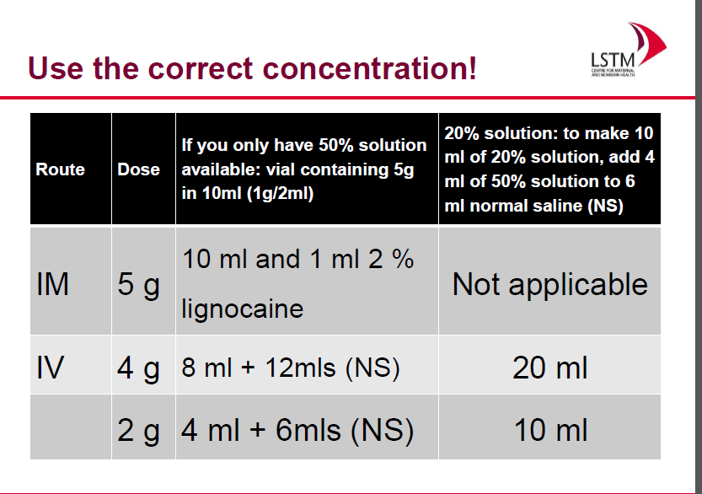

Slide 20
Definitive Management
a) Mild Pre-eclampsia e.g. with BP 140/90
Establish if the mother can rest at home
Advise patient and relatives on importance of bed rest
Give oral antihypertensives (alpha methyl dope 250mg three times daily) Maintain diastolic BP at 90-100 mmHg
Monitor maternal and foetal condition weekly
Admit if coming too far away from hospital,
Advise on worsening signs of the condition, and the need to report if any signs of severe pre-eclampsia are present
Advise mother to take a diet, which is rich in protein, fibre and vitamins but low in carbohydrate and salt
If the mother shows no improvement and facilities /skills to manage severe eclampsia are lacking, refer to higher level

Slide 21
Cont…
b) Severe Pre-eclampsia e.g. BP diastolic > 100 mmHg
Admit patient
Nurse in a quiet semi dark room
Monitor vital signs every 15- 30 minutes
Start MgSO4 regime
Consider timing and mode of delivery
Closely monitor fluid intake and urine output
Do blood chemistry (liver enzymes and creatinine)
If the diastolic blood pressure is 110 mm Hg or more, start antihypertensive drugs, e.g. Hydralazine 5 mg IV slowly every 5 minutes until blood pressure is lowered. Repeat hourly as needed or give hydralazine 12.5mg IM every 2 hours as needed
If hydralazine is not available, give Labetolol or nifedipine
If no improvement, refer to comprehensive centre accompanied by trained nurse

Slide 22
Cont…
Management of eclampsia:
Call for help
Maintain open airway
Control fits
Control the blood pressure and monitor quarter hourly
Start IV line but restrict fluid intake to avoid pulmonary and cerebral oedema. Maximum of 30 drops per minute.
Catheterise, and closely monitor fluid intake and urine output

Slide 23
Cont…
Delivery
Delivery is the definitive treatment for antepartum preeclampsia.
Patients with mild preeclampsia are often induced after 37 weeks' gestation. Prior to this, the immature foetus is treated with expectant management with corticosteroids to accelerate lung maturity in preparation for early delivery.
In patients with severe preeclampsia, induction of delivery should be considered after 34 weeks' gestation. In these cases, the severity of disease must be weighed against the risks of prematurity.
Eclampsia is common after delivery and has occurred up to 6 weeks after delivery. Patients at risk for eclampsia should be carefully monitored postpartum.

Slide 24
Management of fitting patient:
Patient should be put in semi prone position
Tight fitting dresses around the neck should be loosened or removed
No attempt should be made to insert any instrument into the mouth
Administer magnesium sulphate (or diazepam) as per regime to control fits
Aspirate secretions from the mouth and nostrils as necessary
Give Oxygen continuously during fit and for 5 minutes after each fit (if available)
Fitting should be allowed to complete its course without restraining the patient
Privacy and dignity of patient must be observed - pull screens around her

Slide 25
Cont…
Postnatal care:
Continue anticonvulsive therapy for 24 hours after delivery or last convulsion, whichever occurs last.
Continue antihypertensive therapy as long as the diastolic pressure is 110 mmHg or more.
Continue to monitor urine output. If urine output is less than 500 ml in 24 hours, limit the amount of fluid intake to 500 mls per 24 hour + an amount equal to the amount of urine passed
Watch carefully for the development of pulmonary oedema, which often occurs after delivery.

Slide 26
Cont…
Life threatening complications can still occur after delivery. Monitor carefully until the patient is clearly recovering.
Consider referral of women who have:
Oliguria (less than 500 ml urine output in 24 hours) that persists for 48 hours after delivery
Coagulation failure (e.g. coagulopathy or haemolysis, elevated liver enzymes and low platelets (HELLP) syndrome)
- Persistent coma lasting more than 24 hours after convulsion.

Slide 27
Cont…
Complications
Abruptio placentae
Renal insufficiency or failure
Haemolysis, elevated liver enzyme levels, and low platelet count (or HELLP syndrome)
Cerebral haemorrhage
Maternal death and/or foetal demise

Slide 28
Cont,,,
Prognosis/prevention
Early detection and frequent obstetric assessment and prompt management markedly improves prognosis.
Women at risk of preeclampsia must have pre conception care and attend ANC early and regularly
A history of preeclampsia increases a woman's subsequent risk of vascular disease, including hypertension, thrombosis, ischemic heart disease, myocardial infarction, and stroke.

Slide 29
Anaemia in Pregnancy

Slide 30
Definition of anaemia
Anaemia is a disorder characterised by blood haemoglobin concentration lower than the defined normal level and it is usually associated with decrease in circulating mass of red blood cells.

Slide 31
Classification of anaemia
Anaemia is diagnosed when the Hb level of pregnant women is below 10 gm/dl and can be grouped as follows:
Mild: Hb 8.1 – 9.9 g/dl ( mucous membranes look slightly pale)
Moderate: Hb 5.1 g – 8.0 g/ dl (mucous membranes are moderate pale)
Severe: Hb less or equal to 5 g/ dl (mucous membrane markedly pale)

Slide 32
Cont…
Causes of anaemia
Physiological anaemia
(b) Dietary caus
(c)Obstetrical and gynaecological reasons
(d) Non-obstetrical reasons
Frequent attacks of malaria
Dysentery
Hook worm infestation
Urinary tract infections including bilharzia
(e) Chronic illness
Bleeding Disorders
Pulmonary Tuberculosis
Pre -existing medical conditions i.e. HIV/AIDS, sickle cell disease

Slide 33
Women at risk of developing anaemia in pregnancy are those with:
Low socio economic status
Young primigravida
Frequent or too many pregnancies
Previous history of PPH
History of APH
Multiple pregnancy
Pregnant women in Malaria endemic areas

Slide 34
Signs and symptoms
Pallor of mucous membranes
Breathlessness
Dizziness
Fatigue and lethargy
Fainting attacks
Headaches due to lack of sufficient oxygen to brain cells
Anorexia and vomiting

Slide 35
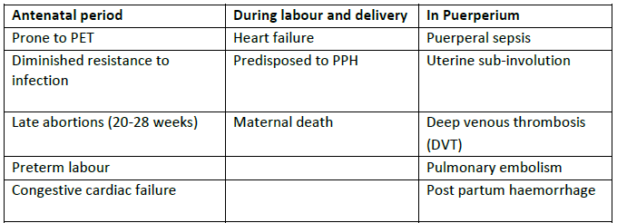
Effects of anaemia in pregnancy
Maternal effects;

Slide 36
Cont…
Effects of anaemia on foetus / neonate include:
- Prematurity
- Intra uterine growth retardation (IUGR)
- Foetal malformations esp. in folate deficiency.
- Intra uterine foetal death (IUFD)
- Foetal distress
- Asphyxia at birth and/or cerebral damage
- Meconium aspiration
- Low birth weight
- Still births (may be fresh or macerated)

Slide 37
Cont…
Diagnosis of anaemia
A comprehensive history and physical examination is imperative to rule out the underlying causes of anaemia, and to detect any complications that may have occurred. Basic laboratory work up should include the following:
1. Haemoglobin and haematocrit Estimation (to know degree of anaemia)
2. Full blood count and peripheral blood film (to know the type of anaemia)
3. Stool examination for ova and cysts, Blood Slide or RDTs for malaria diagnosis, urinalysis / microscopy etc (to know the cause of anaemia)
4. Blood group and Rhesus factor determination

Slide 38
Management of anaemia during pregnancy and labour
General treatment of anaemia during pregnancy
Prescribe ferrous sulphate or ferrous fumerate 200 mg PLUS folic acid 5mg by mouth once daily for 6 months during pregnancy. Continue for 3 months postpartum.
Where hookworm is endemic (prevalence of 20% or more), give:
- Albendazole 400 mg by mouth once;
- Or mebendazole 500 mg by mouth once or 100 mg two times per day for 3 days;
- Or levamisole 2.5 mg/kg body weight by mouth once daily for 3 days;
- Or pyrantel 1Omg/kg body weight by mouth once daily for 3 days;
Treat any underlying cause of anaemia as appropriate
Mild anaemia is to be treated by administration of oral iron and folate.
Moderate anaemia may need parental iron therapy. If detected after 36 weeks, she may need a blood transfusion.

Slide 39
Cont…
Severe cases of anaemia should be managed as follows:
Admit to the hospital for close supervision and intensive treatment.
Investigate for the other causes of anaemia and treat appropriately.
Transfuse using packed red cells. Administer a diuretic (e.g. frusemide 40mg IV) with each unit of blood.
If the woman is in heart failure, transfuse as above slowly, maintain a strict fluid balance chart and manage the congestive cardiac failure.
Thereafter maintain on iron 120mg plus folate 400mcg orally once a day for six months during pregnancy and until 3 months post partum
In case of caesarean section, avoid the use of spinal anaesthesia in women with severe anaemia, haemorrhage and coagulation disorders.

Slide 40
Cont…
Treatment of anaemia during Labour and delivery
Labour and the first two weeks of the puerperium are the periods of greatest danger to the anaemic mother, and more than half of the deaths occur in the first 12 hours after delivery. When a severely anaemic patient is in labour, she should nurse in a propped up position. Judicious monitoring of the mother and foetus must be maintained. The team must always be prepared to manage PPH and for newborn resuscitation.
1. Give oxygen inhalation by mask
2. Transfuse as necessary.
3. Maintain strict aseptic technique in order to minimize puerperal infection.
4. The second stage of labour usually poses no problem, but assisted delivery with forceps or vacuum extraction is recommended.
5. Active management of third stage of labour is recommended. Oxytocin is the uterotonic of choice.

Slide 41
Cont…
Prevention of Anaemia
Pre-pregnancy care for early diagnosis and management of anaemia and any underlying causes should be encouraged.
Early ANC attendance is important for prompt diagnosis of anaemia
Ensure comprehensive obstetric and social history in antenatal clinic to identify factors predisposing to anaemia
During the ANC, give routine supplementation of iron and folic acid
Deworm the pregnant mothers as part of ANC care

Slide 42
Cont…
Give intermittent preventive treatment of malaria in Malaria endemic areas
Treat any concurrent infections, infestations and manage medical conditions as appropriate
Give dietary advice which is appropriate for each woman depending on health status, religious and cultural preferences. Highlight the sources of iron available in the index community
Advise women on healthy timing and spacing of pregnancy
Counsel to discourage pica (especially eating of soil) during pregnancy

Slide 43
assignments
Diabetes in pregnancy
Hyperemesis gravidarum
Polyhydromnious/oligohydromnious
STI/HIV/AIDS
UTI
TB
Malaria
Intrauterine fetal retardation/Intrauterine fetal death
Rhesus incompatibility
Thyrotoxicosis

Slide 44
Use the following heading
Definition
Incidence
Pathopysiology
Risk factors
Screening
Clinical manifestation
Diagnosis
Management( medical/nursing)
Prevention and control
complications

Slide 45
Cardiac Disease in Pregnancy

Slide 46
Definition of cardiac disease in pregnancy
These are disorders that affect the heart muscles, valves or blood vessels in pregnancy. The disease impairs the ability of the heart to supply tissue with oxygen.
Common causes of cardiac disease in pregnancy are:
Congenital anomalies
Rheumatic fever
Cardiomyopathies
Coronary artery disease

Slide 47
Risk Factors for Heart Disease
The following factors predispose patients to heart disease:
Anaemia
Infections-URTI.
Obesity
Hypertension and pre-eclampsia
Smoking mothers
Multiple pregnancies
Exercises that induce breathlessness should be discouraged.
Fatigue

Slide 48
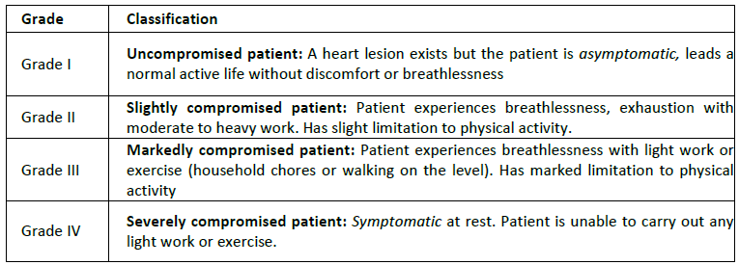
Grades and classification of cardiac disease

Slide 49
Cont…
Signs noted in a normal pregnancy
Fatigue and decreased exercise capacity and orthopnoea
Dyspnoea
Syncope
Palpitations
Distended neck veins
Displaced apex beat
Soft continuous murmur at the apex

Slide 50
Cont…
Warning Signs Suggestive of Heart Disease:
Particular attention must be paid to warning signs, which include the following:
Worsening dyspnoea on exertion, or dyspnoea at rest
Chest pain with exercise or activity
Syncope preceded by palpitations or exertion
Loud systolic or diastolic murmur
Cyanosis or clubbing of fingers or toes
Jugular venous distension
Cardiomegaly or a ventricular heave

Slide 51
Cont…
Effect of Heart Disease on Pregnancy
Cyanosis and poor functional capacity are indicators of significant maternal and foetal risk. Obstetric complications of cardiac disease include:
Preterm Labour
Intrauterine growth retardation (IUGR)
Intrauterine foetal death (IUFD)

Slide 52
Cont…
Investigations
A thorough history and physical examination must be done.
Other recommended investigations include:
Electrocardiogram (ECG) - to assess ischemic acute/chronic changes in cardiac function
Echocardiogram - to identify the specific heart lesion
Chest X-ray (shielded)
Full blood count to rule out anaemia and infection
Urinalysis to rule out urinary tract infection

Slide 53
Management of cardiac disease in pregnancy
Principles of Management:
The following principles must be applied for successful management of Cardiac disease in pregnancy
1. Early diagnosis and evaluation of the functional classification
2. Prevention, timely detection and institution of effective therapy for cardiac failure
3. Prevent and control of any underlying conditions or complications e.g. Anaemia
4. Judicious follow up and prevention /management of any obstetric complications along the continuum of pregnancy, labour and the puerperium
5. Apart from the obstetrician, The patient should be followed up by a cardiologist
6. Mandatory hospital delivery

Slide 54
Cont…
Antenatal Care:
Early initiation of antenatal care is recommended.
Continuity of care with a single provider facilitates early intervention.
There should be close monitoring of foetal growth and viability
The patient should be advised on adequate rest and avoidance of aggravating factors for cardiac failure:
  Infections should be treated vigorously.
  Anaemia should be prevented using prophylactic haematinics, and when present it should be treated vigorously.
  Encourage good dental care
  Patients with prosthetic valves should be put on anticoagulants.

Slide 55
Cont…
Management of Grade I and II:
Manage as outpatient
Admit at 34 weeks gestation ; (In case of unfavourable social surrounding admit earlier)
Admit in case of deterioration of Cardiac state
Admit in the event of any obstetric complications
Management of Grade III and IV:
Admit as soon as pregnancy is diagnosed until delivery
The patient should have complete bed rest
Look out for aggravating signs and treat aggressively

Slide 56
Cont…
Management in labour:
1st Stage of labour:
Prop up in bed and tilt forwards the left side
Give Oxygen continuously by mask or nasal catheter
Provide adequate analgesia with pethidine 25 -50mg IM or morphine
Avoid dehydration; Maintain strict fluid balance chart (limit fluid infusion to minimize the risk of circulatory overload )
If oxytocin infusion is required, use a higher concentration at a slower rate

Slide 57
Cont…
Start on parenteral antibiotics (e.g. crystalline penicillin 1MU)for prophylaxis against infection
Carefully monitor pulse and respiratory rate
If pulse is >110/minute in between uterine contractions or in case of cardiac failure give digoxin
In case of pulmonary oedema give Frusemide 40mg IV
NB/ Caesarean section should only be done for obstetric reasons.

Slide 58
Cont…
Second / Third stage of labour:
Maintain the patient in a propped up position
Assisted vacuum delivery should be done to avoid sustained bearing down efforts during expulsive phase as this can aggravate cardiac failure
Ensure active management of third stage - immediate oxytocin, controlled cord contraction and uterine massage.
DO NOT GIVE ERGOMETRINE as this may lead to sudden overload of the heart as a result of additional blood squeezed out from the uterus
In case of caesarean section avoid spinal anaesthesia

Slide 59
Postpartum Care
The patient should be closely monitored for the first 24 hours
Retain the patient in hospital for at least 10 – 14 days depending on grade
Restrict exercise in the first week of delivery and mobilize slowly thereafter
Give prophylactic crystalline penicillin 2 mega units I.M. 6 hourly for 48 hours after delivery. Continue penicillin treatment orally for 10 days 500mg 6 hourly (this is to prevent sub-acute bacterial endocarditis)
Manage the cardiac condition and any complications as appropriate
Encourage breastfeeding
Advise on family planning

Slide 60
Antepartum haemorragea
Definition of APH
APH is vaginal bleeding during pregnancy usually presenting in the last trimester of pregnancy. Any vaginal bleeding after 28 weeks should be assumed to be due to either placenta praevia or abruptio placentae, unless proven otherwise.
Causes of APH
Bleeding in late pregnancy and in labour is usually due to placenta abruption or placenta praevia.

Slide 61
Cont…
Placenta Praevia:
This is when implantation of the placenta occurs at or near the cervix. It may be partial or complete praevia. In partial placenta praevia a posteriorly situated placenta is more dangerous than an anterior one. In placenta praevia bleeding is always revealed, though it may cease spontaneously. The blood colour is usually bright red.

Slide 62
Types
Type 1 ;The placenta lies in the upper segment and only the lower margin dips into the lower uterine segment.
Type II ;The placenta is partially situated in the lower uterine segment with the lower margin of the placenta reaching the edge of the internal os but does not cover it. It is known as marginal placenta praevia.
Type III ;The placenta covers the internal os when closed up to three to four centimetres dilatation. This is known as partial or incomplete placenta praevia.
Type IV ;The placenta lies centrally over the internal os and covers the os even when the cervix is fully dilated.

Slide 63
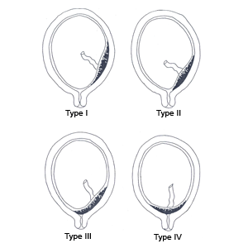

Slide 64
Cont…
The signs and symptoms of placenta praevia are as follows:
painless bleeding
Blood is bright red and may be Scanty or heavy
Pale looking patient, the degree of which corresponds to the amount of blood loss.
No tenderness in the abdomen
Soft and relaxed uterus
The presenting part may be high or there may be abnormal presentation
The foetal parts are easily palpable
Foetal heart sounds are usually present.

Slide 65
Abruptio Placentae
This is premature detachment of a normally situated placenta before the foetus is delivered. The resultant retro - placental bleeding may be revealed, concealed or mixed type.
Mixed or combined, where bleeding is partly revealed and partly concealed.
Concealed, where the blood is trapped between the placenta, membranes and the uterine wall. There is no visible bleeding.
External or revealed, which is where there is free (visible) vaginal haemorrhage.
The causes include toxaemia, trauma, sudden uterine decompression, or short umbilical cord.

Slide 66
Cont…
It is associated with the following conditions:
Hypertensive conditions and pre-eclampsia
High parity
Trauma
Sudden release of polyhydramnious
High fever
Traction of abnormally short umbilical cord during labour
External cephalic version
Fright or sudden shock, for example, bad news

Slide 67
Cont…
Signs and symptoms are as follows:
Bleeding
- In the revealed type, the amount of external blood loss is consistent with the condition of the patient
- In the concealed type, there is usually little or no visible vaginal bleeding, yet the patient is pale
Constant abdominal pain
Tender abdomen
Woody hard, tense uterus
Foetal sounds are absent in severe cases.

Slide 68
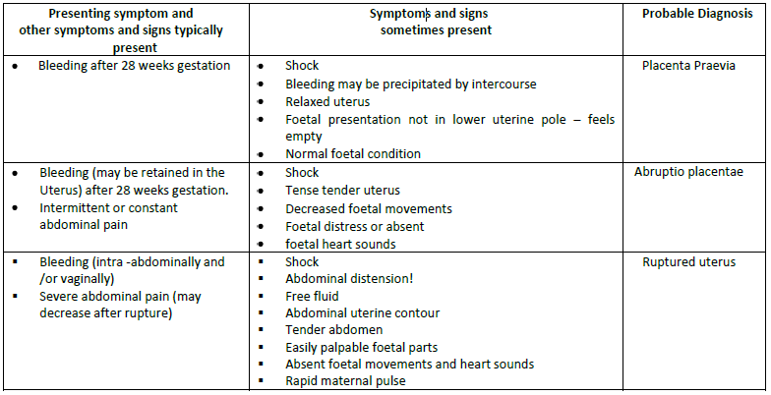
Diagnosis of APH

Slide 69
Cont…
The differential diagnosis of APH includes:
Labour (bloody heavy show)
Cervical erosion
Cervicitis
Cervical polyp
Carcinoma
Trauma.

Slide 70
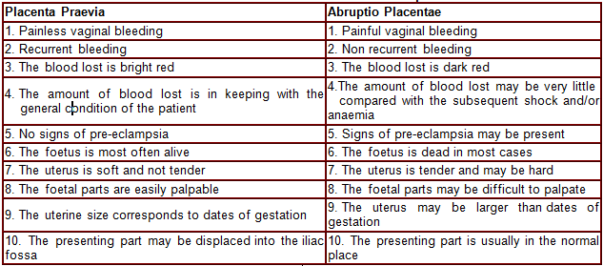
The Differences between Placenta Praevia and Abruptio Placentae

Slide 71
Management of APH
GENERAL MANAGEMENT
Shout for help. Urgently mobilize all available personnel
Make a rapid evaluation of the general condition of the woman including vital signs (pulse, blood pressure, respiration, temperature).
If you suspect shock, begin treatment immediately.
Start a rapid IV infusion (Normal saline or ringers solution)
Even if signs of shock are not present, keep shock in mind as you evaluate the woman further because her status may worsen rapidly

Slide 72
Management of PLACENTA PRAEVIA
Placenta praevia is implantation of the placenta at or near the cervix. If you suspect placenta praevia, DO NOT PERFORM A VAGINAL EXAMINATION unless preparations have been made for immediate caesarean section
Perform a careful speculum examination to rule out other causes of bleeding such as cervicitis, trauma, cervical polyps or cervical malignancy. The presence of these, however, does not rule out placenta praevia
Assess the amount of bleeding.
Restore blood volume by infusing IV fluids (normal saline or Ringer’s lactate)

Slide 73
Cont…
If bleeding is heavy and continuous, arrange for caesarean delivery irrespective of foetal maturity
If bleeding is light or if it has stopped and the foetus is alive but premature, consider expectant management until delivery or heavy bleeding occurs
o Keep the woman in the hospital until delivery
o Correct anaemia with oral iron therapy
o Ensure that blood is available for transfusion, if required
If bleeding recurs, decide management after weighing benefits and risks for the woman and foetus of further expectant management versus delivery.

Slide 74
Confirming the diagnosis of Placenta Praevia
If a reliable ultrasound examination can be performed, localize the placenta.
If placenta praevia is confirmed and the foetus is mature, plan delivery.
If ultrasound is not available or the report is unreliable and the pregnancy is less than 37 weeks, manage as placenta praevia until 37 weeks.
If ultrasound is not available or the report is unreliable and the pregnancy is 37 weeks or more, examine under double set-up to exclude placenta praevia, with the woman in the operating theatre with the surgical team present.

Slide 75
Cont…
The double set-up prepares for either vaginal or caesarean delivery, as follows.
Ensure IV lines are running and cross matched blood is available.
Use a sterile vaginal speculum to see the cervix:
If the cervix is partly dilated and placental tissue is visible, the diagnosis is confirmed; plan caesarean delivery
If the cervix is not dilated, cautiously palpate the vaginal fornices:
If you feel spongy tissue, confirm placenta praevia and plan caesarean delivery
If you feel a firm foetal head, rule out major placenta praevia and proceed to deliver by induction
If a diagnosis of placenta praevia is still in doubt, perform a cautious digital examination:

Slide 76
Cont…
If you feel soft tissue within the cervix, confirm placenta praevia and plan delivery
If you feel membranes and foetal parts both centrally and marginally, rule out placenta praevia and proceed to deliver by induction.
If delivered by caesarean section and there is bleeding from the placental site:
– Under-run the bleeding sites with sutures.
– Infuse oxytocin 20 units in 1 L IV fluids (normal saline or Ringer’s lactate) at 60 drops per minute.
Women with placenta praevia are at high risk for postpartum haemorrhage and placenta accreta/increta, a common finding at the site of a previous caesarean scar

Slide 77
Cont…
Delivery is indicated if:
Foetus is mature
Foetus is dead or has anomaly not compatible with life
Mothers life is at risk due to excessive blood loss
Rupture the membranes for vaginal delivery if:
Minor degree of placentae praevia is suspected and / or detected
Presentation is favourable for vaginal delivery
Bleeding is light
Perform caesarean section if:
Bleeding is heavy and continuous irrespective of gestational age
Major degree of placenta praevia is suspected

Slide 78
MANAGEMENT OF ABRUPTIO PLACENTAE
An abruptio placentae (placental abruption, retro placental bleed) is the detachment of a normally located placenta from the uterus before the foetus is delivered
Management is as follows:
Assess clotting status using a bedside clotting test. Failure of a clot to form after 7 minutes or a soft clot that breaks down easily suggests coagulopathy.
Ensure that blood is available for transfusion, if required
If bleeding is heavy (evident or hidden), deliver as soon as possible
If the cervix is fully dilated, perform assisted vaginal delivery if there are no other contraindications.

Slide 79
Cont…
If vaginal delivery is not imminent, deliver by caesarean section.
If bleeding is light to moderate (the mother is not in immediate danger),the course of action depends on the foetal heart rate:
o If foetal heart rate is normal or absent, rupture the membranes with an amniotic hook or a Kocher’s clamp
If contractions are poor, augment labour with oxytocin
If the cervix is unfavourable (firm, thick, closed), perform a caesarean section
o If the foetal heart rate is less than 100 or more than 180 beats per minute:
- Perform rapid vaginal delivery
- If rapid vaginal delivery is not possible, deliver by immediate caesarean section.
In every case of abruptio placentae, be prepared for postpartum haemorrhage.

Slide 80
Cont…
Lower segment caesarean section in the management of APH is indicated in case of:
poor progress of labour
failure of the uterus to relax between contractions
foetal distress
increased bleeding

Slide 81
Complications of Abruptio Placentae
These can be very serious and include the following:
Failure of blood clotting mechanisms, leading to excessive haemorrhage in concealed bleeding
Renal failure or hypovoleamia
Puerperal sepsis
Anaemia
Maternal death
Foetal death
Anterior pituitary gland necrosis.

Slide 82
Multiple pregnancies
Multiple pregnancy is when there is a pregnancy with more than one foetus. Twin,triplets and quadruplets pregnancy are the most common form of multiple pregnancy.
Symptoms and signs
A positive family history of twins
Exaggerated symptoms of pregnancy (hyperemesis gravidarum, pre-eclampsia)
Uterus greater than gestational age
Globular uterus
Two or more foetal hearts
Heads feel smaller than the dates would indicate

Slide 83
Classification of multiple pregnancy
    Number of fetuses: twins, quadruplets, etc.
    Number of fertilized eggs: zygosity
    Number of placentas: chorionicity

Slide 84
Cont…
Varieties of Twins
Twins may be binovular or uniovular. Binovular twins are developed from two separate ova, which may or may not come from the same ovary. Uniovular twins are developed from a single fertilised ovum, which undergoes division to form two embryos.

Slide 85
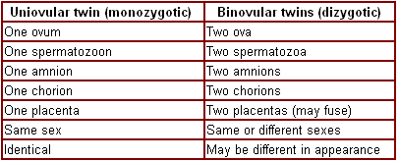
Cont…

Slide 86
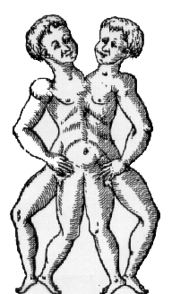
Conjoined Twins
(paraphagus)
http://www.conjoined-twins.i-p.com

Slide 87
Diagnosing a Multiple Pregnancy
On Inspection
The abdomen looks larger than it should at the given date
Polyhydramnios may increase the abdominal size leading to confusion of the diagnosis
On Auscultation
Two foetal hearts are recorded simultaneously and there is a difference of 10 to 20 beats

Slide 88
Cont…
On Palpation
Abdominal girth will be 101.5 or more centimetres
Fundal height is larger than dates from twentieth week of gestation
You will reveal two foetal poles on fundal palpation
The size of the head is smaller than the size of
the uterus
You will palpate an unusual number of foetal parts

Slide 89
Cont…
Ultrasound Scan
An ultrasound scan at seventh week can distinguish two separate sacs while from the twelfth week two foetal bodies can be identified. On the fourteenth week, two heads can be detected.

Slide 90
Cont…
Differential diagnosis
Large single foetus
Wrong dates
Polyhydramnios
Obesity of the mother
Hydrocephalus
Uterine / ovarian mass
Investigations
Ultrasonography

Slide 91
Effects of Multiple Pregnancy
The effects of twins on pregnancy include:
Preeclampsia
Anaemia
Polyhydramnios could occur due to more fluid in the two
foetal sacs
Pressure symptoms are more marked, and may include backache, oedema, varicose veins, indigestion, constipation, dyspnoea and bladder irritability
Minor disorders of pregnancy are more marked, including headache, morning sickness and vomiting
Premature labour is likely, due to over stretching of the uterus
Congenital malformation occurs twice as much than in
single pregnancy
Intrauterine growth retardation may occur due to
placenta insufficiency

Slide 92
Management…
If twins are expected, refer to facility that can provide Comprehensive Emergency Obstetric and Newborn Care
Screen for possible complications, e.g. pre-eclampsia, anaemia, etc.
Reasons for admission are:
- To ensure bed rest
- For women who have no access to emergency transport
- Polyhydramnios
- Preterm labour
- Anaemia
- APH
- Hypertension in pregnancy
- Poor past obstetric history
- Malpresentation of the first twin

Slide 93
Cont…
Labour
Allow spontaneous labour only if the first twin is presenting cephalic. If the first baby is a malpresentation, CS should be performed.
Set up an IV line and take blood for grouping and cross matching
Ensure preparedness of neonatal / paediatric unit
No oxytocics should be administered after delivery of first baby
After delivery of the first baby, ascertain lie of second baby. If longitudinal, rupture the membranes and wait for spontaneous delivery of second baby

Slide 94
Cont…
Continue foetal monitoring
If no contraction within 10 minutes, put up oxytocin drip to augment labour and deliver second baby.
In case of retained subsequent baby (>30 minutes after delivery of first twin), consider C/section
Palpate uterus and ensure that there is no baby before giving oxytocin
Conduct active management of third stage of labour
Examine placenta(s) for consanguinity and zygosity
Continue with IV oxytocin for one hour after delivery of placenta

Slide 95
Complications of twins in pregnancy
Malpresentation
Delay in the birth of the second twin
Cord prolapse
Maternal and foetal distress is common due to prolonged labour
Locked twins is a rare complication but may prevent spontaneous delivery
Postpartum haemorrhage due to large placental site

Slide 96
INTRAUTERINE GROWTH RETARDATION (IUGR)
Defination;
Rate of fetal growth that is less than normal for the population and for the growth potential of a specific baby
Occurs where there is normal fetal growth potential during the 1st and 2nd trimester but during the course of pregnancy growth becomes severely reduced by adverse extra fetal and maternal factors that results in the birth of a small for dates baby
Often recurrent

Slide 97
Causes…
a. Maternal
PET, chronic HPTN
DM
Undernutrition, underwt, short stature
Smoking, alcoholism
Renal disease, collagen disorders
UTIs
Irradiation
Young &elderly mothers
Severe cardiac disease
Uterine abnormalities/fibroids
Recurrent APH
HIV/AIDS/TB
Multiple gestation

Slide 98
b. Fetal factors
Multiple gestation
Chromosomal/genetic abnormalities
Congenital malformations
Intrauterine infection - TORCH

Slide 99
c. Placental factors
Placenta abruptio
Placenta praevia
Chorioamnionitis
Single umbilical artery
Abnormal cord insertion

Slide 100
classification of IUGR
ASYMETRIC GR
Weight is reduced out of proportion to the length and head circumference .
Caused by extrinsic factors
The head looks disproportionally large compared with the body but head circumference is usually within the normal parameters

Slide 101
Cont…
Abd looks scaphoid or sunken because of the liver and spleen shrinkage due to their surrender of glycogen and red blood cell mass respectively.
Decreased s/c fat deposit which makes the skin loose and old appearance
Vernix caseoasa reduced or absent
Appear hyperactive and hungry with lusty cry

Slide 102
Cont…
SYMMETRIC GR(chronic)
Due to decreased growth potential of the fetus as a result of congenital/genetic defects (intrinsic)
Head circumference’ length and weight are all proportionally reduced for gestation.

Slide 103
Clinical features
Growth of pregnancy normal until 28weeks, then reduced
Reduction in amt of amniotic fluid
Uterine size smaller than expected
Maternal weight inadequate or decreasing

Slide 104
Investigations
Specific investigations to rule out suspected causes
Serial ultrasound
Alpha feto-protein

Slide 105
Antenatal
Manage in adequately equipped/staffed settings with emergency facilities and staffing
Adequate bed rest
Close monitoring of pregnancy
  Check fundal ht, fetal size, amt of liqour, maternal wt and girth
Mother to maintain a fetal kick chart
Make a definite decision when and how to deliver
Multidisciplinary

Slide 106
Intrapartal
Delivery in hospital capable of dealing with various neonatal morbidities associated with GR eg asphyxia, hypoglycemia., meconium aspiration
If the fetus is in great danger, deliver via c/s
Others by induction-do Bishop’s score
Fetal maturity should be weighed visa viz severity of IUGR

Slide 107
Cont…
Consult paediatrician- prone to neonatal asphyxia, hypoglycaemia, cerebral haemorrhage
Exclude congenital abnormalities

Slide 108
Prevention
Prenatal testing thru AFP, karyotyping and US
Pregnant women should avoid close contact with individuals known to be infected with rubella or CMV
Non pg women of reproductive age should be tested for rubella and if susceptible be immunized
Pg women to avoid alcohol/smoking

Slide 109
Cont…
Treat HPTN, PET and chronic renal failure
Correct maternal anemia
Ensure adequate maternal nutrition

Slide 110
IUFD-INTRAUTERINE FETAL DEATH
Death of the fetus in the uterus for whatever cause after 28 wks of pg
CAUSES
Maternal conditions
  PET
  Metabolic abnormalities DM, thyroid dysfuntion
  Syphilis
  Rh incompatibility
  High fever or other acute maternal illness
  Severe anaemia

Slide 111
CAUSES
Fetal conditions
  Chromosomal abnormalities
  IUGR
  Chorioamnionitis
FEATURE;
Cessation of fetal movts >12hrs
Cessation of symptoms of pg
Absence of fetal heart sounds
Maternal wt decreasing
Or does not incr with gestation
Failure of the uterus to grow and as days goes by, uterus is smaller in size

Slide 112
INVESTIGATION
Obstetric US
On confirming Dx
  Hb estimation
  Hepatitis B
  HIV
  VDRL
  BG/Rh
  Blood urea/glucose
  Serum fibrinogen/platelet count

Slide 113
Management…
Psychological counselling
Upon confirming Dx explain to the mother
X match 3 unit of fresh blood
Avoid ARM-unneccessary infxn +c/s
If not delivered after 12hrs of induction STOP-give 1 days rest then start induction again. If 2nd attempt fails consult
Treat cause

Slide 114
Postpartum…
Examine fetus for congenital malformn
Examine placenta
Examine cord
Examine mother for infxn
Prevention…
As for IUGR

Slide 115
HIV/AIDS IN PREGNANCY
HIV: stands for Human Immunodeficiency Virus, the virus that causes AIDS. Clients with HIV infection do not have symptoms. However, they can still pass HIV to others.
AIDS: stands for Acquired Immunodeficiency Syndrome. Clients have physical signs and symptoms of HIV infection that come as a result of weakened immune system. Progression of HIV depends on type of virus and specific characteristics of person, including general health, nutritional and immune status

Slide 116
Effect of HIV on pregnancy
HIV/ AIDS may have the following effects on pregnancy
Maternal
1. Spontaneous Miscarriage
2. Low weight gain/ may experience weight loss
3. Frequent infections especially UTI and RTI
4. Anaemia (common)
5. APH in 3rd trimester/ placental abruption
6. Greater likelihood of PPH reported
7. High risk of maternal mortality
8. Preterm PROM
9. Chorioamnionitis

Slide 117
Cont…
Baby
1. Preterm delivery
2. Low birth weight/ IUGR
3. Increased IUFD and still births
4. Low apgar scores at 5 minutes
5. High infant mortality rates

Slide 118
Cont…
Risk factors for MTCT
The most important risk factor for MTCT is the amount of HIV in the mother's blood. This is known as the viral load. The viral is usually high in case of:
Recent HIV infection
Advanced AIDS
Maternal Risk factors for MTCT during pregnancy
High maternal viral load (new infection or advanced AIDS)
Low CD4 count
Placental Infections e.g. Malaria
Anaemia
Sexually transmitted infections (STIs) especially the ulcerative ones
Unprotected sex
Multiple sexual partners
Smoking

Slide 119
Cont…
Maternal Risk factors for MTCT during labour and delivery
High maternal viral load (new infection or advanced AIDS)
Rupture of membranes for more than 4 hours
Instrumental delivery
Episiotomy
APH or Intrapartum haemorrhage
Chorioamnionitis
Vaginal delivery
External cephalic version
Infant Risk factors for MTCT
Premature delivery
Low birth weight
Breaks in the skin or mucous membranes ((e.g. thrush or sores)

Slide 120
Management
1. Preconception care
• Knowledge of HIV status to make informed choices
• Partner involvement
• Good nutrition
• Provision of Comprehensive Post Rape Care services
• STI screening and management
• Contraception to prevent unintended pregnancies
• Life style and behaviour change
• ART for those who are eligible

Slide 121
Cont…
2. Antenatal care;
Assessment. This includes taking a complete history and physical examination.
• Antenatal profile including HIV testing for those who do not know their status
• Laboratory investigations including full blood count (FBC), CD4 count, viral load, and Hepatitis B and C screening
• TB screening should be done and the positive clients referred for treatment
Prophylactic treatment should include
• Iron and folate
• Multivitamin supplementation
• TT immunization
• Malaria prophylaxis (only for those who are HIV negative)
• Co-trimoxazole prophylaxis
• Antiretroviral treatment or prophylaxis

Slide 122
Cont…
3. Use of ARVs in Pregnancy
ARV therapy (ART): This is the long-term use of antiretroviral drugs to treat maternal HIV and for PMTCT
ARV prophylaxis: Is the short-term use of antiretroviral drugs to reduce HIV transmission from mother-to-child
MOH guidelines for ARV prophylaxis in HIV +ve women in WHO stage 1 or 2, or CD4 count over 350
• Start Zidovudine (AZT) at 14 weeks of pregnancy or first contact thereafter and continue in labour
• Give single dose Nevirapine (sdNVP) at onset of labour
• Start Lamivudine (3TC) in labour
• Continue AZT and 3TC for 1 week after delivery
• HIV +ve women presenting for the first time at 38 weeks and not eligible for HAART should be offered ARV prophylaxis during labour and up to 1 week post pa

Slide 123
Cont…
ARV prophylaxis in pregnancy New recommendations (WHO 2009)
Mother
Antenatal: Start AZT from 14 weeks or immediately thereafter up to 36 weeks
Intrapartum: give AZT 600 mg stat (or 300mg BD) + 3TC 150mg BD + single-dose NVP 200 mg onset of labour
Post partum: Give AZT 300mg BD +3TC 150mg BD for seven days
Baby
• Breastfeeding infant: Daily NVP from birth until one week after exposure to breast milk has ended.
• Non-breastfeeding infant: NVP daily for 6 weeks

Slide 124
Cont…
4. Intrapartum Care
Use universal precautions for all patients
Minimize vaginal examination
Use of the partograph
Avoid artificial rupture of membranes unless necessary
Avoid unnecessary trauma during delivery.
o Avoid invasive procedures, such as using scalp electrodes or scalp sampling
o Avoid routine episiotomy
o Minimize the use of forceps or vacuum extractors
Minimize risk of postpartum haemorrhage through:
o Active management of the third stage of labour
o Carefully remove all products of conception
o Carefully repair genital tract lacerations and tears

Slide 125
Cont…
5. Postpartum Care
Specific postpartum care includes
• Ongoing treatment, care and support for new HIV-positive mother, including referral for ARV therapy if eligible
• EID for HIV exposed infants
• Educate on personal hygiene to prevent contamination of baby with maternal blood and other secretions
• Nutritional counselling and support for both
• Early detection and seeking care for HIV-related conditions, including TB and malaria.
• Family planning options including dual protection
• Advice on breast care depending on her feeding option
• Discuss partner CT
• Cervical cancer screening at 6 weeks

Slide 126
Cont…
6. Neonatal care
Wipe the mouth and nostrils with gauze at delivery of the head.
Clamp and cut cord immediately after birth and avoid milking the cord. Cover with gauze before cutting the cord
Avoid suctioning unless there is a meconium or excess secretions. If you must suction, use low pressure or bulb suction.
Avoid beating or turning baby upside down
Wipe baby dry with particular attention to the mucous membranes. Feed the baby within one hour to avoid infection.
Umbilical cord requires good hygiene; the mother should be instructed on how to clean the cord as per the recommended guidelines
Prophylaxis for all HIV exposed infants is recommended
All HIV exposed infants are given cotrimoxazole prophylaxis starting from 6 weeks.

Slide 127
Abnormal labour
Malpresentation
Malpresentations are all presentations of the foetus other than vertex.
They may occur in the following instances
1. Breech presentation
2. Compound presentation
3. Transverse lie and shoulder presentation
4. Face presentation
5. Brow presentation
6.Occipital posterior position

Slide 128
Face Presentation
Face presentation occurs when the head has complete extension, and the occiput is in contact with its spine.
Primary face presentation is when the face presents before labour. secondary face presentation is used when the face presents during labour.
The denominator is the mento, the presenting diameters are the submento bregmatic (9.5cm) and the bi-temporal (8.2cm).
There are six positions in a face presentation, namely:
Right mento-posterior
Left mento-posterior
Right mento-lateral
Left mento-lateral
Right mento-anterior
Left mento-anterior

Slide 129
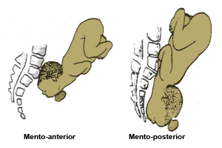

Slide 130
Causes of Face Presentation
Anterior Obliquity of the Uterus
Contracted Pelvis
Polyhydramnios
Congenital Abnormality

Slide 131
Abdominal and Per Vaginal Diagnosis
The diagnosis is usually made in labour. During an abdominal examination check for the following features:
The shape of the foetal spine is an s-shape.
The round occiput is prominent and may be ballottable when the position is mento-posterior and a deep groove can be felt between it and the back.

Slide 132
Cont…
The presenting part is usually high, soft and irregular
On V.E; In a sufficiently dilated cervix you may feel orbital ridges, eyes, nose and mouth
The mouth may be open with hard gums
The foetus may suck the examining finger
In progressive labour, the face becomes oedematous and is difficult to distinguish it from a breech presentation
To determine the mentum, you must locate it, and if it is posterior, you should decide whether it is lower than the sinciput in order to rotate forward and advance
The orbit ridges determine the position either on the left or right oblique of the pelvis brim

Slide 133
Mechanism of Left Mento-Anterior Position
In face presentation, you will be substituting occiput with the chin. Instead of flexion you will maintain deflexion and instead of extension you will maintain flexion.
Lie is longitudinal
Attitude is one of extension of the head and the back
The presentation is face
The position is left mento anterior. In a left mento anterior position the orbital ridges will be in the left oblique diameter of the pelvis
The denominator is the mentum
The presenting part is the left molar bone

Slide 134
Cont…
Extension
Descent takes place throughout and with increasing extension and thus the mentum becomes the leading part
Internal Rotation of the Head
This occurs when the chin reaches the pelvis floor and rotates forwards 1/8 of a circle. The chin escapes under the symphysis pubis. When this takes place and the sinciput, vertex and occiput sweep the perineum, the head is born.
Restitution
This occurs when the chin turns 1/8 of a circle to the mother’s left.

Slide 135
Cont…
Internal Rotation of Shoulders
The shoulders enter the pelvis in the left oblique diameter and the anterior shoulder reaches the pelvis floor first and rotates forward 1/8 of a circle along the right side of
the pelvis.
External Rotation of the Head
This occurs simultaneously and the chin moves a further 1/8 of a circle to the left.
Lateral Flexion
The anterior shoulder escapes under the symphysis pubis, the posterior shoulder sweeps the perineum and the body is born by a movement of lateral flexion.

Slide 136
Cont…
Prolonged Labour
Labour is often prolonged due to ineffective uterine contraction caused by an ill-fitting presenting part. The facial bones do not mould and in order to enable the mentum reach the pelvic floor and rotate forwards, the shoulders must enter the pelvic cavity at the same time as the head.
With good uterine contractions, descent and rotation of the head occurs and labour progresses through to a spontaneous delivery
Mento-Posterior Position
When the head is completely extended with an effective contraction, the mentum reaches the pelvic floor first and will rotate forwards and the position becomes anterior.

Slide 137
Cont…
Persistent Mento-Posterior Position
The head is incompletely extended, the sinciput reaches the pelvic floor first and rotates forwards 1/8 of a circle, which brings the chin into the hollow of the sacrum. Further mechanism is prohibited, which results in impacted face. In order for further descent, both head and chest have to be accommodated in the pelvis.

Slide 138
Cont…
Management of Labour in Face Presentation
Upon diagnosing the condition the first action you must take is to inform the doctor about the face presentation. Routine maternal and foetal condition observations are done as in normal labour (maternal pulse, foetal heart rate and contraction) half hourly. Blood pressure and temperature is done two hourly. Empty the urinary bladder every two hours.

Slide 139
Cont…
Vaginal examination to determine cervical dilation and descent of the head, is done every four hours to monitor progress of labour.
Take care not to injure the foetal eyes. In mento-posterior positions, the midwife should note whether the mentum is lower than the sinciput since rotation and descent depends on this.
If the head remains high despite good uterine contractions, the mother is prepared for caesarean section.

Slide 140
Management of 2nd stage of Labour in Face Presentation
Face extends to the Perineum
When the face extends to the perineum, give episiotomy to prevent extensive perineum tear.
Face appears at the Vulva
When the face appears at the vulva, maintain extension by holding back the sinciput until the chin is delivered.

Slide 141
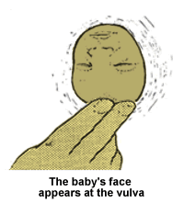

Slide 142
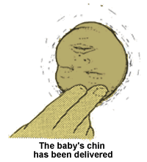
Chin has been delivered
Once the chin has been delivered allow the occiput to sweep the perineum. In this way the submento-vertical diameter (11.5cm) distends the vaginal orifice, instead of the mento vertical diameter (13.5cm)

Slide 143
Cont…
Head is flexed completely
The head is flexed completely and it is delivered.
Inform the doctor if the head does not descend in the second stage. In a mento-anterior position, it may be possible to deliver the baby using forceps.
If the head becomes impacted, or there is any suspicion of disproportion, a caesarean section will be necessary.

Slide 144
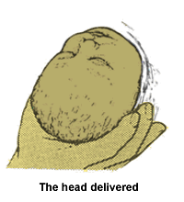

Slide 145
complications
Obstructed Labour
Cord Prolapse
Facial Bruising
Cerebral Haemorrhage
Maternal Trauma

Slide 146
Assignment…
Read and Write notes on; brow presentation, shoulder presentation, unstable lie and compound presentation using the following headings-
Causes
Diagnosis; antenatal and labour
Mechanism of labour (where applicable)
Management
Possible outcome
complications

Slide 147
Breech presentation
In breech presentation, the foetus lies with the buttocks in the lower pole of the uterus, after 34 weeks of pregnancy.
The presenting diameter is the bitrochanteric (10cm) and the denominator is the sacrum.

Slide 148
Classification of breech
Complete breech; the buttocks presents with the feet and legs flexed on the thighs and the thighs flexed on the abdomen.
Frank breech; the buttocks present with the hips flexed and the legs extended against the abdomen and chest; this is the most common type of breech presentation.
Footling breech; one or both feet present due to the fact that neither hips are fully flexed
Knee presentation; rare and presents with one or both hips extended with the knees flexed

Slide 149
Causes of breech presentation
Extended legs
Pre-term labour
Multiple pregnancy
Polyhydramnious
Hydrocephaly
Uterine abnormalities such as septum or a fibroid
Placenta previa

Slide 150
Diagnosis of breech
Previous history of breech, though this is not conclusive
On palpation at the fundus, a round, hard, ballotable mass is palpated
On auscultation, the foetal heart is heard above the level of the umbilicus
The bitrochanteric diameter (10cm) enters in the left oblique diameter of the pelvic brim. The sacrum points to the left ilio-pectineal eminence.

Slide 151
Types of breech birth
Spontaneous; occurs with little assistance from the attendant
Assisted breech; the buttocks are born spontaneously, but some assistance is necessary for the birth of extended legs, arms and the head
Breech extraction; this birth involves manipulating the fetal body by an experienced attendant in order to hasten the birth of baby in emergency situation

Slide 152
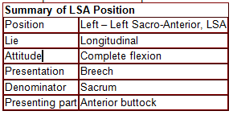
Mechanism of Labour in a Left Sacro Anterior (LSA) Position

Slide 153
Mechanism of labour
Prepare the equipment for delivery
Prepare resuscitation trolley and drugs in case of an asphyxiated baby
Inform the obstetrician and paediatrician
Descent
This takes place with increasing compaction due to increased flexion of limbs.
Internal Rotation of the Buttocks
The anterior buttock reaches the pelvic floor first and rotates one eighth of a circle forwards along the right side of pelvis. The bitrochanteric diameter is now in the
antero-posterior diameter of the outlet.

Slide 154
Cont…
Lateral Flexion of the Body
The anterior buttock escapes under the symphysis pubis. The posterior buttock sweeps the perineum and the buttocks are born by a movement of lateral flexion.
Restitution of the Buttock
The anterior buttock turns slightly to the patient’s right side.

Slide 155
Cont…
Internal Rotation of the Shoulders
The shoulders enter in the same oblique diameter of the brim as the buttocks. The anterior shoulder rotates forwards one eighth of a circle along the right side of the pelvis and escapes under the symphysis pubis. The posterior shoulder sweeps the perineum and the shoulders are born.

Slide 156
Cont…
Internal Rotation of the Head
The head enters in the transverse diameter of the pelvic brim. The occiput rotates along the left or right side of the pelvis. The sub-occipital region (nape of the neck) impinges under surface of the symphysis pubis.
External Rotation of the Body
The body turns so that the back is uppermost, a movement which accompanies internal rotation
of the head.

Slide 157
Cont…
Birth of the Head
The chin, face and sinciput sweep the perineum and the head is born in flexed attitude.

Slide 158
Management of complete breech
The following procedure should be followed when delivering the complete breech:
Mother’s buttocks are positioned at the edge of the bed to allow the baby to hang and apply supra-pubic pressure to the head if required
Give episiotomy when the buttocks extend the perineum, to avoid compression of a moulded head
The buttocks should be expelled by an aided bearing down effort of the mother
With the same contraction the baby is born up to the umbilicus

Slide 159
Cont…
Pull a loop of cord to prevent traction of the cord. The cord should be handled gently to avoid inducing spasm and should be nipped under the pubic arch to avoid anoxia
Check if elbows are on the chest as is the case with complete breech
The midwife can assist the expulsion of the shoulder by wrapping a small towel around the baby's hips as it is slippery and loses heat
Hold the baby by the iliac crest to avoid crushing of liver and spleen

Slide 160
Cont…
The procedure continues:
While the uterus is contracting and the
woman pushing, the anterior shoulder
escapes under the symphysis pubis
Elevate the buttocks to allow the posterior
shoulder to sweep the perineum
The back should be in the uppermost position
until the shoulders are born
As soon as the shoulders are born, let the
baby hang by its weight for one or two minutes

Slide 161
The birth of the after-coming head
Burns marshall manoeuvre;When the hairline appears, grasp the baby by the feet and hold the stretch, applying sufficient traction to prevent fracture of the neck
Move the feet through an arch of 180° until the mouth and nose are free at the vulva
At this stage, ask the mother to pant through an open mouth, 'breathing out the head'. One or two minutes should elapse to allow slow delivery of the vault of the head to prevent a tentorial tear

Slide 162
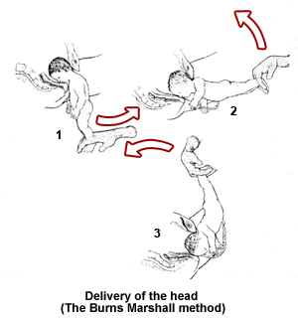

Slide 163
Cont…
Mauriceau-Smellie-Veit Manoeuvre (jaw flexion and shoulder traction).
The following procedure should be followed when delivering the extended head:
Position hands and fingers to extract extended head
Put the baby astride your left arm with the palm supporting the chest
First and third finger of left hand should
be placed on the malar bones to flex the head, middle finger in the mouth well back
to aid flexion
First and second right hand fingers should be hooked over the shoulders pulling moderately in a downwards direction

Slide 164
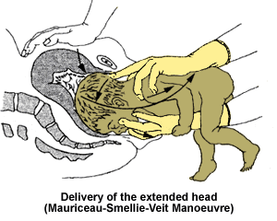

Slide 165
Cont…
Controlled traction is exerted in a downwards direction as the head descends in the curved birth canal. Traction continues until the sub occiput area appears before the appearance of the nape of the neck. Upward traction at this level will inflict fracture of the neck
Instruct the mother to pant
Exert traction in upward direction to allow for the birth of the head. Nose and mouth are free. Your intervention will clear the airway
The Vault is delivered slowly

Slide 166
Cont…
Delay in the Birth of the Head
Forceps birth; If an insufficiently dilated cervix holds up the head, the baby will make gasping movements. You should mop the vaginal wall in contact with the baby’s face and inserting two fingers make a channel through which you can meet the baby.
If the head is arrested high in the cavity, disproportion may exist. Suprapubic pressure may help, but application of forceps is necessary.

Slide 167
Management of extended legs
Apply downward traction until popliteal fossae appear at the vulva
An episiotomy is made when the buttocks extend
the perineum
Pressure is applied at the popliteal fossae with abduction of the thigh
The knee will flex and this will aid extraction of the feet and avoid fractures of lower limbs
The foot will be swept over the baby’s abdomen and the feet are born

Slide 168
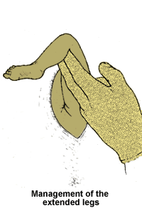
Cont…
You should now wait until the baby is delivered up to the umbilicus, pull a loop of cord
Feel for the elbow at the chest, which should not be felt with extended hands

Slide 169
Cont…
Lovset manoeurvre;( delivery of extented hands)This is a combination of rotation and downward traction to deliver the arms whatever position they are in. The direction of rotation must always bring the back uppermost.
When the baby’s umbilicus is born and shoulders are in antero-posterior diameter, grasp the baby by the iliac crest applying downward traction until the axilla is visible.
Rotate the baby through half a circle 180° anticlockwise. One arm which is now anterior is delivered. Rotate the baby back 180° clockwise and the second shoulder is delivered in a similar manner.

Slide 170
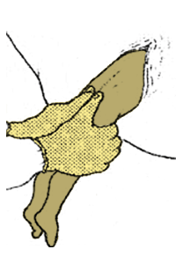
Cont…
Take hold of the baby
The position of the baby is Left Sacro-Anterior. During a contraction when the umbilicus is born and the shoulders are in the anteroposterior diameter, grasp the baby at the illiac crest with the thumbs over the sacrum. A small towel should be wrapped around the baby’s waist to prevent it from being slippery.

Slide 171
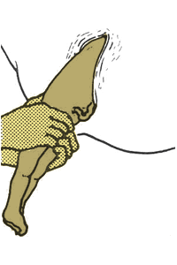
Cont…
Rotate the baby
Rotate the baby through half a circle, 180° anti-clockwise, (starting by turning the back upper most) while applying downwards traction until the axillar is visible. The hand that was posterior now becomes anterior, this movement sweeps the arm infront of the face and also allows the shoulders to enter the pelvis in the transverse diameter.

Slide 172
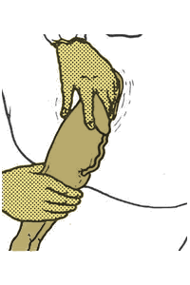
Cont…
Deliver the anterior arm
The arm that was previously posterior is now anterior. With the two first fingers of
your left hand (which is at the baby's back) splint the baby's humerous to avoid breaking it.
The elbow is drawn downwards and delivered under the pubic arch. Wait for the next contraction.

Slide 173
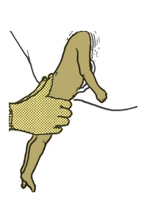
Cont…
Rotate the baby again
Rotating the body half circle clockwise, make anterior arm posterior. Using the right hand, splint the humerous, draw it downwards and deliver it under the pubic arch.
Repeat the next side and deliver the other hand.

Slide 174
Cont…
Causes of Delayed Breech
Delay in the first stage due to a large baby, a small pelvis or weak contractions in which case a caesarean section is done
Delay during the second stage is usually caused by extended legs

Slide 175
complication
Risk to the skull
Intracranial haemorrhage
Hypoxia
Cord compression
injuries

Slide 176
Version
This is turning the foetus from an undesirable position to a desirable position. The two types of version are external version and pondalic (or internal) version.
External Version
This is the external manipulation of the foetus through the abdomen and the uterine walls, used to correct malpresentation. The procedure is successful when done a month before term.
External version is contraindicated in the case of antepartum haemorrhage, high blood pressure, rhesus negative mother, previous scars and twin pregnancy.

Slide 177
Preparation
Reassure the mother by explaining the procedure
Make sure the bladder is empty
The mother lies with partial flexion of the thighs to relax her abdominal muscles
Sprinkle powder on her abdomen to prevent friction during the movement
Engage the mother in conversation during the procedure to divert her attention so as to be relaxed.

Slide 178
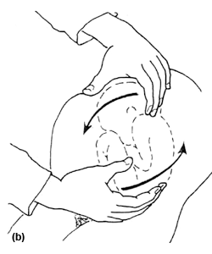
Cont…

Slide 179
Pondalic Version
This is a manoeuvre designed to change any existing presentation to breech presentation. It is also known as internal version. This manoeuvre is useful in delivery of delayed or transverse second twin. It is now never used in any other circumstances.
While the cervical os is fully dilated, the whole hand is introduced high in the uterus. The baby’s feet are grasped and pulled in the direction of the birth canal. The other hand helps to turn the foetus by pushing the head up at the fundus. The version is followed by breech extraction.

Slide 180
Occipito Posterior Position
Occipito posterior position is a malposition of the occiput. In this position, the vertex presents but it occupies the posterior position instead of the anterior. The occipito posterior position can be either left or right.
The cause is not clear but it is associated with abnormalities of the pelvis eg android and anthropoid pelvis

Slide 181
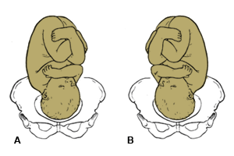
Right/left OPP

Slide 182
Diagnosis of Occipito Posterior Position
On inspection of the abdomen you will notice a saucer shaped depression at or below the umbilicus. The unengaged head will outline the bladder as if it is a full bladder.
On palpation the head is high, as the engaged diameter of 11.5cm cannot enter the brim until flexion takes place. The head feels large and the occiput and sinciput are on the same level. The back is difficult to palpate. Limbs are felt on both sides of the abdomen.

Slide 183
Cont…
On auscultation the foetal heart is heard on the right flank. It could also be heard at the umbilicus, either at the middle line or slightly to the left.
During labour the mother may complain of severe backache. You may note a slow descent of the presenting part in spite of good contractions. Early rupture of membrane may occur.
On vaginal examination the diagnosis can be confirmed on feeling the anterior fontanelle to the left anterior in ROP.

Slide 184
Management of Labour in the Occipito Posterior Position
In the occipito posterior position you should expect prolonged, painful labour due to poor fitting of the presenting part, which does not stimulate good contractions.
First Stage of Labour
The mother may experience severe backache. You should give a back massage and encourage the mother to remain mobile as long as she can and to adopt what ever position that is most comfortable to her. Most women find the all-fours position most comfortable, pain relieving and is also believed to aid in the rotation of the foetal head. Labour is prolonged with incoordinate uterine action. Give intravenous fluid to ensure that the mother is not dehydrated.

Slide 185
Cont…
Uterine action should be regulated by the use of syntocinon.
Keep accurate records by plotting half-hourly observations of the foetal heart, contractions every four hours, and blood pressure in the partograph.
The mother may have the urge of early pushing due to the occiput pressing on the rectum. You should discourage her from pushing at this stage as this will cause the cervix to be oedematous and delay the onset of the second stage.
Encourage her to change her position and use breathing techniques, as these will control the urge of early pushing

Slide 186
Second Stage of Labour
The second stage should be confirmed by vaginal examination as the caput may be seen at the vulva with the anterior lip of the cervix. During labour, one of the following may occur:
Long internal rotation
Short internal rotation
Deep transverse arrest

Slide 187
Cont…
Long Internal Rotation
This is where the head turns 3/8 of a circle in 90% of cases and the baby is born as in occiput anterior.
Characteristics of Long Internal Rotation
The lie is longitudinal
The attitude is one of deflexion
The presentation is vertex
The presenting part is the middle or anterior area of the left pariental bone
The position is right occipito posterior
The denominator is the occiput
The occipito frontal diameter 11.5cm lies in the right oblique diameter of the pelvic brim

Slide 188
Cont…
The occiput points at the right sacroiliac joints and the sinciput points at the left iliopectineal eminence
There is increased flexion and descent takes place the head reaches the pelvic floor
Internal rotation of the head occurs which rotates 3/8 of a circle on the right side of the pelvis while the shoulder rotates 2/8 of a circle on the same side
The head crowns occiput escapes under the sympysis pubis
The sinciput, face and chin sweep the perineum, the head is born by extension
Restitution where the occiput turns 1/8 to the right, undoes the twist at the neck and realigns itself with the shoulder

Slide 189
Cont…
Internal rotation of the shoulders. The shoulder enters in the same oblique diameter of the pelvis. Anterior shoulder reaches the pelvic floor and rotates 1/8 of a circle forward and lies under the symphysis pubis
External rotation of the head accompanies the internal rotation of the shoulder
Anterior shoulder escapes under the symphysis pubis, while the posterior shoulder sweeps the perineum
The body is born by movement of lateral flexion

Slide 190
Cont…
Short Rotation
In cases of short rotation or persistent occiput posterior position, the occiput fails to rotate forward. It persists with the same position. The sinciput reaches the pelvic floor and rotates forwards, while the occiput sinks in the hollow of the sacrum.
The baby is born face to pubis.

Slide 191
Cont…
Give an episiotomy when necessary:
You should watch for signs of buttonhole tear due to the large presenting diameter.
A buttonhole tear is a rupture at the centre of the perineum.
If you failed to diagnose this earlier you may be extending the head thinking it is a vertex delivery, until you see the hairless forehead escaping under the pubis arch. You should then flex the head towards the symphysis pubis.

Slide 192
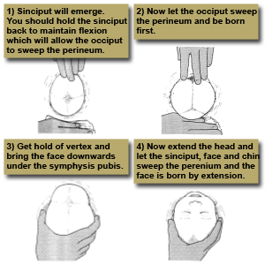

Slide 193
Cont…
Deep Transverse Arrest
This is where the occiput fails to rotate forward. This forces the sinciput to reach the pelvic floor first and rotate forwards. The occiput then goes into the hollow of the sacrum, which results in the face to pubis delivery. At first there is good flexion.
The occipit reaches the pelvic floor and begins to rotate but flexion is not maintained. The occipito frontal diameter is caught by the bispinious diameter of the outlet.
This arrest may be due to poor contractions, a straight sacrum or prominent ischial spines.

Slide 194
Cont…
On vaginal examination the sagittal suture is on the transverse diameter of the pelvis and both anterior and posterior fontanels are palpable. The head is caught at the ischial spines.

Slide 195
Cont…
Management of Deep Transverse Arrest
Reassure the mother while explaining the position of her labour. Take her consent for the operative procedures which will be necessary. Inform the doctor of her situation.
Encourage her to breathe slowly and change her position to discourage pushing. When the doctor arrives, administer analgesics. A vacuum extraction may be performed or the head may be rotated with forceps and the baby delivered.
Aftercare is the same as in operative manipulation.

Slide 196
Cont…
Conversion to Face or Brow
At the onset of labour with a deflexed head, an extension may occur instead of flexion. When there is complete extension, the baby will be born as face presentation but when there is incomplete extension (this is refered to as ’military attitude‘), the presenting part turns to brow. A delivery by caesarean section is recommended.

Slide 197
Complications of OPP
Obstructed labour, as a result of deflexed or partially extended head that is impacted in the pelvis
Maternal trauma, as a result of prolonged labour, or instrumental delivery causing perineum tears. In undiagnosed OPP, instrumental delivery may cause third degree tears
Neonatal trauma to the baby, if forceps or ventous vacuum extraction are used
Cord prolapse which may cause hypoxia, that may result in stillbirth
Cerebral haemorrhage, due to the compression of a large presenting part
Asphyxia, leading to brain damage

Slide 198
SHOULDER DYSTOCIA
This describes the Impaction of the anterior shoulder against the symphysis pubis after delivery of the fetal head.
Risk factors
The single most common risk factor for shoulder dystocia is the use of a vacuum extractor or forceps during delivery. They may be classified as follows:
Maternal
Abnormal pelvic anatomy
Gestational diabetes
Post-dates pregnancy
Previous shoulder dystocia
Short stature
High pre pregnancy weight and increased weight gain

Slide 199
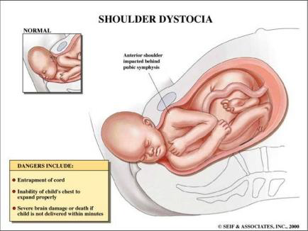
Cont…

Slide 200
Cont…
Fetal
Suspected macrosomia
Labor related
Assisted vaginal delivery (forceps or vacuum)
Protracted active phase of first-stage labor
Protracted second-stage labor
Prior shoulder dystocia

Slide 201
Diagnosis
The following signs are indicative of possible shoulder dystocia
The shoulders fail to deliver shortly after the foetal head.
The fetal head retracts against perineum (“turtle sign”)
The face of the baby becomes erythematous, red and puffy - indicative of facial flushing.
Gentle traction does not effect delivery

Slide 202
Management:
Shoulder dystocia is an obstetrical emergency, with foetal demise occurring within about 5 minutes if the infant is not delivered, due to compression of the umbilical cord within the birth canal.
A common treatment algorithm is ALARMER; which stands for:
Ask for help. This involves requesting the help of an obstetrician, a paediatrician for subsequent resuscitation of the infant and anaesthesia in case if surgical intervention.
Leg hyper flexion (McRobert’s manoeuvre)
Anterior shoulder disimpaction (apply suprapubic pressure)
Rubin manoeuvre
Manual delivery of posterior arm
Episiotomy
Roll over on all fours (Gaskin Manoeuvre)

Slide 203
Also commonly used is the HELPERR Mnemonic.
H Call for help.
Requesting the appropriate personnel to respond with necessary equipment to the labor and delivery unit.
E Evaluate for episiotomy.
Shoulder dystocia is a bony impaction, so episiotomy alone will not release the shoulder. Because most cases of shoulder dystocia can be relieved with the McRobert's maneuver and suprapubic pressure
L Legs (the McRobert's maneuver)
This procedure involves flexing and abducting the maternal hips, positioning the maternal thighs up onto the maternal abdomen.

Slide 204
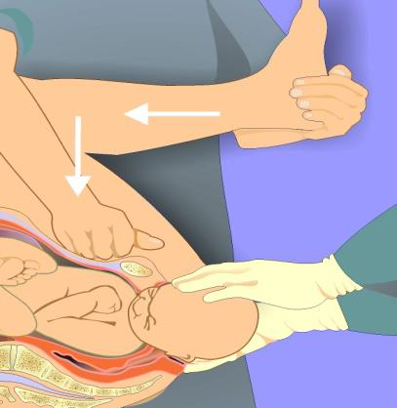
P Suprapubic pressure
The hand of an assistant should be placed suprapubically over the fetal anterior shoulder, applying pressure in a cardiopulmonary resuscitation style with a downward and lateral motion on the posterior aspect of the fetal shoulder. The aim is to adduct the anterior shoulder.

Slide 205
Cont…
E Enter maneuvers (internal rotation)
These maneuvers attempt to manipulate the fetus to rotate the anterior shoulder into an oblique plane and under the maternal symphysis.
Rubin maneuver, the anterior shoulder should be approached from behind and the scapula adducted and rotated to oblique position. If this fails, the
Woodscrew maneuver (Enter II) may be applied. In this case the posterior shoulder is approached from the front and gently rotated towards the symphysis pubis. When this fails, the
Reverse woodscrew maneuver (Enter III) may be applied; In this instance the posterior shoulder is approached from behind and rotated I the opposite direction from Rubin or woodscrew maneuvers. These maneuvers can be difficult to perform when the anterior shoulder is wedged beneath the symphysis. At times, it is necessary to push the fetus up into the pelvis slightly to accomplish the maneuvers.

Slide 206
Cont…
R Remove the posterior arm.
Removing the posterior arm from the birth canal also shortens the bisacromial diameter, allowing the fetus to drop into the sacral hollow, freeing the impaction. The elbow then should be flexed and the forearm delivered in a sweeping motion over the fetal anterior chest wall. Grasping and pulling directly on the fetal arm may fracture the humerus.

Slide 207
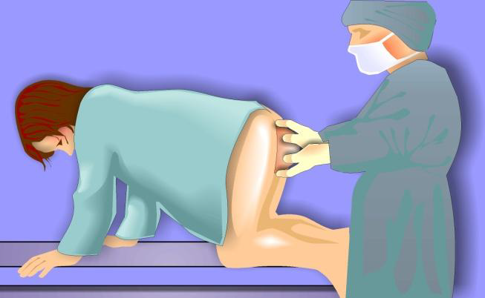
Cont…
R Roll the patient.
The patient rolls from her existing position to the all-fours position. This usually increases the pelvic diameters. Often, the shoulder will dislodge during the act of turning, In addition, once the position change is completed, gravitational forces may aid in the disimpaction of the fetal shoulders.

Slide 208
Manoeuvres of Last Resort for Shoulder Dystocia
Deliberate clavicle fracture
Direct upward pressure on the mid-portion of the fetal clavicle; reduces the shoulder-to-shoulder distance.
Zavanelli maneuver
Cephalic replacement followed by cesarean delivery; involves rotating the fetal head into a direct occiput anterior position, then flexing and pushing the vertex back into the birth canal, while holding continuous upward pressure until cesarean delivery is accomplished.

Slide 209
Complications of Shoulder dystocia
Maternal
Postpartum hemorrhage –commonest (11%)
Rectovaginal fistula
Symphyseal separation or diathesis, with or without transient femoral neuropathy
Third- or fourth-degree episiotomy or tear with anal sphincter damage Uterine rupture
Soft tissue injuries
Fetal
Brachial plexus palsy- commonest 3-15%
Clavicle fracture
Fetal death
Fetal hypoxia, with or without permanent neurologic damage
Fracture of the humerus

Slide 210
PROLONGED LABOUR
Definition of prolonged labour
Prolonged labour is active labour with regular uterine contractions and progressive cervical dilatation, which lasts for more than 12 hours in both multiparas and primigravidas.
Causes of Prolonged Labour
It is usual to describe this as due to the three "Ps":
Powers: poor or uncoordinated uterine action
Passenger: fetal head too large or position abnormal
Passage: pelvis abnormal, or tumor or obstruction in pelvis or birth canal.

Slide 211
Cont…
Diagnosis of Prolonged Labour
Findings from history and physical examination or as interpreted from the partograph that is correctly charted will guide in the diagnosis of prolonged labour.
History
At what time did the contractions begin?
How frequent are the contractions?
When did the membranes (water) break?

Slide 212
Cont…
Examination
The frequency, duration and intensity of the contractions
Determine the foetal position and identify any evidence of cephalopelvic disproportion and /or foetal malposition
Evaluate foetal heart rate
Determine whether the mother’s bladder is full. Encourage the woman to empty the bladder frequently. If not able to pass urine then catheterize
Inspect the external genitalia to determine the presence of liquid and /or blood
Vaginal exam with sterile gloves every four hours (or at a different frequency when indicated.

Slide 213
Cont…
Laboratory investigations
Blood grouping and cross match two units
Urine for albumin, sugar, acetone
Management of Prolonged labour
Monitor maternal vital signs: Temperature 2-4 hourly, Pulse ½ hourly, Respirations 4 hourly
Monitor foetal heart rate ½ hourly
Measure the urine volume every 2-4 hours (encourage mother to void regularly)
Start I.V fluid (NS OR ringers lactate)
Start broad spectrum antibiotics
Oxygen by mask

Slide 214
Cont…
First choice antibiotics:
IV Ampicillin 500mg 6 hourly for 3 days
IV Gentamicin 80 mg 8 hourly for 7 days
Followed by Amoxicillin 500mg oral 8 hourly for 7 days
Second choice line antibiotics
IV second generation Cephalosporin
IV amoxicillin/clavulanic acid 1.2g stat dose followed by oral preparation

Slide 215
Cont…
Second stage
Maternal expulsive efforts increase fetal risk by reducing the delivery of oxygen to the placenta. While spontaneous maternal “pushing” should be allowed, prolonged effort and holding the breath should not be encouraged. If malpresentation and obvious obstruction have been ruled out, labor should be augmented with oxytocin.
If there is no descent after augmentation and:
If the head is not more than 1/5 above the symphysis pubis or the leading bony edge of the fetal head is at the 0 station, delivery should be by vacuum extraction or forceps

Slide 216
Cont…
If the head is between 1/5 and 3/5 above the symphysis pubis or the leading bony edge of the fetal head is between 0 station and -2 station, and birth is taking place in a facility where safe caesarean section is not possible, delivery should be by vacuum extraction and symphysiotomy
If the service provider is not proficient in symphysiotomy, immediate referral is required for delivery by caesarean section
If the head is more than 3/5 above the symphysis pubis or the leading bony edge of the fetal head is above -2 station, delivery must be by caesarean section.
If the woman arrived very late and the foetus is dead, do destructive obstetric procedure.

Slide 217
OBSTRUCTED LABOUR
Obstructed labour means that, in spite of strong uterine contraction, the foetus cannot descend because of mechanical factors. Obstruction usually occurs at the brim, but it may occur in the mid cavity or pelvic outlet.
Definition of Cephalopelvic Disproportion (CPD): This occurs when foetal head is large in comparison with the pelvis. Cephalopelvic disproportion may be due to a small pelvis with a normal sized head, or a normal pelvis with a large foetus or a combination of a large baby and small pelvis. This means it is difficult or impossible for the foetus to pass safely through the pelvis.

Slide 218
Cont…
Cephalopelvic disproportion may be:
Marginal CPD, which means that the problem may be overcome during labour. The relaxation of the pelvic joints and moulding of the foetal skull may enable vaginal delivery. Half of these patients will need an operative delivery.
True CPD: This means the pelvis is small or abnormally shaped and/or foetus is unusually large or abnormal e.g. hydrocephalus. Operative delivery will be needed.

Slide 219
Causes of obstructed labour
Common factors predisposing to obstructed labour include:
Cephalopelvic disproportion
Foetal macrosomia e.g. in poorly controlled diabetes mellitus in pregnancy
Malpresentation e.g. brow, shoulder, face with mentoposterior, breech
Foetal abnormalities e.g. hydrocephalus
Multiple gestation with locked twins
Abnormalities of the reproductive tract e.g. pelvic tumour, cervical or vaginal stenosis, tight perineum and FGM/FGC scar.
Underdeveloped pelvis e.g. adolescent pregnancy
Childhood malnutrition leading to contracted pelvis

Slide 220
Early signs
Presenting part does not enter pelvic brim despite good uterine contractions-exclude loaded rectum, full bladder, excessive liqour volume
Dilatation of the cervix is slow
Early rupture of membranes and formation of large elongate sac of forewaters

Slide 221
Later signs
Dehydration
Maternal exhaustion
Ketosis
Pyrexia
Tachycardia
Tenderness of the uterus
Poor urinary output
Presenting part is high and feels wedged and immovable

Slide 222
Contd.
Haematuria
Fetal distress
Formation of Bandl’s ring and presenting part is high
Uterine exhaustion especially in primi
VE-hot and dry
Bladder may be full and displaced upwards
Lack of progress/prolonged labor

Slide 223
antenatal
Anticipate during antenatal period by carrying out thorough assessments
  Short stature
  Previous history of difficulty or obstructed labor, fresh still birth, neonatal asphyxia
  Abdominal examination to rule out any malpresentation/features of CPD, big baby
  Imaging studies
  Findings on routine VE during early and late pg
Make appropriate referral and arrange for c/s
Consider trial of labor for others

Slide 224
Intrapartum mnx
Partograph reading
Examination of the partograph may reveal:
Foetal heart rate of more than 160/minute or less than 120/minute indicating foetal distress
Foul smelling meconium-stained liquor
Severe moulding
Severe caput formation
The rate of cervical dilatation slow or remains static in spite of strong contraction
Maternal tachycardia and pyrexia
Scanty urine with ketonuria.

Slide 225
Cont…
a) Resuscitation of the Mother
Perform a rapid assessment of the airway, breathing and circulation and manage as appropriate.
b) Rehydrate the patient
If the woman is in shock give IV fluids e.g. normal saline. Run 1 litre in the first 15 minutes or as quickly as possible. If the woman is mainly starved and exhausted, give 1-2 litres 5 or 10% dextrose in 6 hours.
c) Catheterize
monitor urine output.

Slide 226
Cont…
d) Give antibiotics
Ampicillin 2 g every 6 hours, and
Gentamicin 5 mg/body weight IV every 24 hours.
If the woman is delivered by caesarean section, continue antibiotics and give Metronidazole 500 mg IV every 8 hours until the woman is fever-free for 48 hours.
(e.) Deliver the baby
If cephalo -pelvic disproportion is confirmed, delivery should be by caesarean section
If the fetus is dead: - delivery should be by craniotomy - if this is not possible, delivery should be by caesarean section.

Slide 227
Maternal complications
Maternal death
Chorioamnionitis
Uterine rupture
Obstetric fistula
Puerperal sepsis
Neurological injury e.g. foot drop
Spontaneous symphysiotomy and/or osteitis pubis

Slide 228
Foetal complications
Intrauterine foetal death
Foetal distress
Foetal injury
Birth asphyxia
Neonatal sepsis

Slide 229
prevention
Good prenatal care to detect mothers at risk
Clinical and radiological investigations of pelvis adequacy if necessary during the prenatal period
Good partographing during labour
All mothers who have had a previous caesarean section should have a hospital delivery
Discourage home deliveries, especially of primigravidae and grand multiparous
Provide health education to the community on the risks of too early or too late pregnancies
Advise pregnant mothers on the importance of a well balanced diet

Slide 230
RUPTURE OF THE UTERUS
Rupture of the uterus is defined as a complete separation or tear in the wall of the uterus with or without expulsion of the foetus.
It may be complete when the visceral peritoneum is involved
Incomplete when the visceral peritoneum is intact.

Slide 231
Predisposing factors for uterine rupture
Neglected obstructed labour
Previous operations on the uterus ( e.g. caesarean section, myomectomy, previous uterine rupture)
Obstetric manoeuvres on the uterus (e.g. external cephalic version, breech extraction, internal podalic version)
Harmful obstetric practice e.g. Application of fundal pressure
High parity
Multiple pregnancies
Large foetus

Slide 232
Diagnosis of ruptured uterus
A patient with ruptured uterus may present with hemorrhagic or neurogenic shock from bleeding or vasovagal stimulation, respectively.
History
During history taking, explore the presence of risk factors listed above.
Suspect rupture of the uterus if the following signs and symptoms are present:
• Shock
• Abdominal distension/free fluid
• Abnormal uterine contour (Bandl’s ring)
• Tender abdomen
• Easily palpable fetal parts or dislodged presenting part
Absent fetal movements and fetal heart sounds
• Rapid maternal pulse.
• Speculum vaginal examination may reveal vaginal bleeding..

Slide 233
Investigations
Blood for grouping and cross matching
Urinalysis for Haematuria, protein, sugar and acetone.
Differential Diagnosis
Placenta praevia
Abruptio placentae
Extra uterine pregnancy
Ruptured spleen or liver
Acute abdomen in pregnancy.

Slide 234
Management of ruptured uterus
a) Emergency Treatment
Start resuscitation.
Set up IV line with a wide bore branula and start Ringer’s lactate solution or normal saline
Give oxygen by face mask
Transfuse blood
Catheterise for continuous bladder drainage
Provide loading dose of parenteral antibiotics
Monitor vital signs

Slide 235
CORD PRESENTATION AND CORD PROLAPSE
Cord prolapse is when the cord lies in front of the presenting part of the baby after the membranes have ruptured.
Cord presentation is when the cord lies in front of the presenting part of the baby before the membranes have ruptured.

Slide 236
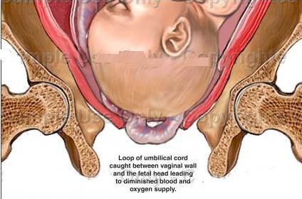

Slide 237
Cont…
Diagnosis of cord presentation and cord prolapse is made on:
Vaginal examination by palpating cord under the intact membranes (cord presentation)
Vaginal examination after rupture of the membranes reveals loops of the cord in the birth canal (cord prolapse).

Slide 238
Potential predisposing risk factors include:
High or ill fitting presenting part
Premature rupture of the amniotic sac
Polyhydramnios
Long umbilical cord
Foetal malpresentationi.e in breech
Multiparity
Multiple gestation
Differential Diagnosis
Foetal membranes
Footling breech or compound presentations.

Slide 239
Management of cord prolapse and cord presentation
Emergency Treatment
The aim of management is to deliver the foetus as quickly as possible before hypoxia and death occurs due to cord compression.
Remove pressure by elevating the buttocks or putting patient in knee chest or exaggerated left lateral position
Give oxygen to the mother by mask
Establish IV line with 5% dextrose
Monitor the foetal heart appropriately, every 5 minutes
Counsel mother on the condition of the foetus.

Slide 240
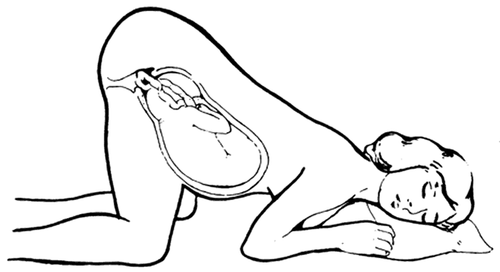
Knee-chest position

Slide 241
Cont…
If the cord is pulsating and patient is in first stage of labour:
• Replace the cord into the vagina.
• Transfer the mother to a healthcare facility capable of providing comprehensive emergency obstetric care for urgent caesarean section.
• Carry a delivery kit during transfer and maintain knee chest position during transfer.

Slide 242
Cont…
If the cord is pulsating and patient is in second stage of labour:
Rule out cephalopelvic disproportion and other malpresentations
If in doubt about pelvic capacity, perform caesarean section
If pelvis and presentation are normal, deliver by assisted vacuum extraction.
If the cord is not pulsating and patient is in first or second stage of labour:
Rule out any contraindication to vaginal delivery (e.g. CPD, mal-presentation)
Allow labour to progress.

Slide 243
Precautions to take in order to avoid complications
Apply any of the following principles prior to definitive management:
Avoid iatrogenic cord prolapse (correct skill for artificial rupture of membranes –ARM )
Remove pressure from the cord
Keep the cord warm
Refer promptly
Deliver quickly
Be prepared for neonatal resuscitation.

Slide 244
Trial of Labour
Trial of labour is a test of labour conducted where there is a minor or moderate degree of Cephalopelvic Disproportion (CPD) in which it is difficult to decide whether delivery per vagina is possible.
Factors influencing good prognosis
Strength of the uterine contractions
Flexion of the head
Degree of moulding of the foetal head, that is, reduced engaging diameters
The giving of pelvic joints. In pregnancy, the joints of the pelvis are relaxed and separate by half to one centimetre
Maternal courage

Slide 245
Cont…
Factors influencing poor prognosis
Early rupture of membrane which may be accompanied by prolapsed cord
Poor moulding of the head
Maternal or foetal distress which will necessitate intervention on trial of vaginal delivery
Contraindications for trial of labour
Grossly contracted pelvis
Medical or obstetrical complications
Malpresentations, for example, breech
Elderly primigravida
Cases where trial of labour failed before
Cases of two previous caesarean sections

Slide 246
Management of Trial of Labour
Explain the situation to the mother and prepare her for possible operative intervention. Assess patient carefully on admission to ascertain the following:
Whether the mother is in established labour
Presentation of foetus
Check for flexion of the head
State of foetal heart, that is, rate, rhythm and volume
General condition of mother physically and emotionally
Confine the mother to bed to prevent early rupture of membranes
Close observations of temperature and blood pressure every four hours
Observe foetal heart rate and maternal pulse quarterly to half hourly

Slide 247
Undesirable Factors in Trial of Labour
Rupture of membranes
Colour of liquor is meconium-stained
Uterine action is abnormal
Abnormal presentation, where there is a change from vertex to brow
When the presenting part fails to descend in spite of good uterine contraction
When there are signs of foetal or maternal distress
Nb…Trial of labour may result in spontaneous vaginal delivery, assisted vaginal delivery by either forceps or vacuum, or caesarean section due to complications.

Slide 248
Trial of Scar: Vaginal Birth After Caesarean Section
Trial of scar is a test of labour for a woman with a previous caesarean section scar, where no recurrent indication is present
The Main Contraindications to Trial of Scar
cephalopelvic disproportion
Classical type of caesarean section
Malpresentation, for example; breech
Two previous caesarean section scars, regardless of the causes
Where the previous scar wound did not heal with the first intension
Where pregnancy occurs within six months of a caesarean section
Where there is over-distension due to multiple pregnancy or hydromnious
Multiparty

Slide 249
Cont…
The management of this mother is as for trial of labour with the addition of these few points below:
Palpate abdomen gently
Check for any tenderness over the scar
Observe for any signs of impending rupture of the uterus
Report any constant pain in abdomen

Slide 250
Cont…
Educating the Patient on Avoiding Unnecessary Caesarean Birth
Many other women have a caesarean section due to a series of events, which leads to an inevitable section seen as necessary at that particular time.
Some mothers insist on the operation if the month coincides with the previous month of birth of other children, so as to have the same birthdays for their babies.
Others prefer not to push and go through the whole process of enlarging the birth canal. If these women were well informed, they might see the sense of preventing a caesarean section.
Additional contributing factors to the decision to have a caesarean section include mismanagement of the syntocinon drip, choice of obstetrician and/or hospital policy.

Slide 251
AMNIOTIC FLUID EMBOLISM
It is a serious obstetric emergency whereby amniotic fluid enters the maternal circulation via the sinuses at the placental site thus forming an emboli which obstruct pulmonary arterioles or alveoli or capillaries. In response they trigger anaphylactic response. There must be an opening into maternal circulation and increased in intrauterine pressure to force the fluid into circulation

Slide 252
Cont…
Body responses in two ways.
Pulmonary vasospasm because of hypoxia hypotension and pulmonary edema
Development left ventricular failure
Causes not known – precipitating factors
Rapid or precipitate labour where strong uterine contractions forces amniotic fluid into maternal circulation
Multi-parity- associated with strong and rapid contrations
Overstimulation of the uterus as a result of excessive use of cytotoxic drugs
Uterine trauma eg raptured uterus ,CS,manual removal of placenta
Multi-pregnacy
Poly hydromnous

Slide 253
Cont…
PROGNOSIS: Motality rate is 80% with 20% dying within the first hour.
Complications
PPH- hypofibrinogenemia
ARF – excessive blood loss
DIC- due to presence of amniotic fluid
Cardiac arrest

Slide 254
Cont…
Pathology
Amniotic fluid enters maternal circulation through utero- placental site. Amntionic fluid is rich in thromboplastin which utilizes fibrinogen from blood causing disseminated intravascular coagulation ,coagulation disorder and depletion of fibrinogen( hypofibrinogenemia) with resultant bleeding.

Slide 255
signs
Sudden onset of respiratory distress
Severe dyspnea , cyanosis
Labored breathing
Hypotension, shock
Sudden collapse
Chest pain
Tachycardia
Pulmonary edema
Fetal distress
Maternal anxiety
Shivering and shivering
Hemorrhage due to DIC
She may go into convulsion and cardiac arrest

Slide 256
Mgt
Call emergency team
Prop up the pt
Give 4L/min of oxygen
Rx shock with iv fluids
Take blood for GXM
Sedate or give GA to reduce anxiety or stop uterine contractions
Give hydrocortisone to counteract effects of amniontic fluid
Give IV 250 aminophylline to reduce bronchospasm
Blood transfusion as soon as possible with fresh blood if not available plasma is given
Delivery is done by CS / vaccum extraction as soon as possible
Monitor FHR
Resuscitation equipment should be ready incase of cardiac arrest

Slide 257
Hypotonic Uterine Action
This is poor tone in the uterine muscle fibres which results from weak/short contractions. The contractions are infrequent and cause less pain.
There are two types of hypotonia;
Primary hypotonia starts at the onset of labour. The cause is unknown and it is common in primigravida.
Secondary hypotonia occurs when labour has already been established. The uterus is exhausted and contractions slow down, due to:
Retained second twin
Cephalopelvic disproportion
Malpresentation or malposition
Effect after epidural anaesthesia

Slide 258
Mnx…
Admit and Reassure
You should perform an abdominal and pelvic exam to exclude cephalopelvic disproportion. Determine the cause of OPP. If this is present she should be prepared for a caesarean section.
If there are no uterine contractions, these should be stimulated by administering an enema or repeat administration if it had been given previously.
You should check on the following factors:
Frequency, strength and duration of the contractions
Vital signs, that is, maternal pulse and BP and general condition
Foetal heart rates
Descent of the presenting part

Slide 259
Cont…
A vaginal examination
The urine is tested every two hours for sugar, acetone and albumin. If there is foetal or maternal distress in the first stage of labour, the mother is prepared for caesarean section. However, if the mother is in the second stage or nearing second stage and contracting and dilating well, the delivery can be assisted by vacuum extraction.
The possibility of post partum haemorrhage should be kept in mind Hence AMSTEL
NB… read and make notes on incoordinate uterine action, hypertonic lower uterine , colicky uterus/spurious uterus and cervical distocia

Slide 260
Precipitate Labour
The contractions are strong and frequent from the onset of labour. This results in an abnormally rapid progress of labour and delivery may occur within an hour to three hours from the onset of labour.
Remember: Precipitate labour tends to recur. Therefore, with future pregnancies the mother needs to be admitted early into hospital for safe delivery.

Slide 261
Cont…
Maternal complications
cervical and perenial lacerations.
The uterus may fail to contract during the third stage of labour, leading to a retained placenta.
Post partum haemorrhage,
uterine inversion,
shock and collapse may occur due to sudden relief of pressure.
Foetal complications
foetal hypoxia
intracranial haemorrhage.
Asphyxia

Slide 262
Preterm labor
Definition: regular contractions and cervical change prior to 37 wks and after 28wks
Classifications
extremely preterm (<28 weeks)
very preterm (28 to <32 weeks)
moderate to late preterm (32 to <37 weeks).

Slide 263
Risks Factors Of Preterm Labor
Smoking
Not getting good prenatal care
Drinking alcohol or use of drug abuse
Having health conditions, such as high blood pressure, preeclampsia, diabetes, blood clotting disorders, or infections
Being pregnant with a baby that has certain birth defects
Multiple pregnancies
A family or personal history of premature labor

Slide 264
Preterm labor causes
4 basic causes
  infection
  bleeding/abruption/thrombophilia
  incompetent cervix
  Multiple gestation
Note that the first two are also most common causes of PPROM
These causes can be classified as spontaneous or elective

Slide 265
Causes
Spontaneous causes
Multiple gestation
Macrosomia
PROM(infxns)
Short stature
Maternal age/parity
Cervical incompetence
Poor social circumstances
hyperpyrexia
Elective causes
PIH/PET/
Maternal diseases
PP, PA
IUGR
Rh incompatibility
Congenital abnormalities
Fetal infxns

Slide 266
Dx
Hx-LMP, EDD
Hx of painful uterine contractions occurring after every 10 minutes
Evidence of cervical dilatation and effacement
US

Slide 267
DDx
False labor
Braxton-Hick’s contraction
Uterine fibroids
Twisted ovarian tumour
UTI

Slide 268
Management
Admit and provide bed rest
Examine and confirm stage of labor
Treat underlying cause
Consider if reasonable to attempt to stop labor, esp if <34wks
Hydrate the pt,
Provide emotional support
Discuss possible outcome with the family

Slide 269
Contd.
Antibiotics
Tocolytics-ventolin iv 10mg in 1000NS @10drops/min and incr. by 10drops every 30mins until l’pains are stopped
Mtn maternal PR btw 100-120 atleast for 12 hrs after the last contraction
When contractions cease start PO salbutamol 4mg tds till maturity

Slide 270
Contd.
Enhance fetal lung maturity-dexa 6mg im four doses 6hrly or betamethasone 12mg im 2 doses 12hrly if in latent phase
Avoid VE
If pt goes off labor discharge if no CI
Counsel pt/partner to avoid coitus

Slide 271
Contd.
If a pt with pg below 34wks progresses to active labor(4cms), transfer where appropriate/deliver
Inform paed
manage in well staffed and fully equipped facility

Slide 272
Prevention
Careful hx and examination
Early detection and Tx of potential causes

Slide 273
Premature rupture of membranes (PROM)
It is the rupture of the amnion and chorion 1 hour or more before the onset of labor.
If this event occurs before 37 weeks' gestation, it is referred to as preterm PROM (PPROM).
It becomes prolonged PPROM when ruptured longer than 12 hours before the onset of labor.

Slide 274
Predisposing factors
local amniotic membrane defect;
infection(including vaginal, cervical, or intra-amniotic infection)
history of PROM;
incompetent cervix;
hydramnios;
multiple gestation;
trauma;
fetal malformations;
abruptio placentae; and placenta previa.

Slide 275
Effects of PROM
Maternal
Infections; intrauterine, puerperal
Placenta abruption
Preterm delivery

Slide 276
Contd.
Infants:
(1) Preterm Baby and their Complications :
(RDS / Fetal and Neurologic dysfunction
Intracranial hemorrhage)
(2) neonatal pneumonia、sepsis
(3) Pulmonary hypoplasia

Slide 277
Clinical manifestation
1.Fluid passing through the vagina suddenly, and then small amounts of fluid flow through the vagina intermitently, particularly when there’s increase of abdominal pressure (cough,sneeze)
2. Free flowing amniotic fluid
3. Fever / heart rate of mother and
infants ↑ / WBC ↑/ Uterine
tenderness on palpation

Slide 278
Diagnosis
Vaginal speculum leakage of amniotic fluid
(2) PH determination of vaginal fluid
(3) Reduced FH
(4) place a vaginal pad over the vulva and examine an hr later visually and by odour
5) Ultra sound*

Slide 279
DDx
Excessive secretions or vaginal discharge
Urinary incontinence

Slide 280
Management
PROM at term:
Admit
Antibx-ampicillin/amoxycillin 500mg stat im then 500mg PO qid and flaggyl 400mg tds
Deliver appropriately

Slide 281
PROM before term:
admit and retain till delivery
Start on antibx-ampicillin 500mg Po qid for 1 wk
Daily use of sanitary pad
Check pad daily to:
  Confirm continued drainage
  Check the color of liqour esp for meconium
  Ro chorioamnionitis

Slide 282
Contd.
Ruling out chorioamnionitis
  Hrly temp and pulse chart
  Abdominal exam –tenderness
  Weekly total WBC-leukocytosis
  Pads-foul smell
Monitor fetal heart-exclude tachycardia or other signs of fetal compromise
Administer dexa 6mg im qid 4 doses or betamethasone 12mg im BD 2 doses

Slide 283
Contd.
Deliver if:
Evidence of fetal pulmonary maturation
Evidence of intrauterine infection
IUFD-don’t give steroids
Delivery is by induction unless there’s CI
Aim at maintaining pg to term unless there’s complication then deliver by induction

Slide 284
NB:
Expectant therapy
Indication :
(1) Gestation<34wks
(2) Without evidence of intrauterine infection
Management:
(1)To enhance fetal pulmonary maturation
(2) Antibiotic
(3) Tocolytics

Slide 285
DELAYED DELIVERY AFTER SROM OR ARM IN LABOR
Antibx
Augment labor unless contraindicated
Critically assess
  Give more time
  Assisted delivery
  c/s

Slide 286
ABNORMAL PUERPERIUM

Slide 287
UTERINE INVERSION
Definition
This occurs when there is prolapse of the fundus to or through the cervix so that the uterus is in effect turned inside out. It is said to happen when uterus turns inside out during delivery of the placenta.

Slide 288
classifications
First degree - the inverted fundus extends to, but not through the cervix.
Second degree - the inverted fundus extends through the cervix but remains within the vagina.
Third degree - the inverted fundus extends outside the vagina.
Total inversion - the vagina and uterus are inverted.

Slide 289
Precipitating factors
Short umbilical cord
Excessive traction on the umbilical cord
Excessive fundal pressure
Fundal implantation of the placenta
Retained placenta and abnormal adherence of the placenta
Chronic endometritis
Vaginal births after previous caesarean section
Rapid or long labours
Previous uterine inversion
Certain drugs such as magnesium sulphate (drugs promoting tocolysis)
Unicornuate uterus

Slide 290
Presentation
Uterine inversion may present:
Acutely - within 24 hours of delivery
Sub acutely - over 24 hours and up to the 30th postpartum day
Chronic - more than 30 days after delivery
Nb…
It presents most often with symptoms of a post-partum haemorrhage.

Slide 291
Cont…
The classic presentation is of:
Post-partum haemorrhage
Sudden appearance of a vaginal mass
Cardiovascular collapse (varying degrees)
Pain in the lower abdomen,
a Sensation of vaginal fullness with a desire to bear down after delivery of the placenta

Slide 292
Management…
Get help. This should include the most experienced anaesthetic help available.
Give pethidine 1 mg/kg body wt (not more than 100 mg) IM/IV slowly or morphine 0.1 mg/kg IM
Secure further intravenous access with large bore cannula and commence fluids.
Resuscitation is usually started with crystalloids such as normal saline or Hartmann's solution
Thoroughly cleanse the inverted area with antiseptic solution Insert a urinary catheter.
Administer tocolytics to allow uterine relaxation. For example:
o Nitroglycerin (0.25-0.5 mg) intravenously over 2 minutes OR
o Terbutaline 0.1-0.25 mg slowly intravenously OR
o Magnesium sulphate 4-6 g intravenously over 20 minutes

Slide 293
Cont…
Attempt prompt replacement of the uterus.
This is best done manually and quickly as delay can render replacement progressively more difficult.
Grasp the uterine fundus and push it through the cervix in the direction of the umbilicus to its normal anatomic position while stabilising with the other hand is important that the part of the uterus that came out last (part closest to the cervix) goes in first.
If this fails then a general anaesthetic is usually required. If manual correction fails proceed to hydrostatic correction
DO not give any oxytocic drugs until inversion is corrected

Slide 294
Cont…
If bleeding continues, assess clotting status using bedside clotting test. Failure of a clot to form after 7 minutes or a soft clot that breaks down easily suggests coagulopathy
Give a single dose of prophylactic antibiotics after correcting the inverted uterus o Ampicillin 2 g IV plus Metronidazole 500mg IV or o Cefazolin 1 g IV plus Metronidazole 500mg IV If there are signs of infection (fever, foul smelling vaginal discharge) give antibiotics as for metritis.
If necrosis is suspected, perform vaginal hysterectomy

Slide 295
Hydrostatic repositioning
Exclude uterine rupture first
Place the patient in deep Trendelenburg position Infuse warm saline into the vaginal posterior fornix via a rubber tube (or ordinary IV administration set) held 1-2 metres above the patient while an assistant blocks the vaginal orifice
It may be easier to do this by attaching the IV giving set to a silicone venous cup inserted into the vagina as this gives a better seal (The water distends the posterior fornix leading to increase in the circumference of the orifice which in turn relieves cervical constriction hence correcting the inversion)
If hydrostatic correction is not successful, try manual repositioning under general anaesthesia

Slide 296
Surgery
If above techniques do not work, it is necessary to use Surgery Perform laparatomy and reposition the uterus either by
o Pulling from above using Allis’ forceps placed in the dimple of the inverted uterus and gentle gradual upward traction (Huntington’s procedure) Or
o Cut the cervical ring posteriorly using a longitudinal incision first (Haultain’s technique)

Slide 297
After repositioning
If placenta is still attached remove it manually After correction
Maintain bimanual uterine compression and massage until the uterus is well contracted and bleeding has stopped
Administer oxytocin 20 units in 500 mls IV fluids at 10 drops per minute to keep the uterus contracted. Increase to 60 drops per minute in case of haemorrhage.
Give antibiotics to prevent infection(if not already commenced)
Monitor closely after replacement to avoid re-inversion.

Slide 298
Differential diagnosis
Prolapse of a uterine tumour
Gestational trophoblastic disease
Occult genital tract disease
Marked uterine atony
Undiagnosed second twin

Slide 299
Post partum haemorrage
Definition
This is blood loss in excess of 500mls following vaginal delivery or 1000mls following caesarean section.
Types of Postpartum haemorrhage
Primary PPH: Excessive vaginal bleeding within 24 hours of childbirth
Secondary PPH: Excessive vaginal bleeding 24 hours following childbirth until 6 weeks after childbirth

Slide 300
Secondary post partum hemorrhage
This usually occurs 24 hours after delivery or up to six weeks post delivery. The mother may present with retention of a placenta piece/products of conception, blood clots or puerperal sepsis, especially due to caesarean section. There may be low grade fever, lochia is usually heavier than normal and bright red in colour. Sub involution is present.

Slide 301
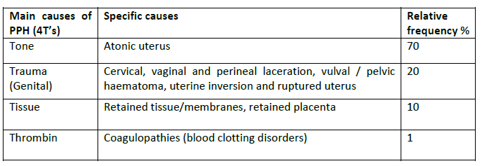
Causes of PPH

Slide 302
Cont…
Uterine Atony; This is when the uterus fails to contract adequately.
Predisposing factors to uterine atony:
Retained placenta,
placental fragments, tissue/membranes, blood clots
Overdistention of the uterus due to multiple gestation, excess amniotic fluid or a large baby.
High parity.
Prolonged labour Induction or augmentation of labour
Precipitous labour (labour lasting less than 3 hours)
Full bladder

Slide 303
Cont…
2. Trauma to the perineum, vagina, cervix or uterus is the second most frequent cause of PPH. Unrepaired or poorly repaired episiotomies or tears can also cause severe bleeding.
3. Tissue Retained placenta, This is defined as failure to deliver the placenta within 30 minutes of childbirth.
Predisposing factors to tissue retention include: Previous C/S
Previous history of retained placenta
Previous dilatation and curettage
Previous placenta praevia

Slide 304
Cont…
4. Thrombin When the blood fails to clot despite the routine interventions, a coagulation disorder should be suspected.
Predisposing factors for disseminated intravascular coagulation include:
Severe pre-eclampsia,
Placenta abruption,
Intrauterine foetal death
Amniotic fluid embolism.
Excessive bleeding can deplete coagulation factors and promote further bleeding.
Infection
Genetic factors

Slide 305
Predisposing factors
Grand multipara, that is, high parity of more than five children and advanced age
Precipitate labour, that is, rapidly progressing labour
Over distension of the uterus resulting from polyhydramnios, multiple pregnancy or overly large infant
Previous history of PPH
Blood clotting/coagulation disorders and disseminated intravascular coagulation
Preeclampsia and eclampsia
Heavy sedative medication during labour or general anaesthesia
APH
Anaemia in pregnancy

Slide 306
Signs of PPH
There is an escape of blood through the vagina.
There is an abnormally high fundus and the uterus feels larger and softer than normal.
The patient becomes shocked especially with
concealed haemorrhage.
With excessive haemorrhage the blood pressure falls, the pulse rate rises, pallor and air hunger may occur.
Post partum necrosis of the anterior lobe of the pituitary gland is rare and occurs with low level blood pressure.

Slide 307
MANAGEMENT
The main principles of treatment involve arresting the bleeding, restoration of the blood volume and treatment of circulatory failure (shock).
You should ascertain whether the uterus is contracted, if it is not, you should rub it to cause a contraction.
Incase of uterus is well contracted ,check the trauma and if the trauma is in the lower genital tract , apply pressure and repair
Start iv infusion of 40iu syntocinon in 1L of hartmans or NS to infuse slowly to ensure continued uterine contraction
Incase of raptured uterus –hysterectomy may be done
Incase of hypofibrinogenemia inform the doctor who will give human fibrinogen 4-6mg or fresh blood which contain platelets and coagulaton factor v and vii

Slide 308
Cont…
Take blood for GXM
TPR and BP ½ houry
Ensure bladder is empty Reassure and keep warm to prevent shock
If the uterus is well contracted ensure it is empty
If the placenta is not delivered, deliver it by firm and gentle pressure of the fundus
If the the placenta has been delivered and bleeding continues expel clots and do bimanual palpation
If not do bi manual compression and if bleeding does not stop rule out trauma , hypofirinogenemia, if bleeding continues do hysterectomy

Slide 309
Cont…
-If the placenta is separated and is in the lower uterine segment deliver placenta by controlled cord traction ,if unseparated do manual removal of placenta under GA. Once delivered antibiotics and cytotic drugs given and placenta is delivered observe for completeness
Immediately blood transfusion or IV fluids are given to restore blood volume

Slide 310
Cont…
Raise the foot of the bed
Observe ¼ to ½ hourly till the pt. is stable
Uterus is palpated to check if it is well contracted
Input and out put chart is maintained
Safe retaining catheter is placed in position and left in situ for 24hours or till condition of the mother improves

Slide 311
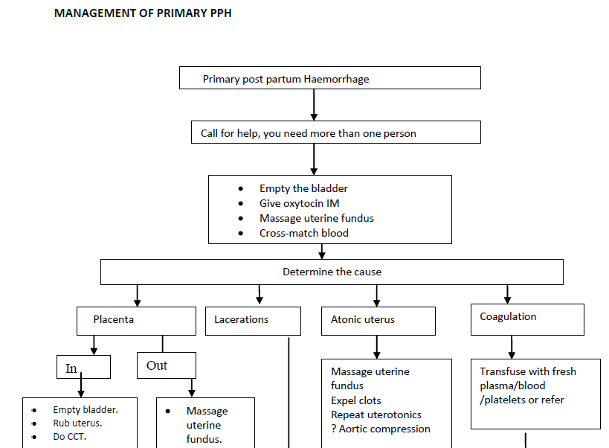

Slide 312
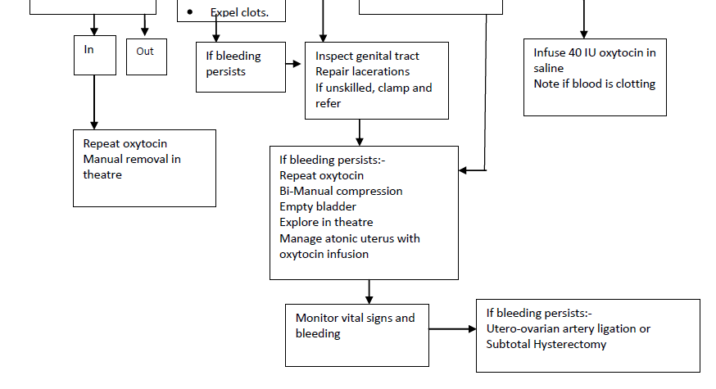

Slide 313
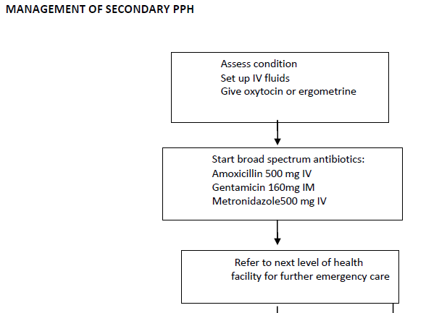
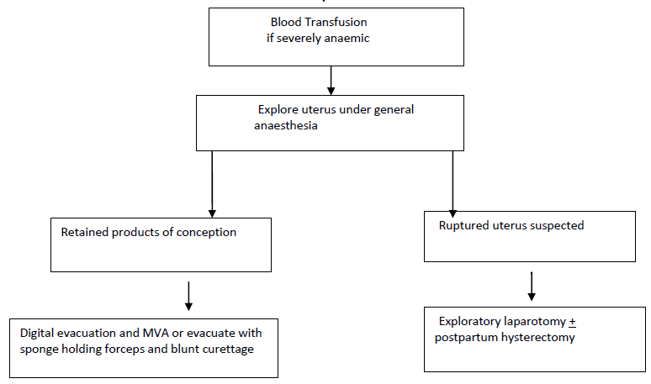

Slide 314
Cont…
Any abnormality is reported to the doctor
Complications
Hemorrhagic shock
Renal failure – Anuria due to blood loss
Anemia
Pueperial sepsis
Anoxia of anterior pituirary gland leading to necrosis and failure
Premature senility

Slide 315
LACERATIONS OF THE BIRTH CANAL
Classification:
Lacerations of the vagina and perineum are classified as first, second, third, or fourth degree.
First-degree lacerations
It involve the fourchette (frenulum of labia minora), perineal skin, and vaginal mucous membrane but not the underlying fascia and muscle.
Second-degree lacerations
Involves, in addition to skin and mucous membrane, the fascia and muscles of the perineal body but not the anal sphincter
These tears usually extend upward on one or both sides of the vagina, forming an irregular triangular injury.

Slide 316
Cont…
Third-degree lacerations
Extend through the skin, mucous membrane, and perineal body, and involve the anal sphincter.
Fourth-degree laceration
Extends through the rectal mucosa to expose the lumen of the rectum
Tears in the region of the urethra that may bleed profusely are also likely to occur with this type of laceration.

Slide 317
Treatment of 1st and 2nd degree tears:
It is important to repair all perineal tears
immediately , to prevent any infection of the raw surface.
Local infiltration of the perineum with lignocaine is
required for repair.
The vaginal epithelium is sutured from the apex of the
tear ( which must be clearly identified) down to the introitus
with a continuous or interrupted sutures
The perineal muscles are repaired with interrupted
sutures.
The skin edge are brought together without tension.

Slide 318
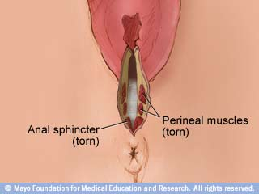
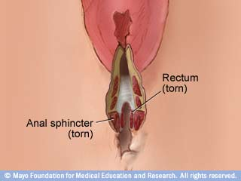
THIRD DEGREE FOURTH

Slide 319
Treatment of 3rd and 4th degree tears:
The operation should be done by an experienced obstetrician in the theatre with general or epidural anesthesia.
The anal mucosa is first repaired with fine stitches, tying the knots inside the bowel lumen
The ends of the sphincter are found and carefully brought together with interrupted suture
The other tissues are repaired as in 2nd degree.

Slide 320
Cervical injuries:
Bleeding which does not appear to be arising from the vagina or perineum and which continues despite a well contracted uterus, is an indication for examining the cervix to exclude cervical injury.
Minor cervical lacerations are extremely common but does not cause symptoms.
Deep lacerations and particularly those that involve the vaginal vault cause excessive bleeding and need to be managed in the theatre under anesthesia.

Slide 321
Causes of deep cervical lacerations:
1.Precipitate labour.
2.Application of forceps with the cervix
incompletely dilated.
3.Rapid delivery of the head in breech
presentation.
4.A scar in the cervix may also tear.

Slide 322
Management:
Prompt recognition of the injury and action to control
the bleeding is essential.
Good light for proper visualization of the tear is
essential so the patient should be taken to the theatre and
examined under general anesthesia.
By using two pairs of sponge forceps applied to the
cervix at any one time, it is possible to inspect the whole
circumference accurately.
Identification of the apex of the tear is essential before
commencing repair.
Interrupted sutures can be inserted through the whole
thickness of its wall.

Slide 323
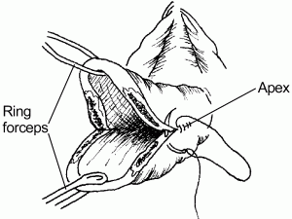
Repair of cervical tears

Slide 324
Puerperal Pyrexia
Puerperal pyrexia is a febrile condition, which presents with a temperature of 38°C and above within 14 - 21 days following childbirth or abortion.
Causes of puerperal pyrexia include:
Genital tract infection
Urinary tract infection
Breast disorders, for example, mastitis, breast engorgement or breast abscess
Thrombophlebitis
Respiratory tract infection
Other causes of pyrexia such as malaria
Vesico-vaginal fistula
Recto-vaginal fistula
Pyrexia of unknown origin

Slide 325
PUERPERAL SEPSIS
Puerperal sepsis is defined as infection of genital tract occurring at any time between the onset of rupture of membranes or labour and 6 weeks postpartum
The most common site of infection in puerperal sepsis is the placental bed. However infection may also occur in the cervix, vagina, perineum and the episiotomy site.

Slide 326
Predisposing factors
Medical/ Obstetric
Anaemia
Prolonged rupture of the membrane
Prolonged labour
Retained products of conception
Caesarean section especially emergency C/S,
Assisted delivery (vacuum, forceps)
Post partum Haemorrhage
Twin delivery especially with manipulation of the second twin
Malnutrition
Chronic diseases (Diabetes mellitus, HIV, TB)

Slide 327
Cont…
Health Systems
Poor infection prevention / control practices
Delivery by unskilled birth attendants e.g. TBAs
Poorly equipped and understaffed health facility
Social
Poor personal hygiene
Low status of women, which contributes to their poor general health and deprives them of adequate medical care and resources
Delay in care seeking
Lack of knowledge about signs and symptoms of puerperal sepsis

Slide 328
Symptoms and signs
Fever (temperature of 38°C or more)
Chills and general malaise
Lower abdominal pain
Vomiting,
Headache in severe cases
Tender uterus
Sub-involution of the uterus
Purulent, foul-smelling lochia,
Perineal pain,
Infected perineal wound

Slide 329
Diagnosis of puerperal sepsis
Take full medical history including that of the peripartum period
Carry out a complete physical examination to include at least
o Vital signs of Temperature, Pulse, RR and BP
o Examination for anaemia
o Breast inspection and palpation
o Inspect and Palpate abdomen for involution of the uterus, tenderness, state of C/S wound if present
o Perform bimanual pelvic exam observing the status of any tears, lacerations, and lochia

Slide 330
Cont…
Laboratory investigation should include
o Full blood count
o High vaginal swab for microscopy culture and sensitivity
o Urine microscopy, culture and sensitivity
o Blood culture and sensitivity

Slide 331
Management…
A broad spectrum antibiotic is given
An analgesic in case of pain, and a
Iron supplements is givenIf haemoglobin is below 7.4dl packed cell transfusion is recommended.
Fluid and electrolytes balances is maintained
In case of infected perineal wound, the stitch should be clipped to allow drainage of pus.
Localised infection is treated, with hydrogen peroxide and antibiotic spray.

Slide 332
Cont…
You should nurse the mother in a propped up position with a pillow to encourage uterine drainage of lochia..
Encourage the mother to eat a light nutritious diet, ensuring she takes plenty of fluids.
She should have vulva swabs every four hours and change of beddings frequently.
Vital signs every four hours and carry out a daily head to toe examination to assess her condition.

Slide 333
Preventions…
Advise to eat a well balanced diet before and during pregnancy to prevent anaemia.
She should receive early and regular prenatal care and exercise moderately
In the hospital, ensure proper infection control and monitoring.
Maintain the use of the aseptic technique
proper management of the three stages of labour.
prevent caesarean section whenever possible.

Slide 334
Puerperal mental disorders
More recent evidence suggests that postpartum psychiatric illness is virtually indistinguishable from psychiatric disorders that occur at other times during a woman's life.
Types:
  Postpartum blues; Rapidly fluctuating mood, tearfulness, irritability, and anxiety are common symptoms.
  Postpartum depression; Symptoms may include depressed mood, tearfulness, inability to enjoy pleasurable activities, insomnia, fatigue, appetite disturbance, suicidal thoughts, and recurrent thoughts of death.
  Postpartum psychosis.

Slide 335
Postpartum/ Puerperal Psychosis
Postpartum psychosis may be characterized by:
Abrupt onset of delusions or hallucinations,
Insomnia, paranoia,
Mania,
Abnormal preoccupation with the baby,
Severe depression, anxiety, despair
Suicidal or infanticidal impulses
Abnormal reaction towards her family members;

Slide 336
Puerperal psychosis treatment
Puerperal psychosis is a psychiatric emergency that typically requires inpatient treatment.
Most patients with puerperal psychosis suffer from bipolar disorder. Acute treatment includes a mood stabilizer (eg, lithium, valproic acid, carbamazepine) in combination with antipsychotic medications and benzodiazepines.
ECT (often bilateral) is tolerated well and rapidly effective.
Risk of suicide is significant in this population.
Rates of infanticide associated with untreated puerperal psychosis are as high as 4%.

Slide 337
Special concerns:
Breastfeeding and psychotropic medications
Women who plan to breastfeed must be informed that all psychotropic medications, including antidepressants, are secreted into breast milk. Concentrations in breast milk vary widely.
Data on the use of tricyclic antidepressants, fluoxetine, sertraline, and paroxetine during breastfeeding are encouraging, and serum antidepressant levels in the nursing infant are either low or undetectable. Reports of toxicity in nursing infants are rare, although the long-term effects of exposure to trace amounts of medication are not known.

Slide 338
Cont…
Avoid breastfeeding in women treated with lithium because this agent is secreted at high levels in breast milk and may cause significant toxicity in the infant.
Avoid breastfeeding in premature infants or in those with hepatic insufficiency who may have difficulty metabolizing medications present in breast milk.

Slide 339
Cont…
Children of mothers with postpartum depression are more likely than children of nondepressed mothers to exhibit behavioral problems (eg, sleep and eating difficulties, temper tantrums, hyperactivity), delays in cognitive development, emotional and social dysregulation, and early onset of depressive illness.

Slide 340
Breast complications
Breast Engorgement; occurs when there is congestion as well as over accumulation of milk
Diagnosis
The breasts feel hard with distended vessels. They are also warm and tender. The areola may look oedematous

Slide 341
Management
1. Mother is breastfeeding:
If the baby is not able to suckle encourage the woman to express the milk
Encourage the woman to breastfeed more frequently, using both breasts at each feeding
Show the woman how to hold and attach baby to breast
Relief measures before breastfeeding may include:
Applying warm/ cold compresses to the breasts just before breastfeeding, or encourage the woman to take warm shower
Massage the woman’s neck and back

Slide 342
Cont…
Have the woman express some milk manually prior to breastfeeding and wet the nipple area with breast milk to help the baby latch properly and easily
Relief measures after feeding may include: Good support to the breast with a binder or brassier but avoid tight ones
Apply cold/ warm compresses to the breast between feeding to reduce swelling and pain
Give analgesics e.g. Paracetamol 500mg orally as needed
Follow up 3 days after initiating management to ensure response

Slide 343
Cont…
2. Mother is not breastfeeding:
Support breasts with binder or brassiere to reduce swelling and pain
Apply cold/warm compresses to the breasts to reduce swelling and pain
Express enough milk to relieve pain but avoid complete emptying as this will reduce milk production. Let her gradually reduce volume expressed
Give analgesic e.g. paracetamol 500mg orally when needed
Review /Follow up 3 days after initiating treatment to ensure response
Advise to seek care if breasts become painful, swollen and red, or if she feels ill or her temperature is > 38ºC

Slide 344
Sore or cracked nipples
Sore nipples are caused by either the loss of the epithelium cover on a big area of the nipple or a deep, small, painful crack at either the tip or base of the nipple.
Diagnosis
Mother reports pain on breastfeeding
Cracks may be seen on nipples
Management
Counsel on personal hygiene and how to keep the nipples clean
Express the milk from the affected breast to prevent engorgement
Show mother how to position and attach baby
Apply milk on the cracks and encourage exposure to air or sunshine if possible
Continue breastfeeding both breasts
Check for oral thrush in baby

Slide 345
Mastitis
Definition; inflammation of the breast.
CAUSATIVE ORGANISM;haemolytic streptococcus organisms and staphylococcus aureus. The usual route for transmission of organisms to the mother’s breast is from the:
Nasopharynx of her infant
The patient’s hands
Nursery personnel in contact with the infant
Skin infection of the baby
The umbilical cord

Slide 346
Signs and symptoms
acute pain and tenderness in the breast
General malaise characterised by a chilly sensation,
followed by rise of temperature to 40°C with increased
pulse rate
On inspection, the breast appears reddened and hard
The inflammation may be generalised, confined to a lobe or a local area
There are indurations, tenderness and erythema of the involved area
Mastitis is usually unilateral, in advanced cases there
maybe local abscess formation

Slide 347
Management
Treat with antibiotics e.g. Cloxacillin 500mg every six hours for 5-10 days Or Erythromycin 500mg every six hours for 5 – 10 days
Analgesics e.g. Paracetamol 500mg orally as needed
Encourage the woman to:
Continue breastfeeding on the unaffected side
Support breast with brassiere
Apply cold/ warm compresses to the breast between feeds to reduce swelling and pain
Express the milk from affected side several times a day and discard
Follow up three days later to ensure response.

Slide 348
Breast Abscess
Definition; localized collection of pus in the breast.
Management
Treat with antibiotics as in mastitis
Drain the abscess
General anaesthesia e.g. Ketamine is usually required; you may also use Local anaesthetic spray
Make the incision radially extending from near the alveolar margin towards the periphery of the breast to avoid injury to the milk ducts
Wearing sterile gloves and use a finger or tissue forceps to break up the pockets of pus
After draining the pus loosely pack the cavity with gauze

Slide 349
Cont…
Remove the gauze pack after 24 hours and replace it with a small gauze pack
If there is still pus in the cavity place a small gauze pack in the cavity and bring the edge out
through the wound as a wick to facilitate drainage of any remaining pus
Encourage the woman to:
Continue breastfeeding even when there is a collection of pus
Support breast with a binder or brassiere
Apply cold/ warm compresses to the breast between feeds to reduce swelling and pain
Give analgesics e.g. Paracetamol 500mg orally 8hrly for 7 days
Follow up 3 days after initiating management to ensure response
Educate the mothers on the importance of emptying the breasts

Slide 350
Venous Thrombosis
This refers to the formation of clots in the veins, usually in the lower limbs. Puerperal mothers are prone to venous thrombosis.
Puerperal mothers who have had a caesarean section often haemorrhage and after a difficult delivery it may take a longer time for her to move around.
Another possible cause of the condition is varicosity, which may occur during delivery due to injury or inflammation. Mothers over 35 years and those with high parity are also at high risk.

Slide 351
Cont…
Prophylaxis
During pregnancy you should ensure that pregnant mothers with thrombo-embolic disorders are not given oestrogen preparations and are encouraged to do exercise.
Pregnant women with marked varicose veins should wear embolic stockings or crepe bandage. Mothers at a high risk of developing thrombosis or pulmonary embolism should be given a low dose of heparin 5,000 units subcutaneous.

Slide 352
End…

