Slide 1
DISORDERS OF THE ADRENAL GLAND
MEDICINE 2
ENDOCRINE DISORDERS

Slide 2
INTRODUCTION
ADRENAL
Also called supra renal gland.
Consists of outer cortex & inner medulla.
Hormones secreted are :
  Cortex→ androgens, aldosterone, corticosterone.
  Medulla → epinephrine & nor epinephrine.
Major disorders are : Cushing syndrome, Addison's disease, Primary aldesteronism, hyper secretion of catecholamine.

Slide 3
COMMON ADRENAL GLAND DISEASES
1. Disease of the adrenal cortex
a) Resulting from excess production of hormones
Cushing’s syndrome: excess cortisol production
Primary hyperaldosteronism: excess production of aldosteron
b) Inadequate production
Addison’s diseases: inadequate production of cortisol and aldosteron
2. Disease of the adrenal medulla
Pheochromocytoma: excess production of catecholamine

Slide 4
CUSHING'S SYNDROME
HYPERCORTISOLISM

Slide 5
INTRODUCTION
Cushing syndrome is a clinical state of increased free circulating glucocorticoid.
Is caused by excessive concentration of cortisol or other glucocorticoid hormones in the circulation
Syndrome of chronic exposure to inappropriately elevated levels of free plasma glucocorticoids
Rare. True prevalence difficult to define
It occurs following therapeutic administration of synthetic steroids or ACTH (Adrenocorticotropic hormone) or it may occur spontaneously

Slide 6
EPIDEMIOLOGY
Spontaneous Cushing’s syndrome and disease can occur in children and adults
Cushing’s disease generally occurs after puberty
In adults women are more affected and is found in those aged 25-45 years M:F 1:5
Ectopic ACTH from tumor is more in male

Slide 7
ETIOLOGY AND PATHOPHYSIOLOGY
a) Bilateral adrenal hyperplasia
Is the commonest cause of Cushing’s syndrome.
It is caused by increased pituitary secretion of ACTH.
Pituitary tumors large enough to be seen by skull x-ray, are present in more than 10 % of these patients, and smaller basophilic adenomas are found in more than 50 % of patients.
b) Adrenal adenomas and adrenal carcinoma
May produce excess cortisol

Slide 8
ETIOLOGY AND PATHOPHYSIOLOGY
c) Ectopic ACTH production by tumors
EX: such as oat cell carcinoma of the lung, carcinoma of the pancreas, bronchial carcinod tumors , and other, cause adrenal hyperplesia and Cushing’s syndrome
d) Iatrogenic Cushing’s syndrome
Is seen more often than spontaneous occurring syndrome.
It is an expected complication in patients receiving long term glucocorticoid treatment for asthma, arthritis, and other conditions.

Slide 9
CLINICAL FEATURES
1. Central obesity
Is caused by the effect of excess cortisol on fat distribution.
Fat accumulation in the face, neck and trunk, while thelimns remain thin.
The “moon face” , “buffalo hump” ( cervical fat pad ) and supraclavicular fat pads contribute to the Cushingiod appearance
2. Hypertension
Result from the vascular effects of cortisol and sodium retention
3. Decreased glucose tolerance
is common, 20 % of patients have overt diabetes. This is a result of hepatic gluconeogenesis, and decreased peripheral glucose utilization.

Slide 10
CLINICAL FEATURES
4. Symptoms of androgen excess
E.g. oligomenorrhea, hirsutism, and acne→ may occur in women with Cushing’s diseases, because of stimulation by ACTH of adrenal androgen production.
5. Purple striae
Are linear marks on the abdomen, where the thin, wasted skin is stretched by underlying fat.
Atrophic skin with senile purpura may also be seen.
6. Muscle wasting and weakness
Reflects the catabolic effect of cortisol on muscle protein.

Slide 11
CLINICAL FEATURES
7. Osteoporosis→ is caused by increased bone catabolism.
8. Susceptibility to bruising→ is probably caused by enhanced capillary fragility.
9. Psychiatric disturbance→ especially depression, are frequently seen.
10. Poor wound healing→ due to impaired immune function.
11. Growth retardation in children may be severe.

Slide 12
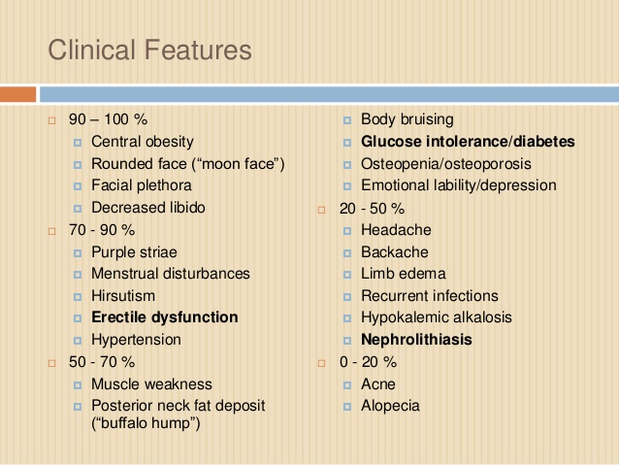

Slide 14
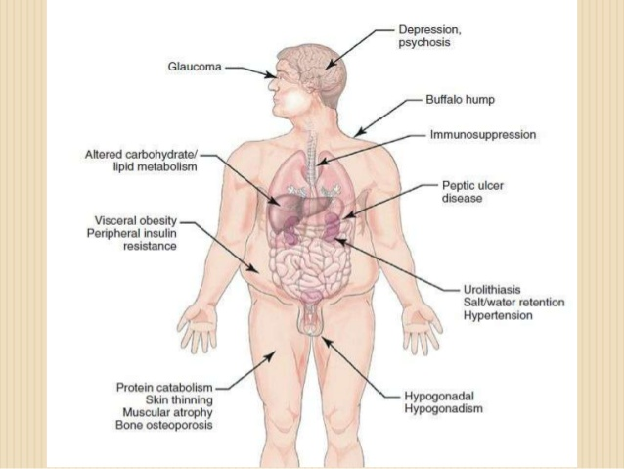

Slide 15
EXAMINATION OF SYSTEMS
Elevated blood pressure
Muscle weakness
Increased pigmentation around neck and creases

Slide 16
INVESTIGATIONS
Its is useful to divide the investigations into:
  those which establish whether the patient has Cushing’s syndrome
  those which are used subsequently to elucidate the etiology
Additional test are also needed

Slide 17
LAB INVESTIGATIONS
Measurement of 24 hour urine free cortisol→ increased in most patients with Cushing’s syndrome
Dexamethasone suppression test
Overnight Dexamethasone suppression test→ is recommended as an initial screening test
Administer dexamethasone 1 mg PO at 11 PM at midnight and measure serum cortisol at 8:00 AM the following day
The serum cortisol level should be <5 μg/dl in most individuals, indicating normal suppression of ACTH and cortisol by dexamethasone. Patients with Cushing’s syndrome will have cortisol level > 5 μg/dl usually greater than 10 μg/dl .

Slide 18
LAB INVESTIGATIONS
Plasma ACTH levels: ACTH measurement may help to differentiate the cause of Cushing’s syndrome
a. High normal or slightly elevated ACTH→ Cushing’s diseases
b. Markedly elevated ACTH → Ectopic ACTH production
c. Extremely low ACTH level→ Automatically functioning adrenal tumor is the source of excess cortisol. Pituitary secretion of ACTH is suppressed due to the excess cortisol
Serum cortisol level
CBC→ leukocytosis, with relatively low percentage of lymphocytes and eosinophils

Slide 19
ADDITIONAL TESTS
Plasma electrolytes
Serum glucose
Glycosylated hemoglobin
Bone mineral density

Slide 20
RADIOLOGICAL
a. Skull x-ray: enlargement of sella turcica in 10 % of patients with Cushing’s syndrome who have macroadenoma.
b. CT scan with injection of contrast medium: detect approximately 50 % of pituitary adenomas
c. CT scan of the adrenal gland: reveal most adrenal tumors.
Uniform enlargement of both adrenal glands suggests an ACTH dependent Cushing’s syndrome (ether Cushing’s disease o r the ectopic ACTH syndrome )
d) MRI

Slide 21
TREATMENT
Treatment is essential as untreated Cushing’s syndrome has a 50% 5 year mortality
Most patients are treated surgically with medical therapy given for a few weeks prior to operation
Type of surgery depends on the cause
1. Adrenal adenoma→ complete surgical resection of the adenoma cures the disease, but patients may need cortisol replacement post operatively for several months
2. Ectopic ACTH syndrome→ can be cured by treating or removal of the tumor that is producing the ectopic ACTH.
3. Cushing’s Disease→ Pituitary radiation or Bilateral adrenalectomy or Transphenoidal pituitary surgery:

Slide 22
TREATMENT
Medical treatment used to inhibit corticosteroid biosynthesis include:
Metyrapone
Aminoglutethimide
Ketaconazole

Slide 23
HYPERALDOSTERONISM
Overview

Slide 24
ALDOSTERONISM
It is characterized by the overproduction of the mineralocorticoid hormone aldosterone.
Etiology:
1. Primary aldosteronism: the cause of excess aldosterone production resides with in the adrenal gland
Aldosterone producing adrenal adenoma (Conn’s syndrome): in most cases, unilateral small adenoma which can occur on either side
Adrenal carcinoma: rare cause of aldosteronism
Bilateral cortical nodular hyperplasia /idiopathic hyperaldosteronism

Slide 25
ETIOLOGY
2. Secondary aldosteronism: the stimulus for excess aldosterone production is outside the adrenal gland.
It refers to a appropriately increased production of aldosterone in response to activation of the renin-angiotensin system
Accelerated phase of hypertension
Pregnancy
Congestive heart failure
Other edema states : nephritic syndrome , CLD etc

Slide 26
PATHOPHYSIOLOGY
The excess aldosterone increase the reabsorption of sodium and excretion of potassium and hydrogen ions, in the distal renal tubules, which results progressive depletion of potassium and leads to hypokalemia.

Slide 27
SYMPTOMS
Hypernatremia
Hypokalemia.
Increased bicarbonate retention and the excreted hydrogen combine to generate a metabolic alkalosis.
High pH of the blood makes calcium less available to the tissues and causes symptoms of hypocalcemia.
Elevated blood pressure
Manifestations of muscle cramps (due to hyperexcitability of neurons).
Muscle weakness (due to hypoexcitability of skeletal muscles).
Decreased cardiac output.

Slide 28
LABORATORY DIAGNOSIS
Hypokalemia in hypertensive patients is often the clue that triggers the search for primary aldosteronism
Serum aldosterone level: elevated aldosterone and metabolites in 24-h urine
Plasma renin activity: is the most important useful indicator of whether elevated aldosterone is primary or secondary.
Increased plasma renin activity favors the diagnosis of secondary aldosteronism.
While raised aldosterone level with reduced plasma renin activity suggests primary aldosteronism.
CT scan and MRI: may detect aldosterone secreting adenomas.

Slide 29
TREATMENT
1. Surgery
Removal of solitary adenoma results cure of hypertension in about 60 % of cases and improvement in another 25 %.
Adrenalectomy is done after 4 week treatment with spironolactone
2. Medical Therapy
Spironolactone inhibits the effects of aldosterone on renal tubule.
In idiopathic form: Spironolactone (50-100 mg/d), possibly combined with potassium sparing diuretics correct the hypokalemia and with anti-hypertensive medication, high blood pressure can be controlled.

Slide 30
ADDISON DISEASE
OVERVIEW

Slide 31
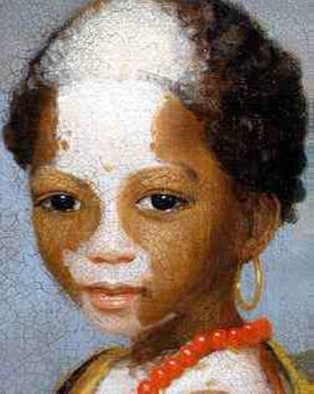
ADDISON DISEASE
Addison’s disease is named after Dr. Thomas Addison.
It is a rare endocrine disorder wherein the adrenal glands produce insufficient steroid hormones (glucocorticoids and often mineralocorticoids).

Slide 32
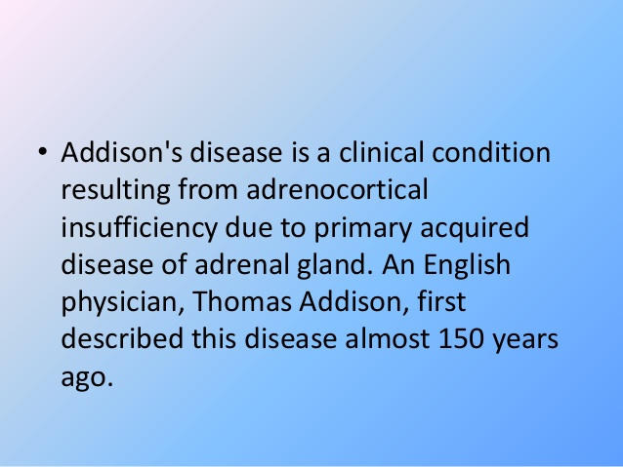

Slide 33
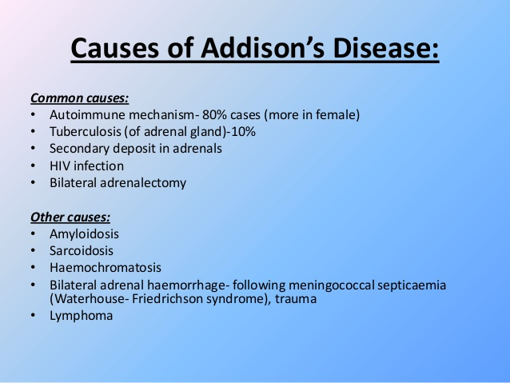

Slide 34
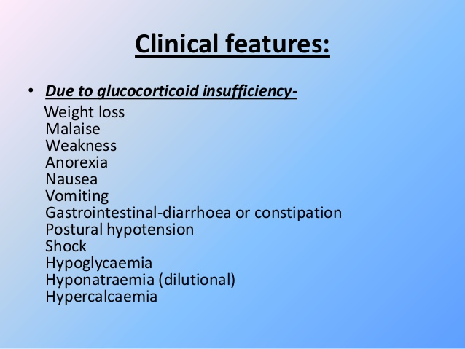

Slide 35
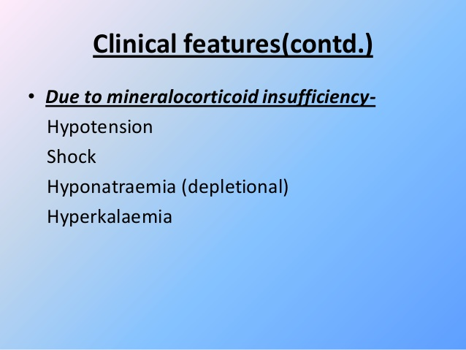

Slide 36
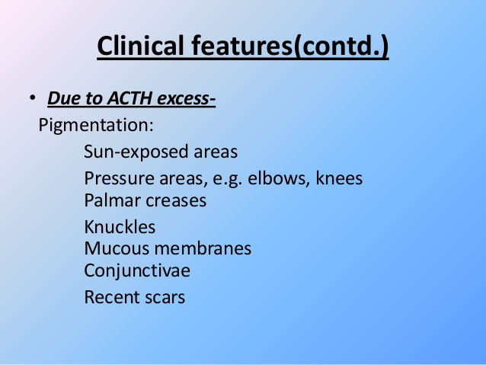

Slide 37
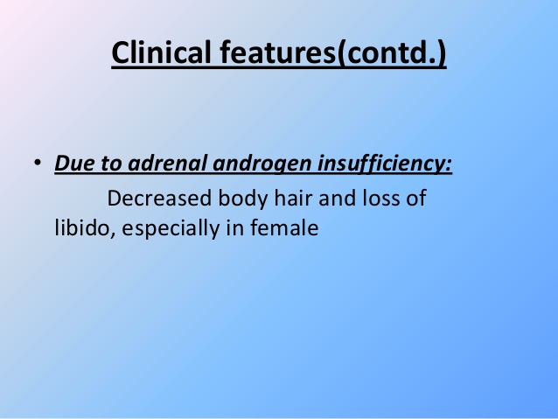

Slide 38
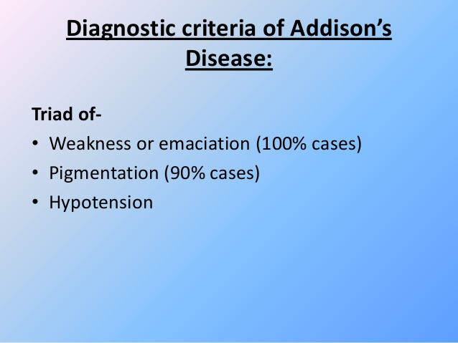

Slide 39
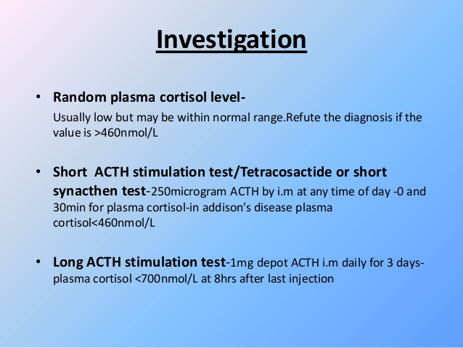

Slide 40
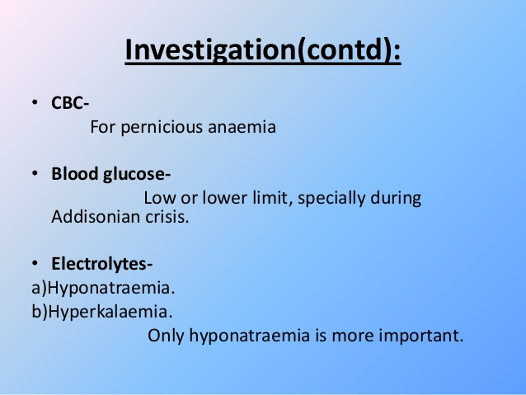

Slide 41
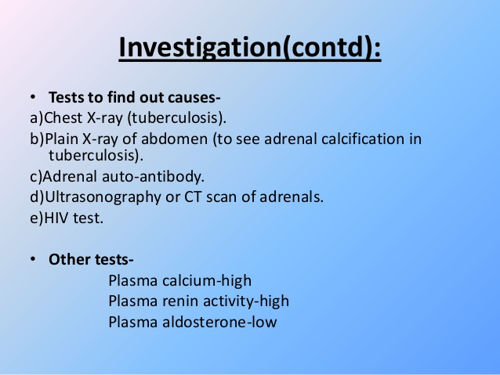

Slide 42
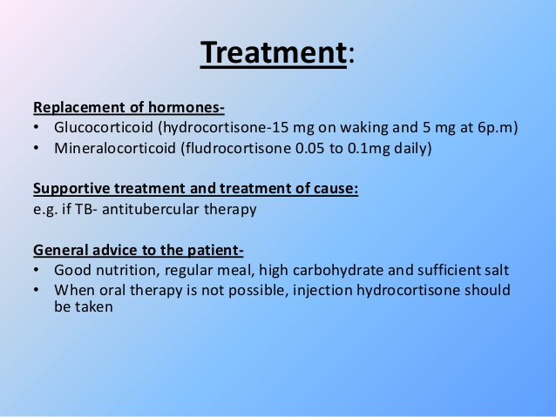

Slide 43
ADDISONIAN CRISIS
It is a medical emergency due to acute adrenocortical insufficiency
Causes:
Sudden withdrawal of steroid (commonest cause, if pt. on steroid for long time)
Following stress e.g. intercurrent disease, trauma, surgery, severe infection or prolonged fasting in a pt with latent insufficiency
Following sudden destruction of pituitary gland(pituitary necrosis)or when thyroid hormone or drugs which increase steroid metabolism(e.g. phenytoin)given to a pt with hypoadrenalism
Following bilateral adrenalectomy
Following injury to both adrenals due to trauma,adrenal vein thrombosis,adrenal haemorrhage due to meningococcaemia or anticoagulant therapy

Slide 44
CLINICAL FEATURES
Nausea, vomiting, diarrhoea
Abdominal pain
Diarrhoea
Muscle cramps
Unexplained fever
Unconsciousness
Severe hypotension
Hyponatraemia, hyperkalaemia, hypoglycaemia, hypercalcaemia

Slide 45
TREATMENT
I/V hydrocortisone 100 mg 6 hrly until GI symptoms abate then oral therapy
I/V fluid normal saline and 10% dextrose for hypoglycaemia
Precipitating factors should be find out and treated

Slide 46
PHAEOCHROMOCYTOMA
Phaeochromocytoma, is a neuroendocrine tumor of the medulla of the adrenal glands (originating in the chromaffin cells),
It secretes excessive amounts of catecholamine, usually adrenaline (epinephrine) if in the adrenal gland and not extra-adrenal.
Up to 25% of pheochromocytomas may be familial.

Slide 47
PHAEOCHROMOCYTOMA
SYMPTOMS
Skin sensations
Flank pain
Elevated heart rate
Elevated blood pressure
Inhibition of glucose uptake by muscle cells.
Anxiety often resembling that of a panic attack.

Slide 48
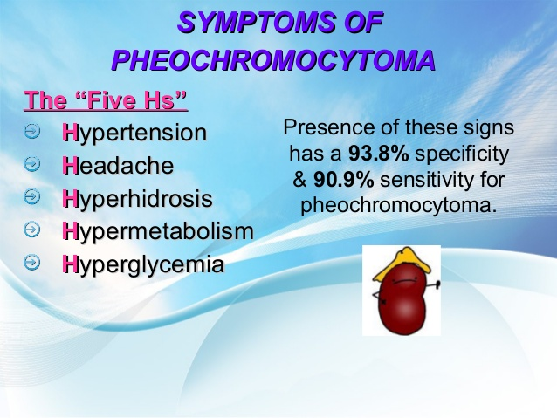

Slide 49
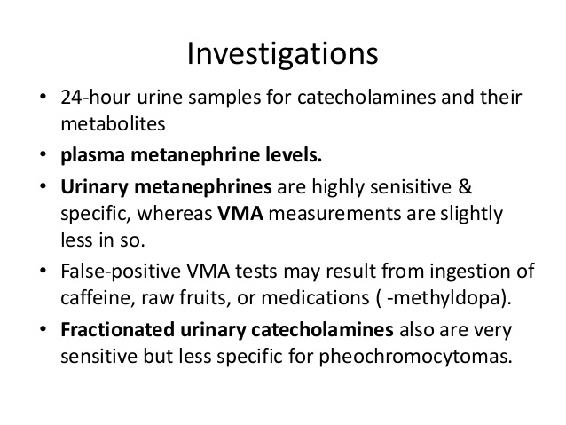
VANILLYLMANDELIC Acid (VMA)

Slide 50
PITUITARY GLAND DISORDERS
MEDICINE 2
ENDOCRINE MEDICINE

Slide 51
PITUITARY GLAND DISORDERS
1. Anterior pituitary diseases may result from:
  i) Insufficient production of pituitary hormones: hypopituitarism
  ii) Excess production of pituitary hormones:
    a. Acromegaly,
    b. Cushing’s diseases
    c. Hyperprolactinoma
  iii) Local effect of pituitary tumors
  2. Posterior Pituitary diseases

Slide 52
HYPOPITUITARISM
Definition: Endocrine deficiency syndromes due to partial or complete loss of anterior lobe
Hyposecretion may be generalized (hypopituitarism) or caused by the selective loss of one or more pituitary hormones pituitary function.
Etiology:
1. Pituitary tumors
2. Infarction or ischemic necrosis of the pituitary: DM, SC anemia
3. Inflammatory /infectious process : meningitis (tuberculous), pituitary abscess
4. Infiltrative diseases: Sarcoidosis , hemochromatosis
5. Iatrogenic: irradiation or Surgical removal of pituitary tumors or during operation for other bran tumors

Slide 53
CLINICAL FEATURES
The onset is usually insidious and may not be recognized as abnormal by the patient, but occasionally it may be sudden or dramatic.
The function of all target glands will decrease when all hormones are deficient (panhypopituitarism).
With slow progressive destruction of pituitary tissue:-
  Failure of GH and gonadotrophin secretion occurs early
  TSH failure comes next
  ACTH level falls finally

Slide 54
HYPOPITUITARISM
Deficiency of all anterior pituitary hormones is more common than individual hormone deficiency.
Luteinizing hormone (LH) & Follicle-stimulating hormone (FSH)
Women experience infrequent menstrual periods and infertility.
Men lose facial and trunk hair, as well as suffering decreased muscle mass and anemia increased risk of osteoporosis
Growth hormone (GH)
decrease in muscle mass, central obesity
impaired attention and memory
Children experience growth retardation and short stature

Slide 55
HYPOPITUITARISM
Adrenocorticotropic hormone (ACTH)
lack of production of glucocorticoids such as cortisol by the adrenal gland.
fatigue, weight loss, delayed puberty (in adolescents),
hypoglycemia, anemia and hyponatremia.
Thyroid-stimulating hormone (TSH)
deficiency leads to hypothyroidism
Typical symptoms are tiredness, intolerance to cold, constipation, weight gain, hair loss, low blood pressure

Slide 56
HYPOPITUITARISM
Prolactin
It plays a role in breastfeeding, and inability to breastfeed may point at abnormally low prolactin levels.
Postpartum failure of lactation
Pituitary apoplexy
It is a symptom complex caused by hemorrhagic infarction of either a normal pituitary gland or, more commonly, a tumor.
Acute symptoms may include severe headache, stiff neck, fever, and visual disturbances.

Slide 57
DIAGNOSIS
1) Evaluation of target organ function: is often the first step in the diagnosis of hypopituitarism; this condition is often suspected because of failure more than one target organ
Evaluation of thyroid function: T4, T3, TSH
Evaluation of ACTH secretion
Evaluation of prolactin levels
Evaluation of serum LH and FSH levels
Measurement of GH hormone level
2) Imaging studies
Skull x-ray of sella turcica (detects macroadenomas > 10 mm)
High-resolution CT or MRI if available

Slide 58
TREATMENT
Treatment of the underlying cause the patients pituitary insufficiency
Hormone replacement therapy → treatment is directed toward replacing the hormones of the hypofunctioning target glands.
GH replacement: given for children with growth failure
Thyroid hormone replacement
Cortisol
Estrogens and progesterone combination: may be given to women to restore menstrual function and Testosterone may be given to men to restore libido and potency

Slide 59
HYPERSECRETION OF ANTERIOR PITUITARY HORMONES
The anterior pituitary hormones that are most commonly secreted in excess are
GH hypersectretion: which manifests as an Acromegaly or gigantism
Hyperprolactinoma
Excess secretion of ACTH: results as in the pituitary type of Cushing's syndrome

Slide 60
ACROMEGALY AND GIGANTISM
Caused by excessive secretion of Growth hormones.
Characterized by excessive growth in the form of swelling of hands, legs & soft tissues.

Slide 61
CLINICAL MANIFESTATIONS
Bone and soft tissue changes:
Gigantism
GH hypersecretion beginning in childhood before closure of epiphyses may cause increase linear growth of long bones resulting gigantism.
There is little bony deformity, soft tissue swelling or enlargement of peripheral nerves.
Delayed puberty or hypogonadotropic hypogonadism may be present.
2. Acromegaly
GH hypersecretion beginning after epiphyseal closure, in adults, result soft tissue growth and bony enlargement, especially in acral areas (appendicular) of the skeleton, which may affect the patient’s appearance.

Slide 62
CLINICAL MANIFESTATIONS
Enlargement of hands (especially fingertips) and feet
Coarsening of facial features
  Thick skin folds: brows and nasolabialfolds
  Enlargement of the nose
  Enlargement of mandible: Prognathism, spreading of teeth
Body hair increases and the skin thickens and becomes darker.
Excessive perspiration, offensive body odour may be noted.
Voice becomes husky, tongue enlarged and furrowed.
Barrel chest deformity may be noted.
Joint symptoms are common, crippling degenerative osteoarthritis may occur.

Slide 63
CLINICAL MANIFESTATIONS
Galactorrhea may occur in women and menstrual irregularities/amenorrhea may be noted.
Impotence is common in men.
Peripheral neuropathies due to entrapment of peripheral nerves are common, as are headaches (due to pituitary tumor).
Bitemporal hemianopsia (visual field defect) may develop due to the pressure effect of pituitary adenoma.

Slide 64
CLINICAL MANIFESTATIONS
Enlargement of internal organs: The heart, liver, kidneys, spleen, thyroid, parathyroid glands, and pancreas are also larger than normal.
Cardiac disease in 1/3 of patients.
3. Metabolic changes:
Poor glucose tolerance, a result of the anti-insulin actions of GH, is common.
Over diabetes occurs in only 10% of acromegalic patients.

Slide 65
INVESTIGATIONS
Diagnosis of Acromegaly depends on the clinical manifestations.
GH level: should be measured in the morning under basal condition. A level higher than 10ng/dl favors the diagnosis of Acromegaly.
Glucose tolerance test: to diagnose for possible DM
Skull x-ray: in most cases the pituitary adenoma is large enough to distort the sella turcica and can be seen on lateral skull x-ray
CT or MRI: will help to visualize the tumor.

Slide 66
TREATMENT
1. Ablative therapy
Transpheniodal pituitary adenomectomey: results prompt normalization of GH in the majority of patients
Irradiation therapy radiation is generally indicated, but be aware of danger of hypopituitarism.
2. Medical therapy
It is indicated if surgery and radiotherapy are contraindicated or have failed.
Give bromocriptine up to 15 mg/d PO in divided doses.

Slide 67
POSTERIOR PITUITARY LOBE DISORDERS
DIABETES INSIPIDUS
Caused due to insufficient production of Anti diuretic hormone.
Characterized by excessive thirst and excretion of large amounts of severely diluted urine.
SYMPTOMS
Extreme thirst
Blurred vision
Dehydration
extreme urination
Fever, vomiting, or diarrhea

Slide 68
TREATMENT
Desmopressin acetate
The drug of choice
Dose: Initial dose: 0.05 mg orally twice a day or 1 to 2 mcg IV twice a day or 1 to 2 mcg SC
The optimal dosage depends on the patient's response
Side effects: Transient headache, nausea, mild abdominal cramps, facial flushing and vulval pain.
Thiazide diuretics e.g. Hydrochlorthiaziade
Promote sodium excretion leading to extra cellular fluid volume contraction.
Dose for HCTZ: 25mg OD or BD

Slide 69
TREATMENT
OTHER DRUGS
Chlorpropamide (anti-diabetic) can also stimulate ADH release in partial neurogenic DI at 125-250mg oral dose/day.
Carbamazepine used 100-300mg BD in central DI.
Clofibrate used 500mg QDS in central DI.
Indomethacin 50 mg every 8-12 hrs in both types of DI.

Slide 70
PITUITARY TUMORS
The two most common pituitary tumors are :
Pituitary adenomas are tumors that occur in the pituitary gland , and account for about 15% of intracranial neoplasm
Prolactinomas are the most common type of pituitary tumor.
It secrete prolactin acidophilic galactorrhea, hypogonadism, amenorrhea, infertility, and impotence

