Slide 1
BASIC LIFE SUPPORT
ADULT

Slide 2
THE CHAIN OF SURVIVAL
The First Link-Early Access.
The Second Link-Early CPR.
The Third Link-Early Defibrillation
The Fourth Link-Early ACLS.
The Fifth – post resuscitation care

Slide 3
FIRST-EARLY ACCESS
Early identification of patient collapse by a person who can give active EMS system. This has 2 components
1)Recognition of unresponsiveness.
2)Rapid notification of EMS before CPR is began for
adults and after one minute of rescue support for
children and infants.

Slide 4
ACTIVE EMS SYSTEM
Call the emergency number.
Ambulance.
Police.
Fire brigade.

Slide 5
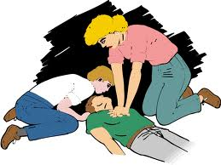
SECOND-EARLY CPR
CPR is most effective when started immediately after the victim’s collapse.
By stander CPR is the best treatment that a cardiac patient can receive until the arrival of a defibrillator and ACLS care.

Slide 6
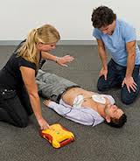
THIRD-EARLY DEFIBRILLATION
Defibrillation improves survival rates.
Emergency vehicles to be equipped with the defibrillator.
EMTs to be trained how to use the defibrillator.

Slide 7
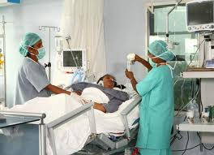
FORTH-EARLY ACLS
Establishes intravenous access.
Administers drugs.
Equipment to support ventilation.
Controls arrhythmias.
Stabilizes victim for transport.

Slide 8
FIFTH- POST RESUSCITATION CARE
START PATIENT ON ADJUNCT TREATMENT
CORRECT HEMODYNAMICS: Hb, u/e/cs , VITALS
INOTROPIC SUPPORT
HEMODIALYSIS

Slide 9
CARDIAC ARREST
CA = Abrupt cessation of effective cardiac pumping resulting in cessation of circulation.
Function of Heart = to pump blood to the lungs and to the body.
Function of the Blood Vessels = to carry blood to and from the heart and tissues.
In CA, circulation ceases an vital organs are deprived of oxygen.

Slide 10
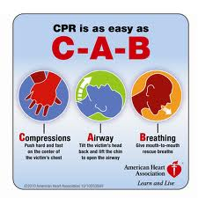
SEQUENCE OF EVENTS
Quickly assess any injury.
Tap or gently shake the victim and shout, ARE YOU OK?
If no response.
Activate EMS.
If injured DO NOT move the victim unless absolutely necessary.

Slide 11
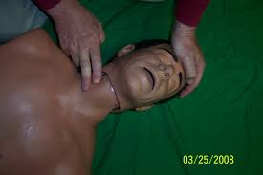
CIRCULATION
Determine pulselessness.
Check the pulse at the carotid artery 5 to 10 seconds.
If there is a pulse and no breathing give rescue breaths.
If there is NO pulse activate EMS. Start chest compressions.

Slide 12
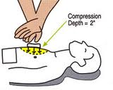
COMPRESSION TECHNIQUE
PROPER HAND POSITION
Place the hand heels properly at the sternum.
Keep the fingers off the chest.

Slide 13
THE CHAIN OF SURVIVAL
The First Link-Early Access.
The Second Link-Early CPR.
The Third Link-Early Defibrillation
The Fourth Link-Early ACLS.
The Fifth – post resuscitation care

Slide 14
RECOMMENDATIONS
Chest compressions rate should be at least 100 per minute.
Chest compression produce systolic arterial blood pressure of 60 to 80 mm Hg, diastolic is low.

