Slide 1
GASTROINTESTINAL & BILIARY TRACT DISORDERS (25 HRS)

Slide 2
OBJECTIVES
Recall the anatomy and physiology of the GIT and related structures
Describe common manifestations in a patient with GIT disorders
Describe the assessment of a patient suffering from GIT disorders
Describe diseases/conditions of the GIT and their management
Describe diseases/conditions of the biliary tract and their management

Slide 3
Review of GIT
Includes GIT and accessory digestive organs (teeth, tongue, salivary glands, liver, gallbladder, and pancreas).
Digestion includes 6 basic processes:
ingestion,
secretion,
mixing and propulsion,
mechanical & chemical digestion,
absorption,
defecation
Histology: most of GIT, from deep to superficial;
mucosa,
submucosa,
muscularis,
Adventitia (serosa)

Slide 4
Inervation
Enteric Nervous System (ENS) and
Myenteric or Auerbach's plexus, (muscularis):- regulates GI tract motility
Submucosal or Meissner's plexus, (submucosa):- regulates GI secretion
Autonomic Nervous System (ANS).
Parasympathetic fibers of the Vagus (X) & Spinal nerves:- increase GI secretion & motility
Sympathetic fibers from thoracic & upper lumbar regions:- decrease GI secretion & motility
Blood supply
Esophagus: esophageal arteries
Abdominopelvic organs: coeliac artery and the superior and inferior mesenteric arteries
Drainage
Esophagus: esophageal veins
Abdominopelvic organs: portal vein
Lower rectum and the anus: internal iliac veins

Slide 5
Organs of the GIT

Slide 6
The Mouth

Slide 7
Esophagus

Slide 8
Stomach
CELLS | SECRETION
Goblet | Mucus
Parietal | HCl & Intrinsic factor
Chief | Pepsinogen
Enterochromaffin-like | Histamine & Serotonin
G cells | Gastrin
D cells. | Somatostatin

Slide 9
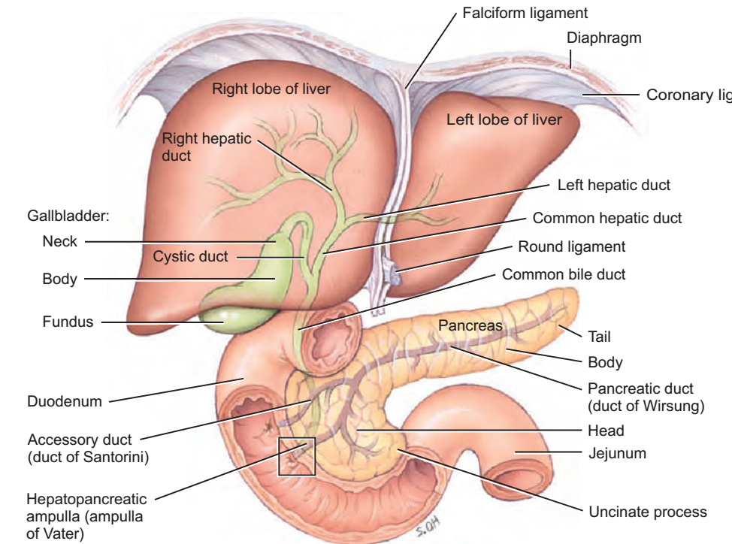
Liver, Gallbladder & Pancreas

Slide 11
Large intestine, Rectum & Anus

Slide 12
Absorption

Slide 13
Break!

Slide 15
ASSESSMENT OF THE GIT₁
HISTORY
Changes in bowel habits
Evaluate dietary pattern and fluid intake.
Weight loss or gain.
Pain.
Nausea and vomiting.
Presence or problems with flatulence.
Medication history.
Previous GI related surgeries.

Slide 16
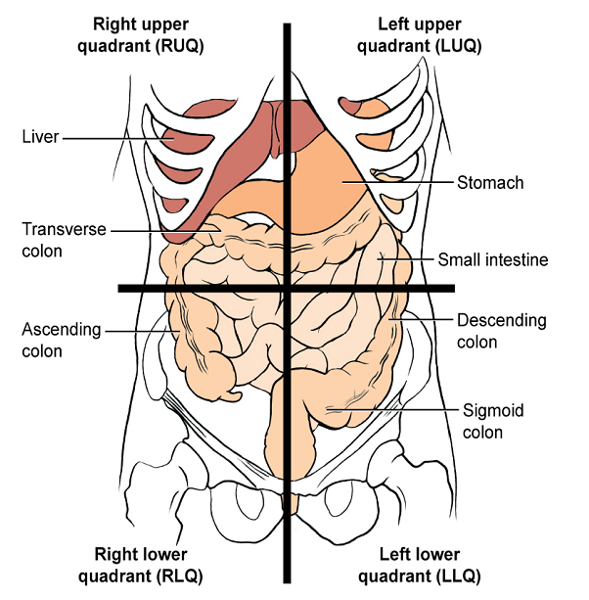
ASSESSMENT OF THE GIT₂
PHYSICAL EXAMINATION
Vitals & general condition
Pain
Oral cavity
Abdomen
Inspection: flat; round; distended
Auscultation-listen b4 you touch!
bowel sounds
Absent, hypoactive,
active, hyperactive.
Percussion: air? fluid?
Palpation: shallow; deep
Rectal & anal area
Notes:
Vitals & general condition.
Presence & characteristics of pain.
Mouth
Abdomen (client lying flat)
Inspection: flat; rotund; distended
Auscultation-listen before you touch!
bowel sounds 4 quadrants
Absent, hypoactive, active, hyperactive.
Percussion: air? fluid?
Palpation: shallow; deep
Rectal and anal area

Slide 17
Regions of the Abdomen
Video on Assessing the Abdomen
Part 1part5.flv
Part 2 part6.flv

Slide 18
COMMON MANIFESTATIONS OF GIT DISORDERS
ABDOMINAL PAIN
Unpleasant sensory/emotional experience associated with actual or potential tissue damage
Character, duration, pattern, frequency, location, & distribution vary depending on cause.
Meals, defecation, rest, & vascular disorders, may affect the pain.
Notes:
ABDOMINAL PAIN
Unpleasant sensory/emotional experience associated with actual or potential tissue damage
A major GI symptom.
Character, duration, pattern, frequency, location, & distribution vary depending on the underlying cause.
Other factors such as meals, defecation, rest, & vascular disorders, may directly affect this pain.

Slide 19
DYSPEPSIA/ INDIGESTION
Upper abd. discomfort associated with eating.
Most common complaint.
Bowel movements may or may not relieve pain.
Fatty foods tend to cause the most discomfort
Also course vegetables & highly seasoned foods
Notes:
Upper abdominal discomfort or distress associated with eating.
Most common complaint.
Bowel movements may or may not relieve pain.
Fatty foods tend to cause the most discomfort, remain longer
Course vegetables & highly seasoned foods can also cause considerable distress

Slide 20
INTESTINAL GAS
The accumulation of gas in the GIT
May result in belching or flatulence.
Belching:- swallowed air expelled from stomach.
Gases in the small intestines pass down as flatus.
Flatulence can be sign of gallbladder disease or food intolerance
Notes:
INTESTINAL GAS
The accumulation of gas in the GIT
May result in belching or flatulence.
It is through belching that swallowed air is quickly expelled when it reaches stomach.
Usually, gases in the small intestines pass into colon & are released as flatus.
Flatullence may be a sign of gallbladder disease or food intolerance

Slide 21
NAUSEA & VOMITING; HEMATEMESIS
Vomiting is usually preceded by nausea
Triggers:- odors, activity, or food intake.
Vomitus, may vary in colour/content.
With undigested food particles or blood (hematemesis).
Red: vomiting soon after hemorrhage
Coffee ground: blood retained in the stomach.
Fecal odor:- back-flow of intestinal contents into stomach
Notes:
NAUSEA & VOMITING; HEMATEMESIS
Vomiting is usually preceded by nausea
Can be triggered by odors, activity, or food intake.
Vomitus, may vary in colour & content.
May contain undigested food particles or blood (hematemesis).
Red: when vomiting occurs soon after hemorrhage
Coffee ground appearance: if blood has been retained in the stomach; action of the digestive enzymes.
Fecal odor:- back flow of intestinal contents into stomach

Slide 22
CHANGE IN ELIMINATION PATTERN
May signify colon disease.
Diarrhoea: abnormal increase in the frequency & liquidity of stool or in daily stool weight/volume.
May be associated with abd. pain, cramping & nausea or vomiting.
Constipation: decrease in the frequency of stool or stools that are hard, dry & of smaller volumes.
May be associated with anal discomfort & rectal bleeding.
May involve:-
Straining
Incomplete evacuations
Hard stools
<3 bowel movements per week.
(EASE, CONSISTENCY, FREQUENCY)
Notes:
CHANGE IN ELIMINATION PATTERN
Change in bowel habits may signify colon disease.
Diarrhoea: abnormal increase in the frequency & liquidity of stool or in daily stool weight or volume.
Sometimes associated with abdominal pain or cramping & nausea or vomiting.
Constipation: a decrease in the frequency of stool or stools that are hard, dry & of small volumes than normal. May be associated with anal discomfort & rectal bleeding.
Note:
According to a more specific definition, constipation is the presence of more than one of the following conditions for at least three months: • According to a more specific definition, constipation is the presence of more than one of the following conditions for at least three months: • Straining with bowel movements more than 25% of the time. • Hard stools more than 25% of the time. • Incomplete evacuations more than 25% of the time. • Fewer than three bowel movements per week.

Slide 23
CONT…
Normal:-light to dark brown.
Tarry black(malena):- upper GI bleeding
Bright/dark red:- lower GI bleeding.
Blood streak on stool surface:- lower rectal or anal bleeding.
Light grey/clay-coloured:- no urobilinogen.
Small rock-hard (scybala):- constipation
Notes:
CONT…
Normal stool colour is light to dark brown.
Tarry black colour (malena):- upper GI bleeding
Bright or dark red:- lower GI bleeding.
Blood streak on the surface of stool/toilet tissue:- lower rectal or anal bleeding.
Light grey or clay coloured:- absence of urobilin.
Small rock-hard masses (scybala); sometimes streaked with blood from rectal trauma as they pass through the rectum.

Slide 24
DYSPHAGIA
Difficulty in swallowing
Commonest symptom of esophageal disease.
Vary from feeling of food bolus caught in the throat, to painful swallowing (odynophagia).
soft or even liquid food obstruction may occur.
Often pt. can locate the problem ie. upper, middle, or lower 3rd of the esophagus.
Notes:
DYSPHAGIA
Difficulty in swallowing
Most common symptom of esophageal disease.
May vary from uncomfortable feeling of food bolus caught in the throat, to acute pain on swallowing (odynophagia).
soft & solid or even liquid food obstruction may occur anywhere along the esophagus.
Often the pt can indicate if the problem is located in the upper, middle, or lower 3rd of the esophagus.

Slide 25
.
DISORDERS OF THE ESOPHAGUS
Achalasia
Cancer of the esophagus
Gastro-esophageal reflux disease (GERD)

Slide 26
ACHALASIA
Absent or ineffective peristalsis of distal esophagus accompanied by failure of the cardiac sphincter to relax during swallowing.
Leads to gradual dilation of the esophagus in the upper chest.
RISK FACTORS
Cause unknown
Age over 40 years
Family history of achalasia

Slide 27
MANIFESTATIONS
Difficulty in swallowing both liquids & solids.
Sensation of food stack in the lower esophagus.
Food regurgitation.
Chest pain & heartburn (pyrosis) with or without eating.
Secondary pulmonary complications from aspiration of gastric contents.

Slide 28
DIAGNOSIS
X-ray studies: e.g. Barium swallow.
Endoscopy
Manometry (confirmatory test): esophageal pressure is measured by a radiologist or gastroenterologist.
Notes:
Barium swallow; show esophageal dilation above the narrowing at gastroesophageal junction.

Slide 29
MANAGEMENT
To eat slowly & drink fluids with meals.
Calcium channel blockers & nitrates ( to ⬇esophageal pressure & improve swallowing).
Injection of botulinum toxin via endoscopy to inhibit contraction of smooth muscles
Pneumatic (forceful) dilation or surgical separation of the muscle fibers
Esophagomyotomy
Esophageal muscle fibers separated to relieve stricture.
Follow-up with esophagoscopy to R/O esophageal ca.
Notes:
Esophageal perforation signs:- (abdominal tenderness, fever, leukocytosis, & severe hypotension, signs of pneumothorax)
To eat slowly & drink fluids with meals.
Calcium channel blockers & nitrates ( to decrease esophageal pressure & improve swallowing).
Injection of botulinum toxin via endoscopy to inhibit contraction of smooth muscles
Pneumatic (forceful) dilation or surgical separation of the muscle fibers
Esophagomyotomy

Slide 30
GASTRO-ESOPHAGEAL REFLUX DISEASE (GERD)
Back-flow of gastric or duodenal contents into the esophagus.
Gastric acid inflames esophageal mucosa.
Hiatal hernia; presents with same symptoms as GERD; same management
AETIOLOGY
Medications like, bronchial inhalers
Incompetent lower esophageal sphincter.
Pyloric stenosis
Amotility disorder
Lifestyle factors: obesity, smoking, excess alcohol intake, high fat diet, spicy food.
Common in clients with chronic respiratory problems.

Slide 31
CLINICAL MANIFESTATIONS
Pyrosis: burning sensation in the esophagus
Dyspepsia (indigestion)
Regurgitation
Dysphagia or odynophagia
Hypersalivation
Esophagitis
DIAGNOSIS
12 to 36hr esophageal pH monitoring.
Endoscopy i.e esophagoscopy
Barium swallow.

Slide 32
MANAGEMENT
Modify diet:
Avoid highly seasoned foods and tomato products.
Eat frequent, small meals (4 to 6 daily).
Avoid carbonated beverages, alcohol & caffeine.
Avoid any other food that precipitates discomfort (e.g., fats, chocolate).
Low fat, high fiber diet.
Eat more than 2 hrs before bedtime
Avoid tobacco; nicotine decrease sphincter tone.
Avoid tight clothing
Maintain normal body weight.
Elevate head of bed on15-20cm blocks.
Medications:
H2 receptor antagonist (e.g. cimetidine),
PPIs (e.g. omeprazole),
Antacids (e.g aluminum hydroxide),
Prokinetics (e.g. domperidone)
Surgery ie. laparascopic fundoplication

Slide 33
CANCER OF THE ESOPHAGUS
Commonly squamous cell carcinoma & less commonly is adonocarcinoma.
Can occur at any level; common at gastroesophageal junction.
AETIOLOGY/RISK FACTORS
About 60 yrs of age
Deficiencies of trace elements & vitamins
Malnutrition
Alcoholism & smoking
Reflux esophagitis (heartburn, dyspepsia)
Sliding hiatal hernia

Slide 34
CLINICAL MANIFESTATIONS
Two main
Chest pain; commonly heartburn (pyrosis)
Dysphagia & odynophagia- may radiate posteriorly between the scapulae
Others:
Ulcerated throat lesions
Feeling of a mass in the throat
Regurgitation of undigested food with foul breath.
Progressive weight/energy loss.
Respiratory difficulty
Persistent hiccups

Slide 35
ASSESSMENT & DIAGNOSTIC FINDINGS
Esophagogastroduodenoscopy (EGD) with biopsy
Bronchoscopy (for middle or upper 3rd) tracheal involvement & if lesion can be removed.
Mediastinoscopy: determine spread to the nodes & mediastinal structures.

Slide 36
MED-SURG MANAGEMENT
Early diagnosis has better prognosis.
In late stages, symptom relief is only reasonable goal.
Tx may include surgery, radiation, chemo, or a combination.
Esophagectomy: total removal of the tumor plus tumor free area of the esophagus plus associated lymph nodes.
Surgical resection: has high mortality because of infection, pulmonary complications, or leakage.

Slide 37
NURSING MANAGEMENT
Improve pts nutritional & physical condition in prep. for surgery, radiation therapy, or chemotherapy.
High caloric & high protein diet, liquid or soft.
Pre-op teaching: on post-op equipment i.e closed chest drainage, NG suction, IV fluid therapy, & gastrostomy.

Slide 38
Immediate post-op care (for thoracotomy)
When fully awake, position in a semi-fowlers then fowlers to prevent reflux.
Observe for regurgitation & dyspnea
NGT should not be manipulated to note dislodging.
Mark NGT position.
Close monitoring until x-ray confirms the anastomosis is secure & not leaking.
Palliative care to keep the esophagus open, to assist with nutrition, & to control saliva.
If graft has been fixed check viability hourly at least for 1st 12 hrs:- colour & pulse (doppler ultrasonography)

Slide 39
Later post-op
NG is removed after 5 to 7 days.
Barium swallow is performed before pt feeds
Small sips of water, later small amounts of food.
With adequate feeds, parental feeds are discontinued.
Food should be well-chewed to avoid blockage.
Remain upright at least for 2hrs of feeding.
Involve family to bring favorite foods.
Educate on nutrition; observations to be made; dealing with complications; and access to physical & emotional support.

Slide 40
COMPLICATIONS
Infection
Pneumonia —aspiration
Bleeding
Obstructed oesophagus
Atrial fibrillation due to esophageal irritation

Slide 41
.
DISORDERS OF THE STOMACH AND DUODENUM
Gastritis
Peptic Ulcer Disease (PUD)
Cancer of the Stomach

Slide 42
GASTRITIS
Inflammation, irritation of the gastric mucosa/lining of the stomach
Could be acute, few days, or chronic, with recurring episodes
AETIOLOGY
Food poisoning- vomiting/irritation
Highly seasoned food
NSAIDs- reduce HCL increasing pH, destroys barrier
Bile reflux-erosion from back flow of bile-incompetent valves
Excessive alcohol- reduce gastric mucosal flow
H. pylori inhabits the mucosa, infection cause ulcers –increase mucosal permeability
Stress
Pernicious anemia

Slide 43
PATHOPHYSIOLOGY
The gastric mucosa becomes edematous with hyperemia & undergoes superficial erosion following irritation by , gastric atrophy, alcohol, drugs-damage to mucosa allow ingested bacteria to become invasive
Secretion of scanty amount of gastric juice, with very little acid but more mucus (HCL prevent growth of bacteria due to low pH).
Superficial ulceration may occur & may bleed.
Pt presents with severe pain, tenderness, vomiting
In chronic; continued deterioration & atrophy with loss of function of parietal cells.
Inadequate intrinsic factor hence inability to absorb vit. B12.
Notes:
Hyperemia:- congestion with fluid & blood

Slide 44
CONT….
Chronic Gastritis appears in 3 forms.
a. Superficial gastritis: reddened edematous mucosa with small erosion & hemorrhage.
b. Atrophic gastritis: all gastric layers involved;
decreased number of parietal & chief cells; associated with gastric ulcer & gastric ca.
c. Hypertrophic gastritis: dull & nodular mucosa with irregular, thickened, or nodular ruggae; frequent hemorrhages.

Slide 45
Qiz
Name 3 forms of chronic gastritis
Vitamin B12 deficiency is associated with _________ anaemia
In gastritis there is:
Hypersecretion of HCl
Hyposecretion of HCl

Slide 46
CLINICAL MANIFESTATIONS
ACUTE GASTRITIS
Abdominal discomfort/ epigastric tenderness with nausea and vomiting
Headache
Lassitude (weariness; exhaustion)
Nausea, anorexia, vomiting & hiccups
Some pts are asymptomatic
Bloating , diarrhoea
CHRONIC GASTRITIS
Symptoms of vitamin B12 deficiency (anaemia)
Anorexia, heartburn after eating, belching
Sour taste in the mouth
Nausea & vomiting

Slide 47
ASSESSMENT & DIAGNOSIS
Endoscopy of gastric mucosa & biopsy-cause
Upper GI x-ray series (Barium swallow)-thickened mucosa and folds
H. pylori antigen or antibody serology
Stool examinations of occult blood-H.PYLORI
History and p/examination

Slide 48
Classification
Acute
- Sudden-painful inflammatory swelling
May be presided by mucosal bleeding
May be initiated by H. pylori
Subsides in 24 hours
Chronic
Long term swelling of mucosal lining
Cause may be H.pylori
Erosive
- Erosion of gastric lining, cause unknown

Slide 49
MED-SURG MANAGEMENT
Eliminate cause
H2 receptor antagonists to maintain pH of gastric content above 4-reduce inflammation-ranitidine
Sulcrafate-mucosal barrier-to protect damaged mucosa
Antibiotics- triple therapy-clarithromycin, amoxicillin, metronidazole, furazolidone. Include omeprazole or ranitidine
Proton pump inhibitors- omeprazole
Supportive therapy i.e. analgesic, sedation, antacids & intravenous infusions
Vitamins and iron supplements
Surgery:- failed medical Tx or hemorrhage; to remove gangrenous or perforated tissue.

Slide 50
NURSING MANAGEMENT
Goal of management:
Reduce anxiety
Relieve pain.
Promoting fluid balance
Promote optimal nutrition.
Enhance knowledge

Slide 51
Pain reduction
Encourage rest during acute phase-minimize exacerbation
Encourage relaxation techniques-breathing-to decrease muscle tension, increase sense of control and coping abilities
Administration of prescribed ant inflammatory drugs
Proton pump inhibitors, and h2 receptor antagonists

Slide 52
COMPLICATIONS
Bleeding
Pernicious anemia
Gastric cancer

Slide 53
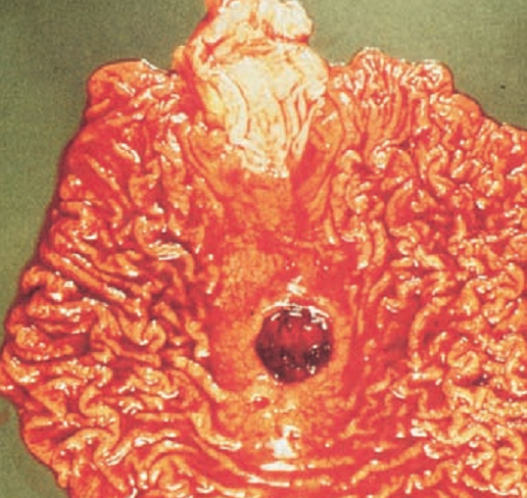
PEPTIC ULCER DISEASE (PUD)*
A peptic ulcer is a break/ulceration in the protective mucosal lining of the lower oesophagus, stomach or duodenum.
Also; erosion of the GI mucosa by HCl & pepsin.
Locations include: lower esophagus, stomach, pyloric channel & duodenum.
Post-op ulcers can occur near sites
of surgical anastomosis.

Slide 54
AETIOLOGY
H. pylori, gram –ve bacterial infection (causes 80% of gastric, 90% of duodenal ulcers)
Medication that alter gastric mucosa & secretions eg NSAIDs.
Increased physical stress (trauma, surgery, hepatic & biliary diseases)
Psychological stress (duodenal ulcers), adrenaline
Smoking, alcohol-increase effects of H.pylori, alters protective mechanism, decrease gastric blood flow
Zollinger Ellison Syndrome (gastrin secreting tumour, gastrinoma, of the panceatic islets resulting in hypersecretion of gastric acid.

Slide 55
TYPES OF PEPTIC ULCER DISEASE
Duodenal (most common)
Gastric
COMPARISON: DUODENAL vs GASTRIC ULCER
DUODENAL ULCER | GASTRIC ULCER
1. Incidence age 30-60 years | 1. Incidence age ≥50 years
2. Hypersecretion of HCl | 2. Normal secretion of HCl
3. May have weight gain | 3. May have weight loss
4. Pain occurs 2-3 hrs after a meal | 4. Pain occurs ½-1hour after a meal
5. Awakened by pain 1-2am | 5. Pain rarely occurs at night
6. Pain relieved by ingestion of food | 6. Food ingestion does not help
7. Vomiting uncommon | 7. Vomiting common
8. Hemorrhages less likely | 8. Hemorrhage more likely

Slide 56
PATHOPHYSIOLOGY
Lining of stomach, pylorus, duodenum, esophagus is eroded
Histamine release occurs with gastric mucosa erosion in both cases.
H. stimulates further secretion of gastric acid & mucosal edema.
Continued erosion damages blood vessels, hence hemorrhage or erosion through gastric mucosa.
Mucosal damage decreases bacterial resistance/unable to secrete adequate mucus to act as barrier against HCL
Bacterial colonization of ulcer makes the healing difficult.
Rapid gastric emptying combined with acid hypersecretion creates a large amount of acid moving into duodenum-duodenal ulcers--commonest

Slide 57
CLINICAL MANIFESTATIONS
Pain, burning in high left epigastric region-gastric/more pain with food ingestion or 1-2 hrs post
Doudenal-cramping/burning pain in mid epigastrium or upper abdominal area-2-4 hrs after meals or in middle of night-relieved by antiacids/meals
Nausea & vomiting-both
Significant weight change.
Bleeding; from vessel erosion.
Pyrosis-burning sensation in chest due to gastroesophageal reflux
Constipation or diarrhea due to diet & medication.
Notes:
Pyrosis; burning sensation in the esophagus & stomach that move up to mouth, occasionally with sour eructation (burping).

Slide 58
ASSESSMENT AND DIAGNOSTIC FINDINGS
A physical examination:- pain, epigastric tenderness, or abdominal distention.
A barium study:- ulcer
Stools for occult blood
H. pylori:- an IgG antibody detection test
Biopsy for campylobacter-like orgs/histopathology-esophagodoudenoscopy
Urea breath test-urea is metabolized rapidly by H.pylori

Slide 59
MED-SURG MANAGEMENT
Goals: Eradicate H. pylori and Manage gastric acidity.
Methods: Pharmacotherapy, Lifestyle changes, and Surgery.

Slide 60
Pharmacotherapy
Combination of Antibiotics, PPIs, and Bismuth salts to suppress or eradicate H. pylori.
Recommended therapy for 10 to 14 days:
Triple therapy:
Two antibiotics (eg, Metronidazole or Amoxicillin and Clarithromycin)
PLUS
PPI (eg, Omeprazole)
OR
Quadruple therapy with two antibiotics (Metronidazole and Tetracycline) plus a PPI and Bismuth salts.

Slide 61
Ulcer Healing Drugs
Histamin H2-receptor Antagonist--Block the action of histamine on the H2 receptors reducing HCl secretion and enhancing ulcer healing.
Ranitidine_150mg BD or 300mg bedtime
Cimetidine_400mg BD or 800mg bedtime
Therapy:- 6wks for duodenal & 8wks for gastric ulcers
Proton Pump Inhibitors - Block the ATPase enzyme important for the secretion of gastric acid
Examples:
Omeprazole 20mg OD
Esomeprazole 40mg OD
Therapy:- 4wks for duodenal & 6wks for gastric ulcer
Notes:
Famotidine_20mg BD or 40mg bedtime
Nizatidine_150mg BD or 300mg bedtime
lansoprazole30mg OD
Rabeprazole 20mg OD

Slide 62
Other Drugs
Antacids- Decrease gastric acidity and acid content of chime/stregthens gastric mucosal barrier
Cytoprotective drugs- e.g. sucralfate- accelerate healing/forms a sticky gel and adheres to ulcer surface, forming a protective barrier
Colloidal bismuth salts- facilitates ulcer healing; partially effective against H. pylori infection.
Misoprostol- a Prostaglandin with protective and anti -secretory effects on gastric mucosa.

Slide 63
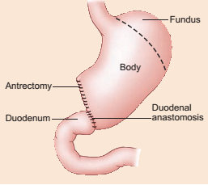
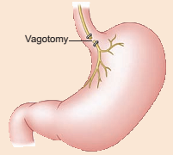
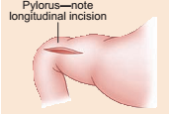
Surgical Interventions
Partial gastrectomy: removal of major portion of the stomach (antrum & pylorus) with anastomosis to duodenum or jejunum.
Vagotomy: one or more branches of the vagus nerves is removed to reduce rate of gastric secretion
Pyloroplasty: relieving pyloric stenosis for easy passage of stomach contents into the duodenum.

Slide 64
COMPLICATIONS
Hemorrhage
Perforation of ulcer into the peritoneal cavity
Sudden, severe, diffuse, upper abdominal pain
Pyloric obstruction
Generalized upper abdominal pain; relieved by vomiting
Increased bowel sounds
Dumping syndrome: in up to ½ of gastrectomy patients.
Epigastric fullness
Feeling of faintness and sweating after meals
5. Gastric cancer
Notes:
1. Hemorrhage
a). Hematemesis, malena or both
b). Hypovolemic shock
2. Perforation of ulcer into the peritoneal cavity
Sudden, severe, diffuse, upper abdominal pain
Abdominal muscles contract as abdomen becomes rigid
Bowel sounds are absent
Respirations become shallow & rapid
Severity of peritonitis is proportional to size of perforation & amount of gastric spillage.
3. Dumping syndrome: affects up to half of gastrectomy patients.
a). Epigastric fullness
b). Feeling of faintness and sweating after meals

Slide 65
Nursing process
Goal of mx
Pain mx
Knowledge enhancement
Injury prevention
Maintain nutritional status
Alley anxiety
Improve /maintain coping-d’se chronicity

Slide 66
GASTRIC CANCER
May occur in any portion of the stomach & are adenocarcinoma.
Commonest in the body & antrum
Poor prognosis in cardia & fundus.
Metastasis by direct extension to adjacent organs/structures (esophagus, spleen, pancreas, liver, duodenum).
Lymphatic metastasis occurs later.
Notes:
3rd most-common GI malignancy after oesophageal & colorectal

Slide 67
RISK FACTORS
Alcohol consumption, Tobacco
Pernicious anemia
Atrophic gastritis and gastric ulcers,
Male gender,
H pylori
Family Hx
Peak incidence at age 50-70yrs.
Diet high in smoked fish and meat

Slide 68
CLINICAL MANIFESTATIONS
Maybe asymptomatic in early stages, till metastasis-s/s mistaken for pud
Presence of a palpable mass in the stomach, ascitis or bone pain from metastasis may be first symptom.
2. Early symptoms
Loss of appetite; persistent indigestion
Nausea & vomiting
Blood in stool
Late symptoms
Pain; often exacerbated by eating
Weight loss
GI obstruction & hemorrhage

Slide 69
DIAGNOSIS
Gastroscopy-tumor
Upper GI x-ray examination
Gastric fluid analysis
Serum gastrin levels
CT scan abdomen and pelvis-metastasis

Slide 70
MED-SURG MANGEMENT
Removal of tumor while still localized in the stomach.
(Sub)total gastrectomy with anastomosis and lymphadenectomy.
Chemotherapy:- for control or palliation.
Assessment of tumor markers to assess effectiveness of rx.
Palliative care; symptom mx
Perforation & gastric outlet obstruction; managed surgically
Notes:
Anastomossis to jejunum.

Slide 71
NURSING INTERVENTION
Manage anxiety
Promote optimal nutrition
Address anorexia: small, frequent balanced diet
Foods high in calories, vit. A & C & iron.
If not eating enough TPN may be necessary.
Assess hydration status; rehydrate.
For gastrectomy observe for dumping syndrome (epigastric fullness & feeling of faintness & sweating after meals).
6 small feeds daily with water between feeds.

Slide 72
Relieving pain: position changes, distraction, backrubs, periods of rest, analgesics.
Provide psychosocial support in anticipatory grieving
Help the patient express fears, concerns, & grief about the diagnosis.
Involve family members, clergy, social worker, psychologist.
Teach self care: depending on Tx. modality.
Diet & nutrition,
Tx regimens,
Activity & lifestyle changes,
Pain management,
Possible complications (perforation, obstruction).
Notes:
N/B Most pts will begin to participate in self-care activities when they have acknowledged their loss.
By the time patients have symptoms, the disease is advanced and incurable. Tx is palliative

Slide 73
Post operative Mx of gastric Surgery
Gastrectomy
Injury prevention-bleeding
Vital signs
Incision site for bleeding
Monitor drainage from NGT for color and amount
Avoid repositioning the NGT to prevent trauma on suture line
Measure abdominal girth and assess for distension
Pain mx
Analgesics
Splinting when coughing
Positioning-semi fowler’s
Deep breathing/coughing exercises

Slide 74
Post operative Mx of gastric Surgery
Gastrectomy
Maintain nutritional status
NPO-24-48 hrs till bowel sounds return
IVF to meet caloric needs/or TPN
After removal of NGT, full fluids, then soft foods, gradual introduction to prevent regurgitation
Enhance pt knowledge
Incisional care/early ambulation and activity/dietary restrictions
Infection prevention

Slide 75
Gastrectomy
Complications
Hemorrhage- dislodged clot at site/slippage of suture
Gastric distension- clogged NGT/failure to insert NGT
Pernicoius anemia- vit B12 deficiency in total G-lack of intrinsic factor- needs lifelong injection of vit b12
Steatorrhea- excessive fat in stool-rapid gastric emptying- reduce fat intake
Pyloric obstruction-scarring, edema,
Dumping syndrome- rapid entry of food into jejunum without proper mixing with digestive juices

Slide 76
.
DISORDERS OF THE PERITONEUM &
INTESTINES
Peritonitis
Appendicitis
Intestinal obstruction
Cancer of the colon
Hernia
Ulcerative colitis
Diverticulitis

Slide 77
PERITONITIS
Generalized inflammation of the peritoneal cavity usually from intra-abdominal infection.
RISK FACTORS
Abdominal trauma
Perforated peptic ulcer
Anastomotic leak following surgery
Strangulated bowel
Ruptured appendix-commonest
Pancreatitis
Gangreneous gallbladder
Incercerated hernia
Gangreneous small bowel
Peritoneal dialysis
Ascending infection: e.g. salpingitis and postpartum infection.

Slide 78
PATHOPHYSIOLOGY
Trauma, ischemia, or tumor perforation in any abdominal organ causes leakage of the organ’s contents into the peritoneal cavity
Inflammation of tissues occur from the leakage. Become edematous, and begin leaking fluid containing increasing amounts of blood, proteins, cellular debris, and WBCs
GI responds with hypermotility, then paralysis (paralytic ileus), with an accumulation of air & fluid in the bowel.

Slide 79
CLINICAL MANIFESTATIONS
Presence of precipitating cause e.g. appendicitis
Pain, tenderness, guarding; worsens on movement or coughing
Abdominal distention
Abdominal muscle rigidity.
Unexplained persistent or labile fever-infection
Anorexia, nausea, & vomiting-decreased peristalsis
Increased pulse, reduced BP, shallow respiration.
Decreased or absent bowel sound-decreased peristalsis
Hypovolemia, dehydration
Shallow respiration in attempt to avoid pain.

Slide 80
DIAGNOSTICS
CBC- elevated WBCs
Abdominal U/S
Abdominal x-ray
Contrast CT Scan
Paracentesis

Slide 81
MED-SURG MANAGEMENT
Insert a NGT with low intermittent suction for gastric decompression- relieve distension
NPO due to impaired peristalsis
Identify & treat precipitating cause (may need surgery)-excise/drain/repair
Antibiotics:- Ampicillin 2 g IV QID, Gentamicin 5mg/kg OD plus Metronidazole 500 mg IV TDS-prevent septicemia
Analgesics.
IV fluids; fluid & electrolyte replacement- hypovolemia
O₂ therapy with resp. distress:-abdominal pressure.

Slide 82
Medical-surgical mx
Ostomy to divert feces to allow resolution of infection
Catheterisation/NGT/wound drain after surgery
Nursing Process
Goal of mx
= pain mx- narcotics/positioning-semi-fowler’s/diversion and relaxation exercises
= maintain body fluid volume-IVF/antemetics/input-output/monitor s/s of dehydration

Slide 83
Nursing process--
Injury prevention-resp. complications; coughing and breathing exercises/oxygen therapy/monitor output from drainage-color.vol.odour/maintain patent NGT/frequent oral care
Maintain nutritional status- TPN if pt is NPO/IVF/daily weighing
Improve pt knowledge
Alley pt anxiety

Slide 84
NURSING MANAGEMENT
On-going assessment of pain, vital signs, GI function & fluid & electrolyte balance.
Maintain gastric decompression.
Maintain IV fluids replacement
Evaluate peristalsis & return of bowel function
Administer analgesics and antibiotics
Semi-fowlers position to enhance respirations, localize drainage & prevent sub diaphragmatic abscess.

Slide 85
COMPLICATIONS
Sepsis
Shock (septic or hypovolemic)-fluid shift from circulation to abdomen
Intestinal obstruction from inflammatory process (bowel adhesions).
Post-op: wound evisceration, dehiscence, & abscess formation.
Intra-abdominal organ failure

Slide 86
APPENDICITIS
Inflammation of the appendix.
A common disorder in the five to 30 years age group.
Cause is not clear but related to obstruction or twisting of appendix- due to its small size
Obstruction usually results in inflammation due to increased intraluminal pressure
All layers inflamed.

Slide 87
RISK FACTORS
Age10-30 yrs old, rare in younger than 2 yrs
Diet: low fiber & refined carbohydrate diets.
Viruses: coxsackie virus B, adenovirus
Amoebiasis
Mumps
Bacterial Gastroenteritis
Barium ingestion

Slide 88
PATHOPHYSIOLOGY
The appendix becomes edematous as a result of kinking or occlussion (by a fecalith, tumor, or foreign body).
The inflammatory process increases intraluminal pressure, initiating a progressive, generalized, or peri umbilical pain (localizes to RLQ in a few hrs).
Inflamed appendix fills with pus.
It can result in gangrene and perforation.
Incase of perforation, peritonitis occurs.
Kinking/occlusion
Increased intraluminal pressure
Pain
Pus
Gangrene & perforation
Peritonitis may occur

Slide 89
CLINICAL MANIFESTATIONS
Upper abdominal pain & cramping (worsens with time).
Pain localised at RLQ at Mcburney’s point, midway btn umbilicus and right iliac crest-classic symptom
Anorexia, nausea, vomiting, constipation.
Elevated temp & pulse.
Slight abdominal muscle rigidity and guarding
Rovsing’s sing- pain in the RLQ when LLQ is palpated
Pt prefers keeping right leg flexed for comfort-intensity increase when streightened
With rupture, pain more diffuse with distention. Sudden pain relief may indicate rupture
Notes:
PAIN:- beginning near umbilicus toward McBurney’s point.

Slide 90
DIAGNOSTICS
Clinical examination—positive classic sign
CBC –elevated leukocytes and neutrophils
Ultrasound to identify inflamed appendix.
4. CT scan-enlargement in area of cecum

Slide 91
MED-SURG MANAGEMENT
To correct or prevent:- fluid+electrolyte imbalance, dehydration, and sepsis.
Emergency appendectomy
Antibiotics
IV fluids till surgery.
Avoid enemas/laxatives
Notes:
To correct or prevent fluid and electrolyte imbalance, dehydration, and sepsis; Antibiotics and IV fluids are administered until surgery is performed.
With perforation, an abscess may form. Initially Tx with antibiotics, and the surgeon may place a drain

Slide 92
NURSING INTERVENTION- appendicectomy
Pre-op
Injury prevention- NPO/IVF/vitals-r/o rupture
Prevention of septicemia- antibiotics
Pain mx-semi-fowler’s
Knowledge enhancement
Anxiety reduction
Post-op mx
Injury prevention-NGT/NPO to prevent vomiting and distension/early ambulation/coughing /breathing excercises
Infection prevention-vitals r/o peritonitis/antibiotics
Pain mx

Slide 93
Post-op
NPO
Gastric decompression by NGT.
Monitor abdomen for distention.
Assess peristalsis.
Evaluate character of bowel movements.
Semi-fowlers position; to localize infection
IV antibiotics
Analgesics.
Monitor vitals.
Appropriate wound care; evaluate drainage.
Maintain adequate hydration & nutrition.
Start oral fluids when peristalsis returns; progress diet as tolerated.

Slide 94
COMPLICATIONS
Peritonitis
Septicemia
Paralytic ileus
Subphrenic abscess
Pelvic abscess
Notes:
Subphrenic abcess(abcess under the diaphragm)

Slide 95
INTESTINAL OBSTRUCTION (IO)
Interference with normal peristalsis & impaired forward flow of intestinal contents.
Flow can be impeded by:
Mechanical- an intraluminal (mural) obstruction e.g intussusception, tumors, stenosis, strictures, adhesions, hernias, & abscesses.
Functional- intravascular or neural defect impairing peristalsis. e.g. amyloidosis, Parkinson's disease.
Notes:
Amyloidosis (metabolic disorder marked by deposition of amyloid(proteins) in organs & tissue),
Mechanical- an intraluminal (mural) obstruction e.g intussusception, tumors, stenosis, strictures, adhesions, hernias, & abscesses.
Functional- intravascular or neural defect imparing peristalsis. e.g amyloidosis, parkinson’s disease.

Slide 96
TYPES OF INTESTINAL OBSTRUCTION
Obstruction can be partial or complete
Small or large bowel obstruction.
AETIOLOGY
Small Intestine Obstruction
Adhesions:- commonest cause
Hernias
Neoplasms.
Intussusception
Volvulus
Paralytic ileus.

Slide 97
Large Intestine Obstruction
Mostly in the sigmoid colon.
Carcinoma,
Diverticulitis,
Inflammatory Bowel Disorders,
Tumors

Slide 98
There essentially are three common causes of IO
Intussusception; One segment of bowel invaginates/ telescopes into another.
Volvulus: twist of the intestine along its axis; mostly counterclockwise & affecting the sigmoid colon.
Hernia (inguinal). Protrusion of the intestine through an abnormal abdominal wall opening

Slide 99
CONT…
A
C
B

Slide 100
A. SMALL BOWEL OBSTRUCTION
PATHOPHYSIOLOGY
Accumulation of contents, fluid & gas above the obstruction.
Reduced absorption of fluids stimulates more gastric secretion.
Increased distention, with increased luminal pressure
Decrease venous return.
Edema, congestion, necrosis, & eventual rupture or perforation causing peritonitis.
Reflux may occur from the abdominal distention.

Slide 101
Pathophysiology of IO

Slide 102
CLINICAL MANIFESTATIONS
Crampy pain, colicky
Pass blood & mucus but no fecal matter & no flatus
Vomiting fecal matter
Vigorous peristaltic waves; turns reverse later.
Signs of dehydration e.g thirst
Distended abdomen
7. Dyspnoea
Note: If not corrected early shock occurs.

Slide 103
ASSESSMENT & DIAGNOSTIC FINDINGS
Clinical assessment
X-ray findings- abnormal accumulation of gas/fluid in the bowel.
CBC & electrolytes; reveal dehydration, plasma vol. loss, infection.

Slide 104
MED-SURG MANAGEMENT
NGT for decompression
Complete obstruction with possibility of strangulation warrants surgery.
For herniorrhaphy, release of adhesions.
Before surgery- IV replacement of fluids & electrolytes.

Slide 105
NURSING MANAGEMENT
Maintaining NGT,
Input-output; fluid & electrolytes assessment.
Monitor nutritional status
Assess improvement;
return of bowel sounds, decreased abdominal distention, reduced abdominal pain/tenderness, passage of flatus & stool.

Slide 106
B. LARGE BOWEL OBSTRUCTION
PATHOPHYSIOLOGY
Accumulation of contents, fluid & gas proximally.
Severe distention & perforation unless with backflow.
Undramatic if blood supply is not disturbed.
Dehydration is slower compared to small bowel
Notes:
Note: (colon can absorb its fluid content & can distended beyond its full normal capacity).

Slide 107
CLINICAL MANIFESTATIONS
Constipation; obstruction at sigmoid or rectal region
Distended abdomen
Visible loops of large bowel
Crampy lower abdominal pain.
Fecal vomiting
Manifestations of shock

Slide 108
DIAGNOSTIC FINDINGS
Clinical exam
Abdominal X-ray
MED-SURG MANAGEMENT
Colonoscopy to decompress/untwist.
Cecostomy to urgently relieve obstruction
Rectal decompression-tube.
Surgical resection
to remove the obstructing lesion
colostomy may be necessary.
ileoanal anastomosis may be done.
Notes:
Note: Barium studies contraindicated.

Slide 109
NURSING MANAGEMENT
Monitor for signs of worsening & prepare for surgery.
Emotional support & comfort
Monitor fluid & electrolyte balance, IV replacement.
General pre & post-op care for abdominal surgery.

Slide 110
HERNIA*
An abnormal protrusion of an organ or structure through the wall of the cavity normally containing it; the abdominal wall
ASSIGNMENT:
Read about Hiatal hernia
Axial or sliding hernia
Paraesophageal hernia
*Hiatal hernias excluded included
Notes:
1. Hiatal hernia: opening in the diaphragm through which the esophagus passes becomes enlarged, & part of the upper stomach tends to move up into the lower portion of the thorax.
i. Axial or sliding hernia: upper stomach & gastroesphageal junction are displaced upward & slide in & out of the thorax. It is the most common type of haital hernia 90%
ii. Paraesophageal hernia: occurs when all or part of the stomach pushes through the diaphragm next to the gastroesophageal junction.

Slide 111
TYPES OF HERNIA
Inguinal hernia: a weakness in which the spermatic cord in men & the round ligament in women passes through the abdominal wall into the groin area- indirect hernia
Umbilical hernia: common in obese women and children; umbilical opening fails to close adequately; or rectus muscle is weak.
Incisional/ventral hernia: due to weakness in the abdominal wall caused by a previous incision, esp. where drainage system was used-poor wound healing/inadequate nutrition/obesity

Slide 112
CLASSIFICATION OF HERNIA
Reducible: may be replaced into the abdominal cavity by manual manipulation.
Incarcerated (irreducible or imprisoned): can not be manipulated back into place, adhesions or edema occur btn the sac and contents, the hernia bowel is trapped and cannot be returned into the abdomen
Strangulated: blood supply & intestinal flow in the herniated area are obstructed, esp in incarcerated hernia

Slide 113
RISK FACTORS
Chronic cough-increased intra abdominal pressure with abdominal weakness-heavy lifting, straining
Obesity.
Straining during bowel movement
Lifting heavy objects.
Pregnancy.
Poor wound healing
= indirect hernias-caused by a defect of structural closure
= direct hernias- acquired , arise from a weakness in the abdl wall, e.g old incisional sites

Slide 114
CLINICAL MANIFESTATIONS
Hernia protrudes over involved area when pt stands or strains.
Severe pain occurs if hernia becomes strangulated.
Strangulated hernia occurs with symptoms of IO.

Slide 115
DIAGNOSTICS
History
Clinical features
MED-SURG MANAGEMENT
Elective surgery to prevent complications of strangulation (herniorrhaphy).
Strangulated hernia involves resection of the involved bowel.

Slide 116
NURSING MANAGEMENT- post operative
Inguinal hernia repair---
Male pt-swelling of scrotum-icepacks and elevation
Input/output
Assess for voiding/bowel sounds
Knowledge- s/s of infection-fever, drainage,redness
Avoid lifting for 2-6 weeks
Notes:
For repair of an indirect inguinal hernia: assess male pts for development of scrotal edema.

Slide 117
ULCERATIVE COLITIS
Recurrent ulcerative & inflammatory disease of the mucosal and submucosal layers of the colon & rectum.
Lesions spread throughout the large intestines.
High risk for colorectal cancer
RISK FACTORS
Infection
Allergy
Autoimmune response

Slide 118
PATHOPHYSIOLOGY
The mucosa becomes edematous and inflamed.
The lesions are continuous, occurring one after the other.
There are multiple ulcerations, diffuse inflammations, and shedding of epithelium.
Usually spreads proximally from rectum to involve the entire colon.
Bleeding may occur from ulcerations.
Eventually, the bowel narrows, shortens, and thickens from muscle hypertrophy & fat deposits

Slide 119
CLINICAL MANIFESTATIONS
Diarrhea, frequently bloody, fecal urgency
Abdominal pain with rebound tenderness.
Fever
Rapid loss of fluid & electrolytes-passing of 5-20 liquid stools /day-dehydration
Anorexia & weight loss.
Anemia & hypocalcemia-rectal bleeding/electrolyte imbalance
Notes:
Extra intestinal manifestations e.g uveitis, arthritis, skin leisions(erythema nodosum)
Diarrhoea: ; ussualy ≥20 stools per day.

Slide 120
DIAGNOSIS
Stool is positive for blood
CBC: low HCT and Hb levels; elevated WBC,
Low albumin levels, an electrolyte imbalance/malabsorption and liver dysfunction
Abdominal x-ray; barium enema —mucosal irregularities
Colonoscopy —inflamed, ulcerated mucosa
CT scan, MRI, and U/S

Slide 121
MANAGEMENT
High-protein, high-calorie diet with supplemental vitamin therapy and iron replacement
IV fluid therapy as necessary
Avoid foods that exacerbate diarrhea-milk, spices, caffeine
Avoid smoking/alcohol/cold foods- increase intestinal motility
Sedatives; antidiarrheal; immunosuppresants:- to rest the bowel
Aminosalicylates:-reduce inflammation
Corticosteroids for severe disease
Parenteral nutrition
Notes:
Smoking; cold foods can increase GI motility
MX aimed at reducing inflammation, suppressing innapropriate immune rsponses , providing rest for deceased bowel, improving quality of life, minimize complications

Slide 122
Surgery
Colectomy; colon is surgically removed
Total Procto-colectomy with ileostomy (ie, complete excision of colon, rectum, and anus)
Nursing Process
Impaired bowel elimination r/t inflammatory process
Imbalanced nutrition <body requirements r/t impaired absorption, reduced intake
Deficient fluid volume r/t increased loss through stool
Impaired comfort r/t acute pain sec to increased peristalsis
Impaired skin integrity r/t frequent loose stools
Ineffective coping r/t repeated episodes of diarrhoea

Slide 123
Nursing process
Impaired elimination
Pt proximity to washrooms/bedside commode/bedrest to reduce peristalsis/antdiarrheal drugs/avoid GI stimulants
Fluid deficit
Monitor for s/s/IVF/input and output/daily weights
Improve comfort
analgesics/diversional therapy
Skin integrity
- Dry skin/sitz baths/moisturizers after each stool

Slide 124
NURSING CARE
Adequate hydration
NPO to decrease bowel activity & oral fluids introduced gradually.
IV fluids; or parenteral alimentation
Evaluate electrolyte status.
Good skin hygiene
Antidiarrheal agents
Assess characteristics in patterns of stool.
Self care: small frequent meals; precautions for steroids; stress management
Dressings & wound care if fistula is present

Slide 125
COMPLICATIONS
Toxic megacolon (dilatation of the colon) inhibiting its contraction
Perforation
Bleeding; ulceration, vascular engorgement, vascularised granulation tissue.

Slide 126
DIVERTICULAR DISEASE
Diverticulum- an outpouching of the intestinal wall particularly the sigmoid colon
Diverticulosis- multiple diverticulum
Diverticulitis- inflammation of diverticula
Can be from food & bacteria or faecal contamination impeding drainage
RISK FACTORS
Low fiber diet; refined foods.
Male (40-45yrs)
Congenital weakness of muscle fibers of the intestine.
Chronic constipation

Slide 127
CLINICAL MANIFESTATIONS
Could be asymptomatic; if present, symptoms vary with degree of inflammation.
Intermittent LLQ tenderness, cramping.
Bowel irregularity with intervals of diarrhea.
Diverticulitis: fever, LLQ pain, usually accompanied by nausea & vomiting, abdominal distention, constipation or obstruction.
Perforation/abscess formation

Slide 128
DIAGNOSIS
Barium enema.
Sigmoidoscopy or colonoscopy
U/S or CT scan.
Stool examination
Abdominal x-ray

Slide 129
TREATMENT
Management of uncomplicated diverticulum.
High residue diet & fiber supplements.
Avoid laxatives & enemas.
Diverticulosis with pain
Liquid or soft diet
Stool softeners or mineral oil
Diverticulitis with perforation.
Hospitalized, NPO, with IV fluids
Antibiotics
Antispasmodics
Surgery for obstruction, hemorrhage or perforation.

Slide 130
NURSING CARE
Assist pt to understand need for
High fiber diet & avoid indigestable roughage such as nuts, popcorn, , corn & seeds.
Maintain high fluid intake.
Avoid large meals
Avoid alcohol
Weight reduction if indicated
Avoid activities that increase intra-abdominal pressure eg straining at stools, bending, lifting, tight clothing.
To decrease colon activities; in diverticulitis
Clear liquids or NPO
Bed rest
Adequate hydration via IV fluids
As attack subsides introduce oral fluids gradually

Slide 131
COMPLICATIONS
Peritonitis
Abscess formation
Bleeding
Bowel obstruction

Slide 132
COLORECTAL CANCER
One of the most prevalent types of internal cancer.
Highly curable when localized in the bowel.
Most common sites
Sigmoid colon— 20-30 %
Cecum & ascending colon— 20 – 30%
Rectum— 50%

Slide 133
RISK FACTORS
Age around 50yrs
Ulcerative colitis
High fat, low residue diet.
Family Hx.
Crohns disease
Immunosuppression
PATHOPHYSIOLOGY
95% adenocarcinoma (from epithelia).
May start as a benign polyp
May become malignant metastatize to surrounding structures. (often to the liver).
Notes:
Crohns disease (chronic recurrent granulomatous inflammation affecting any part of bowel)

Slide 134
CLINICAL MANIFESTATION
According to location, stage, & intestinal function.
Vague symptoms—early.
Change in bowel habits: constipation & diarrhoea with tenesmus
Change in shape of stool (pencil-or ribbon-shaped)
Weakness & fatigue.
Pain is a late symptom
Rectal bleeding or malena from ascending colon
Bowel obstruction
Notes:
Tenesmus: painfull straining to empty bowel or bladder

Slide 135
DIAGNOSIS
History, physical examination
Fecal occult blood
Double contrast barium enema
Sigmoidoscopy/colonoscopy; with biopsy for cytology
CT scan; chest, abdomen and pelvis

Slide 136
TREATMENT
Colon resection: may have resection with(out) a colostomy
Colostomy: surgical creation of an opening (stoma) into the colon. (temporally or permanent).

Slide 137
Types of colostomies
Ascending:- for right-sided tumors.
The transverse (double barreled):- often for emergencies (e.g IO, perforation); is quick.
There two stomas. The proximal one, closest to small intestine, drain feces. The distal stoma drains mucus. Usually temporary.
Transverse loop:- colostomy has two openings in the transverse colon, but one stoma usually temporary.
Descending colostomy
Sigmoid colostomy.
Notes:
Ascending colostomy: is done for right-sided tumors.
The transverse (double barreled) colostomy is often used emergencies (e.g IO, perforation); can be created quickly. There two stomas. The proximal one, closest to small intestine, drain feces. The distal stoma drains mucus. Usually temporary.
Transverse loop:- colostomy has two openings in the transverse colon, but one stoma usually temporary.
Descending colostomy
Sigmoid colostomy.

Slide 138
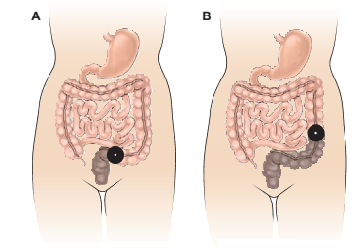
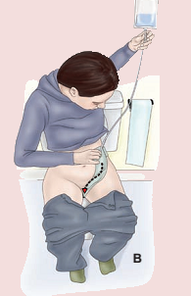
Colonoscopy
A, Sigmoid colostomy, the feces are formed.
B, Descending colostomy, the feces are semiformed.
C, Transverse colostomy, the feces are unformed.
D, Ascending colostomy, the feces are fluid.

Slide 139
NURSING MANAGEMENT
Pre-op care
Determine extend of surgery anticipated: colostomy not always required.
Bowel preparation: low residue diet, prophylactic antibiotics, enemas.
If colostomy is to be, discuss implications; prepare Pt. for change in body image.

Slide 140
Post-op care
Pt with 3 incisions; abdominal, perineal and area for colostomy
Perineal incision:- closed with a drain or left open to heal by secondary intention.
-irrigate the perineal wound.
- warm sitz bath.
Abdominal & perineal wounds need frequent dressings.
Perineal wound may heal after several months.
Position pt lateraly.

Slide 141
Assess healing and perform colostomy care
Measure stoma & select an appropriate sized appliance. Stoma will shrink after surgery.
Appliance should fit easily around the stoma & protect the skin.
Keep the skin around the stoma clean, dry from intestinal juices.
Prevent contamination of the abdominal incision.
Change the skin appliance only when it begins to leak or becomes dislodged.
Irrigate the colostomy same time each day to assist in establishing a normal pattern of elimination.
Involve pt in care as early as possible
For adults irrigate with 500-1000 mls of warm tap water
Assist control odor, use control tablets or diet
Educate on self-care and long-term care

Slide 142
DISORDERS OF THE RECTUM AND ANUS

Slide 143
HEMORRHOIDS (PILES)
Dilated portions of veins in the anus & rectum
RISK FACTORS
Pregnancy
Prolonged constipation
Prolonged standing or sitting
Portal hypertension (venous flow obstruction).
Obesity
Straining at bowel movement.

Slide 144
CLINICAL MANIFESTATIONS
Internal hemorrhoids occur above the internal sphincter, become congested, & are painful.
External hemorrhoids occur below or outside external sphincter, appear as protrusions at the anus.
Thrombosed hemorrhoids: a blood clot in a hemorrhoid that causes inflammation & pain
Rectal bleeding during defecation

Slide 145
Anal fissures & Hamorrhoids

Slide 146
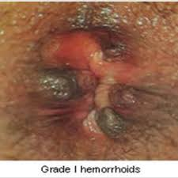
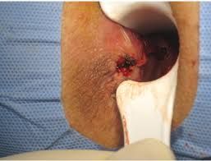
DIAGNOSIS
Rectal examination
MANAGEMENT
Conservative treatment
Sitz baths, stool softeners, ointments, topical anesthetics.
Diet high in fiber/roughage
Avoid straining with bowel movements
Aggressive treatment
Rubber ligation of internal hemorrhoids
Laser or infrared photocoagulation
Surgery for bleeding or thrombosed hemorrhoids.

Slide 147
NURSING CARE
Avoid prolonged standing or sitting
Sitz bath to decrease discomfort
Ointments to decrease discomfort
Ice pack, followed by a hot sitz bath
Avoid constipation & straining at stools.
Weight management
Proper diet.

Slide 148
ANORECTAL ABSCESS
Infection in the pararectal (close to rectum) spaces.
Immuno-suppressed people are more at risk.
SIGNS & SYMPTOMS
Foul-smelling pus.
Pain
Swelling
Redness
Tenderness

Slide 149
MANAGEMENT
Sitz baths & analgesics
I & D of abscess with gauze packing
If fistula is present , same is removed

Slide 150
ANAL FISTULA
A tiny, tubular, fibrous tract that extends into the anal canal from an opening located besides the anus.
RISK FACTORS
Infection
Trauma
Fissures
Regional enteritis (inflammation of intestine)

Slide 151
MANIFESTATIONS
Constant leaking of pus or stool from the cutaneous opening
Passage of flatus or feces from the vagina or bladder depending on the fistula tract.
Untreated fistulas may cause systemic infection.
MANAGEMENT
Fistulectomy: excision of the fistulous tract.
Enema pre-operatively to evacuate lower bowel thoroughly.
Pt comes from theatre with wound packed with gauze.

Slide 152
ANAL FISSURE
A longitudinal tear or ulceration in the lining of the anal canal.
RISK FACTORS
Passing a large, firm stool.
Persistent tightening of the anal canal secondary to stress & anxiety leading to constipation.
Child birth
Trauma
Overuse of laxatives.

Slide 153
SIGNS & SYMPTOMS
Extremely painful defecation
Burning sensation
Bleeding.
MANAGEMENT
Conservative
Stool softeners & bulk agents
High water intake
Sitz bath
Emollient suppositories
Anaesthetic & corticosteroid help relief the discomfort.
Anal dilation with excision of fissure under anesthesia.

Slide 154
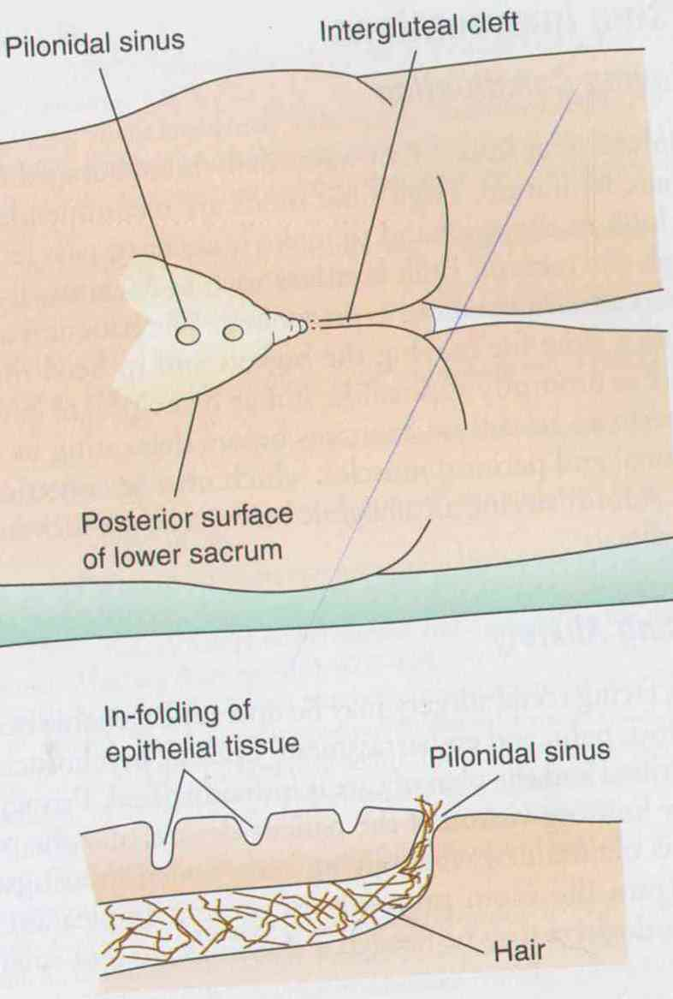
PILONIDAL SINUS/CYST
Found in the intergluteal cleft of the lower sacrum.
Results from local trauma, causing penetration of hairs into the epithelium
Can be congenital (infolding of epithelial tissue beneath the skin)
May have one or several small sinus openings on skin surface.

Slide 155
PRESENTATION
Are easily irritated by perspiration or friction.
Infection causes irritation or abscess.
TREATMENT
Antibiotics till abscess is formed then surgery (I & D).
After it resolves cyst & secondary sinus tract is excised.
Gauze dressing is put to keep edges separate as healing by granulation occurs.

Slide 156
POLYPS*
Masses of tissue that protrudes into bowel lumen.
Occur anywhere in the intestinal tract & rectum.
Most are benign
CLASSIFICATION
Neoplastic (denomas and carcinomas)
Non-neoplastic (mucosal and hyperplastic)
Adenomas commonly occur in the large intestines.
* Can occur anywhere

Slide 157
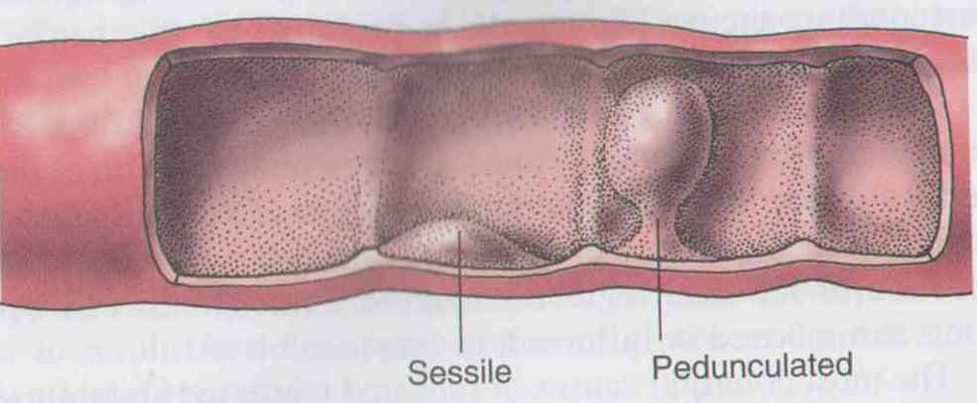
CLINICAL MANIFESTATIONS
Rectal bleeding
Lower abdominal pain
Obstruction
DIAGNOSIS
History & DRE
Barium enema studies
Sigmoidoscopy or colonoscopy.

Slide 158
MANAGEMENT
Surgery: Colonic polypectomy; with biopsy
Post-op (i.e anorectal region):
Position the Pt. comfortably e.g use air ring or side-lying.
Pain control
Sitz bath
Nutrition: high fiber, plenty of fluid diet
Promote voiding
Control anxiety.

Slide 159
LIVER CONDITIONS

Slide 160
JAUNDICE
A condition resulting when bilirubin concentration in the blood is abnormally elevated.
All the body tissues including the sclerae & the skin become yellow-tinged or greenish yellow.
Serum bilirubin must exceed 2mg/dL for jaundice to occur.

Slide 161
TYPES OF JAUNDICE
Hemolytic jaundice
Increased breakdown of RBC, which causes an increase in the amount of unconjugated bilirubin in the blood.
The liver can not handle the increased level of unconjugated bilirubin. The bilirubin is not water soluble; therefore it cannot be excreted.

Slide 162
LIVER CONDITIONS
Unconjugated bilirubin is lipid soluble & is capable of entering nerve cells & causing brain damage.
The increased production of urobilinogen will increase the amount of bilirubin excreted in the urine & feces.
Causes of hemolytic jaundice
Blood transfusion reactions.

Slide 163
LIVER CONDITIONS
Sickle cell crisis
Hemolytic anemia
Hemolytic disease of the new-born
Hepatocellular jaundice
Results from the inability of the damaged liver cells to clear normal amounts of bilirubin from the blood.

Slide 164
LIVER CONDITIONS
Increase in serum levels of unconjugated bilirubin.
Causes
a) Viral hepatitis A, B, C, D, or E.
b) Cirrhosis.
c) Hepatic cancer.

Slide 165
LIVER CONDITIONS
Obstructive jaundice
Results from an impediment to bile flow through the liver & the biliary system.
The obstruction maybe within the liver or outside the liver
Causes
Hepatitis
Liver tumors

Slide 166
LIVER CONDITIONS
Cirrhosis
Obstruction of the common bile duct by a stone.
Hereditary hyperbilirubinemia
Results from several inherited disorders.

Slide 167
LIVER CONDITIONS
HEPATITIS
Widespread inflammation of liver tissue is called hepatitis.
Viral hepatitis as a systemic, viral infection in which necrosis & inflammation of liver cells produce characteristic cluster of clinical, biochemical & cellular changes.
Five types of viral hepatitis have been identified hepatitis A, B, C, D, & E.

Slide 168
LIVER CONDITIONS
HEPATITIS A VIRUS (HAV) (INFECTIOUS HEPATITIS)
Mode of transmission
Carriers are most contagious just before onset of symptoms (jaundice).
Predominate route of infection is fecal-oral (food, water, & shellfish)
Other routes of infection are through sexual

Slide 169
LIVER CONDITIONS
contact & percutaneous transmission.
Incubation period: 7 to 10 days.
SIGNS & SYMPTOMS
Flue like symptoms
Low grade fever
Anorexia
Jaundice
Dark urine
Indigestion (nausea, heartburn, & flatulence)

Slide 170
LIVER CONDITIONS
Mortality rate is low, but there is an increase in fatalities in the geriatric population.
Administration of immune serum globulin (immunoglobin G) resistance &/or decreases to exposed individuals increases the immune severity of the illness (passive immunization).

Slide 171
LIVER CONDITIONS
HEPATITIS B VIRUS (HBV) (SERUM HEPATITIS)
Mode of transmission
Percutaneous inoculation with contaminated needles or instruments is primary mode.
Others nonpercutaneous transmission- contact with HBV contaminated body fluids sexual, oral-oral contact, perinatal (mother to child).

Slide 172
LIVER CONDITIONS
Incubation period 6 weeks to 6 months.
SIGNS & SYMPTOMS
May occur with symptoms.
a) arthralgia (pain in joints)
Rash
Malaise
weakness

Slide 173
LIVER CONDITIONS
Antigen is present in blood, vaginal secretions, menstrual fluid, semen, saliva & respiratory secretions.
Test: identification of HBsAg.
Adminstration of Hep. B immunoglobulin will provide some temporary immunity.
HBV vaccine should be administered to everyone as a standard immunization.

Slide 174
LIVER CONDITIONS
3. HEPATITIS C (NON-A, NON-B)
Mode of transmission
Blood & blood products, IV or percutenously.
Incubation period 6-7 weeks.
Signs & symptoms are similar to Hep. B virus. Usually mild symptoms.

Slide 175
LIVER CONDITIONS
4. HEPATITIS D
Occurs in some cases of hep. B. Requires hep B surface antigen for it’s replication.
Mode of transmission
Iv inj. drug-users
Hemodialysis pt
Blood transfusion
Sexual contact

Slide 176
LIVER CONDITIONS
Incubation period 3-20 weeks.
Symptoms are similar to those of hep. B except pt is more likely to have fulminant (sudden severe onset) hepatitis
Treatment with interferon is under investigation.

Slide 177
LIVER CONDITIONS
HEPATITIS E VIRUS
Mode of transmission
Fecal-oral route, contaminated water
Incubation period 2-9 weeks.
Generally hepatitis E resembles hepatitis A & jaundice is nearly always present
There are no chronic forms of hep. E.
Effectiveness of immune globulin in protecting against hep. E

Slide 178
LIVER CONDITIONS
HEPATITIS G VIRUS (NON-A, NON-B, NON-C)
Mode of transmission
Transfusion, IV injection drug users or percutenously (like C)
Incubation period is 2-21 weeks (too long for hep. B & C).
Autoantibodies are absent.

Slide 179
LIVER CONDITIONS
GENERAL CLINICAL MANIFESTATION
All pts experience inflammation of the liver tissue & exhibit similar symptoms.
Anicteric phase (without jaundice)
Anorexia, nausea
Upper right quadrant discomfort
Malaise headache
Low-grade fever
hepatomegaly

Slide 180
LIVER CONDITIONS
Icteric phase (jaundiced)
Dark urine caused by increased excretion of bilirubin
Pruritus
Stools light & clay colored
Liver remains enlarged & tender

Slide 181
LIVER CONDITIONS
Postecteric phase (after jaundice)
Malaise
Easily fatigued
Hepatomegaly remains for several weeks

Slide 182
LIVER CONDITIONS
DIAGNOSTICS
Increased alanine aminotransferase, aspartate transferase, & serum bilirubin levels.
Presence of HBsAg in serum of pt with hepatitis B.
Presence of anti-HAV antibodies in the blood with hepatitis A.

Slide 183
LIVER CONDITIONS
ELISA is initial screening test for hep. C.
Recombinant immunoblot assay (RIBA) is confirmation test.
COMPLICATIONS
Chronic, active hepatitis
Fulminant hepatitis: severe acute case of hepatitis.
Permanent destruction of liver cells, leading to cirrhosis

Slide 184
LIVER CONDITIONS
Total destruction of the liver.
TREATMENT
Bed rest in acute phase
Anorexia- frequent small feeds with protein restriction or supplemented wit IV glucose infusion.
Alpha interferon for hep. B.
Antacids & antiemetic to control dyspeptic symptoms.

Slide 185
LIVER CONDITIONS
Administration of immunoglobulin
NURSING INTERVENTION
Observe personal hygiene
Education on sanitation, food preparation, mode of spread.
Promote healing & regeneration by bed rest, psychological care, nutrition & hydration.
Educate to avoid alcohol, sexual contact.

Slide 186
LIVER CONDITIONS
NONVIRAL HEPATITIS
Certain chemicals have toxic effects on the liver & when taken by mouth or injected parenterally produce acute cell necrosis, or toxic hepatitis.
Toxic hepatitis
Resembles viral hepatitis in onset.
Toxic chemicals (tetrachloride, phosphorus, chloroform, & gold compounds.

Slide 187
LIVER CONDITIONS
Medications ( isoniazid, halothane, acetaminophen & certain antibiotics).
When cause is identified then early initiation of treatment is set up including removal of offending agent.
Signs & symptoms: anorexia, nausea & vomiting, jaundice & hepatomegaly.
Recovery is unlikely if there is a prolonged period between exposure & onset of symptoms.
No effective antidot is available.

Slide 188
LIVER CONDITIONS
Drug induced hepatitis is responsible for 25% of fulminant hepatic failure.
Drug induced hepatitis has abrupt onset, chills, fever, rash pruritis, arthralgia, nausea & vomiting. Later jaundice, dark urine & enlarged liver.

Slide 189
LIVER CONDITIONS
PORTAL HYPERTENSION
Elevated pressure in the portal circulation resulting from obstruction of venous flow into & through the liver.
Occurs in hepatic cirrhosis & non-hepatic cirrhotic liver disease.

Slide 190
LIVER CONDITIONS
Two major sequelae/ result from portal hypertension.
1. Elevated pressures lead to formation of esophageal, gastric, & hemorrhoidal varicosities (varices) which are prone to rupture & often source of massive hemorrhages from upper GI tract & the rectum. Clotting abnormalities in patients with cirrhosis increases likelihood of bleeding

Slide 191
LIVER CONDITIONS
2. Ascites i.e accumulation of fluid in the abdominal cavity. As portal hypertension continues fluid retention contributes to the formation of even more ascites as the albumin in the ascitic fluid creates an osmotic gradient & pulls more fluid into the peritoneal cavity. Ascites may occur in the liver damage, kidney disease & heart failure.

Slide 192
LIVER CONDITIONS
CLINICAL MANIFESTATION
Esophageal varices that can bleed easily
Hemorrhoids
Collateral veins visible on abdominal wall.
Development of edema & ascites.
Edema in feet, ankles, & presacral area.
Severe abdominal distension & wt gain
Presence of fluid waves in the abdomen.

Slide 193
LIVER CONDITIONS
ASSESSMENT & DIAGNOSTIC EVALUATION
Ascites is percussed
Flanks bulge in ascitic pts on supine position
Measure abdominal girth & body weight.
MANAGEMENT
Low salt diet & vit. Suppliments.
Diuretics: monitor for electrolyte imbalance

Slide 194
LIVER CONDITIONS
3. paracentesis: Removal of fluid from peritoneal cavity through a small surgical incision or puncture made through the abdominal wall under sterile conditions.
Salt poor albumin helps reduce edema by causing the ascitic fluid to be drawn back into the blood stream. & ultimately eliminated by the kidney. It is a temporally measure as there will be recurrence.

Slide 195
LIVER CONDITIONS
CIRRHOSIS OF THE LIVER
Is a chronic disease characterized by replacement of normal liver tissue with diffuse fibrosis that disrupts the structure & function of the liver.

Slide 196
TYPES OF LIVER CIRRHOSIS
There are three types of cirrhosis or scarring of the liver:
1. Alcoholic cirrhosis_ in which the scar tissue characteristically surrounds the portal areas. This is most frequently caused by chronic alcoholism and is the most common type of cirrhosis.
2. Postnecrotic cirrhosis, in which there are broad bands of scar tissue. This is a late result of a previous bout of
acute viral hepatitis.
2.Biliary cirrhosis, in which scarring occurs in the liver around the bile ducts. This type of cirrhosis usually results from chronic biliary obstruction and infection (cholangitis)

Slide 197
LIVER CONDITION
RISK FACTORS
Excessive, prolonged alcohol consumption.
Nutritional deficiencies
Frequently, a combination of alcoholism & nutritional deficiency
Predisposing chronic hepatic & biliary infections.

Slide 198
LIVER CONDITION
CLINICAL MANIFESTATIONS
GI disturbances: anorexia, indigestion, change in bowel habits.
Change in the skin
Jaundice (hepatocellular & biliary)
Spider angiomas on the face, neck & shoulder.
Palmar erythema: reddened areas on the palms that blanch with pressure.
3. Blood disorders: anemia, thrombocytopenia, coagulation disorders.

Slide 199
LIVER CONDITION
Changes in sexual characteristics: gynecomastia, impotence in male, amenorrhea, vaginal bleeding in females.
Peripheral neuropathy: inadequate intake of vit. B complex.
Hepatomegaly, splenomegaly
Clinical manifestations of portal hypertension
Portal- system encephalopathy (PSE)(reduced level of arousal or cognitive function)
a. Change in responsiveness: memory loss, reduced level of consciousness leading to stupor

Slide 200
LIVER CONDITION
Apraxia: deterioration in writing & drawing.
Asterixis: when pt is asked to dorsiflex hands at the wrist & extend fingers, a flapping of the hands will occur.
DIAGNOSTIC FINDINGS
(i)Elevated aspitate & alanine aminotransferase levels.
(ii) elevated enzyme test indicate liver cell damage

Slide 201
LIVER CONDITION
(iii) decrease in total protein, hypoalbuminemia
(iv) prolonged prothrombin time
(v) altered bilirubin metabolism
Liver u/s- used to measure the difference in density of parenchymal cells & scar tissue.
Ct-scan, MRI & radioisotope liver scans give information about liver size & hepatic blood flow & obstruction.

Slide 202
LIVER CONDITION
Liver biopsy to confirm diagnosis
ABG analysis for ventilation- perfusion imbalance & hypoxia.
TREATMENT
Cirrhosis
Rest
Dietary modification: increase calories & carbohydrates, protein & fat maybe consumed as tolerated.
Vitamin supplement, especially vit. B complex
Abstinence from alcohol

Slide 203
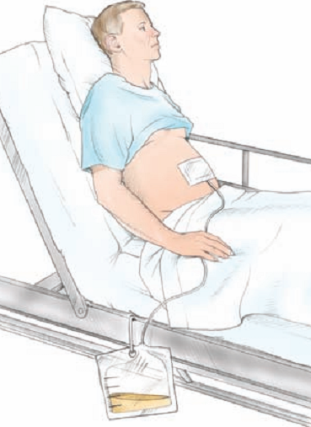
LIVER CONDITION
Ascites
Administer salt poor albumin by iv infusion
Sodium restriction in diet.
Fluid restriction in severe ascites.
Diuretics
Paracentesis
Peritoneal venous shunt: to reinfuse ascitic fluid
Paracentesis

Slide 204
LIVER CONDITION
Shunting portal blood flow to decrease portal hypertension.
Esophageal varices
Shunting portal blood flow
Mechanical compression of bleeding varices via esophageal gastrics balloon tamponade.
Blood transfusion to restore volume from bleeding varices.

Slide 205
LIVER CONDITION
Administration of iv vasopressin (pitrossin) directly into mesenteric artery to control bleeding.
Injection sclerotherapy: injection of a sclerorising agent directly into esophageal varices(to treat varicose veins) Bleeding may occur because there has has been no reduction in portal hypertension.

Slide 206
LIVER CONDITION
D. Portal system encephalopathy
Restriction of dietary protein intake.
Neomycin: decreases the normal flora in the intestines to reduce bacterial activity on protein
Lactulose: to reduce the amount of ammonia in the blood of clients with liver disease.
Control of GI hemorrhage to decrease protein available in the intestines.

Slide 207
LIVER CONDITION
NURSING CARE
Adequate rest
Avoid OTC drugs, asprin & alcohol
Education on disease, treatment & prognosis
Psychological care
Assist meet ADLs
Promote nutrition & administer antiemetics Half an hour before meals, fix NGT if unable to feed.
Give iron & vitamin suppliments.

Slide 208
LIVER CONDITION
Skin care because of pruritis, & assess for bleeding tendencies.
Electrolyte check because of diuretics to reduce ascitis & edema
Vital observation because of susceptibility to infection
Measure abdominal girth
For esophageal varices- soft non-irritating foods & monitor for hematemesis & malena

Slide 209
LIVER CONDITION
13. If sclerotherapy has been done for bleeding esophageal varices give analgesic for chest discomfort.
14. If esophageal bleeding, keep NBM, elevate head of bed to decrease gastric regurgitation
15. With ascites give low salt diet & do daily wt
16. For hepatic encephalopathy give low protein, high carbohydrate & fluid diet & assess the level of consciousness.

Slide 210
LIVER CONDITION
17. Post portal systemic shunt give general post op care & observe for post op complications like hemorrhage, electrolyte imbalance, seizures, delirium tremens.
COMPLICATIONS
Portal hypertension
Peripheral edema & ascites
3. Hepatic encephalopathy (coma)

Slide 211
LIVER CONDITION
LIVER ABSCESSES
Two categories of liver abscess are amoebic & pyogenic.
Cause: entamoeba histolylitica, ecoli, proteus valgaris, s. aureus, klebsiella pneumonae
PATHOPHYSIOLOGY
Liver can be invaded by bacteria via the portal vein (pylephlebitis), common duct (ascending cholangitis), the hepatic artery, secondary to bacteremia or direct extension from an infectious process & traumatic implantation of bacteria

Slide 212
LIVER CONDITION
Through the abdominal wall. The bacterial toxins destroy the neighbouring liver cells & the resulting necrotic tissue serves as a protective wall for the organisms. Leukocytes migrate in to the infected area. The result is an abscess cavity full of a liquid containing living & dead leukocytes liquified liver cells & bacterial liver cells & bacteria. Pyogenic abscesses of this type may be either single or multiple & small.

Slide 213
LIVER CONDITION
CLINICAL MANIFESTATION
Fever with chills & diaphoresis
Malaise
Anorexia, nausea & vomiting
Weight loss
Dull abdominal pain & tenderness (RUQ)
Hepatomegaly
Jaundice
Anemia
Pleural effusion
Sepsis & shock maybe life threatening

Slide 214
LIVER CONDITION
DIAGNOSTIC FINDINGS
U/S or CT scan guided aspiration for culture of specific organism.
TREATMENT
Percutaneous drainage of pyogenic abscess to promote healing, a drain may be left insitu.
Iv antibiotic therapy as per organism present.
Supportive care
Open surgical drainage maybe required if antibiotics & percutenous drainage are ineffective.

Slide 215
LIVER CONDITION
CANCER OF THE LIVER
Primary cancer of the liver is rare, metastatic cancer is more common
PRIMARY LIVER TUMOR
RISK FACTORS: hepatitis B & C, cirrhosis, chemical toxins, cigarette smoking, aflotoxins, alcoholism.
Hepatocellular carcinoma is by far the most common type of primary liver cancer.

Slide 216
LIVER CONDITION
It is non-reversable because of rapid growth & metastasis.
Other types of cancer are cholangiocellular carcinoma (malignancy of biliary ducts) & a combination of hepatocellular carcinoma.
LIVER METASTASES
Found in about half of all advanced cancer cases.
Malignant tumors are likely to reach the liver eventually, by way of portal system or lymphatic channels or by direct extension from an abdominal tumour.

Slide 217
LIVER CONDITION
Often the first evidence of cancer in an abdominal organ is the appearance of liver metastases.
CLINICAL MANIFESTATIONS
Anorexia & weight loss.
Anemia with fatigue
Right upper quadrant pain
Ascitis & jaundice
5. Hepatomegally.

Slide 218
LIVER CONDITION
DIAGNOSTIC S
LFTs
Blood sugar
Tumor markers
Liver U/S
X-ray
Biopsy

Slide 219
LIVER CONDITION
Metastasis: from lungs, regional lymph nodes, adrenals, bone, kidneys, heart, pancreas & stomach.
TREATMENT
Rx is primarily palliative; chemotherapy, radiation therapy
Lobectomy if tumor is localized, percutaneous(through the skin) biliary drainage.
Liver transplant.

Slide 220
LIVER CONDITION
POST-OP NURSING CARE
Observe for cardiopulmonary complications
1st 48 hrs 10% glucose for the decreased gluconeogenesis, albumin infusion.
Iv fluids & blood transfusion as needed.
For pts post cryosurgery(use of intense ,controlled cold to remove or destroy diseased tissue) monitor for hypothermia, hemorrhage or bile leak.

Slide 221
LIVER CONDITION
N/B
Myoglobinuria(excreation of myoglobin in urine) can occur as a result of tissue necrosis & is minimized by hydration, diuresis, & medications (allopurinol) to bind to & aid in the excretion of toxic products

Slide 222
DISORDERS OF THE PANCREAS

Slide 223
PANCREATITIS
Inflammation of the pancreas
Usually associated with auto digestion of the pancreas.
Acute or chronic
RISK FACTORS
5th decade of life
Injury or disruption of the pancreatic ducts (enzyme leakage)
Biliary tract disease
Alcoholism & smoking
PUD

Slide 224
1. ACUTE PANCREATITIS
Ranges from a mild, self-limiting disorder to a severe rapidly fatal disease that may not respond treatment.
Mild acute pancreatitis: edema & inflammation confined to the pancreas. Minimal organ dysfunction & healing in 3-6 months.
Severe acute pancreatitis: characterized by wide spread & complete enzymatic digestion of the gland. Tissue necrosis with extension to peritoneum.
Aetiology:
Gallstones; Alcohol; Infections e.g Mumps; Trauma; Idiopathic

Slide 225
PATHOPHYSIOLOGY
Injury/disruption to pancreatic duct flow
Leakage of pancreatic juice leading to autodigestion:-edema, vascular damage, hemorrhage & necrosis.
Toxic enzymes are released in blood & cause injury to vessels & other organs such as the lungs & kidneys.

Slide 226
CLINICAL MANIFESTATIONS
Severe abdominal pain:- worsened by meals; unreleaved by antacids.
Nausea & vomiting.
Abdominal rigidity with guarding
Ecchymosis in the flank or around the umbilicus in severe pancreatitis.
Hypotension due to hypovolemia & shock
Acute renal failure
Hyperglycemia
Respiratory distress & hypoxia

Slide 227
2. CHRONIC PANCREATITIS
Progressive anatomic & functional destruction of the pancreas.
Repeated attacks of pancreatitis, associated with alcoholism
Cells replaced by the fibrous tissue
Pressure within the pancreas increases:-ductular HPT
Mechanical obstruction of pancreatic & common bile ducts.
There is ductal, inflammation & atrophy
Aetiology:
Alcoholism; malnutrition; cystic fibrosis; malignancy; hereditary; congenital.

Slide 228
CLINICAL MANIFESTATION
Recurrent attacks of severe upper abdominal & back pain.
Nausea and vomiting
Weight loss due to anorexia or fear that eating will worsen the discomfort.
Malabsorption
Frequent, frothy & foul smelling stools—steatorrhea:
Glands may calcify

Slide 229
DIAGNOSIS (acute & chronic)
Lab tests:-
Serum/urine amylase levels—raised (standard)
Serum lipase for over 5 days—raised
WBC—raised,
Hypocalcemia, increased fibrinogen, raised CRP, trypsinogen activation peptide.
X-ray abdomen & chest to r/o other problems
CT-scan: enlarged pancrease, pseudo(cysts), or abscesses.
ERCP (endoscopic retrograde cholangiopancreatography): diagnose chronic pancreatitis.
OGTT:-evaluates pancreatic islet function.
Stools exam:—bulky, pale & foul smelling.

Slide 230
MED-SURG MANAGEMENT
Goal: preventing or treating complications.
NPO to inhibit pancreatic stimulation:- TPN or may consider nasojejunal tube feeding.
Gastric decompression via NGT
Pain management: non-opioids (less sphincter of oddi spasm).
Maintenance fluids
Antibiotics
Consider insulin.
Respiratory care: high risk of elevation of the diaphragm, pulmonary infiltrates & effusion, & atelectasis.
Surgical intervention:- Biliary drainage:
external drains or indwelling stents.
resection or debridement
Notes:
Gastric decompression via NGT:-releaves nausea & vomiting, decrease painful abdominal distention & paralytic ileus, remove hydrochloric acid so that it does not enter the duodenum & stimulate the pancreas.

Slide 231
Postacute management.
Antacids
Introduction of oral feeds low fat diet & low protein
Avoid caffeine & alcohol
Continue with previous meds (if indicated).
Follow-up including U/S, ERCP to determine resolving.
Pain management
Avoid alcohol & foods that produce pain.
DM is treared with diet, insulin or oral hypoglycemics.
Pancreatic enzyme replacement in pt with malabsorption & steatorrhea.
Pancreaticojejunostomy: joining of the pancreatic duct to jejunum to allow drainage

Slide 232
COMPLICATIONS
LOCAL:
pancreatic cysts/abscesses,
acute fluid collection in or near the pancreas.
SYSTEMIC:
Acute Resp. Distress Syndrome,
shock,
DIC,
pleural effusion.

Slide 233
Cancer of pancreas
Cancer affects any portion of the pancreas (head, body or tail).
5th leading cause of death
Spreads rapidly by direct extension to stomach, gallbladder, duodenum, or by lymph or blood
Benign (adenoma) or malignant (carcinoma)
Examples include:
Carcinoma of head of pancreas
Pancreatic islet tumors e.g
Gastrinoma—Zollinger-Ellison Syndrome
Insulinomas—Hyperinsulinism
Notes:
pancreatic islet tumors e.g ulcerogenic (zollinger-ellison tumor(gastrin secreting tumor of pancreatic islets),
overgrowth of islets (hyperinsulinism,elavated circulating levels of insulin due to pancreating tumour)

Slide 234
Ca pancreas
Etiology
Chemical carcinogens such as high fat diet/cigarette smoking/diabetes mellitus
Alcohol intake
Chronic pancreatitis
Metastasis from ca lungs, breast, thyroid gland

Slide 235
CLINICAL MANIFESTATION
Vague s/s- wt loss, pain, anorexia, nausea, vomiting, weakness
Abdominal pain worse at night, radiating to the back, lessened by side-lying with knees drawn up to thechest
Bloated feeling of fullness after eating
Jaundice in obstruction, with dark urine, pruritus, and light colored stool
Fatigue and depression
Notes:
WEIGHT LOSS (fat & protein malabsorption)

Slide 236
DIAGNOSIS
Contrast enhanced CT scan:- investigation of choice
Abdominal U/S.
Fine-needle biopsy- needle aspiration during ultrasonography
Tumor markers:- nonspecific.
ERCP (endoscopic retrograde cholangiopancreatography)-visualize common ducts/biopsy samples
Angiography & laparoscopy-size/presence
Elevated serum amylase, lipase, phosphatase
Elevated bilirubin levels
Carcinoembryonic antigen (CEA)-confirmatory

Slide 237
MED-SURG MANAGEMENT
Surgery: may be curative
Removal of resectable localized tumors.
Duodenopancreatectomy
Distal/Total pancreatectomy
Whipple’s procedure (pancreatoduodenectomy)-remove head of pancreas, part of stomach, lower portion of bile duct, duodenum
Radiotherapy
Chemotherapy
Biliary stent to relieve obstructive jaundice in obstruction

Slide 238
NURSING MANAGEMENT
Mainly palliative:
Pain management; also manage severe pruritus; lethargy and anorexia
Nutritional support
Emotional support

Slide 239
Ca pancreas- nursing process
Imbalanced nutrition < body requirements r/t inability to digest food, anorexia, nausea, vomiting
NGT feeding or other enteral feeding
Observe for pt’s intolerance to feeds, e.g vomiting
Give pancreatic enzymes replacements as ordered
Steatorrhea (fatty stools), enzyme replacement therapy

Slide 240
Ca pancreas
Altered comfort r/t pain
Opioids
Semi-fowler’s position to prevent diaphragmatic congestion
Diversional therapy- guided imagery/distraction/massage

Slide 241
Ca pancreas- n/process
Risk for fluid volume deficit
input/output
Vitals
Low albumin levels- albumin replacement
Coagulation studies- low clotting time- vit K deficiency-bleeding gums, bruises
If pt has has tubes/drains, inspect around incision sites for bleeding
Encourage use of an electric razor
Prescribed vit K

Slide 242
Ca pancreas- n/process
Risk for impaired skin integrity r/t impaired functioning of the pancreas
Assess for itching
Protect skin aroung drains with skin protective barrier

Slide 243
CONDITIONS OF THE BILIARY TRACT
Cholecystitis: Inflammation of the gallbladder.
Cholelithiasis: Presence of calculi in the gallbladder.
Choledolithiasis: Stones in the common bile duct.
Cholangitis: Inflammation of the bile ducts

Slide 244
The Biliary Tract

Slide 245
A. CHOLECYSTITIS
Chronic or acute infection of the gallbladder
The inflammation of the gallbladder
Associated with nausea, vomiting & acute inflammation.
Gall bladder usually filled with purulent fluid (empyema).
Calculous cholecystitis occurs in over 90% of patients.
Gallstones obstruction initiate a chemical autolysis & edema leading to ischaemia or gangrene.

Slide 246
Cholecystitis
Often the response of the common bile duct resulting in edema and inflammation
Bacteria invade the bile and add to the inflammation and irritation of the gallbladder
Chronic cholecystitis results from repeated attacks of acute cholecystitis or chronic irritation of gallstones
The gallbladder becomes fibrotic and thickened, fails to empty easily/completely

Slide 247
RISK FACTORS
Gallstones 90%
E. coli & other enteric organisms 40%
Neoplasms or adhesions.

Slide 248
CLINICAL MANIFESTATIONS
Abdominal guarding, rigidity & rebound tenderness in the RUQ
Fever
Epigastric pain
Onset maybe sudden with severe pain
Complications
Cholangitis perforation/necrosis
Empyemia
Fistulae
Adenocarcinoma

Slide 249
B. CHOLELITHIASIS (GALL STONES)
Calculi/gall stones in the gallbladder; choledolithiasis is stones in the common bile duct
From the solid constituents of bile, primarily composed of cholesterol
Vary in size, shape & composition.
Two common types of gall stones i.e cholesterol (80%) & pigment stones (calcuim bilirubinate).
RISK FACTORS
Female (x4). (oral contraceptives, estrogens, increased cholesterol saturation)
During pregnancy.
Age >40yrs.
Obesity -cholesterol

Slide 250
Cholelithiasis- etiology
Stasis caused by reduced gallbladder emptying
Excessive cholesterol intake
Low-fat diet- free cholesterol crystalizes in gallbladder before it is excreted
Family history
Diabetes mellitus

Slide 251
CLINICAL MANIFESTATIONS
Severity of symptoms depend on the mobility of the stone & whether obstruction occurs.
Epigastric distress due to fat intolerance.
Feeling of fullness
Abdominal distention
Vague LUQ pain—after consumption of high fat meals.

Slide 252
Clinical Manifestations of Cholelithiasis

Slide 253
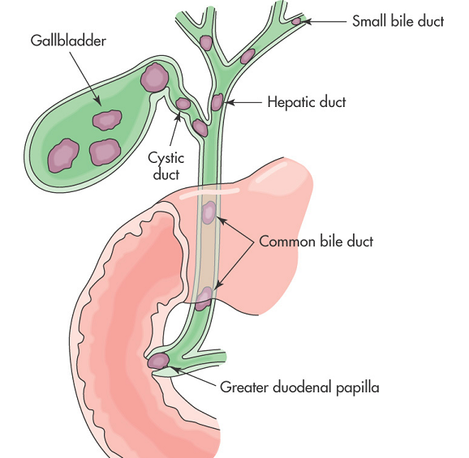
Common Locations of Stones

Slide 254
C. CHOLEDOCHOLITHIASIS
Obstruction of the common bile duct by stones.
Severe, steady abdominal pain radiating to the back & shoulder or right scapula-biliary colic
Nausea, vomiting, tachycardia, diaphoresis
Pain occurs hours after consumption of a fatty meal and lasts till the stone has passed into the duodenum
Jaundice with itching-blockage of the duct
Urine may be dark-coloured & stools clay-colored
Fat-soluble vitamin deficiency. ADEK & their symptoms.

Slide 255
COMPLICATIONS OF CHOLEDOCHOLITHIASIS
Acute pancreatitis.
Secondary biliary cirrhosis with hepatic failure: from extrahepatic biliary obstruction.
Portal HPT with bleeding esophageal varices:-socondary to prolonged incomplete obstruction.

Slide 256
D. CHOLANGITIS
Inflammation of the bile ducts
CLINICAL MANIFESTATIONS:- CHOLANGITIS
Biliary colic
Jaundice with dark urine
Fever
Nausea & vomiting
N/B Charcot triad (pain, jaundice, & fever/chills)

Slide 257
DIAGNOSIS OF BILIARY TRACT CONDITIONS
Abdominal x-ray: to R/O other causes or visualize stones.
Abdominal U/S
Oral cholecystogram:.
Cholecystography or radionuclide imaging.- location of stones
Endoscopic retrograde cholangiopancreatography (ERCP)
Serum amylase –elevated with stones in pancreatic duct
Full hemogram-elevated WBCs

Slide 258
MEDICAL MANAGEMENT OF BILLIARY DISORDERS
Is based on type of condition:
Pain control in cholecystitis/infection prevention and fluid balance
Anticholinergics e.g atropine:- for relaxation of the gallbladder.
Antispasmodics- Dicyclomine hydrochloride (Buscopan) –reduce biliary colic
Analgesic, usually pethidine- avoid morphine
Antibiotics
Decreased dietary fat intake=correct obesity=avoid gas-forming foods
Anti-emetics
Pre-op preparation: CXR, ECG, LFT, in reduced prothrombin level give vit. K, nutrition.
Notes:
Morphine can cause spasms in the sphincter of oddi causing an increase in pain

Slide 259
SURGICAL INTERVENTIONS
Cholecystostomy: surgical opening &drainage of the gallbladder.
Open cholecystectomy: surgical opening & removal of the gallbladder.
Choledocholithotomy: surgical incision of common bile duct for removal of stones.
Choledochoduodenostomy: surgical anastomosis of common duct to jejunum.
Lithotripsy: disintergration of gallstones by shock-waves.
Laparoscopic cholecystectomy: removal of gallbladder through endoscopic procedure.
Laser cholecystectomy: removal of gallbladder using laser

Slide 260
NURSING MANAGEMENT/nursing process
Assessment
pain/vitals/weight/skin turgor/urinary output/input output/stool and urine color/lab studies and abnormalities in electrolytes and bilirubin
Nursing dxes
Altered comfort r/t acute biliary pain
Risk for deficient fluid volume r/t anorexia/vomiting/excessive tube drainage
Risk for imbalanced nutrition < body requirement r/t vomiting/anorexia/dietary restrictions
Risk for impaired skin integrity r/t surgical incision/T-tube drainage
Risk for Ineffective breathing pattern r/t pain sec. to surgical incision
Deficient knowledge regarding the etiology/presentation/mx of di’se

Slide 261
Nursing mx
Pain management
Pain assessment
Pethidine
Antispasmodics
Quiet environment
Semi-fowler’s position
Maintaining fluid balance
Free oral intake
Antiemetics
IVF in oral intake restrictions
Post-op assess return of bowel sound
Monitor T-tube drainage

Slide 262
Nursing mx
Maintaining skin integrity
Frequent position change
Encouraged to stay in low semi-fowler’s position as much as possible
Post op, inspect the incision for excessive drainage /infection s/s
Regular change of dressing around incision site/minimal exposure to adhesive bandages
Inspect skin for jaundice
r/o itching

Slide 263
n/mx
Promote effective breathing
Deep breathing and coughing exercises-prevent infections/collapse
Splinting with breathing
Analgesics
Enhancement of knowledge
Dietary restrictions-fats
Wt loss in obesity

Slide 264
Post-op care (CHOLECYSTECTOMY).
General post-op care for abdominal surgery.
Evaluate tolerance & gradually introduce low-fat diet.
Change dressing frequently especially with copious drainage.
Maintain and evaluate drainage until edema subsides.
Monitor urine & stool for color changes (hyperbiliribinemia).
Educate on: weight reduction, low fat diet, avoid heavy lifting, signs of bile obstruction.

Slide 265
EXAMPLE T-tube drainage

Slide 266
COMPLICATIONS OF BILLIARY TRACT CONDITIONS
Acute colecystitis
Galstone related panctreatitis
Billiary enteric fistula— erosion of gall bladder into intestine
Intestinal obstruction

Slide 267
END

