Slide 1
Anatomy 1
OTM YEAR 1: SEM 1

Slide 2
Broad objective
To enable the learner apply principles of anatomy in relation to management of orthopaedic and trauma patients
Specific objectives
Demonstrate understanding of terminologies and historical background of anatomy
Explain organization of human body
Explain various body tissues
Explain the structural organization of the skin and body cavities
Demonstrate the understanding of anatomical organization of lower limbs

Slide 3
INTRODUCTION TO ANATOMY
Anatomy is the study of the structure of the body and the physical relationships between body
Anatomy includes those structures that can be seen grossly (without the aid of magnification) and microscopically (with the aid of magnification).
Typically, when used by itself, the term anatomy tends to mean gross or macroscopic anatomy — that is, the study of structures that can be seen without using a microscopic

Slide 4
Historical background
Anatomy comes from the greek word “ana” meaning “up” and “tome “ meaning “a cutting” .
Traditionally, studies of anatomy involved cutting up or dissecting organisms

Slide 5
Anatomy is the oldest discipline in medicine
In second century Galen who was a physician used to study anatomy through dissections of animals primarily pigs and monkeys and other animals and not humans
The first documented scientific dissections on human body were carried out at the third century B.C in Alexandria by Herophilus and Erasistratus
philosopher-surgeons Herophilus and Erasistratus used to dissect bodies of condemned criminals to reveal information about human body
Andreas Vesalius was a Belgian born anatomist and physician born in 1514 into a family of physicians
He is considered the father of modern anatomy and his work the beginning of modern medicine

Slide 6
Vesalius challenged the centuries old teachings of Galen
This was made possible by approval from the catholic church to dissect convicted criminals following death by hanging.
Vesalius performed dissections himself and then accurately recorded what he saw.
Vesalius also enlisted an artist to prepare drawings of his dissections and integrated these treatise he wrote.
The product of these efforts was a comprehensive anatomy book called On the fabric of human body

Slide 7
In 1932-1723, invention of microscope by Antonie Van Leeuwenhoek ushered in a new way to view and study anatomy
This advance opened a new area of study which become known as microscopic anatomy or histology
By taking small samples of tissues of tissues, anatomists could further explore the body to learn how it was put together on a cell or tissue
This has evolved over centuries and today anatomists use sophisticated transmission and scanning electron miscroscope to look at fine details of surfaces of cells as well as their subcellular components
Invasive procedures techniques which includes imaging are used currently for examining interior structures of the body

Slide 8
Terminologies used in anatomy
These are terms used to describe the relationships between body structures
Anatomical position
Anatomical reference point which is a standard body position is needed to describe body parts and position accurately
The body is in upright position with head facing forward, the arms at the sides with palms of the hands facing forward and feet together
Directional terms
These allow us to explain exactly where one body structure is in relation to another.
They describe location of the body parts

Slide 9
List of directional/ orientational terms used in anatomy
Anterior (or ventral)- Is the front or direction toward the front of the body. e.g The toes are anterior to the foot
Posterior (dorsal)- is the back or direction toward the back e.g the heart is posterior to the breastbones
Distal – a position in a limb that is farther from point of attachment of the body e.g the knee is distal to the thigh
Proximal- a position in a limb that that is nearer to the point of attachment or the trunk of the body e.g the elbow is proximal to the wrist

Slide 10
Medial- is the middle or direction towards the midline of the body e.g the heart is medial to the arm
Lateral- the side or direction towards the side of the body e.g the hands are lateral to the chest
Superior- describes a position above or higher than another part of the body e.g head is superior to the abdomen
Inferior- a position below or lower than another part of the body e.g the navel is inferior to the chin

Slide 11
Superficial - describes a position closer to the surface of the body. E.g The skin is superficial to bones
Deep- a position farther from the surface of the body. E.g The brain is deep to the skull, the lungs are deep to the skin
Intermediate – between a more medial and more lateral structure e.g the collarbone is intermediate between breastbone and shoulder

Slide 12
Regional terms
Regional terms are used to designate specific areas of the body
The body has 2 divisions; axial and appendicular
Axial part
Axial part makes up the main axis of the body
It includes the head, neck, and trunk
Appendicular part
Consists of appendages or limbs which are attached to the body’s axis

Slide 13
Body planes and sections
The body is often sectioned (cut) along a flat surface called a plane
The most frequently used body planes are; sagittal, frontal, and transverse planes which lie at right angles to one another.
A section is named for the plane along which it is cut
The cut along sagittal plane produces sagittal section

Slide 14
A sagittal plane is a vertical plane that divides the body into right and left parts
A sagittal plane that lies exactly in the midline is the median plane or midsagittal plane
All other sagittal planes, offset from midline are parasagittal planes (para=near)
Frontal plane lie vertically.
Frontal plane divide the body into anterior and posterior parts
A frontal plane is also called a coronal plane

Slide 15
A transverse or horizontal plane runs horizontally from right to left dividing the body into superior and inferior parts.
A transverse section is also called cross-section
Cuts made diagonally between horizontal and vertical planes are called oblique sections

Slide 16
Body cavities
Within the axial portion of the body are two large cavities called dorsal and ventral cavities
These cavities are closed to the outside and each contains internal organs
Dorsal body cavity
The dorsal cavity which protects the fragile nervous system organs has two subdivision
cranial cavity within the skull encases the brain. Its boundaries are formed by the bones of the skull

Slide 17
ii. Vertebral or spinal cavity encloses the delicate spinal cord
Since the spinal cord is a continuation of the brain, the cranial and spinal cavities are continuous with one another
Ventral body cavity
It is anteriorly located
It has two major subdivisions, the thoracic and abdominopelvic cavity
The ventral body cavity houses a group of internal organs that are collectively called viscera (an organ in a body) or visceral organs

Slide 18
The thoracic cavity is sorrounded by ribs and muscles of the chest
The thoracic cavity is separated from the more inferior abdominopelvic cavity by diaphragm
This cavity contains, the trachea, 2 bronchi, 2, lungs, the heart, aorta, superior and inferior venacava, the oesophagus, lymph vessels and lymph nodes, nerves

Slide 19
Abdominopelvic cavity has 2 parts- the abdominal cavity and pelvic cavity
Abdominal cavity is the largest of all cavities.
Abdominal cavity contains the stomach, intestines, spleen, liver and other organs
Pelvic cavity contains the bladder, reproductive organs and the rectum

Slide 20
Other body cavities
Oral cavity-contains tongue and teeth
Nasal cavity- located within and posterior to nose. Nasal cavity is part of the respiratory system passageways
Orbital cavities- it house the eyes and present them in anterior position
Middle ear cavities- contains tiny bones that transmit sound to the organs of hearing in the inner ear
Synovial cavity- are joint cavities that are enclosed within fibrous capsule that sorround freely movable joints of the body such as elbow and knee joints

Slide 21
Abdominol-pelvic regions and quadrants
The abdominolpelvic cavity is divided into smaller areas for study by two transverse and two parasagittal planes
The planes divide the abdomen into nine regions
Umbilical region- is the centermost region and sorrounding the umbilicus (navel)
Epigastric region- is located superior to the umbilical region

Slide 22
Hypogastric (pubic)- region is located inferior to the umbilical region
The right and left iliac or inguinal regions- are located lateral to hypogastric region
Right and left hypochondriac regions- flank the epigastric region laterally

Slide 23
Quadrants
One transverse and one median sagittal plane pass through the umbilicus at right angles forming 4 quadrants
The resulting quadrants are named according to their positions from subject’s point of view: the right upper quadrant, left upper quadrant, right lower quadrant, and left lower quadrant

Slide 26
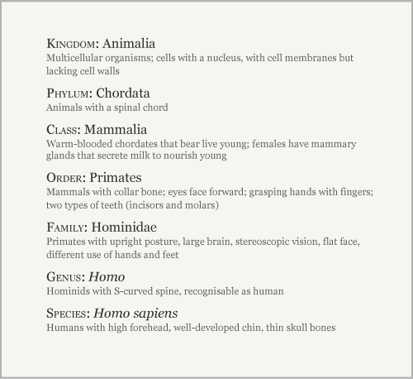
Classification of human being

Slide 27
How can gross anatomy be studied
Anatomy can be studied following either regional or systemic approach
Regional approach
Each region of the body is studied separately and all aspects of that region are studied at the same time.
For example if the thorax is to be studied, all of its structures are examined.
This includes vasculature, the nerves, the bones, muscles and all other structures and organs located in the region of the body defined as thorax.
After studying this region the other regions of the body are studied in a similar fashion

Slide 28
Systemic approach
Each system of the body is studied and followed throughout the entire body.
For example a study of cardiovascular system look at the heart and all the blood vessels in the body
When this is completed, nervous system might be examined in detail.
This approach continues for the whole body until every system has been studied

Slide 29
NB: Each of these approaches has benefits and deficiences. The regional approach works very well if anatomy course involves cadavar dissection but falls short when it comes to understanding the continuity of the entire system throughout the body. Similarly, the systemic approach fosters an understanding of an entire system throughout the body but it is very difficult to coordinate this directly with cadavar dissection or to acquire sufficient details

Slide 30
Disciplines studying anatomy
Gross anatomy
The term ‘gross’ means ‘big’
This is a study of the structure and organization of body without the aid of magnification
It is macroscopic anatomy
It involves dissection of cadavers (dead bodies)
This branch existed until microscope was invented

Slide 31
Histology
“Histo” means tissue
This is the study of tissue and cells of body fluids
Analysis of this requires magnification aid of some kind
To improve viewing and interpretation of results of what is being examined, investigators have had ways of cutting tissue into thin sections so that light can pass through the tissues sections

Slide 32
Cell biology
In this study scientists extract cells from tissues for examination. For example pap smear
Using a variety of microscopic, biochemical, molecular or immunological techniques, they dissect the structure and function of subcellular components.

Slide 33
Embryology
Embryology or developmental anatomy is the study of human development from conception to birth .
In this area scientists learn how organs and individual parts of the body develop and when and what biological signals control these processes
Neuroanatomy
It involves study of nervous system
Radiology
Is studying body structure through radiological imaging such as magnetic resonance imaging, X-rays. etc

Slide 34
Importance of studying anatomy
Anatomy leads the physician toward an understanding of a patient ’ s disease, whether he or she is carrying out a physical examination or using the most advanced imaging techniques.
Anatomy is also important for dentists, chiropractors, physical therapists, and all others involved in any aspect of patient treatment that begins with an analysis of clinical signs. The ability to interpret a clinical observation correctly is therefore the endpoint of a sound anatomical understanding.

Slide 35
Levels of structural organization
The body has different levels of structural organizations
The levels from smallest to the largest include; chemical level, cellular level, tissue level, organ level and organ system, organism level
Chemical level
This is the atomic level
Atoms bond to form molecules and many molecules form an organelle and organelles form a cell
Basic molecules include protein, carbohydtates, fats, nucleic acids

Slide 36
Cellular level
Variety of molecules combine to form the fluid and organelles of a body cell.
The cell is the basic unit of life.
The cell equipped to perform the basic and essential functions to sustain life
Tissue level
Several similar cells form a body tissue.
The group of similar cells have common origin and function
There are are 4 major types of tissues; epithelial, connective , nervous and muscle tissues
Organ level
Two or more different tissue combine to form an organ
Each organ perform a specific function
Organ system level
Two or more organs work closely together to perform functions of a body system i.e the organs functions in common
In most cases the organs are connected to one another.
Example of system are; musculoskeletal system, endocrine system, nervous system, digestive system, circulatory system, lymphatic system, etc

Slide 37
Organism level
It is the most complex level of organization
It consists of all levels of organization
Its success is dependent upon proper structure and function of all organs system
Dysfunction of one system can cause malfunction of others

Slide 38
Levels of structural organization

Slide 39
Cells structure and its functions
A cell is basic unit of the body that has life
A cell is made up of microstructures called organelles
The organelles include
Plasma membrane (cell membrane)
This forms a boundary between intracellular and extracellular spaces
It selectively regulates passage of all materials into and out of the cell
The plasma membrane is made up of 2 layers i.e protein and phospholipid layer

Slide 40
The phospholipid molecules have a head, which is electrically charged and hydrophilic (meaning ‘water loving’), and a tail which has no charge and is hydrophobic (meaning ‘water hating’, ). The phospholipid bilayer is arranged like a sandwich with the hydrophilic heads aligned on the outer surfaces of the membrane and the hydrophobic tails forming a central water-repelling layer.
These differences influence the transfer of substances across the membrane.

Slide 41
The membrane proteins perform several functions:
branched carbohydrate molecules attached to the outside of some membrane protein molecules give the cell its immunological identity
They can act as specific receptors (recognition sites) for hormones and other chemical messengers
some are enzymes and some are involved in transport across the membrane

Slide 42
2. Nucleus
All cells except mature red blood cell contains the nucleus
The skeletal muscle contains several nucleus
The nucleus is the largest organelle and is contained within the nuclear envelope, a membrane similar to the plasma membrane but with tiny pores through which some substances can pass between it and the cytoplasm, i.e. the cell contents excluding the nucleus.

Slide 43
The nucleus contain body’s genetic material which directs all the metabolic activities of the cell.
The nucleus controls transmission of hereditary traits from generation to generation
Within the nucleus is a roughly spherical structure called the nucleolus, which is involved in manufacture (synthesis) and assembly of the components of ribosomes.

Slide 44
3. Mitochondria
Is a sausage-shaped structures in the cytoplasm, sometimes described as the ‘power house’ of the cell
They are involved in aerobic respiration, the processes by which chemical energy is made available in the cell.
This is in the form of ATP, which releases energy when the cell breaks it down .
Synthesis of ATP is most efficient in the final stages of aerobic respiration, a process requiring oxygen
The most active cell types have the greatest number of mitochondria, e.g. liver, muscle and spermatozoa

Slide 45
4. Ribosomes
These are tiny granules composed of RNA and protein.
They synthesize proteins from amino acids, using RNA as the template
They are sites at which aminoacids are linked to form protein molecules
Some are attached to endoplasmic reticulum while others are distributed in the cytoplasm

Slide 46
5. Endoplasmic reticulum (ER)
There are two types: smooth and rough.
Smooth ER synthesises lipids and steroid hormones, and is also associated with the detoxification of some drugs. Some of the lipids are used to replace and repair the plasma membrane and membranes of organelles.
Rough ER is studded with ribosomes. These are the site of synthesis of proteins, some of which are ‘exported’ from cells, i.e. enzymes and hormones that leave the parent cell by exocytosis to be used by cells elsewhere.

Slide 47
6. Golgi apparatus
They are stocks of membrane structures
It is present in all cells but is larger in those that synthesise and export proteins.
The proteins move from the endoplasmic reticulum to the Golgi apparatus where they are ‘packaged’ into membrane-bound vesicles called secretory granules.
The vesicles are stored and, when needed, they move to the plasma membrane and fuse with it. The contents then leave the cell by exocytosis

Slide 48
7. Lysosomes
Lysosomes are one type of secretory vesicle with membranous walls, which are formed by the Golgi apparatus.
They contain a variety of enzymes involved in breaking down fragments of organelles and large molecules (e.g. RNA, DNA, carbohydrates, proteins) inside the cell into smaller particles that are either recycled, or extruded from the cell as waste material.
Lysosomes in white blood cells contain enzymes that digest foreign material such as microbes.

Slide 49
8. Cytoskeleton
This consists of an extensive network of tiny protein fibres
9. Microfilaments
These are the smallest fibres. They provide structural support, maintain the characteristic shape of the cell and permit contraction, e.g. in muscle cells.

Slide 50
10. Cytoplasm
Is a cellular material between membrane and nucleus
The cytoplasm has 3 elements: cytosol, organelles and inclusions
It sorrounds the nucleus
It consists of protoplasm located between cell nucleus and cell membrane and it is the cytoplasm without the organelles

Slide 51
11. Centrioles
Are important in cell division
In cell division they form filaments between them that stretch to form spindle fibres which attach the chromosomes
12. Fibrils
Are long than thread-like structures found mostly in the cytoplasm of muscle and nerve cell.
Fibrils in the muscles cells are called contractile fibrils because of their ability to shorten during muscle contraction

Slide 52
13. Cilia and flagella
They are microscopic filamentaous projections of the cell cytoplasm and membrane
Both have same basic structure
If the projections on a cell are short and numerous, they are called cilia
If they are long and whip like they are called flagella
All the members of kingdom rely upon the movement of these organelles for performance of various activities

Slide 53
In human being, cerebrospinal fluid is circulated within the ventricles spaces of the brain and spinal cord through the activity of cilia
Cilia lining the airways in the lungs cleanse the surface by sweeping foreign matter upwards into the throat to be coughed out
Cilia also transports the ovum from ovary through out the uterine tubes to the uterus
The sperm have flagelllum which propels them upwards in the female reproductive system

Slide 54
14. vacuoles and tubules
Vacuoles are membrane sacs that serve to store fluid and excretory functions of the cell.
Tubules aid in transporting materials throughout the cytoplasm.
Tubules add strength and support to the cells
15. Peroxisomes
Are membrane bound organelles occurring in the cytoplasm of eukaryotic cells
They play are key role in oxidation of specific biomolecules
They are involved in conversion of reactive oxygen species into safer molecules like water and oxygen by enzyme catalase
They also play important role in lipid production

Slide 55
Human cell structure

Slide 56
Tissue Membranes
The two broad categories of tissue membranes in the body are
connective tissue membranes, which include synovial membranes
(2) epithelial membranes, which include mucous membranes, serous membranes, and the cutaneous membrane, in other words, the skin.

Slide 57
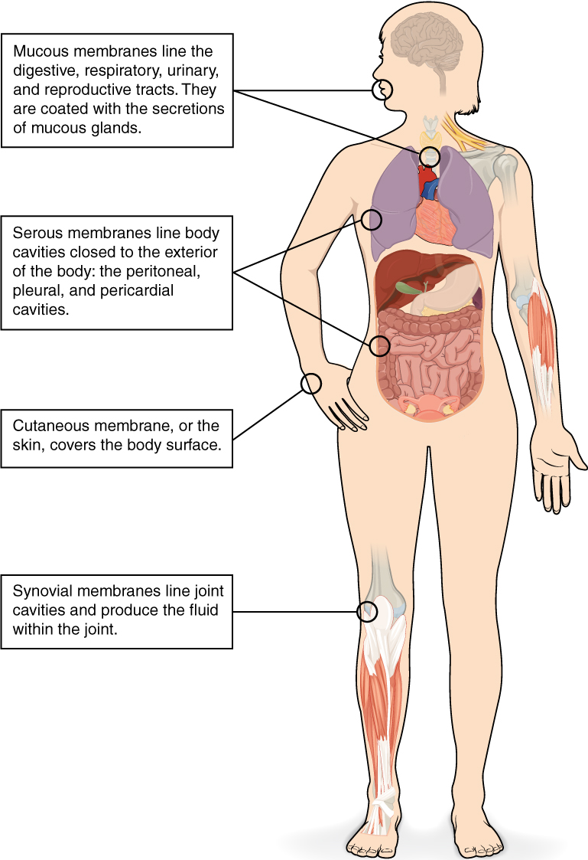

Slide 58
Epithelial Membranes
The epithelial membrane is composed of epithelium attached to a layer of connective tissue, for example, your skin. The mucous membrane is also a composite of connective and epithelial tissues. Sometimes called mucosae, these epithelial membranes line the body cavities and hollow passageways that open to the external environment, and include the digestive, respiratory, excretory, and reproductive tracts. Mucous, produced by the epithelial exocrine glands, covers the epithelial layer. The underlying connective tissue, called the lamina propria (literally “own layer”), help support the fragile epithelial layer.

Slide 59
A serous membrane is an epithelial membrane composed of mesodermally derived epithelium called the mesothelium that is supported by connective tissue. These membranes line the coelomic cavities of the body, that is, those cavities that do not open to the outside, and they cover the organs located within those cavities. They are essentially membranous bags, with mesothelium lining the inside and connective tissue on the outside. Serous fluid secreted by the cells of the thin squamous mesothelium lubricates the membrane and reduces abrasion and friction between organs. Serous membranes are identified according locations. Three serous membranes line the thoracic cavity; the two pleura that cover the lungs and the pericardium that covers the heart. A fourth, the peritoneum, is the serous membrane in the abdominal cavity that covers abdominal organs and forms double sheets of mesenteries that suspend many of the digestive organs.

Slide 60
The skin is an epithelial membrane also called the cutaneous membrane. It is a stratified squamous epithelial membrane resting on top of connective tissue. The apical surface of this membrane is exposed to the external environment and is covered with dead, keratinized cells that help protect the body from desiccation and pathogens.

Slide 61
Connective Tissue Membranes
Connective tissue membranes contain only connective tissue. Synovial membranes and meninges belong to this category.
1.Synovial Membranes
Synovial membranes are connective tissue membranes that line the cavities of the freely movable joints such as the shoulder, elbow, and knee. Like serous membranes, they line cavities that do not open to the outside. Unlike serous membranes, they do not have a layer of epithelium. Synovial membranes secrete synovial fluid into the joint cavity, and this lubricates the cartilage on the ends of the bones so that they can move freely and without friction.
2.Meninges
The connective tissue covering on the brain and spinal cord, within the dorsal cavity, are called meninges. They provide protection for these vital structures.

Slide 62
3. Epimysium
The connective tissue membrane, that binds many fasiculi into a muscle
skeletal muscle is surrounded by a fibrous elastic connective tissue sheath called the epimysium. It surrounds the muscle formed by groups of parallel fascicles. The epimysium protects muscles from friction against other muscles and bones. Epimysium along with the perimysium and endomysium layers generally extend beyond the fleshy part of the muscle, forming a thick rope-like tendon or a broad, flat sheet-like aponeurosis.

Slide 63
4. Periosteum
The connective tissue membrane that surrounds a bone is known as.
5. Perichondrium
The perichondrium is a dense layer of connective tissue that covers the external surface of most of the body’s cartilage (a strong, flexible, and semi-rigid tissue found throughout the body). Perichondrium is mainly found on the surfaces of elastic and hyaline cartilage, which can be found in multiple locations of the body, such as in the ears, nose, joints and ribs.

Slide 64
6. Epinerium
The epineurium is the outermost layer of dense irregular connective tissue surrounding a peripheral nerve. It usually surrounds multiple nerve fascicles as well as blood vessels which supply the nerve

Slide 65
Ct
CONNECTIVE TISSUES
Blood
This is a fluid connective tissue
Blood is bodily fluid that delivers substances such as nutrients and oxygen to cells
It is an atypical (not conforming to a group/ abnormal) connective tissue since it does not bind, connect or network with any body cells.
It is made up of blood cells and is sorrounded by nonliving fluid called plasma

Slide 66
Cartilage
Cartilage is an avascular form of connective tissue consisting of extracellular fibers embedded in a matrix that contains cells localized in small cavities.
The amount and kind of extracellular fibers in the matrix varies depending on the type of cartilage.
In heavy weight-bearing areas or areas prone to pulling forces, the amount of collagen is greatly increased and the cartilage is almost inextensible.
In contrast, in areas where weight-bearing demands and stress are less, cartilage containing elastic fibers and fewer collagen fibers is common

Slide 67
Cartilage is firmer than other connective tissues
The cells are called chondrocytes and are less numerous.
The functions of cartilage are to:
■ support soft tissues;
■ provide a smooth, gliding surface for bone articulations at joints; and
■ enable the development and growth of long bones.
There are three types: hyaline cartilage, fibrocartilage and elastic fibrocartilage.

Slide 68
1.Hyaline cartilage
Hyaline cartilage is a smooth bluish-white tissue.
The chondrocytes are in small groups within cell nests and the matrix is solid and smooth.
Hyaline cartilage provides flexibility, support and smooth surfaces for movement at joints. It is found

Slide 69
Hyaline cartilage is found in
in the ends of long bones that form joints
forming the costal cartilages, which attach the ribs to the sternum
forming part of the larynx, trachea and bronchi

Slide 70
2.Fibrocartilage
This consists of dense masses of white collagen fibres in a matrix similar to that of hyaline cartilage with the cells widely dispersed.
It is a tough, slightly flexible, supporting tissue
it is found:
as pads between the bodies of the vertebrae, the intervertebral discs
between the articulating surfaces of the bones of the knee joint, called semilunar cartilages
on the rim of the bony sockets of the hip and shoulder joints, deepening the cavities without restricting movement
As ligaments joining bones.

Slide 71
3. Elastic fibrocartilage
This flexible tissue consists of yellow elastic fibres lying in a solid matrix.
The chondrocytes lie between the fibres.
It provides support and maintains shape of, e.g. the pinna or lobe of the ear, the epiglottis, alae of the nose and part of the tunica media of blood vessel walls.

Slide 72
Bone
Is a connective tissue containing cells, fibers and ground substance
It is the hardest tissue
Although bones are often thought to be static or permanent, they are highly vascular living structures that are continuously being remodelled.

Slide 73
Bone cells (osteocytes) are surrounded by a matrix of collagen fibres strengthened by inorganic salts, especially calcium and phosphate.
This provides bones with their characteristic strength and rigidity.
Bone also has considerable capacity for growth in the first two decades of life, and for regeneration throughout life.
Two types of bone tissues can be identified by the naked eye: compact bone tissue – solid or dense appearance spongy or cancellous bone tissue – ‘spongy’ or fine honeycomb appearance.

Slide 74
Types of bones
Bones are classified as long, short, irregular, flat and sesamoid
Long bones- These consist of a shaft and two extremities. As the name suggests, these bones are longer than they are wide. Examples include the femur, tibia and fibula.
Short, irregular, flat and sesamoid bones.These have no shafts or extremities and are diverse in shape and size. Examples include: short bones – carpals (wrist), irregular bones – vertebrae and some skull bones flat bones – sternum, ribs and most skull bones, sesamoid bones – patella (knee cap)

Slide 75
Bone structure
General structure of a long bone
These have a diaphyses or shaft and two epiphyses or extremities.
The diaphyses is composed of compact bone with a central medullary canal, containing fatty yellow bone marrow.
The epiphyses consist of an outer covering of compact bone with spongy (cancellous) bone inside.
The diaphyses and epiphyses are separated by epiphyseal cartilages, which ossify when growth is complete.
Thickening of a bone occurs by the deposition of new bone tissue under the periosteum.

Slide 76
Long bones are almost completely covered by a vascular membrane, the periosteum, which has two layers.
The outer layer is tough and fibrous, and protects the bone underneath.
The inner layer contains osteoblasts and osteoclasts, the cells responsible for bone production and breakdown and is important in repair and remodelling of the bone.
The periosteum covers the whole bone except within joint cavities, allows attachments of tendons and is continuous with the joint capsule. Hyaline cartilage replaces periosteum on bone surfaces that form joints.

Slide 77
Blood and nerve supply
Blood supply to the shaft of the bone derives from one or more nutrient arteries
The epiphyses have their own blood supply, although in the mature bone the capillary networks arising from the two are heavily interconnected.
The sensory supply usually enters the bone at the same site as the nutrient artery, and branches extensively throughout the bone.
Bone injury is, therefore, usually very painful.

Slide 78
Diagram of a Mature bone

Slide 79
Bone cells
Bone has different types of cells
Osteoblast
Are found within the bone, its function is to form new bone tissue. They secrete both the organic and inorganic components of bone.
They are present:
in the deeper layers of periosteum
in the centres of ossification of immature bone
At the ends of the diaphysis adjacent to the epiphyseal cartilages of long bones
At sites of fracture

Slide 80
2.Osteoclast
Are very large cells formed in the bone marrow. Their function is resorption of bone to maintain the optimum shape.
This takes place at bone surfaces: under the periosteum, to maintain the shape of bones during growth and to remove excess callus formed during healing of fractures, around the walls of the medullary canal during growth and to canalise callus during healing.

Slide 81
3. Osteocytes
found within the bone. Its function is to help maintain shape of bone
As bone develops, osteoblasts become trapped within the newly formed bone.
They stop forming new bone at this stage and are called osteocytes.
These are the mature bone cells that monitor and maintain bone tissue, and are nourished by tissue fluid in the canaliculi that radiate from the central canals.

Slide 82
Development of bone tissue
Also called osteogenesis or ossification
This begins before birth and is not complete until about the 21st year of life
Long, short and irregular bones develop in the fetus from rods of cartilage, cartilage models.
Flat bones develop from membrane models and sesamoid bones from tendon models

Slide 83
During the process of bone development, osteoblasts secrete osteoid, which gradually replaces the initial model; then this osteoid is progressively calcified, also by osteoblast action.
As the bone grows, the osteoblasts become trapped in the matrix of their own making and become osteocyte

Slide 84
Development of long bones
In long bones the focal points from which ossification begins are small areas of osteogenic cells, or centres of ossification in the cartilage model.
This is accompanied by development of a bone collar at about 8 weeks of gestation.
Later the blood supply develops and bone tissue replaces cartilage as osteoblasts secrete osteoid components in the shaft.

Slide 85
The bone lengthens as ossification continues and spreads to the epiphyses.
Around birth, secondary centres of ossification develop in the epiphyses, and the medullary canal forms when osteoclasts break down the central bone tissue in the middle of the shaft.
During childhood, long bones continue to lengthen because the epiphyseal plate at each end of the bone, which is made of cartilage, continues to produce new cartilage on its diaphyseal surface (the surface facing the shaft of the bone)

Slide 86
This cartilage is then turned to bone.
As long as cartilage production matches the rate of ossification, the bone continues to lengthen.
At puberty, under the influence of sex hormones, the epiphyseal plate growth slows down, and is overtaken by bone deposition.
Once the whole epiphyseal plate is turned to bone, no further lengthening of the bone is possible

Slide 87
Stages of bone development of a long bone

Slide 88
Activity
From Ross and Wilson A&P textbook do further reading on;
structure of short, irregular, flat and sesamoid bones
Miscroscopic structure of bone
Compact and spongy bones

Slide 89
NERVE TISSUE
A group of nerve tissue make up the nervous system
The nervous system consists of;
Central nervous system-brain and spinal cord
Peripheral nervous system- cranial and spinal nerve
The nervous system consists of
Neurons (nerve cells) which conduct nerve impulses from one site to another and receive and process information
Neuroglia (glial cells) which are non-conducting cells (connective tissue cells) providing functional and structural support for the neurons. Example is schwann cell which produces the lipid sheath (insulating sheath) of peripheral neurones

Slide 90
Neuron
Each neuron consists of
a cell body and its processes
one axon
many dendrites.
Neurons are commonly referred to as nerve cells.
Bundles of axons bound together are called nerves.
Neurons cannot divide, and for survival they need a continuous supply of oxygen and glucose.
Unlike many other cells, neurons can synthesise chemical energy (ATP) only from glucose.

Slide 91
Neurone generate and transmit electrical impulses called action potentials.
The initial strength of the impulse is maintained throughout the length of the neuron.
Some neurons initiate nerve impulses while others act as ‘relay stations’ where impulses are passed on and sometimes redirected.

Slide 92
Nerve impulses can be initiated in response to stimuli from;
outside the body, e.g. touch, light waves
inside the body, e.g. a change in the concentration of carbon dioxide in the blood alters respiration
a thought may result in voluntary movement
Transmission of nerve signals is both electrical and chemical.
The action potential travelling down the nerve axon is an electrical signal, but because nerves do not come into direct contact with each other, the signal between a nerve cell and the next cell in the chain is chemical

Slide 93
Structure of neuron: The arrow indicates direction of impulse conduction

Slide 94
Cell bodies
Nerve cells vary considerably in size and shape but they are all too small to be seen by the naked eye.
Cell bodies form the grey matter of the nervous system and are found at the periphery of the brain and in the centre of the spinal cord.
In nervous system, group of neuronal cell bodies are called nuclei in the central nervous system and ganglia in the peripheral nervous system. An important exception is the basal ganglia (nuclei) situated within the cerebrum

Slide 95
The cell body holds the nucleus. It is a site of protein synthesis which occurs on small granules of rough endoplasmic reticulum
Dendrites
Are elongated portions of cell body which are extensions of cell bodies
They have the same structure as axons but are usually shorter.
In motor neurons dendrites form part of synapses and in sensory neurons they form the sensory receptors that respond to specific stimuli.
They extend outwards receiving input from the environment and from other neurons

Slide 96
Diagram of synapse

Slide 97
Axons
This is an extension of cell body.
It is a long thin structure down which action potentials (nerve impulses) are conducted.
While neurons have many dendrites, most cells only have one axon
Axons and dendrites are extensions of cell bodies and form the white matter of the nervous system

Slide 98
Axons are found deep in the brain and in groups, called tracts, at the periphery of the spinal cord. They are referred to as nerves or nerve fibres outside the brain and spinal cord.
Axons begin at a tapered area of the cell body, the axon hillock
Axons carry impulses away from the cell body and are usually longer than the dendrites, sometimes as long as 100 cm.
In CNS, axons carry electrical signals from one nerve cell body to another
In PNS, axons carry signals to muscles and glands or from sensory organs such as the skin.

Slide 99
Structure of axon
The membrane of the axon is called the axolemma and it encloses the cytoplasmic extension of the cell body.
Myelinated neurones
Large axons and those of peripheral nerves are surrounded by a myelin sheath
Myelin sheath is formed by cells wrapping themselves around the nerve axon. In central nervous system, this is performed by oligodendrocyte cells. In peripheral nervous system the schwann cells are responsible for this action.

Slide 100
The outermost layer of the Schwann cell plasma membrane is the neurilemma
There are tiny areas of exposed axolemma between adjacent Schwann cells, called nodes of Ranvier, which assist the rapid transmission of nerve impulses in myelinated neurones (saltatory conduction)

Slide 101
Non-myelinated neurones
Postganglionic fibres and some small fibres in the central nervous system are non-myelinated.
In this type a number of axons are embedded in Schwann cell plasma membranes.
The adjacent Schwann cells are in close association and there is no exposed axolemma.
The speed of transmission of nerve impulses is significantly slower in non-myelinated fibres.

Slide 102
Axon terminals
This is the most distal part of axon.
It is from here that the neuron sends chemical signals to other cells- usually via neurotransmitters.
The axon terminals contain large number of mitochondria

Slide 103
Neuroglia
Glia, also called glial cells or neuroglia, are non-neuronal cells in the central nervous system (brain and spinal cord) and the peripheral nervous system that do not produce electrical impulses.
They maintain homeostasis, form myelin in the peripheral nervous system, and provide support and protection for neurons.

Slide 104
The neurones of the central nervous system are supported by four types of non-excitable glial cells that greatly outnumber the neurones .
Unlike nerve cells, which cannot divide, glial cells continue to replicate throughout life.
They are astrocytes, oligodendrocytes, ependymal cells and microglia.

Slide 105
Astrocytes
These cells form the main supporting tissue of the central nervous system.
They are star shaped with fine branching processes and they lie in a mucopolysaccharide ground substance.
At the free ends of some of the processes are small swellings called foot processes.
Astrocytes are found in large numbers adjacent to blood vessels with their foot processes forming a sleeve round them.
This means that the blood is separated from the neurones by the capillary wall and a layer of astrocyte foot processes which together constitute the blood–brain barrier

Slide 106
The blood–brain barrier is a selective barrier that protects the brain from potentially toxic substances and chemical variations in the blood, e.g. after a meal.
Oxygen, carbon dioxide, alcohol, glucose and other lipid-soluble substances quickly cross the barrier into the brain.
Some large molecules, drugs, inorganic ions and amino acids pass slowly from the blood to the brain

Slide 107
Oligodendrocytes
These cells are smaller than astrocytes and are found in clusters round nerve cell bodies in grey matter; where they are thought to have a supportive function; adjacent to, and along the length of, myelinated nerve fibres.
The oligodendrocytes form and maintain myelin, having the same functions as Schwann cells in peripheral nerves.

Slide 108
Ependymal cells
These cells form the epithelial lining of the ventricles of the brain and the central canal of the spinal cord.
Those cells that form the choroid plexuses of the ventricles secrete cerebrospinal fluid.

Slide 109
Microglia
These cells may be derived from monocytes that migrate from the blood into the nervous system before birth.
They are found mainly in the area of blood vessels.
They enlarge and become phagocytic, removing microbes and damaged tissue, in areas of inflammation and cell destruction.

Slide 110
Response of nervous tissue to injury
Neurones reach maturity a few weeks after birth and cannot be replaced.
Damage to neurones can either lead to rapid necrosis with sudden acute functional failure, or to slow atrophy with gradually increasing dysfunction.
These changes are associated with:
hypoxia and anoxia

Slide 111
nutritional deficiencies
poisons, e.g. organic lead
Trauma infections
Ageing
Hypoglycaemi

Slide 112
Peripheral nerve regeneration
The axons of peripheral nerves can sometimes regenerate if the cell body remains intact.
Distal to the damage, the axon and myelin sheath disintegrate and are removed by macrophages, but the Schwann cells survive and proliferate within the neurilemma.
The live proximal part of the axon grows along the original track provided the two parts of neurilemma are correctly positioned and in close apposition

Slide 113
Restoration of function depends on the re-establishment of satisfactory connections with the effector organ.
When the neurilemma is out of position or destroyed, the sprouting axons and Schwann cells form a tumour-like cluster (traumatic neuroma) producing severe pain, e.g. following some fractures and amputation of limbs

Slide 114
Neuroglial damage
Astrocytes
When severely damaged, astrocytes undergo necrosis and disintegrate.
In less severe and chronic conditions there is proliferation of astrocyte processes and later cell atrophy (gliosis).
This process occurs in many diseases and is analogous to fibrosis in other tissues.

Slide 115
Oligodendrocytes
These cells form and maintain myelin, having the same functions as Schwann cells in peripheral nerves.
They increase in number around degenerating neurones and are destroyed in demyelinating diseases such as multiple sclerosis

Slide 116
Microglia
Microglia are thought to be derived from monocytes that migrate from the blood into the nervous system before birth, and are found mainly around blood vessels.
Where there is inflammation and cell destruction the microglia increase in size and become phagocytic.

Slide 117
Neuroglia (glial cells) found in the peripheral nervous system
There are 2 types found in PNS
These are schwann cells and satellite cells
Schwann cells
Equal to oligodendrocyte in CNS and produce myelin sheath in PNS which insulate nerve fibers
Important in regeneration of peripheral nerve after injury.

Slide 118
Satellite cells
Surround or cover the surface of neuron cell bodies in ganglia in peripheral nervous system (nucleus in PNS i.e plenty of cell bodies).
They are found in sensory, parasympathetic and sympathetic ganglia.
The specific function of satellite cells is not yet known but it is generally assumed that they;
Regulate and stabilize the environment around ganglion cell (i.e regulation of chemical external environment)
supply nutrients to surrounding neurons and have some structural function.
act as protective, cushioning cells

Slide 119
Muscle tissue
Muscles facilitate their movements through their contractile and relaxing ability.
peoples lives depend on action of muscles.
The air they breathe, the rhythmic heart beat and transport of the food they eat all rely on muscle action.
The structural unit of a muscle is a single muscle cell also known as muscle fiber.
Muscle contraction requires an adequate blood supply to provide sufficient oxygen, calcium and nutrients and to remove waste products.
Muscle cells are full of proteins that make them contract

Slide 120
There are 3 types of muscles
Skeletal
Cardiac
Smooth muscles
Each of these muscles differ in its location, appearance under microscope and function.

Slide 121
1. Skeletal muscles
This type is described as skeletal because it forms those muscles that move the bones [of the skeleton]
Majority of muscles in the body are skeletal muscles
They typically attach to each ends of the bones although some attach to the eyeball, skin of face and head or mucous membrane of the tongue

Slide 122
In reality, movements can be finely coordinated, e.g. writing, but may also be controlled subconsciously. For example, maintaining an upright posture does not normally require thought unless a new locomotor skill is being learned, e.g. skating or cycling, and the diaphragm maintains breathing while asleep

Slide 123
They are long and cylindrical.
They contain many nuclei which are located outside the edges of the cell.
Each cell contains abundant contractile proteins.
They are striated because striations (stripes) can be seen on microscopic examination and voluntary as it is under conscious control
The skeletal muscles is often called voluntary muscle because a person largely controls its contraction.
Skeletal muscle contraction is stimulated by motor nerve impulses originating in the brain or spinal cord and ending at the neuromuscular junction

Slide 124
2. Smooth muscles
Smooth muscle may also be described as non-striated, visceral or involuntary.
It does not have striations and is not under conscious control.
They are spindle-shaped
Smooth muscle has the intrinsic ability to contract and relax.
Contraction is under involuntary control by autonomic nervous system.
The autonomic nerve impulses, some hormones and local metabolites stimulate contraction.

Slide 125
A degree of muscle tone is always present, meaning that smooth muscle is completely relaxed for only short periods.
Contraction of smooth muscle is slower and more sustained than skeletal muscle
It is found in the walls of hollow organs:regulating the diameter of blood vessels and parts of the respiratory tract propelling contents of the ureters, ducts of glands and alimentary tract expelling contents of the urinary bladder and uterus

Slide 126
They lack concentration of contractile proteins found in the skeletal and cardiac muscle cells.
They contain a single centrally placed nuclei
3. Cardiac muscles
This type of muscle tissue is found only in the heart wall.
It is not under conscious control but, when viewed under a microscope, cross-stripes (striations) characteristic of skeletal muscle can be seen.
Each fibre (cell) has a nucleus and one or more branches.
Unlike skeletal muscles, a single nucleus is located at the center of the cell.
The ends of the cells and their branches are in very close contact with the ends and branches of adjacent cells.

Slide 127
Microscopically these ‘joints’, or intercalated discs, can be seen as lines that are thicker and darker than the ordinary cross-stripes.
This arrangement gives cardiac muscle the appearance of a sheet of muscle rather than a very large number of individual fibres.
The end-to-end continuity of cardiac muscle cells has significance in relation to the way the heart contracts.
A wave of contraction spreads from cell to cell across the intercalated discs, which means that cells do not need to be stimulated individually

Slide 128
Like skeletal muscles, cardiac muscles contains abundant of proteins.
Cardiac muscle is unique in that it contracts on its own without need of nerves. Only the rate and strenght of heart beat is modified by autonomic nervous system (or by cardiac drugs).
Cardiac muscle is involuntary muscle meaning that its contraction is not under person’s conscious control

Slide 129
Naming the muscles of the body
Methods of naming skeletal muscles
Location of the muscle.g intercostal muscle
Shape of the muscle e.g deltoid muscle
Relative size e.g those that have names ending with maximus, minimus, e.g gluteous maximus, longus, etc
Direction of muscle fibers e.g external obligue muscle

Slide 130
Muscle origin e.g biceps, triceps
Location of its attachment e,g sternocleidoamastoid muscle originating from sternum
The action of the muscles e.g flexor carpi ulnaris
Assignment-
Make diagrams of skeletal, smooth and cardiac muscles
Further reading
Read and make notes on organization within skeletal muscle- i.e its connective tissue and muscle fibers

Slide 131
Diagrams of different muscles

Slide 132
Organization of skeletal muscle
Skeletal muscle is composed of bundles of muscle fibers each called a fasciculus.
The coverings include the outer empimysium formed by dense connective tissues and inner endomysium which is formed by reticular connective tissue
Each of these connective tissue layers runs the length of the muscle.
They bind the fibres into a highly organised structure, and blend together at each end of the muscle to form the tendon, which secures the muscle to the bone.

Slide 133
Often the tendon is rope-like, but sometimes it takes the form of a broad sheet called an aponeurosis.
The multiple connective tissue layers throughout the muscle are important for transmitting the force of contraction from each individual muscle cell to its points of attachment to the skeleton.

Slide 134
Microscopic structure of skeletal muscle
The skeletal muscle cells are elongated and multinucleated
Their plasma membrane is called sarcolemma
Their cytoplasm is called sarcoplasm which contains structures called glycosomes and proteins called myoglobin which gives the muscles red color
Muscle fibers are myofibrils and sarcoplasmic reticulum

Slide 135
Muscle fibers (myofibrils)
Account for 80% of cellular volume of muscle cells
They are contractile elements of skeletal muscles
Sarcomere is the contractile element of muscles
Each sarcomere is bounded at each end by a dense stripe called the Z line, to which the myosin fibres are attached, and lying in the middle of the sarcomere are the actin filaments, overlapping with the myosin.

Slide 136
Z-line is formed by proteins called connectins
Actin filaments are the thin filaments
Myosin filaments are thick filaments
Blood supply and nerve supply
Each muscle is supplied by a nerve an artery and vein
One muscle may be drained by more than one vein.

Slide 138
SKIN
The integumentary system consists of the skin, its accessory structures such as hair, knails and sweat glands, and the subcutaneous tissue below the skin.
The skin is made of several different tissue types and is considered an organ.

Slide 139
The skin is important because;
It protects the underlying structures from injury and from invasion by microbes
contains sensory (somatic) nerve endings of pain, temperature and touch
is involved in the regulation of body temperature.

Slide 140
Structure of the skin
The skin is the largest organ in the body
It includes glands, hair and nails.
There are two main layers: the epidermis and the dermis.
Between the skin and underlying structures is the subcutaneous layer composed of areolar tissue and adipose (fat) tissue.

Slide 141
Structure of the skin

Slide 142
Factors affecting skin color changes
Melanin produced by melanocytes which are cells located in stratum basale cell layer (germinative layer). Granules of melanin are transferred from melanocytes in to skin cells of the deepest rows of epidermis. These granules then collect in these cells so as to shield them (and their DNA) from harmful effects of ultraviolet radiation. Darkening of skin “tanning” following exposure to light happens as a result of increased production of these melanin granules and their accumulation in skin cells.

Slide 143
Normal saturation of haemoglobin and the amount of blood circulating in the dermis give white skin its pink colour.
Excessive levels of bile pigments in blood and carotenes in subcutaneous fat give the skin a yellowish colour.

Slide 144
Epidermis
The epidermis is the most superficial layer of the skin and is composed of stratified keratinised squamous epithelium which varies in thickness in different parts of the body.
It is thickest on the palms of the hands and soles of the feet.
There are no blood vessels or nerve endings in the epidermis, but its deeper layers are bathed in interstitial fluid from the dermis, which provides oxygen and nutrients, and drains away as lymph.

Slide 145
There are several layers (strata) of cells in the epidermis which extend from the deepest germinative layer to the most superficial stratum corneum (a thick horny layer).
The cells on the surface are flat, thin, non-nucleated, dead cells, or squames, in which the cytoplasm has been replaced by the fibrous protein keratin.
These cells are constantly being rubbed off and replaced by cells that originated in the germinative layer and have undergone gradual change as they progressed towards the surface.
Complete replacement of the epidermis takes about a month

Slide 146
The maintenance of healthy epidermis depends upon three processes being synchronised: desquamation (shedding) of the keratinised cells from the surface
Effective keratinisation of the cells approaching the surface
Continual cell division in the deeper layers with newly formed cells being pushed to the surface

Slide 147
Hairs, secretions from sebaceous glands and ducts of sweat glands pass through the epidermis to reach the surface
The surface of the epidermis is ridged by projections of cells in the dermis called
The pattern of ridges on the fingertips is unique to every individual and the impression made by them is the ‘fingerprint’.

Slide 148
The downward projections of the germinative layer between the papillae are believed to aid nutrition of epidermal cells and stabilise the two layers, preventing damage due to shearing forces.
Blisters develop when trauma causes separation of the dermis and epidermis and serous fluid collects between the two layers.

Slide 149
Layers or strata of epidermis
The strata starting from bottom to top are the following
Stratum corneum- consists of 15 to 30 layers of thin scales which are continuously shedded off. Most superficial and the layer is exposed to the outside these dry dead layers prevent penetration of microbes, dehydration of underlying tissues and provides mechanical protection against abrasion for more delicate underlying layers
Stratum lucidum- cells in this layer are very flat and translucent. Here cells die and lose their nuclei and organelles when they become full of keratin. Only found on thick skin of palms of hands, fingertips and soles of feet

Slide 150
Stratum granulosum (granular cell layer)- cells in this layer become filled with granules that secrete waterproof lipid that functions to prevent fluid loss from the body. Keratinocytes migrating from the underlying stratum spinosum become known as granular cells in this layer
Stratum spinosum (prickle cell layer)- cells in this layer are tightly joined by spinelike projections which give them a pricky appearance. The cells contain filaments of keratin
Stratum basale (germinative layer)- this is the deepest layer, resting on basement membrane. It contains stem cells that divide and provide constant renewal of cells.

Slide 151
Layers of epidermis

Slide 152
Dermis
The dermis is tough and elastic. It is formed from connective tissue and the matrix contains collagen fibres interlaced with elastic fibres.
Rupture of elastic fibres occurs when the skin is overstretched, resulting in permanent striae, or stretch marks, that may be found in pregnancy and obesity.
Collagen fibres bind water and give the skin its tensile strength, but as this ability declines with age, wrinkles develop. Fibroblasts macrophages and mast cells are the main cells found in the dermis.
Underlying its deepest layer there is areolar tissue and varying amounts of adipose (fat) tissue

Slide 153
The structures in the dermis are:
blood vessels lymph vessels
sensory (somatic) nerve endings
sweat glands and their ducts
hairs
arrector pili muscles
sebaceous glands.

Slide 154
Blood and lymph vessels
Arterioles form a fine network with capillary branches supplying sweat glands, sebaceous glands, hair follicles and the dermis.
Lymph vessels form a network throughout the dermis.
Sensory nerve endings
Sensory receptors (specialised nerve endings) sensitive to touch, temperature, pressure and pain are widely distributed in the dermis.
Incoming stimuli activate different types of sensory receptors.
The Pacinian corpuscle is sensitive to deep pressure and is
The skin is an important sensory organ through which individuals receive information about their environment.
Nerve impulses, generated in the sensory receptors in the dermis, are conveyed to the spinal cord by sensory nerves, then to the sensory area of the cerebrum where the sensations are perceived.

Slide 155
Hairs
These are formed by a down growth of epidermal cells into the dermis or subcutaneous tissue, called hair follicles.
At the base of the follicle is a cluster of cells called the papilla or bulb.
The hair is formed by multiplication of cells of the bulb and as they are pushed upwards, away from their source of nutrition, the cells die and become keratinised.
The part of the hair above the skin is the shaft and the remainder, the root shows hair growing through the skin. Desquamation at the surface provides a haven for micro-organisms
The colour of the hair is genetically determined and depends on the amount of melanin present.
White hair is the result of the replacement of melanin by tiny air bubbles.

Slide 156
Sweat glands
These are widely distributed throughout the skin and are most numerous in the palms of the hands, soles of the feet, axillae and groins.
They are formed from epithelial cells. The bodies of the glands lie coiled in the subcutaneous tissue.
There are two types of sweat gland:
The commonest type opens onto the skin surface through tiny pores, and the sweat produced here is a clear, watery fluid important in regulating body temperature.
The second type opens into hair follicles, and is found, for example, in the axilla.

Slide 157
Bacterial decomposition of these secretions causes an unpleasant odour.
A specialised example of this type of gland is the ceruminous gland of the outer ear, which secretes earwax.
The most important function of sweat, which is secreted by glands, is in the regulation of body temperature.
Excessive sweating may lead to dehydration and serious depletion of sodium chloride unless intake of water and salt is appropriately increased.
After 7 to 10 days’ exposure to high environmental temperatures the amount of salt lost is substantially reduced but water loss remains high.

Slide 158
Hairs
These are formed by a down growth of epidermal cells into the dermis or subcutaneous tissue, called hair follicles.
At the base of the follicle is a cluster of cells called the papilla or bulb.
The hair is formed by multiplication of cells of the bulb and as they are pushed upwards, away from their source of nutrition, the cells die and become keratinised.
The part of the hair above the skin is the shaft and the remainder, the root shows hair growing through the skin. Desquamation at the surface provides a haven for micro-organisms
The colour of the hair is genetically determined and depends on the amount of melanin present.
White hair is the result of the replacement of melanin by tiny air bubbles.

Slide 159
Arrector pili
These are little bundles of smooth muscle fibres attached to the hair follicles.
Contraction makes the hair stand erect and raises the skin around the hair, causing ‘goose flesh’.
The muscles are stimulated by sympathetic nerve fibres in response to fear and cold.
Erect hairs trap air, which acts as an insulating layer.
This is an efficient warming mechanism, especially when accompanied by shivering, i.e. involuntary contraction of skeletal muscles.

Slide 160
Sebaceous glands
These consist of secretory epithelial cells derived from the same tissue as the hair follicles.
They secrete an oily substance, sebum, into the hair follicles and are present in the skin of all parts of the body except the palms of the hands and the soles of the feet.
They are most numerous in the skin of the scalp, face, axillae and groins.
In regions of transition from one type of superficial epithelium to another, such as lips, eyelids, nipple, labia minora and glans penis, there are sebaceous glands that are independent of hair follicles, secreting sebum directly onto the surface

Slide 161
Sebum keeps the hair soft and pliable and gives it a shiny appearance.
On the skin it provides some waterproofing and acts as a bactericidal and fungicidal agent, preventing infection.
It also prevents drying and cracking of skin, especially on exposure to heat and sunshine.
The activity of these glands increases at puberty and is less at the extremes of age, rendering the skin of infants and older adults prone to the effects of excessive moisture (maceration).

Slide 162
Nails
Human nails are equivalent to the claws, horns and hoofs of animals.
They are derived from the same cells as epidermis and hair and consist of hard, horny keratin plates.
They protect the tips of the fingers and toes.
The root of the nail is embedded in the skin and covered by the cuticle, which forms the hemispherical pale area called the lunula.
The nail plate is the exposed part that has grown out from the germinative zone of the epidermis called the nail bed.
Finger nails grow more quickly than toe nails and growth is quicker when the environmental temperature is high.
Nails function to protect tips of fingers and scratching

Slide 164
Functions of the skin
1.Protection
The skin forms a relatively waterproof layer, provided mainly by its keratinised epithelium, which protects the deeper and more delicate structures.
As an important non-specific defence mechanism it acts as a barrier against: invasion by micro-organisms chemicals physical agents, e.g. mild trauma, ultraviolet light dehydration.
The epidermis contains specialised immune cells called Langerhans cells, which are a type of microphage

Slide 165
They phagocytose intruding antigens and travel to lymphoid tissue, where they present antigen to T-lymphocytes, thus stimulating an immune response .
Due to the presence of the sensory nerve endings in the skin the body reacts by reflex action (withdrawal) to unpleasant or painful stimuli, protecting it from further injury .
The pigment melanin affords some protection against harmful ultraviolet rays in sunlight.

Slide 166
Heat production
When metabolic rate increases, body temperature rises, and when it decreases body temperature falls.
Some of the energy released during metabolic activity is in the form of heat and the most active organs produce most heat.
The principal organs involved are: skeletal muscles – contraction of skeletal muscles produces a large amount of heat and the more strenuous the muscular exercise, the greater the heat produced.
Shivering also involves skeletal muscle contraction, which increases heat production when there is the risk of the body temperature falling below normal.

Slide 167
The liver is very metabolically active, and heat is produced as a by-product. Metabolic rate and heat production are increased after eating.
The digestive organs produce heat during peristalsis and during the chemical reactions involved in digestion.

Slide 168
Heat loss
Heat loss from the body occurs through the skin.
Small amounts are lost in expired air, urine and faeces.
Only heat loss through the skin can be regulated; heat lost by the other routes cannot be controlled.
Heat loss through the skin is affected by the difference between body and environmental temperatures, the amount of the body surface exposed and the type of clothes worn.
Air insulates against heat loss when trapped in layers of clothing and between the skin and clothing.
For this reason several layers of lightweight clothes provide more effective insulation against low environmental temperatures than one heavy garment.

Slide 169
Mechanisms of heat loss
In evaporation, the body is cooled as heat converts the water in sweat to water vapour.
In radiation, exposed parts of the body radiate heat away from the body.
In conduction, clothes and other objects in direct contact with the skin take up heat.
In convection, air passing over the exposed parts of the body is heated and rises, cool air replaces it and convection currents are set up. Convection also cools the body when clothes are worn, except when they are windproof

Slide 170
Control of body temperature
The temperature regulating centre in the hypothalamus is sensitive to the temperature of circulating blood.
This centre responds to decreasing temperature by sending nerve impulses to: arterioles in the dermis, which constrict decreasing blood flow to the skin skeletal muscles stimulating shivering.
As heat is conserved, body temperature rises and when it returns to the normal range again the negative feedback mechanism is switched off

Slide 171
Conversely when body temperature rises, heat loss is increased by dilation of arterioles in the dermis, increasing blood flow to the skin, and stimulation of the sweat glands causing sweating, until it falls into the normal range again when the negative feedback mechanism is switched off.
Activity of the sweat glands
When body temperature is increased by 0.25 to 0.5°C the sweat glands secrete sweat onto the skin surface.
Evaporation of sweat cools the body, but is slower in humid conditions. Loss of heat from the body by evaporation of water through the skin and expired air still occurs even when the environmental temperature is low. This is called insensible water loss (around 500 ml per day) and is accompanied by insensible heat loss

Slide 172
Regulation of blood flow through the skin
The amount of heat lost from the skin depends largely on blood flow through dermal capillaries. As body temperature rises, the arterioles dilate and more blood enters the capillary network in the skin.
The skin is warm and pink in colour. In addition to increasing the amount of sweat produced, the temperature of the skin rises and more heat is lost by radiation, conduction and convection.
If the environmental temperature is low or if heat production is decreased, the arterioles in the dermis are constricted. This reduces the blood flow near the body surface, conserving heat. The skin appears paler and feels cool

Slide 173
Fever
This is often the result of infection and is caused by release of chemicals (pyrogens) from inflammatory cells and invading bacteria.
Pyrogens act on the hypothalamus, which releases prostaglandins that reset the hypothalamic thermostat to a higher temperature.
The body responds by activating heat-promoting mechanisms, e.g. shivering and vasoconstriction, until the new higher temperature is reached. When the thermostat is reset to the normal level, heat-loss mechanisms are activated.
There is profuse sweating and vasodilation accompanied by warm, pink (flushed) skin until body temperature falls to the normal range again.

Slide 174
Hypothermia
This means a core (e.g. rectal) temperature below 35°C. At a core temperature below 32°C, compensatory mechanisms to restore body temperature usually fail, e.g. shivering is replaced by muscle rigidity and cramps, vasoconstriction fails and blood pressure, pulse and respiration rates fall.
Mental confusion and disorientation occur.
Death usually occurs when the temperature falls below 25°C. Individuals at the extremes of age are prone to hypothermia as temperature regulation is less effective in the young and elderly.

Slide 175
3. Formation of vitamin D
7-dehydrocholesterol is a lipid-based substance in the skin, and ultraviolet rays in sunlight convert it to vitamin D.
This circulates in the blood and is used, with calcium and phosphate, in the formation and maintenance of bone.

Slide 176
4. Cutaneous sensation
Sensory receptors are nerve endings in the dermis that are sensitive to touch, pressure, temperature or pain.
Stimulation generates nerve impulses in sensory nerves that are transmitted to the cerebral cortex.
Some areas have more sensory receptors than others causing them to be especially sensitive, e.g. the lips and fingertips.

Slide 177
5. Formation of vitamin D
7-dehydrocholesterol is a lipid-based substance in the skin, and ultraviolet rays in sunlight convert it to vitamin D.
This circulates in the blood and is used, with calcium and phosphate, in the formation and maintenance of bone.

Slide 178
6. Hydroregulation -The thickened, keratinized, and cornified epidermis of the skin is adapted to continuous exposure to the air. The outer-layers are dead and scalelike, and a protein-polysaccharide basement mebrane adheres the stratum basale to the dermis. Human skin is virtually waterproof, protecting the body from desiccation on dry land and from absorption when immersed in water.
7. Communication-Contraction of facial muscles, and blushing are ways that emotions can be communicated through the skin. Also, certain integumentary glands have odors that elicit subconscious responses.

Slide 179
Body cavities
The organs that make up the systems of the body are contained in the following cavities: cranial, spinal/vertebral, thoracic, abdominal and pelvic.
Within the axial portion of the body are two large cavities called dorsal and ventral cavities
These cavities are closed to the outside and each contains internal organs

Slide 180
Diagram of body cavities

Slide 181
1.Thoracic cavity
This cavity is situated in the upper part of the trunk.
Its boundaries are formed by a bony framework and supporting muscles
Anteriorly – the sternum and costal cartilages of the ribs Laterally – 12 pairs of ribs and the intercostal muscles
Posteriorly – the thoracic vertebrae
Superiorly – the structures forming the root of the neck
Inferiorly – the diaphragm, a dome-shaped muscle

Slide 182
Contents
The main organs and structures contained in the thoracic cavity
These include: the trachea, 2 bronchi, 2 lungs the heart, aorta, superior and inferior vena cava, numerous other blood vessels the oesophagus lymph vessels and lymph nodes some important nerves.
The mediastinum is the name given to the space between the lungs including the structures found there, such as the heart, oesophagus and blood vessels.

Slide 183
2.Abdominal cavity
This is the largest cavity in the body and is oval in shape
It is situated in the main part of the trunk and its boundaries are:
Superiorly – the diaphragm, which separates it from the thoracic cavity
Anteriorly – the muscles forming the anterior abdominal wall
Posteriorly – the lumbar vertebrae and muscles forming the posterior abdominal wall
Laterally – the lower ribs and parts of the muscles of the abdominal wall Inferiorly – it is continuous with the pelvic cavity

Slide 184
Contents
Most of the abdominal cavity is occupied by the organs and glands of the digestive system
These are: the stomach, small intestine and most of the large intestine the liver, gall bladder, bile ducts and pancreas.
Other structures include: the spleen 2 kidneys and the upper part of the ureters 2 adrenal (suprarenal) glands numerous blood vessels, lymph vessels, nerves lymph nodes.

Slide 185
3.Pelvic cavity
The pelvic cavity is roughly funnel shaped and extends from the lower end of the abdominal cavity
The boundaries are:
Superiorly – it is continuous with the abdominal cavity
Anteriorly – the pubic bones
Posteriorly – the sacrum and coccyx
Laterally – the innominate bones
Inferiorly – the muscles of the pelvic floor

Slide 186
Contents
The pelvic cavity contains the following structures: sigmoid colon, rectum and anus some loops of the small intestine urinary bladder, lower parts of the ureters and the urethra
In the female, the organs of the reproductive system: the uterus, uterine tubes, ovaries and vagina
In the male, some of the organs of the reproductive system: the prostate gland, seminal vesicles, spermatic cords, deferent ducts (vas deferens), ejaculatory ducts and the urethra (common to the reproductive and urinary systems)

Slide 187
Dorsal cavities
1.Cranial cavity
The cranial cavity contains the brain, and its boundaries are formed by the bones of the skull
Anteriorly – 1 frontal bone
Laterally – 2 temporal bones
Posteriorly – 1 occipital bone
Superiorly – 2 parietal bones
Inferiorly – 1 sphenoid and 1 ethmoid bone and parts of the frontal, temporal and occipital bones

Slide 188
2. Spinal cavity/vertebral
It is in posterior portion of the dorsal cavity
Is a very long cavity which is narrow
It is inside vertebral column and runs the length of the trunk
The canal has a typical shape depending on it’s level.
Cervical: small and triangular
Thoracic: small and round
Lumbar: large and triangular

Slide 189
The boundaries of the spinal cavity are
Anterior: vertebral bodies, intervertebral discs, posterior longitudinal ligament
Posterior: ligamentum flavum lining the laminae
Lateral: vertebral pedicles
Contents
Spinal meninges
Spinal cord with associated nerve roots and blood vessels
Epidural space- the fluid -filled space

Slide 190
Bones of lower limbs and pelvis
The pelvis
The pelvis is the term given to the basin-shaped structure formed by the pelvic girdle and its associated sacrum.
The pelvis is formed by the hip bones, the sacrum and the coccyx. It is divided into upper and lower parts by the brim of the pelvis, consisting of the promontory of the sacrum and the iliopectineal lines of the innominate bones. The greater or false pelvis is above the brim and it provides support of lower abdominal viscera (such as ilium and sigmoid colon). The lesser or true pelvis is below ie located inferiorly
The pelvis consists of two anatomical regions; the pelvic girdle and pelvic spine

Slide 191
Greater and lesser pelvis

Slide 192
Pelvic girdle
The pelvic girdle is formed from two innominate (hip) bones.
Innominate (hip) bones
Each hip bone consists of three fused bones: the ilium, ischium and pubis.
On its lateral surface is a deep depression, the acetabulum, which forms the hip joint with the almost-spherical head of femur.

Slide 193
The ilium is the upper flattened part of the bone and it presents the iliac crest, the anterior curve of which is called the anterior superior iliac spine.
The ilium forms a synovial joint with the sacrum, the sacroiliac joint, a strong joint capable of absorbing the stresses of weight bearing and which tends to become fibrosed in later life.
The pubis is the anterior part of the bone and it articulates with the pubis of the other hip bone at a cartilaginous joint, the symphysis pubis.

Slide 194
The ischium is the inferior and posterior part.
The rough inferior projections of the ischia, the ischial tuberosities, bear the weight of the body when seated.
The union of the three parts takes place in the acetabulum.

Slide 195
The parts of pelvis

Slide 196
Hip bone

Slide 197
2. Pelvic spine
This is the posterior portion of the pelvis below the lumbar spine composed of sacrum and coccyx
The sacrum is a triangular bone that is formed by fusion of five originally separate sacral vertebrae . The sacrum forms a slight projection at the midline known as sacral promontory which helps in defining the pelvic diameters.
The coccyx also called tailbone. It is formed by the fusion of originally four separated coccygeal bones

Slide 198
Joints of pelvis
Sacroiliac joint- there are two sacroiliac joints. These joints are formed by articulation between ilium of hip bone and sacrum
Sacrococcygeal symphysis- formed by articulation of sacrum and coccyx
Pubis symphysis –formed by articulation of pubis bones of the two hip bones
Lumbosacral joint is a joint formed by articulation of fifth lumbar vertebrae and base of sacrum

Slide 199
Differences between male and female pelvis
The shape of the female pelvis allows for the passage of the baby during childbirth.
In comparison with the male pelvis, the female pelvis has lighter bones, is more shallow and rounded and is generally roomier.

Slide 200
Muscles of pelvis
The muscles of pelvis form its floor
The muscles of pelvic floor are collectively referred to as levator ani and coccygeus muscles.
i. Levator ani
This is a pair of broad flat muscles, forming the anterior part of the pelvic floor.
They originate from the inner surface of the true pelvis and unite in the midline.
Together they form a sling that supports the pelvic organs.

Slide 201
There is a gap (urogenital hiatus or opening) between the right and left levator ani through which pass urethra, vagina and anal canal in the female and urethra and anal canal in male
The levator ani is composed of three separate paired muscles: pubococcygeus, puborectalis and iliococcygeus

Slide 202
Pubococcygeus is the main part of levator ani, runs backward from the body of pubis towards the coccyx.
Puborectalis is U-shaped sling. It extends from the bodies of pubis bones past urogenital hiatus.
Iliococcygeus is the most posterior part of levator ani. Starts anteriorly at ischial spines and posterior aspect of tendinous arch. They attach posteriorly to coccyx.

Slide 203
ii. Coccygeous
This is a paired triangular sheet of muscle and tendinous fibres situated behind the levator ani.
They originate from the medial surface of the ischium and are inserted into the sacrum and coccyx. They complete the formation of the pelvic floor, which is perforated in the male by the urethra and anus, and in the female by the urethra, vagina and anus.

Slide 204
Muscles of the pelvis

Slide 205
Blood supply to the pelvis
Arterial blood supply
The internal iliac artery is the major artery of the pelvis. It originates from bifurcation of the common iliac artery into internal and external branches.
Note:The external iliac artery supplies the lower limbs
The internal iliac artery is divided into anterior and posterior trunk.

Slide 206
The anterior trunk supplies the pelvic viscera perineum, gluteal regions, medial(adductor) regions of thigh, the fetus (through umbilical arteries)
The branches of anterior division (trunk) include the internal pudendal branch which is the main artery of perineum. Other branches are umbilical, obturator, inferior vesical (males), uterine (in females), middle rectal and inferior gluteal arteries
Posterior trunk supplies posterior abdominal wall, posterior pelvic wall and the gluteal region
In the females, one of the largest branches is the uterine artery, which provides the main arterial blood supply to the reproductive organs.

Slide 207
Venous blood supply
Venous blood from pelvis is drained by venous plexus that surround pelvic organs.
They include the rectal, vesical (urinary bladder), prostatic, uterine and vaginal venous plexus.
Most of them drain into the internal iliac vein which is a tributary to the inferior venacava
Other than the venacava, some portion of venous blood flows into inferior mesenteric vein and then into hepatic portal system

Slide 208
Like the arterial blood vessels, the external iliac vein primarily drains the lower limbs while internal iliac veins drains the pelvic viscera, walls, gluteal region and perineum

Slide 209
Nerve supply to the pelvis
There are four major nervous structures found in the pelvis
Lumbosacral trunk
Sacral plexus
Coccygeal plexus
Autonomic pelvic nerves
These nerves supply viscera, muscles of pelvic floor and perineum, gluteal region and lower limb

Slide 210
Lumbosacral trunk is a nerve bundle formed by the anterior rami of L4-L5 lumbar nerves. It is a root which contributes to the sacral plexus.
The lumbosacral trunk and anterior rami of S1-S4 interconnect to form sacral plexus
The anterior rami of S4, S5 and coccygeal nerve unite to form coccygeal plexus.
Concerning the autonomic pelvic nerve, there are sympathetic and parasympsthetic inputs. They are given by lumbar, sacral and pelvic splanchnic nerves (bilateral autonomic nerves that supply the abdominal and pelvic viscera)

Slide 211
Symphathetic nerve supply to pelvis
Sympathetic nerves from inferior hypogastric plexus (T10- L1) supply the uterus and cervix.
Parasympathetic nerve supply to pelvic
Pudendal nerve (S2,3,4) supplies the vagina and pelvic outlet
There is also minor supply from genito-femoral nerve (L1,2 and perineal branch of posterior femoral nerve (L2,3,4)

Slide 212
Bones of lower limbs Femur
The femur is the only bone in the thigh and the longest bone in the body.
It acts as the site of origin and attachment of many muscles and ligaments, and can be divided into three parts; proximal, shaft and distal.

Slide 213
a. Proximal
The proximal aspect of the femur articulates with the acetabulum of the pelvis to form the hip joint.
It consists of a head and neck, and two bony processes – the greater and lesser trochanters. There are also two bony ridges connecting the two trochanters; the intertrochanteric line anteriorly and the trochanteric crest posteriorly.

Slide 214
Head – articulates with the acetabulum of the pelvis to form the hip joint. It has a smooth surface, covered with articular cartilage (except for a small depression – the fovea – where ligamentum teres attaches).
Neck – connects the head of the femur with the shaft. It is cylindrical, projecting in a superior and medial direction. It is set at an angle of approximately 135 degrees to the shaft. This angle of projection allows for an increased range of movement at the hip joint.

Slide 215
Greater trochanter – the most lateral palpable projection of bone that originates from the anterior aspect, just lateral to the neck. It is the site of attachment for many of the muscles in the gluteal region, such as gluteus medius, gluteus minimus and piriformis. The vastus lateralis originates from this site.

Slide 216
Lesser trochanter – smaller than the greater trochanter. It projects from the posteromedial side of the femur, just inferior to the neck-shaft junction.
It is the site of attachment for iliopsoas.
Intertrochanteric line – a ridge of bone that runs in an inferomedial direction on the anterior surface of the femur, spanning between the two trochanters. After it passes the lesser trochanter on the posterior surface, it is known as the pectineal line. It is the site of attachment for the iliofemoral ligament (the strongest ligament of the hip joint).
It also serves as the anterior attachment of the hip joint capsule.

Slide 217
Intertrochanteric crest – like the intertrochanteric line, this is a ridge of bone that connects the two trochanters. It is located on the posterior surface of the femur. There is a rounded tubercle on its superior half called the quadrate tubercle; where quadratus femoris attaches.

Slide 218
The anterior surface of right femur

Slide 219
The posterior surface of right femur

Slide 220
b. The Shaft
The shaft of the femur descends in a slight medial direction. This brings the knees closer to the body’s centre of gravity, increasing stability. A cross section of the shaft in the middle is circular but flattened posteriorly at the proximal and distal aspects.
On the posterior surface of the femoral shaft, there are roughened ridges of bone, called the linea aspera (Latin for rough line). This splits distally to form the medial and lateral supracondylar lines. The flat popliteal surface lies between them.

Slide 221
Proximally, the medial border of the linea aspera becomes the pectineal line. The lateral border becomes the gluteal tuberosity, where the gluteus maximus attaches.
Distally, the linea aspera widens and forms the floor of the popliteal fossa, the medial and lateral borders form the medial and lateral supracondylar lines. The medial supracondylar line ends at the adductor tubercle, where the adductor magnus attaches.
By Teach21)

Slide 222
Posterior shaft of right femur

Slide 223
c. Distal
The distal end of the femur is characterised by the presence of the medial and lateral condyles, which articulate with the tibia and patella to form the knee joint.
Medial and lateral condyles – rounded areas at the end of the femur. The posterior and inferior surfaces articulate with the tibia and menisci of the knee, while the anterior surface articulates with the patella. The more prominent lateral condyle helps prevent the natural lateral movement of the patella; a flatter condyle is more likely to result in patellar dislocation.

Slide 224
Medial and lateral epicondyles – bony elevations on the non-articular areas of the condyles. The medial epicondyle is the larger.
The medial and lateral collateral ligaments of the knee originate from their respective epicondyles.
Intercondylar fossa – a deep notch on the posterior surface of the femur, between the two condyles. It contains two facets for attachment of intracapsular knee ligaments; the anterior cruciate ligament (ACL) attaches to the medial aspect of the lateral condyle and the posterior cruciate ligament (PCL) to the lateral aspect of the medial condyle.

Slide 225
Anterior aspect of right femur

Slide 226
Posterior surface of distal right femur

Slide 227
Tibia
The tibia is the main bone of the lower leg, forming what is more commonly known as the shin.
It expands at its proximal and distal ends; articulating at the knee and ankle joints respectively. The tibia is the second largest bone in the body and it is a key weight-bearing structure.

Slide 228
Proximal
The proximal tibia is widened by the medial and lateral condyles, which aid in weight-bearing. The condyles form a flat surface, known as the tibial plateau. This structure articulates with the femoral condyles to form the key articulation of the knee joint.
Located between the condyles is a region called the intercondylar eminence – this projects upwards on either side as the medial and lateral intercondylar tubercles.

Slide 229
This area is the main site of attachment for the ligaments and the menisci of the knee joint. The intercondylar tubercles of the tibia articulate with the intercondylar fossa of the femur.

Slide 230
Tibia plateau. The tibia condyles articulates with femoral condyles to form the knee joint

Slide 231
Shaft
The shaft of the tibia is prism-shaped, with three borders and three surfaces; anterior, posterior and lateral.
Anterior border – palpable subcutaneously down the anterior surface of the leg as the shin. The proximal aspect of the anterior border is marked by the tibial tuberosity; the attachment site for the patella ligament.

Slide 232
Posterior surface – marked by a ridge of bone known as soleal line. This line is the site of origin for part of the soleus muscle, and extends inferomedially, eventually blending with the medial border of the tibia. There is usually a nutrient artery proximal to the soleal line.
Lateral border – also known as the interosseous border. It gives attachment to the interosseous membrane that binds the tibia and the fibula together.

Slide 233
Bony landmarks of tibia shaft

Slide 234
Distal
The distal end of the tibia widens to assist with weight-bearing.
The medial malleolus is a bony projection continuing inferiorly on the medial aspect of the tibia. It articulates with the tarsal bones to form part of the ankle joint. On the posterior surface of the tibia, there is a groove through which the tendon of tibialis posterior passes.
Laterally is the fibular notch, where the fibula is bound to the tibia – forming the distal tibiofibular joint.

Slide 235
Fibula
The fibula is a bone located within the lateral aspect of the leg. Its main function is to act as an attachment for muscles, and not as a weight-bearer.
It has three main articulations:
Proximal tibiofibular joint – articulates with the lateral condyle of the tibia.
Distal tibiofibular joint – articulates with the fibular notch of the tibia.
Ankle joint – articulates with the talus bone of the foot.

Slide 236
Bony Landmarks
Proximal
At the proximal end, the fibula has an enlarged head, which contains a facet for articulation with the lateral condyle of the tibia. On the posterior and lateral surface of the fibular neck, the common fibular nerve can be found.
Shaft
The fibular shaft has three surfaces – anterior, lateral and posterior. The leg is split into three compartments, and each surface faces its respective compartment e.g anterior surface faces the anterior compartment of the leg.

Slide 237
Distal
Distally, the lateral surface continues inferiorly, and is called the lateral malleolus. The lateral malleolus is more prominent than the medial malleolus, and can be palpated at the ankle on the lateral side of the leg.
Adapted from work by OpenStCollege[CC BY 3.0], via Wikimedia Commons

Slide 238
Anatomical landmarks of fibula

Slide 239
Bones of the Foot: Tarsals, Metatarsals and Phalanges
The bones of the foot provide mechanical support for the soft tissues; helping the foot withstand the weight of the body whilst standing and in motion.
They can be divided into three groups:
Tarsals – a set of seven irregularly shaped bones. They are situated proximally in the foot in the ankle area.
Metatarsals – connect the phalanges to the tarsals. There are five in number – one for each digit.

Slide 240
Phalanges – the bones of the toes. They are fourteen in number.Each toe has three phalanges – proximal, intermediate, and distal (except the big toe, which only has two phalanges).
The foot can also be divided up into three regions: (i) Hindfoot – talus and calcaneus; (ii) Midfoot – navicular, cuboid, and cuneiforms; and (iii) Forefoot – metatarsals and phalanges.

Slide 241
Bones of the foot

Slide 242
Tarsals
The tarsal bones of the foot are organised into three rows: proximal, intermediate, and distal.
Proximal Group (Hindfoot)
The proximal tarsal bones are the talus and the calcaneus. These comprise the hindfoot, forming the bony framework around the proximal ankle and heel.

Slide 243
Talus
The talus is the most superior of the tarsal bones. It transmits the weight of the entire body to the foot. It has three articulations:
Superiorly – ankle joint – between the talus and the bones of the leg (the tibia and fibula).
Inferiorly – subtalar joint – between the talus and calcaneus.
Anteriorly – talonavicular joint – between the talus and the navicular.

Slide 244
The main function of the talus is to transmit forces from the tibia to the heel bone (known as the calcaneus). It is wider anteriorly compared to posteriorly which provides additional stability to the ankle.
Whilst numerous ligaments attach to the talus, no muscles originate from or insert onto it. This means there is a high risk of avascular necrosis as the vascular supply is dependent on fascial structures.

Slide 245
Calcaneus
The calcaneus is the largest tarsal bone and lies underneath the talus where it constitutes the heel. It has two articulations:
Superiorly – subtalar (talocalcaneal) joint – between the calcaneus and the talus.
Anteriorly – calcaneocuboid joint – between the calcaneus and the cuboid.
It protrudes posteriorly and takes the weight of the body as the heel hits the ground when walking. The posterior aspect of the calcaneus is marked by calcaneal tuberosity, to which the Achilles tendon attaches.

Slide 246
Tarsals of the foot

Slide 248
Intermediate Group (Midfoot)
The intermediate row of tarsal bones contains one bone, the navicular (given its name because it is shaped like a boat).
Positioned medially, it articulates with the talus posteriorly, all three cuneiform bones anteriorly, and the cuboid bone laterally. On the plantar surface of the navicular, there is a tuberosity for the attachment of part of the tibialis posterior tendon.

Slide 249
Distal Group (Midfoot)
In the distal row, there are four tarsal bones – the cuboid and the three cuneiforms. These bones articulate with the metatarsals of the foot
The cuboid is furthest lateral, lying anterior to the calcaneus and behind the fourth and fifth metatarsals. As its name suggests, it is cuboidal in shape. The inferior (plantar) surface of the cuboid is marked by a groove for the tendon of fibularis longus.

Slide 250
The three cuneiforms (lateral, intermediate (or middle) and medial) are wedge shaped bones. They articulate with the navicular posteriorly, and the metatarsals anteriorly. The shape of the bones helps form a transverse arch across the foot. They are also the attachment point for several muscles:
Medial cuneiform – tibialis anterior, (part of) tibialis posterior and fibularis longus
Lateral cuneiform – flexor hallucis brevis

Slide 251
Metatarsals
The metatarsals are located in the forefoot, between the tarsals and phalanges. They are numbered I-V (medial to lateral).
Each metatarsal has a similar structure. They are convex dorsally and consist of a head, neck, shaft, and base (distal to proximal).

Slide 252
They have three or four articulations:
Proximally – tarsometatarsal joints – between the metatarsal bases and the tarsal bones.
Laterally – intermetatarsal joint(s) – between the metatarsal and the adjacent metatarsals.
Distally – metatarsophalangeal joint – between the metatarsal head and the proximal phalanx.

Slide 253
Phalanges
The phalanges are the bones of the toes. The second to fifth toes all have proximal, middle, and distal phalanges. The great toe has only 2; proximal and distal phalanges.
They are similar in structure to the metatarsals, each phalanx consists of a base, shaft, and head.

Slide 254
Bones of lower limbs Femur
The femur is the only bone in the thigh and the longest bone in the body.
It acts as the site of origin and attachment of many muscles and ligaments, and can be divided into three parts; proximal, shaft and distal.

Slide 255
a. Proximal
The proximal aspect of the femur articulates with the acetabulum of the pelvis to form the hip joint.
It consists of a head and neck, and two bony processes – the greater and lesser trochanters. There are also two bony ridges connecting the two trochanters; the intertrochanteric line anteriorly and the trochanteric crest posteriorly.

Slide 256
Head – articulates with the acetabulum of the pelvis to form the hip joint. It has a smooth surface, covered with articular cartilage (except for a small depression – the fovea – where ligamentum teres attaches).
Neck – connects the head of the femur with the shaft. It is cylindrical, projecting in a superior and medial direction. It is set at an angle of approximately 135 degrees to the shaft. This angle of projection allows for an increased range of movement at the hip joint.

Slide 257
Greater trochanter – the most lateral palpable projection of bone that originates from the anterior aspect, just lateral to the neck. It is the site of attachment for many of the muscles in the gluteal region, such as gluteus medius, gluteus minimus and piriformis. The vastus lateralis originates from this site.

Slide 258
Lesser trochanter – smaller than the greater trochanter. It projects from the posteromedial side of the femur, just inferior to the neck-shaft junction.
It is the site of attachment for iliopsoas.
Intertrochanteric line – a ridge of bone that runs in an inferomedial direction on the anterior surface of the femur, spanning between the two trochanters. After it passes the lesser trochanter on the posterior surface, it is known as the pectineal line. It is the site of attachment for the iliofemoral ligament (the strongest ligament of the hip joint).
It also serves as the anterior attachment of the hip joint capsule.

Slide 259
Intertrochanteric crest – like the intertrochanteric line, this is a ridge of bone that connects the two trochanters. It is located on the posterior surface of the femur. There is a rounded tubercle on its superior half called the quadrate tubercle; where quadratus femoris attaches.

Slide 260
The anterior surface of right femur

Slide 261
The posterior surface of right femur

Slide 262
b. The Shaft
The shaft of the femur descends in a slight medial direction. This brings the knees closer to the body’s centre of gravity, increasing stability. A cross section of the shaft in the middle is circular but flattened posteriorly at the proximal and distal aspects.
On the posterior surface of the femoral shaft, there are roughened ridges of bone, called the linea aspera (Latin for rough line). This splits distally to form the medial and lateral supracondylar lines. The flat popliteal surface lies between them.

Slide 263
Proximally, the medial border of the linea aspera becomes the pectineal line. The lateral border becomes the gluteal tuberosity, where the gluteus maximus attaches.
Distally, the linea aspera widens and forms the floor of the popliteal fossa, the medial and lateral borders form the medial and lateral supracondylar lines. The medial supracondylar line ends at the adductor tubercle, where the adductor magnus attaches.
By Teach21)

Slide 264
Posterior shaft of right femur

Slide 265
c. Distal
The distal end of the femur is characterised by the presence of the medial and lateral condyles, which articulate with the tibia and patella to form the knee joint.
Medial and lateral condyles – rounded areas at the end of the femur. The posterior and inferior surfaces articulate with the tibia and menisci of the knee, while the anterior surface articulates with the patella. The more prominent lateral condyle helps prevent the natural lateral movement of the patella; a flatter condyle is more likely to result in patellar dislocation.

Slide 266
Medial and lateral epicondyles – bony elevations on the non-articular areas of the condyles. The medial epicondyle is the larger.
The medial and lateral collateral ligaments of the knee originate from their respective epicondyles.
Intercondylar fossa – a deep notch on the posterior surface of the femur, between the two condyles. It contains two facets for attachment of intracapsular knee ligaments; the anterior cruciate ligament (ACL) attaches to the medial aspect of the lateral condyle and the posterior cruciate ligament (PCL) to the lateral aspect of the medial condyle.

Slide 267
Anterior aspect of right femur

Slide 268
Posterior surface of distal right femur

Slide 269
Tibia
The tibia is the main bone of the lower leg, forming what is more commonly known as the shin.
It expands at its proximal and distal ends; articulating at the knee and ankle joints respectively. The tibia is the second largest bone in the body and it is a key weight-bearing structure.

Slide 270
Proximal
The proximal tibia is widened by the medial and lateral condyles, which aid in weight-bearing. The condyles form a flat surface, known as the tibial plateau. This structure articulates with the femoral condyles to form the key articulation of the knee joint.
Located between the condyles is a region called the intercondylar eminence – this projects upwards on either side as the medial and lateral intercondylar tubercles.

Slide 271
This area is the main site of attachment for the ligaments and the menisci of the knee joint. The intercondylar tubercles of the tibia articulate with the intercondylar fossa of the femur.

Slide 272
Tibia plateau. The tibia condyles articulates with femoral condyles to form the knee joint

Slide 273
Shaft
The shaft of the tibia is prism-shaped, with three borders and three surfaces; anterior, posterior and lateral.
Anterior border – palpable subcutaneously down the anterior surface of the leg as the shin. The proximal aspect of the anterior border is marked by the tibial tuberosity; the attachment site for the patella ligament.

Slide 274
Posterior surface – marked by a ridge of bone known as soleal line. This line is the site of origin for part of the soleus muscle, and extends inferomedially, eventually blending with the medial border of the tibia. There is usually a nutrient artery proximal to the soleal line.
Lateral border – also known as the interosseous border. It gives attachment to the interosseous membrane that binds the tibia and the fibula together.

Slide 275
Bony landmarks of tibia shaft

Slide 276
Distal
The distal end of the tibia widens to assist with weight-bearing.
The medial malleolus is a bony projection continuing inferiorly on the medial aspect of the tibia. It articulates with the tarsal bones to form part of the ankle joint. On the posterior surface of the tibia, there is a groove through which the tendon of tibialis posterior passes.
Laterally is the fibular notch, where the fibula is bound to the tibia – forming the distal tibiofibular joint.

Slide 277
Fibula
The fibula is a bone located within the lateral aspect of the leg. Its main function is to act as an attachment for muscles, and not as a weight-bearer.
It has three main articulations:
Proximal tibiofibular joint – articulates with the lateral condyle of the tibia.
Distal tibiofibular joint – articulates with the fibular notch of the tibia.
Ankle joint – articulates with the talus bone of the foot.

Slide 278
Bony Landmarks
Proximal
At the proximal end, the fibula has an enlarged head, which contains a facet for articulation with the lateral condyle of the tibia. On the posterior and lateral surface of the fibular neck, the common fibular nerve can be found.
Shaft
The fibular shaft has three surfaces – anterior, lateral and posterior. The leg is split into three compartments, and each surface faces its respective compartment e.g anterior surface faces the anterior compartment of the leg.

Slide 279
Distal
Distally, the lateral surface continues inferiorly, and is called the lateral malleolus. The lateral malleolus is more prominent than the medial malleolus, and can be palpated at the ankle on the lateral side of the leg.
Adapted from work by OpenStCollege[CC BY 3.0], via Wikimedia Commons

Slide 280
Anatomical landmarks of fibula

Slide 281
Bones of the Foot: Tarsals, Metatarsals and Phalanges
The bones of the foot provide mechanical support for the soft tissues; helping the foot withstand the weight of the body whilst standing and in motion.
They can be divided into three groups:
Tarsals – a set of seven irregularly shaped bones. They are situated proximally in the foot in the ankle area.
Metatarsals – connect the phalanges to the tarsals. There are five in number – one for each digit.

Slide 282
Phalanges – the bones of the toes. They are fourteen in number.Each toe has three phalanges – proximal, intermediate, and distal (except the big toe, which only has two phalanges).
The foot can also be divided up into three regions: (i) Hindfoot – talus and calcaneus; (ii) Midfoot – navicular, cuboid, and cuneiforms; and (iii) Forefoot – metatarsals and phalanges.

Slide 283
Bones of the foot

Slide 284
Tarsals
The tarsal bones of the foot are organised into three rows: proximal, intermediate, and distal.
Proximal Group (Hindfoot)
The proximal tarsal bones are the talus and the calcaneus. These comprise the hindfoot, forming the bony framework around the proximal ankle and heel.

Slide 285
Talus
The talus is the most superior of the tarsal bones. It transmits the weight of the entire body to the foot. It has three articulations:
Superiorly – ankle joint – between the talus and the bones of the leg (the tibia and fibula).
Inferiorly – subtalar joint – between the talus and calcaneus.
Anteriorly – talonavicular joint – between the talus and the navicular.

Slide 286
The main function of the talus is to transmit forces from the tibia to the heel bone (known as the calcaneus). It is wider anteriorly compared to posteriorly which provides additional stability to the ankle.
Whilst numerous ligaments attach to the talus, no muscles originate from or insert onto it. This means there is a high risk of avascular necrosis as the vascular supply is dependent on fascial structures.

Slide 287
Calcaneus
The calcaneus is the largest tarsal bone and lies underneath the talus where it constitutes the heel. It has two articulations:
Superiorly – subtalar (talocalcaneal) joint – between the calcaneus and the talus.
Anteriorly – calcaneocuboid joint – between the calcaneus and the cuboid.
It protrudes posteriorly and takes the weight of the body as the heel hits the ground when walking. The posterior aspect of the calcaneus is marked by calcaneal tuberosity, to which the Achilles tendon attaches.

Slide 288
Tarsals of the foot

Slide 290
Intermediate Group (Midfoot)
The intermediate row of tarsal bones contains one bone, the navicular (given its name because it is shaped like a boat).
Positioned medially, it articulates with the talus posteriorly, all three cuneiform bones anteriorly, and the cuboid bone laterally. On the plantar surface of the navicular, there is a tuberosity for the attachment of part of the tibialis posterior tendon.

Slide 291
Distal Group (Midfoot)
In the distal row, there are four tarsal bones – the cuboid and the three cuneiforms. These bones articulate with the metatarsals of the foot
The cuboid is furthest lateral, lying anterior to the calcaneus and behind the fourth and fifth metatarsals. As its name suggests, it is cuboidal in shape. The inferior (plantar) surface of the cuboid is marked by a groove for the tendon of fibularis longus.

Slide 292
The three cuneiforms (lateral, intermediate (or middle) and medial) are wedge shaped bones. They articulate with the navicular posteriorly, and the metatarsals anteriorly. The shape of the bones helps form a transverse arch across the foot. They are also the attachment point for several muscles:
Medial cuneiform – tibialis anterior, (part of) tibialis posterior and fibularis longus
Lateral cuneiform – flexor hallucis brevis

Slide 293
Metatarsals
The metatarsals are located in the forefoot, between the tarsals and phalanges. They are numbered I-V (medial to lateral).
Each metatarsal has a similar structure. They are convex dorsally and consist of a head, neck, shaft, and base (distal to proximal).

Slide 294
They have three or four articulations:
Proximally – tarsometatarsal joints – between the metatarsal bases and the tarsal bones.
Laterally – intermetatarsal joint(s) – between the metatarsal and the adjacent metatarsals.
Distally – metatarsophalangeal joint – between the metatarsal head and the proximal phalanx.

Slide 295
Phalanges
The phalanges are the bones of the toes. The second to fifth toes all have proximal, middle, and distal phalanges. The great toe has only 2; proximal and distal phalanges.
They are similar in structure to the metatarsals, each phalanx consists of a base, shaft, and head.

Slide 296
Muscles of gluteal region
The gluteal region is an anatomical area located posteriorly to the pelvic girdle, at the proximal end of the femur. The muscles in this region move the lower limb at the hip joint.
The muscles of the gluteal region can be broadly divided into two groups:
Superficial abductors and extenders – group of large muscles that abduct and extend the femur. Includes the gluteus maximus, gluteus medius, gluteus minimus and tensor fascia lata.

Slide 297
Deep lateral rotators – group of smaller muscles that mainly act to laterally rotate the femur. Includes the quadratus femoris, piriformis, gemellus superior, gemellus inferior and obturator internus.
The Superficial Muscles
The superficial muscles in the gluteal region consist of the three glutei and the tensor fascia lata. They mainly act to abduct and extend the lower limb at the hip joint.
Gluteus Maximus
The gluteus maximus is the largest of the gluteal muscles. It is also the most superficial, producing the shape of the buttocks.

Slide 298
Attachments: Originates from the gluteal (posterior) surface of the ilium, sacrum and coccyx. It slopes across the buttock at a 45 degree angle, then inserts into the iliotibial tract and the gluteal tuberosity of the femur.
Actions: It is the main extensor of the thigh, and assists with lateral rotation. However, it is only used when force is required, such as running or climbing.
Innervated by inferior gluteal muscle

Slide 299
The superficial muscles of the gluteal region.

Slide 300
Gluteus Medius
The gluteus medius muscle is fan-shaped and lies between to the gluteus maximus and the minimus. It is similar in shape and function to the gluteus minimus.
Attachments: Originates from the gluteal surface of the ilium and inserts into the lateral surface of the greater trochanter.
Actions: Abducts and medially rotates the lower limb. During locomotion, it secures the pelvis, preventing pelvic drop of the opposite limb. (Note: the posterior fibres of the gluteus medius are also thought to produce a small amount of lateral rotation)
Innervated by superior gluteal nerve

Slide 301
Gluteus Minimus
The gluteus minimus is the deepest and smallest of the superficial gluteal muscles. It is similar in shape and function to the gluteus medius.
Attachments: Originates from the ilium and converges to form a tendon, inserting to the anterior side of the greater trochanter.
Actions: Abducts and medially rotates the lower limb. During locomotion, it secures the pelvis, preventing pelvic drop of the opposite limb.
Innervated by superior gluteal nerve

Slide 302
Tensor Fascia Lata
Tensor fasciae lata is a small superficial muscle which lies towards the anterior edge of the iliac crest. It functions to tighten the fascia lata, and so abducts and medially rotates the lower limb.
Attachments: Originates from the anterior iliac crest, attaching to the anterior superior iliac spine (ASIS). It inserts into the iliotibial tract, which itself attaches to the lateral condyle of the tibia.
Actions: Assists the gluteus medius and minimus in abduction and medial rotation of the lower limb. It also plays a supportive role in the gait cycle.
Innervated by superior gluteal muscles

Slide 303
The Deep Muscles
The deep gluteal muscles are a set of smaller muscles, located underneath the gluteus minimus. The general action of these muscles is to laterally rotate the lower limb. They also stabilise the hip joint by ‘pulling’ the femoral head into the acetabulum of the pelvis.
Piriformis
The piriformis muscle is a key landmark in the gluteal region. It is the most superior of the deep muscles.

Slide 304
Attachments: Originates from the anterior surface of the sacrum. It then travels infero-laterally, through the greater sciatic foramen, to insert into the greater trochanter of the femur.
Actions: Lateral rotation and abduction.
Innervated by nerve to piriformis

Slide 305
Obturator Internus
The obturator internus forms the lateral walls of the pelvic cavity. In some texts, the obturator internus and the gemelli muscles are considered as one muscle – the triceps coxae.
Attachments: Originates from the pubis and ischium at the obturator foramen. It travels through the lesser sciatic foramen, and attaches to the greater trochanter of the femur.
Actions: Lateral rotation and abduction
Innervated by nerveto obturator internus

Slide 306
The Gemelli- superior and inferior
The gemelli are two narrow and triangular muscles. They are separated by the obturator internus tendon.
Attachments: The superior gemellus muscle originates from the ischial spine, the inferior from the ischial tuberosity. They both attach to the greater trochanter of the femur.
Actions: Lateral rotation and abduction
Superior gemelli is innervated by nerve to obturator internus, the inferior gemelli is innervated by nerve to quadratus femoris

Slide 307
Quadratus Femoris
The quadratus femoris is a flat, square-shaped muscle. It is the most inferior of the deep gluteal muscles, located below the gemelli and obturator internus.
Attachments: It originates from the lateral side of the ischial tuberosity, and attaches to the quadrate tuberosity on the intertrochanteric crest.
Actions: Lateral rotation.

Slide 308
The deep muscles of the gluteal region.

Slide 309
Muscles in the Anterior Compartment of the Thigh
The musculature of the thigh can be split into three sections; anterior, medial and posterior. Each compartment has a distinct innervation and function.
The muscles in the anterior compartment of the thigh are innervated by the femoral nerve (L2-L4), and act to extend the leg at the knee joint.

Slide 310
There are three major muscles in the anterior thigh - the pectineus, sartorius and quadriceps femoris. In addition to these, the end of the iliopsoas muscle passes into the anterior compartment.
Iliopsoas
The iliopsoas is actually two muscles, the psoas major and the iliacus. They originate in different areas, but come together to form a tendon, hence why they are commonly referred to as one muscle.

Slide 311
Unlike many of the anterior thigh muscles, the iliopsoas does not extend the leg at the knee joint.
Attachments: The psoas major originates from the lumbar vertebrae, and the iliacus originates from the iliac fossa of the pelvis. They insert together onto the lesser trochanter of the femur.
Actions: Flexes the thigh at the hip joint.

Slide 312
Quadriceps Femoris
The quadriceps femoris consists of four individual muscles; three vastus muscles and the rectus femoris. They form the main bulk of the thigh, and collectively are one of the most powerful muscles in the body.
The muscles that form the quadriceps femoris unite proximal to the knee and attach to the patella via the quadriceps tendon. In turn, the patella is attached to the tibia by the patella ligament. The quadriceps femoris is the main extensor of the knee.

Slide 313
Vastus Lateralis
Proximal attachment: Originates from the greater trochanter and the lateral lip of linea aspera.
Actions: Extends the knee joint and stabilises the patella.
Vastus Intermedius
Proximal attachment: Anterior and lateral surfaces of the femoral shaft.
Actions: Extends the knee joint and stabilises the patella.

Slide 314
Vastus Medialis
Proximal attachment: The intertrochanteric line and medial lip of the linea aspera.
Actions: Extends the knee joint and stabilises the patella, particularly due to its horizontal fibres at the distal end.
Rectus Femoris
Attachments: Originates from the anterior inferior iliac spine and the area of the ilium immediately superior to the acetabulum. It runs straight down the leg and attaches to the patella via the quadriceps femoris tendon.
Actions: The only muscle of the quadriceps to cross both the hip and knee joints. It flexes the thigh at the hip joint, and extends at the knee joint.

Slide 315
Sartorius
The sartorius is the longest muscle in the body. It is long and thin, running across the thigh in a inferomedial direction. The sartorius is positioned more superficially than the other muscles in the leg.
Attachments: Originates from the anterior superior iliac spine, and attaches to the superior, medial surface of the tibia.
Actions: At the hip joint, it is a flexor, abductor and lateral rotator. At the knee joint, it is also a flexor.

Slide 316
Pectineus
The pectineus muscle is a flat muscle that forms the base of the femoral triangle. It has a dual innervation, and thus can be considered a transitional muscle between the anterior thigh and medial thigh compartments.
Attachments: It originates from the pectineal line on the anterior surface of the pelvis, and attaches to the pectineal line on the posterior side of the femur, just inferior to the lesser trochanter.
Actions: Adduction and flexion at the hip joint.

Slide 317
Muscles of anterior thigh

Slide 318
Muscles in the Posterior Compartment of the Thigh
The muscles in the posterior compartment of the thigh are collectively known as the hamstrings.
They consist of the biceps femoris, semitendinosus and semimembranosus, which form prominent tendons medially and laterally at the back of the knee.
As group, these muscles act to extend at the hip, and flex at the knee. They are innervated by the sciatic nerve (L4-S3).
Note: The hamstring portion of the adductor magnus has a similar action to these muscles, but is located in the medial thigh.

Slide 319
Biceps femoris
Like the biceps brachii in the arm, the biceps femoris muscle has two heads – a long head and a short head.
It is the most lateral of the muscles in the posterior thigh – the common tendon of the two heads can be felt laterally at the posterior knee.
Attachments: The long head originates from the ischial tuberosity of the pelvis. The short head originates from the linea aspera on posterior surface of the femur. Together, the heads form a tendon, which inserts into the head of the fibula.
Actions: Main action is flexion at the knee. It also extends the thigh at the hip, and laterally rotates at the hip and knee

Slide 320
Semitendinosus
The semitendinosus is a largely tendinous muscle. It lies medially to the biceps femoris, and covers the majority of the semimembranosus.
Attachments: It originates from the ischial tuberosity of the pelvis, and attaches to the medial surface of the tibia.
Actions: Flexion of the leg at the knee joint. Extension of thigh at the hip. Medially rotates the thigh at the hip joint and the leg at the knee joint.

Slide 321
Semimembranosus
The semimembranosus muscle is flattened and broad. It is located underneath the semitendinosus.
Attachments: It originates from the ischial tuberosity, but does so more superiorly than the semitendinosus and biceps femoris. It attaches to the medial tibial condyle.
Actions: Flexion of the leg at the knee joint. Extension of thigh at the hip. Medially rotates the thigh at the hip joint and the leg at the knee joint

Slide 322
Muscles of posterior compartment

Slide 323
Muscles in the Medial Compartment of the Thigh
The muscles in the medial compartment of the thigh are collectively known as the hip adductors. There are five muscles in this group; gracilis, obturator externus, adductor brevis, adductor longus and adductor magnus.
All the medial thigh muscles are innervated by the obturator nerve, which arises from the lumbar plexus. Arterial supply is via the obturator artery.

Slide 324
Muscles of the Medial Thigh
Adductor Magnus
The adductor magnus is the largest muscle in the medial compartment. It lies posteriorly to the other muscles.
Functionally, the muscle can be divided into two parts; the adductor part, and the hamstring part.

Slide 325
Attachments
Adductor part – Originates from the inferior rami of the pubis and the rami of ischium, attaching to the linea aspera of the femur.
Hamstring part – Originates from the ischial tuberosity and attaches to the adductor tubercle and medial supracondylar line of the femur.
Actions: They both adduct the thigh. The adductor component also flexes the thigh, with the hamstring portion extending the thigh.

Slide 326
Muscles of the medial thigh

Slide 327
Adductor Longus
The adductor longus is a large, flat muscle. It partially covers the adductor brevis and magnus. The muscle forms the medial border of the femoral triangle.
Attachments: Originates from the pubis, and expands into a fan shape, attaching broadly to the linea aspera of the femur
Actions: Adduction of the thigh.

Slide 328
Adductor Brevis
The adductor brevis is a short muscle, lying underneath the adductor longus.
It lies in between the anterior and posterior divisions of the obturator nerve. Therefore, it can be used as an anatomical landmark to identify the aforementioned branches.
Attachments: Originates from the body of pubis and inferior pubic rami. It attaches to the linea aspera on the posterior surface of the femur, proximal to the adductor longus.
Actions: Adduction of the thigh

Slide 329
Obturator Externus
This is one of the smaller muscles of the medial thigh, and it is located most superiorly.
Attachments: It originates from the membrane of the obturator foramen, and adjacent bone. It passes under the neck of femur, attaching to the posterior aspect of the greater trochanter.
Actions: Adduction and lateral rotation of the thigh.

Slide 330
Gracilis
The gracilis is the most superficial and medial of the muscles in this compartment. It crosses at both the hip and knee joints. It is sometimes transplanted into the hand or forearm to replace a damaged muscle.
Attachments: It originates from the inferior rami of the pubis, and the body of the pubis. Descending almost vertically down the leg, it attaches to the medial surface of the tibia, between the tendons of the sartorius (anteriorly) and the semitendinosus (posteriorly).
Actions: Adduction of the thigh at the hip, and flexion of the leg at the knee.

Slide 331
View of the medial thigh

Slide 332
Muscles of anterior compartment of leg
There are four muscles in the anterior compartment of the leg: tibialis anterior, extensor digitorum longus, extensor hallucis longus and fibularis tertius.
Collectively, they act to dorsiflex and invert the foot at the ankle joint. The extensor digitorum longus and extensor hallucis longus also extend the toes.
The muscles in this compartment are innervated by the deep fibular nerve (L4-S1), and blood is supplied via the anterior tibial artery.

Slide 333
Tibialis Anterior
The tibialis anterior muscle is located alongside the lateral surface of the tibia.
It is the strongest dorsiflexor of the foot.
To test the power of the tibialis anterior, the patient can be asked to stand on their heels.
Attachments: Originates from the lateral surface of the tibia, attaches to the medial cuneiform and the base of metatarsal I.
Actions: Dorsiflexion and inversion of the foot.
Innervation: Deep fibular nerve.

Slide 334
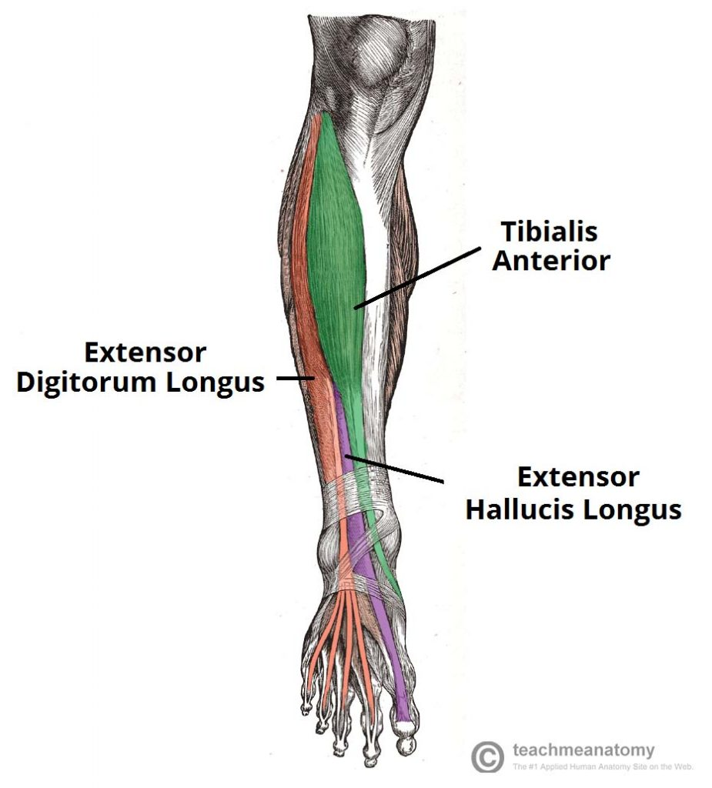

Slide 335
Extensor Digitorum Longus
The extensor digitorum longus lies lateral and deep to the tibialis anterior. The tendons of the EDL can be palpated on the dorsal surface of the foot.
Attachments: Originates from the lateral condyle of the tibia and the medial surface of the fibula. The fibres converge into a tendon, which travels to the dorsal surface of the foot. The tendon splits into four, each inserting onto a toe.
Actions: Extension of the lateral four toes, and dorsiflexion of the foot.
Innervation: Deep fibular nerve.

Slide 336
Extensor Hallucis Longus
The extensor hallucis longus is located deep to the Extensor digitorum longus and Tibialis anterior.
Attachments: Originates from the medial surface of the fibular shaft. The tendon crosses anterior to the ankle joint and attaches to the base of the distal phalanx of the great toe.
Action: Extension of the great toe and dorsiflexion of the foot.
Innervation: Deep fibular nerve.

Slide 337
Fibularis Tertius
The fibularis tertius muscles arises from the most inferior part of the EDL. It is not present in all individuals and is considered by some texts as a part of the extensor digitorum longus.
Attachments: Originates with the extensor digitorum longus from the medial surface of the fibula. The tendon descends with the EDL, until they reach the dorsal surface of the foot. The fibularis tertius tendon then diverges and attaches to metatarsal V.
Actions: Eversion and dorsiflexion of the foot.
Innervation: Deep fibular nerve.

Slide 338
Muscles in lateral compartment of the leg
There are two muscles in the lateral compartment of the leg; the fibularis longus and brevis (also known as peroneal longus and brevis).
The common function of the muscles is eversion – turning the sole of the foot outwards. They are both innervated by the superficial fibular nerve.

Slide 339
Fibularis longus
The fibularis longus is the larger and more superficial muscle within the compartment.
Attachments
The fibularis longus originates from the superior and lateral surface of the fibula and the lateral tibial condyle.
The fibres converge into a tendon, which descends into the foot, posterior to the lateral malleolus.
The tendon crosses under the foot, and attaches to the bones on the medial side, namely the medial cuneiform and base of metatarsal I.
Actions: Eversion and plantarflexion of the foot. Also supports the lateral and transverse arches of the foot.
Innervation: Superficial fibular (peroneal) nerve, L4-S1.

Slide 340
Fibularis brevis
The fibularis brevis muscles is deeper and shorter than the fibularis longus.
Attachments:
Originates from the inferolateral surface of the fibular shaft. The muscle belly forms a tendon, which descends with the fibularis longus into the foot.
It travels posteriorly to the lateral malleolus, passing over the calcaneus and the cuboidal bones.
The tendon then attaches to a tubercle on metatarsal V.
Actions: Eversion of the foot.
Innervation: Superficial fibular (peroneal) nerve, L4-S1.

Slide 341
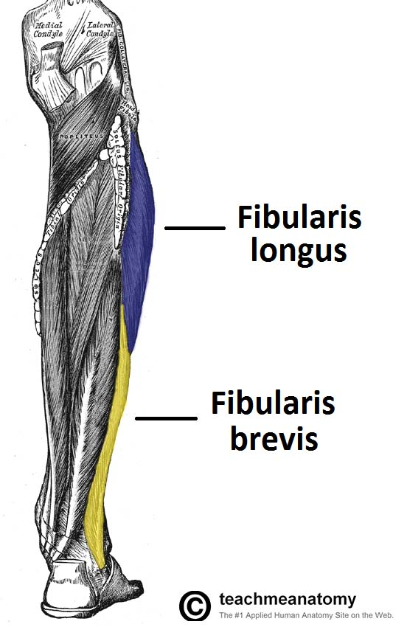

Slide 342
Muscles on posterior compartment of the leg
The posterior compartment of the leg contains seven muscles, organised into two layers – superficial and deep. The two layers are separated by a band of fascia.
The posterior leg is the largest of the three compartments. Collectively, the muscles in this area plantarflex and invert the foot. They are innervated by the tibial nerve, a terminal branch of the sciatic nerve.

Slide 343
Superficial Muscles
The superficial muscles form the characteristic ‘calf’ shape of the posterior leg. They all insert into the calcaneus of the foot (the heel bone), via the calcaneal tendon. The calcaneal reflex tests spinal roots S1-S2.
To minimise friction during movement, there are two bursae (fluid filled sacs) associated with the calcaneal tendon:
Subcutaneous calcaneal bursa – lies between the skin and the calcaneal tendon.
Deep bursa of the calcaneal tendon – lies between the tendon and the calcaneus.

Slide 344
a. Gastrocnemius
The gastrocnemius is the most superficial of all the muscles in the posterior leg. It has two heads – medial and lateral, which converge to form a single muscle belly.
Attachments: The lateral head originates from the lateral femoral condyle, and medial head from the medial femoral condyle. The fibres converge, and form a single muscle belly. In the lower part of the leg, the muscle belly combines with the soleus to from the calcaneal tendon, with inserts onto the calcaneus (the heel bone).
Actions: It plantarflexes at the ankle joint, and because it crosses the knee, it is a flexor there.
Innervation: Tibial nerve.

Slide 345
b. Plantaris
The plantaris is a small muscle with a long tendon, which can be mistaken for a nerve as it descends down the leg. It is absent in 10% of people.
Attachments: Originates from the lateral supracondylar line of the femur. The muscle descends medially, condensing into a tendon that runs down the leg, between the gastrocnemius and soleus. The tendon blends with the calcaneal tendon.
Actions: It plantarflexes at the ankle joint, and because it crosses the knee, it is a flexor there. It is not a vital muscle for these movements.
Innervation: Tibial nerve.

Slide 346
c. Soleous
The soleus is located deep to the gastrocnemius. It is large and flat, named soleus due to its resemblance of a sole – a flat fish.
Attachments: Originates from the soleal line of the tibia and proximal fibular area. The muscle narrows in the lower part of the leg, and joins the calcaneal tendon.
Actions: Plantarflexes the foot at the ankle joint.
Innervation: Tibial Nerve.

Slide 347
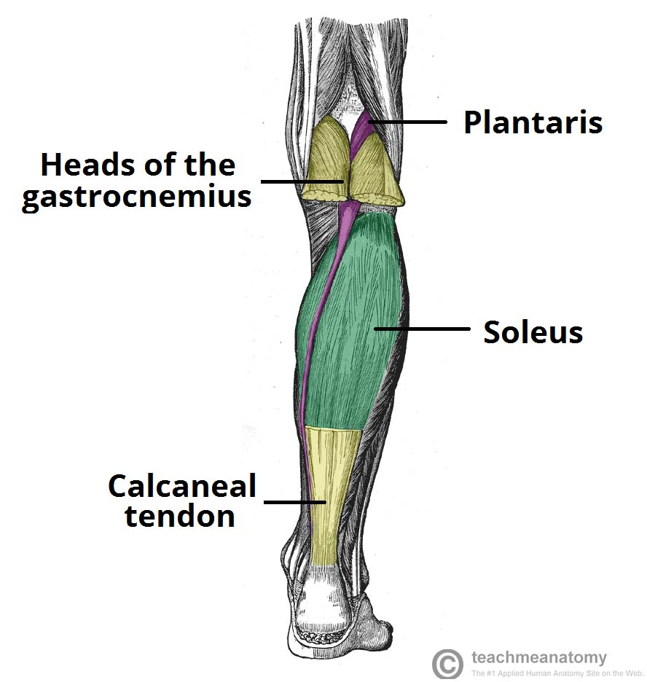

Slide 348
Deep muscles
There are four muscles in the deep compartment of the posterior leg.
One muscle, the popliteus, acts only on the knee joint.
The remaining three muscles (tibialis posterior, flexor hallucis longus and flexor digitorum longus) act on the ankle and foot.

Slide 349
a. Popliteus
The popliteus is located superiorly in the leg. It lies behind the knee joint, forming the base of the popliteal fossa.
There is a bursa (fluid filled sac) that lies between the popliteal tendon and the posterior surface of the knee joint. It is called the popliteus bursa.
Attachments: Originates from the lateral condyle of the femur and the posterior horn of the lateral meniscus. From there, it runs inferomedially towards the tibia and inserts above the origin of the soleus muscle.
Actions: Laterally rotates the femur on the tibia – ‘unlocking’ the knee joint so that flexion can occur.
Innervation: Tibial nerve.

Slide 350
b. Tibialis Posterior
The tibialis posterior is the deepest out of the four muscles. It lies between the flexor digitorum longus and the flexor hallucis longus.
Attachments: Originates from the interosseous membrane between the tibia and fibula, and posterior surfaces of the two bones. The tendon enters the foot posterior to the medial malleolus, and attaches to the plantar surfaces of the medial tarsal bones.
Actions: Inverts and plantarflexes the foot, maintains the medial arch of the foot.
Innervation: Tibial nerve.

Slide 351
C. Flexor Digitorum Longus
The FDL is (surprisingly) a smaller muscle than the flexor hallucis longus. It is located medially in the posterior leg.
Attachments: Originates from the medial surface of the tibia, attaches to the plantar surfaces of the lateral four digits.
Actions: Flexes the lateral four toes.
Innervation: Tibial nerve.

Slide 352
d. Flexor Hallucis Longus
The flexor hallucis longus muscle is found on the lateral side of leg. This is slightly counter-intuitive, as it is opposite the great toe, which it acts on.
Attachments: Originates from the posterior surface of the fibula, attaches to the plantar surface of the phalanx of the great toe.
Actions: Flexes the great toe.
Innervation: Tibial nerve.

Slide 353
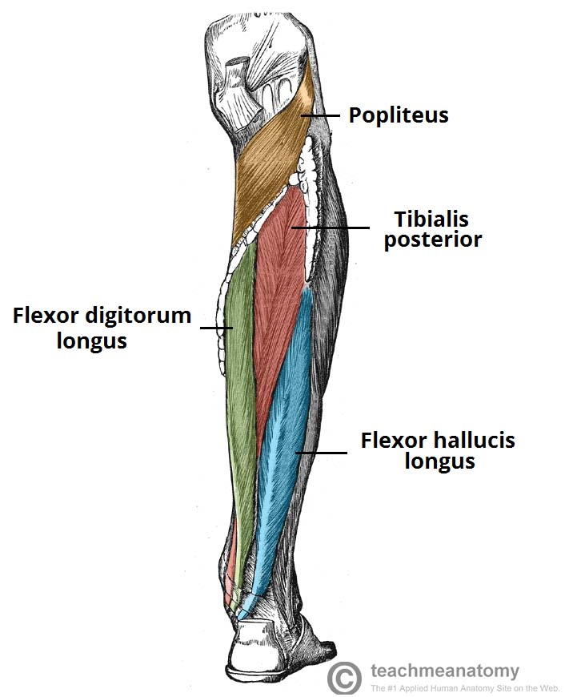

Slide 354
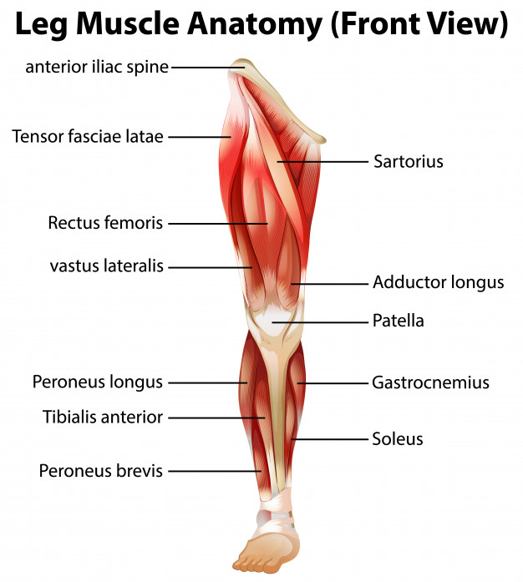

Slide 355
Muscles of the foot
The muscles acting on the foot can be divided into two distinct groups; extrinsic and intrinsic muscles
The extrinsic muscles arise from the anterior, posterior and lateral compartments of the leg. They are mainly responsible for actions such as eversion, inversion, plantarflexion and dorsiflexion of the foot.
The intrinsic muscles are located within the foot and are responsible for the fine motor actions of the foot, for example movement of individual digits.

Slide 356
They can be divided into those situated on the dorsum of the foot, and those in the sole of the foot.
Dorsal Aspect
Whilst many of the extrinsic muscles attach to the dorsum of the foot, there are only two intrinsic muscles located in this compartment – the extensor digitorum brevis, and the extensor hallucis brevis.
They are mainly responsible for assisting some of the extrinsic muscles in their actions. Both muscles are innervated by the deep fibular nerve.

Slide 357
a. Extensor Digitorum Brevis
The extensor digitorum brevis muscle lies deep to the tendon of the extensor digitorum longus.
Attachments: Originates from the calcaneus, the interosseous talocalcaneal ligament and the inferior extensor retinaculum. It attaches to proximal phalanx of the great toe and the long extensor tendons of toes 2-4.
Actions: Aids the extensor digitorum longus in extending the medial four toes at the metatarsophalangeal and interphalangeal joints.
Innervation: Deep fibular nerve

Slide 358
b. Extensor Hallucis Brevis
The extensor hallucis brevis muscle is medial to extensor digitorum longus and lateral to extensor hallucis longus.
Attachments: Originates from the calcaneus, the interosseous talocalcaneal ligament and the inferior extensor retinaculum. It attaches to the base of the proximal phalanx of the great toe.
Actions: Aids the extensor hallucis longus in extending the great toe at the metatarsophalangeal joint.
Innervation: Deep fibular nerve.

Slide 359
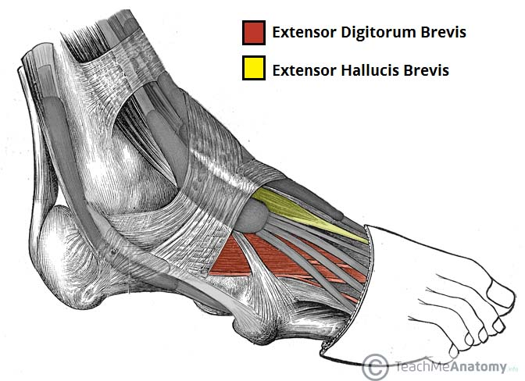

Slide 360
Plantar aspect
There are 10 intrinsic muscles located in the sole of the foot. They act collectively to stabilise the arches of the foot, and individually to control movement of the digits.
All the muscles are innervated either by the medial plantar nerve or the lateral plantar nerve, which are both branches of the tibial nerve.
The muscles of the plantar aspect are described in four layers (superficial to deep).

Slide 361
First Layer
The first layer of muscles is the most superficial to the sole, and is located immediately underneath the plantar fascia. There are three muscles in this layer.
Abductor Hallucis
The abductor hallucis muscle is located on the medial side of the sole, where it contributes to a small soft tissue bulge.
Attachments: Originates from the medial tubercle of the calcaneus, the flexor retinaculum and the plantar aponeurosis. It attaches to the medial base of the proximal phalanx of the great toe.
Actions: Abducts and flexes the great toe.
Innervation: Medial plantar nerve.

Slide 362
Flexor Digitorum Brevis
The flexor digitorum brevis muscle is located laterally to the abductor hallucis. It sits in the centre of the sole, sandwiched between the plantar aponeurosis and the tendons of flexor digitorum longus.
Attachments: Originates from the medial tubercle of the calcaneus and the plantar aponeurosis. It attaches to the middle phalanges of the lateral four digits.
Actions: Flexes the lateral four digits at the proximal interphalangeal joints.
Innervation: Medial plantar nerve.

Slide 363
Abductor Digiti Minimi
The abductor digiti minimi muscle is located on the lateral side of the foot. It is homologous with the abductor digiti minimi of the hand.
Attachments: Originates from the medial and lateral tubercles of the calcaneus and the plantar aponeurosis. It attaches to the lateral base of the proximal phalanx of the 5th digit.
Actions: Abducts and flexes the 5th digit.
Innervation: Lateral plantar nerve.

Slide 364
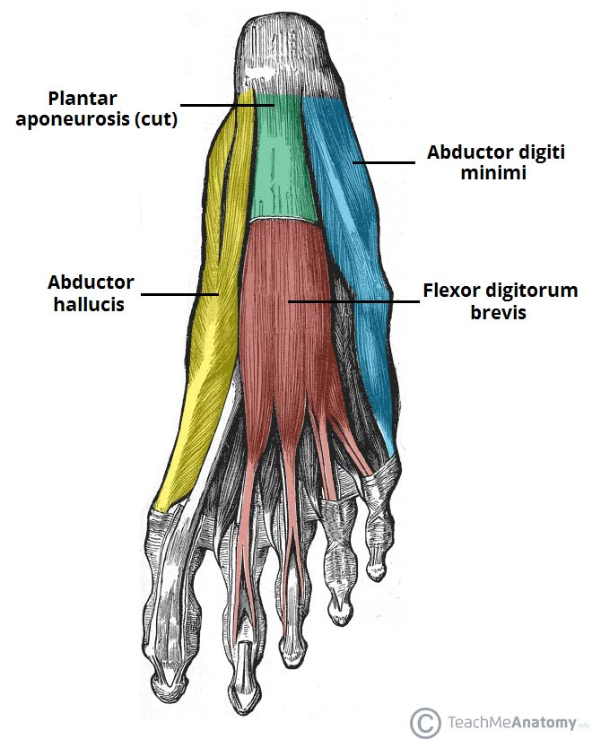

Slide 365
Second Layer
The second layer contains two muscles – the quadratus plantae, and the lumbricals. In addition, the tendons of the flexor digitorum longus (an extrinsic muscle of the foot) pass through this layer.
Quadratus Plantae
The quadratus plantae muscle is located superior to the flexor digitorum longus tendons. It is separated from the first layer of muscles by the lateral plantar vessels and nerve.
Attachments: Originates from the medial and lateral plantar surface of the calcaneus. It attaches to the tendons of flexor digitorum longus.
Actions: Assists flexor digitorum longus in flexing the lateral four digits.
Innervation: Lateral plantar nerve.

Slide 366
Lumbricals
There are four lumbrical muscles in the foot. They are each located medial to their respective tendon of the flexor digitorum longus.
Attachments: Originates from the tendons of flexor digitorum longus. Attaches to the extensor hoods of the lateral four digits.
Actions: Flexes at the metatarsophalangeal joints, while extending the interphalangeal joints.
Innervation: The most medial lumbrical is innervated by the medial plantar nerve. The remaining three are innervated by the lateral plantar nerve.

Slide 367
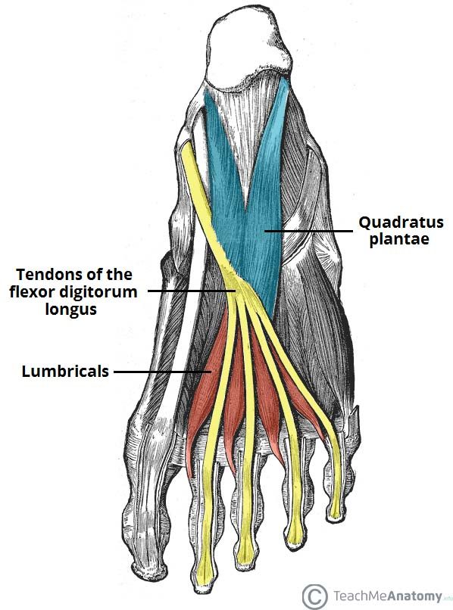

Slide 368
Third Layer
The third layer contains three muscles. The flexor hallucis brevis and adductor hallucis are associated with movements of the great toe. The remaining muscle, the flexor digiti minimi brevis, moves the little toe.
Flexor Hallucis Brevis
The flexor hallucis brevis muscle is located on the medial side of the foot. It originates from two places on the sole of the foot.
Attachments: Originates from the plantar surfaces of the cuboid and lateral cuneiforms, and from the tendon of the posterior tibialis tendon. Attaches to the base of the proximal phalanx of the great toe.
Actions: Flexes the proximal phalanx of the great toe at the metatarsophalangeal joint.
Innervation: Medial plantar nerve.

Slide 369
Adductor Hallucis
The adductor hallucis muscle is located laterally to the flexor hallucis brevis. It consists of an oblique and transverse head.
Attachments: The oblique head originates from the bases of the 2nd, 3rd and 4th metatarsals. The transverse head originates from the plantar ligaments of the metatarsophalangeal joints. Both heads attach to the lateral base of the proximal phalanx of the great toe.
Actions: Adduct the great toe. Assists in forming the transverse arch of the foot.
Innervation: Deep branch of lateral plantar nerve.

Slide 370
Flexor Digiti Minimi Brevis
The flexor digiti minimi brevis muscle is located on the lateral side of the foot, underneath the metatarsal of the little toe. It resembles the interossei in structure.
Attachments: Originates from the base of the fifth metatarsal. Attaches to the base of the proximal phalanx of the fifth digit.
Actions: Flexes the proximal phalanx of the fifth digit.
Innervation: Superficial branch of lateral plantar nerve.

Slide 371
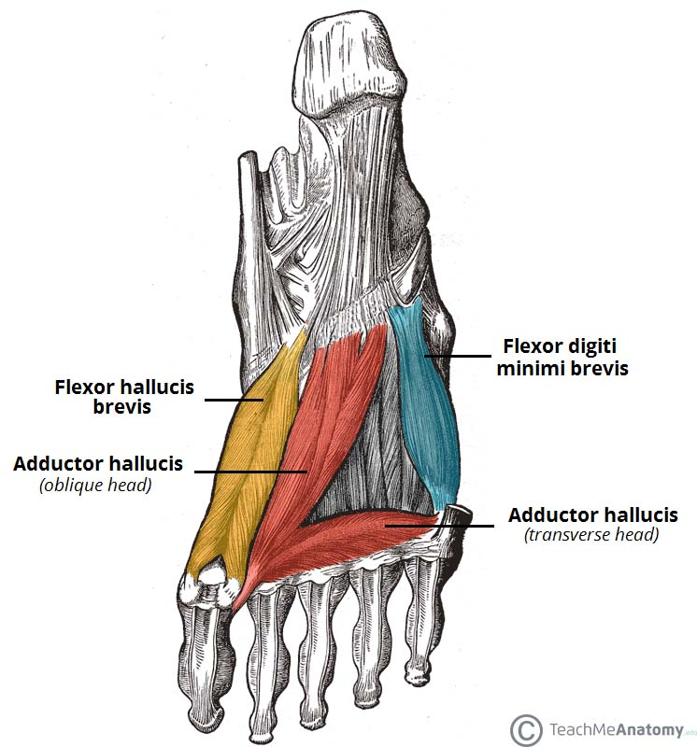

Slide 372
Fourth Layer
The plantar and dorsal interossei comprise the fourth and final plantar muscle layer. The plantar interossei have a unipennate morphology, while the dorsal interossei are bipennate.
Plantar Interossei
There are three plantar interossei, which are located between the metatarsals. Each arises from a single metatarsal.
Attachments: Originates from the medial side of metatarsals three to five. Attaches to the medial sides of the phalanges of digits three to five.
Actions: Adduct digits three to five and flex the metatarsophalangeal joints.
Innervation: Lateral plantar nerve.

Slide 373
Dorsal Interossei
There are four dorsal interossei, which are located between the metatarsals. Each arises from two metatarsals.
Attachments: Originates from the sides of metatarsals one to five. The first muscle attaches to the medial side of the proximal phalanx of the second digit. The second to fourth interossei attach to the lateral sides of the proximal phalanxes of digits two to four.
Actions: Abduct digits two to four and flex the metatarsophalangeal joints.
Innervation: Lateral plantar nerve.

Slide 374
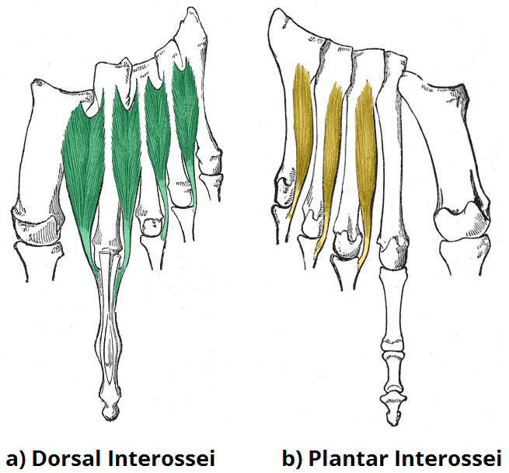

Slide 375
Joints of the lower limb
The joints of free lower limb comprise the articulations from lower extremity, excepted the pelvic girdle:
Hip
Knee
Tibiofibular
Ankle
Intertarsal
Tarsometatarsal
Intermetatarsal
Metatarsophalangeal
Articulations of the Digits

Slide 376
Hip joint
This ball and socket joint is formed by the cup-shaped acetabulum of the innominate (hip) bone and the almost spherical head of the femur.
The capsular ligament encloses the head and most of the neck of the femur. The cavity is deepened by the acetabular labrum, a ring of fibrocartilage attached to the rim of the acetabulum, which stabilises the joint without limiting its range of movement.
The hip joint is necessarily a sturdy and powerful joint, since it bears all body weight when standing upright.
It is stabilised by its surrounding musculature, but its ligaments are also important.

Slide 377
The three main external ligaments are the iliofemoral, pubofemoral and ischiofemoral ligaments, which are localised thickenings of the joint capsule .
Within the joint, the ligament of the head of the femur (ligamentum teres) attaches the femoral head to the acetabulum

Slide 378
Movements at the hip joint
Movements which take place at the hip joint are:flexion, mainly due to contraction of the iliopsoas muscle, with help from sartorius, rectus femoris and pectineus.
Extension, chiefly by the gluteus maximus muscle with help by the hamstrings
Adduction, by the adductors longus, brevis, magnus and the gracilis

Slide 379
Lateral rotation, by gluteus maximus, quadratus femoris, piriformis, obturator internus and externus, gemelli.
Medial rotation, by anterior part of the gluteus minimus and medius and tensor fasciae latae muscles
Abduction by Gluteus medius and minimus, sartorius

Slide 380
Ligaments
The ligaments of the hip joint act to increase stability. They can be divided into two groups – intracapsular and extracapsular:
Intracapsular
The only intracapsular ligament is the ligament of head of femur. It is a relatively small structure, which runs from the acetabular fossa to the fovea of the femur.
It encloses a branch of the obturator artery (artery to head of femur), a minor source of arterial supply to the hip joint.

Slide 381
Extracapsular
There are three main extracapsular ligaments, continuous with the outer surface of the hip joint capsule:
Iliofemoral ligament – arises from the anterior inferior iliac spine and then bifurcates before inserting into the intertrochanteric line of the femur.
It has a ‘Y’ shaped appearance, and prevents hyperextension of the hip joint. It is the strongest of the three ligaments.
Pubofemoral – spans between the superior pubic rami and the intertrochanteric line of the femur, reinforcing the capsule anteriorly and inferiorly.
It has a triangular shape, and prevents excessive abduction and extension.
Ischiofemoral– spans between the body of the ischium and the greater trochanter of the femur, reinforcing the capsule posteriorly.
It has a spiral orientation, and prevents hyperextension and holds the femoral head in the acetabulum.

Slide 382
Nerves to hip joint
The hip joint is supplied by the:
Femoral- lateral and medial circumflex femoris are the main supplies- branches of profunda femoris artery (deep femoral artery).
obturator
sciatic
nerve to quadratus femoris
direct branches of sacral plexus

Slide 383
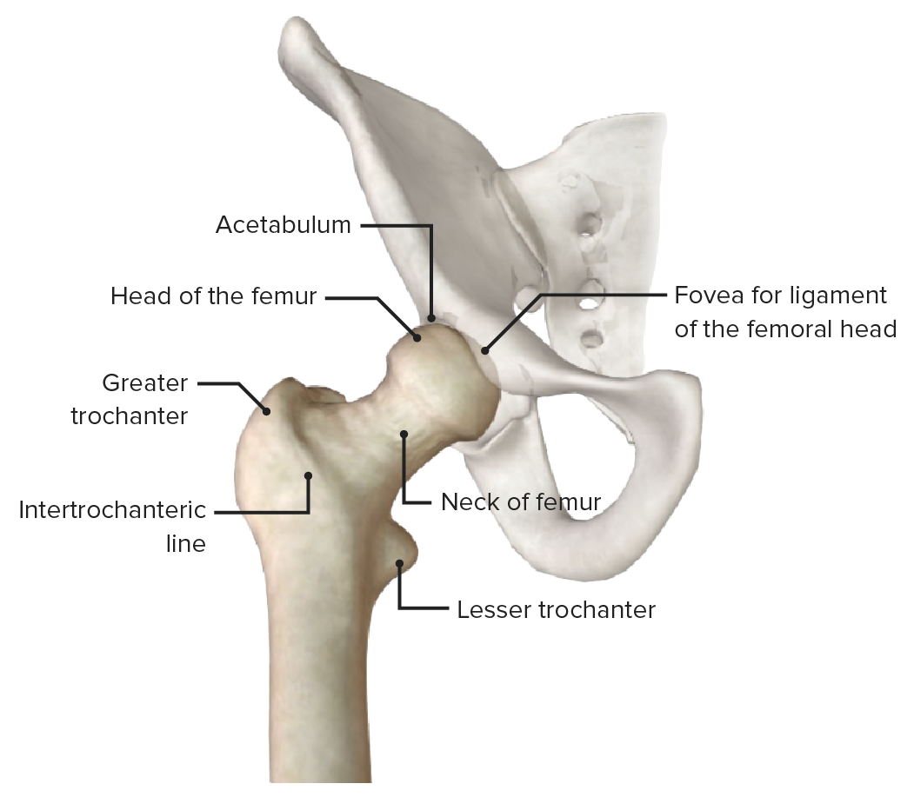

Slide 384
Knee joint
This is the largest and most complex joint. It is a synovial hinge joint formed by the condyles of the femur, the condyles of the tibia and the posterior surface of the patella.
The anterior part of the capsule is formed by the tendon of the quadriceps femoris muscle, which also supports the patella.
Intracapsular structures include two cruciate ligaments that cross each other, extending from the intercondylar notch of the femur to the intercondylar eminence of the tibia. They help to stabilise the joint

Slide 385
Semilunar cartilages or menisci are incomplete discs of white fibrocartilage lying on top of the articular condyles of the tibia They are wedge shaped, being thicker at their outer edges, and provide stability. They prevent lateral displacement of the bones, and cushion the moving joint by shifting within the joint space according to the relative positions of the articulating bones.
Bursae and pads of fat are numerous. They prevent friction between a bone and a ligament or tendon and between the skin and the patella.

Slide 386
Synovial membrane covers the cruciate ligaments and the pads of fat. The menisci are not covered with synovial membrane because they are weight bearing.
External ligaments of the joint provide further support, making it a hard joint to dislocate. The main ligaments are the patellar ligament, an extension of the quadriceps tendon, the popliteal ligaments at the back of the knee and the collateral ligaments to each side.

Slide 387
Articulating Surfaces
The knee joint consists of two articulations – tibiofemoral and patellofemoral. The joint surfaces are lined with hyaline cartilage and are enclosed within a single joint cavity.
Tibiofemoral – medial and lateral condyles of the femur articulate with the tibial condyles. It is the weight-bearing component of the knee joint.
Patellofemoral – anterior aspect of the distal femur articulates with the patella. It allows the tendon of the quadriceps femoris (knee extensor) to be inserted directly over the knee – increasing the efficiency of the muscle.

Slide 388
Ligaments of knee joint
Patellar ligament – a continuation of the quadriceps femoris tendon distal to the patella. It attaches to the tibial tuberosity.
Collateral ligaments – two strap-like ligaments. They act to stabilise the hinge motion of the knee, preventing excessive medial or lateral movement
Tibial (medial) collateral ligament – wide and flat ligament, found on the medial side of the joint. Proximally, it attaches to the medial epicondyle of the femur, distally it attaches to the medial condyle of the tibia.
Fibular (lateral) collateral ligament – thinner and rounder than the tibial collateral, this attaches proximally to the lateral epicondyle of the femur, distally it attaches to a depression on the lateral surface of the fibular head.

Slide 389
Cruciate Ligaments – these two ligaments connect the femur and the tibia. In doing so, they cross each other, hence the term ‘cruciate’ (Latin for like a cross)
Anterior cruciate ligament – attaches at the anterior intercondylar region of the tibia where it blends with the medial meniscus. It ascends posteriorly to attach to the femur in the intercondylar fossa. It prevents anterior dislocation of the tibia onto the femur.
Posterior cruciate ligament – attaches at the posterior intercondylar region of the tibia and ascends anteriorly to attach to the anteromedial femoral condyle. It prevents posterior dislocation of the tibia onto the femur.

Slide 390
Movements at the knee joint
The main movement at the knee joint it flexion and extension
There are several muscles that flex the leg at the knee joint: hamstring muscles, sartorius, gracilis, gastrocnemius
The main extensor is the quadriceps femoris muscle. The muscle that locks the knee into full extension is the tensor fasciae latae and gluteus maximus by way of the iliotibial tract.

Slide 391
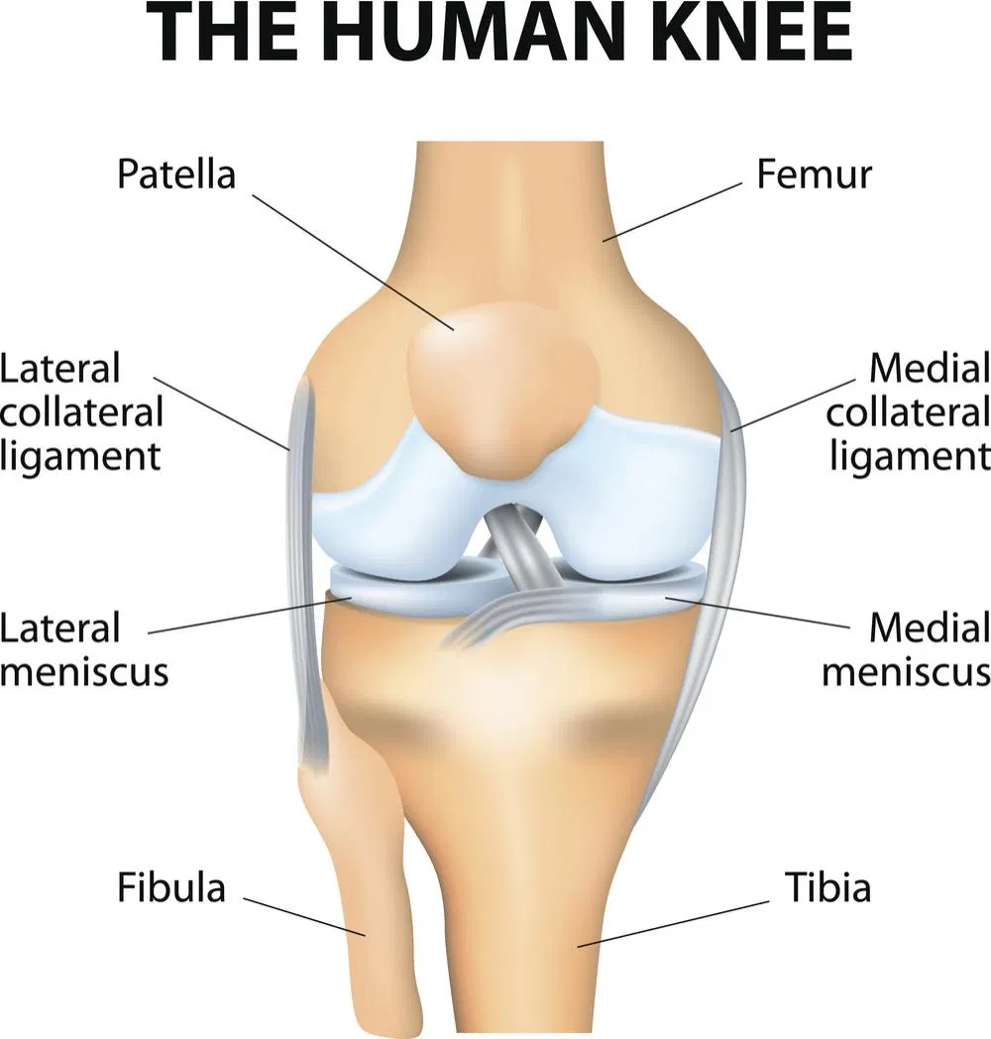

Slide 392
Ankle Joint
The ankle joint is an articulation between the tibia, fibula and talus. It is a synovial hinge joint with only two movements possible, dorsiflexion (extension) or plantarflexion (flexion).
There are four important ligaments strengthening this joint: the deltoid and the anterior, posterior, medial and lateral ligaments.

Slide 393
Movement and muscles
The movements of inversion and eversion occur between the tarsal bones and not at the ankle joint
Dorsiflexion (lifting toes towards calf)- is produced by Anterior tibialis and toe extensors
Plantar flexion (rising on tiptoe) – produced by Gastrocnemius, soleus and toe flexors

Slide 394
Tibiofibular joints
The proximal and distal tibiofibular joints refer to two articulations between the tibia and fibula of the leg. These joints have minimal function in terms of movement but play a greater role in stability and weight-bearing.

Slide 395
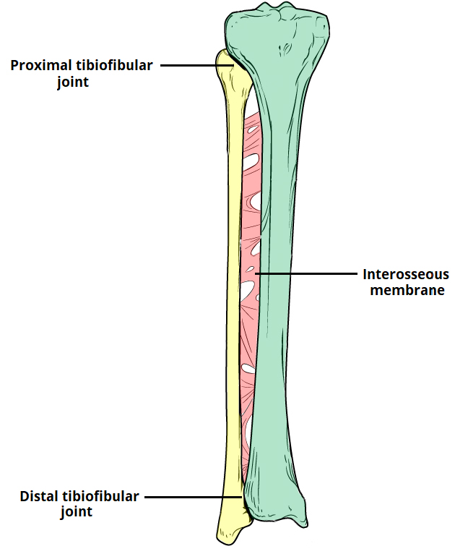

Slide 396
Proximal Tibiofibular Joint
Articulating Surfaces
The proximal tibiofibular joint is formed by an articulation between the head of the fibula and the lateral condyle of the tibia.
It is a plane type synovial joint; where the bones to glide over one another to create movement.

Slide 397
Supporting Structures
The articular surfaces of the proximal tibiofibular joint are lined with hyaline cartilage and contained within a joint capsule.
The joint capsule receives additional support from:
Anterior and posterior superior tibiofibular ligaments – span between the fibular head and lateral tibial condyle
Lateral collateral ligament of the knee joint
Biceps femoris – provides reinforcement as it inserts onto the fibular head.
Neurovascular Supply
The arterial supply to the proximal tibiofibular joint is via the inferior genicular arteries and the anterior tibial recurrent arteries.
The joint is innervated by branches of the common fibular nerve and the nerve to the popliteus (a branch of the tibial nerve).
By TeachM2021)

Slide 398
Distal tibiofibular joint
Articulating Surfaces
The distal (inferior) tibiofibular joint consists of an articulation between the fibular notch of the distal tibia and the fibula.
It is an example of a fibrous joint, where the joint surfaces are by bound by tough, fibrous tissue.
Supporting Structures
The distal tibiofibular joint is supported by:
Interosseous membrane – a fibrous structure spanning the length of the tibia and fibula.
Anterior and posterior inferior tibiofibular ligaments

Slide 399
Inferior transverse tibiofibular ligament – a continuation of the posterior inferior tibiofibular ligament.
As it is a fibrous joint, the distal tibiofibular joint does not have a joint capsule (only synovial joints have a joint capsule).
Neurovascular Supply
Arterial supply to the distal tibiofibular joint is via branches of the fibular artery and the anterior and posterior tibial arteries.
The nerve supply is derived from the deep peroneal and tibial nerves.

Slide 400
Subtalar joint
The subtalar joint ((talocalcaneal joint) is an articulation between posterior surface of two of the tarsal bones in the foot – the talus and calcaneus. The joint is classed structurally as a synovial joint, and functionally as a plane synovial joint.
Articulating Surfaces
The subtalar joint is formed between two of the tarsal bones:
Inferior surface of the body of the talus – the posterior talar articular surface.
Superior surface of the calcaneus – the posterior calcaneal articular facet.
As is typical for a synovial joint, these surfaces are covered by articular cartilage.

Slide 401
Stability
The subtalar joint is enclosed by a joint capsule, which is lined internally by synovial membrane and strengthened externally by a fibrous layer. The capsule is also supported by three ligaments:
Posterior talocalcaneal ligament
Medial talocalcaneal ligament
Lateral talocalcaneal ligament
An additional ligament – the interosseous talocalcaneal ligament – acts to bind the talus and calcaneus together. It lies within the sinus tarsi (a small cavity between the talus and calcaneus), and is particularly strong; providing the majority of the ligamentous stability to the joint.

Slide 402
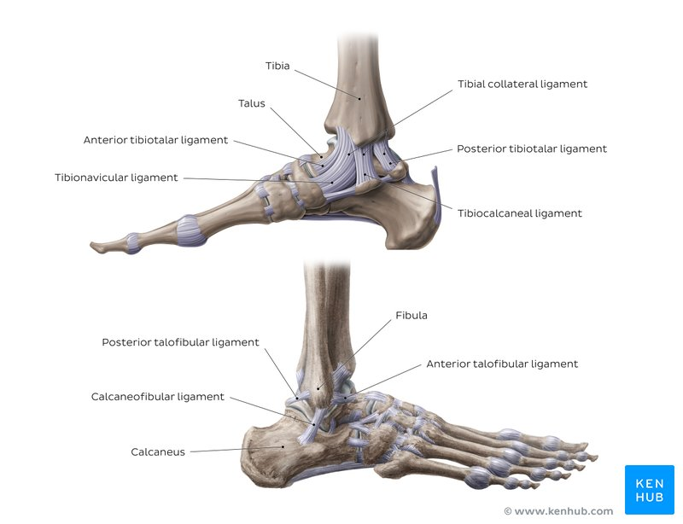

Slide 403
Movements
The subtalar joint is formed on an oblique axis and is therefore the chief site within the foot for generation of eversion and inversion movements. This movement is produced by the muscles of the lateral compartment of the leg. and tibialis anterior muscle respectively.
The nature of the articulating surface means that the subtalar joint has no role in plantar or dorsiflexion of the foot.

Slide 404
Neurovascular Supply
The subtalar joint receives supply from two arteries and two nerves. Arterial supply comes from the posterior tibial and fibular arteries.
Innervation to the plantar aspect of the joint is supplied by the medial or lateral plantar nerve, whereas the dorsal aspect of the joint is supplied by the deep fibular nerve.

Slide 405
Talocalcaneonavicular joint
The talocalcaneonavicular joint consists of two articulations: the anterior articulation of the subtalar joint and the articulation between the talus and the navicular, the talonavicular joint
Ligaments: talonavicular, plantar calcaneonavicular
Innervation: medial plantar, deep fibular nerves

Slide 406
Calcaneocuboid joint
The calaneocuboid joint is a saddle (biaxial) joint, and is formed by the distal surface of the calcaneus and the proximal aspect of the cuboid.
Ligaments
The three ligaments that stabilize this joint are:
The bifurcate ligament-is a Y-shaped band, which attaches proximally to the anterior aspect of the calcaneus. Distally, it divides into two parts: the calacaneocuboid and the calcaneonavicular parts. The calcaneocuboid part attaches to the dorsomedial surface of the cuboid bone whilst the calcaneonavicular part attaches to the dorsolateral aspect of the navicular bone.

Slide 407
The long plantar ligament-the longest ligament associated with the tarsus. It runs from the plantar surface of the calcaneus bone to the tuberosity located on the plantar aspect of the cuboid bone. More superficial fibres continue on to attach to the bases of the second to fourth metatarsals.
The plantar calcaneocuboid ligament-is located deep to the long plantar ligament and is separated from it by areolar tissue. It extends from the anterior tubercle of the calcaneus to the plantar aspect of the cuboid.

Slide 408
Innervation
Innervation of the calcaneocuboid joint is provided by the lateral plantar nerve (plantar aspect), sural and deep fibular nerves (dorsally).
Naviculocuneiform joint
The naviculocuneiform joint is a compound joint and consists of articulations between the navicular and the three cuneiform bones.

Slide 409
Ligaments
Two ligaments help form connections between these bones: the dorsal ligaments and the plantar ligaments.
The dorsal and plantar ligaments connect the navicular bone with each cuneiform. The medial dorsal ligament continues as a capsule around the medial aspect of the joint.
Innervation
Innervation of the naviculocuneiform joint is provided by the deep fibular (dorsally), medial and lateral plantar nerves (plantar surface).

Slide 410
Cuboideonavicular joint
The cuboideonavicular joint is a that connects the cuboid and navicular bones.
This joint is stabilized by dorsal, plantar and interosseus ligaments.
Intercuneiform and cuneocuboid joints
The intercuneiform and cuneocuboid joints are synovial joints involving the cuneiform and cuboid bones.

Slide 411
The bones are connected together by dorsal, plantar and interosseus ligaments.
Both the dorsal and plantar ligaments consist of three transverse bands, which run between the cuneiform bones and between the lateral cuneiform and the cuboid bone. The interosseus ligaments connect non-articular surfaces of the bones.
Innervation
The innervation of these two joints is from the deep fibular nerve (dorsally), medial and lateral plantar nerves (plantar surface).

Slide 412
Tarsometatarsal joints
Metatarsals form articulations with some of the tarsal bones of the foot to form the tarsometatarsal joints.
The first metatarsal articulates with the medial cuneiform, the second with the intermediate cuneiform and the third metatarsal articulates with the lateral cuneiform.
The lateral cuneiform also articulates with the fourth metatarsal and the cuboid bone forms articulations with both the fourth and fifth metatarsals.

Slide 413
There are three bands of ligaments involved in stabilising these joints:
The dorsal tarsometatarsal ligaments
The plantar tarsometatarsal ligaments and;
The interosseus cuneometatarsal ligaments
Innervation
The innervation of the tarsometatarsal joints is from the deep fibular nerve (dorsally), medial and lateral plantar nerves (plantar surface).

Slide 414
Intermetatarsal joints
The intermetatarsal joints are articulations formed between the metatarsal bones and are stabilized by intermetatarsal interosseus ligaments.
These ligaments run between the lateral four metatarsal bones. Dorsal and plantar intermetatarsal ligaments are also involved in the stabilisation of this joint.

Slide 415
Metatarsophalangeal joints
The metatarsophalangeal joints are joints, which consist of articulations between the heads of the metatarsals and the bases of the proximal phalanges.
On the plantar surface of the first metatarsal head, there are two longitudinal grooves separated by a ridge, the crista. These two grooves articulate with the two sesamoid bones within the joint capsule

Slide 416
Ligaments
sesamoid bones are connected together by the intersesamoid ligament. Other ligaments that stabilize the metatarsophalangeal joints include the:
Plantar ligaments
Deep transverse metatarsal ligaments
Collateral ligaments
Innervation
The innervation of the metatarsophalangeal joints is provided by the plantar interdigital nerve, digital branches of the lateral plantar nerve, medial dorsal cutaneous branch of the superficial fibular nerve and the deep fibular nerve.

Slide 417
Interphalangeal joints
The trochlear surface of the phalangeal heads articulates with the curved surface of the bases of the corresponding phalanges to form the interphalangeal joints.
These hinge joints are stabilized by an articular capsule and two collateral ligaments.
Innervation
The innervation of the interphalangeal joints is from the plantar interdigital nerves and the medial dorsal cutaneous branch of the superficial fibular nerve.
Occasionally, branches of the sural, deep fibular and intermediate dorsal cutaneous nerves innervate these joints.

Slide 418
The Arches of foot
The foot has three arches: two longitudinal (medial and lateral) arches and one anterior transverse arch .
They are formed by the tarsal and metatarsal bones, and supported by ligaments and tendons in the foot.
Their shape allows them to act in the same way as a spring, bearing the weight of the body and absorbing the shock produced during locomotion. The flexibility conferred to the foot by these arches facilitates functions such as walking and running.

Slide 419
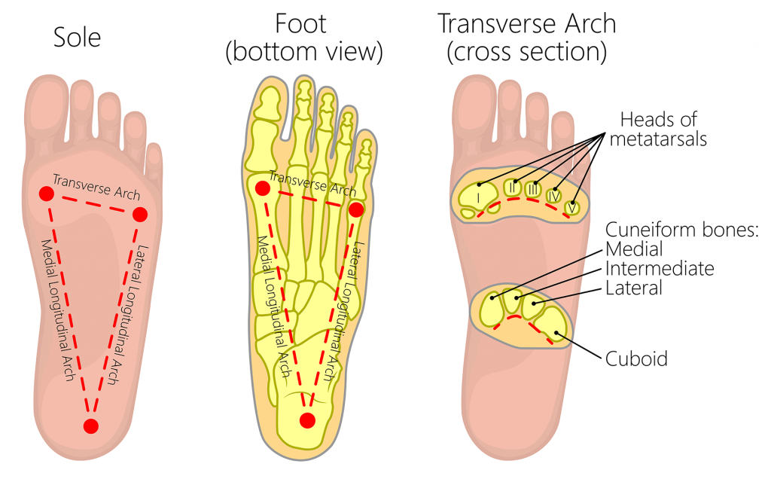

Slide 420
Longitudinal Arches
There are two longitudinal arches in the foot – the medial and lateral arches. They are formed between the tarsal bones and the proximal end of the metatarsals.
Medial Arch
The medial arch is the higher of the two longitudinal arches. It is formed by the calcaneus, talus, navicular, three cuneiforms and first three metatarsal bones. It is supported by:
Muscular support: Tibialis anterior and posterior, fibularis longus, flexor digitorum longus, flexor hallucis, and the intrinsic foot muscles

Slide 421
Ligamentous support: Plantar ligaments (in particular the long plantar, short plantar and plantar calcaneonavicular ligaments), medial ligament of the ankle joint.
Bony support: Shape of the bones of the arch.
Other: Plantar aponeurosis.
Lateral arch
The lateral arch is the flatter of the two longitudinal arches, and lies on the ground in the standing position.
It is formed by the calcaneus, cuboid and 4th and 5th metatarsal bones. It is supported by:

Slide 422
Muscular support: Fibularis longus, flexor digitorum longus, and the intrinsic foot muscles
Ligamentous support: Plantar ligaments (in particular the long plantar, short plantar and plantar calcaneonavicular ligaments).
Bony support: Shape of the bones of the arch.
Other: Plantar aponeurosis.

Slide 423
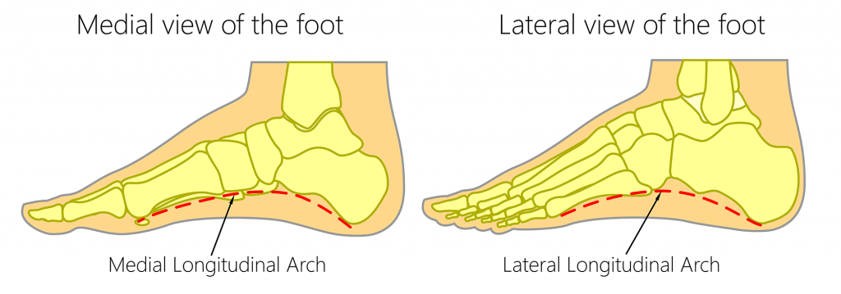

Slide 424
Transverse Arch
The transverse arch is located in the coronal plane of the foot. It is formed by the metatarsal bases, the cuboid and the three cuneiform bones. It has:
Muscular support: Fibularis longus and tibialis posterior.
Ligamentous support: Plantar ligaments (in particular the long plantar, short plantar and plantar calcaneonavicular ligaments) and deep transverse metatarsal ligaments.
Other support: Plantar aponeurosis.
Bony support: The wedged shape of the bones of the arch.

Slide 425
Blood supply to the lower limbs
Arterial supply
Blood supply to lower limbs is provided by femoral artery
This vessel is continous with external iliac artery that originates from abdominal cavity. It enters the thigh through under inguinal ligament.
After entering the thigh the external iliac artery divides into deep femoral artery
Deep femoral artery gives rise to the lateral and medial circumflex femoral artery that provide branches that supply blood to the head and neck of femur and overlying skin and muscles

Slide 426
Deep femoral artery also gives rise to several branches that enter and supply the posterior muscles of the thigh.
The femoral artery continues in a downward and medial direction in the thigh and then passes behind the knee where it’s name changes to popliteal artery. This artery provides several branches to the knee joint before dividing into anterior and posterior tibial arteries.
The anterior tibial artery runs over the interossesous membrane to enter the and supply the anterior compartment of the leg

Slide 427
In the lower part of the leg, it runs in front of the ankle onto the dorsal surface of the foot and become the dorsalis pedis. Here it supplies to the branches ankle and foot and a ‘pedal’ pulse can be felt.
The posterior tibial artery descends in the posterior compartment of the leg in company with the tibial nerve. It gives rise into fibular artery which descends on the lateral side of the leg.
The fibular artery provides branches that supply muscles of the lateral compartment

Slide 428
The posterior tibial artery passes behind medial malleolus to enter the sole of the foot where it terminates by dividing into medial and lateral plantar arteries but supplies the muscles and skin of the sole of the foot
Venous supply/ return
The venous return of blood from the lower limbs like in the upper limb involves superficial and deep veins and perforator veins connecting these two systems
These veins contains numerous one-way valves that through pumping actions of nearby muscles moves venous blood from the lower limbs to ward the heart
The superficial veins called greater and lesser saphenous veins begin onto the dorsum of the foot from dorsal venous arch.

Slide 429
The greater saphenous vein, the longest vein in the body begins its climb from the medial side of the foot in front of malleolus. It passes along the medial side of the leg and thigh before emptying into femoral vein the medial in the upper thigh
The lesser saphenous vein arises from lateral side of the dorsum of the foot and course upwards on the back of the calf to enter the popliteal fossa. Here it empties into popliteal vein.
Popliteal vein is deep vein. It becomes the femoral vein when enters the thigh

Slide 432
Nerve supply to lower limbs
The musculature and skin of the thigh, leg and foot are supplied by the following nerves
Femoral nerve arises from ventral rami of L2,3 and 4 spinal nerves. This nerve enters the thigh by passing beneath the inguinal ligament. Its fibers supply the anterior compartment muscles and much of the skin on the thigh, leg and medial side of the foot.
Obturator nerve-also contains fibers from L2,3 and 4 levels. It supplies the muscles of the medial or adductor compartment and a small area of skin along the upper medial thigh

Slide 433
Sciatic nerve- the largest nerve in the body. It consists of fibers from ventral rami of L4-S3. It leaves the pelvic cavity through the greater sciatic foramen and enters gluteal region. From here it passes downwards into the posterior compartment of the thigh and supplies the muscles in this compartment
The sciatic nerve enters the popliteal fossa where it terminates into common fibular and tibial nerves
Common fibular nerve- wraps around the neck of the fibula and divides into the superficial and deep fibular nerves

Slide 434
The superficial fibular nerve enters the lateral compartment of the leg and supplies the fibularis longus and brevis muscles of this compartment. It also supplies most of the skin on the top of the foot.
The deep fibular nerve enters the anterior compartment of the leg and supplies muscles of this compartment. It has limited sensory supply to the skin between the big and second toe
The tibial nerve- descends in the posterior compartment of the leg and supplies all the muscles in this compartment. It passes behind medial malleolus and enters the sole of the foot. There it divides into the medial and lateral plantar nerves which supplies intrinsic muscles. Its sensory fibers supply the skin on the back of the leg and sole of foot.

Slide 436
Classification of joints
The joints are classified by the type of tissue present (fibrous, cartilaginous or synovial) or by degree of movement permitted (synarthrosis, amphiarthrosis or diarthrosis)
By tissue type
Fibrous- bones connected by fibrous tissue
Cartilaginous- bones connected by cartilage
Synovial – articulating surfaces enclosed within fluid-filled joint capscule

Slide 437
Classification of joints by degree of movement
Synarthrosis (immovable)- include fibrous joints such as suture joints (found in the cranium) and gomphosis joints (found between teeth and sockets of the maxilla and mandible)
Diarthrosis (freely movable)
Amphiarthrosis (slightly movable)- e.g cartilaginous joints such as those found between the vertebrae and the pubic symphysis

Slide 438
Types of joints of freely movable joints
There are six types of freely movable joint diarthrosis (synovial joints)
Ball and socket joint- permitting movements in all directions. Example hip joint, shoulder joint
Hinge joint- the hinge joint is like a door, opening and closing in one direction, along one place. Examples include elbow joint and knee joint
Condyloid- the condyloid joint allows movement but no rotation . Examples include finger joints and jaw joints

Slide 439
4. Pivot joint- also called rotary joint or trochoid joint is characterized by a ring formed from a second bone. Examples are ulna and radius bones that can rotate the forearm and the joint between first and second vertebrae of the neck
5. Gliding joints- also called plane joints. Although it only permits limited movement, its characterized by smooth surfaces that slip over one another. Example is wrist joint.
6. Saddle joint- although it does not allow rotation, it does enable movement back and forth and side to side. Example is bone at the base of the thumb

Slide 441
Femoral triangle
The femoral triangle is a wedge-shaped area located within the superomedial aspect of the anterior thigh.
It acts as a conduit for structures entering and leaving the anterior thigh.

Slide 442
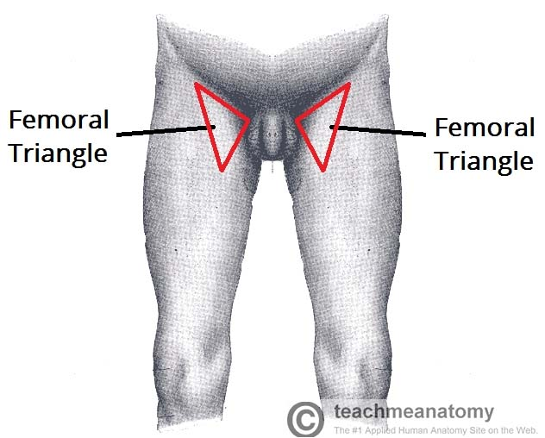
Surface anatomy of femoral triangle

Slide 443
Borders
The femoral triangle consists of three borders, a floor and a roof:
Roof – fascia lata.
Floor – pectineus, iliopsoas, and adductor longus muscles.
Superior border – inguinal ligament (a ligament that runs from the anterior superior iliac spine to the pubic tubercle).
Lateral border – medial border of the sartorius muscle.

Slide 444
Medial border- medial border of the adductor longus muscle. The rest of this muscle forms part of the floor of the triangle
The inguinal ligament acts as a flexor retinaculum, supporting the contents of the femoral triangle during flexion at the hip.

Slide 445
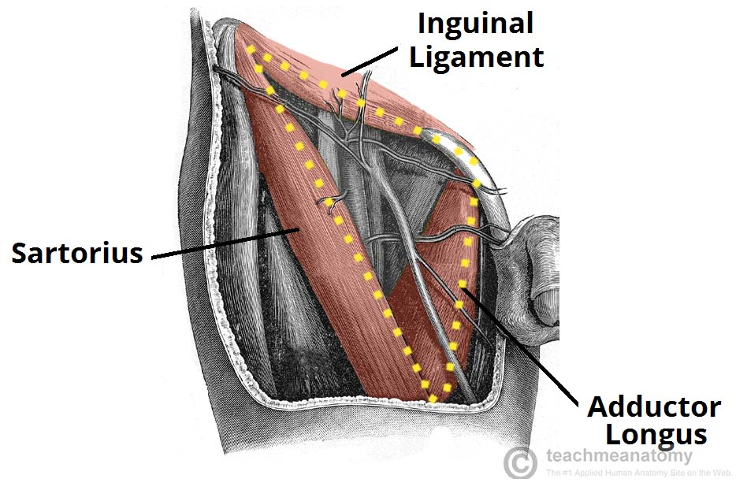
The borders of the right femoral triangle.

Slide 446
Contents of femoral triangle
The femoral triangle contains some of the major neurovascular structures of the lower limb. Its contents (lateral to medial) are:
Femoral nerve – innervates the anterior compartment of the thigh, and provides sensory branches for the leg and foot.
Femoral artery – responsible for the majority of the arterial supply to the lower limb.
Femoral vein – the great saphenous vein drains into the femoral vein within the triangle.
Femoral canal – contains deep lymph nodes and vessels.
The femoral artery, vein and canal are contained within a fascial compartment – known as the femoral sheath.

Slide 447
Acronym for the contents of the femoral triangle (lateral to medial) – NAVEL: Nerve, Artery, Vein, Empty space (allows the veins and lymph vessels to distend to accommodate different levels of flow), Lymph nodes.

Slide 448
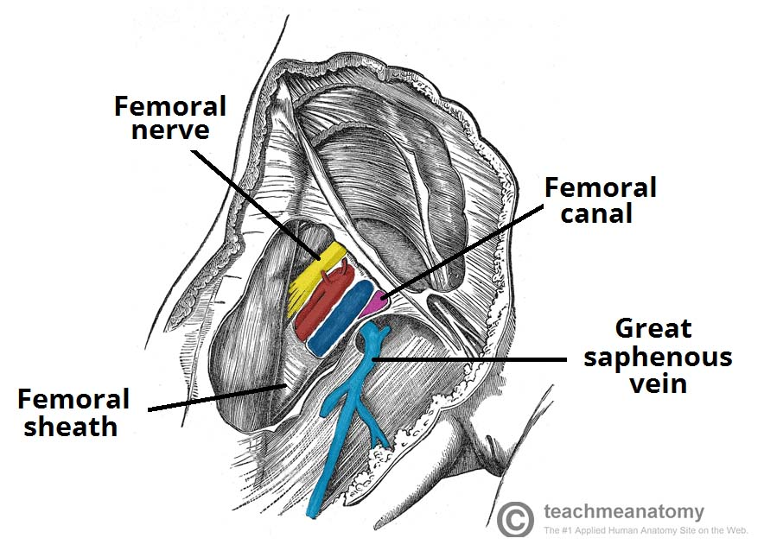
Contents of femoral triangle

Slide 449
Popliteal fossa
The popliteal fossa is a diamond shaped area located on the posterior aspect of the knee. It is the main path by which vessels and nerves pass between the thigh and the leg.
Borders
The popliteal fossa is diamond shaped with four borders. These borders are formed by the muscles in the posterior compartment of the leg and thigh:
Superomedial border – semimembranosus.
Superolateral border – biceps femoris.
Inferomedial border – medial head of the gastrocnemius.
Inferolateral border – lateral head of the gastrocnemius and plantaris

Slide 450
The floor of the popliteal fossa is formed by the posterior surface of the knee joint capsule, popliteus muscle and posterior femur.
The roof is made of up two layers: popliteal fascia and skin. The popliteal fascia is continuous with the fascia lata of the leg.

Slide 451
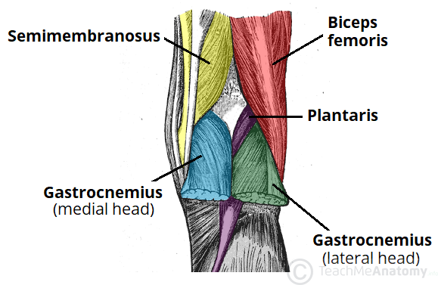

Slide 452
Contents
The popliteal fossa is the main conduit for neurovascular structures entering and leaving the leg. Its contents are (medial to lateral):
Popliteal artery
Popliteal vein
Tibial nerve
Common fibular nerve (common peroneal nerve)

Slide 453
The tibial and common fibular nerves are the most superficial of the contents of the popliteal fossa. They are both branches of the sciatic nerve. The common fibular nerve follows the biceps femoris tendon, travelling along the lateral margin of the popliteal fossa.
The small saphenous vein pierces the popliteal fascia and passes between the two heads of gastrocnemius to empty into the popliteal vein.
In the popliteal fossa, the deepest structure is the popliteal artery. It is a continuation of the femoral artery, and travels into the leg to supply it with blood.

Slide 454
