Slide 1
ANATOMY II (ANT 106)
ORTHOPAEDIC AND TRAUMA MEDICINE
YEAR 1
SEM II

Slide 2
Broad objective
The learner will be able to apply concept in anatomy in application of cast and traction
Specific objectives
demonstrate understanding of anatomical organizations of the upper limb
Identify the structures within chest
Describe structures within the abdominal cavity
Demonstrate understanding of anatomical organization of head and neck

Slide 3
Module content
Upper limb
Chest
Abdomen
Head and neck

Slide 4
Upper limb
The upper limb is associated with the lateral aspect of the lower portion of the neck and with the thoracic wall
Based on the position of its major joints and component bones, the upper limb is divided into; shoulder, arm, forearm, and hand
The shoulder is the area of upper limb attachment to the trunk
The arm is the part of the upper limb between the shoulder and the elbow joint; the forearm is between the elbow joint and the wrist joint; and the hand is distal to the wrist joint.

Slide 5
The axilla, cubital fossa, and carpal tunnel are significant areas of transition between the different parts of the limb.
Important structures pass through, or are related to, each of these areas.

Slide 6
A.BONES OF THE UPPER EXTREMITY AND SHOULDER GIRDLE
The upper extremities consists of 64 bones(each upper limb has 32 bones)
These are;
10 bones of shoulder and upper arm
16 wrist bones and 38 handbones
10 bones of the shoulder and upper arm
Each side of the upper extremity
1 Clavicle
1 Scapula
1 humerus

Slide 7
1 Radius and ulna
Shoulder girdle
The bones of the shoulder consist of the scapula, clavicle, and proximal end of the humerus
The superficial muscles of the shoulder consist of the trapezius and deltoid muscles, which together form the smooth muscular contour over the lateral part of the shoulder. These muscles connect the scapula and clavicle to the trunk and to the arm, respectively

Slide 8
a. The clavicle (collar bone)
Long bone with double curve
The clavicle is the only bony attachment between the trunk and the upper limb.
Its is S-shaped
Medial end (sternal) has a much larger facet for articulation with manubrium of the sternum to form sternoclavicular joint and to a lesser extent, with the first costal cartilage.
Lateral end (acromial end) has a small oval facet on its surface for articulation with acromion process of scapula to form acromioclavicular joint

Slide 9
Ct
The inferior surface of the lateral third of the clavicle possesses a distinct tuberosity consisting of a tubercle (the conoid tubercle ) and lateral roughening (the trapezoid line ), for attachment of the important coracoclavicular ligament.

Slide 11
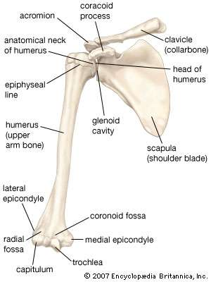

Slide 12
b) Scapula (shoulder blade)
Flat and triangular shaped bow like bone
Lies on posterior chest wall superficial to ribs and separated from them by muscles
Forms shoulder joint where humerus meet the glenoid cavity of the scapula
Posteriorly a spinous process, the acromion process articulates with clavicle to form acromioclavicular joint
A coracoid process a projection from upper borders gives attachment to muscles that move shoulder joint

Slide 13
Ct,
The scapula is a large, flat triangular bone with:
three angles (lateral, superior, and inferior)
three borders (superior, lateral, and medial)
two surfaces (costal and posterior)
three processes (acromion, spine, and coracoid process)

Slide 14
Ct,
The lateral angle of the scapula is marked by a shallow, somewhat comma-shaped glenoid cavity, which articulates with the head of the humerus to form the glenohumeral joint
A large triangular-shaped roughening (the infraglenoid tubercle ) inferior to the glenoid cavity is the site of attachment for the long head of the triceps brachii muscle.
A less distinct supraglenoid tubercle is located superior to the glenoid cavity and is the site of attachment for the long head of the biceps brachii muscle.

Slide 15
A prominent spine subdivides the posterior surface of the scapula into a small, superior supraspinous fossa and a much larger, inferior infraspinous fossa

Slide 17
Upper extremities
The humerus
is an upper arm bone
Head articulates with glenoid cavity to form shoulder joint
Distal to the head are 2 roughed surfaces, the greater and lesser tubercles and between them is bicipital groove or intertrabecular sulcus occupied by one of the tendons of biceps
Distal ends articulates with radius and ulna

Slide 18
Ct,
The two articular parts of the condyle, the capitulum and the trochlea , articulate with the two bones of the forearm.
The capitulum articulates with the radius of the forearm.
The trochlea articulates with the ulna of the forearm.
Three fossae occur superior to the trochlea and capitulum on the distal end of the humerus.

Slide 19
The radial fossa is the least distinct of the fossae and occurs immediately superior to the capitulum on the anterior surface of the humerus.
The coronoid fossa is adjacent to the radial fossa and is superior to the trochlea.
The largest of the fossae, the olecranon fossa , occurs immediately superior to the trochlea on the posterior surface of the distal end of the humerus.
These three fossae accommodate projections from the bones in the forearm during movements of the elbow joint.

Slide 21
Radius and ulna
Are 2 bones of the forearm
Ulna is medial while radius is lateral.
Ulna is longer than radius
The two bones are parallel to each other.
They articulate at the elbow with humerus to form elbow joints
They articulate with carpal joint at the wrist to form wrist joint and with each other at the proximal and distal to form radial ulna joint

Slide 22
An interosseous membrane, a fibrous joint, connects the bones along their shafts, stabilising their association and maintaining their relative positions despite forces applied from the elbow or wrist.
Landmarks of ulna
Olecranon- A large projection of bone forming part of trochlear notch. It can be palpated at the tip of the elbow. The triceps brachii muscles attaches to its superior surface
Trochlear notch- formed by olecranon and coronoid process. It articulates with the trochlear of humerus

Slide 23
Coronoid process- this ridge of bone projects outwards anteriorly forming part of trochlear notch
Radial notch – located on lateral surface of trochlear notch, this area articulates with the head of the radius.
Tuberosity of ulna- A rough surface distal to coronoid process. It is where brachialis muscles attaches

Slide 25
Wrist and handbones

Slide 26
Carpal or wrist bones
Are 8 irregularly shaped bones arranged in two rows i.e proximal and distal
Each row has 4 bones
These bones are held together by ligaments and allow a certain amount of movement
Those proximal form wrist joint also known as radio-carpal joint while those distal form joints with metacarpal to form metacarpal joints
From outside inwards they are:
Proximal row (lateral-medial) consists of : scaphoid, lunate, triquetrum, pisiform
Distal row (lateral-medial) consists of: trapezium, trapezoid, capitate, hamate.

Slide 27
Tendons of muscles lying in the forearm cross the wrist and are held close to the bones by strong fibrous bands, called retinacula

Slide 30
Metacarpal bones
These five bones form the palm of the hand.
The proximal ends articulate with the carpal bones and the distal ends with the phalanges.
They are numbered from the thumb side inwards and each metacarpal is associated with a digit
Metacarpal I –Thumb
Metacarpal II- Index finger
Metacarpal III- Middle finger
Metacarpal IV- Ring finger
Metacarpal V- Little finger

Slide 31
Phalanges (finger bones)
There are 14 phalanges, three in each finger and two in the thumb.
They articulate with the metacarpal bones and with each other, by hinge joints.
The thumb has distal and proximal phalanx while rest of digits have proximal, middle and distal phalanges,

Slide 32
Muscles of the upper extremities and shoulder
Muscles are involved in contraction and relaxation to allow movement of limbs
Upper extremities and shoulder are supplied with skeletal muscles are involved in voluntary movement
These muscles stabilise the association between the appendicular and axial skeletons at the pectoral girdle, and stabilise and allow movement of the shoulders and upper arms.

Slide 33
Muscles of shoulder girdle (anterior muscles)
1. pectoral region muscle
They are 4 in number and consists of pectoral major, pectoral minor, subclavius and serrateous anterior.
a.Pectoralis major
This lies on the anterior thoracic wall.
The fibres originate from the middle third of the clavicle and from the sternum and are inserted into the lip of the intertubercular groove of the humerus.
It draws the arm forward and towards the body, i.e. flexes and adducts.
Innervation: Lateral and medial pectoral nerves

Slide 34
b.Pectoralis minor
Lies underneath pectoralis major.
Form part of axilla region
Originates from 3rd -5th ribs and inserts into the coracoid process of scapula
Stabilises scapula by drawing it anterioinferiorly against thoracic wall
Innervation: Medial pectoral nerve

Slide 35
c.Serratus anterior
Is located more laterally in the chest wall and forms the medial border of the axilla region
They originate from lateral aspects of ribs 1-8.
They attach to costal (rib facing) surface of the medial border of the scapula
Rotates the scapula allowing the arm to be raised over 90 degrees.
Holds scapula against ribcage
Innervated by Long thoracic nerve

Slide 36
d. Subclavius
Is a small muscle located underneath the clavical running horizontally
It gives protection to underlying neurovascular structures e.g in cases of clavicular fracture or other trauma
Originates from the junction of first rib and costal cartilage inserting to inferior surface of the middle third of clavicle
Anchors and depresses the clavicle
Innervated by nerve to subclavius (C5&C6)-A branch of brachial plexus

Slide 39
2.Posterior muscles
Scapula-humeral muscles (intrinsic muscles)
They originate from the scapula and or clavicle and attach to humerus
They 6 in number and include;
Deltoid
Teres major
Rotator cuff muscle-These rotator cuff muscles are 4 in number i.e supraspinatus, infraspinatus, teres minor and subscaspularis

Slide 40
a.Deltoid muscles
These muscle fibres originate from the lateral one third of clavicle, acromion process and spine of scapula and radiate over the shoulder joint to be inserted into the deltoid tuberosity of the humerus.
It forms the fleshy and rounded contour of the shoulder and the main function is movement of the arm.
Movements allowed: abduction of the arm, extension, flexion and medial rotation (anterior fibre) and lateral rotation (posterior fibers) of humerus

Slide 41
They also cause rythmic swinging movement of arm e.g during walking
Innervation: Axillary nerve.
Note: to easily remember the three origins of deltoid use mnemonic SAC
Spine of scapula
Acromion process
Clavicle
b.Teres major
Originates from posterior surface of scapula adjacent to lateral border
It attaches to greater tubercle of humerus
Laterally rotates the arm
innervation: Lower subscapular nerve.

Slide 42
Infraspinatus- originates from medial ¾ infraspinous fossa of scapula and inserts in greater tubercle of humerus. It stabilises the shoulder joint and is involved lateral rotation of the humerus. It is innervated by Suprascapular nerve
Teres minor- Originate from posterior surface of scapula adjacent to its lateral border. It attaches to greater tubercle of the humerus. It is innervated by Axillary nerve
Subscapularis- originates from subscapular fossa on costal surface of scapula. It attaches to lesser tubercle of humerus. It is important in stabilizing the shoulder and in medial rotation of humerus. It is innervated by Upper and lower subscapular nerves

Slide 43
b.Rotator cuff muscles
Supraspinatus- originates from superior surface of spine of the scapula and inserts on superior aspect of greater tubercle of humerus. It stabilizes shoulder joint and prevents downward dislocation of humerus. Allows abduction of the arm. It is innervated by Suprascapular nerve.

Slide 44
Instrinsic muscles/Scapula-humeral muscles

Slide 45
Intrinsic muscles (Rotator cuff muscles)

Slide 46
Extrinsic muscles (axial –appendicular muscles)

Slide 47
3. Axio-appendicular muscles (extrinsic muscles)
Connect axial skeleton to appendicular skeleton
They originate from torso (trunk) and attach to bones of shoulder (clavicle, scapula or humerus)
The muscles are both deep and superficial muscles
Superficial layer- trapezium and latissmus dorsi
Deep layer- levator scapula, rhomboid major and rhomboid minor

Slide 48
a.Trapezium-
is flat and triangular muscle. Is the most superficial of all back muscles. originates from the skull, nuchal ligament and spinous process 0f C7-T12.
The fibres attach to the clavicle, acromion and scapula spine.
Upper fibers rotates it during adduction of arm.
Middle fibres retract the scapula and lower fibres pull scapula inferiorly
Innervation: Motor innervation is from the accessory nerve. It also receives proprioceptor fibres (sensory receptors) from C3 and C4 spinal nerves.

Slide 49
b.Latissmus Dorsi
Is superficial and originates from lower thoracic vertebrae , the 3rd and 4th ribs, iliac crest and lumbar vertebrae
It inserts to intertubercular sulcus of humerus
It extends, adducts and medially rotates the upper limb
Innervated by Thoracodorsal nerve

Slide 50
c.Levator scapula
It is a deep muscle
It begins in the neck and extends to the scapula
Originates from transverse processes of C1-C4 vertebrae and attaches to medial border of scapula
It elevates the scapula
It is innervated by Dorsal scapular nerve

Slide 51
d. Rhomboids
Are deep muscles
There are 2 rhomboid muscles-major an minor
Rhomboid minor is located superiorly to major
Rhomboid major- originates from spinous processes of T2-T5 vertebrae. Attaches to medial border of scapula between scapula spine and inferior angle. It retracts and rotates scapula. It is innervated by Dorsal scapular nerve
Rhomboid minor-originates from spinous process of C7-T1. it attaches to medial border of scapula at the level of spine of scapula. It retracts and rotates scapula. It is innervated by Dorsal scapular nerve

Slide 52
Muscles of arm
It consists of 4 muscle
3 in anterior compartment (biceps brachii, brachialis, coracobrachialis and one in posterior compartment (triceps brachii)
The muscles in the anterior compartment of arm are innervated by musculocutaneous nerve

Slide 53
Muscles of arm : anterior compartment

Slide 54
Muscles of posterior compartment of arm

Slide 55
Anterior compartment
It consists of
Coracobrachialis
This lies on the upper medial aspect of the arm.
It arises from the coracoid process of the scapula, stretches across in front of the shoulder joint and is inserted into the middle third of the humerus.
It flexes the shoulder joint
Is innervated by musculocutaneous nerve

Slide 56
Biceps
This lies on the anterior aspect of the upper arm.
At its proximal end it is divided into two parts (heads), each of which has its own tendon.
The short head rises from the coracoid process of the scapula and passes in front of the shoulder joint to the arm.
The long head originates from the rim of the glenoid cavity (supraglenoid cavity )and its tendon passes through the joint cavity and the bicipital groove of the humerus to the arm.
It is retained in the bicipital groove by a transverse humeral ligament that stretches across the groove.
The distal tendon crosses the elbow joint and is inserted into the radial tuberosity.
It helps to stabilise and flex the shoulder joint and at the elbow joint it assists with flexion and supination. Actions of biceps is supinator of forearm, flexion of forearm at elbow
Is innervated by Musculocutaneous nerve. The bicep tendon reflex tests spinal cord segment C6.

Slide 57
Use the following mnemonic to remember the origins of biceps
You walk Shorter to street Corner
You ride Longer on a Superhighway
Short head originates from Coracoid process
Long head originates from Supraglenoid cavity

Slide 58
Brachialis
This lies on the anterior aspect of the upper arm deep to the biceps.
It originates from the shaft of the humerus, extends across the elbow joint and is inserted into the ulna just distal to the joint capsule.
It is the main flexor of the elbow joint.
It is musculocutaneous nerve with contributions from radial nerve

Slide 59
Posterior compartment of arm
It contains of triceps brachii muscles which has 3 heads-long, medial, lateral
Triceps brachii
Long head originates from infraglenoid tubercle
Lateral head originates from humerus superior to radial groove (posterior of humerus)
Medial head from humerus inferior to the radial groove (posterior of humerus)
Distally, the head converge onto one tendon and insert into the olecranon process of the ulna.
It helps to stabilise the shoulder joint
Assists in adduction of the arm and extends the elbow joint.
It is innervated by radial nerve. A tap on the triceps tendon tests spinal segment C7
Note: In some individuals, the long head of the triceps brachii is innervated by the axillary nerve.

Slide 60
Muscles of forearm Deep muscles of anterior compartment of forearm

Slide 61
Muscles in forearm
Anterior compartment
The anterior compartment consists of muscles that perform flexion at the wrist and fingers and pronation. These muscles are both deep and superficial muscles.
All muscles of anterior compartment of forearm are innervated by median nerve except flexor carpi ulnaris and medial half of flexor digitorum profundus which are innervated by ulna nerve
Deep muscles
1.Pronator quadratus
This square-shaped muscle is the main muscle causing pronation of the hand and has attachments on the lower sections of both the radius and the ulna.
It is innervated by Median nerve (anterior interosseous branch).

Slide 62
2.Flexor pollicus longus
Originate from anterior surface of shaft of radius
Insert into distal phalanx of the thumb
They flex distal phalanx of the thumb
Is innervated by Median nerve (anterior interosseous branch).
3.Flexor digitorum profundus
Originate from anteromedial surface of shaft of ulna
Insert to distal phalanges of medial four fingers

Slide 63
Flexes distal phalanx of fingers then assist in flexion of middle and proximal phalanges and wrist
The medial half (acts on the little and ring fingers) is innervated by the ulnar nerve. The lateral half (acts on the middle and index fingers) is innervated by the anterior interosseous branch of the median nerve.

Slide 64
Superficial muscles of anterior compartment of forearm

Slide 65
Superficial layer of forearm consists of
1.Pronator teres
This lies obliquely across the upper third of the front of the forearm.
It arises from the medial epicondyle of the humerus and the coronoid process of the ulna and passes obliquely across the forearm to be inserted into the lateral surface of the shaft of the radius.
It rotates the radioulnar joints, changing the hand from the anatomical to the writing position, i.e. pronation.
innervated by median nerve

Slide 66
2.Flexor carpi radialis
This lies on the anterior surface of the forearm.
It originates from the medial epicondyle of the humerus and is inserted into the second and third metacarpal bones.
It flexes the wrist joint, and when acting with the extensor carpi radialis, abducts the joint.
Is innervated by innervated by median nerve

Slide 67
3.Flexor carpi ulnaris
This lies on the medial aspect of the forearm. It originates from the medial epicondyle of the humerus and the upper parts of the ulna and is inserted into the pisiform, the hamate and the fifth metacarpal bones.
It flexes the wrist, and when acting with the extensor carpi ulnaris, adducts the joint.
Is innervated by ulna nerve

Slide 68
4.Palmaris longus
This muscle resists shearing forces that might pull the skin and fascia of the palm away from the underlying structures, and flexes the wrist.
Its origin is on the medial epicondyle of the humerus, and it inserts on tendons on the palm of the hand
innervated by median nerve

Slide 69
Intermediate Compartment
The flexor digitorum superficialis is the only muscle of the intermediate compartment.
Flexor digitorum superficialis is divided into two heads; a humeral head and radial head.
Its muscular belly courses distally towards the wrist where it splits into four tendons and attaches into middle phalanges of the second through fifth digits of the hand.
The main action of this muscle is flexion of the digits 2-5 at both metacarpophalangeal and proximal interphalangeal joints
Origin :humeroulnar head:medial epicondyle of humerus, coronoid process of ulna
Radial head: Proximal half of anterior border of radius
It is innervated by median nerve (C8-T1)
Blood supply is by ulna artery, radial artery, median artery

Slide 70
Muscles in superficial layer of posterior forearm

Slide 71
Muscles in posterior compartment of forearm
They produce extension of wrist and fingers
They include;
Superficial layer
1.Extensor carpi radialis longus and brevis
These lie on the posterior aspect of the forearm.
The fibres originate from the lateral epicondyle of the humerus and are inserted by a long tendon into the second and third metacarpal bones.
They extend and abduct the wrist
Innervated by Radial nerve

Slide 72
2.Extensor carpi ulnaris
This lies on the posterior surface of the forearm.
It originates from the lateral epicondyle of the humerus and is inserted into the fifth metacarpal bone.
It extends and adducts the wrist
Innervated by Radial nerve(deep branch).

Slide 73
3.Extensor digitorum
This muscle originates on the lateral epicondyle of the humerus and spans both the elbow and wrist joints; in the wrist, it divides into four tendons, one for each finger.
Action of this muscle can extend any of the joints across which it passes, i.e. the elbow, wrist or finger joints.
Innervated by Radial nerve

Slide 74
4.Anconeus
Originates from lateral epicondyle of humerus and attaches to posterior and lateral part of olecranon of ulna
Extends and stabilises the elbow joint
Abducts the ulna during pronation of forearm
Innervated by radial nerve
5.Brachioradialis
originate from lateral supracondylar ridge (epicondyle) of humerus
Inserts on base of styloid process of radius
Flexes forearm and stabilises the elbow joint
Innervated by Radial nerve

Slide 75
6. Extensor digiti minimi
Originates from lateral epicondyle of humerus
Inserts at extensor expansion of little finger
Extends metacarophalangeal joint of little finger
Innervated by Radial nerve

Slide 76
Muscles in deep layer of posterior forearm

Slide 77
Deep muscles
Supinator
Is a deep muscle and lies obliquely across the posterior and lateral aspects of the forearm.
Its fibres arise from the lateral epicondyle of the humerus and the upper part of the ulna and are inserted into the lateral surface of the upper third of the radius.
It rotates the radio-ulnar joints, often with help from the biceps, changing the hand from the writing to the anatomical position, i.e. supination
Innervated by radial nerve (deep branch)

Slide 78
Extensor pollicis brevis
Originates from posterior surface of shaft of radius
Inserts at the base of proximal phalanx of the thumb
Extends metacarpophalangeal joints of thumb
Innervated by radial nerve (posterior interosseous branch)
Extensor pollicis longus
Originates from posterior surface middle 1/3 of shaft of ulna
Inserts at the base of distal phalanx of thumb
Extends the metacarpophalangeal thumb
Innervated by radial nerve (posterior interosseous branch)

Slide 79
Extensor indicis
Originate from posterior surface of shaft of distal ulna
Inserts at index finger (second finger)
Extends index finger
Innervated by radial nerve (posterior interosseous branch)
Adbuctor pollicis longus
Originates from posterior surface of radius/ulna and interosseous membrane
Inserts to first metacarpal
Abduct the thumb at the wrist
Innervated by radial nerve (posterior interosseous branch)

Slide 80
Muscles of the hand
These muscles are grouped into 2
Extrinsic muscles are long flexor muscles. They are called extrinsic because they are located in the anterior and posterior compartments of the forearm
Nb/extrinsic muscles have been disussed earlier
Intrinsic muscles are located within the hand itself.
The intrinsic muscles move phalanges and metacarpals and are found on the palmar apsect
The intrinsic muscles are Thenar (4), Hypothenar(4)Lumbricals (4), Interossei-Palmar intersossei, Adductor pollicis, Palmar brevis

Slide 81
Intrinsic muscles of the hand
Thenar muscles
Are 4 short muscles located at the base of the thumb
They produce a bulge known as thenar eminence
They are;
Opponens pollicis
It is the largest of the the thenar muscles.
It originates from tubercle of trapezium and the associated flexor retinaculum
It inserts into lateral margin of metacarpal of the thumb

Slide 82
It opposes the thumb by medially rotating and flexing the metacarpal on the trapezium
Innervated by median nerve
b) Abductor pollicis brevis
is found anteriorly to the opponens policis and proximal to the flexor pollicis brevis
Originates from tubercles of scaphoid and trapezium and from the associated flexor retinaculum
It attaches on lateral side of proximal phalanx of the thumb
Abducts the thumb at metacarpophalangeal joint
Innervated by median nerve

Slide 83
d) Flexor pollicis brevis
is the most distal of the thenar muscles
It originates from tubercles of trapezium and from the associated flexor retinaculum.
Attaches to the base of the proximal phalanx of the thumb
Flexes metacarpophalangeal joint of the thumb
Innervated by median nerve

Slide 84
Hypothenar muscles
Produces the hypothenar eminence- a muscular protrusion on medial side of the palm at the base of little finger
These muscles are the similar to the thenar muscles in both name and organization
a) Opponens digiti minimi
Originates from hook of hamate and associated flexor retinaculum
Inserts into the medial margin of metacarpal V

Slide 85
It rotates metacarpal of the little finger towards the palm producing opposition
Innervated by ulnar nerve
b) Abductor digiti minimi
Is the most superficial hypothenar muscle
Originates from pisiform and tendon of flexor carpi ulnaris
Attaches to the base of the proximal phalanx of the little finger
Abducts the little finger
Innervated by ulna nerve

Slide 86
c)Flexor digiti minimi brevis
It lies laterally to the abductor digiti minimi
Originates from hook of hamate and adjacent flexor retinaculum
Inserts into the base of proximal phalanx of the little finger
Flexes MCP joint of the little finger
Innervated by ulnar nerve

Slide 87
Lumbricals
Muscles of midpalm
There are 4 lumbricals in the hand
They are crucial in finger movement linking extensor tendons to flexor tendons
Each lumbrical originate from a tendon of flexor digitorum profundus. They pass dorsally and laterally around each finger and inserts into extensor hood (Extensor hoods of index, ring, middle, and little fingers)
They cause flexion at metacarpal joint and extension at the interphalangeal joints of each digit
The lateral two lumbricals of the (index and middle finger) are innervated by median nerve. The medial two lumbricals (of little and ring finger ) are innervated by the ulnar nerve

Slide 88
Interossei
Are muscles of midpalm
Are located between metacarpals
Interossei muscles are responsible for spreading the fingers apart and bringing them together
Are divided into 2 groups: dorsal and palmar intersossei
Dorsal interossei
Is most superficial of all dorsal muscles
These can be palpated at the dorsum of the Hand
There are 4 dorsal interossei muscles
Each interossei originates from lateral and medial surfaces of metacarpals
They attach to extensor hood and proximal phalanx of each finger
Are innervated by ulnar nerve

Slide 89
Abducts the fingers at MCP joint
Palmar interossei
Are located anteriorly on the hand
Each interossei originates from medial or lateral surface of metacarpals and attaches to extensor hood and proximal phalanx of the same finger
Adducts the fingers at MCP joint
Are innervated by ulna nerve
Note: an easy way to remember which interossei do the following: The Palmar interossei
ADduct the fingers (“PAD”) whereas the Dorsal interossei ABduCt the fingers (“DAB”)

Slide 90
Thenar muscles

Slide 91
Hypothenar muscles

Slide 92
Lumbricals of the hand

Slide 93
Interossei muscle

Slide 94
Other muscles on the palm
There are 2 other muscles on the palm that are not lumbricals or interossei and do not fit into hypothenar or thenar compartments
Palmar brevis
Is a small thin muscle found superficially on subcutaneous tissue of hypothenar eminence
Originates from palmar aponeurosis and flexor retinaculum
Attaches to dermis of skin on medial margin of the hand
wrinkles the skin of hypothenar eminence and deepens curvature of the hand improving grip.
Is innervated by ulnar nerve

Slide 95
b) Adductor pollicis
Is large triangular muscle with two heads
It is comprised of two heads: oblique and transverse.
Origin
The transverse head: palmar base of metacarpal bone 3
Oblique head: capitate bone, palmar base of metacarpal bones 2 & 3
Both heads attach into base of the proximal phalanx of the thumb
Main function is adduction of the thumb
Is innervated by ulnar nerve

Slide 96
Joints of the upper limb
A joint is a site where two or more bones come together
Joints are classified according to to tissue that lie between the bones: fibrous joints, cartilageous joints, synovial joints.
The joints of the upper limb include
Acromio-clavicular joints
Sternoclavicular joint
Shoulder joint
Elbow joint
Radio-ulnar joint
Wrist joint
Metacarpal joints
Metacarpophalangeal joints
Interphalangeal joint

Slide 97
1. Acromioclavicular joint
It is formed by articulation of lateral end of clavical with the acromion of the scapula
It is a type of synovial joint
The articular surfaces of the joint are lined with fibrocartilage
Ligaments
There are 3 ligaments that strengthen the acromioclavicular joint
Intrinsic ligaments
Acromioclavicular ligament-runs horizontally from acromion to clavicle

Slide 98
Extrinsic ligaments
Conoid ligament-runs vertically from coracoid of scapula to the conoid process of clavicle
Trapezoid ligament- runs from coracoid process of scapula to the trapezoid line of clavicle
Collectively the conoid and trapezoid ligament are known as the coracoclavicular ligaments

Slide 99
Movements
Glinding motion of the articular ends of the clavicle and acromion
Rotation of the clavicle backwards and forward upon the clavicle

Slide 100
2. Sternoclavicular joint
It is the joint between the manubrium of the sternum and medial end of the clavicle
It is the only attachment of the upper limb to the axial skeleton
It is a synovial joint and synovial membrane lines inner surface and produces synovial fluid to reduce friction between the articulating structures
The articular surfaces covered with fibrocartilage

Slide 101
Ligaments
The ligaments stabilise the sternoclavicular joint
There are 4 major ligaments:
Sternoclavicular ligament (anterior and posterior)-strengthen joint capscule anteriorly and posteriorly
Interclavicular ligament-links the ends to the two clavicles to each other and to the superior surface of manubrium of sternum
Costoclavicular ligament- is positioned laterally to the joint and links the proximal end of the clavicle to the first rib and related costal cartilages. It is the main stabilising force for the joint resisting elevation of pectoral girdle.

Slide 102
Movements
The sternoclavicular joint has a large degree of movements that require joint involvement
Elevation of shoulders- shrugging the shoulders or abducting the arm over 90 degrees
Depression of shoulders- drooping shoulders or extending the arm at the shoulder behind the body
Protraction of shoulders-moving the shoulder girdle anteriorly
Retraction- moving shoulder girdle posteriorly
Rotation – when the arm is raised over head by flexion the clavicle rotates passively as the scapula rotates. This is transmitted to clavicle by coracoclavical ligament

Slide 103
3. Glenohumeral joint (shoulder joint)
Is a synovial joint (ball and socket )
The articulation is between the head of the humerus and glenoid cavity of scapula
Joint stability is provided by rotator cuff muscles, the long head of the biceps brachii muscles, related body processes and extracapsular ligament.
Each of the articulating surfaces is covered with hyaline cartilage

Slide 104
Movements
Flexion
Extension
Abduction
Adduction
Medial rotation
Lateral rotation
Circumduction

Slide 105
4. Elbow joint
This joint has three separate articulations which share a common synovial cavity
The joints between the trochlear notch of the ulna and trochlea of the humerus and between head of the radius and capitulum of humerus are primarily involved with hinge-like flexion and extension of the forearm on the arm and together the principal articulations of the elbow joint
The joint between the head of radius and the radial notch of the ulna (proximal radio-ulnar) joint is involved with pronation and supination of forarm

Slide 106
The articulating surfaces of the bones are covered with hyaline cartilage
Ligaments
Radial collateral ligament- one end attaches to the lateral epicondyle of humerus the distal fibers blend with later part of annular ligament
Ulnar collateral ligament- extends from medial epicondyle of humerus to coronoid process of ulna
Annular ligament of radius- it reinforces the joint holding the radius and ulna together

Slide 107
5. Wrist joint
This is a synovial joint between the distal end of the radius and articular disc overlying the distal end of the ulna and scaphoid, lunate and triquetrium.
The wrist joint allows movement around two axes. The hand can be abducted, adducted, flexed and extended at wrist joint

Slide 108
Ligaments
The capsule of the wrist joint is reinforced by the following ligaments
Palmar radiocarpal
Palmar ulnocarpal
Dorsal radiocarpal
radial and ulnar collateral ligaments of the wrist span the distance between the styloid processes of the radius and ulnar and the adjacent carpal bones. These ligaments reinforce the medial and lateral sides of the wrist joint and support them during flexion and extension

Slide 109
5. Carpal joints
The synovial joints between the carpal bones share a common articular cavity.
The joint capsule of the joint is reinforced by numerous ligaments
Although movement at the carpal joints (intercarpal joints) is limited, the joints do contribute to the positioning of the hand in adduction, abduction, flexion and particularly extension

Slide 110
6. Carpometacarpal joints
There are 5 carpometacarpal joints between the metacarpal and related distal row of carpal bones
The saddle joint between metacarpal I and the trapezium imparts a wide range of mobility to the thumb that is not a feature of the rest digits. Movements at this carpometacarpal joint is flexion, extension, abduction, adduction, rotation and circumduction

Slide 111
The carpometacarpal joints between metacarpals II to V and the carpal bones are much less mobile than the carpometacarpal joint of the lumb allowing only limited glinding movements
Movement of the joints increases medially so metacarpal V slides to the greatest degree. This can be best observed on the dorsal surface of hand as it makes a fist

Slide 112
6. Metacarpophalangeal joints
The joints between the distal ends of the metacarpals and proximal phalanges of the digits are condylar joints which allows flexion, extension, adduction, abduction, circumduction
The capsule of each joint is reinforced by palmar ligament and medial and collateral ligaments

Slide 113
7. Interphalangeal joints
These are synovial hinge joints that allow flexion and extension
Each interphalangeal joint is composed of the head of the more proximal phalanx and base of its distal counterpart
They are reinforced by collateral ligament and palmar ligaments

Slide 114
Blood supply to the upper limb
Arteries
Subclavian artery
The right subclavian artery arises from the brachiocephalic artery; the left branches from the arch of the aorta.
They are slightly arched and pass behind the clavicles and over the first ribs before entering the axillae, where they continue as the axillary arteries
Before entering the axilla, each subclavian artery gives off two branches: the vertebral artery, which passes upwards to supply the brain, and the internal thoracic artery, which supplies the breast and a number of structures in the thoracic cavity.

Slide 115
Axillary artery
The principal source of blood to the upper limb is the axillary artery.
The axillary artery is a continuation of the subclavian artery and lies in the axilla.
The first part lies deeply; then it runs more superficially to become the brachial artery at the lowest border of teres major

Slide 116
Brachial artery
This is the major artery of the arm and is found in the anterior compartment
It is a continuation of axillary artery
Distal to teres major the brachial artery rise to Profunda brachii artery (deep artery) the largest branch of the brachial artery. It supplies the posterior compartment of arm
Brachial artery terminates just distal to the elbow joint where it divides it radial and ulnar arteries

Slide 117
Radial artery
passes down the radial or lateral side of the forearm to the wrist.
Just above the wrist it lies superficially and can be felt in front of the radius, as the radial pulse.
The artery then passes between the first and second metacarpal bones and enters the palm of the hand.

Slide 118
Ulnar artery
The ulnar artery runs downwards on the ulnar or medial aspect of the forearm to cross the wrist and pass into the hand.
Superficial and deep palmar aches
There are anastomoses between the radial and ulnar arteries, called the deep and superficial palmar arches, from which palmar metacarpal (branch off deep palmar arch) and palmar digital arteries (branch off superficial palmar arch) arise to supply the structures in the hand and fingers.
Superficial palmar arch is gives rise to digital arteries that supply the four fingers
Deep palmar arch contributes to blood supply to the first digit and lateral side of index finger

Slide 119
Veins of the upper limb
Provide venous return to the heart
The veins of the upper limb are divided into two groups: deep and superficial veins
The superficial and deep veins are periodically connected by perforating veins. Both sets of veins have valves that direct blood flow in one direction
Deep veins of the upper limb
The deep veins follow the course of the arteries and have the same names:
palmar metacarpal veins
deep palmar venous arch
ulnar and radial veins
brachial vein
axillary vein
subclavian vein

Slide 120
Superficial veins of upper limb
The superficial veins begin in the hand and consist of the following:
cephalic vein-begins at the back of the hand where it collects blood from a complex of superficial veins. It ascends the antero-lateral aspect of the upper limb and empties into axilla vein which is within the axilla
basilic vein- begins at the back of the hand on the ulnar aspect. It ascends on the medial side of the forearm and upper arm then joins the axillary vein. It receives blood from the medial aspect of the hand, forearm and arm.

Slide 121
median vein- is a small vein that is not always present. It begins at the palmar surface of the hand, ascends on the front of the forearm and ends in the basilic vein or the median cubital vein.
median cubital vein- it connects cephalic veins with basilic vein at the elbow

Slide 122
Nerve supply to the upper limb
Spinal nerves from C5,C6, C7, C8 and T1 levels of the spinal cord enter the axilla from the neck and form a network of nerves called brachial plexus
From this plexus arise the nerves that supply the muscles and skin of upper limb
The major branches of this plexus are

Slide 123
Axillary nerve
After leaving the brachial plexus it passes through the surgical neck of humerus and breaks into small branches that supplies the deltoid muscle and teres minor muscles, shoulder joint and overlying skin.
Give rise to upper cutaneous nerve of arm which innervates the skin over lower deltoid. Emerges from C5 and C6
This nerve may be injured during fractures of the upper humerus resulting in weakness or paralysis of these muscles
The axillary nerve also supplies an area of the skin along the upper lateral surface of the arm

Slide 124
2. Radial nerve
It contains fibres from nerve root C5-T1
The nerve arises in axilla region where is situated posteriorly to the axillary artery
Leaves brachial plexus and enters the posterior compartment of the arm where it supplies the triceps muscle
As it descends it supplies a branch of medial head of triceps brachii
To enter the forearm, the radial nerve travels anterior to lateral epicondyle of humerus through cubital fossa.
The nerve terminates by dividing into deep branch (motor)which innervates the posterior compartment of forearm and superficial branch (sensory) which contributes to cutaneous innervation of the dorsal of hand and fingers-particularly lateral three and half digits (the thumb, index finger middle finger and lateral half of ring finger)

Slide 125
3. Musculocutaneous nerve
Emerges from C6-T1
The nerve of anterior compartment of the arm, motor fibers supplies coracobrachialis, brachialis and biceps brachii muscle.
It continues as a sensory nerve and supplies the skin along the anterolateral aspect of the forearm

Slide 126
4. Median nerve
Emerges from C6-T1
This nerve provides no branches in the arm
It enters the flexor compartment of the the forearm where it supplies these muscles except the flexor carpi ulnaris and medial half of flexor digitorum profundus (these muscles are supplied by ulnar nerve)
The median nerve passes into the palm of the hand within the carpal tunnel before dividing into branches that supply the thenar muscles of the thumb and the skin of the thumb, index, middle and lateral half of ring finger

Slide 127
The median nerve is very important nerve of the hand because it supplies intrinsic thumb muscles and much of the skin of the hand.
It is described as the “eye of the hand” because it can enable a person identify an object by feeling.

Slide 128
5. Ulnar nerve
Emerges from C8-T1
t runs through the arm without giving off any branches
As it descents, it passes behind the medial epicondyle of the humerus before it enters the flexor compartment of the forearm
The ulnar nerve only supplies the flexor carpi ulnaris and medial half of flexor digitorum profundus in flexor compartment of forearm
It descents in the medial aspects of forearm and enters the hand outside of carpar tunnel.

Slide 129
It gives rise to branches in the hand that supply most of intrinsic muscles of the hand and supplies skin of the medial aspect of the palm, the little finger and medial half of ring finger.
Its sensory supply to hand is rather limited

Slide 130
Anatomical areas of upper limb
Axilla region
The axilla is the name given to an area that lies underneath the glenohumeral joint, at the junction of the upper limb and the thorax.
It is a passageway by which neurovascular and muscular structures can enter and leave the upper limb.

Slide 132
Borders
The overall 3D shape of the axilla looks slightly like a pyramid. It consists of four sides, an open apex and base:
Apex – also known as the axillary inlet, it is formed by lateral border of the first rib, superior border of scapula, and the posterior border of the clavicle.
Lateral wall – formed by intertubercular groove of the humerus.
Medial wall – consists of the serratus anterior and the thoracic wall (ribs and intercostal muscles).
Anterior wall – contains the pectoralis major and the underlying pectoralis minor and the subclavius muscles.
Posterior wall – formed by the subscapularis, teres major and latissimus dorsi.

Slide 133
The size and shape of the axilla region varies with arm abduction. The apex decreases in size most markedly when the arm is fully abducted – leaving the contents of the axilla at risk of compression.

Slide 135
contents
The contents of the axilla region include muscles, nerves, vessels, and lymphatics:
Axillary artery (and branches) – the main artery supplying the upper limb. It is commonly referred as having three parts; one medial to the pectoralis minor, one posterior to pectoralis minor, and one lateral to pectoralis minor. The medial and posterior parts travel in the axilla.
Axillary vein (and tributaries) – the main vein draining the upper limb, its two largest tributaries are the cephalic and basilic veins.

Slide 136
Brachial plexus (and branches) – a collection of spinal nerves that form the peripheral nerves of the upper limb.
Axillary lymph nodes – they filter lymphatic fluid that has drained from the upper limb and pectoral region. Axillary lymph node enlargement is a non-specific indicator of breast cancer.
Biceps brachii (short head) and coracobrachialis – these muscle tendons move through the axilla, where they attach to the coracoid process of the scapula.

Slide 138
Passageways Exiting the Axilla
There are three main routes by which structures leave the axilla.
The main route of exit is immediately inferiorly and laterally, into the upper limb. The majority of contents of the axilla region leave by this method.
Another pathway is via the quadrangular space. This is a gap in the posterior wall of the axilla, allowing access to the posterior arm and shoulder area. Structures passing through include the axillary nerve and posterior circumflex humeral artery (a branch of the axillary artery.

Slide 139
The last passageway is the clavipectoral triangle, which is an opening in the anterior wall of the axilla. It is bounded by the pectoralis major, deltoid, and clavicle. The cephalic vein enters the axilla via this triangle, while the medial and lateral pectoral nerves leave.

Slide 140
Boundaries and contents of clavipectoral triangle

Slide 142
Cubital fossa
The cubital (anticubital) fossa is a triangular-shaped depression over the anterior aspect of the elbow joint.
It represents an area of transition between the anatomical arm and the forearm, and conveys several important structures between these two areas.

Slide 143
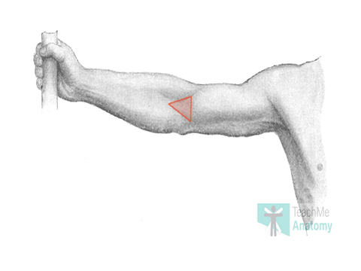

Slide 144
Borders
The cubital fossa is triangular in shape and consists of three borders, a roof, and a floor:
Lateral border – medial border of the brachioradialis muscle.
Medial border – lateral border of the pronator teres muscle.
Superior border – horizontal line drawn between the epicondyles of the humerus.
Roof – bicipital aponeurosis, fascia, subcutaneous fat and skin.

Slide 145
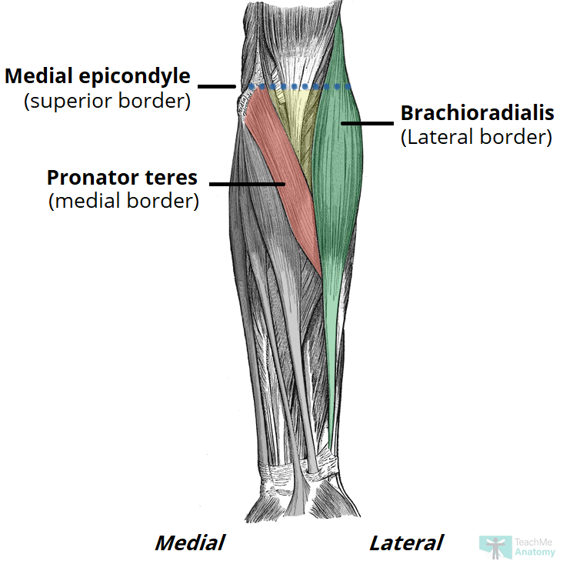

Slide 146
Contents
The cubital fossa is a passageway for structures to pass between the upper arm and forearm.
Its contents are (lateral to medial):
Radial nerve – travels along the lateral border of the cubital fossa and divides into superficial and deep branches.
It has a motor and sensory function in the posterior forearm and hand.
Biceps tendon – passes centrally through the cubital fossa and attaches the radial tuberosity (immediately distal to the radial neck).
It gives rise to the bicipital aponeurosis which contributes to the roof of the cubital fossa.
Brachial artery – bifurcates into the radial and ulnar arteries at the apex of the cubital fossa.
The brachial pulse can be felt in the cubital fossa by palpating medial to the biceps tendon

Slide 147
Median nerve-travels medially through the cubital fossa, exiting by passing between the two heads of the pronator teres.
It has a motor and sensory function in the anterior forearm and hand.
The roof of the cubital fossa also contains several superficial veins. Notably, the median cubital vein, which connects the basilic and cephalic veins and can be accessed easily – a common site for venepuncture.

Slide 148
Contents of cubital fossa

Slide 149
Ulnar tunnel
The ulnar (cubital) tunnel is a fibro-osseous space located on the posteromedial aspect of the elbow.
It transmits the ulnar nerve from the arm into the forearm.

Slide 151
Borders
The ulnar tunnel is oval shaped with medial and lateral walls, a floor, and a roof:
Medial wall – medial epicondyle of the humerus.
Lateral wall – olecranon of the ulna.
Floor – elbow joint capsule and medial collateral ligament of the elbow.
Roof – ligament spanning between the medial epicondyle and olecranon
The ligament forming the roof of the cubital tunnel is also known as the cubital tunnel retinaculum or the arcuate ligament of Osbourne. It is a band of fascia which runs between the ulnar and humeral heads of the flexor carpi ulnaris.

Slide 152
Contents
The ulnar tunnel transmits the ulnar nerve – a major peripheral nerve of the upper limb. After passing through this space, the ulnar nerve travels between the two heads of the flexor carpi ulnaris and continues into the forearm and hand.

Slide 153
Carpal tunnel
The carpal tunnel is a narrow passageway found on the anterior portion of the wrist.
It serves as the entrance to the palm for several tendons and the median nerve.
Borders
The carpal tunnel is formed by two layers: a deep carpal arch and a superficial flexor retinaculum. The deep carpal arch forms a concave surface, which is converted into a tunnel by the overlying flexor retinaculum (transverse carpal ligament).

Slide 154
Carpal Arch
Concave on the palmar side, forming the base and sides of the carpal tunnel.
Formed laterally by the scaphoid and trapezium tubercles
Formed medially by the hook of the hamate and the pisiform
Flexor Retinaculum
Thick connective tissue which forms the roof of the carpal tunnel.
Turns the carpal arch into the carpal tunnel by bridging the space between the medial and lateral parts of the arch.

Slide 155
Spans between the hook of hamate and pisiform (medially) to the scaphoid and trapezium (laterally).
To find where the carpal tunnel begins on yourself, locate your distal wrist crease, which aligns with the entrance of the carpal tunnel.

Slide 156
Transverse section of carpal tnnel

Slide 157
Contents
The carpal tunnel contains a total of 9 tendons, surrounded by synovial sheaths, and the median nerve. The palmar cutaneous branch of the median nerve is given off prior to the carpal tunnel, travelling superficially to the flexor retinaculum.
Tendons
The tendon of flexor pollicis longus
Four tendons of flexor digitorum profundus
Four tendons of flexor digitorum superficialis

Slide 158
The 8 tendons of the flexor digitorum profundus and flexor digitorum superficialis are surrounded by a single synovial sheath. The tendon of flexor pollicis longus is surrounded by its own synovial sheath. These sheaths allow free movement of the tendons.
Sometimes you may hear that the carpal tunnel contains another tendon, the flexor carpi radialis tendon, but this is located within the flexor retinaculum and not within the carpal tunnel itself

Slide 159
Muscular and tendinous components of carpal tunnel

Slide 160
Median Nerve
Once it passes through the carpal tunnel, the median nerve divides into 2 branches: the recurrent branch and palmar digital nerves.
The palmar digital nerves give sensory innervation to the palmar skin and dorsal nail beds of the lateral three and a half digits. They also provide motor innervation to the lateral two lumbricals. The recurrent branch supplies the thenar muscle group.

Slide 161
The Extensor Tendon Compartments of the Wrist
the extensor tendon compartments of the wrist are six tunnels which transmit the long extensor tendons from the forearm into the hand
They are located on the posterior aspect of the wrist. Each tunnel is lined internally by a synovial sheath and separated from one another by fibrous septa

Slide 162
Extensor tendon compartments

Slide 163
Compartment 1
The first extensor compartment is located on the lateral (radial) aspect of the wrist. It transmits two tendons:
Extensor pollicis brevis
Abductor pollicis longus
These tendons form the lateral border of the anatomical snuffbox.

Slide 164
Compartment 2
The second extensor compartment contains the tendons of the extensor carpi radialis longus and extensor carpi radialis brevis.
This compartment is separated from compartment 3 by Lister’s tubercle – a bony prominence of the distal aspect of the radius.
Compartment 3
Compartment three conducts the extensor pollicis longus tendon – this forms the medial border of the anatomical snuffbox.

Slide 165
Compartment 4
The 4th extensor compartment of the wrist transmits the tendons of the extensor digitorum and extensor indicis.
Compartment 5
Compartment five contains the extensor digiti minimi tendon, which travels into the little finger.
Compartment 6
The sixth compartment is the located on the medial (ulnar) aspect of the wrist. It conducts the tendon of the extensor carpi ulnaris.

Slide 167
Anatomical snuffbox
The anatomical snuffbox (also known as the radial fossa), is a triangular depression found on the lateral aspect of the dorsum of the hand.
It is located at the level of the carpal bones, and best seen when the thumb is extended.
In the past, this depression was used to hold snuff (ground tobacco) before inhaling via the nose – hence it was given the name ‘snuffbox’.

Slide 169
Borders
As the snuffbox is triangularly shaped, it has three borders, a floor, and a roof:
Ulnar (medial) border: Tendon of the extensor pollicis longus.
Radial (lateral) border: Tendons of the extensor pollicis brevis and abductor pollicis longus.
Proximal border: Styloid process of the radius.
Floor: Carpal bones; scaphoid and trapezium.
Roof: Skin.

Slide 170
The tendinous border of anatomical snuff box

Slide 171
Contents
The main contents of the anatomical snuffbox are the radial artery, a branch of the radial nerve, and the cephalic vein:
Radial artery – crosses the floor of the anatomical snuffbox, then turns medially and travels between the heads of the adductor pollicis muscle.
The radial pulse can be palpated in some individuals by placing two fingers on the proximal portion of the anatomical snuffbox.

Slide 172
Superficial branch of the radial nerve – found in the skin and subcutaneous tissue of the anatomical snuffbox. It innervates the dorsal surface of the lateral three and half digits, and the associated area on the back of the hand.
Cephalic vein – arises from the dorsal venous network of the hand and crosses the anatomical snuffbox to travel up the anterolateral aspect of the forearm.

Slide 173
The ulnar (Guyon’s) canal
is a fibro-osseous tunnel located at the level of the palm.
It transmits the ulnar neurovascular bundle from the forearm into the hand
Borders
The ulnar canal is approximately 4cm in length.
It extends from the proximal aspect of the pisiform bone to the origin of the hypothenar muscles at the hook of hamate.

Slide 174
Its borders consist of:
Medial (ulnar) – pisiform, pisohamate ligament and abductor digiti minimi.
Lateral (radial) – hook of hamate.
Roof – palmar carpal ligament.
Floor – flexor retinaculum and hypothenar muscles.

Slide 175
The borders of ulnar canal

Slide 176
Contents
The ulnar canal conveys the ulnar neurovascular bundle into the hand:
Ulnar nerve – bifurcates within the canal into superficial (sensory) and deep (motor) branches.
Ulnar artery – located on the radial aspect of the ulnar nerve. It gives rise to a deep palmar branch and continues laterally across the palm as the superficial palmar arch.
Venae comitantes of ulnar artery (refers to a vein that is usually paired, with both veins lying on the sides of an artery.
Lymphatic vessels

Slide 177
CHEST
Chest also called thorax is the superior part of the trunk located between the neck and the abdomen
It consists of several components:
Thoracic wall
Several cavities-pleural cavity, pericardial cavity
Neurovasculature and lymphatics
Internal organs-e.g heart, lungs, thymus
Breast

Slide 178
Ct
Thoracic wall
The thoracic/chest wall consists of skeletal framework, fascia, muscles and neurovascular –all connected together to form a strong and protective yet flexible cage (thoracic cage)
The thorax has two major openings: the superior thoracic aperture found superiorly and inferior thoracic aperture found inferiorly

Slide 179
Ct,
The superior thoracic aperture opens towards the neck. It is bounded by the bones of upper thorax; manubrium of sternum, first pair of ribs and body of the vertebra T1
The inferior thoracic aperture is almost completely covered by diaphragm separating it from the abdominal cavity

Slide 180
ct
Thoracic cage
The thoracic cage is made up of these bones 12 pairs of ribs and the sternum, or breastbone and 12 thoracic vertebrae
a) Sternum
This flat bone can be felt just under the skin in the middle of the front of the chest
The three parts of the sternum are the manubrium, the body, and the xiphoid process.

Slide 181
manubrium
Is the most superior portion of the sternum
It is trapezoid in shape
The superior aspect of manubrium is concave protruding a depression known as the jugular notch
This is visible underneath the skin
At either side of the jugular notch, there is a large fossa or a notch known as clavicular notch lined with cartilage where the clavicle articulates with the sternum to form sternoclavicular joint

Slide 182
On lateral edges, of manubrium, there is a facet (a cartilage lined depression)for articulation with costal cartilage of first rib and a demifacet (half-facet) for articulation with part of the costal cartilage of 2nd rib
Inferiorly, the manubrium articulates with the body of the sternum forming the sternal angle. This can be felt as a transverse ridge of the bone on anterior aspect of the sternum
The sternal angle is commonly used as an aid to counts ribs as it marks the level of 2nd costal cartilage

Slide 183
Body
Is flat and elongated
Is the largest part of the sternum.
It articulates with manubrium superiorly forming manubriosternal joint and xiphoid processes inferiorly forming xiphisternal joint
The lateral side of the body are marked are marked by numerous facets (cartilage filled depressions in the bone). These facets articulate with the costal cartilages of rib 3-6

Slide 184
There are smaller articulations with part of the second and the seventh ribs known as demifacets
Xiphoid process
Is the most inferior and smallest part of the sternum
It is of variable size, shape and size with the tip located at the level of T 10 vertebrae.
The xiphoid process is highly cartilaginous in structure and completely ossifies late in life around the age of 40
In some people individuals, the xiphoid process articulates with part of the costal cartilage of the seventh rib.

Slide 185
b) Ribs
The ribs are a set of 12 paired bones which form protective cage of the thorax
All of the ribs articulate posteriorly with the thoracic vertebrae and terminate anteriorly as cartilage (known as costal cartilage).
The first seven pairs of ribs are called true ribs; they articulate directly with the manubrium and body of the sternum by means of costal cartilages.
The next three pairs are called false ribs; their cartilages join the 7th rib cartilage

Slide 186
The last two pairs are called floating ribs because they do not articulate with the sternum at all
Between each two adjacent ribs are anatomical spaces called intercostal spaces. These intercostal spaces are eleven in total each containing the intercostal muscles (internal, external and innermost) together with intercostal neurovascular bundle. This consists of intercostal nerves and arteries.

Slide 187
The ribs protect the internal thoracic organs e.g the heart, lungs, oesophagus, trachea etc.
The ribs also have a role in ventilation, moving during chest expansion (enlarging chest cavity) to enable lung inflation
Keep in mind, though, that the rib cage also protects organs in the upper abdominal cavity, such as the liver and spleen.

Slide 188
Ribs and costal cartilages

Slide 189
Ribs structure
There are two classification of ribs- atypical and typical
The typical ribs have generalised structure while the atypical have variations on this structure
1. Typical ribs
The typical rib consists of head, neck and body
The head is wedge shaped and has two articular surfaces.
One facet articulates with numerically corresponding vertebrae and the other articulates with vertebrae above

Slide 190
The neck contains no bony prominences but simply connects the head with the body. Where neck meets the body there is a roughed tubercle with a facet for articulation with the transverse process of corresponding vertebrae
The body or shaft of the rib is flat and curved. The internal surface of the surface of the shaft has groove for neurovascular supply of the thorax, protecting the vessels and nerves from damage.

Slide 191
Bony landmarks of a typical rib

Slide 192
2. Atypical ribs
Ribs 1, 2, 10, 11 and 12 can be described as atypical ribs. They have a feature that is not common to all.
Rib 1 is shorter and wider than other ribs. It only has one facet on its head for articulation with the corresponding vertebrae (there is not a thoracic vertebrae above). The superior surface is marked with two grooves which make way for subclavian vessels

Slide 193
Rib 2 is thinner and longer than rib 1 and has two articular facets on the head as normal. It has roughened area on its upper surface from which the serratus anterior muscle originates
Rib 10 only has one facet- for articulation with numerically corresponding vertebrae
Rib 11 and 12 have no neck, and only contain one facet which is for articulation with corresponding vertebrae

Slide 194
Articulations
The majority of the ribs have an anterior and posterior articultations
Posterior
All the 12 ribs articultes posteriorly with the vertebrae of the spine. Each rib forms two joints
Costotransverse joint- between the tubercle of the rib and transverse costal facet of corresponding vertebrae
costovertebral joint- between the head of the rib, superior costal facet of the corresponding vertebrae and inferior costal facet of the vertebrae above. Costovertebral joint describe two groups of synovial plane joints which connects the proximal end of the ribs with corresponding thoracic vertebrae . Joining of ribs to the vertebrae occur at two places
Head-two convex facets from head attach to two adjacent vertebrae. This form a synovial (gliding joint)
Tubercle of rib- articulation of the tubercle to the transverse process of the adjacent vertebrae. This articulation is reinforced by dorsal transverse ligament.

Slide 195
Anteriorly
The anterior attachment of the ribs vary
Ribs 1-7 attach independently to the sternum
Ribs 8-10- attach to the costal cartilages superior to them
11 and 12 do not have an anterior attachment and end in abdominal musculature. Because of this, they are sometimes called floating ribs.

Slide 196
Posterior articulation between a typical ribs and its numerically corresponding vertebrae

Slide 197
Intercostal spaces
The bones forming the thoracic cage are arranged in a pattern that allows some space between them. Those spaces are referred to as the intercostal spaces .
The intercostal spaces separate the ribs and their costal cartilages from one another and allow smooth expansion of the cage during inspiration.
The spaces are named according to the rib forming the superior border of the space, for example, the 4th intercostal space lies between the 4th rib and 5th rib; therefore, there are 11 intercostal spaces in the rib cage.
Intercostal spaces are occupied by intercostal muscles (internal, external & innermost) and membranes, 11 intercostal nerves and two sets (main and collateral) of intercostal blood vessels (intercostal vein, artery and nerve) also identified by the same number assigned to the intercostal space.
Below the 12th rib, is referred to as the subcostal space and the anterior ramus of the spinal nerve T12 runs through this space, and it is thus referred to as the subcostal nerve.

Slide 198
Joints in the thorax
The joints forming the domed-shaped thoracic cage include the:
Xiphisternal joint – xiphoid process and body of sternum
Intervertebral joints – between vertebrae
Sternochondral joints – sternum and costal cartilages
Sternoclavicular joints – manubrium and clavicles
Manubriosternal joints – manubrium and body of sternum
Costochondral joints – costal cartilage and rib
Costovertebral joints – formed by the ribs and bodies of the vertebrae.
Interchondral joints – joining the costal cartilages to one another.

Slide 199
Intercostal muscle
Intercostal muscles are many different muscle groups of muscles that run between the ribs, and help form and move the chest wall.
The intercostal muscles are mainly involved in the mechanical aspect of breathing.
These muscles help expand and shrink the size of the chest cavity to facilitate breathing.

Slide 200
Structure
There are 3 principal layers
1.External intercostal muscles aid in quiet and forced inhalation. They originate on ribs 1-11 and have their insertion on ribs 2-12.
The external intercostals are responsible for the elevation of the ribs and bending them more open, thus expanding the transverse dimensions of the thoracic cavity.
2. Internal intercostal muscles aid in forced expiration (quiet expiration is a passive process). They originate on ribs 2-12 and have their insertions on ribs 1-11.Their fibers pass anterior and superior from the upper margin of the rib and costal cartilage to the lower margin of the rib above.
The internal intercostals are responsible for the depression of the ribs and bending them inward, thus decreasing the transverse dimensions of the thoracic cavity.
3. Innermost intercostal muscle, the deep layers of the internal intercostal muscles which are separated from them by a neurovascular bundle.

Slide 201
Nerve supply
Both the external and internal muscles together with innermost intercostal muscles are innervated by the intercostal nerves T1-T11
Blood supply
Intercostal muscles are supplied by the intercostal arteries, and are drained by the intercostal veins.
Actions
Elevation or Depression of the Ribs

Slide 202
Ct
Diaphragm
The diaphragm is a dome-shaped muscular structure separating the thoracic and abdominalcavities.
It forms the floor of the thoracic cavity and the roof of the abdominal cavity and consists of acentral tendon from which muscle fibres radiate to be attached to the lower ribs and sternum and to the vertebral column by two crura

Slide 203
When the muscle of the diaphragm is relaxed, the central tendon is at the level of the 8th thoracic vertebra.
When it contracts, its muscle fibres shorten and the central tendon is pulled downwards to the level of the 9th thoracic vertebra, lengthening the thoracic cavity. This decreases pressure in the thoracic cavity and increases it in the abdominal andpelvic cavities.
The diaphragm is supplied by the phrenic nerves

Slide 204
Ct,
Quiet, restful breathing is sometimes called diaphragmatic breathing because 75% of the work is done by the diaphragm.
The external intercostal muscles and the diaphragm contract simultaneously, enlarging the thoracic cavity in all directions, that is from back to front, side to side and top to bottom

Slide 205
Ct,
Apart from the intercostal and diaphragm which are the most important thoracic muscles responsible for breathing, there are additional ones which are involved in forming the thoracic wall.
These include;
Transversus thoracic- superior attachment is on Inferior margins and internal surfaces of costal cartilages of second to sixth ribs. Inferior attachment is on Inferior aspect of deep surface of body of sternum, xiphoid process and costal cartilages ribs IV – VII. Innervated by related intercostal nerves. Action:Depresses costal cartilages
Subcostals- superior attachment: Internal surface (near angle) of lower ribs
inferior attachment: Internal surface of second or
third rib below
innervation: Related intercostal nerves
action: depresses the ribs

Slide 206
Ct,
Levatores costarum
origin: Short paired muscles arising from transverse processes of CVII to TXI.
Insertion: The rib below vertebra of
origin near tubercle
Action: Contraction elevates rib
Serratus posterior superior- elevates the rib. Innervated by Anterior rami of upper thoracic nerves (T2 to T5).originate from Lower portion of ligamentum nuchae, spinous processes of CVII to TIII and supraspinous ligaments insert to Upper border of ribs II to V just lateral to their angles
Serratus posterior inferior- Depresses ribs IX to XII and may prevent lower ribs from being elevated when the diaphragm contracts. Innervated by Anterior rami of lower thoracic nerves (T9 to T12). Originate from Spinous processes of TXI to LIII and supraspinous ligaments and insert to Lower border of ribs IX to XII just lateral to their angles

Slide 207
Ct.,
These muscles attaches to the ribs, their cartilages or thoracic vertebrae-ultimately depressing or elevating the ribs
In addition thoracic muscles provide support and strength for thorax
NB: The muscles of the thoracic wall, together with muscles between the vertebrae and ribs posteriorly (i.e., the levatores costarum , and serratus posterior superior and serratus posterior inferior muscles) alter the position of the ribs and sternum and so change thoracic volume during breathing. They also reinforce the thoracic wall.

Slide 208
Critical Thinking Questions
1. Define the parts and functions of the thoracic cage.
2. Describe the parts of the sternum.
3. Discuss the parts of a typical rib.
4. Define the types of ribs.

Slide 209
Thoracic vertebrae
The twelve thoracic vertebrae are strong bones that are located in the middle of the vertebral column, sandwiched (inserted) between the cervical bones above and the lumbar vertebrae below.
The presence of costal facet/facets on the sides of their bodies for articulation with the heads of the ribs is how they can be identified or detected.

Slide 210
Presence of the articular facet(s) on the side of the body is the cardinal attribute of the thoracic vertebrae.
These joints are not found in the cervical lumbar and sacral vertebrae and therefore these joints are characteristic of thoracic vertebrae. The slow increment in the size of thoracic vertebrae is from up to downwards.

Slide 211
The main anatomical components of a thoracic vertebra are:
Body
Spinous process
Costal facets: transverse costal facet, superior costal facet, and inferior costal facet
Transverse process
Superior and inferior articular facets
Lamina
Intervertebral foramen
Vertebral foramen

Slide 212
Categorization
Based on the features, the thoracic vertebrae are classified into 2 types:
Typical: 2nd to eighth
Atypical: first and ninth to twelfth

Slide 213
Typical thoracic vertebrae
Characteristic features
Presence of articular facets on every side of the body and on front of transverse processes for articulation with the ribs.
Body is heart shaped, especially in the midthoracic region when seen from above. Its transverse and anteroposterior measurements are just about equivalent.
Vertebral foramen is circular.
Spinous process is long, thin, and pointed downwards.
Pedicle is connected to the upper part of the body, so making the inferior vertebral notch deeper.

Slide 215
Atypical vertebrae
Vertebra Distinguishing features
T1 1.Resembles 7th cervical vertebra
2. Superior costal facet is circular
3. Superior vertebral notch is deep and clearly seen
T9 1. Presence of only superior demifacet
T10 1. Presence of only single large complete costal facet
T11 1. Presence of single large circular costal facet .
2. Absence of articular facet on transverse process

Slide 216
Vertebrae distinguishing feature
T12 1.Resembles 1st lumbar vertebra
2.Presence of single large circular facet extending onto the root of tubercle
3.Transverse process presents three tubercles: superior, inferior, and lateral

Slide 217
mediastinum
The mediastinum, or mediastinal cavity, is a visceral compartment of the thoracic cavity.
It completely separates the two pleural cavities by being placed longitudinally between them in a median sagittal position.
It extends superinferiorly from the superior thoracic aperture to the diaphragm, anteroposteriorly from the sternum to the bodies of thoracic vertebrae, and laterally from the mediastinal pleura of the adjacent pleural cavities.

Slide 218
The main mediastinal contents are the heart, esophagus, trachea, thoracic nerves and systemic blood vessels.
The mediastinum is divided into the superior mediastinum and inferior mediastinum by a transverse plane that extends from the sternal angle (manubriosternal junction), to the intervertebral disc between T4 and T5 vertebrae.

Slide 220
Superior mediastinum
The superior mediastinum is bounded in front by the manubrium sterni and behind by the first four thoracic vertebrae
The contents of the superior mediastinum includes many organs, vessels and nerves
These include;
Thymus
Trachea
Esophagus
Aortic arch

Slide 221
Brachiocephalic trunk
Left common carotid artery
Left subclavian artery
Internal thoracic arteries
Superior vena cava
Left superior intercostal vein
Brachiocephalic veins
Phrenic nerves
Vagus nerves
Left recurrent laryngeal branch of the left vagus nerve
Thoracic duct
Lymph nodes and vessels,
Other small arteries, veins and nerves

Slide 222
Superior mediastinum

Slide 223
Inferior mediastinum
The inferior mediastinum extends from the inferior border of the superior mediastinum to the diaphragm. It is subdivided anterior-to-posterior into three spaces:
Anterior mediastinum - posterior to the body of the sternum and anterior to the pericardium
Middle mediastinum - bounded by the pericardium, which encloses the heart and origins of the great vessels
Posterior mediastinum - posterior to the pericardium and anterior to the vertebrae

Slide 224
Anterior mediastinum
Inferior portion of thymus
Connective tissue
Lymph nodes
Mediastinal branches of internal thoracic vessels
Sternopericardial ligaments
Middle mediastinum
Pericardial sac
Heart
Origins of great vessels: pulmonary trunk, ascending aorta, pulmonary veins, superior vena cava, inferior vena cava
Tracheal bifurcation and main bronchi

Slide 225
Posterior mediastinum
Descending thoracic aorta and its branches
Thoracic duct & cisterna chyli which is a dilated lymph channel situated in front of the bodies of the first two lumbar vertebrae
Esophagus and esophageal plexus
Vagus nerves
Thoracic splanchnic nerves (greater, lesser, least)
Lymphatics

Slide 226
Nerves in mediastinum
The right vagus nerve descends in the thorax, first posterolateral to the brachiocephalic artery then lateral to the trachea
Passes behind the root of the right lung and assists in the formation of the pulmonary plexus.
On leaving the plexus, the vagus passes onto the posterior surface of the esophagus and takes part in the formation of the esophageal plexus.
It then passes through the esophageal opening of the diaphragm.

Slide 228
Pleura
The pleurae refer to the serous membranes that line the lungs and thoracic cavity.
They permit efficient and effortless respiration
Structure of the Pleurae
There are two pleurae in the body: one associated with each lung.
They consist of a serous membrane – a layer of simple squamous cells supported by connective tissue. This simple squamous epithelial layer is also known as the mesothelium.

Slide 229
Each pleura can be divided into two parts:
Visceral pleura – covers the lungs.
Parietal pleura – covers the internal surface of the thoracic cavity.
These two parts are continuous with each other at the hilum of each lung.
There is a potential space between the viscera and parietal pleura, known as the pleural cavity.

Slide 230
Parietal Pleura
The parietal pleura covers the internal surface of the thoracic cavity. It is thicker than the visceral pleura, and can be subdivided according to the part of the body that it is contact with:
Mediastinal pleura – Covers the lateral aspect of the mediastinum (the central component of the thoracic cavity, containing a number of organ).
Cervical pleura – Lines the extension of the pleural cavity into the neck.
Costal pleura – Covers the inner aspect of the ribs, costal cartilages, and intercostal muscles.

Slide 231
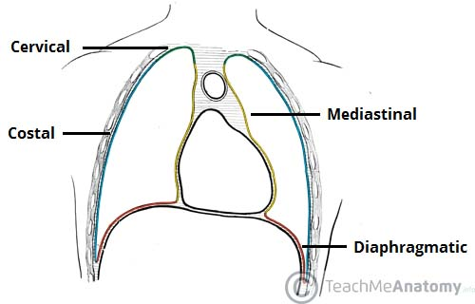
Diaphragmatic pleura – Covers the thoracic (superior) surface of the diaphragm.

Slide 232
Visceral pleura
The visceral pleura covers the outer surface of the lungs. It is continuous with the parietal pleura at the hilum of each lung (this is where structures enter and leave the lung).
Pleural Cavity
The pleural cavity is a potential space between the parietal and visceral pleura.
It contains a small volume of serous fluid, which has two major functions.

Slide 233
It lubricates the surfaces of the pleurae, allowing them to slide over each other.
The serous fluid also produces a surface tension, pulling the parietal and visceral pleura together. This ensures that when the thorax expands, the lung also expands, filling with air.

Slide 235
Neurovascular Supply
The two parts of the pleurae receive a different neurovascular supply:
Parietal Pleura
The parietal pleura is sensitive to pressure, pain, and temperature. It produces a well localised pain, and is innervated by the phrenic and intercostal nerves.
The blood supply is derived from the intercostal arteries.

Slide 236
Visceral Pleura
The visceral pleura is not sensitive to pain, temperature or touch. Its sensory fibres only detect stretch. It also receives autonomic innervation from the pulmonary plexus (a network of nerves derived from the sympathetic trunk and vagus nerve).
Arterial supply is via the bronchial arteries (branches of the descending aorta), which also supply the parenchyma of the lungs.

Slide 237
Abdomen
The abdomen is the part of the body that contains all of the structures between the thorax (chest) and the pelvis, and is separated from the thorax via the diaphragm.
The bones of the abdomen are made up of the lumbar spine, the third region of the vertebral column, located in the lower back between the thoracic (above) and sacral (below) vertebral segments.

Slide 238
The muscles of the abdomen work together to protect the internal organs (viscera) by covering them completely, and are made up of the muscles of the anterolateral abdominal wall and the muscles of the posterior abdominal wall.
The region occupied by the abdomen is called the abdominal cavity, and is enclosed by the abdominal muscles at front and to the sides, and by part of the vertebral column at the back.

Slide 239
Ct,
The abdomen contains many accessory organs, including the liver, gallbladder, pancreas, spleen, adrenal glands, kidneys and the mesentery.
The role of these organs is to help the functioning of the other organs in the system.
The abdominal vasculature consists of various arterial branches that all come from the aorta, and two venous structures that help to drain the abdominal structures, carrying deoxygenated blood and waste products away.
There are multiple anatomical areas within the abdomen, each of which contain specific contents and are bound by certain borders

Slide 240
These include the abdominal cavity, Calot’s triangle (cystohepatic triangle) the peritoneum, the inguinal canal, and Hesselbach’s triangle (inguinal triangle)
The abdomen contains organs involved in the gastrointestinal tract, including the oesophagus, stomach, small intestine, cecum, appendix, colon, rectum and the anal canal.
The gastrointestinal tract is an organ system that enables us to ingest food, digest it, absorb it, and then expel the remaining waste as faeces.

Slide 241
Areas of the abdomen
There are multiple anatomical areas within the abdomen, each of which contain specific contents and are bound by certain borders.
The purpose of the areas of the abdomen is to compartmentalise the abdomen, or to locate various pathologies and the organ they are affecting.
The main areas of the abdomen include the abdominal cavity, Calot’s triangle, the peritoneum, the inguinal canal, and Hesselbach’s triangle.
The abdominal (peritoneal) cavity is an area that normally only contains a small amount of peritoneal fluid, however can become a potential space for pathology. This area contains various subdivisions, and differs in both males and females.
Calot’s triangle is a small anatomical area within the abdomen, containing arteries and lymphatics, and this area is located where the hepatic ducts and neurovascular structures enter and exit the liver.

Slide 242
1. Anterior abdominal wall
The abdominal wall represents the boundaries of the abdominal cavity. The abdominal wall encloses the abdominal cavity and can be divided into anterolateral and posterior sections.
The abdominal wall:
Forms a firm, yet flexible boundary which keeps the abdominal viscera in the abdominal cavity and assists the viscera in maintaining their anatomical position against gravity.
Protects the abdominal viscera from injury.
Assists in forceful expiration by pushing the abdominal viscera upwards.
Is involved in any action (coughing, vomiting, defecation) that increases intra-abdominal pressure.

Slide 243
Ct,
There is a common set of layers covering and forming all the walls: the deepest being the visceral peritoneum, which covers many of the abdominal organs (most of the large and small intestines, for example), and the parietal peritoneum- which covers the visceral peritoneum below it, the extraperitoneal fat, the transversalis fascia, the internal and external oblique and transversus abdominis aponeurosis, and a layer of fascia, which has different names according to what it covers (e.g., transversalis, psoas fascia).
The anterolateral abdominal wall consists of four main layers (external to internal): skin, superficial fascia, muscles and associated fascia, and parietal peritoneum.

Slide 244
Layers of anterolateral abdominal wall
In human anatomy, the layers of the anterolateral abdominal wall are (from superficial to deep):
Skin
Subcutaneous tissue (layer underlying the skin. It is also known as hypodermia)

Slide 245
Ct,
Superficial Fascia- The superficial fascia is connective tissue. The composition of this layer depends on its location:
Above the umbilicus – a single sheet of connective tissue. It is continuous with the superficial fascia in other regions of the body.
Below the umbilicus – divided into two layers; the fatty superficial layer (Camper’s fascia) and the membranous deep layer (Scarpa’s fascia).
The superficial vessels and nerves run between these two layers of fascia

Slide 246
The layers of the anterolateral abdominal wall. Below the umbilicus, there are two layers of superficial fascia – Camper’s and Scarpa’s.

Slide 247
Ct,
Muscles- external oblique abdominal muscle, internal oblique abdominal muscle, rectus abdominis, transverse abdominal muscle and quadratus lomborum
Transversalis fascia - a thin aponeurotic membrane which lies between inner surface of transverse abdominal muscle and parietal peritoneum
Extraperitoneal fat
Peritoneum

Slide 248
Muscles of the Abdominal Wall
The muscles of the anterolateral abdominal wall can be divided into two main groups:
Flat muscles – three flat muscles, situated laterally on either side of the abdomen.
Vertical muscles – two vertical muscles, situated near the mid-line of the body.

Slide 249
Flat Muscles
There are three flat muscles located laterally in the abdominal wall, stacked upon one another. Their fibres run in differing directions and cross each other – strengthening the wall and decreasing the risk of abdominal contents herniating through the wall.
In the anteromedial aspect of the abdominal wall, each flat muscle forms an aponeurosis (a broad, flat tendon), which covers the vertical rectus abdominis muscle. The aponeuroses of all the flat muscles become entwined in the midline, forming the linea alba (a fibrous structure that extends from the xiphoid process of the sternum to the pubic symphysis).

Slide 250
External Oblique
The external oblique is the largest and most superficial flat muscle in the abdominal wall. Its fibres run inferomedially.
Attachments: Originates from ribs 5-12, and inserts into the iliac crest and pubic tubercle.
Functions: Contralateral rotation of the torso.
Innervation: Thoracoabdominal nerves (T7-T11) and subcostal nerve (T12).

Slide 251
Internal Oblique
The internal oblique lies deep to the external oblique. It is smaller and thinner in structure, with its fibres running superomedially (perpendicular to the fibres of the external oblique).
Attachments: Originates from the inguinal ligament, iliac crest and lumbodorsal fascia, and inserts into ribs 10-12.
Functions: Bilateral contraction compresses the abdomen, while unilateral contraction ipsilaterally rotates the torso.
Innervation: Thoracoabdominal nerves (T7-T11), subcostal nerve (T12) and branches of the lumbar plexus.

Slide 252
Transversus Abdominis
The transversus abdominis is the deepest of the flat muscles, with transversely running fibres. Deep to this muscle is a well-formed layer of fascia, known as the transversalis fascia.
Attachments: Originates from the inguinal ligament, costal cartilages 7-12, the iliac crest and thoracolumbar fascia. Inserts into the conjoint tendon, xiphoid process, linea alba and the pubic crest.
Functions: Compression of abdominal contents.
Innervation: Thoracoabdominal nerves (T7-T11), subcostal nerve (T12) and branches of the lumbar plexus.

Slide 253
Vertical Muscles
There are two vertical muscles located in the midline of the anterolateral abdominal wall – the rectus abdominis and pyramidalis.
Rectus Abdominis
The rectus abdominis is long, paired muscle, found either side of the midline in the abdominal wall. It is split into two by the linea alba. The lateral borders of the muscles create a surface marking known as the linea semilunaris.
At several places, the muscle is intersected by fibrous strips, known as tendinous intersections. The tendinous intersections and the linea alba give rise to the ‘six pack’ seen in individuals with a well-developed rectus abdominis.

Slide 254
Attachments: Originates from the crest of the pubis, before inserting into the xiphoid process of the sternum and the costal cartilage of ribs 5-7.
Functions: As well as assisting the flat muscles in compressing the abdominal viscera, the rectus abdominis also stabilises the pelvis during walking, and depresses the ribs.
Innervation: Thoracoabdominal nerves (T7-T11).

Slide 255
Pyramidalis
This is a small triangular muscle, found superficially to the rectus abdominis. It is located inferiorly, with its base on the pubis bone, and the apex of the triangle attached to the linea alba.
Attachments: Originates from the pubic crest and pubic symphysis before inserting into the linea alba.
Functions: It acts to tense the linea alba.
Innervation: Subcostal nerve (T12).

Slide 256
Muscles of the abdomen

Slide 258
Blood Supply and Lymphatics to the anterior abdominal wall
There are multiple large venous drainage systems as well as arterial systems supplying the anterolateral abdominal wall.
The major arteries of the anterolateral abdominal wall are the superior epigastric, inferior epigastric, musculophrenic, subcostal, and posterior intercostal arteries, deep circumflex iliac artery, superficial circumflex iliac artery, and superficial epigastric artery.
The four origins of the arterial supply of the wall are the internal thoracic artery, aorta, external iliac, and femoral artery—the internal thoracic artery branches to the musculophrenic and superior epigastric arteries.

Slide 259
Nerve supply to anterolateral abdominal wall
Major nerves to the anterolateral abdominal wall include the thoracoabdominal, lateral cutaneous, subcostal, iliohypogastric, and ilioinguinal nerves

Slide 260
Posterior abdominal wall muscles
Psoas major muscle
Iliacus muscle
Quadratus lumborum muscle
Psoas minor muscle

Slide 261
Key facts about the posterior abdominal muscles
Psoas major muscle | Origin: Vertebral bodies of T12-L4, Intervertebral discs between T12-L4, Transverse processes of L1-L5 vertebrae Insertion: Lesser trochanter of femur Innervation: Anterior rami of spinal nerves L1-L3 Function: Hip joint: Thigh/trunk flexion, Thigh: external rotation, Trunk: lateral flexion
Iliacus muscle | Origin: Iliac fossa Insertion: Lesser trochanter of femur Innervation: Femoral nerve (L2-L4) Function: Hip joint: Thigh/trunk flexion, Thigh: external rotation, Trunk: lateral flexion
Quadratus lumborum muscle | Origin: Iliac crest, Iliolumbar ligament, superficially to psoas major Insertion: Inferior border of rib 12, Transverse processes of vertebrae L1-L4 Innervation: Subcostal nerve (T12), Anterior rami of spinal nerves L1-L4 Function: Bilateral contraction - Fixes Ribs 12 during inspiration, Trunk extension Unilateral contraction - Lateral flexion of trunk (ipsilateral)
Psoas minor muscle | Origin: Vertebral bodies of T12 & L1 vertebrae Insertion: Iliopubic eminence, Pectineal line of pubis Innervation: Anterior rami of spinal nerves L1-L3 Function: Hip joint: Thigh/trunk flexion, Thigh: external rotation, Trunk: lateral

Slide 262
Ct,
Psoas minor muscle | Origin: vertebral bodies of T12 &L1 vertebrae Insertion: iliopubic eminence, pectineal line or pubis Innervation: Anterior rami of spinal nerves L1-L3 Function: Hip joint: Thigh/trunk flexion, Thigh: external rotation, Trunk: lateral flexion

Slide 263
Quadratus lomborum muscle

Slide 264
Posterior abdominal wall blood and nerve supply
Nerves and vessels
Branches derived from the descending aorta supply the posterior abdominal wall. These include paired subcostal arteries, which run right below the 12th ribs and four pairs of lumbar arteries arising from the back of the aorta.
A variable fifth pair of lumbar arteries arising from the median sacral artery can be present.
Subcostal and lumbar arteries anastomose with one another and with the superior epigastric, lower intercostal and iliolumbar arteries, supplying the posterior abdominal wall and related structures.
Venous drainage of the posterior abdominal wall is carried out mainly by the lumbar veins which empty into the inferior vena cava.

Slide 265
There is a plethora of nerves and vessels coursing through the abdominal cavity which are closely related to the posterior abdominal wall.
These include: abdominal aorta and its major branches, inferior vena cava with its tributaries, lumbar plexus, sympathetic ganglion chain and sympathetic plexus.
The lumbar plexus is formed by the divisions from L1 – L4 spinal nerves with contribution of T12, which merge on the anterior surface of psoas major.

Slide 266
Rectus sheath
The rectus sheath is a tendon sheath (aponeurosis) which encloses the rectus abdominis and pyramidalis muscles.
It is an extension of the tendons of the external abdominal oblique, internal abdominal oblique, and transversus abdominis muscles. In addition to these muscles, the rectus sheath also contains neurovasculature of the anterior abdominal wall. Its function is to protect the contents it encloses.

Slide 267
The rectus sheath has an anterior and posterior wall. The walls are composed of a fusion of the aponeuroses of the external abdominal oblique, internal abdominal oblique, and transversus abdominis muscles.
Besides the rectus abdominis and pyramidalis muscles, the rectus sheath contains the superior and inferior epigastric arteries and veins, lymphatic vessels, termination parts of lower five intercostal nerves (T7-T11), and the termination of the 12th thoracic nerve (T12).
The superior and inferior epigastric arteries anastomose with each other at the level of umbilicus after entering into the rectus sheath.

Slide 268
The space between the right and left rectus abdominis muscles is filled with the thickening of the anterior wall of the rectus sheath. This entire thickening which extends from the xiphoid process of the sternum to the pubic symphysis is called the linea alba.
In summary the contents of rectus sheath are
rectus abdominis and pyramidalis muscles
lower 6 thoracic nerves and accompanying branches of the posterior intercostal vessels
superior and inferior epigastric vessels

Slide 269
Calot’s triangle
Calot’s triangle (cystohepatic triangle) is a small anatomical space in the abdomen.
It is located at the porta hepatis (a fissure) at of the liver – where the hepatic ducts and neurovascular structures enter/exit the liver.

Slide 270
Contents
The contents of the Calot’s triangle include:
Right hepatic artery – formed by the bifurcation of the proper hepatic artery into right and left branches.
Cystic artery – typically arises from the right hepatic artery and traverses the triangle to supply the gall bladder.
Lymph node of Lund – the first lymph node of the gallbladder.
Lymphatics

Slide 271
Borders and major contents of calot’s triangle

Slide 272
Borders of calot’s triangle
Calot’s triangle is orientated so that its apex is directed at the liver. The borders are as follows:
Medial – common hepatic duct.
Inferior – cystic duct.
Superior – inferior surface of the liver.
Adapted from work by Journal of Minimal Access Surgery [CC BY 4.0]

Slide 273
Inguinal triangle
The inguinal triangle (Hesselbach’s triangle) is a region in the anterior abdominal wall. It is alternatively known as the medial inguinal fossa.
Contents
Other than the layers of the abdominal wall, the inguinal triangle does not contain any structures of clinical importance.
However, the triangle does demarcate an area of potential weakness in the abdominal wall – through which herniation of the abdominal contents can occur.

Slide 274
Boundaries
The inguinal canal is bordered by anterior, posterior, superior (roof) and inferior (floor) walls. It has two openings – the superficial and deep rings.
Walls
Anterior wall – aponeurosis of the external oblique, reinforced by the internal oblique muscle laterally.
Posterior wall – transversalis fascia.
Roof – transversalis fascia, internal oblique, and transversus abdominis.
Floor – inguinal ligament (a ‘rolled up’ portion of the external oblique aponeurosis), thickened medially by the lacunar ligament.
During periods of increased intra-abdominal pressure, the abdominal viscera are pushed into the posterior wall of the inguinal canal. To prevent herniation of viscera into the canal, the muscles of the anterior and posterior wall contract, and ‘clamp down’ on the canal.
By 21)

Slide 275
Sagittal view of inguinal canal borders

Slide 276
Borders of inguinal triangle

Slide 277
Rings
The two openings to the inguinal canal are known as rings.
The deep (internal) ring is found above the midpoint of the inguinal ligament which is lateral to the epigastric vessels. The ring is created by the transversalis fascia, which invaginates to form a covering of the contents of the inguinal canal.
The superficial (external) ring marks the end of the inguinal canal, and lies just superior to the pubic tubercle. It is a triangle shaped opening, formed by the evagination of the external oblique, which forms another covering of the inguinal canal contents. This opening contains intercrural fibres, which run perpendicular to the aponeurosis of the external oblique and prevent the ring from widening.

Slide 278
Contents
The contents of the inguinal canal include:
Spermatic cord (biological males only) – contains neurovascular and reproductive structures that supply and drain the testes.
Round ligament (biological females only) – originates from the uterine horn and travels through the inguinal canal to attach at the labia majora.
Ilioinguinal nerve – contributes towards the sensory innervation of the genitalia
Note: only travels through part of the inguinal canal, exiting via the superficial inguinal ring (it does not pass through the deep inguinal ring)
This is the nerve most at risk of damage during an inguinal hernia repair.

Slide 279
Genital branch of the genitofemoral nerve – supplies the cremaster muscle and anterior scrotal skin in males, and the skin of the mons pubis and labia majora in females.
The walls of the inguinal canal are usually collapsed around their contents, preventing other structures from potentially entering the canal and becoming stuck.

Slide 280
Note: Male inguinal canals convey the spermatic cord, which contains the vas deferens, its related neurovasculature, lymphatics and connective tissue. Superficial and deep inguinal rings impose weak points in the abdominal wall, creating a predisposition to inguinal hernias.
In females, the round ligament of the uterus passes through each canal

Slide 281
Peritoneum
The peritoneum is a continuous membrane which lines the abdominal cavity and covers the abdominal organs (abdominal viscera).
It acts to support the viscera, and provides pathways for blood vessels and lymph to travel to and from the viscera.

Slide 282
The arrangement of the peritoneum is such that the organs are invaginated (pushed into itself forming a pouch) into the closed sac from below, behind and above so that they are at least partly covered by the visceral layer, and attached securely within the abdominal cavity.
This means that: pelvic organs are covered only on their superior surface

Slide 283
The stomach and intestines, deeply invaginated from behind, are almost completely surrounded by peritoneum and have a double fold (the mesentery) that attaches them to the posterior abdominal wall.
The fold of peritoneum enclosing the stomach extends beyond the greater curvature of the stomach, and hangs down in front of the abdominal organs like an apron.
This is the greater omentum, and it stores fat, which provides both insulation and a long-term energy store

Slide 284
The pancreas, spleen, kidneys and adrenal glands are invaginated from behind but only their anterior surfaces are covered and are therefore retroperitoneal (lie behind the peritoneum) the liver is invaginated from above and is almost completely covered by peritoneum, which attaches it to the inferior surface of the diaphragm
The main blood vessels and nerves pass close to the posterior abdominal wall and send branches to the organs between folds of peritoneum

Slide 285
Structure of the Peritoneum
The peritoneum consists of two layers that are continuous with each other: the parietal peritoneum and the visceral peritoneum.
Both types are made up of simple squamous epithelial cells called mesothelium.

Slide 286
Parietal Peritoneum
The parietal peritoneum lines the internal surface of the abdominopelvic wall.
It receives the same somatic nerve supply as the region of the abdominal wall that it lines; therefore, pain from the parietal peritoneum is well localised.
Parietal peritoneum is sensitive to pressure, pain, laceration and temperature.

Slide 287
Visceral Peritoneum
The visceral peritoneum invaginates to cover the majority of the abdominal viscera.
The visceral peritoneum has the same autonomic nerve supply as the viscera it covers.
Unlike the parietal peritoneum, pain from the visceral peritoneum is poorly localised and the visceral peritoneum is only sensitive to stretch and chemical irritation.
Pain from the visceral peritoneum is referred to areas of skin (dermatomes) which are supplied by the same sensory ganglia and spinal cord segments as the nerve fibres innervating the viscera.

Slide 288
Peritoneum (abdominal) cavity
The peritoneal cavity is a potential space between the parietal and visceral peritoneum.
It normally contains only a thin film of peritoneal fluid, which consists of water, electrolytes, leukocytes and antibodies. This fluid acts as a lubricant, enabling free movement of the abdominal viscera, and the antibodies in the fluid fight infection.

Slide 289
While the peritoneal cavity is ordinarily filled with only a thin film of fluid, it is referred to as a potential space because excess fluid can accumulate in it, resulting in the clinical condition of ascites

Slide 290
Peritoneal cavity

Slide 291
Intraperitoneal & Retroperitoneal Organs
The abdominal viscera can be divided anatomically by their relationship to the peritoneum. There are two main groups: intraperitoneal and retroperitoneal organs.
Intraperitoneal Organs
Intraperitoneal organs are enveloped by visceral peritoneum, which covers the organ both anteriorly and posteriorly. Examples include the stomach, liver and spleen.

Slide 292
Retroperitoneal organs
Retroperitoneal organs are not associated with visceral peritoneum; they are only covered in parietal peritoneum, and that peritoneum only covers their anterior surface.
They can be further subdivided into two groups based on their embryological development:
Primarily retroperitoneal organs developed and remain outside of the parietal peritoneum. The oesophagus, rectum and kidneys are all primarily retroperitoneal.
Secondarily retroperitoneal organs were initially intraperitoneal, suspended by mesentery. Through the course of embryogenesis, they became retroperitoneal as their mesentery fused with the posterior abdominal wall. Thus, in adults, only their anterior surface is covered with peritoneum. Examples of secondarily retroperitoneal organs include the ascending and descending colon.

Slide 293
A useful mnemonic to help in recalling which abdominal viscera are retroperitoneal is SAD PUCKER:
S = Suprarenal (adrenal) Glands
A = Aorta/ IVC
D =Duodenum (except the proximal 2cm, the duodenal cap)
P = Pancreas (except the tail)
U = Ureters
C = Colon (ascending and descending parts)
K = Kidneys
E = (O)esophagus
R = Rectum

Slide 294
Intraperitoneal and retroperitoneal organs

Slide 295
Peritoneal Reflections
The peritoneum covers nearly all viscera within the gut and conveys neurovascular structures from the body wall to intraperitoneal viscera.
In order to adequately fulfil its functions, the peritoneum develops into a highly folded, complex structure and a number of terms are used to describe the folds and spaces that are part of the peritoneum.

Slide 296
Mesentery
Mesentery
A mesentery is double layer of visceral peritoneum. It connects an intraperitoneal organ to (usually) the posterior abdominal wall.
It provides a pathway for nerves, blood vessels and lymphatics to travel from the body wall to the viscera.
The mesentery of the small intestine is simply called ‘the mesentery’. Mesentery related to other parts of the gastrointestinal system is named according to the viscera it connects to, for example the transverse and sigmoid mesocolons, the mesoappendix.
Omentum
The omenta are sheets of visceral peritoneum that extend from the stomach and proximal part of the duodenum to other abdominal organs.

Slide 297
Greater Omentum
The greater omentum consists of four layers of visceral peritoneum. It descends from the greater curvature of the stomach and proximal part of the duodenum, then folds back up and attaches to the anterior surface of the transverse colon.
It has a role in immunity and is sometimes referred to as the ‘abdominal policeman’ because it can migrate to infected viscera or to the site of surgical disturbance.

Slide 298
Lesser Omentum
The lesser omentum is a double layer of visceral peritoneum, and is considerably smaller than the greater and attaches from the lesser curvature of the stomach and the proximal part of the duodenum to the liver.
It consists of two parts: the hepatogastric ligament (the flat, broad sheet) and the hepatoduodenal ligament (the free edge, containing the portal triad).

Slide 299
Greater and lesser omenta

Slide 300
Peritoneal Ligaments
A peritoneal ligament is a double fold of peritoneum that connects viscera together or connects viscera to the abdominal wall.
An example is the hepatogastric ligament, a portion of the lesser omentum, which connects the liver to the stomach.
Clinical Relevance

Slide 301
Arteries of the abdomen
Are: the aorta, coeliac trunk, inferior and superior mesenteric arteries
1. Aorta
The aorta is the largest artery in the body, initially being an inch wide in diameter. It receives the cardiac output from the left ventricle and supplies the body with oxygenated blood via the systemic circulation.
The aorta can be divided into four sections: the ascending aorta, the aortic arch, the thoracic (descending) aorta and the abdominal aorta. It terminates at the level of L4 by bifurcating into the left and right common iliac arteries. The aorta is classified as a large elastic artery

Slide 302
Ascending aorta
The ascending aorta arises from the aortic orifice from the left ventricle and ascends to become the aortic arch. It is 2 inches long in length and travels with the pulmonary trunk in the pericardial sheath.
Branches
The left and right aortic sinuses are dilations in the ascending aorta, located at the level of the aortic valve. They give rise to the left and right coronary arteries that supply the myocardium.

Slide 303
Aortic Arch
The aortic arch is a continuation of the ascending aorta and begins at the level of the second sternocostal joint. It arches superiorly, posteriorly and to the left before moving inferiorly.
The aortic arch ends at the level of the T4 vertebra. The arch is still connected to the pulmonary trunk by the ligamentum arteriosum (remnant of the foetal ductus arteriosus).

Slide 304
Branches
There are three major branches arising from the aortic arch. Proximal to distal:
Brachiocephalic trunk: The first and largest branch that ascends laterally to split into the right common carotid and right subclavian arteries. These arteries supply the right side of the head and neck, and the right upper limb.
Left common carotid artery: Supplies the left side of the head and neck.
Left subclavian artery: Supplies the left upper limb.

Slide 305
Schematic of the aortic arch and major branches.

Slide 306
Thoracic Aorta
The thoracic (descending) aorta spans from the level of T4 to T12. Continuing from the aortic arch, it initially begins to the left of the vertebral column but approaches the midline as it descends. It leaves the thorax via the aortic hiatus in the diaphragm, and becomes the abdominal aorta.

Slide 307
Branches
In descending order:
Bronchial arteries: Paired visceral branches arising laterally to supply bronchial and peribronchial tissue and visceral pleura. However, most commonly, only the paired left bronchial artery arises directly from the aorta whilst the right branches off usually from the third posterior intercostal artery.
Mediastinal arteries: Small arteries that supply the lymph glands and loose areolar tissue in the posterior mediastinum.
Oesophageal arteries: Unpaired visceral branches arising anteriorly to supply the oesophagus.
Pericardial arteries: Small unpaired arteries that arise anteriorly to supply the dorsal portion of the pericardium

Slide 308
Superior phrenic arteries: Paired parietal branches that supply the superior portion of the diaphragm.
Intercostal and subcostal arteries: Small paired arteries that branch off throughout the length of the posterior thoracic aorta. The 9 pairs of intercostal arteries supply the intercostal spaces, with the exception of the first and second (they are supplied by a branch from the subclavian artery). The subcostal arteries supply the flat abdominal wall muscles.
By2021)

Slide 309
Lateral view of the thoracic aorta, with the intercostal branches shown.

Slide 310
Abdominal aorta
The abdominal aorta is a continuation of the thoracic aorta beginning at the level of the T12 vertebrae. It is approximately 13cm long and ends at the level of the L4 vertebra. At this level, the aorta terminates by bifurcating into the right and left common iliac arteries that supply the lower body.
Branches
In descending order:
Inferior phrenic arteries: Paired parietal arteries arising posteriorly at the level of T12. They supply the diaphragm.

Slide 311
Coeliac artery: A large, unpaired visceral artery arising anteriorly at the level of T12. It is also known as the celiac trunk and supplies the liver, stomach, abdominal oesophagus, spleen, the superior duodenum and the superior pancreas.
Superior mesenteric artery: A large, unpaired visceral artery arising anteriorly, just below the celiac artery. It supplies the distal duodenum, jejuno-ileum, ascending colon and part of the transverse colon. It arises at the lower level of L1.
Middle suprarenal arteries: Small paired visceral arteries that arise either side posteriorly at the level of L1 to supply the adrenal glands.
Renal arteries: Paired visceral arteries that arise laterally at the level between L1 and L2. They supply the kidneys.

Slide 312
Gonadal arteries: Paired visceral arteries that arise laterally at the level of L2. Note that the male gonadal artery is referred to as the testicular artery and in females, the ovarian artery.
Inferior mesenteric artery: A large, unpaired visceral artery that arises anteriorly at the level of L3. It supplies the large intestine from the splenic flexure to the upper part of the rectum.
Median sacral artery: An unpaired parietal artery that arises posteriorly at the level of L4 to supply the coccyx, lumbar vertebrae and the sacrum.
Lumbar arteries: There are four pairs of parietal lumbar arteries that arise posterolaterally between the levels of L1 and L4 to supply the abdominal wall and spinal cord.

Slide 313
The abdominal aorta and its major branches.

Slide 314
2. Coeliac trunk
The coeliac trunk is a major artery of the abdomen. It arises from the abdominal aorta, and supplies many of the gastrointestinal viscera.
Major Branches
After emerging from the aorta, the coeliac trunk extends approximately 1cm before dividing into three major branches – left gastric, splenic and common hepatic arteries.

Slide 315
Of these branches, two go left and one goes to the right-hand side. Collectively, they are the major arterial supply to the stomach, spleen, liver, gall bladder, abdominal oesophagus, pancreas and duodenum.
Left Gastric Artery
The left gastric artery is the smallest of the three branches. It ascends across the diaphragm, giving rise to oesophageal branches, before continuing anteriorly along the lesser curvature of the stomach. Here, it anastomoses with the right gastric artery.

Slide 316
Major branches of coeliac trunk

Slide 317
Splenic Artery
The splenic artery arises from the coeliac trunk just inferior to the left gastric artery. It then travels left towards the spleen, running posterior to the stomach and along the superior margin of the pancreas. During its course, it is contained within the splenorenal ligament. It terminates into five branches which supply the segments of the spleen.

Slide 318
In addition to supplying the spleen, the splenic artery also gives rise to several important vessels
Left gastroepiploic: supplies the greater curvature of the stomach. Anastomoses with the right gastroepiploic artery.
Short gastrics: 5-7 small branches supplying the fundus of the stomach.
Pancreatic branches: supply the body and tail of the pancreas.
The splenic artery has a tortuous appearance (similar to the facial branch of the external carotid artery) and thus is easily identifiable from other nearby vessels.

Slide 319
Common Hepatic Artery
The common hepatic artery is the sole arterial supply to the liver and the only branch of the coeliac artery to pass to the right.
As it travels past the superior aspect of the duodenum, it divides into its two terminal branches – the proper hepatic and gastroduodenal arteries. Each of these arteries has multiple branches and variation in the arrangement of these branches is common.

Slide 320
Proper hepatic artery
The proper hepatic artery ascends through the lesser omentum towards the liver. It gives rise to:
Right gastric: supplies the pylorus and lesser curvature of the stomach.
Right and left hepatic: divide inferior to the porta hepatis and supply their respective lobes of the liver.
Cystic: branch of the right hepatic artery – supplies the gall bladder.

Slide 321
Gastroduodenal
The gastroduodenal artery descends posterior to the superior portion of the duodenum. Its branches are:
Right gastroepiploic: supplies the greater curvature of the stomach. Found between the layers of the greater omentum, which it also supplies.
Superior pancreaticoduodenal: divides into an anterior and posterior branch, which supplies the head of the pancreas.

Slide 322
Stomach
The stomach is the only organ to receive arterial supply from all three branches of the coeliac trunk. This is achieved through a system of anastomoses along the greater (gastroepiploic arteries) and lesser (gastric arteries) curvatures.
Pancreas
The pancreaticoduodenal arcade is a network of arteries that surround and supply the head of the pancreas.
There are two main arteries – each has an anterior and posterior branch, that anastomose (e.g. anterior to anterior) forming a ring structure:
Superior pancreaticoduodenal– a branch of the gastroduodenal artery.
Inferior pancreaticoduodenal – branch of superior mesenteric artery (SMA).

Slide 323
3.The superior mesenteric artery
The superior mesenteric artery (SMA) is a major artery of the abdomen. It arises from the abdominal aorta, and supplies arterial blood to the organs of the midgut – which spans from the major duodenal papilla (of the duodenum) to the proximal 2/3 of the transverse colon.

Slide 324
Anatomical Position
The superior mesenteric artery is the second of the three major anterior branches of the abdominal aorta (the other two are the coeliac trunk and inferior mesenteric artery). It arises anteriorly from the abdominal aorta at the level of the L1 vertebrae, immediately inferior to the origin of the coeliac trunk.

Slide 325
After arising from the abdominal aorta, the superior mesenteric artery descends down the posterior aspect of the abdomen. At this point, it has several important anatomical relations:
Anterior to the SMA – pyloric part of the stomach, splenic vein and neck of the pancreas.
Posterior to the SMA – left renal vein, uncinate process of the pancreas and inferior part of the duodenum.
The uncinate process is the only part of the pancreas that hooks around the back of the SMA.

Slide 326
Major Branches
The superior mesenteric artery then gives rise to various branches that supply the small intestines, cecum, ascending and part of the transverse colon
Inferior Pancreaticoduodenal Artery
The inferior pancreaticoduodenal artery is the first branch of the SMA. It forms anterior and posterior vessels, which anastomose with branches of the superior pancreaticoduodenal artery (derived from the coeliac trunk). This network supplies the inferior region of the head of the pancreas, the uncinate process, and the duodenum.

Slide 327
Jejunal and ileal arteries
The superior mesenteric artery gives rise to numerous arteries that supply the jejunum and ileum.
The arteries pass between the layers of the mesentery and form anastomotic arcades – from which smaller, straight arteries (known as the “vasa recta”) arise to supply the organs

Slide 328
The jejunal blood supply is characterised by a smaller number of arterial arcades, but longer vasa recta. In contrast, the ileal blood supply is marked by more arterial arcades with shorter vasa recta.
Middle and Right Colic Arteries
The right and middle colic arteries arise from the right side of the superior mesenteric artery to supply the colon:
Middle colic artery – supplies the transverse colon.
Right colic artery – supplies the ascending colon.

Slide 329
Ileocolic Artery
The ileocolic artery is the final major branch of the superior mesenteric artery. It passes inferiorly and to the right, giving rise to branches to the ascending colon, appendix, cecum, and ileum. In cases of appendectomy, the appendicular artery is ligated.

Slide 330
The superior mesenteric artery and its branches. Note: the inferior pancreatoduodenal artery arises more proximally, and is not visible on thia illustration.

Slide 331
4. inferior mesenteric artery (IMA)
The inferior mesenteric artery (IMA) is a major branch of the abdominal aorta. It supplies arterial blood to the organs of the hindgut – the distal 1/3 of the transverse colon, splenic flexure, descending colon, sigmoid colon and rectum.

Slide 332
Anatomical Position
The inferior mesenteric artery is the last of the three major anterior branches of the abdominal aorta (the other two are the coeliac trunk and superior mesenteric artery). It arises at L3, near the inferior border of the duodenum, 3-4 cm above where the aorta bifurcates into the common iliac arteries.
As the artery arises from the aorta, it descends anteriorly to its parent vessel, before moving to the left side. It is a retroperitoneal structure – situated behind the peritoneum.
By (2021)

Slide 333
The origin of the IMA from the abdominal aorta. It is the third major branch.

Slide 334
Major Branches
The branches of the inferior mesenteric artery supply the structures of the embryonic hindgut. These include the distal 1/3 of the transverse colon, splenic flexure, descending colon, sigmoid colon and rectum.
There are three major branches that arise from the IMA – the left colic artery, sigmoid artery and superior rectal artery.

Slide 335
Left colic artery
The left colic artery is the first branch of the IMA. It supplies the distal 1/3 of the transverse colon and the descending colon. After arising from its parent artery, it travels anteriorly to the psoas major muscle, left ureter and left internal spermatic vessels, before dividing into ascending and descending branches:
Ascending branch – crosses the left kidney anteriorly, before entering the mesentery of the transverse colon, moving superiorly. It supplies the distal 1/3 of the transverse colon, and the upper aspect of the descending colon.
Descending branch – moves inferiorly to supply the lower part of the descending colon. It anastomoses with the superior sigmoid artery.

Slide 336
Sigmoid Arteries
The sigmoid arteries supply the descending colon and the sigmoid colon. There are typically 2-4 branches, with the uppermost branch termed the superior sigmoid artery. They run inferiorly, obliquely and to the left, crossing over the psoas major, left ureter and left internal spermatic vessels.

Slide 337
Superior Rectal Artery
The superior rectal artery is a continuation of the inferior mesenteric artery, supplying the rectum. It descends into the pelvis, crossing the left common iliac artery and vein.
At the S3 vertebral level, the artery divides into two terminal branches – one supplying each side of the rectum. Within the walls of the rectum, smaller divisions of these branches eventually communicate with the middle and inferior rectal arteries.

Slide 338
The major branches of the IMA supplying the sigmoid colon and rectum

Slide 339
Venous drainage of the abdomen
There are two venous systems that drain abdominal structures – the portal venous system and the systemic venous system.
The portal system transports venous blood to the liver for processing, whilst the systemic venous system returns blood to the right atrium of the heart.

Slide 340
Systemic Venous System
The systemic venous system transports deoxygenated blood to the right atrium of the heart. The major vessel in this system is the inferior vena cava.
Inferior Vena Cava
The inferior vena cava is the common convergence of venous drainage from all structures below the diaphragm.
It is located on the posterior abdominal wall; anteriorly to the vertebral column and to the right of the abdominal aorta.

Slide 341
Ct;
The vessel is formed by the union of the common iliac veins at the L5 vertebral level. It ascends superiorly, and leaves the abdomen by piercing the central tendon of the diaphragm at the T8 level (the caval hiatus).
Within the thorax, the inferior vena cava drains into the right atrium of the heart.
During its long course, the inferior vena cava shares an anatomical relationship with numerous abdominal structures – including the right common iliac artery, the root of the mesentery, the head of the pancreas, the bile duct, the portal vein and the liver.

Slide 342
Ct,
Tributaries
The inferior vena cava is responsible for the venous drainage of all structures below the diaphragm. It receives tributaries from:
Common iliac veins – formed by the external and internal iliac veins. They drain the lower limbs and gluteal region.
Lumbar veins – drain the posterior abdominal wall.
Renal veins – drain the kidneys, left adrenal gland and left testis/ovary.
Right testicular/ovarian vein – drain the right testes or ovary respectively in men and women (the left testicular/ovarian vein drains into the left renal vein).
Right suprarenal vein – drains the right adrenal gland (the left adrenal vein drains into the left renal vein).
Inferior phrenic veins – drain the diaphragm.
Hepatic veins – drain the liver.

Slide 343
Ct,
There are no tributaries from the spleen, pancreas, gallbladder or the abdominal part of the GI tract – as these structures are first drained into the portal venous system. However, venous return from these structures ultimately enters the inferior vena cava via the hepatic veins (after being processed by the liver).

Slide 344
Portal venous system
The portal system carries venous blood (rich in nutrients that have been extracted from food) to the liver for processing.
The major vessel of the portal system is the portal vein. It is the point of convergence for the venous drainage of the spleen, pancreas, gallbladder and the abdominal part of the gastrointestinal tract.
The portal vein is formed by the union of the splenic vein and the superior mesenteric vein, posterior to the neck of the pancreas, at the level of L2.
As it ascends towards the liver, the portal vein passes posteriorly to the superior part of the duodenum and the bile duct. Immediately before entering the liver, the portal vein divides into right and left branches which then enter the parenchyma of the liver separately.

Slide 345
Ct,
Tributaries
The portal vein is formed by the union of the splenic vein and superior mesenteric vein. It receives additional tributaries from:
Right and left gastric veins – drain the stomach.
Cystic veins – drains the gallbladder.
Para-umbilical veins – drain the skin of the umbilical region.
Splenic Vein
The splenic vein is formed from a variety of smaller vessels as they leave the hilum of the spleen.
Unlike the splenic artery, the splenic vein is straight and it maintains contact with the body of the pancreas as it crosses the posterior abdominal wall. As it reaches the neck of the pancreas, the splenic vein joins the superior mesenteric vein to form the portal vein.

Slide 346
Ct,
Tributaries
Tributaries to the splenic vein include:
Short gastric veins – drain the fundus of the stomach.
Left gastro-omental vein – drains the greater curvature of the stomach.
Pancreatic veins – drain the pancreas.
Inferior mesenteric vein – drains the colon.
The inferior mesenteric vein drains blood from the rectum, sigmoid colon, descending colon and splenic flexure. It begins as the superior rectal vein and ascends, receiving tributaries from the sigmoid veins and the left colic veins. As it ascends further it passes posteriorly to the body of the pancreas and typically joins the splenic vein.

Slide 347
Superior Mesenteric Vein
The superior mesenteric vein drains blood from the small intestine, cecum, ascending colon and transverse colon.
It begins in the right iliac fossa, as a convergence of the veins draining the terminal ileum, cecum and appendix. It ascends within the mesentery of the small intestine, and then travels posteriorly to the neck of the pancreas to join the splenic vein.

Slide 348
ct.,
Tributaries
Tributaries to the superior mesenteric vein include:
Right gastro-omental vein – drains the greater curvature of the stomach.
Anterior and posterior inferior pancreaticoduodenal veins – drain the pancreas and duodenum.
Jejunal vein – drain the jejunum.
Ileal vein – drain the ileum.
Ileocolic vein – drains the ileum, colon and cecum.
Right colic vein – drains the ascending colon.
Middle colic vein – drains the transverse colon.
Many of these tributaries are formed as an accompanying vein for each branch of the superior mesenteric artery

Slide 349
Ct,
Assignment
Read further on;
GIT tract organs in the abdomen and accessory organs of the abdomen
Bones of the abdomen (lumbar vertebrae)

Slide 350
Surface anatomy
Many of the organs in the abdominal cavity can be palpated through the abdominal wall, or their position can be visualised by surface markings.
The umbilicus is the most visible structure of the abdominal wall and is the scar of the site of attachment of the umbilical cord. It is usually located midway between the xiphoid process and the pubis symphysis.
The rectus abdominis muscle gives rise to abdominal markings. The lateral border of this muscle is indicated by the linea semilunaris, a curved line running from the 9th rib to the pubic tubercle. The linea alba is a fibrous line that splits the rectus abdominis into two. It is visible as a vertical groove extending inferiorly from the xiphoid process.

Slide 351
The abdomen is a large area, and so it split into nine regions – these are useful clinically for describing the location of pain, location of viscera and describing surgical procedures. The nine regions are formed by two horizontal and two vertical planes:
Horizontal planes:
Transpyloric plane – halfway between the jugular notch and the pubic symphysis, approximately the level of the L1 vertebrae.
Intertubercular plane – horizontal line that runs between the superior aspect of the right and left iliac crests.
Vertical planes – run from the middle of the clavicle to the mid-inguinal point (halfway between the anterior superior iliac spine of the pelvis and the pubic symphysis). These planes are the mid-clavicular lines.

Slide 352
Nine regions of the abdomen

Slide 353
Head and face
Skull
The skull is a strong, bony capsule that rests on the neck and encloses the brain.
The adult skull consists of 28 bones, including 6 middle ear ossicles located within the 2 middle ear cavities
It consists of two major parts:
The neurocranium (cranial vault) – This consists of the floor, sides and roof of the cranium. The latter two together are called the calvaria or ‘skullcap’. The neurocranium contains and protects the brain
The viscerocranium (facial skeleton). The viscerocranium supports mainly the facial muscles and a variety of anatomical structure

Slide 354
The viscerocranium contains and protects the upper parts of the digestive and respiratory system
The floor of the neurocranium contains numerous openings and holes called foramina (singular foramen)
Cranial nerves from the brain and their branches leave through specific holes to be distributed to various areas of the head to supply muscle, glands, skin or muvous membrane. Blood vessels also pass through these foramina

Slide 355
The skull is a bony structure that supports the face and forms a protective cavity for the brain. It is comprised of many bones, which are formed by intramembranous ossification, and joined by sutures (fibrous joints).
The bones of the skull can be considered as two groups: those of the cranium (which consist of the cranial roof and cranial base) and those of the face.

Slide 356
Cranium
The cranium (also known as the neurocranium) is formed by the superior aspect of the skull. It encloses and protects the brain, meninges, and cerebral vasculature.
Anatomically, the cranium can be subdivided into a roof and a base:
Cranial roof – comprised of the frontal, occipital and two parietal bones. It is also known as the calvarium.
Cranial base – comprised of six bones: frontal, sphenoid, ethmoid, occipital, parietal and temporal. These bones articulate with the 1st cervical vertebra (atlas), the facial bones, and the mandible (jaw).

Slide 357
The bones of the cranium are:
frontal bone
2 parietal bones
2 temporal bones
1 occipital bone
1 sphenoid bone
1 ethmoid bone.

Slide 358
Frontal bone
This is the bone of the forehead.
It forms part of the orbital cavities (eye sockets) and the prominent ridges above the eyes, the supraorbital margins.
Just above the supraorbital margins, within the bone, are two air-filled cavities or sinuses lined with ciliated mucous membrane, which open into the nasal cavity.
The coronal suture joins the frontal and parietal bones and other fibrous joints are formed with the sphenoid, zygomatic, lacrimal, nasal and ethmoid bones.
The bone originates in two parts joined in the midline by the frontal suture

Slide 359
Parietal bones
These bones form the sides and roof of the skull.
They articulate with each other at the sagittal suture, with the frontal bone at the coronal suture, with the occipital bone at the lambdoidal suture and with the temporal bones at the squamous sutures.
The inner surface is concave and is grooved to accommodate the brain and blood vessels.

Slide 360
Temporal bones
These bones lie one on each side of the head and form fibrous immovable joints with the parietal, occipital, sphenoid and zygomatic bones.
Each temporal bone has several important features.
The squamous part is the thin fan-shaped area that articulates with the parietal bone. The zygomatic process articulates with the zygomatic bone to form the zygomatic arch (cheekbone)

Slide 361
The mastoid part contains the mastoid process, a thickened region easily felt behind the ear.
It contains a large number of very small air sinuses that communicate with the middle ear and are lined with squamous epithelium.
The petrous portion forms part of the base of the skull and contains the organs of hearing (the spiral organ) and balance.

Slide 362
The temporal bone articulates with the mandible at the temporomandibular joint, the only movable joint of the skull.
Immediately behind this articulating surface is the external acoustic meatus (auditory canal), which passes inwards towards the petrous portion of the bone.
The styloid process projects from the lower process of the temporal bone, and supports the hyoid bone (u-shaped bone located at root of the tongue) and muscles associated with the tongue and pharynx.

Slide 363
Occipital bone
This bone forms the back of the head and part of the base of the skull.
It has immovable fibrous joints with the parietal, temporal and sphenoid bones.
Its inner surface is deeply concave and the concavity is occupied by the occipital lobes of the cerebrum and by the cerebellum. The occiput has two articular condyles that form condyloid joints with the first bone of the vertebral column, the atlas.
This joint permits nodding movements of the head. Between the condyles is the foramen magnum (meaning ‘large hole’) through which the spinal cord passes into the cranial cavity.

Slide 364
Sphenoid bone
This bone occupies the middle portion of the base of the skull and it articulates with the occipital, temporal, parietal and frontal bones .
It links the cranial and facial bones, and cross braces the skull.
On the superior surface in the middle of the bone is a little saddle-shaped depression, the hypophyseal fossa (sella turcica) in which the pituitary gland rests.
The body of the bone contains some fairly large air sinuses lined with ciliated mucous membrane with openings into the nasal cavity.

Slide 365
Ethmoid bone
The ethmoid bone occupies the anterior part of the base of the skull and helps to form the orbital cavity, the nasal septum and the lateral walls of the nasal cavity.
On each side are two projections into the nasal cavity, the superior and middle conchae or turbinated processes.
It is a very delicate bone containing many air sinuses lined with ciliated epithelium and with openings into the nasal cavity.
The horizontal flattened part, the cribriform plate, forms the roof of the nasal cavity and has numerous small foramina through which nerve fibres of the olfactory nerve (sense of smell) pass upwards from the nasal cavity to the brain.
There is also a very fine perpendicular plate of bone that forms the upper part of the nasal septum.

Slide 366
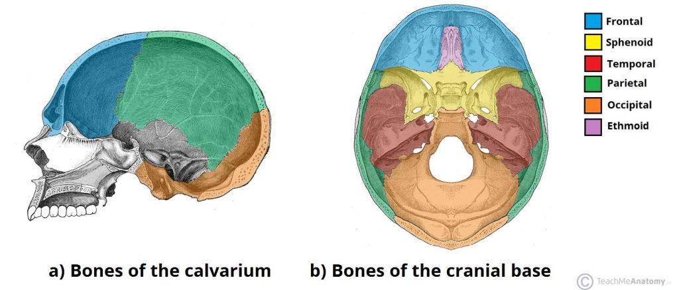

Slide 367
Face
The facial skeleton (also known as the viscerocranium) supports the soft tissues of the face.
It consists of 14 bones, which fuse to house the orbits of the eyes, the nasal and oral cavities, and the sinuses.
The frontal bone, typically a bone of the calvaria, is sometimes included as part of the facial skeleton.

Slide 368
The skeleton of the face is formed by 13 bones in addition to the frontal bone already described.
2 zygomatic (cheek) bones
1 maxilla
2 nasal bones
2 lacrimal bones
1 vomer
2 palatine bones
2 inferior conchae
1 mandible

Slide 369
Zygomatic (cheek) bones
The zygomatic bone originates as two bones that fuse before birth.
They form the prominences of the cheeks and part of the floor and lateral walls of the orbital cavities.

Slide 370
Maxilla (upper jaw bone)
This originates as two bones, but fusion takes place before birth.
The maxilla forms the upper jaw, the anterior part of the roof of the mouth, the lateral walls of the nasal cavity and part of the floor of the orbital cavities.
The alveolar ridge, or process, projects downwards and carries the upper teeth.
On each side is a large air sinus, the maxillary sinus, lined with ciliated mucous membrane and with openings into the nasal cavity.

Slide 371
Nasal bones
These are two small flat bones that form the greater part of the lateral and superior surfaces of the bridge of the nose.
Lacrimal bones
These two small bones are posterior and lateral to the nasal bones and form part of the medial walls of the orbital cavities.
Each is pierced by a foramen for the passage of the nasolacrimal duct that carries the tears from the medial canthus (the inner corner of the eye where upper and lower lid meets) of the eye to the nasal cavity.

Slide 372
Vomer
The vomer is a thin flat bone that extends upwards from the middle of the hard palate to form most of the inferior part of the nasal septum.
Superiorly it articulates with the perpendicular plate of the ethmoid bone.
Palatine bones
These are two small L-shaped bones.
The horizontal parts unite to form the posterior part of the hard palate and the perpendicular parts project upwards to form part of the lateral walls of the nasal cavity.
At their upper extremities they form part of the orbital cavities.

Slide 373
Inferior conchae
Each concha is a scroll-shaped bone, which forms part of the lateral wall of the nasal cavity and projects into it below the middle concha.
The superior and middle conchae are parts of the ethmoid bone.
The conchae collectively increase the surface area in the nasal cavity, allowing inspired air to be warmed and humidified more effectively.

Slide 374
Mandible (lower jaw bone)
This is the lower jaw, the only movable bone of the skull.
It originates as two parts that unite at the midline.
Each half consists of two main parts: a curved body with the alveolar ridge containing the lower teeth and a ramus, which projects upwards almost at right angles to the posterior end of the body.

Slide 375
At the upper end the ramus divides into the condylar process which articulates with the temporal bone to form the temporomandibular joint and the coronoid process, which gives attachment to muscles and ligaments that close the jaw.
The point where the ramus joins the body is the angle of the jaw.

Slide 376
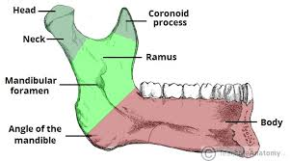

Slide 377
Hyoid bone
This is an isolated horseshoe-shaped bone lying in the soft tissues of the neck just above the larynx and below the mandible.
It is located in the upper neck near the level of the inferior mandible, with the tips of the “U” pointing posteriorly.
It does not articulate with any other bone, but is attached to the styloid process of the temporal bone by ligaments.
It supports the larynx and gives attachment to the base of the tongue.

Slide 378
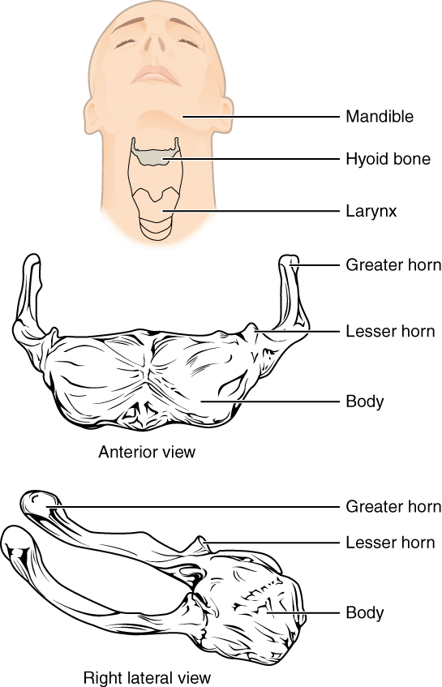

Slide 379
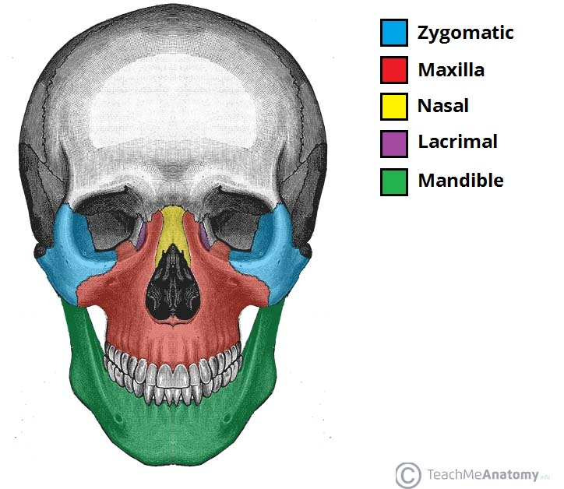
Anterior view of face. Vomer, palatine and inferior conchae lie deep within the face

Slide 380
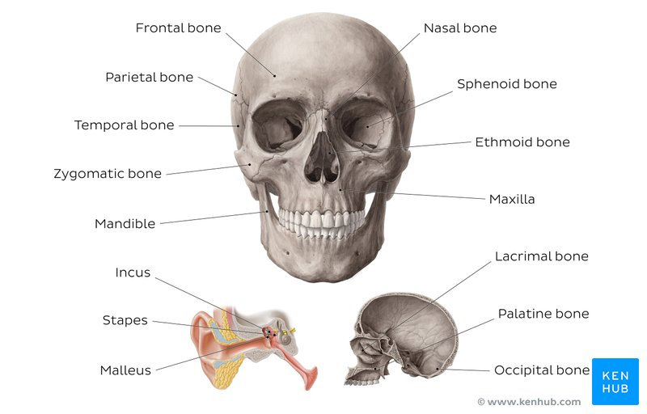
Skull bones

Slide 381
Sutures of the Skull
Sutures are a type of fibrous joint that are unique to the skull. They are immovable and fuse completely around the age of 20.
These joints are important in the context of trauma, as they represent points of potential weakness in the skull. The main sutures in the adult skull are:
Coronal suture – fuses the frontal bone with the two parietal bones.

Slide 382
Sagittal suture – fuses both parietal bones to each other.
Lambdoid suture – fuses the occipital bone to the two parietal bones.
In neonates, the incompletely fused suture joints give rise to membranous gaps between the bones, known as fontanelles. The two major fontanelles are:
Frontal fontanelle – located at the junction of the coronal and sagittal sutures
Occipital fontanelle – located at the junction of the sagittal and lambdoidal sutures
By Te (2021)

Slide 383
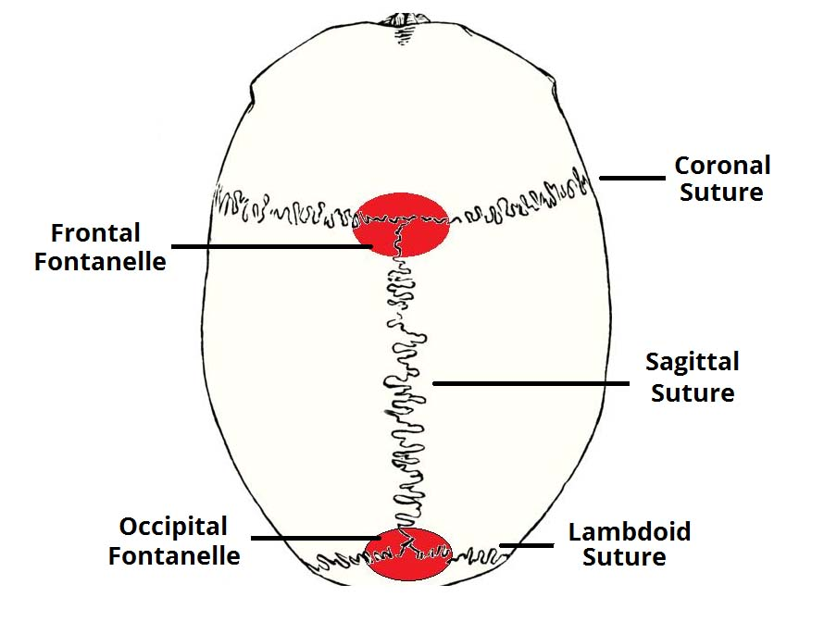
Major fontanelles and sutures of the skull

Slide 384
Muscles of face and head
Muscles of facial expression
The muscles of facial expression are located in the subcutaneous tissue, originating from bone or fascia, and inserting onto the skin. By contracting, the muscles pull on the skin and exert their effects. They are the only group of muscles that insert into skin.
All the muscles of facial expression are innervated by the facial nerve.
The facial muscles can broadly be split into three groups: orbital, nasal and oral.

Slide 385
1.Orbital Group
The orbital group of facial muscles contains two muscles associated with the eye socket.
These muscles control the movements of the eyelids, important in protecting the cornea from damage.
They are both innervated by the facial nerve

Slide 386
a. Orbicularis Oculi
The orbicularis oculi muscle surrounds the eye socket and extends into the eyelid. It has three distinct parts – palpebral, lacrimal, and orbital.
Attachments – Originates from the medial orbital margin, the medial palpebral ligament, and the lacrimal bone. It then inserts into the skin around the margin of the orbit, and the superior and inferior tarsal plates.

Slide 387
Actions:
Palpebral part – gently closes the eyelids.
Lacrimal part – involved in the drainage of tears.
Orbital part – tightly closes the eyelids.
Innervation
Temporal and zygomatic branches of facial nerve (CN VII)

Slide 388
b. Corrugator supercilii (superficialialis)
The corrugator supercilii is a much smaller muscle and is located posteriorly to the orbicularis oculi.
Attachments – Originates from the superciliary arch, running in a superolateral direction. Inserts into the skin of the eyebrow.
Actions – Acts to draw the eyebrows together, creating vertical wrinkles on the bridge of the nose.
Innervation – Facial nerve

Slide 389
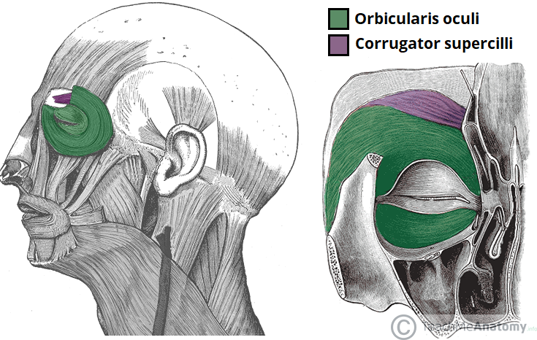

Slide 390
2. Nasal group
The nasal group of facial muscles are associated with movements of the nose, and the skin around it.
There are three muscles in this group, and they are all innervated by the facial nerve.
They serve little importance in humans.

Slide 391
Nasalis
The nasalis is the largest of the nasal muscles.
It is split into two parts: transverse and alar.
Attachments: Both portions of the muscle originate from the maxilla. The transverse part attaches to an aponeurosis across the dorsum of the nose. The alar portion of the muscle attaches to the alar cartilage of the nasal skeleton.
Actions: The two parts have opposing functions. The transverse part compresses the nares, and the alar part opens the nares.
Innervation: Facial nerve.

Slide 392
Procerus
The procerus is the most superior of the nasal muscles. It also lies superficially to the other muscles of facial expression.
Attachments: It originates from the nasal bone, inserting into the lower medial forehead.
Actions: Contraction of this muscle pulls the eyebrows downward to produce transverse wrinkles over the nose.
Innervation: Facial nerve.

Slide 393
Depressor Septi Nasi
This muscle assists the alar part of the nasali in opening the nostrils.
Attachments: It runs from the maxilla (above the medial incisor tooth) to the nasal septum.
Actions: It pulls the nose inferiorly, opening the nares.
Innervation: Facial nerve.

Slide 394
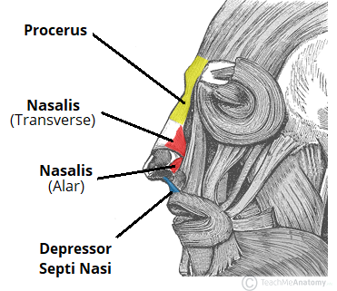

Slide 395
3.Oral group
These are the most important group of the facial expressors: responsible for movements of the mouth and lips. Such movements are required in singing and whistling and add emphasis to vocal communication.
The oral group of muscles consists of the orbicularis oris, buccinator, and various smaller muscles.

Slide 396
Orbicularis Oris
The fibres of the orbicularis oris enclose the opening to the oral cavity.
Attachments: Arises from the maxilla and from the other muscles of the cheek. It inserts into the skin and mucous membranes of the lips.
Action: Purses the lips.
Innervation: Facial nerve.

Slide 397
Buccinator
This muscle is located between the mandible and maxilla, deep to the other muscles of the face.
Attachments: It originates from the maxilla and mandible. The fibres run in an inferomedial direction, blending with the orbicularis oris and the skin of the lips.
Actions: The buccinator pulls the cheek inwards against the teeth, preventing accumulation of food in that area.
Innervation: Facial nerve.

Slide 398
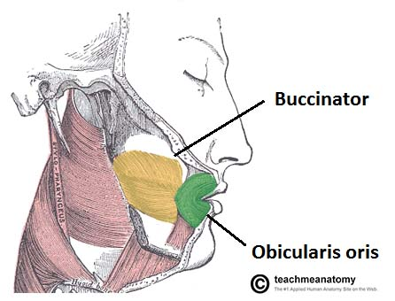

Slide 399
Other Oral Muscles
There are other muscles that act on the lips and mouth. Anatomically, they can be divided into upper and lower groups:
The lower group contains the depressor anguli oris, depressor labii inferioris and the mentalis.
Depressor anguli oris – originates from mental tubercle and oblique mandible (it is continous with platysma muscle). Inserts into modiolus. Its action is to depress angle of the mouth. Blood supply is by inferior labial artery(facial artery); mental artery (maxillary artery). Nerve supply is by buccal and mandibular branches of facial nerve

Slide 400
Depressor labii inferioris- originates from oblique line of mandible (continous with platsyma)and inserts into skin and submucosa of lower lip. Its blood supply is by inferior labial branch of facial artery, mental branch of maxillary artery . Nerve supply is by Mandibular branch of facial nerve (CN VII) . It action is to depress lower lip inferolaterally
Mentalis- originates from the mandible (lower jaw) and runs vertically from below the lower lip to the lower part of the chin. Elevates, everts and protrudes lower lip, wrinkles skin of chin. Innerveted by Mandibular branch of facial nerve (CN VII). Inferior labial branch of facial artery, mental branch of the maxillary artery

Slide 401
The upper group contains the
Risorius- responsible for the lateral movement of the mouth i.e it if found around the lips. It closes the lips, responsible for whistling and kissing i.e protrusion of mouth. It originates from parotid fascia, buccal skin, zygomatic bone and inserts in modiolus. Nerve supply is by buccal branch of facial nerve. Blood supply is by superior labial artery of facial artery

Slide 402
zygomaticus major- a muscle of facial expression which draws the muscle of angle of the mouth superiorly and posteriorly to allow one to smile. Originates from anterior of zygomatic and inserts in modiolus of the mouth. Nerve supply is by zygomatic and buccal branches of the facial nerve. Blood supply is by superficial labial branches of facial artery. It draws the angle of the mouth upward laterally
zygomaticus minor- it originates from lateral aspect of vzygomatic bone and inserts into the outer part of the upper lip. It is innerted by zygomatic and buccal branches of facial nerve (CN VII). Blood supply is superior labial branch of facial artery. It elevates upper lip, exposes maxillary teeth

Slide 403
levator labii superioris- originates from maxillary process of zygomatic bone. Inserts in upper lip. Elevates upper lip, exposes maxillary teeth. Blood supply is by facial artery and infraorbital branch of maxillary artery. It is innervated by zygomatic and buccal branches of facial nerve
levator labii superioris alaeque nasi- originates from maxilla and inserts into nostrils and upper lip. Nerve innervation is by buccal branch of facial nerve. It dilates nostrils, elevates upper lip and wing of the nose
levator anguli oris- originates from Canine fossa of maxilla. It inserts in modiolus. Its action is to elevate angle of mouth. It is supplied by Zygomatic and buccal branches of facial nerve (CN VII) and Superior labial branch of facial artery, infraorbital branch of maxillary artery

Slide 404
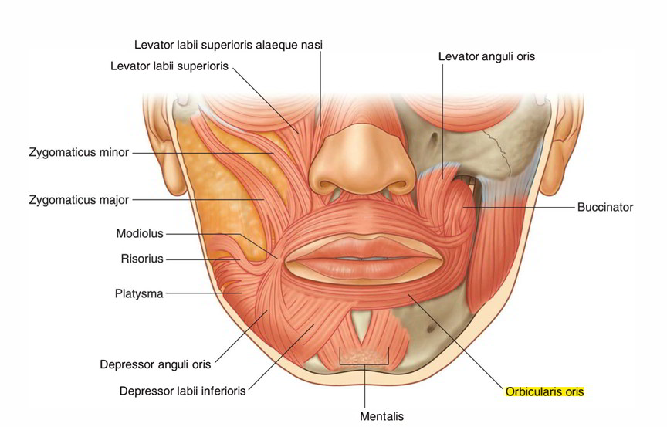

Slide 405
Muscles of mastication
The muscles of mastication are associated with movements of the jaw (temporomandibular joint). They are one of the major muscle groups in the head – the other being the muscles of facial expression.
There are four muscles:
Masseter
Temporalis
Medial pterygoid
Lateral pterygoid

Slide 406
The muscles of mastication develop from the first pharyngeal arch. Thus, they are innervated by a branch of the trigeminal nerve (CN V), the mandibular nerve.
Masseter
The masseter muscle is the most powerful muscle of mastication.
It is quadrangular in shape and has two parts: deep and superficial.
The entirety of the muscle lies superficially to the pterygoids and temporalis, covering them.
Attachments: The superficial part originates from maxillary process of the zygomatic bone. The deep part originates from the zygomatic arch of the temporal bone. Both parts attach to the ramus of the mandible.
Actions: Elevates the mandible, closing the mouth.
Innervation: Mandibular nerve (V3).

Slide 407
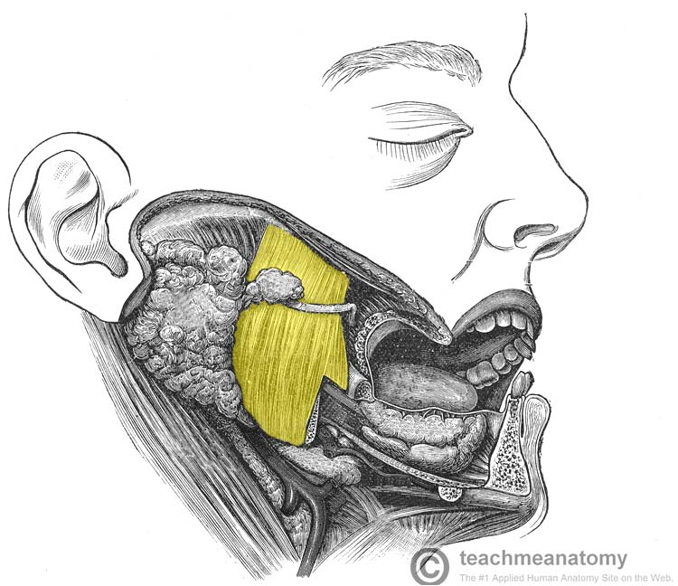

Slide 408
Temporalis
The temporalis muscle originates from the temporal fossa – a shallow depression on the lateral aspect of the skull.
The muscle is covered by tough fascia which can be harvested surgically and used to repair a perforated tympanic membrane (an operation known as a myringoplasty).

Slide 409
Attachments: Originates from the temporal fossa. It condenses into a tendon, which inserts onto the coronoid process of the mandible.
Actions: Elevates the mandible, closing the mouth. Also retracts the mandible, pulling the jaw posteriorly.
Innervation: Mandibular nerve (V3).

Slide 410
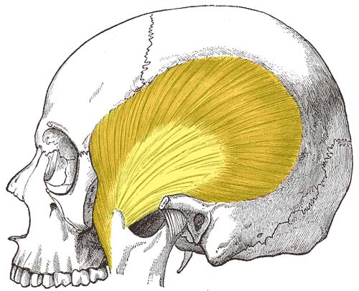

Slide 411
Lateral Pterygoid
The lateral pterygoid muscle has a triangular shape with two heads: superior and inferior. It has horizontally orientated muscle fibres, and thus is the major protractor of the mandible.
Attachments:
The superior head originates from the greater wing of the sphenoid.
The inferior head originates from the lateral pterygoid plate of the sphenoid.
The two heads converge into a tendon which attaches to the neck of the mandible.

Slide 412
Actions: Acting bilaterally, the lateral pterygoids protract the mandible, pushing the jaw forwards. Unilateral action produces the ‘side to side’ movement of the jaw.
Note: Contraction of the lateral pterygoid will produce lateral movement on the contralateral side. For example, contraction of left lateral pterygoid will deviate the mandible to the right.
Innervation: Mandibular nerve (V3).

Slide 414
Muscles of the tongue
Most muscles serve to attach one bone, usually via a tendon, to another.
There are a few places where that is not entirely true: the ocular muscles, the scapulothoracic joint, the diaphragm and perineum are all good exceptions.
However, the tongue is extraordinary. A boneless mass that you can protrude at will, fold, invert, lay flat or fill the mouth

Slide 415
Intrinsic Muscles
The intrinsic muscles only attach to other structures in the tongue.
There are four paired intrinsic muscles of the tongue and they are named by the direction in which they travel: the superior longitudinal, inferior longitudinal, transverse and vertical muscles of the tongue.
These muscles affect the shape and size of the tongue – for example, in tongue rolling – and have a role in facilitating speech, eating and swallowing.
Motor innervation for the intrinsic muscles of the tongue is via the hypoglossal nerve (CNXII).

Slide 416
Extrinsic Muscles
The extrinsic muscles are as follows:
a. Genioglossus
Attachments: Arises from the mandibular symphsis. Inserts into the body of the hyoid bone and the entire length of the tongue.
Function: Inferior fibres protrude the tongue, middle fibres depress the tongue, and superior fibres draw the tip back and down
Innervation: Motor innervation via the hypoglossal nerve (CNXII).

Slide 417
b. Hyoglossus
Attachments: Arises from the hyoid bone and inserts into the side of the tongue
Function: Depresses and retracts the tongue
Innervation: Motor innervation via the hypoglossal nerve (CNXII).
c. Styloglossus
Attachments: Originates at the styloid process of the temporal bone and inserts into the side of the tongue
Function: Retracts and elevates the tongue
Innervation: Motor innervation via the hypoglossal nerve (CNXII).

Slide 418
c. Palatoglossus
Attachments: Arises from the palatine aponeurosis and inserts broadly across the tongue
Function: Elevates the posterior aspect of the tongue
Innervation: Motor innervation via the vagus nerve (CNX).
All of the intrinsic and extrinsic muscles are innervated by the hypoglossal nerve (CN XII), except palatoglossus, which has vagal innervation (CN X).

Slide 419
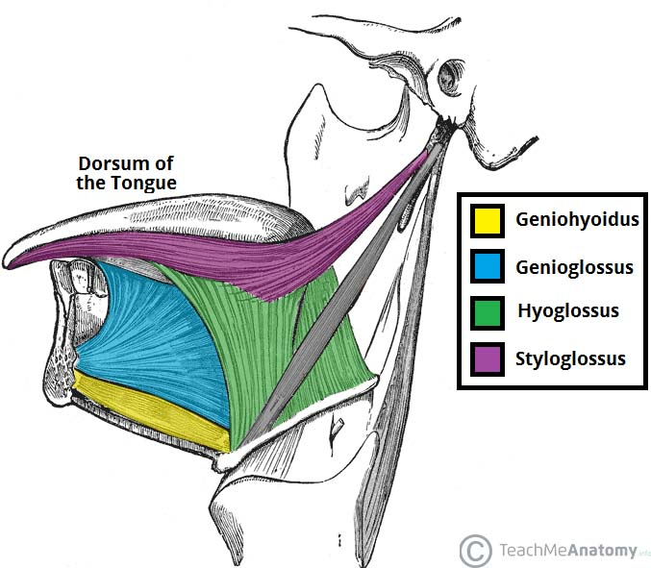
Extrinsic muscles of the tongue

Slide 420
Innervation
In the anterior 2/3, general sensation is supplied by the trigeminal nerve (CNV). Specifically the lingual nerve, a branch of the mandibular nerve (CN V3).
On the other hand, taste in the anterior 2/3 is supplied from the facial nerve (CNVII). In the petrous part of the temporal bone, the facial nerve gives off three branches, one of which is chorda tympani. This travels through the middle ear, and continues on to the tongue.
The posterior 1/3 of the tongue is slightly easier. Both touch and taste are supplied by the glossopharyngeal nerve (CNIX).

Slide 421
Vasculature
The lingual artery (branch of the external carotid) does most of the supply, but there is a branch from the facial artery, called the tonsillar artery, which can provide some collateral circulation. Drainage is by the lingual vein.
Lypmphatic drainage
The lymphatic drainage of the tongue is as follows:
Anterior two thirds – initially into the submental and submandibular nodes, which empty into the deep cervical lymph nodes
Posterior third – directly into the deep cervical lymph nodes

Slide 422
Muscles of the neck
Suboccipital muscles
The suboccipital muscles are a group of four muscles situated underneath the occipital bone. All the muscles in this group are innervated by the suboccipital nerve.
They are located within the suboccipital compartment of the neck; deep to the sternocleidomastoid, trapezius, splenius and semispinalis muscles. They collectively act to extend and rotate the head.

Slide 423
a. Rectus Capitis Posterior Major
The rectus capitis posterior major is the larger of the rectus capitis muscles. It is located laterally to the rectus capitis posterior minor.
Attachments: Originates from the spinous process of the C2 vertebrae (axis), and inserts into the lateral part of the inferior nuchal line of the occipital bone.
Actions: Extension and rotation of the head.
Innervation: Suboccipital nerve (posterior ramus of C1).
b. Rectus Capitis Posterior Minor
The rectus capitis posterior minor is the most medial of the suboccipital muscles. There is a connective tissue bridge between this muscle and the dura mater (outer membrane of the meninges) – which may play a role in cervicogenic headaches.

Slide 424
Attachments: Runs from the posterior tubercle (a rudimentary spinous process) of the C1 vertebra to the medial part of the inferior nuchal line of the occipital bone.
Actions: Extension of the head.
Innervation: Suboccipital nerve (posterior ramus of C1).

Slide 425
c. Obliquus Capitis Inferior
As its name suggests, the obliquus capitis inferior is the most inferiorly positioned of the suboccipital muscles. Additionally, it is the only capitis muscle that has no attachment to the cranium.
Attachments: Originates from the spinous process of the C2 vertebra, and attaches into the transverse process of C1.
Actions: Extension and rotation of the head.
Innervation: Suboccipital nerve (posterior ramus of C1)

Slide 426
d. Obliquus Capitis Superior
The obliquus capitis superior is located laterally in the suboccipital compartment.
Attachments: Originates from the transverse process of C1 and attaches into the occipital bone (between the superior and inferior nuchal lines).
Actions: Extension of the head.
Innervation: Suboccipital nerve (posterior ramus of C1)

Slide 427
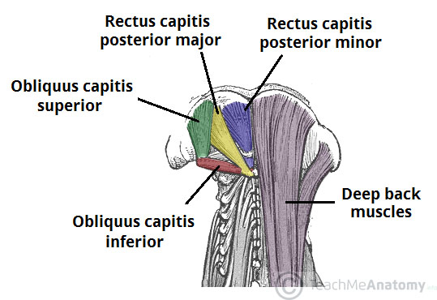

Slide 428
Suprahyoid muscle
The suprahyoid muscles are a group of four muscles located superior to the hyoid bone of the neck. They all act to elevate the hyoid bone – an action involved in swallowing.
The arterial supply to these muscles is via branches of the facial artery, occipital artery, and lingual artery.

Slide 429
a. Stylohyoid
The stylohyoid muscle is a thin muscular strip, which is located superiorly to the posterior belly of the digastric muscle.
Attachments: Arises from the styloid process of the temporal bone and attaches to the lateral aspect of the hyoid bone.
Actions: Initiates a swallowing action by pulling the hyoid bone in a posterior and superior direction.
Innervation: Stylohyoid branch of the facial nerve (CN VII). This arises proximally to the parotid gland.

Slide 430
b. Digastric
The digastric is comprised of two muscular bellies, which are connected by a tendon. In some cadaveric specimens, this tendon can be seen to pierce the stylohyoid muscle.
Attachments:
The anterior belly arises from the digastric fossa of the mandible.
The posterior belly arises from the mastoid process of the temporal bone.
The two bellies are connected by an intermediate tendon, which is attached to the hyoid bone via a fibrous sling.
Actions: Depresses the mandible and elevates the hyoid bone.

Slide 431
Innervation:
The anterior belly is innervated by the inferior alveolar nerve, a branch of the mandibular nerve (which is derived from the trigeminal nerve, CN V).
The posterior belly is innervated by the digastric branch of the facial nerve.
c. Mylohyoid
The mylohyoid is a broad, triangular shaped muscle. It forms the floor of the oral cavity and supports the floor of the mouth.
Attachments: Originates from the mylohyoid line of the mandible, and attaches onto the hyoid bone.
Actions: Elevates the hyoid bone and the floor of the mouth.
Innervation: Inferior alveolar nerve, a branch of the mandibular nerve (which is derived from the trigeminal nerve).

Slide 432
d. Geniohyoid
The geniohyoid is located close to the midline of the neck, deep to the mylohyoid muscle.
Attachments: Arises from the inferior mental spine of the mandible. It then travels inferiorly and posteriorly to attach to the hyoid bone.
Actions: Depresses the mandible and elevates the hyoid bone.
Innervation: C1 nerve roots that run within the hypoglossal nerve.

Slide 433
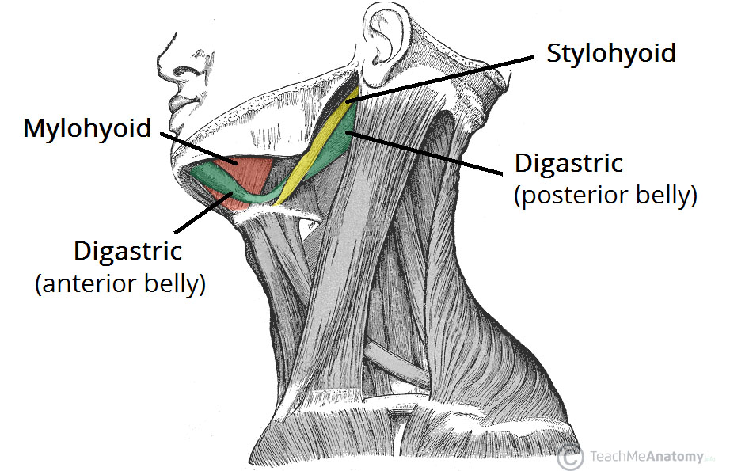

Slide 434
Infrahyoid muscles
The infrahyoid muscles are a group of four muscles that are located inferiorly to the hyoid bone in the neck. They can be divided into two groups:
Superficial plane – omohyoid and sternohyoid muscles.
Deep plane – sternothyroid and thyrohyoid muscles.
The arterial supply to the infrahyoid muscles is via the superior and inferior thyroid arteries, with venous drainage via the corresponding veins.

Slide 435
a. Omohyoid
The omohyoid is comprised of two muscle bellies, which are connected by a muscular tendon.
Attachments:
The inferior belly of the omohyoid arises from the scapula. It runs superomedially underneath the sternocleidomastoid muscle.
It is attached to the superior belly by an intermediate tendon, which is anchored to the clavicle by the deep cervical fascia.
From here, the superior belly ascends to attach to the hyoid bone.
Actions: Depresses the hyoid bone.
Innervation: Anterior rami of C1-C3, carried by a branch of the ansa cervicalis.

Slide 436
b. Sternohyoid
The sternohyoid muscle is located within the superficial plane.
Attachments: Originates from the sternum and sternoclavicular joint. It ascends to insert onto the hyoid bone.
Actions: Depresses the hyoid bone.
Innervation: Anterior rami of C1-C3, carried by a branch of the ansa cervicalis.

Slide 437
c. Sternothyroid
The sternothyroid muscle is wider and deeper than the sternohyoid. It is located within the deep plane.
Attachments: Arises from the manubrium of the sternum, and attaches to the thyroid cartilage.
Actions: Depresses the thyroid cartilage.
Innervation: Anterior rami of C1-C3, carried by a branch of the ansa cervicalis.

Slide 438
d.Thyrohyoid
The thyrohyoid is a short band of muscle, thought to be a continuation of the sternothyroid muscle.
Attachments: Arises from the thyroid cartilage of the larynx, and ascends to attach to the hyoid bone.
Actions: Depresses the hyoid. If the hyoid bone is fixed, it can elevate the larynx.
Innervation: Anterior ramus of C1, carried within the hypoglossal nerve.

Slide 439
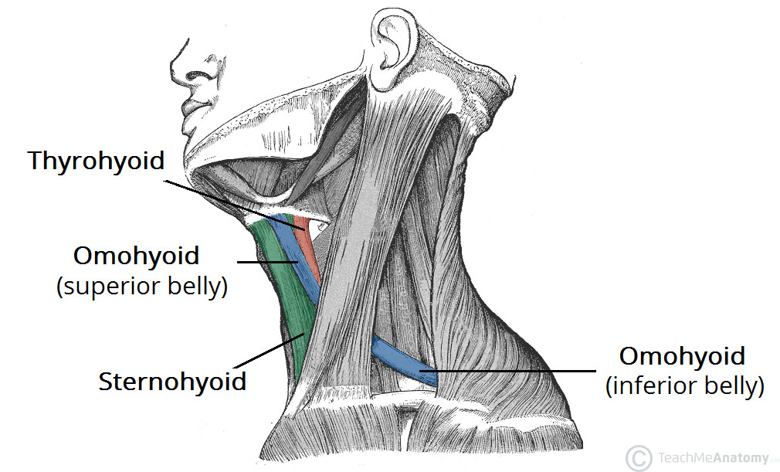
Lateral review of infrahyoid bone

Slide 440
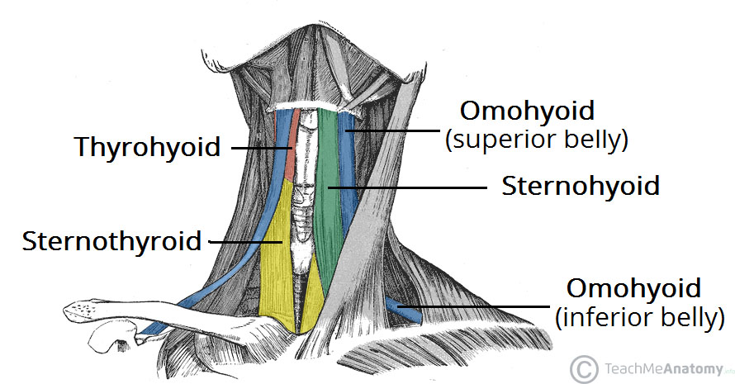
Anterior view of infrahyoid bone

Slide 441
Scalene muscles
The scalene muscles are three paired muscles (anterior, middle and posterior), located in the lateral aspect of the neck. Collectively, they form part of the floor of the posterior triangle of the neck.
The scalenes act as accessory muscles of respiration, and perform flexion at the neck

Slide 442
Anterior Scalene
The anterior scalene muscle lies on the lateral aspect of the neck, deep to the prominent sternocleidomastoid muscle.
Attachments: Originates from the anterior tubercles of the transverse processes of C3-C6, and attaches onto the scalene tubercle, on the inner border of the first rib.
Function: Elevation of the first rib. Ipsilateral contraction causes ipsilateral lateral flexion of the neck, and bilateral contraction causes anterior flexion of the neck.
Innervation: Anterior rami of C5-C6.

Slide 443
Middle Scalene
The middle scalene is the largest and longest of the three scalene muscles. It has several long, thin muscles bellies arising from the cervical spine, which converge into one large belly that inserts into the first rib.
Attachments: Originates from the posterior tubercles of the transverse processes of C2-C7, and attaches to the scalene tubercle of the first rib.
Function: Elevation of the first rib. Ipsilateral contraction causes ipsilateral lateral flexion of the neck.
Innervation: Anterior rami of C3-C8.

Slide 444
Posterior Scalene
The posterior scalene is the smallest and deepest of the scalene muscles. Unlike the anterior and middle scalene muscles, it inserts into the second rib.
Attachments: Originates from the posterior tubercles of the transverse processes of C5-C7, and attaches into the second rib.
Function: Elevation of the second rib, and ipsilateral lateral flexion of the neck.
Innervation: Anterior rami of C6-C8.

Slide 445
Anatomical Relationships
The scalene muscles are an important part of the anatomy of the neck, with several important structures located between and around them.
The brachial plexus and subclavian artery pass between the anterior and middle scalene muscles. This provides an important anatomical landmark in anaesthetics for performing an interscalene block.
The subclavian vein and phrenic nerve pass anteriorly to the anterior scalene – the subclavian vein courses horizontally across it, while the phrenic nerve runs vertically down the muscle. The subclavian artery is located posterior to the anterior scalene.

Slide 446
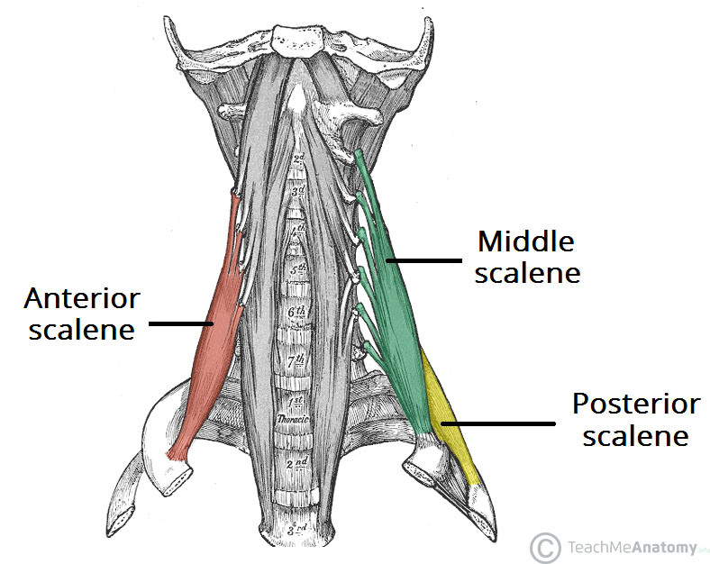

Slide 447
Other muscles of the neck
Sternocleidomastoid
This muscle arises from the manubrium of the sternum and the clavicle and extends upwards to the mastoid process of the temporal bone.
It assists in turning the head from side to side.
When the muscle on one side contracts it draws the head towards the shoulder.
When both contract at the same time they flex the cervical vertebrae or draw the sternum and clavicles upwards when the head is maintained in a fixed position, e.g. in forced respiration

Slide 448
Trapezius
This muscle covers the shoulder and the back of the neck.
The upper attachment is to the occipital protuberance, the medial attachment is to the transverse processes of the cervical and thoracic vertebrae and the lateral attachment is to the clavicle and to the spinous and acromion processes of the scapula.
It pulls the head backwards, squares the shoulders and controls the movements of the scapula when the shoulder joint is in use.

Slide 449
SCALP
The scalp refers to the layers of skin and subcutaneous tissue that cover the bones of cranial vault.
Layers of the scalp
The scalp consists of five layers. The first three layers are tightly bound together and move as a collective structure.
The mnemonic ‘SCALP’ can be a useful way to remember the layers of the scalp: Skin, Dense Connective Tissue, Epicranial Aponeurosis, Loose Areolar Connective Tissue and Periosteum.

Slide 450
Skin – contains numerous hair follicles and sebaceous glands (thus a common site for sebaceous cysts).
Dense Connective tissue – connects the skin to the epicranial aponeurosis. It is richly vascularised and innervated.
The blood vessels within the layer are highly adherent to the connective tissue. This renders them unable to constrict fully if lacerated – and so the scalp can be a site of profuse bleeding.

Slide 451
Epicranial Aponeurosis – a thin, tendon-like structure that connects the occipitalis and frontalis muscles.
Loose Areolar Connective Tissue – a thin connective tissue layer that separates the periosteum of the skull from the epicranial aponeurosis.
It contains numerous blood vessels, including emissary veins which connect the veins of the scalp to the diploic veins and intracranial venous sinuses.
Periosteum – the outer layer of the skull bones. It becomes continuous with the endosteum at the suture lines.

Slide 452
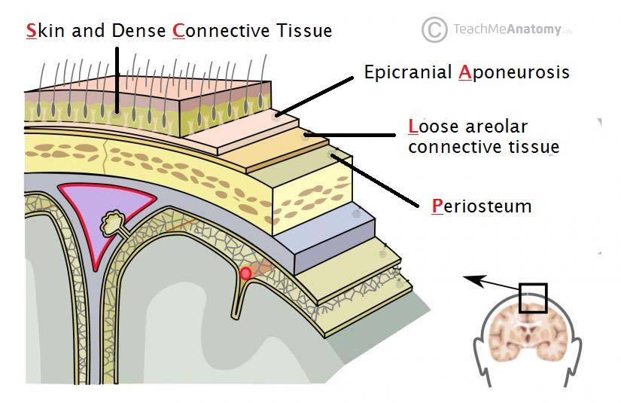

Slide 453
Arterial Supply
The scalp receives a rich arterial supply via the external carotid artery and the ophthalmic artery (a branch of the internal carotid). There are three branches of the external carotid artery involved:
Superficial temporal – supplies the frontal and temporal regions
Posterior auricular – supplies the area superiorly and posteriorly to the auricle.
Occipital – supplies the back of the scalp
Anteriorly and superiorly, the scalp receives additional supply from two branches of the ophthalmic artery – the supraorbital and supratrochlear arteries. These vessels accompany the supraorbital and supratrochlear nerves respectively.

Slide 454
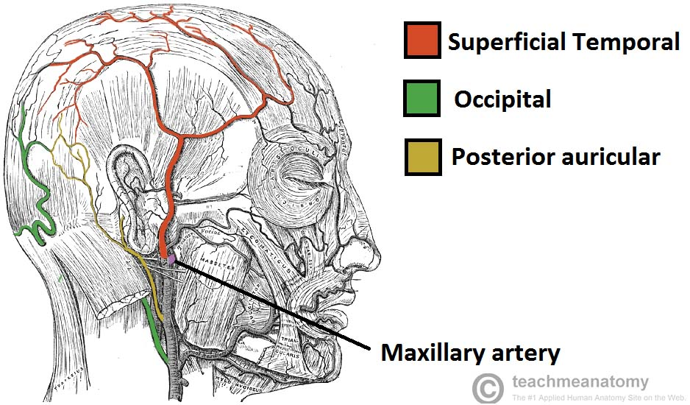
Three branches supplying the scalp

Slide 455
Venous drainage
The venous drainage of the scalp can be divided into superficial and deep components.
The superficial drainage follows the arterial supply: superficial temporal, occipital, posterior auricular, supraorbital and supratrochlear veins.
The deep (temporal) region of the skull is drained by the pterygoid venous plexus. This is a large plexus of veins situated between the temporalis and lateral pterygoid muscles,and drains into the maxillary vein.
Importantly, the veins of the scalp connect to the diploic veins of the skull via valveless emissary veins. This establishes a connection between the scalp and the dural venous sinuses.

Slide 456
Innervation
The scalp receives cutaneous innervation from branches of the trigeminal nerve or the cervical nerve roots.
Trigeminal Nerve
Supratrochlear nerve – branch of the ophthalmic nerve which supplies the anteromedial forehead.
Supraorbital nerve – branch of the ophthalmic nerve which supplies a large portion of the scalp between the anterolateral forehead and the vertex.
Zygomaticotemporal nerve – branch of the maxillary nerve, this supplies the temple.
Auriculotemporal nerve – branch of the mandibular nerve which supplies skin anterosuperior to the auricle.

Slide 457
Cervical Nerves
Lesser occipital nerve – derived from the anterior ramus (division) of C2 and supplies the skin posterior to the ear
Greater occipital nerve – derived from the posterior ramus (division) of C2 and supplies the skin of the occipital region.
Great auricular nerve – derived from the anterior rami of C2 and C3 and supplies the skin posterior to the ear and over the angle of the mandible.
Third occipital nerve – derived from the posterior ramus of C3 and supplies the skin of the inferior occipital region.

Slide 458
Cranial cavity
The cranial cavity, also known as intracranial space, is the space within the skull
The space inside the skull is formed by eight cranial bones known as the neurocranium. The neurocranium is the upper back part that forms the protective case around the brain.
The skull cap of the neurocranium covers the cranial cavity and the remainder of the skull is called the facial skeleton.
The skull (minus the mandible) is also known as the cranium, and contains the brain.
Meninges are protective membranes that surround the brain to minimize damage of the brain when there is head trauma. Meningitis is the inflammation of meninges caused by bacterial or viral

Slide 459
The spaces between meninges and the brain are filled with a clear cerebrospinal fluid, increasing the protection of the brain. Facial bones of the skull are not included in the cranial cavity.
It is formed by blending of eight cranial bones: The occipital, two parietal, the frontal, two temporal, the ethmoid and the sphenoid bones are fused together by the ossification of fixed fibrous sutures

Slide 460
The three meninges are the three membranes that envelop the brain and spinal cord, in which the central nervous system developed, which are the pia mater, the arachnoid mater, and the dura mater.
The latter is the thickest and outermost of the three membrane layers; it contains the most collagen, and it is derived from the mesoderm
The pituitary gland is also found in the make up of the cranial cavity. It plays a major role in the body, creating and secreting many bodily hormones. The gland secretes different fluids that are important for the body to function. The body's temperature, physical, and sexual functions are regulated by this gland. One of the major glands are controlled through this cavity.

Slide 461
Cranial cavity is divided into 3 fossae
Anterior
Middle
Posterior
Anterior cranial fossae
The anterior cranial fossa is the most shallow and superior of the three cranial fossae. It lies superiorly over the nasal and orbital cavities. The fossa accommodates the anteroinferior portions of the frontal lobes of the brain.
The anterior fossae consists of three bones: frontal, ethmoid and sphenoid bones

Slide 462
Middle Cranial Fossa
The middle cranial fossa is deeper and situated posterior to the anterior fossa. It extends from the lesser wings of the sphenoid bone anteriorly, to the petrous ridges (petrous portion of the temporal bones) posteriorly
The middle cranial fossa consists of three bones – the sphenoid bone and the two temporal bones.
Middle cranial fossa consists of central portion that contain pituitary gland and two lateral portions which accommodate temporal bones of the brain

Slide 463
Posterior Cranial Fossa
The posterior cranial fossa is the most posterior and deepest portion of the cranial cavity.
It accommodates the brainstem and cerebellum of the brain.
The posterior fossa is bounded anteriorly by the petrous ridges, while the occipital bone forms the floor and posterior wall. It is divided at the midline by the large foramen magnum (“great aperture”), the opening that provides for passage of the spinal cord.
The posterior cranial fossa is comprised of three bones; occipital bone and two temporal bones

Slide 464
BRAIN
The brain has three main parts: forebrain middle brain and hind brain
The brain is contained in, and protected by, the skull bones of the head

Slide 465
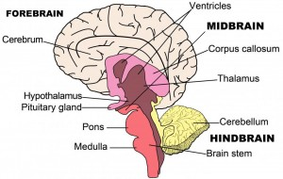
Parts of the brain

Slide 466
Forebrain
The Cerebrum: Also known as the cerebral cortex,
The cerebrum is the largest part of the human brain, and it is associated with higher brain function such as thought and action.
Nerve cells make up the gray surface, which is a little thicker than our thumb.
White nerve fibers beneath the surface carry signals between nerve cells in other parts of the brain and body.

Slide 467
Its wrinkled surface increases the surface area, and is a six-layered structure found in mammals, called the neocortex.
It is divided into four sections, called “lobes”. They are; the frontal lobe, the parietal lobe, the occipital lobe and the temporal lobe.

Slide 469
Functions Of The Lobes:
Frontal Lobe – The frontal lobe lies just beneath our forehead (the front of the head) and is associated with our brain’s ability to reason, organize, plan, speak, move, make facial expressions, serial task, problem solve, control inhibition, spontaneity, initiate and self-regulate behaviors, pay attention, remember and control emotions.

Slide 470
Parietal Lobe – The parietal lobe is located at the upper rear of our brain (the middle part of the brain), and controls our complex behaviors, including senses such as vision, touch, body awareness and spatial orientation.
It plays important roles in integrating sensory information from various parts of our body, knowledge of numbers and their relations, and in the manipulation of objects.
Portions are involved with our visuospatial processing, language comprehension, the ability to construct, body positioning and movement, neglect/inattention, left-right differentiation and self-awareness/insight.

Slide 471
Occipital Lobe – The occipital lobe is located at the back of our brain, and is associated with our visual processing, such as visual recognition, visual attention, spatial analysis and visual perception of body language; such as postures, expressions and gestures.
Temporal Lobe – The temporal lobe is located near our ears (the sides of the brain) and is associated with processing our perception and recognition of auditory stimuli (including our ability to focus on one sound among many, like listening to one voice among many at a party), comprehending spoken language, verbal memory, visual memory and language production (including fluency and word-finding), general knowledge and autobiographical memories.

Slide 472
A deep furrow divides the cerebrum into two halves, known as the left and right hemispheres.
The two halves join at a large deep sulcus (interhemispheric fissure AKA, the medial longitudinal fissure) that runs from front of head to the back
And, while the two hemispheres look almost symmetrical, each side seems to function differently.
The right hemisphere is considered our creative side, and the left hemisphere is considered our logical side.
The right hemisphere controls the left side of the body while the left hemisphere control the right side of the body
A bundle of axons, called the corpus callosum (a C-shaped structure of white matter and nerve pathways), connects the two hemispheres and allow communication between the two halves. The corpus callosum is at the center of the cerebrum

Slide 473
Midbrain
The midbrain is located below the cerebral cortex, and above the hindbrain placing it near the center of the brain.
It is comprised of the tectum(Latin for roof)- is the dorsal side of the midbrain , tegmentum -is the ventral part of the midbrain , cerebral aqueduct (the structure within the brainstem that connects the third ventricle to the fourth) cerebral peduncles (are the two stalks that attach the cerebrum to the brainstem) and several nuclei and fasciculi.
The primary role of the midbrain is to act as a sort of relay station for our visual and auditory systems.

Slide 474
Portions of the midbrain called the red nucleus and the substantia nigra are involved in the control of body movement, and contain a large number of dopamine-producing neurons.
The degeneration of neurons in the substantia nigra is associated with Parkinson’s disease.
The midbrain is the smallest region of the brain, and is located most centrally within the cranial cavity.

Slide 475
Limbic System – the limbic system is often referred to as our “emotional brain”, or ‘childish brain’. It is found buried within the cerebrum and contains the thalamus, hypothalamus, amygdala and hippocampus.
Thalamus – the primary role of the thalamus is to relay sensory information from other parts of the brain to the cerebral cortex
Hypothalamus – the primary role of the hypothalamus is to regulate various functions of the pituitary gland and endocrine activity, as well as somatic functions e.g.body temperature, sleep, appetite.

Slide 476
Amygdala – the primary role of the amygdala is to be a critical processor for the senses. Connected to the hippocampus, it plays a role in emotionally laden memories and contains a huge number of opiate receptor sites that are implicated in rage, fear and sexual feelings
Hippocampus – the primary role of the hippocampus is memory forming, organizing and storing information. It is particularly important in forming new memories, and connecting emotions and senses, such as smell and sound, to memories.

Slide 477
Pituitary Gland – the primary role of the pituitary gland is an important link between the nervous system and the endocrine system.
It releases many hormones which affect growth, metabolism, sexual development and the reproduction system.
It is connected to the hypothalamus and is about the size of a pea.
It is located in the center of the skull, just behind the bridge of the nose.

Slide 478
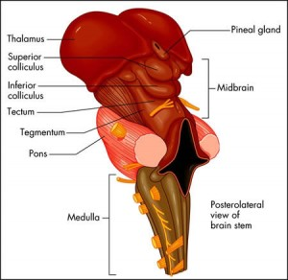
Midbrain

Slide 479
Hindbrain
The Cerebellum – The cerebellum, or “little brain”, is similar to the cerebrum with its two hemispheres and highly folded surface. It is associated with regulation and coordination of movement, posture, balance and cardiac, respiratory and vasomotor centers.
Brain Stem – The brain stem is located beneath the limbic system. It is responsible for vital life functions such as breathing, heartbeat, and blood pressure. The brain stem is made of the midbrain, pons, and medulla.

Slide 480
Pons – The primary role of the pons is to serve as a bridge between various parts of the nervous system, including the cerebellum and cerebrum. Many important nerves that originate in the pons, such as the trigeminal nerve, responsible for feeling in the face, as well as controlling the muscles that are responsible for biting, chewing, and swallowing.
It also contains the abducens nerve, which allows us to look from side to side and the vestibulocochlear nerve, which allows to hear.
As part of the brainstem, a section of the lower pons stimulates and controls the intensity of breathing, while a section of the upper pons decreases the depth and frequency of breaths.
The pons is also associated with the control of sleep cycles, and controls respiration and reflexes. It is located above the medulla, below the midbrain, and just in front of the cerebellum.

Slide 481
Medulla – The primary role of the medulla is regulating our involuntary life sustaining functions such as breathing, swallowing and heart rate.
As part of the brain stem, it also helps transfer neural messages to and from the brain and spinal cord.
It is located at the junction of the spinal cord and brain.

Slide 482
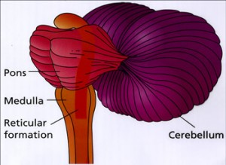

Slide 483
Cranial nerves
There are 12 pairs of major nerves called cranial nerves that serve both sides of the body.
These nerves innervate the structuresof head and neck
Except for accessory nerve (CN XI) which has origin in the spinal cord, all other cranial nerves emerge from the brain
The cranial nerves and their responsibilities include:
Olfactory (CN 1)- a sensory nerve: smell
Optic (CN II) – sensory nerve: sight
Oculomotor (CN 111)- motor nerve: contraction of eye muscles
Trochlear ( CN 1V)- motor nerve: one muscle of the eye

Slide 484
Trigeminal (CN V)-mixed nerve: large sensory nerve of
Has 3 branches; opthalmic branch, maxillary branch, mandibular branch
Abducens (CN VI)-motor nerve: one muscle of the eye
Facial (CN VII) - mixed nerve: facial expression, taste sensation
Vestibulocochlear (CN VIII)- sensory nerve-: has 2 division vestibule division for body balance and cochlea division for hearing

Slide 485
Glossopharyngeal (CN IX)- mixed nerve: back of tongue, including taste senses, and the sylopharyngeus muscle in the throat
Vagus (CN X)- mixed nerve: thoracic and abdominal cavities as well as larynx. Is the only nerve which innervates structures beyond head and neck region
Accessory (CN XI)- motor nerve: larynx, neck, and lower neck muscles
Hypoglossal (CN XII)-motor nerve: muscles of the tongue

Slide 486
Arterial blood supply
The head’s blood supply comes mainly from the external and internal carotid arteries. These are the arteries you use to check your pulse in your neck.
Damage to these arteries poses severe, immediate health risks that can be fatal.
The vertebral arteries also supply the brain.
Internal carotid artery
The internal carotid artery travels up from the aortic arch just outside the heart. It travels into the brain to provide oxygenated blood to the eyes, the front of the brain, and portions of the scalp.

Slide 487
This is a major contributor to the circulus arteriosus (circle of Willis) which supplies the greater part of the brain.
It also has branches that supply the eyes, forehead and nose.
It ascends to the base of the skull and passes through the carotid foramen in the temporal bone

Slide 488
Circulus arteriousus (Circle of willis)
The greater part of the brain is supplied with arterial blood by an arrangement of arteries called the circulus arteriosus or the circle of Willis .
Four large arteries contribute to its formation: the two internal carotid arteries and the two vertebral arteries .

Slide 489
The vertebral arteries arise from the subclavian arteries, pass upwards through the foramina in the transverse processes of the cervical vertebrae, enter the skull through the foramen magnum, then join to form the basilar artery.
The arrangement in the circulus arteriosus is such that the brain as a whole receives an adequate blood supply when a contributing artery is damaged and during extreme movements of the head and neck.

Slide 490
Anteriorly, the two anterior cerebral arteries arise from the internal carotid arteries and are joined by the anterior communicating artery.
Posteriorly, the two vertebral arteries join to form the basilar artery.
After travelling for a short distance the basilar artery divides to form two posterior cerebral arteries, each of which is joined to the corresponding internal carotid artery by a posterior communicating artery, completing the circle.

Slide 491
The circulus arteriosus is therefore formed by:
2 anterior cerebral arteries
2 internal carotid arteries
1 anterior communicating artery
2 posterior communicating arteries
2 posterior cerebral arteries
1 basilar artery

Slide 492
From this circle, the anterior cerebral arteries pass forward to supply the anterior part of the brain, the middle cerebral arteries pass laterally to supply the sides of the brain, and the posterior cerebral arteries supply the posterior part of the brain.
Branches of the basilar artery supply parts of the brain stem.

Slide 493
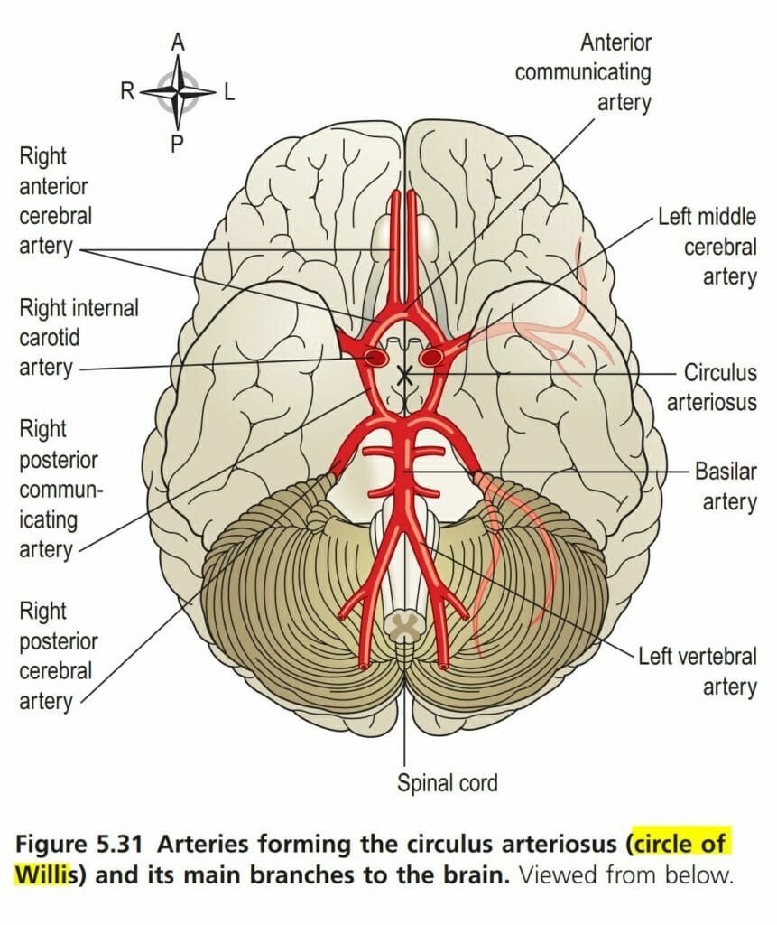

Slide 494
External carotid artery
The external carotid artery helps supply part of the brain through its many branches, and it also gives blood to the thyroid gland in the neck. The thyroid gland is one of the largest endocrine glands in the body. Hormones from the thyroid gland control how quickly the body uses energy, when to make proteins, and how the body responds to other hormones.
Inside the brain, important areas get blood from more than one source, which involves communication between two blood vessels. This is called anastomosis. This process also occurs in the hands, feet, and intestinal tract.

Slide 495
This artery supplies the superficial tissues of the head and neck, via a number of branches:
The superior thyroid artery supplies the thyroid gland and adjacent muscles.
The lingual artery supplies the tongue, the lining membrane of the mouth, the structures in the floor of the mouth, the tonsil and the epiglottis.
The facial artery passes outwards over the mandible just in front of the angle of the jaw and supplies the muscles of facial expression and structures in the mouth. The pulse can be felt where the artery crosses the jaw bone.

Slide 496
The occipital artery supplies the posterior part of the scalp.
The temporal artery passes upwards over the zygomatic process in front of the ear and supplies the frontal, temporal and parietal parts of the scalp. The pulse can be felt in front of the upper part of the ear.
The maxillary artery supplies the muscles of mastication and a branch of this artery, the middle meningeal artery, runs deeply to supply structures in the interior of the skull.

Slide 497
Venous return from the head and neck
The venous blood from the head and neck is returned by deep and superficial veins.
Superficial veins with the same names as the branches of the external carotid artery return venous blood from the superficial structures of the face and scalp and unite to form the external jugular vein

Slide 498
The external jugular vein begins in the neck at the level of the angle of the jaw.
It passes downwards in front of the sternocleidomastoid muscle, then behind the clavicle before entering the subclavian vein.
The venous blood from the deep areas of the brain is collected into channels called the dural venous sinuses. The dural venous sinuses of the brain are formed by layers of dura mater lined with endothelium. The dura mater is the outer protective covering of the brain .
The main venous sinuses are listed below:

Slide 499
The sigmoid sinuses are a continuation of the transverse sinuses. Each curves downwards and medially and lies in a groove in the mastoid process of the temporal bone.
Anteriorly only a thin plate of bone separates the sinus from the air cells in the mastoid process of the temporal bone. Inferiorly it continues as the internal jugular vein.

Slide 500
The superior sagittal sinus carries the venous blood from the superior part of the brain. It begins in the frontal region and passes directly backwards in the midline of the skull to the occipital region where it turns to the right side and continues as the right transverse sinus.
The inferior sagittal sinus lies deep within the brain and passes backwards to form the straight sinus.
The straight sinus runs backwards and downwards to become the left transverse sinus.
The transverse sinuses begin in the occipital region. They run forward and medially in a curved groove of the skull, to become continuous with the sigmoid sinuses.

Slide 501
The internal jugular veins begin at the jugular foramina in the middle cranial fossa and each is the continuation of a sigmoid sinus. They run downwards in the neck behind the sternocleidomastoid muscles. Behind the clavicle they unite with the subclavian veins, carrying blood from the upper limbs, to form the brachiocephalic veins.
The brachiocephalic veins are situated one on each side in the root of the neck. Each is formed by the union of the internal jugular and the subclavian veins.

Slide 502
Special sense
Humans have five special senses: olfaction(smell), gustation (taste), equilibrium (balance and body position), vision, and hearing.
What Are the Functions of the Five Senses?
Eyes obviously allow us to see. But if you break it down, they do more than just that. Using our eyes, we can judge depth, interpret new information, and identify color (the wavelengths of light that reflect off surfaces).
Noses are used to smell scents. They get a sense for what particles are traveling through the air, which can help us identify if dangerous chemicals are nearby. Smell also has the strongest connection to memory; a familiar smell can remind us of things long forgotten.
Ears allow us to hear sound - to detect vibrations in the air particles around us. But the inner ear also helps us maintain balance and regulate sinus pressure. This is especially useful when you change altitude (like, for example, when you are flying in an airplane).

Slide 503
Tongues are used to taste foods, allowing us to figure out if something is going to be useful to our bodies or poisonous.. They also allow us to sense hot and cold in food and liquids.
The skin is general sense organ, which is responsible for what may be the most important senses in the human body. The skin performs a huge number of functions. These include:
Perspiration (sweating) to cool the body
Protection from the elements
Sensing what's in contact with our bodies
Communication with other human beings through touch
Storage of water and lipids
Formation of vitamin D from the Sun
Water resistance
Heat regulation

Slide 504
Sensory Receptors - receive input, generate receptor potentials and with enough summation, generate action potentials in the neurons they are part of or synapse with
5 Types of Sensory Receptors - based on the type of stimuli they detect:
Mechanoreceptors - pressure receptors, stretch receptors, and specialized mechanoreceptors involved in movement and balance.
Thermoreceptors - skin and viscera, respond to both external and internal temperature
Pain receptors - stimulated by lack of O2, chemicals released from damaged cells and inflammatory cells
Chemoreceptors - detect changes in levels of O2, CO2, and H+ ions (pH) as well as chemicals that stimulate taste and smell receptors
Photoreceptors - stimulated by light

Slide 505
EAR – HEARING
Anatomy of ear
1. Outer ear- pinna, auditory canal
2. Middle ear
Middle ear has 3 small bones or Ossicles -anvil, stirrup, stapes – amplify sound (small bones) which vibrate sound and tympanic membrane
The incus - This is the middle anvil-shaped bone. Its body articulates with the malleus, the long process with the stapes, and it is stabilised by the short process, fixed by fibrous tissue to the posterior wall of the tympanic cavity.

Slide 506
The stapes -This is the medial stirrup-shaped bone. Its head articulates with the incus and its footplate fits into the oval window.
The malleus - This is the lateral hammer-shaped bone. The handle is in contact with the tympanic membrane and the head forms a movable joint with the incus.
The three ossicles are held in position by fine ligaments.

Slide 507
Inner ear
The inner (internal) ear or labyrinth (meaning ‘maze’) contains the organs of hearing and balance. It is described in two parts, the bony labyrinth and the membranous labyrinth.
1. Bony labyrinth -This is a cavity within the temporal bone lined with periosteum. It is larger than, and encloses, the membranous labyrinth of the same shape that fits into it, like a tube within a tube. Between the bony and membranous labyrinth there is a layer of watery fluid called perilymph and within the membranous labyrinth there is a similarly watery fluid, endolymph. The bony labyrinth consists of: the vestibule the cochlea, three semicircular canals.

Slide 508
The vestibule -This is the expanded part nearest the middle ear. The oval and round windows are located in its lateral wall. It contains two membranous sacs, the utricle and the saccule, which are important in balance.
The cochlea -This resembles a snail’s shell. It has a broad base where it is continuous with the vestibule and a narrow apex, and it spirals round a central bony column. It contains three compartments: the scala vestibuli the scala media, or cochlear duct the scala tympani
The semicircular canals-These are three tubes arranged so that one is situated in each of the three planes of space. They are continuous with the vestibule.

Slide 509
2. Membranous labyrinth- This is a network of delicate tubes, filled with endolymph. It comprises: the vestibule, which contains the utricle and saccule
The ear is supplied by the 8th cranial nerve, i.e. the cochlear part of the vestibulocochlear nerve, which is stimulated by vibrations caused by sound wave

Slide 510
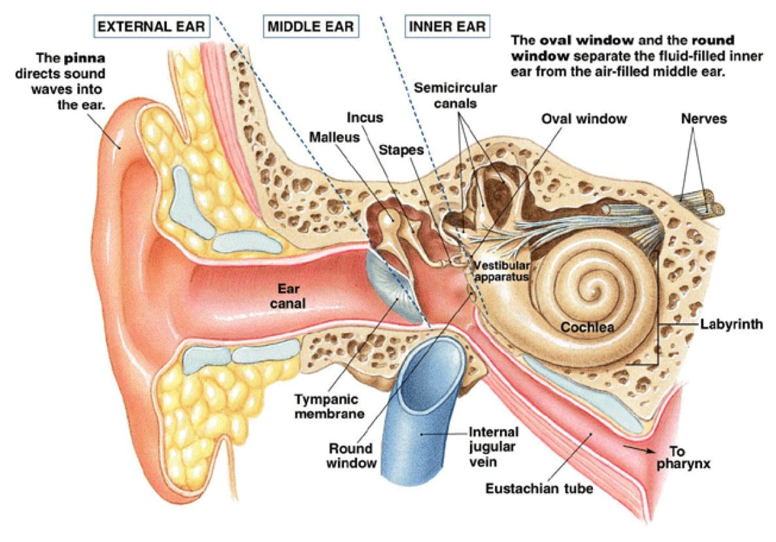

Slide 511
TONGUE- TASTE- Chemical Receptors
The tongue is a sensory organs consisting of taste buds
The tongue is the muscular organ found in the vertebrate mouth. It is attached via muscles to the hyoid bone, mandible, styloid process, palate, and pharynx and divided into two parts by the V-shaped sulcus terminalis
The mouth contains around 10,000 taste buds, most of which are located on and around the tiny bumps on your tongue.
Every taste bud detects five primary tastes:
Sour
Sweet
Bitter
Salty
Umami - salts of certain acids (for example monosodium glutamate)

Slide 512
Each of your taste buds contains 50-100 specialised receptor cells.
The sense of taste, gustatory sense occurs in the taste buds.
The taste buds consists of supporting cells, basal cells and gustatory (taste) receptor cells.
Basal cells are actively dividing cells. The daughter cells develop into supporting cells which subsequently develop into gustatory receptor cells.
Because they are easily damaged by activities occuring in the mouth, gustatory receptor cells are short-lived and are replaced after every 10 days.
Sticking out of every single one of these receptor cells is a tiny taste hair that checks out the food chemicals in your saliva.

Slide 513
When these taste hairs are stimulated, they send nerve impulses to your brain.
Each taste hair responds best to one of the five basic tastes.
Taste buds contain sensory receptors (chemoreceptors) that are found in the papillae of the tongue and widely distributed in the epithelia of the tongue, soft palate, pharynx and epiglottis. They consist of small sensory nerve endings of the glossopharyngeal, facial and vagus nerves (cranial nerves VII, IX and X).

Slide 514
The following papillae cover the tongue and are used for taste perception:
Vallate papillae (circumvallate papillae) are arranged in a V-shape anterior to the sulcus terminalis and studded with numerous taste buds. Innervation is by the glossopharyngeal nerve (CN IX). There are 10-14 circumvallate papillae on most people and are present at the back of the oral part of the tongue.
Fungiform papillae are mushroom-shaped papillae with erythematous domes located on the dorsal aspect of the tongue, lateral aspects and at the apex of the tongue. Innervated by facial nerve. Each papilla contains three to five taste buds. Your tongue has between 200 and 400 fungiform papillae

Slide 515
Filiform papillae are slim, cone-shaped projections organized in rows parallel to the sulcus terminalis. Are most numerous type but do not contain taste taste buds. They are characterised by increased keratinization and are involved in the mechanical aspect of providing abrasion
Foliate papillae are rarely found in humans (vestigial). These are ridges and grooves towards the posterior part of the tongue found at lateral borders. Innervated by facial nerve (anterior papillae) and glasssopharyngeal nerve (posterior papillae)

Slide 516
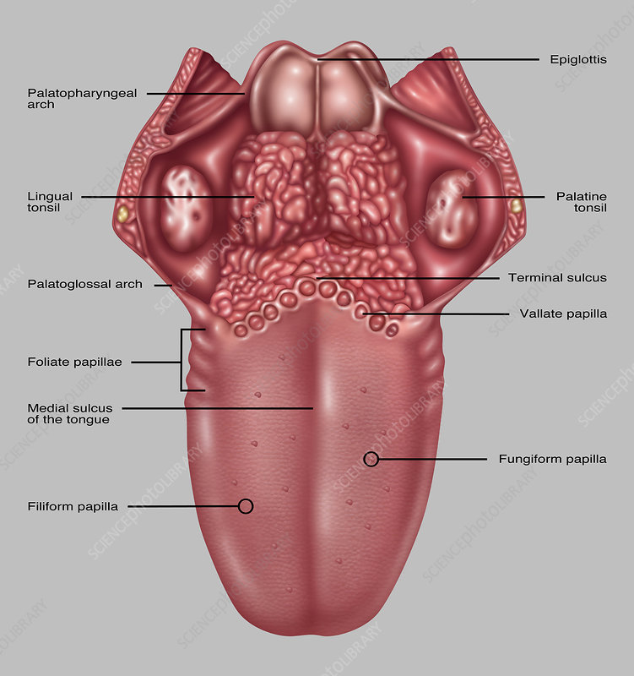

Slide 517
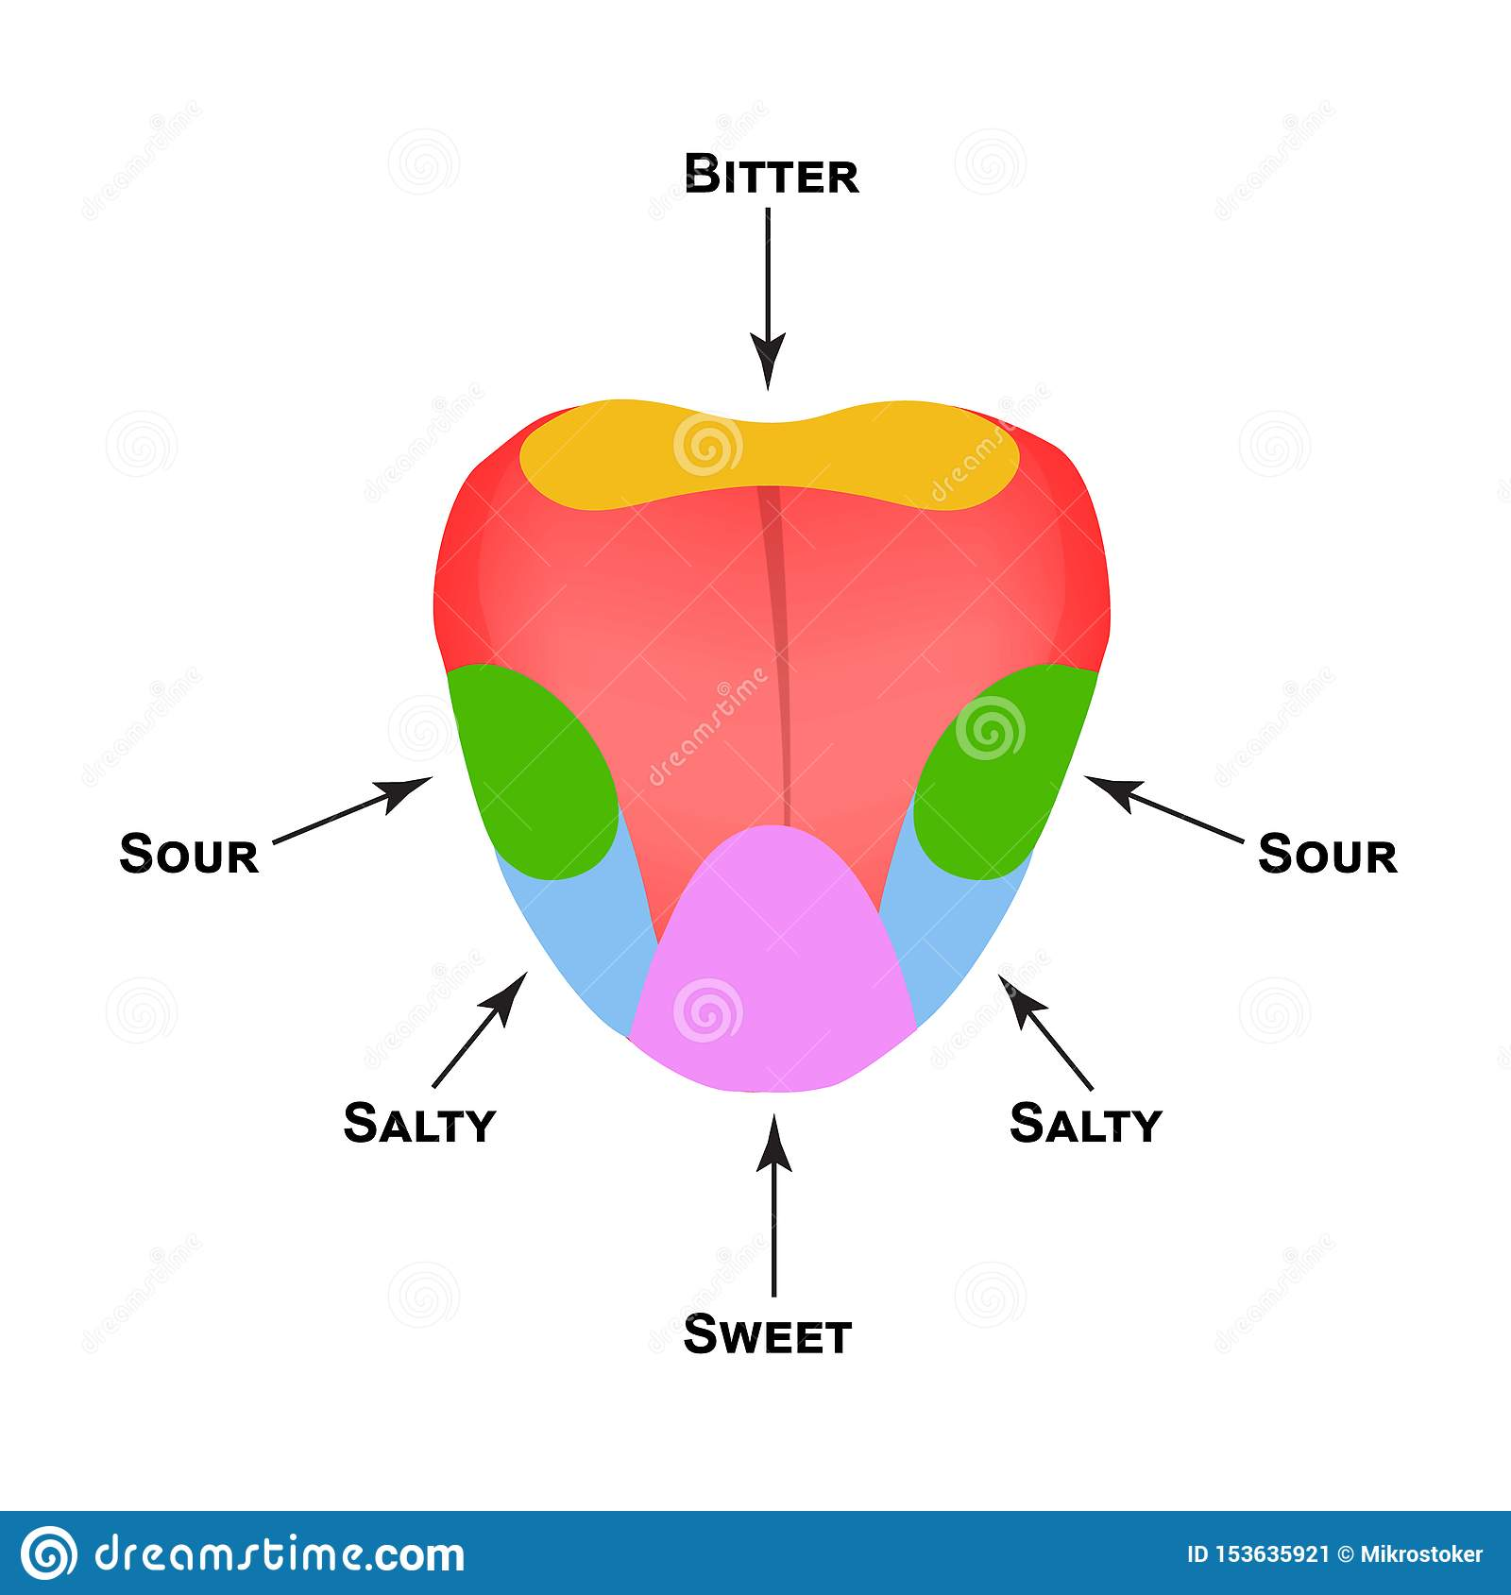

Slide 518
NOSE- SMELL
The nose consist of Smell Receptors or Olfactory receptors ( innervated by olfactory nerve)
Humans able to detect thousands of different smells
Olfactory receptors occupy a stamp-sized area in the roof of the nasal cavity, the hollow space inside the nose

Slide 519
Tiny hairs, made of nerve fibers, dangle from all your olfactory receptors.
They are covered with a layer of mucus.
If a smell, formed by chemicals in the air, dissolves in this mucus, the hairs absorb it and excite your olfactory receptors.
A few molecules are enough to activate these extremely sensitive receptors.
Olfactory Hairs are easily fatigued so you do not notice smells

Slide 520
Linked to memories - when your olfactory receptors are stimulated, they transmit impulses to your brain and the pathway is directly connected to the limbic system - the part of your brain that deals with emotions so you usually either like or dislike a smell
Smells leave long-lasting impressions and are strongly linked to your memories
Much of what we associate as taste also involves smell – that is why hot foods “taste” different than “cold” foods

Slide 521
Structure of the nose
The nasal cavity is the main route of air entry, and consists of a large irregular cavity divided into two equal passages by a septum
The posterior bony part of the septum is formed by the perpendicular plate of the ethmoid bone and the vomer.
Anteriorly, it consists of hyaline cartilage
The roof is formed by the cribriform plate of the ethmoid bone and the sphenoid bone, frontal bone and nasal bones.

Slide 522
The floor is formed by the roof of the mouth and consists of the hard palate in front and the soft palate behind. The hard palate is composed of the maxilla and palatine bones and the soft palate consists of involuntary muscle
The medial wall is formed by the septum.
The lateral walls are formed by the maxilla, the ethmoid bone and the inferior conchae

Slide 523
The posterior wall is formed by the posterior wall of the pharynx.
Lining of the nose The nose is lined with very vascular ciliated columnar epithelium (ciliated mucous membrane
The anterior nares this blends with the skin and posteriorly it extends into the nasal part of the pharynx.

Slide 524
Openings into the nasal cavity
The anterior nares, or nostrils, are the openings from the exterior into the nasal cavity.
Nasal hairs are found here, coated in sticky mucus.
The posterior nares are the openings from the nasal cavity into the pharynx.

Slide 525
The paranasal sinuses are cavities in the bones of the face and the cranium, containing air.
There are tiny openings between the paranasal sinuses and the nasal cavity.
They are lined with mucous membrane, continuous with that of the nasal cavity. The main sinuses are: maxillary sinuses in the lateral walls, frontal and sphenoidal sinuses in the roof, ethmoidal sinuses in the upper part of the lateral walls
The sinuses function in speech and also lighten the skull.
The nasolacrimal ducts extend from the lateral walls of the nose to the conjunctival sacs of the eye . They drain tears from the eyes.

Slide 526
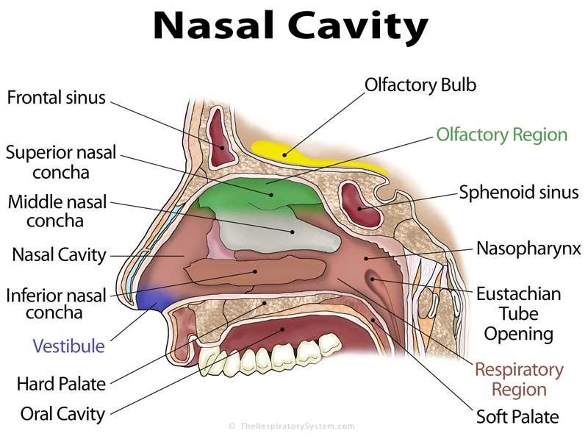

Slide 527
THE EYE- SIGHT/VISION
Sclera or Scleroid Layer – (white of eye) the outermost layer that forms the eyeball- a tough protective layer of connective tissue that helps maintain the shape of the eye and provides an attachment for the muscles that move the eye
Conjunctiva--membrane inside the eyelid attached to the sclera
Cornea - the transparent surface covering the iris and pupil- a clear, dome-shaped part of the sclera covering the front of the eye through which light enters the eye

Slide 528
Anterior Chamber – a small chamber between the cornea and the pupil
Aqueous Humor - fluid behind the cornea - the clear fluid that fills that anterior chamber of the eye and helps to maintain the shape of the cornea providing most of the nutrients for the lens and the cornea and involved in waste management in the front of the eye
Choroid Layer - middle layer of the eye containing may blood vessels

Slide 529
Ciliary Body - the ciliary body is a circular band of muscle that is connected and sits immediately behind the iris- produces aqueous humor, changes shape of lens for focusing, and
Iris - circular muscle that controls the diameter of the pupil - the pigmented front portion of the choroid layer and contains the blood vessels - it determines the eye color and it controls the amount of light that enters the eye by changing the size of the pupil (an albino only has the blood vessels – not pigment so it appears red or pink because of the blood vessels)

Slide 530
Lens - a crystalline structure located just behind the iris - it focuses light onto the retina
Pupil - the opening in the center of the iris- it changes size as the amount of light changes (the more light, the smaller the hole) and it allows light to reach the retina
Vitreous - a thick, transparent liquid that fills the center of the eye - it is mostly water and gives the eye its form and shape (also called the vitreous humor)

Slide 531
Retina - axons of the retina leaving the eye - sensory tissue that lines the back of the eye. It contains millions of photoreceptors (rods for black & white and cones for color ) that convert light rays into electrical impulses that are relayed to the brain via the optic nerve. Rods and Cones are the photoreceptors, useful in providing vision to the eyes. Rods provide vision during dim light or night also known as scotopic vision, whereas cones provide vision during day time or at bright light also known as photopic vision.
Optic nerve - the nerve that transmits electrical impulses from the retina to the brain

Slide 532
