Slide 1
Antiamebic Drugs

Slide 2
Introduction
Protozoal infections are common among people in underdeveloped tropical and subtropical countries, where sanitary conditions, hygienic practices, and control of the vectors of transmission are inadequate. However, with increased world travel, protozoal diseases, such as amebiasis, giardiasis, trichomoniasis malaria, leishmaniasis, trypanosomiasis, are no longer confined to specific geographic locales.
Protozoa are eukaryotes, the unicellular protozoal cells have metabolic processes closer to those of the human host than to prokaryotic bacterial pathogens.

Slide 3
Cont’d
Protozoal diseases are thus less easily treated than bacterial infections, and many of the antiprotozoal drugs cause serious toxic effects in the host, particularly on cells showing high metabolic activity, such as neuronal, renal tubular, intestinal, and bone marrow stem cells.

Slide 4
Amebiasis: (It is also called amoebic dysentery) is an infection of the intestinal tract caused by Entameba histolytica.
The disease can be acute or chronic, with patients showing varying degrees of illness, from no symptoms to mild diarrhoea to fulminating dysentery.
The diagnosis is established by isolating E. histolytica from fresh feces.

Slide 5
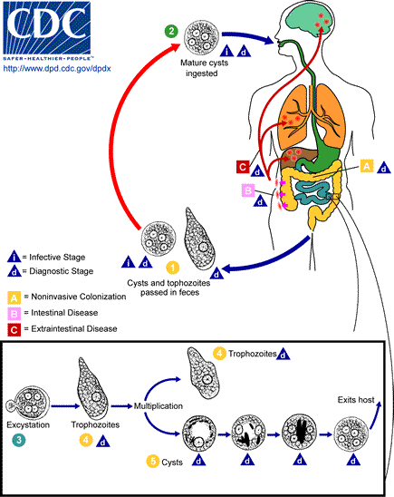
Life cycle of E. histolytica

Slide 6
Cont’d
Entameba histolytica exists in two forms: cysts that can survive outside the body, and labile but invasive trophozoites that do not persist outside the body.
Cysts, ingested through feces contaminated food or water, pass into the lumen of the intestine, where the trophozoites are liberated. The trophozoites multiply, and they either invade and ulcerate the mucosa of the large intestine or simply feed on intestinal bacteria.

Slide 7
Cont’d
One strategy for treating luminal amebiasis is to add antibiotics, such as tetracyclines to the treatment regimen, resulting in a reduction in intestinal flora – the ameba’s major food source.
The trophozoites within the intestine are slowly carried toward the rectum, where they return to the cyst form and are excreted in feces.

Slide 8
Cont’d
Large numbers of trophozoites within the colon wall can also lead to systemic invasion.
Amebiasis is infection with Entameba histolytica. This organism can cause;
Asymptomatic intestinal infection
Mild to moderate colitis
Severe intestinal infection (dysentery)
Amoeboma
Liver abscess
Other intestinal infections

Slide 9
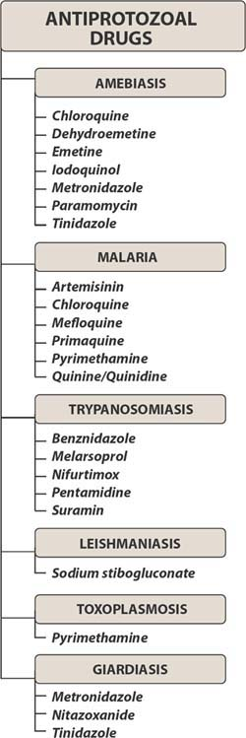

Slide 10
Antiamoebic Drugs
Antiamebic drugs
Diloxanide furoate
Chloroquine
Iodoquinol
Emetine and dehydroemetine
Tinidazole
Metronidazole
Paromomycin
Most antiprotozoal agents have not proved to be safe for pregnant women.

Slide 11
Classification of Antiamebic Drugs:
systemic
Tinidazole
Chloroquine
Luminal
Diloxanide furoate
Iodoquinol
Mixed
luminal and systemic
Dehydroemetine
They are effective against amebas in the intestinal wall and liver.
Paromomycin
They act on the parasites in the lumen of the bowel only
Emetine
metronidazole
Systemic antiamebic against trophozoites
Luminal antiamebic against cyst

Slide 12
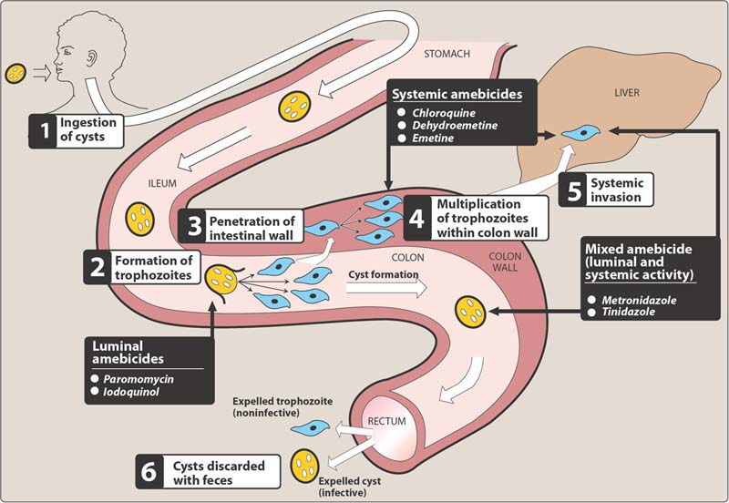

Slide 13
Metronidazole
A nitroimidazole, is the drug of choice in the treatment of extra luminal amebiasis.
It kills trophozoites but not cysts of E.histolytica and effectively eradicates intestinal and extra intestinal tissue infections.

Slide 14
PK of metronidazole
Route of administration: oral and I.V.
Oral metronidazole is readily absorbed and permeates all tissues by simple diffusion.
Intracellular concentration rapidly approaches extracellular levels.
Peak plasma concentration is reached in 1- 3 hours.
Therapeutic levels can be found in vaginal and seminal fluids, saliva, breast milk, and cerebrospinal fluid (CSF).

Slide 15
Cont’d
Protein binding is low (10-20%)
Metabolism of the drug depends on hepatic oxidation followed by glucuronylation
The half life of the drug is 7.5 hours for metronidazole
Metronidazole and its metabolites are excreted mainly in the urine.

Slide 16
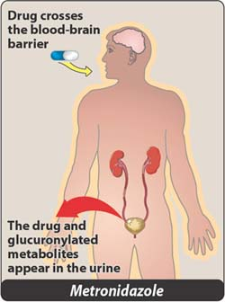

Slide 17
MOA
Some parasites (including amebas) possess (ferrodoxin-like, low-redox-potential, electron-transport proteins)
these proteins remove electrons.
The nitro group of metronidazole accepts the electron from reduced ferrodoxin
Then metronidazole become reduced cytotoxic compounds that bind to proteins and DNA, resulting in cell death.

Slide 18
Uses
Amebiasis: Metronidazole is the drug of choice in the treatment of all tissue infections with E. histolytica.
It is not reliably effective against luminal parasites and must be used with a luminal amebicide

Slide 19
Cont’d
Giardiasis:
Treatment of choice
The dosage for giardiasis is much lower and the drug is thus better tolerated than that for amebiasis.
Trichomoniasis: treatment of choice

Slide 20
Anaerobic Bacterial infections:
for example, Bacteroids fragilis, Fusobacterium, and Clostridium perfringens.
Dracunculosis: infection caused by guinea worm.

Slide 21
Adverse effects
Dry mouth
Metallic taste in the mouth and,
Nausea
Headache
Vomiting, Diarrhea, insomnia, weakness, dizziness, thrush, dysuria, dark urine, paraesthesias, and neutropenia are infrequently encountered.
Pancreatitis along with CNS symptoms eg, ataxia, encephalopathy, and seizures are rarely seen.
Commonly occurs

Slide 22
I.V. infusion rarely causes seizures or peripheral neuropathy.
Precautions
The drug should be used with caution in patients with CNS diseases.
Avoided in pregnancy due to the possible risk of teratogenicity just like any other azole.
Dose adjustment in renal or liver impairment

Slide 23
DRUG INTERACTION
Metronidazole has a disulfiram like effect when taken with alcohol.
It potentiates the anticoagulant effect of coumarin (warfarin) type of anticoagulants.
Phenytoin & phenobarbitone may increase
the elimination of the drug, while cimetidine decreases plasma clearance by manipulating with the hepatic cytochrome enzymes.
Lithium + metronidazole → lithium toxicity

Slide 24
Tinidazole
Tinidazole, a nitroimidazole, is similar to metronidazole
has a better toxicity profile.
It offers simpler dosing regimens.
Tinidazole is as effective as metronidazole, with a shorter course of treatment, yet it is more expensive.
Pharmacokinetics:
The half life of Tinidazole is 12-14 hours
Metabolised in the liver
Excreted in urine

Slide 25
Clinical uses
Trichomoniasis: It may be effective against some of these resistant organisms
Intestinal amoebiasis
Girdiasis
Bacterial vaginosis
Amoebic liver abscess
Adverse effects: toxicity profile is similar to metronidazole, but it is better tolerated.

Slide 26
Diloxanide furoate
Diloxanide furoate is a dichloroacetamide derivative.
It is an effective luminal amebicide but is not active against tissue trophozoites.
Dose: 500mg three times/day for 10 days
PK:
After oral administration diloxanide furoate is split in the gut into diloxanide and furoic acid
90% of the drug is rapidly absorbed then conjugated via glucuronodation to be promptly excreted in the urine.

Slide 27
Cont’d
The unabsorbed portion (10%) is the active antiamebic substance.
MOA: Unknown
Clinical uses:
It is considered the drug of choice for asymptomatic luminal infections
It is used with a tissue amebicide, usually metronidazole to treat serious intestinal and extra intestinal infections.
Adverse effects: flatulence is common, nausea, vomiting, diarrhoea, abdominal cramps, abdominal distention and rashes might also occur
Not recommended in pregnancy

Slide 28
Iodoquinol
Iodoquinol (diiodohydroxyquin) is a halogenated 8- hydroxyquinoline.
PK:
90% of the drug is retained in the intestine and excreted in feces.
The remainder enters the circulation, and is excreted in the urine as glucuronidated and sulphate metabolites.
Half life= 11-12 hours
MOA: Unknown: thought to inacativate parasite enzymes

Slide 29
Cont’d
It is effective against organisms in the bowel lumen but not against trophozoites in the intestinal wall or extra intestinal tissues.
Drug of choice for asymptomatic amoebiasis
Dose: 650mg TDS for 21days
Adverse effects: Diarrhea, anorexia, nausea, vomiting, abdominal pain, headache, rash, pruritus, enlargement of thyroid gland
Optic Neurotoxicity with prolonged use and high dosage.

Slide 30
Precautions:
Iodoquinol should be taken with meals to limit GI toxicity
It should be used with caution in patients with optic neuropathy, renal or thyroid disease, or non amebic hepatic disease.
The drug may increase protein-bound serum iodine, leading to a decrease in measured ¹³¹I uptake that persist for months.
It should be discontinued if it produces persistent diarrhea or signs of iodine toxicity eg, dermatitis, urticaria pruritus, or fever.
It is contraindicated in patients with intolerance to iodine.

Slide 31
Emetine and Dehydroemetine
Emetine, an alkaloid derived from ipecac and dehydroemetine, a synthetic analog, are effective against tissue trophozoites of E. histolytica, but because of major toxicity concerns they have been almost completely replaced by metronidazole.
Route of administration:
Subcutaneous (preferred) or I.M. Never→ IV

Slide 32
CLINICAL USES
Their use is limited to unusual circumstances:
1- severe amebiasis warrants effective therapy
2- metronidazole can not be used.
Dehydroemetine is preferred because it has a better toxicity profile. It should be only used for the minimum period of 3- 5 days.
Adverse effects:
Diarrhea is common
Nausea, vomiting, muscle weakness
Cardiac arrhythmias, heart failure, hypotension (serious toxicity)

Slide 33
Cont’d
Precautions:
The drug should not be used in patients with cardiac or renal disease
Young children
In pregnancy.

Slide 34
Paromomycin
Paromomycin is an aminoglycoside antibiotic.
It is not significantly absorbed from the GIT.
The small amount absorbed. And it is slowly excreted unchanged, mainly by glomerular filtration.
Clinical uses:
It is used only as a luminal amebicide.
Paromomycin has have similar efficacy and less toxicity than other agents.

Slide 35
Cont’d
Parenteral (IV) paromomycin is now used for the treatment of visceral leishmaniasis.
Adverse effects:
  Abdominal distress, diarrhea.
Precautions:
  It should be avoided in patients with significant renal disease and cautiously used with GI ulceration

Slide 36
Tetracyclines:
They are active against many gram-positive and gram-negative bacteria and against some protozoa, for example, amebas.

Slide 37
MOA
Tetracyclines enter microorganisms by
1- passive diffusion
2- active transport.
tetracyclines bind reversibly to the 30S subunit of the bacterial ribosomes, blocking the binding of aminoacyl-tRNA to the acceptor site on the mRNA- ribosome complex.
This prevents the addition of amino acids to the growing peptide .

Slide 38
Adverse effects:
Gi disturbances: anorexia, vomiting diarrhea, epigastric pain, glossitis, essophangitis, dyphagia;
Teeth discoloration, enamel hypoplasia
Rashes, hepatotixicity , nephrotoxicity, bone marrow suppression

Slide 39
Erythromycin
Erythromycin inhibits protein synthesis occurs via binding to the 50S ribosomal RNA, which blocks the aminoacyl translocation reaction and formation of initiation complexes.

Slide 40
Chloroquine
It is used in combination with metronidazole and diloxanide furoate to treat and prevent amoebic liver abscesses.
It eliminates trophozoites in liver abscesses, but it is not useful in treating luminal amebiasis
MOA:
Chloroquine probably acts by concentrating in parasitic food vacuoles, preventing the polymerization of the hemoglobin breakdown product, heme into hemozoin, and thus eliciting parasite toxicity due to the building up of free heme.

Slide 41
Adverse effects:
Pruritus is common,
Nausea, vomiting, abdominal pain, anorexia.
Headache, blurring of vision uncommon.
Hemolysis in G6PD deficient patients, impaired hearing, agranulocytosis, alopecia, hypotension.

