Slide 1
ANTIFUNGAL DRUGS
LECTURER: ARAP KORIR SNR

Slide 2
Introduction/overview
Infectious diseases caused by fungi are called mycoses, and they are often chronic in nature.
Many common mycotic infections are superficial and only involve the skin (cutaneous mycoses), but fungi may also penetrate the skin, causing subcutaneous infections.
The fungal infections that are most difficult to treat are the systemic mycoses, which are often life-threatening.
Unlike bacteria, fungi are eukaryotic.
They have rigid cell walls composed largely of chitin a polymer of N-acetylglucosamine rather than peptidoglycan (a characteristic component of most bacterial cell walls).

Slide 3
Cont..
The fungal cell membrane contains ergosterol rather than the cholesterol found in mammalian membranes.
These chemical characteristics are useful in targeting chemotherapeutic agents against fungal infections.
Fungal infections are generally resistant to antibiotics used in the treatment of bacterial infections, and conversely, bacteria are resistant to the antifungal agents.

Slide 4
The last two decades have seen a rise in the incidence of fungal infections.
This increased incidence of fungal infections is associated with greater numbers of individuals who are on chronic immune suppression following organ transplant, undergoing chemotherapy for myelogenous and solid tumours, or infected with the HIV.

Slide 5
During this same period, there have been significant changes in the therapeutic options available to the clinician. For example, the ongoing development of new azole antifungal drugs offers effective therapy for all but the most serious mycotic infections

Slide 6
TYPES OF FUNGAL ORGANISMS
CANDIDA
ASPERGILLUS
CRYPTOCOCCUS
HISTOPLASMA
STACHYBOTYRS
PNEUMOCYSTIS
MICOSPORUM
TRICHOPHYTON

Slide 7
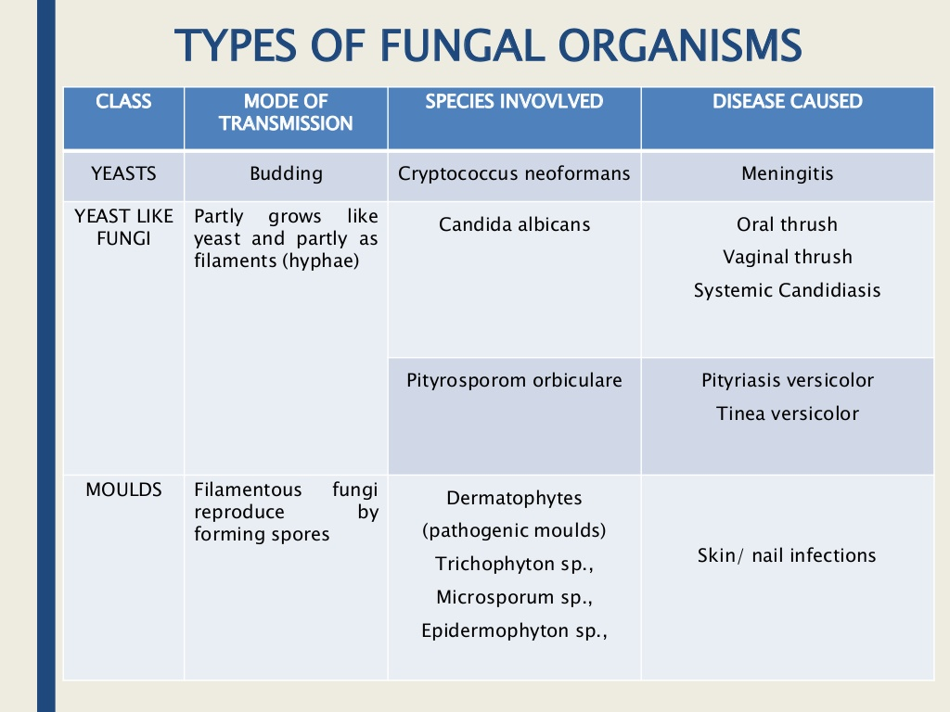

Slide 8
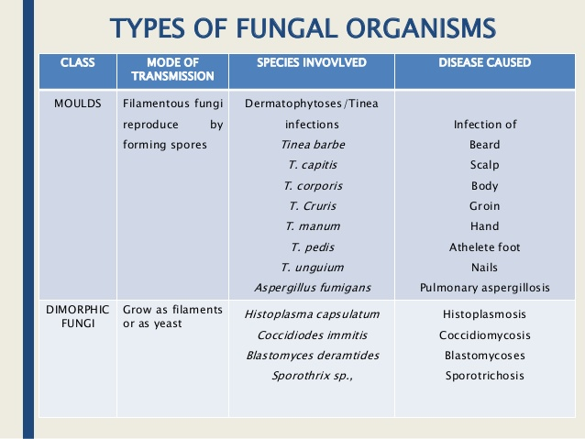

Slide 9
Fungal infections (Superficial)
  Dermatomycosis
  _ Tinea pedis (athlete’s foot)
  Tinea corporis (skin ringworm)
  Tinea cruris (groin)
  Tinea capitis (scalp)
  Tinea unguium (nails)
  Tinea barbae (beard)
  Tinea mannum(hand)
  Candidiasis –skin, mouth, vagina oropharynx

Slide 10
Deep mycoses
Blastomyces
Candida
Coccidiodes
Cryptococcus
Histoplasma
Arspegilus

Slide 11
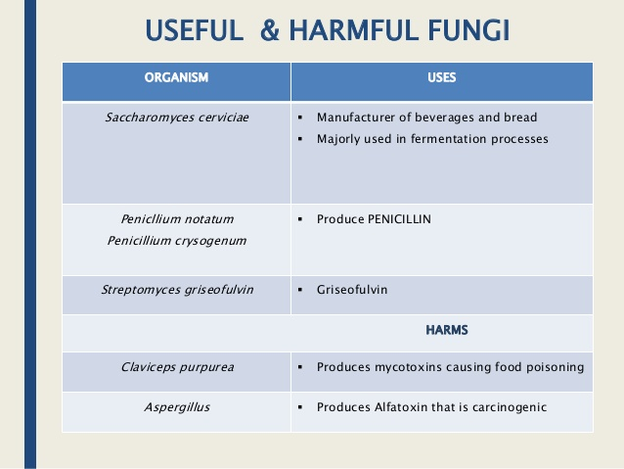

Slide 12
Difference between bacteria and fungi
BACTERIA | FUNGI
PEPTIDOGLYCAN LAYER PRESENT | POLYSACCHARIDES BOTH SIMPLE AND COMPLEX[CHITIN]- 80% OF CELL WALL
CELL WALL COMPOSED OF PROTEINS | CELL WALL IS MADE OF ERGOSTEROL
LIPIDS PRESENT IN THE CELL WALL ARE MADE OF CHOLESTEROL

Slide 13
CLASSIFICATION OF FUNGAL INFECTIONS
SUPERFICIAL INFECTIONS- Skin surface
CUTANEOUS INFECTIN- dermatophytes, all Tinea spp, candida spp
SUBCUTAENOUS INFECTIONS
DEEP MYCOSAL INFECTION OR SYSTEMIC MYCOSAL INFECTIONS-pneumonia,meningitis, endocarditis

Slide 14
CLASSIFICATION OF ANTIFUNGAL AGENTS
BASED ON THE FOLLOWING:
THE MECHANISM OF ACTION
ROUTE OF ADMINISTRATION
CHEMICAL STRUCTURE
INFECTION

Slide 15
MECHANISM OF ACTION
Fungal cell wall synthesis inhibitors [Echinocandins]:
Capsofungin
Micafungin
Anidulafungin
Increase membrane permeability by binding to the fungal cell membrane:
Ampotericin B
Nystatin

Slide 16
Cont..
Inhibition of Ergosterol and lanosterol synthesis(allyamine group):
Terbinafine
Nucleic acid synthesis inhibitors:
Flucytosine
Disruption of mitotic spindle and inhibition of fungal mitosis:
Griseofulvin

Slide 17
Cont..
Ergosterol synthesis inhibitors:
Imidazoles: topical/systemic
Triazoles(only systemic)

Slide 18
ROUTEOF ADMINISTRATION
Topically:
azoles,
terbinafine,
clotrimazole,
miconazole,
nystatin

Slide 19
Systemic:
Antibiotics- griseofulvin, AMB
Antimetabolites- flucytosine
Azole derivatives- clotrimazole, ketoconazole, fluconazole
Allyamine- terbinafine
Echinocandins- capsofungin

Slide 20
CHEMICAL STRUCTURE
Polyenes- AMB, nystatin
Echinocandins- micafungin, capsofungin
Antimetabolites- flucytosine
Allyamines- terbinafine, butenafine
Azoles- imidazoles, triazoles
Miscellaneous- griseofulvin, benzoic acid

Slide 21
BASED ON INFECTION
Cutaneous: clotrimazole, nystatin, griseofulvin
Systemic: AMB, ketoconazole, fluconazole, capsofungin

Slide 22
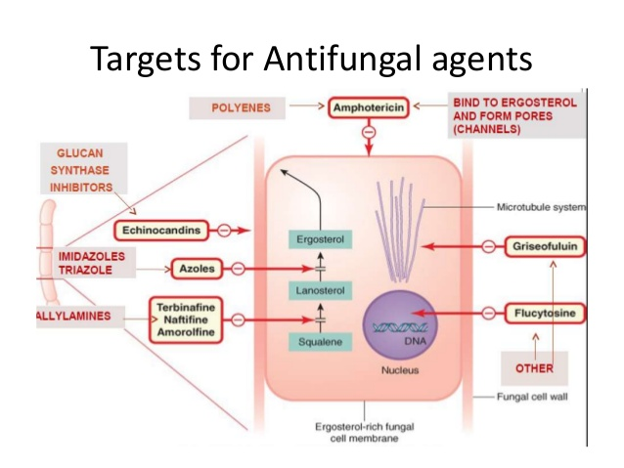

Slide 23
General indications
Treatment of infection by Candida spp.
Cryptococcal infection
  Treatment (e.g. meningitis).
  Prevention in patients with AIDS (fluconazole).
    Alternatively, give amphotericin with flucytosine.
Aspergillus infection.
Histoplasmosis (rare in temperate climates).
  Indolent infection (itraconazole or ketoconazole).
  Severe infection. Can be life-threatening in patients with AIDS..
Fungal skin and nail infections.-tinea infections
Prevention of fungal disease in immunocompromised patients (fluconazole).

Slide 24
Precautions
Most of the following cautions apply to systemic rather than topical administration of these drugs.
  Miconazole is given topically for oral infections, but is absorbed systemically and can cause drug interactions.
Ketoconazole and itraconazole carry a particular risk of liver damage.
  The risk from fluconazole is much lower.
  Itraconazole or ketoconazole should only be used when the potential benefits are significant .
  Avoid systemic administration of these drugs if there is any history of liver disease.
    If treatment is essential use lower doses.

Slide 25
Cont..
If the patient has renal insufficiency, avoid giving itraconazole or ketoconazole.
  Give the usual first dose of fluconazole, but halve subsequent doses if the patient has mild or moderate renal insufficiency.
Long-term use of these drugs can cause congenital abnormalities if given during pregnancy.
Antifungal drugs can precipitate heart failure. Avoid them in patients with cardiac disease, especially if they are taking drugs with negative inotropic actions (e.g. calcium channel blockers).

Slide 26
THANK YOU FOR LISTENING

