Slide 1
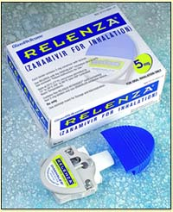
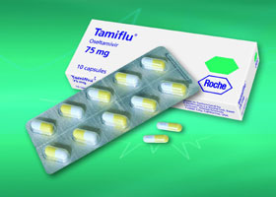
ANTIVIRAL DRUGS
UZIMA UNIVERSITY COLLEGE
DR. CALEB OKOTH

Slide 2
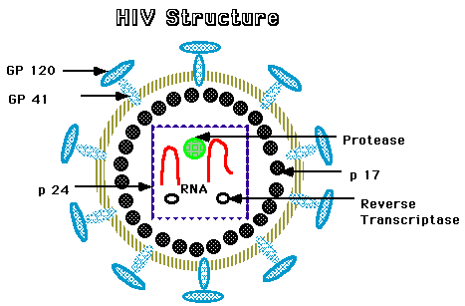
INTRODUCTION
Viruses present more difficult problem of chemotherapy than do other higher organisms e.g. bacteria for they are intracellular parasites that use the metabolism of host cells.
They also share metabolic processes of the host cell
Identification of the difference between human and viral metabolism, however, has led to the development of effective antiviral agents

Slide 3
VIRUS’ PERSONAL LIFE

Slide 5
METHODS OF ATTACK

Slide 6
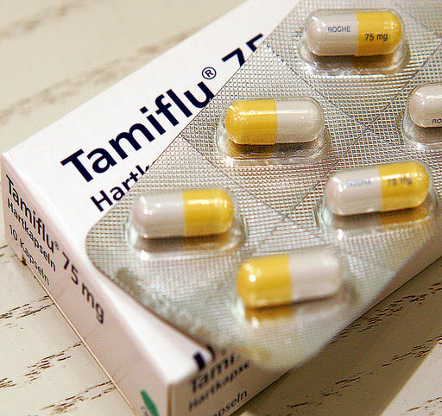
ANTIVIRAL DRUGS

Slide 7
CLASSIFICATION OF ANTIVIRAL DRUGS
There are two classes of antivirals
Drugs that directly impair virus replication
Nucleoside reverse transcriptase inhibitors
Nucleotide reverse transcriptase inhibitors
Non-nucleoside reverse transcriptase inhibitors
Protease inhibitors
Fusion inhibitors
Integrase inhibitors
DNA polymerase inhibitors
Inhibitors of viral coat disassembly and neuraminidase/ ant-influenza drugs
Drug that modulate host immune system
Immunoglobulin
interferons

Slide 8
ANTIVIRALS: CLASSIFICATIONS

Slide 9
CLASSIFICATION: DRUGS THAT DIRECTLY IMPAIR VIRAL REPLICATION
Nucleoside reverse transcriptase inhibitors (NRTI)
This classs include: zidovudine (AZT), abacavir (ABC), lamivudine (3TC), didanosine (ddI), zalcitabine (ddC), stavudine (D4t) and Emtricitabine.
Mechanism of action
All are phosphorylated by host cell enzyme to give 5’-triphosphate. The 5’-triphosphate moiety competes with equivalent host cellular triphosphate , which are essential substrates for the formation of proviral DNA by viral reverse transcriptase ( viral RNA –dependent DNA polymerse); the incorporation of 5;-triphosphate moiety into the growing viral DNA results in chain termination.

Slide 10
NRTI
1. Zidovudine
It is an analogue of thymidine
Indication
Serous manifestation of HIV in patients with AIDS or AIDS related complex
Early symptomatic and asymptomatic HIV infections when blood markers indicate risk of disease progression
Available dosage forms:
Oral: 100 mg capsules, 300 mg tablets, 50 mg/5 ml syrup
Parenteral: 10mg/ml injection
Dose: adult; 200 mg tds or 300 mg bd

Slide 11
NRTI CONT
Adverse effects of zidovudine
Common; myelosuppression resulting in anemia or neutropenia
GIT disturbances- nausea , vomiting
Headaches and insomnia
Management of ADR
Drug withdrawal incase of anemia/change of regimen
Folic acid and ferrous sulphate for anemia; transfuse whole blood if severe
Contraindications
Anemia
Myelosuppressive disorders
Hypersensitivity to zidovudine

Slide 12
NRTI CONT
Metabolism, half life and excretion
Bioavailability is 60-80% and the peak plasma concentration occurs at 30 minutes. Its half life is 1 hour and intracellular half life of active triphosphate is 3 hours
Most of the drug is metabolized to the inactive glucuronide in the liver, only 20% of the active form being excreted in urine.

Slide 13
NRTI CONT
2. Lamivudine
It is a cytosine analogue
Indication: HIV infection, HBV infections
Available dosage forms: oral: 100, 150 mg tablets, 10mg/ml oral solution. Oral (combivir) 150 mg tab in combination with zidovudine 300 mg
Dose: 150 mg bd or 300 mg od daily depending on weight
Adverse effects
Lamivudine has excellent safety profiles. Headache, nausea, insomnia and dizziness are rare
Contraindications
Patients on zalcitabine ( inhibits intracellular phosphorylation of lamivudine)

Slide 14
NRTI CONT..
Metabolism and excretion
Well absorbed and excreted in urine unchanged
Mean elimination half life is 2.5 hours, intracellular half life of active metabolite in HIV infected cell line is 10.5-15.5 hours and HBV cell line is 17-19 hours

Slide 15
NRTI CONT
3. STAVUDINE
Indications
HIV infections
Dose: 30-40 mg bd, depending on the weight
Adverse effects
Neuropathy
Arthralgia
Pancreatitis
Serum elevation of aminotransferase
Lipodystrophy
Management of ADRs
Pyridoxine 50 mg od fro neuropathy
Contraindications
Patients on neuropathic inducing drugs such as zalcitabine , isoniazid and didanosine

Slide 16
NRTI CINT…
Metabolism, half-life and excretion
Plasma half life is 1.22 hours; intracellular half life is 3.5 hours
Excretion is by active tubular secretion and glomerular filtration
High oral bioavailability, 80% that is not food dependent
4. ABACAVIR
It’s a guanosine analogue
Indications
HIV infections in combination with other antiretrovirals
Dose: 300 mg bd

Slide 17
NRTI CONT…
Adverse effects
Hypersensitivity reactions 2-5%
Fever, malaise and GIT complaints occurs within first 6 weeks of therapy
Rash
Nausea, vomiting and diarrhea
Headache and fatigue
Pancreatitis, rare
Hyperglycemia, rare
Hypertriglyceridemia, rare
Half-life, metabolism and excretion
Elimination half life is 1.5 hours
Metabolized by alcohol dehydrogenase and glucuronyl transferase to inactive metabolites that are eliminated primarily in the liver

Slide 18
NUCLEOTIDE REVERSE TRANSCRIPTASE INHIBITORS
TENOFOVIR (TDF)
Tenofovir disoproxil fumarate is a pro drug that is converted in vivo to tenofovir, an acyclic nucleoside phosphate (nucleotide) analogue of adenosine
Mechanism of action
Competitively inhibits HIV reverse transcriptase and causes chain termination after incorporation of DNA.
Indications
HIV infection together with other antiretrovirals
Pre-exposure prophylaxis alone or in combination with emtricitabine
Available dosage forms: 300 mg tablets
Dose: 300 mg od

Slide 19
NUCLEOTIDE REVERSE TRANSCRIPTASE INHIBITOR
Adverse effects
GIT effects; nausea, vomiting, diarrhea and flatulence, renal impairement.
Pharmacokinetics
Bioavailability is increased if the drug is ingested following a high fatty meal
Maximum serum concentrations are achieved in about 1 hour after taking medications
Elimination occurs by a combination of glomerular filtration and active tubular secretions
However , only 70-80% of the dose recovered in the urine, allowing for possibility of hepatic metabolism as well as alteration in hepatic insufficiency

Slide 20
NON-NUCLEOSIDE REVERSE TRANSCRIPTASE INHIBITORS, NNRTI
This class include: nevirapine (NVP), delavirdine and efavirenz (EFV)
1. NEVIRAPINE
Indications
HIV infection as a component of antiretroviral regimen
Prevention of mother to child transmission as a single dose at the onset of labor and followed by 2 mg/kg oral dose given to neonate within 3 days after delivery
Dose: 200 mg bid; gradual dose escalation over 14 days is recommended to decrease frequency of rash i.e. 200 mg od for first 14 days
Precautions: Dose escalation from 200 od over 14 days to decrease frequency of rash
Adverse effects
Severe life threatening skin rashes have occurred during nevirapine therapy including Steven Johnson syndrome and toxic epidermal necrosis
Fulminant hepatitis and fever
Nausea, headache and somnolence

Slide 21
NnRTI CONT…..
2. EFAVIRENZ
Indications
HIV infections in combination with other antiretrovirals
Available dosage forms: oral: 50,100,200 mg capsules; 600 mg tablets
Dose:600 mg od
Adverse effects
CNS effects: dizziness, drowsiness, insomnia, headache, confusion, amnesia, agitation, delusions, depression, nightmares and euphoria
Mild to moderate skin rash
Nausea, vomiting and diarrhea
Crystalluria
Elevated liver enzymes
Increase in total serum cholesterol by 10-20%
Contraindications
Hypercholesterolemia
Hyperlipidemia

Slide 22
NnRTI CONT….
Pharmacokinetics of efavirenz
Has a long half life of 40-55 hours
Peak plasma concentrations are seen 3-5 hours after administration; steady state plasma concentrations are reached in 6-10 days.
Efavirenz is principally metabolized by CYP3A4 and CYP2B6 to inactive hydroxylated metabolites; the remainder is eliminated in feces as unchanged drug.

Slide 23
PROTEASE INHIBITORS, PIs
This class include; Saquinavir, ritonavir, lopinavir,indinavir, nelfinavir, amprenavir and atazanavir
Mechanism of action
During the later stages of the HIV growth cycle, the Gag and Gag-Pol gene products are translated into polyproteins, and these become immature budding particles. Protease is responsible for cleaving these precursor molecules to produce the final structural proteins of the mature virion core. By preventing cleavage of the Gag-Pol polyprotein, protease inhibitors (PIs) result in the production of immature, noninfectious viral particles .
Unfortunately, specific genotypic alterations that confer phenotypic resistance are fairly common with these agents, thus contraindicating monotherapy.

Slide 24
PIs cont…
1. RITONAVIR
Indication
HIV infections in combination with other antiretrovirals
Available dosage forms: oral: 100 mg capsules; 80 mg/ml oral solution
Dose: 600 mg bid
Interactions
Its an inhibitor of CYP3A4 and therefore concurrent administration with other PIs results in increased plasma levels of latter drugs
Adverse effects
GIT disturbances e.g. diarrhea
Paresthesias (circumoral and peripheral)
Elevated serum aminotransferases
Altered taste
Hypertriglyceridemia
Nausea, vomiting and abdominal pain

Slide 25
PIs cont….
Precautions
Caution is advised when administering the drug to patients with impaired hepatic function
Pharmacokinetics
Metabolism to an active metabolite occurs via the CYP3A and CYP2D6 isoforms
Excretion is primarily in the feces
Bioavailability is about 75% that increases when the drug is given with food

Slide 26
PIs cont…
2.LOPINAVIR/RITONAVIR (Kaletra, Alluvia)
Several studies have shown enhanced efficacy or improved tolerability if two PIs are administered together
Lopinanavir 100 mg/ritonavir 400 mg is a licensed combination in which subtherapeutic doses of ritonavir inhibits CYP3A4 mediated metabolism of lopinavir, thereby resulting in increased exposure to lopinavir
Indications
HIV infection in combination with other antiretrovirals.
Available dosage forms: oral: 133.3 mg/33.3 mg capsules: 400 mg/100 mg per 5 ml solution
Dose: 400mg/100mg bd
Adverse effects
Diarrhea, abdominal pain, nausea, vomiting and asthenia.

Slide 27
PIs cont…
Pharmacokinetics
Absorption is enhanced with food
Lopinavir is 98-99% protein bound and is extensively metabolized by the CYP3A4 isoenzyme, which is inhibited by ritonavir.
Serum levels of lopinavir may be increased in patients with hepatic impairment.

Slide 28
PIs cont…
3. ATAZANAVIR
Atazanavir is a newer azapeptide PI with a pharmacokinetic profile that allows once-daily dosing.
Its oral bioavailability is approximately 60–68%.
The plasma half-life is 6–7 hours, which increases to approximately 11 hours when co-administered with ritonavir.
The primary route of elimination is biliary; atazanavir should not be given to patients with severe hepatic insufficiency.
Adverse effects: nausea, vomiting, diarrhea, abdominal pain, headache, peripheral neuropathy, and skin rash

Slide 29
FUSION INHIBITORS
ENFURVITIDE
Mechanism of action
Blocks entry of virus into the cell
It binds to gp14 sub unit of the viral envelop glycoprotein, preventing conformational changes required for fusion of viral and cellular membranes
Indications
Treatment of patients with persistent HIV-1 replication despite ongoing therapy
Avaialble dosage forms: Parenteral; 90 mg/ml for injection
Dose: 90 mg bid subcutaneously
Adverse effects
Local injection site reactions (most common ADR)
Hypersensitivity reactions
Eosinophilia

Slide 30
FUSION INHIBITOR
Pharmacokinetics
Protein binding is high and metabolism appears to be by proteolytic hydrolysis without involvement of cytochrome P450 systems
Elimination half life is 3.8 hours
Time to peak concentrations is 8 hours

Slide 31
DNA POLYMERASE INHIBITORS
This class include: acyclovir, cidofovir, famciclovir, foscarnet, ganciclovir, idoxuridine and penciclovir
1. ACYCLOVIR
Its acyclic guanosine derivative with clinical activity against HSV-1, HSV-2 and varicella zoster virus
Mechanism of action
Acyclovir requires three phosphorylation steps for activation. It is converted first to the monophosphate derivative by the virus-specific thymidine kinase and then to the di- and triphosphate compounds by host cell enzymes . Because it requires the viral kinase for initial phosphorylation, acyclovir is selectively activated, and the active metabolite accumulates, only in infected cells. Acyclovir triphosphate inhibits viral DNA synthesis by two mechanisms: competition with deoxyGTP for the viral DNA polymerase, resulting in binding to the DNA template as an irreversible complex; and chain termination following incorporation into the viral DNA

Slide 32
DNA POLYMERASE INHIBITORS, DPIs
Indications
Primary genital herpes
Herpes labialis
Management of zoster associated pain
Given prophylactically to patients undergoing organ transplantation to prevent reactivation of HSV infections
Treatment of herpes simplex encephalitis, neonatal HSV infections and serous HSV or VZV infections
Available dosage forms: oral: 200 mg capsules, 400, 800 mg tablets; 200 mg/5 ml suspension. Parenteral: 50 mg/ml powder to reconstitute injection ( 500, 1000 mg/vial), topical: 5% ointment
Dose
Oral
First episode genital herpes 400 mg tid or 200 mg five times daily
Recurrent genital herpes 400 mg tid or 200 mg five times or 800 mg bid
Genital herpes suppression 400 mg bid
Herpes proctitis 400 mg five times daily
Mucocutaneos herpes 400 mg five times daily

Slide 33
DPIs
Oral cont..
Varicella 20 mg/kg ( maximum 800 mg) four times daily
Zoster 800 mg five times daily
Intravenous
Severe HSV infection 5 mg/kg q8h
Herpes encephalitis 10-15 mg/kg q8h
Neonatal HSV infection 20 mg/kg q8h
Varicella zoster suppression in immunocompromised host 10mg/kg q8h
Interactions
Has no serious interactions
Adverse effects
Acyclovir is generally well tolerated
IV infusion may cause reversible renal dysfunction due to crystalline neuropathy or neurologic toxicity ( tremors, delirium, seizures)

Slide 34
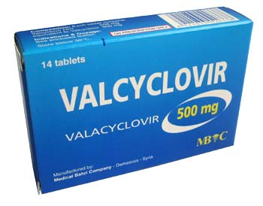
DPIs cont…
2. VALACYCLOVIR
It’s the L-valyl ester of acyclovir. It s rapidly converted to acyclovir after oral administration
It has improved efficacy versus acyclovir for all indications
Indications
Treatment of first attacks of recurrent genital herpes
Suppression of recurrent genital herpes
Treatment of herpes zoster infections
Preventing cytomegalovirus disease after organ transplantation
Available dosage forms: oral: 500, 1000 mg tablets
Dose
Oral
First episode genital herpes 1g bid
Recurrent genital herpes 500 mg bid
Genital herpes suppression 500 mg daily or twice daily
Zoster 1 g tid

Slide 35
DPIs cont…
Adverse effects
Generally well tolerated
Nausea, headache and diarrhea may occur
High doses in AIDS patients may cause GIT intolerance as well as thrombotic microangiopathies such as thrombotic purpura and hemolytic uremic syndrome

Slide 36
DPIs cont..
3. GANCICLOVIR
Indications
Delay progression of CMV retinitis in patients with AIDs
Treatment of CMV colitis and esophagitis
Reduce risk of CMV infections in transplant patients
Treatment of CMV pneumonitis in immunocompromised patients

Slide 37
DPIs cont..
4. VALGANCICLOVIR
Indications
Treatment of CMV retinitis in patients with AIDs
Available dosage forms: oral: 450 mg capsules
Dose
Oral
CMV retinitis induction: 900 mg bid, maintenance : 900 mg od
CMV prophylaxis 900 mg od

Slide 38
DPIs cont…
5. CIDOFOVIR
Indications
Treatment of CMV retinitis, given IV
Treatment of polyomaviruses-associated progressive multifocal leukoencephalopathy syndrome in AIDS patients
Post exposure prophylaxis against small pox
Topical treatment of molluscam contagiosam
Adverse reactions
Dose dependent nephrotoxicity
Uveitis
Decreased intraocular pressure
Probenecid related hypersensitivity reactions
Rare neutropenia and metabolic acidosis

Slide 39
DPIs cont…
7. FOSCARNET
Foscarnet (phosphonofomic acid) is an inorganic pyrophosphate compound that inhibits viral DNA polymerase, RNA polymerase and HIV reverse transcriptase directly , without requiring activation by phosphorylation
It has invitro activity against HSV, VZV, CMV, EBV, HHV-6, HHV-8 and HIV
Indications
CMV retinitis
CMV colitis and esophagitis
Acyclovir resistant HSV infections and VZV infections
Available dosage forms:Parenteral 24 mg/ml for IV injection
Dose
Intravenous:
CMV retinitis treatment induction: 60 mg/kg q8h or 90 mg/kg q12h, maintenance: 90-120 mg/kg/d

Slide 40
INHIBITORS OF VIRAL COAT DISASSEMBLY AND NEURAMINIDASE
This class include: amantadine and rimantadine, zanamivir and oseltamivir
AMANTADINE AND RIMANTADINE
Mechanism of action
Are cyclic amines that inhibit uncoating of viral RNA influenza A within infected host cells, thus preventing its replication
Indications
Viral influenza A infections
Available dosage forms
Amantadine: (symmetrel); oral: 100 mg capsules, tablets; 50 mg/5 ml syrup
Rimanatdine: (flumadine): Oral: 100 mg tablets; 50 mg/ml suspension
Dose
Amantadine 100 or 200 mg bd orally in influenza A
Rimantadine 100 or 200 mg bd orally in influenza A

Slide 41
ANTI-INFLUENZA DRUGS
Adverse effects
GIT intolerance
CNS complaints(nervousness, difficulty in concentrating and light headedness)
Half life, metabolism and excretion
Plasma hal life is 12-18 hours for amantadine and 24-36 hours for rimantadine
Rimantadine is four to ten times more active than amantadine in vitro
Amantadine is excreted unmetabolized in urine, rimantadine undergoes extensive hydroxylation, conjugation and glucuronidation before renal/urinary excretion

Slide 42
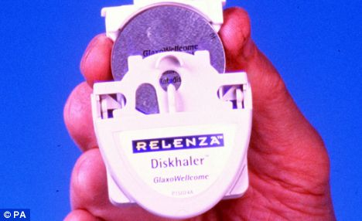
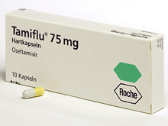
ANTI-INFLUENZA DRUGS
ZANAMIVIR AND OSELTAMIVIR
Are neuraminidase inhibitors
Have activity against both influenza A and B
Indication
Treatment of acute uncomplicated influenza infections
Available dosage forms:
Zanamivir (Relenza):inhalational: 5 mg
Oseltamivir (Tamiflu): oral: 75 mg capsule; powder to reconstitute as suspension (12 mg/ml)
Dose:P.O 75 mg bd
Adverse effects
Nausea and vomiting which may be decreased by administration with food
Halflife metabolism and excretion
Zanamavir is administered via oral inhalation; it has poor oral bioavailablity, rapid renal clearance and abscence metabolism
Oseltamivir is a prodrug that is activated in the gut or liver; its half life is 6-10 hours and excretion is primarily in urine

Slide 43
ANTI-HEPATITIS AGENTS
This class include: ribavirin, lamivudine, adefovir, interferon alfa, pregylated interferon alpha
1. RIBAVIRIN
A guanosine analogue that is phosphorylated intracellularly by host cell enzyme
Mechanism of action
Interferes with synthesis of guanosine triphosphate, to inhibit capping of viral messenger RNA and to inhibit viral RNA –dependent RNA polymerase of certain viruses
Indication
Treatment of chronic hepatitis C in combination with SC interferon alfa-2b; monotherapy is not effective.
Viral hemorrhagic fever
Adverse effects
Dose dependent hemolytic anemia
Depression ,fatigue, irritability, rash , insomnia, cough,pruritus

Slide 44
ANTI-HEPATITIS AGENTS
Management of ADRs
Dose reduction to prevent hemolytic anemia
Available dosage forms:
Aerosol (virazole): powder to reconstitute for aerosol; 6g/100 ml vial. Oral (rebetol) 200 mg capsule; oral:(rebetron): 200 mg in combination with 3 million units of interferon

Slide 45
ANTI-HEPATITIS AGENTS
2. ADEFOVIR
A nucleotide analog of adenosine monophosphate
Indication
Treatment of lamivudine resistant strains of hepatitis B
Available dosage form: oral: 10 mg tablets
Dose: chronic HBV 10 mg od orally
Adverse effects
Dose dependent nephrotoxicity
Lactic acidosis
Hepatomegally with steatosis
Interactions
Ibuprofen increases bioavailability of adefovir by 23%
Pharmacokinetics
Terminal elimination half life is about 7.5 hours
Excreted in the kidneys by glomerular filtration and tubular reabsorption

Slide 46
DRUGS THAT MODULATE HOST IMMUNE SYSTEM
1. INTEFERONS
Interferons are host cytokines that exert complex antiviral, immunomodulatory and antiproliferative activities. Interferon (IFN)-alfa appears to function by induction of intracellular signals following binding to specific cell membrane receptors, resulting in inhibition of viral penetration, translation, transcription, protein processing, maturation, and release, as well as increased expression of major histocompatibility complex antigens, enhanced phagocytic activity of macrophages, and augmentation of the proliferation and survival of cytotoxic T cells
Indications
Treatment of hepatitis B ( dose: SC/IM 5 million units od)
Hepatitis C; Dose: SC/IM 5 million units od for 3 weeks, then 5 million units three times weekly.

Slide 47
IMMUNOMODULATORS
2.PALIVIZUMAB
Palivizumab is a humanized monoclonal antibody directed against an epitope in the A antigen site on the F surface protein of RSV (respiratory syncytial virus). It is licensed for the prevention of RSV infection in high-risk infants and children such as premature infants and those with bronchopulmonary dysplasia or congenital heart disease.
Adverse effects include: upper respiratory tract infection, fever, rhinitis, rash, diarrhea, vomiting, cough, otitis media, and elevation in serum aminotransferase levels.
3. IMIQUIMOD
Imiquimod is an immune response modifier shown to be effective in the topical treatment of external genital and perianal warts (ie, condyloma acuminatum). The 5% cream is applied three times weekly and washed off 6–10 hours after each application. Imiquimod is also effective against actinic keratoses.

Slide 48
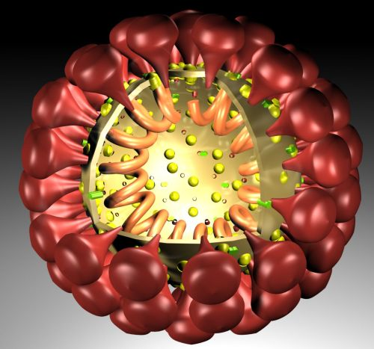
THE END…
THANK YOU.

