Slide 1
AUTOIMMUNE DISEASES

Slide 2
Immunological Tolerance and Autoimmunity
Tolerance (unresponsiveness) to self-antigens is a fundamental property of the immune system, and breakdown of tolerance is the basis of autoimmune diseases.
Types of tolerance include:
  Central tolerance: immature lymphocytes that recognize self-antigens in the central (generative) lymphoid organs are killed by apoptosis; in the B-cell lineage, some of the self-reactive lymphocytes switch to new antigen receptors that are not self-reactive.
  Peripheral tolerance: mature lymphocytes that recognize self-antigens in peripheral tissues become functionally inactive (anergic), or are suppressed by regulatory T lymphocytes, or die by apoptosis.
The variables that lead to a failure of self-tolerance and the development of autoimmunity include;
  (1) inheritance of susceptibility genes that may disrupt different tolerance pathways, and
  (2) infections and tissue alterations that may expose self-antigens and activate APCs and lymphocytes in the tissues.

Slide 3
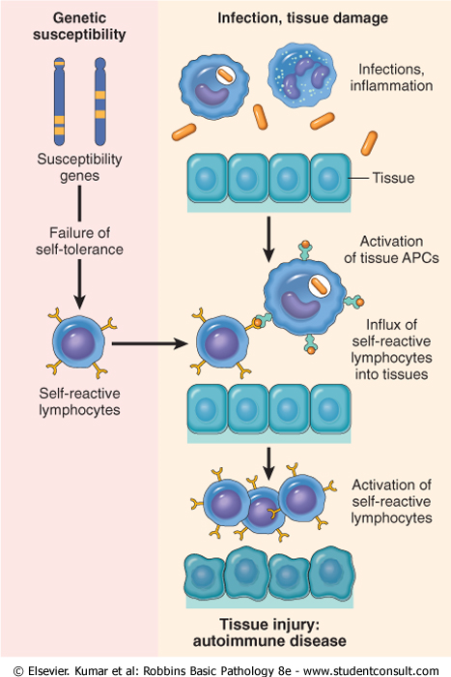
Initiation of autoimmunity

Slide 4
Autoimmune diseases
Organ-Specific | Systemic
Hashimoto thyroiditis | Systemic lupus erythematosus
Autoimmune hemolytic anemia | Rheumatoid arthritis
Autoimmune atrophic gastritis of pernicious anemia | Sjögren syndrome
Multiple sclerosis | Reiter syndrome
Autoimmune orchitis | Inflammatory myopathies*
Goodpasture syndrome | Systemic sclerosis (scleroderma)*
Autoimmune thrombocytopenia | Polyarteritis nodosa*
Insulin-dependent diabetes mellitus
Myasthenia gravis
Graves' disease
Primary biliary cirrhosis*
Autoimmune (chronic active) hepatitis*
Ulcerative colitis

Slide 5
Systemic Lupus Erythematosus
Systemic lupus erythematosus (SLE) is a multisystem autoimmune disease.
Clinically, it is an unpredictable, remitting and relapsing disease of acute or insidious onset that may involve virtually any organ in the body; however, it affects principally the skin, kidneys, serosal membranes, joints, and heart.
Immunologically, the disease is associated with antinuclear antibodies (ANAs) and anti dsDNA antibodies.
The clinical presentation of SLE is so variable and it has so many overlaps with other autoimmune diseases (rheumatoid arthritis, polymyositis, and others)
SLE is a fairly common disease; its prevalence may be as high as 1 case per 2500 persons in certain populations. Like many autoimmune diseases, there is a strong (approximately 9 : 1) female preponderance, affecting 1 in 700 women of childbearing age.
The disease is more common and severe in black Americans, affecting 1 in 245 women in that group.
Its usual onset is in the second or third decade of life, but it may manifest at any age, including early childhood
The immunofluorescence test for ANAs is positive in virtually every patient with SLE, so that the test is quite sensitive. However, it is not specific
Presence of antibodies to dsDNA, is virtually diagnostic of SLE.

Slide 6
Diagnostic criteria
Criterion | Definition
1. Malar rash | Fixed erythema, flat or raised, over the malar eminences, tending to spare the nasolabial folds
2. Discoid rash | Erythematous raised patches with adherent keratotic scaling and follicular plugging; atrophic scarring may occur in older lesions
3. Photosensitivity | Rash as a result of unusual reaction to sunlight
4. Oral ulcers | Oral or nasopharyngeal ulceration, usually painless
5. Arthritis | Non-erosive, involving two or more peripheral joints, characterized by tenderness, swelling, or effusion
6. Serositis | Pleuritis/Pericarditis
7. Renal disorder | Persistent proteinuria >0.5gm/dL or Cellular casts- red blood cell, granular, tubular, or mixed
8. Neurologic disorder | Seizures or Psychosis: in the presence/absence of offending drugs or known metabolic derangements (e.g., uremia, ketoacidosis, or electrolyte imbalance)

Slide 7
9. Hematologic disorder | Hemolytic anemia: with reticulocytosis, Leukopenia: <4.0 ×10⁹ cells per liter (4000 cells per mm³) total on two or more occasions Lymphopenia: <1.5 ×10⁹ cells per liter (1500 cells per mm³) on two or more occasions Thrombocytopenia: <100 ×10⁹ cells per liter (100 ×10³ cells per mm³) in the absence of offending drugs
10. Immunologic disorder | Anti-DNA antibody to native DNA in abnormal titer Anti-Sm: presence of antibody to Sm nuclear antigen Positive finding of antiphospholipid antibodies
11. Antinuclear antibody | An abnormal titer of antinuclear antibody by immunofluorescence or an equivalent assay at any point in time and in the absence of drugs known to be associated with drug-induced lupus syndrome

Slide 8
Rheumatoid Arthritis
Rheumatoid arthritis (RA) is a systemic, chronic inflammatory disease affecting many tissues but principally attacking the joints to produce a nonsuppurative proliferative synovitis that frequently progresses to destroy articular cartilage and underlying bone with resulting disabling arthritis.
When extra-articular involvement develops-for example, of the skin, heart, blood vessels, muscles, and lungs-RA may resemble SLE or scleroderma.
RA is a very common condition, with a prevalence of approximately 1%; it is three to five times more common in women than in men.
The peak incidence is in the second to fourth decades of life, but no age is immune

Slide 9
A broad spectrum of morphologic alterations is seen in RA; the most severe occur in the joints.
RA typically presents as symmetric arthritis, principally affecting the small joints of the hands and feet, ankles, knees, wrists, elbows, and shoulders.
Typically, the proximal interphalangeal and metacarpophalangeal joints are affected, but distal interphalangeal joints are spared.
Axial involvement, when it occurs, is limited to the upper cervical spine; similarly, hip joint involvement is extremely uncommon.
Histologically, the affected joints show chronic synovitis, characterized by;
  (1) Synovial cell hyperplasia and proliferation;
  (2) Dense perivascular inflammatory cell infiltrates (frequently forming lymphoid follicles) in the synovium composed of CD4+ T cells, plasma cells, and macrophages;
  (3) Increased vascularity due to angiogenesis;
  (4) Neutrophils and aggregates of organizing fibrin on the synovial surface and in the joint space; and
  (5) Increased osteoclast activity in the underlying bone, leading to synovial penetration and bone erosion

Slide 10
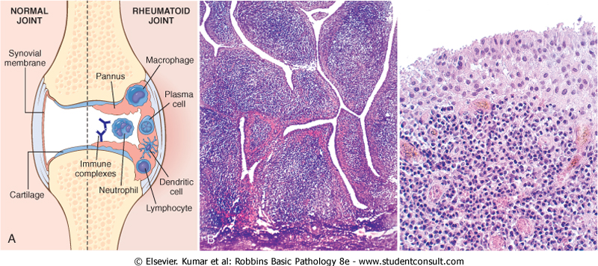

Slide 11
Radiologicalfeatures
Joint effusions and juxta-articular osteopenia with erosions and narrowing of the joint space and loss of articular cartilage.
Destruction of tendons, ligaments, and joint capsules produces the characteristic deformities, including;
  Radial deviation of the wrist
  Ulnar deviation of the fingers
  Flexion-hyperextension abnormalities of the fingers (swan-neck deformity, boutonnière deformity).

Slide 12
Systemic Sclerosis
Systemic sclerosis (commonly called scleroderma) is characterized by progressive fibrosis involving the skin, gastrointestinal tract, and other tissues.Fibrosis may be the result of activation of fibroblasts by cytokines produced by T cells, but what triggers T-cell responses is unknown.
Endothelial injury and microvascular disease are commonly present in the lesions of systemic sclerosis, perhaps causing chronic ischemia, but the pathogenesis of vascular injury is not known.

Slide 13
End
Q/A

