Slide 1
Advance nursing procedures

Slide 2
1. Lumbar puncture (LP)
Refers to the insertion of a hollow tube needle under local anesthesia into the subarachnoid space of the spinal canal to obtain csf
The needle is usually inserted into the subarachnoid space between the third and fourth or fourth and fifth lumbar vertebrae.

Slide 3
Indications for LP
to obtain CSF for examination,
to measure and reduce CSF pressure,
to determine the presence or absence of blood in the CSF,
to detect spinal subarachnoid block,
to administer antibiotics intrathecally (into the spinal canal) in certain cases of infection.
to administer anesthetic agent during surgery

Slide 4
CSF
The CSF should be clear and colorless.
Pink, blood-tinged, or grossly bloody CSF may indicate a cerebral contusion, laceration, or subarachnoid hemorrhage.
Usually, specimens are obtained for cell count, culture, and glucose and protein testing.
The specimens should be sent to the laboratory immediately because changes

Slide 5
Pre procedure management
Determine whether written consent for the procedure has been obtained.
Explain the procedure to the patient and describe sensations that are likely during the procedure
Reassure the patient that the needle will not enter the spinal cord or cause paralysis.
Instruct the patient to void before the procedure

Slide 6
During the procedure
The nurse assists the patient to maintain the position to avoid sudden movement, which can produce a traumatic (bloody) tap.
The patient is encouraged to relax and is instructed to breathe normally

Slide 7
Post procedure
Instruct the patient to lie prone for 2 to 3 hours to separate the alignment of the dural and arachnoid needle punctures in the meninges, to reduce leakage of CSF.
Monitor the patient for complications of lumbar puncture; notify physician if complications occur.
Encourage increased fluid intake to reduce the risk of postprocedure headache.

Slide 8
Complications of LP
Headache
Herniation of the intracranial contents,
Spinal epidural abscess,
Spinal epidural hematoma,
Meningitis
Temporary voiding problems,
Slight elevation of temperature,
Backache or spasms,
Stiffness of the neck

Slide 9
Paracentesis
Puncturing of the peritoneum to remove fluid
Used for
Drainage of ascites
Fluid for lab investigations (histopathology)
For relieving pressure on the chest and abdominal organs
find the cause of fluid build up

Slide 10
Before the procedure
Take medical history or any allergies to drugs
History of bleeding disorders or blood thinning medication
Assess for pregnancy
Advise the patient to empty bladder
Check for a signed consent

Slide 11
During the procedure
Ensure privacy
Shave the skin clean
Record basal vital signs;
Maintain patency of IV lines, for emergency medications and fluids
Observe the fluid color and measure quantity
Immediately seal the puncture wound with sterile dressing

Slide 12
After the procedure
Monitor IO
Monitor vital continuously
Observe for any complication within the first 24 hours

Slide 13
Complications
Fevers higher than 100f
Sever belly pain
More redness or tenderness
Blood in urine
Bleeding from the site

Slide 14
CATHETERIZATION

Slide 15
Catheterization
Refers to the introduction of a plastic tube through the urethra into the bladder
When urine cannot be eliminated naturally and must be drained artificially, catheters may be inserted directly into the bladder, the ureter, or the renal pelvis.
Catheters vary in size, shape, length, material, and configuration.

Slide 16
Catheterization ct
Catheterization is performed to achieve the following:
Relieve urinary tract obstruction
Assist with postoperative drainage in urologic and other surgeries
Monitor accurate urine output in critically ill patients
Promote urinary drainage in patients with neurogenic bladder dysfunction or urine retention
Prevent urinary leakage in patients with stage III to IV pressure ulcers

Slide 17
Types of catheterization
Urethral Catheter
common system consists of an indwelling catheter, a connecting tube, and a collecting bag with an antireflux chamber emptied by a drainage spout
Another system has a triple-lumen indwelling urethral catheter attached to a closed sterile drainage system. With the triple-lumen catheter, urinary drainage occurs through one channel
Triple-lumen catheters are commonly used after transurethral prostate surgery.

Slide 18
Types of catheterization
Suprapubic Catheterization.
Suprapubic catheterization allows bladder drainage by inserting a catheter or tube into the bladder through a suprapubic incision or puncture

Slide 19
Indications of suprapubic catheterization
Injuries to the urethra
Strictures in the urethra
Prostatic obstruction,
After gynecologic or other abdominal surgery when bladder dysfunction is likely to occur, and
Occasionally after pelvic fractures.
long-term basis for women with urethral destruction secondary to long-term indwelling urethral catheters

Slide 20
Advantages of spc
Patients can usually void sooner after surgery than those with urethral catheters,
More comfortable.
The catheter allows greater mobility, permits measurement of residual urine without urethral instrumentation
Less risk of bladder infection.

Slide 21
Insertion of SPC
The patient is placed in a supine position
Bladder distended by administering
The suprapubic area is prepared as for surgery and the puncture site located about 5 cm above symphysis pubis.
The bladder is entered through an incision or through a puncture made by a small trocar (pointed instrument).
The catheter or suprapubic drainage tube is threaded into the bladder and secured with sutures or tape; the area around the catheter is covered with a sterile dressing.

Slide 22
Nursing intervention
During catheterization
Assessing the patient and the system
assesses the drainage system to ensure that it provides adequate urinary drainage.
Monitor the color, odor and volume of the urine

Slide 23
Nursing intervention
Assessing for age-related complications
In the elderly, change in physical condition or mental status must be considered a possible indication of infection and promptly investigated because sepsis may occur before the infection is diagnosed

Slide 24
Nursing intervention
Preventing infection- Most urinary tract infections follow instrumentation of the urinary tract, usually catheterization
Minimizing trauma:- by:
Using an appropriate-sized catheter
Lubricating the catheter adequately with a water-soluble lubricant during insertion
Retraining the bladder:- by making a voiding schedule

Slide 26
Biopsy

Slide 27
Introduction
A biopsy is a medical procedure involving taking a small sample of body tissue for examination
Abnormalities examined can be functional or structural
Biopsy examination helps in diagnosis of a specific condition or in assessing severity of a condition

Slide 28
Introduction ct
Examples of conditions requiring biopsy
Cancer
Inflammation eg nephritis or hepatitis
Infections especially in the lymph nodes eg tb
Various skin conditions

Slide 29
Types of biopsy
A punch biopsy- a special instrument punches a small hole in the skin to obtain skin sample
A needle biopsy- a special hollow needle, guided by X-ray, CT scan etc is used to obtain a tissue from an organ
- A needle biopsy can be Fine Needle Aspiration, Core Needle Biopsy, Vacuum Assisted Biopsy
Endoscopic biopsy- an endoscope is used to remove a tissue
Excision biopsy- surgery is done to remove a larger section of tissue
Perioperative biopsy-

Slide 30
Nursing intervention
Before the procedure
Review the chart for a signed consent
Keep NPO when prescribed
Assess and record baseline vital signs
Review laboratory results
Instruct the patient to empty bladder
Teach about the procedure and its purpose

Slide 31
During the procedure
Help client hold breathe following expiration
Assess for pain or discomfort during procedure
Receive the tissue in the designated container, cork well and preserve in the right fluid

Slide 32
After the procedure
Apply direct pressure on the site in case of needle aspiration
Frequently assess the site for bleeding
Assess the vital signs regularly
Advice on the pain management
Report immediately any incidence of bleeding from the site
Keep NPO as prescribed
For liver biopsy, advice to avoid lifting, coughing or straining for 2 weeks

Slide 33
Dialysis

Slide 34
Introduction
Dialysis is used to remove fluid and uremic waste products from the body when the kidneys cannot do so.
It may also be used to treat patients with edema that does not respond to treatment, hepatic coma, hyperkalemia, hypercalcemia, hypertension, and uremia.
Methods of therapy include hemodialysis, continuous renal replacement therapy and various forms of peritoneal dialysis.

Slide 35
Def
Vascular graft: A surgically placed artificial tube between a vein and artery (usually in the arm).
Accessed via needle for HD
Dialysate: A balanced electrolyte solution on one side of the semi-permeable membrane to exchange solutes with blood during HD
Dialysis water: Purified water that is used to:
mix dialysate
to disinfect, rinse, or reprocess the dialyser

Slide 36
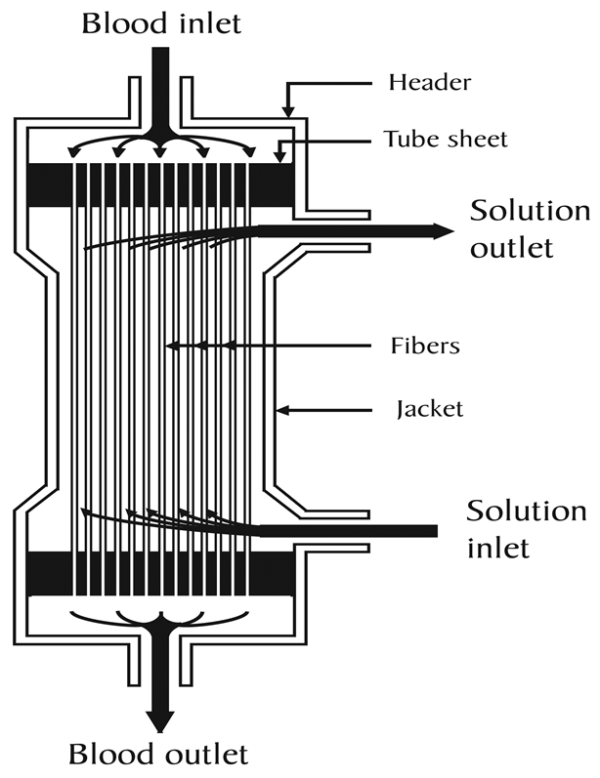
Def
The dialyser : is the piece of equipment that filters the blood

Slide 37
Acute and chronic dialysis
Acute dialysis is indicated when there is a high and rising level of serum potassium, fluid overload, or impending pulmonary edema, increasing acidosis, pericarditis, and severe confusion
Chronic or maintenance dialysis is indicated in chronic renal failure, known as end-stage renal disease (ESRD)
An urgent indication for dialysis in patients with chronic renal failure is pericardial friction rub.

Slide 38
Types of dialysis
Hemodialysis
A dialyzer (once referred to as an artificial kidney) serves as a synthetic semipermeable membrane, replacing the renal glomeruli and tubules as the filter for the impaired kidneys

Slide 39
Hemodialysis

Slide 40
Hemodialysis ct
Blood passes over a semi-permeable membrane which allows some molecules to pass through.
The patient’s blood enters the machine from an access point: A fistula, vascular graft, or a temporary central line.
Fluid removal is achieved by altering the hydrostatic pressure of the dialysate compartment, causing free water and some dissolved solutes to move across the membrane along a created pressure gradient.

Slide 41
Complications of hemodialysis
atherosclerotic cardiovascular disease
Hypertriglyceridemia
Heart failure
coronary heart disease
anginal pain
stroke
peripheral vascular insufficiency
Anemia
Gastric ulcers
bone pain and fractures
fluid overload associated with heart failure
malnutrition
infection
neuropathy
pruritus.

Slide 42
Peritoneal Dialysis

Slide 43
Peritoneal dialysis
The process uses the patient's peritoneum in the abdomen as a membrane across which fluids and dissolved substances (electrolytes, urea, glucose, albumin and other small molecules) are exchanged from the blood.
Fluid is introduced through a permanent tube in the abdomen and flushed out either every night while the patient sleeps (automatic peritoneal dialysis) or via regular exchanges throughout the day (continuous ambulatory peritoneal dialysis).

Slide 44
Peritoneal dialysis
Most catheters are silicone
Fluid is removed to take out toxins
Most common types include:
Chronic ambulatory
Continuous cyclical
Chronic intermittent

Slide 45
Complications of peritoneal dialysis
Hypertriglyceridemia
abdominal hernias (incisional, inguinal, diaphragmatic, and umbilical), probably resulting from continuously increased intra-abdominal pressure.
Hemorrhoids.
Low back pain and anorexia
Peritonitis
Bleeding

Slide 46
Nursing intervention
Before dialysis
Explain the procedure to the patient and obtains signed consent for it.
Take baseline vital signs, weight, and serum electrolyte
Encourage the patient to empty the bladder and bowel to reduce the risk of puncturing internal organs.
Assess the patient’s anxiety about the procedure and provide support and instruction.
Broad-spectrum antibiotic agents may be administered to prevent infection.

Slide 47
Nursing management
Frequently conduct cardiac and respiratory assessment
Control electrolyte levels and diet
Manage discomfort and pain
Care for the catheter site
Administer medications
Provide psychological support
Monitor blood pressure
Prevent infection

Slide 49
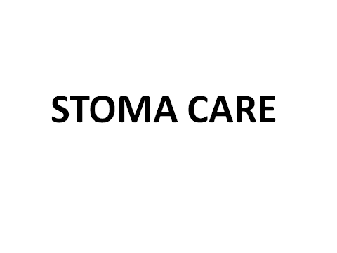
Stoma care

Slide 50
Stoma care
Stoma is an opening that is created to allow stool or urine to pass out of the body.
Common conditions that might necessitate a stoma are:
Imperforate anus: where there is no exit for the bowel or its contents.
Hirschsprungs disease: where nerves called the ganglion nerves are missing and waste matter cannot easily pass.
Inflammatory bowel disease: this includes Crohns Disease and Ulcerative Colitis, both inflammatory diseases of the intestines.
Neonatal necrotising enterocolitis: this occurs when a portion of the bowel is dead and cannot function
Spina bifida

Slide 51
Stoma
Stomas will be a pinkish red in colour, similar to the inside of your mouth, and will be soft and moist.
Stomas have no nerve endings and therefore no feeling so it will not hurt when touched.
The stoma may sit out above or be slightly below the skin level.

Slide 52
Types of stoma
Colostomy
This is the most common stoma type.
A colostomy is an opening made into the large intestine or colon.
The stool can then pass from the stoma out of your child’s body which tends to be solid in consistency but can sometimes be liquid

Slide 53
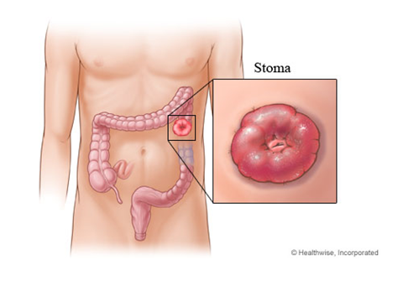

Slide 54
Ileostomy
In an ileostomy the opening is made in the small intestine – the ileum.
An end or loop of the small intestine is brought through the skin’s surface on the abdomen and the output then passes out through the stoma.
Due to the fact that ileostomy output contains digestive enzymes, this can be harmful to the skin and so requires extra care when pouching.

Slide 55
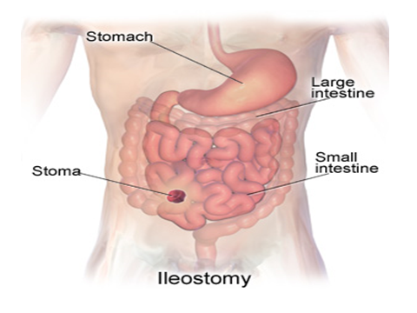

Slide 56
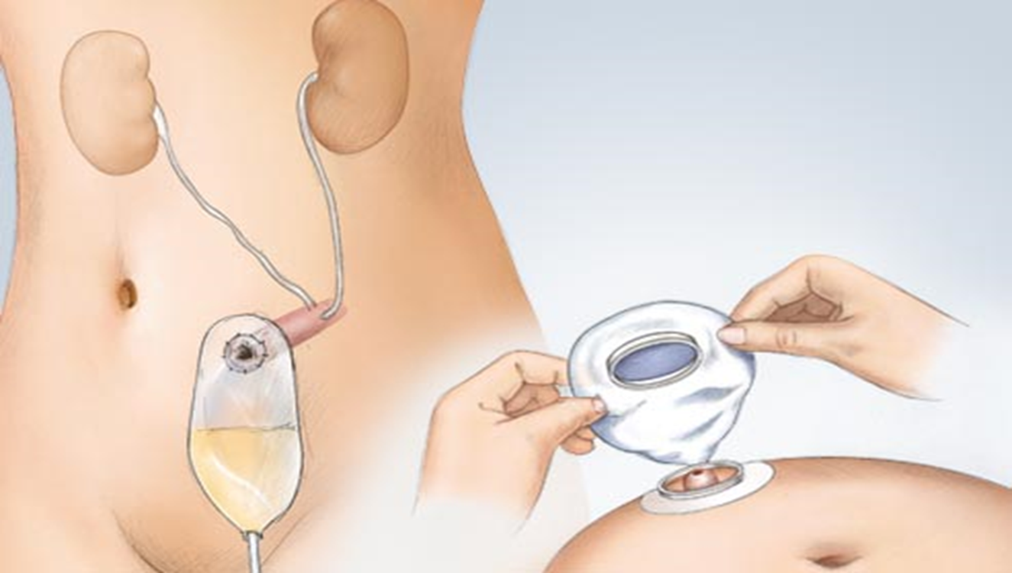
Urostomy
Is an opening made to divert urine from the bladder and also resembles a ‘spout’ as the output is urine.

Slide 57
How to change a pouch
For an open-ended pouch, empty the contents from pouch into the toilet.
Gently remove the pouch by pushing the skin down and away from the adhesive skin barrier with one hand.
With the other hand, pull the pouch up and away from the stoma
Clean the skin around the stoma with warm water. You may also use soap but do not use soaps that have oil or perfumes

Slide 58
How to change a pouch ct
Use skin protection products if you have irritated skin around the stoma.
Center the pouch over the stoma and press it firmly into place on clean, dry skin.
It may be helpful to hold your hand over the newly applied pouch for 30 seconds. The warmth of your hand can help to mold the adhesive skin barrier into place.
Place the old pouch in another plastic bag to be thrown away if the pouch is disposable.
If you use a reusable pouch, talk to your caregiver about how to clean the reusable pouch

Slide 59
How to empty a pouch
Empty the pouch when it is one-third to one-half full.
Do not wait until the pouch is completely full because this could put pressure on the seal, causing a leak. The pouch may also detach, causing all of the pouch contents to spill.
Take the end of the pouch and hold it up. Remove the clamp (if the pouch has a clamp system).
You may need to make a cuff at the end of the pouch to keep it from getting soiled
Drain the pouch by squeezing

Slide 60
How to empty a pouch ct
Clean the cuffed end of the pouch with toilet paper or a moist paper towel
Undo the cuff at the end of the pouch. Replace the clamp or close the end of the pouch

Slide 62
Nursing management
Assessment
Assess the location of the stoma and the type of colostomy performed.
Stoma location is an indicator of the section of bowel in which it is located and a predictor of the type of fecal drainage
• Assess stoma appearance and surrounding skin condition frequently

Slide 63
intervention
Position a collection bag or drainable pouch over the stoma.
Initial drainage may contain more mucus and serosanguineous fluid than fecal material.
irrigate the colostomy, instilling water into the colon similar to an enema procedure. The water stimulates the colon to empty.

Slide 64
Intervention ct
When a colostomy irrigation is ordered for a client with a double-barrel or loop colostomy, irrigate the proximal stoma
Empty a drainable pouch or replace the colostomy bag as needed or when it is no more than one-third full
Good skin and stoma care is important to maintain skin integrity and function
For patients with loop colostomy Use stomahesive or skin barrier wafer as needed to maintain a secure ostomy pouch

Slide 65
ct
A small needle hole high on the colostomy pouch will allow flatus to escape. This hole may be closed with a Band-Aid and opened only while the client is in the bathroom for odor control.

Slide 66
Client and family care
Prior to discharge, provide written, verbal, and psychomotor instruction on colostomy care,pouch management, skin care, and irrigation for the client
Allow ample time for the client (and family, if necessary) to practice changing the pouch, either on the client or a model.
If an abdominoperineal resection has been performed, emphasize the importance of using no rectal suppositories, rectal temperatures, or enemas.

Slide 68
Washouts

Slide 69
Bowel (rectal) washouts
Rectal washouts are performed to decompress the lower intestine and deflate the abdomen by removing gas and stool using small amount of NS

Slide 70
Uses of washouts
In babies and children to relieve low IO eg in meconium plug
As a temporary management of patients with hirschsprungs disease before surgery
In management of enterocolitis
Preoperatively in patients undergoing closure of stoma procedures
Management of constipation in children

Slide 71
The procedure
Position the patient in a semi recumbent position or prone position
Lubricate catheter tip and insert gently into the rectum
Using syringe plunger Instill warm NS solution in 10 – 20ml aliquots over 1-2 mins
Remove the syringe and let the fluid flow back to the kidney dish
Repeat two to three times

Slide 72
Procedure ct
Remove the catheter from the rectum and leave the patient clean and dry
Note and record the results accurately

Slide 73
Nursing management
Assess the frequency, color and amount of vomitus
Assess any increase in amount and change in color of NG aspirate – green indicates IO
Assess and describe the degree of distension of the abdomen
Note the time of each bowel action frequency, amount, consistency and color

Slide 75
ENDOSCOPIC PROCEDURES

Slide 76
ENDOSCOPIC PROCEDURES
Endoscopic procedures used in GI tract assessment include
fibroscopy/esophagogastroduodenoscopy, anoscopy, proctoscopy, sigmoidoscopy, colonoscopy, small-bowel enteroscopy, and endoscopy through ostomy.

Slide 77
Fibroscopy (esophagogastroduodenoscopy)
Fiberscopes are flexible scopes equipped with fiberoptic lenses.
Fibroscopy of the upper GI (EGD) allows direct visualization of the esophageal, gastric, and duodenal mucosa through a lighted endoscope
Valuable when esophageal, gastric, or duodenal abnormalities or inflammatory, neoplastic, or infectious processes are suspected.
also used to evaluate esophageal and gastric motility and to collect secretions and tissue specimens

Slide 78
Fibroscopy ct
Upper GI fibroscopy also can be a therapeutic procedure when it is combined with other procedures.
Therapeutic endoscopy can be used to remove common bile duct stones, dilate strictures, and treat gastric bleeding and esophageal varices.
Laser-compatible scopes can be used to provide laser therapy for upper GI neoplasms.
Sclerosing solutions can be injected through the scope in an attempt to control upper GI bleeding.

Slide 79
Nursing management
Before the procedure
Starve the patient 6-12 hrs
Help the patient spray or gargle with a local anesthetic,
Administer midazolam intravenously just before the scope is introduced.
Administer atropine to reduce secretions,
Give glucagon, if needed and prescribed, to relax smooth muscle.
The nurse positions the patient on the left side to facilitate saliva drainage and to provide easy access for the endoscope.

Slide 80
After the procedure,
The nurse instructs the patient not to eat or drink until the gag reflex returns (in 1 to 2 hours), to prevent aspiration of food or fluids into the lungs.
The nurse places the patient in the Simms position until he or she is awake and then places the patient in the semi-Fowler’s position until ready for discharge.
Observe for signs of perforation, such as pain, bleeding, unusual difficulty swallowing, and an elevated temperature

Slide 81
After the procedure ct
monitor the pulse and blood pressure for changes that can occur with sedation.
test the gag reflex by placing a tongue blade onto the back of the throat to see whether gagging occurs.
After the patient’s gag reflex has returned, offer lozenges, saline gargle, and oral analgesics to relieve minor throat discomfort.
Instruct the patient not to drive for 10 to 12 hours if sedation was used.

Slide 82
Anoscopy, Proctoscopy, and Sigmoidoscopy
The lower portion of the colon can be viewed directly to evaluate
rectal bleeding
acute or chronic diarrhea
change in bowel patterns
Ulceration, fissures, abscesses, tumors, polyps, or other pathologic processes.

Slide 83
Anoscopy, Proctoscopy, and Sigmoidoscopy ct
The anoscope is a rigid scope that is used to examine the anus and lower rectum.
Proctoscopes and sigmoidoscopes are rigid scopes that are used to inspect the rectum and the sigmoid colon

Slide 84
Nursing management
These examinations require only limited bowel preparation, including a warm tap water or Fleet’s enema until returns are clear.
Dietary restrictions usually are not necessary, and sedation usually is not required.
During the procedure,
Monitor vital signs,
skin color and temperature
pain tolerance

Slide 85
After the procedure,
monitor the patient for rectal bleeding and signs of intestinal perforation (ie, fever, rectal drainage, abdominal distention, and pain).
On completion of the examination, the patient can resume regular activities and dietary practices.

Slide 86
Colonoscopy
Direct visual inspection of the colon to the cecum by use of a fibreoptic scope

Slide 87
Uses of colonoscopy
used for cancer screening and for surveillance in patients with previous colon cancer or polyps.
To obtain tissue biopsies
To remove and evaluate polyps
To evaluate patients with diarrhea of unknown cause, occult bleeding, or anemia;
To determine the extent of inflammatory or other bowel disease

Slide 88
Nursing management
BEFORE
Adequate colon cleansing will provide optimal visualization and decreases the time needed for the procedure
Limit fluid intake
Glucagon may be used, if needed, to relax the colonic musculature and to reduce spasm during the test
Administer midazolam

Slide 89
Nursing management
DURING the procedure
monitor for changes in oxygen saturation, vital signs, color and temperature of the skin, level of consciousness, abdominal distention, vagal response, and pain intensity

Slide 90
Nursing management
After the procedure
patients who were sedated are maintained on bed rest until fully alert. Some will have abdominal
observes the patient for signs and symptoms of bowel perforation (eg, rectal bleeding, abdominal pain or distention,
fever, focal peritoneal signs).
If midazolam was used, the explain its amnesic effects.
If the procedure is performed on an outpatient basis, someone must accompany and transport the patient home.
Instruct the patient to report any bleeding to the physician.

Slide 92
Radiation therapy

Slide 93
RADIATION THERAPY
Ionizing radiation is used to interrupt cellular growth.
Radiation may be used to cure the cancer, as in Hodgkin’s disease, testicular seminomas, thyroid carcinomas, localized cancers of the head and neck, and cancers of the uterine cervix.
Radiation therapy may also be used to control malignant disease when a tumor cannot be removed surgically or when local nodal metastasis is present
It can be used prophylactically to prevent leukemic infiltration to the brain or spinal cord.

Slide 94
Palliative radiation therapy is used to relieve the symptoms of metastatic disease

Slide 95
Radiotherapy ct
Two types of ionizing radiation—
electromagnetic rays (x-rays and gamma rays)
particles (electrons [beta particles], protons, neutrons, and alpha particles)

Slide 96
Radiotherapy
Radiotherapy can lead to tissue disruption
most harmful tissue disruption is the alteration of the DNA molecule within the cells of the tissue.
Ionizing radiation breaks the strands of the DNA helix, leading to cell death.
Can also ionize constituents of body fluids, especially water, leading to the formation of free radicals and irreversibly damaging DNA.
If the DNA is incapable of repair, the cell dies

Slide 97
Types of radiotherapy
External radiation:- x-rays are used to destroy cancerous cells at the skin surface or deeper in the body.
Internal radiation:- implantation, or brachytherapy, delivers a high dose of radiation to a localized area. The specific radioisotope for implantation is selected on the basis of its half-life

Slide 98
Nursing Management in Radiotherapy
Explain the procedure for delivering radiation and describe the equipment, the duration of the procedure
If a radioactive implant is used, the nurse informs the patient and family about the restrictions placed on visitors and health care personnel and other radiation precautions
Protect the skin and the mucosa- assess signs of irritation, restriction on use of ointments
Gentle oral hygiene is essential to remove debris, prevent irritation and promote healing
Protect the caregivers

