Slide 1
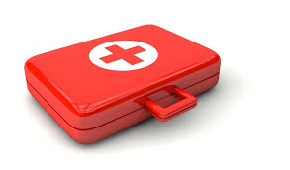
Aims, Responsibilities, & Qualities of a First Aider
Samuel Ngigi K.
KMTC LECTURER

Slide 2
The aims of first aid – the three Ps
A simple way to remember the aims of first aid is to think of the “Three Ps” – Preserve / Prevent / Promote.
A first aider has a number of roles and responsibilities in an emergency situation but all first aiders should be aware of the key aims of first aid.

Slide 3
Preserve life
Your first aim is to preserve life by carrying out emergency first aid procedures. For example, opening a casualty’s airway or performing cardiopulmonary resuscitation (CPR).
Preserving life should always be the overall aim of all first aiders. Remember though, this includes your own life! You should never put yourself or others in danger.
This is why the first stage in assessing a casualty is to conduct a risk assessment and check for any dangers to yourself or bystanders.
If a situation is too dangerous to approach, you should stay back and call for professional help.

Slide 4
Prevent deterioration
The second aim of first aid is to prevent the casualty’s condition from deteriorating any further. For example, asking a casualty with a broken limb to stay still and padding around the injury will prevent the fracture from moving and causing further injury or pain.
In addition, this aim includes preventing further injuries. You should attempt to make the area as safe as possible and removing any dangers.
If removing danger is not possible you should attempt to remove the patient from the danger or call for specialist help.

Slide 5
Promote recovery
Finally, you can promote recovery by arranging prompt emergency medical help. In addition, simple first aid can significantly affect the long-term recovery of an injury. For example, quickly cooling a burn will reduce the risk of long-term scarring and will encourage early healing.

Slide 6
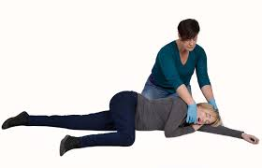
Role of First aider-1
Primary role of first aider is to provide immediate lifesaving care before arrival of further medical care. This could include performing procedures such as:
Placing an unconscious casualty into the recovery position
Performing CPR
Stopping bleeding using pressure and elevation
Keeping fractured part still

Slide 7
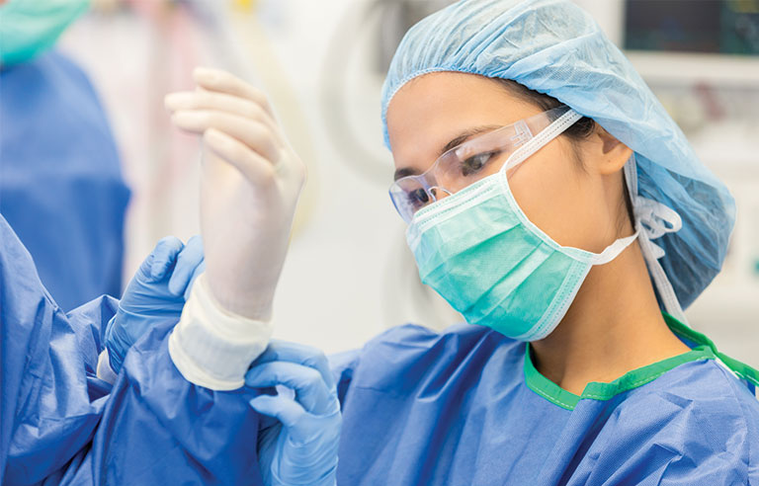
Role of First aider-2
Provision of adequate and appropriate first aid to the victim depending upon the circumstances and nature of event
Performing emergency First aid at site
Use of appropriate PPEs a per event

Slide 8
Responsibilities-1
Manage the incident and ensure the continuing safety of themselves, bystanders and the casualty
Assess the casualties and find out the nature and cause of injuries
Prioritize casualties based upon medical need
Arrange for further medical help
Arrange for other emergency services to attend like – fire/security/ambulance/evacuation

Slide 9
Responsibilities-2
Provide detail information while handing over patient to hospital doctor
Maintenance of First aid boxes
Report all injuries to appropriate authorities

Slide 10
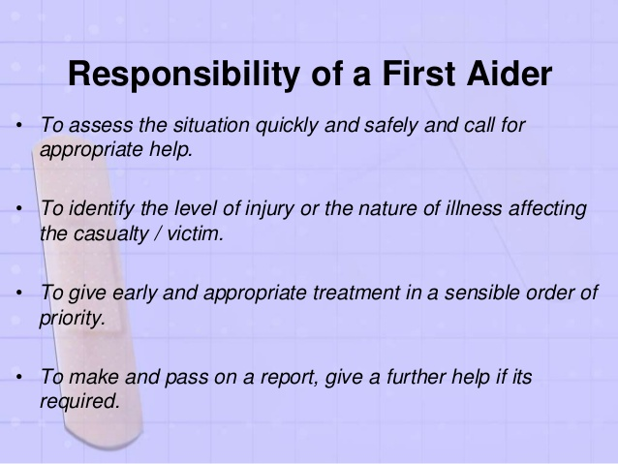

Slide 11
What is the scope of a first aider
The scope of first aid includes the diagnosis, the treatment and the disposal of the case.
(a) For diagnosis, the first aider must first know how the accident or sudden injury has occurred. This can be got from the victim if he can tell or from witnesses. This is called the history of the case.
The next step in diagnosis is to watch the symptoms like faintness, thirst, pain or shivering.
Then the first aider looks at the signs, which are variations from normal conditions. These may include swelling, congestion, paleness or deformity, which can be very easily observed by the first aider. Signs are the most reliable indications on which diagnosis can be based.

Slide 12
What is the scope of a first aider
(b) For treatment, the cause of the condition should be imme­diately removed, with a view to prevent the condition from becoming worse. Special attention should be paid to cases of severe bleeding, shock, unconsciousness and failure of breathing.
(c) For quick disposal, the casualty or the victim should either be examined by the doctor on the spot or, if that is not possible, he should be immediately taken to his home or to a suitable place of shelter or to a hospital, according to circumstances. The members of the victim’s family or his relatives should be informed at once.

Slide 13
8 Qualities That Will Make You a Good First Aid Provider
• Quick and smooth
First aid providers have to be very quick in their actions. As soon as some accident takes place, they have to be quick in response and take over the situation immediately, without any delay. Hesitation, doubts clouding the face and panic, these damage the already injured victim.
• Controlled and calm
Without showing any panic, you should be able to perform in front of the people and the victim. Your actions should exhibit confidence, the only thing that can calm scared people. The first aid training you will undergo will give you the skills; there is no reason to panic.

Slide 14
8 Qualities That Will Make You a Good First Aid Provider
• Intelligent and decisive
You should be able to decide the course of treatment within seconds. Depending on what is there in front of you, you should take an immediate yet a wise call, and keep the injured person stable till help arrives. If there are more than one casualty, you must be quick to judge and must start working on the victim who needs attention the most.
• Resourceful
Your first aid kit should, at all times, have the required material without fail. In case you don't have it, you should make immediate arrangement or look for the right alternatives off what is available. You should be able to use the people around you resourcefully, delegating responsibilities to people around.

Slide 15
8 Qualities That Will Make You a Good First Aid Provider
• Reassuring and sympathetic
It is your duty as a first aider is to reassure the victim that you are there to take care of him and that help is on its way. You need to be calm, kind and sympathetic to the victim's calls. The victim needs reassuring words. He needs to be told that everything will be alright and that he is in safe hands. This quality is the most important when it comes to dealing with small kids in schools and play schools.
• Skilled
A first aider has the basic medical skills. You are trained to perform these skills under pressure. You should have the right skills to judge the problem depending on the symptoms and make quick calls. If you require help, you should be able to garner some from the crowd and should be able to take charge and lead.

Slide 16
8 Qualities That Will Make You a Good First Aid Provider
• Efficient
You should be able to start the first aid without the victim feeling too much pain or without increasing his pain anymore. There is never any time to waste when there is a medical emergency. With the available resources, you need to attend to as many casualties are there, till help arrives.
• Confident
As a first aid provider you must have faith in yourself and your actions before you start first aid on the victim. The confidence which you would exhibit while performing would reassure the victim and the onlookers.

Slide 17
Contents of a basic first aid kit
First aid kit contents vary according to their particular use. For example, a first aid kit for a farm will contain a few different items to a first aid kit for a city-dwelling family.
A basic first aid kit should contain:
Triangular bandages
Crepe ('conforming' or elastic) bandages of varying widths
Non-adhesive (non-stick) dressings of varying sizes
Disposable gloves (medium and large), preferably made of non-latex material
Thermal blanket
Adhesive tape (2.5 cm wide – preferably a permeable tape such as Micropore)
Resuscitation mask or face shield.

Slide 18
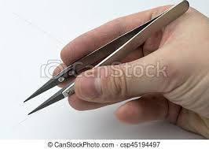
Contents of a basic first aid kit
Other equipment can include:Medium combine dressing pads (9 x 20 cm)
Large combine dressing pads (20 x 20 cm)
Adhesive dressing strips (bandaids)
Medium gauze dressing (7.5 x 7.5 cm)
Four sterile tubes of saline solution (minimum 10 ml)
One pair of scissors- to cut dressing/bandage
One pair of tweezers- to pull out stings
First aid booklet.

Slide 19
First aid equipment explained
The various gauzes, dressings and bandages found in a first aid kit have different uses. Some of these include:Adhesive strip dressings – small strips of gauze attached to a sticky backing. These dressings are used for minor cuts and skin injuries. In Australia, they are commonly called bandaids. It is important to be aware that some people are allergic to bandaids.
Non-adhesive dressings – best used for covering burnt or abraded (scraped or grazed) skin. Never use adhesive dressings on burnt or abraded skin.
Wound dressings – these thick pads are used to help control bleeding and reduce the risk of infection. Different sizes are needed for different-sized wounds.
Crepe or conforming bandages – these elastic bandages are used to create pressure, hold dressings in place, reduce swelling and provide some support.
Triangular bandages – these non-elastic bandages are used for slings, to hold splints in place and to restrict movement.
Sterile eyewash solution – used to flush eyelashes, insects, dust, sand or similar particles from the eye. Never attempt to remove an object that is embedded in or has penetrated an eye – in such an instance, seek urgent medical attention.

Slide 20
End of Presentation
Thank You For Listening

