Slide 1
Anatomy of the Respiratory System
Mrs Musyimi J.M
1

Slide 2
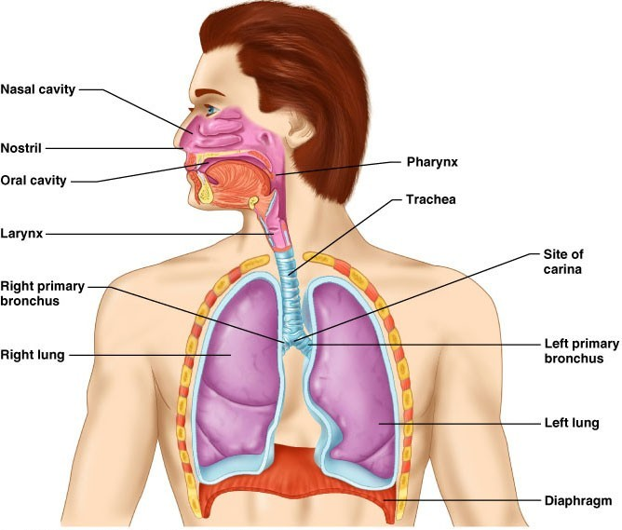
Respiratory System
2
Figure 22.1

Slide 3
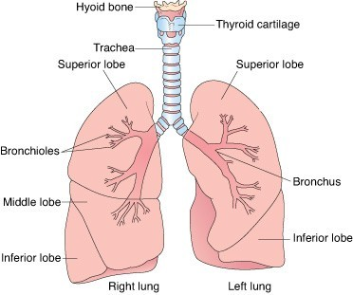
3

Slide 4
Respiratory System Anatomy
Structurally composed of:
1. Upper respiratory system
Nose, pharynx and associated structures
2. Lower respiratory system
Larynx, trachea, bronchi and lungs

Slide 5
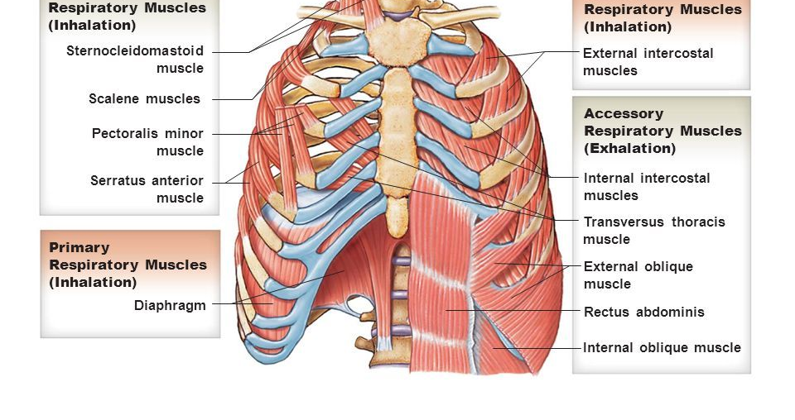
Respiratory muscles – diaphragm and other muscles that promote ventilation

Slide 6
Function of the Nose
The only externally visible part of the respiratory system that functions by:
Providing an airway for respiration
Moistening (humidifying) and warming the entering air
Filtering inspired air and cleaning it of foreign matter
Serving as a resonating chamber for speech
Housing the olfactory receptors

Slide 7
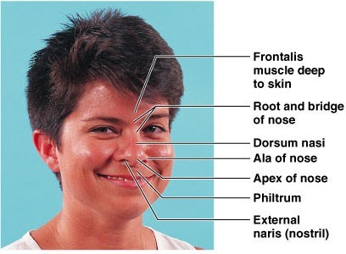
Structure of the Nose
The nose is divided into two regions
The external nose
The internal nasal cavity

Slide 8
The external nose, including the root, bridge, dorsum nasi, and apex
Philtrum – a shallow vertical groove inferior to the apex
The external nares (nostrils) are bounded laterally by the alae

Slide 9
Nasal Cavity
Lies in and posterior to the external nose
Is divided by a midline nasal septum
Opens posteriorly into the nasal pharynx via internal nares
The ethmoid and sphenoid bones form the roof
The floor is formed by the hard and soft palates

Slide 10
Nasal Cavity
Vestibule – nasal cavity superior to the nares
Vibrissae – hairs that filter coarse particles from inspired air
Olfactory mucosa
Lines the superior nasal cavity
Contains smell receptors

Slide 11
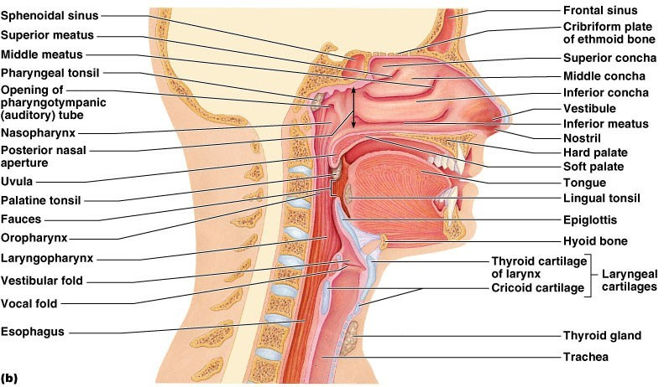
Nasal Cavity
Fig₁u₅re 22.3b

Slide 12
In the Nasal Cavity
Inspired air is:
Humidified by the high water content in the nasal cavity
Warmed by rich plexuses of capillaries
Ciliated mucosal cells remove contaminated mucus

Slide 13
Nasal Cavity
Contains Superior, medial, and inferior conchae which:
Protrude medially from the lateral walls
Increase mucosal area
Enhance air turbulence and help filter air
Sensitive mucosa triggers sneezing when stimulated by irritating particles

Slide 14
Functions of the Nasal Mucosa and Conchae
During inhalation the conchae and nasal mucosa:
Filter, heat, and moisten air
During exhalation these structures:
Reclaim heat and moisture
Minimize heat and moisture loss

Slide 15
Paranasal Sinuses
Sinuses are air cavities found in bones that surround the nasal cavity
Sinuses lighten the skull and help to warm and moisten the air

Slide 17
Pharynx
Funnel-shaped tube of skeletal muscle that connects to the:
Nasal cavity and mouth superiorly
Larynx and esophagus inferiorly
Extends from the base of the skull to the level of the sixth cervical vertebra

Slide 18
Pharynx
It is divided into three regions
Nasopharynx
Oropharynx
Laryngopharynx

Slide 19
Nasopharynx
Lies posterior to the nasal cavity, inferior to the sphenoid, and superior to the level of the soft palate
Strictly an air passageway
Lined with pseudostratified columnar epithelium
Closes during swallowing to prevent food from entering the nasal cavity
The pharyngeal tonsil lies high on the posterior wall
Pharyngotympanic (auditory) tubes open into the lateral walls

Slide 20
Oropharynx
Extends inferiorly from the level of the soft palate to the epiglottis
Serves as a common passageway for food and air
The epithelial lining is protective stratified squamous epithelium
Palatine tonsils lie in the lateral walls
Lingual tonsil covers the base of the tongue

Slide 21
Laryngopharynx
Serves as a common passageway for food and air
Lies posterior to the upright epiglottis
Extends to the larynx, where the respiratory and digestive pathways diverge

Slide 22
Larynx
Short passageway connecting laryngopharynx with trachea
Attaches to the hyoid bone and opens into the laryngopharynx superiorly
Continuous with the trachea posteriorly

Slide 24
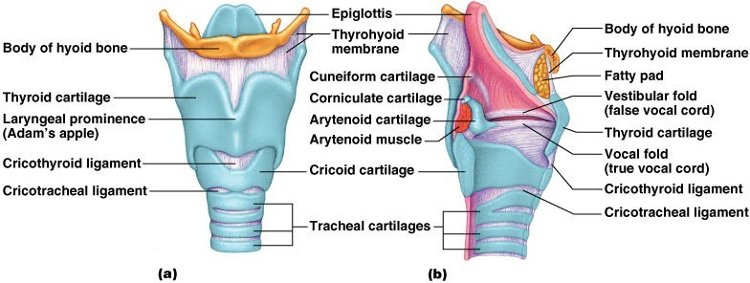
Framework of the Larynx

Slide 25
Functions of the Larynx
The three functions of the larynx are:
To provide a patent airway
To act as a switching mechanism to route air and food into the proper channels
To function in voice production

Slide 26
Sphincter Functions of the Larynx
The larynx is closed during coughing, sneezing, and Valsalva’s maneuver
Valsalva’s maneuver
Air is temporarily held in the lower respiratory tract by closing the glottis
Causes intra-abdominal pressure to rise when abdominal muscles contract
Helps to empty the rectum

Slide 27
Trachea
Flexible and mobile tube extending from the larynx into the mediastinum
Extends from larynx to superior border of T5
Divides into right and left primary bronchi

Slide 28
Trachea
The trachea/ windpipe, is a 10-11 cm long fibrocartilaginous tube of the lower respiratory tract
Made up of 4 layers
Mucosa
Submucosa
Hyaline cartilage
Adventitia

Slide 29
Trachea Layers
Mucosa – made up of goblet cells and ciliated epithelium
Submucosa – connective tissue deep to the mucosa
Hyaline cartilage -16-20 C-shaped rings of hyaline cartilage
Adventitia – outermost layer

Slide 30
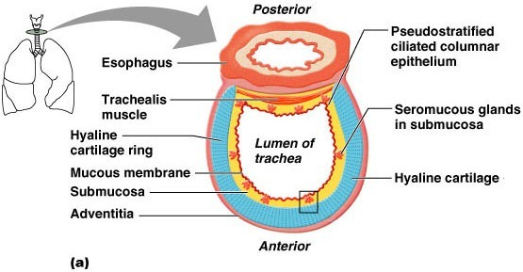
Trachea

Slide 31
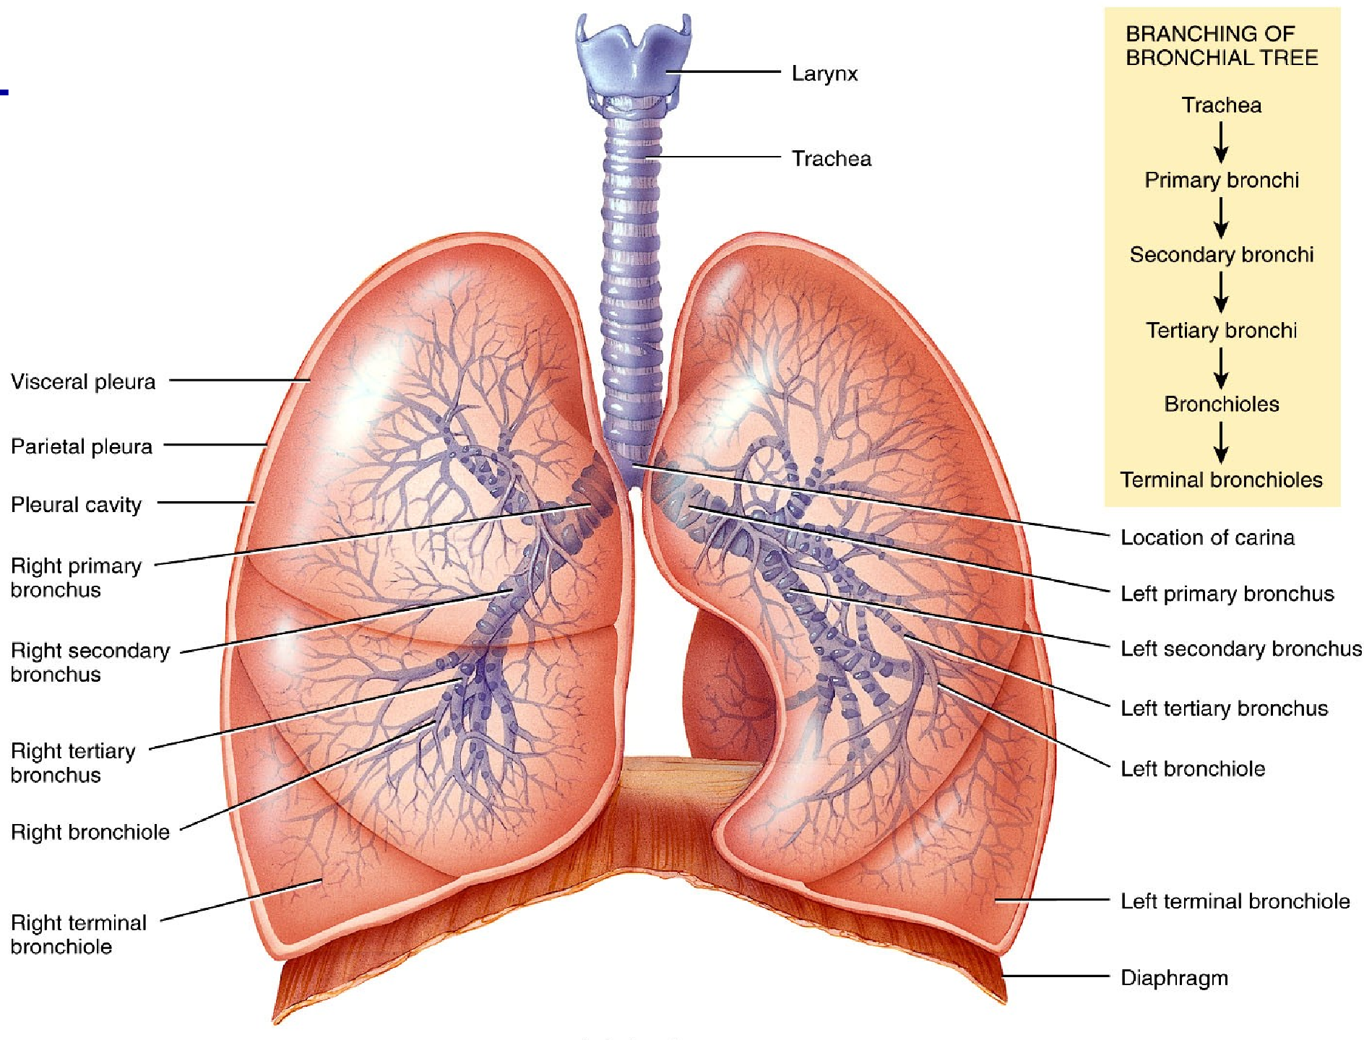

Slide 32
Bronchi
The last tracheal cartilage marks the end of the trachea and the beginning of the right and left bronchi
Bronchi subdivide into secondary bronchi, each supplying a lobe of the lungs
Air passages undergo 23 orders of branching in the lungs

Slide 33
Bronchial Tree
Tissue walls of bronchi mimic that of the trachea
However, as conducting tubes become smaller, several structural changes occur
Cartilage support structures reduces
Epithelium types change
Amount of smooth muscle increases

Slide 34
Bronchioles
Consist of cuboidal epithelium
Have a complete layer of circular smooth muscle
Lack cartilage support and mucus-producing cells

Slide 35
The Lungs
Lungs occupy all of the thoracic cavity except the mediastinum
The lungs have several parts
Root – site of vascular and bronchial attachments
Costal surface – anterior, lateral, and posterior surfaces in contact with the ribs
Apex – narrow superior tip
Base – inferior surface that rests on the diaphragm
Hilus – indentation that contains pulmonary and systemic blood vessels

Slide 36
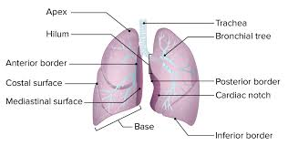

Slide 37
Pleura of the Lungs
Each lung enclosed by double-layered pleural membrane
Parietal pleura – lines wall of thoracic cavity
Visceral pleura – covers lungs themselves
Pleural cavity is space between layers
Pleural fluid reduces friction, produces surface tension (stick together)

Slide 38
Lungs
There are two lungs separated from each other by the heart and other structures in the mediastinum
The left lung has an impression/cavity called Cardiac notch that accommodates the heart

Slide 39
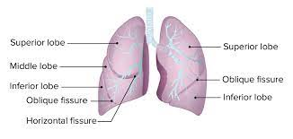
Lungs
Left lung – separated into upper and lower lobes by the oblique fissure
Right lung – separated into three lobes by the oblique and horizontal fissures

Slide 40
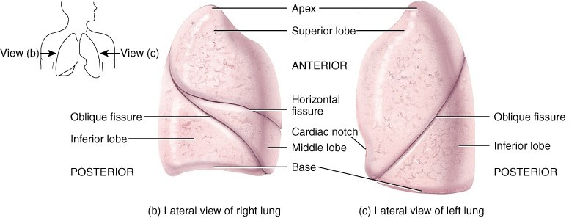
Gross Anatomy of Lungs
Oblique & horizontal fissure in right lung results in 3 lobes Oblique fissure only in left lung produces 2 lobes

Slide 41
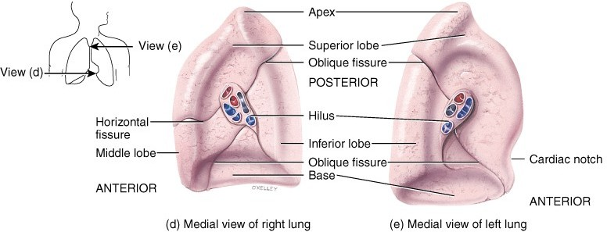
Mediastinal Surface of Lungs
Blood vessels & airways enter lungs at hilum
Forms root of lungs
Covered with pleura (parietal becomes visceral)

Slide 42
Alveoli
The respiratory tree broncioles terminate in cup shaped sacs called alveoli
They are the sites for gaseous exchange in the lungs

Slide 43
Types of Alveolar cells
2 types of alveolar cells
Type I pneumocyte (composed of simple squamous epithelium
-Allow for gas exchange
Type II pneumocyte - secrete pulmonary surfactant
-Surfactant prevents alveoli from collapsing
67

Slide 44
Blood Supply to Lungs
Lungs are perfused by two circulations: pulmonary and bronchial circulations
Pulmonary circulation composed of pulmonary arteries and pulmonary veins.
a. Pulmonary Circulation
Pulmonary arteries – bring systemic venous blood from the heart to be oxygenated
Pulmonary veins – carry oxygenated blood from respiratory zones to the heart

Slide 45
Blood Supply to Lungs ctd...
b. Bronchial Circulation
Bronchial arteries – provide systemic blood to the lung tissue
Arise from aorta and enter the lungs at the hilus
Supply all lung tissue except the alveoli
Bronchial veins anastomose with pulmonary veins
Pulmonary veins carry most venous blood back to the heart

Slide 46
THE END

