Slide 1
Anatomical areas of upper limb
Axilla region
The axilla is the name given to an area that lies underneath the glenohumeral joint, at the junction of the upper limb and the thorax.
It is a passageway by which neurovascular and muscular structures can enter and leave the upper limb.

Slide 3
Borders
The overall 3D shape of the axilla looks slightly like a pyramid. It consists of four sides, an open apex and base:
Apex – also known as the axillary inlet, it is formed by lateral border of the first rib, superior border of scapula, and the posterior border of the clavicle.
Lateral wall – formed by intertubercular groove of the humerus.
Medial wall – consists of the serratus anterior and the thoracic wall (ribs and intercostal muscles).
Anterior wall – contains the pectoralis major and the underlying pectoralis minor and the subclavius muscles.
Posterior wall – formed by the subscapularis, teres major and latissimus dorsi.

Slide 4
The size and shape of the axilla region varies with arm abduction. The apex decreases in size most markedly when the arm is fully abducted – leaving the contents of the axilla at risk of compression.

Slide 6
contents
The contents of the axilla region include muscles, nerves, vessels, and lymphatics:
Axillary artery (and branches) – the main artery supplying the upper limb. It is commonly referred as having three parts; one medial to the pectoralis minor, one posterior to pectoralis minor, and one lateral to pectoralis minor. The medial and posterior parts travel in the axilla.
Axillary vein (and tributaries) – the main vein draining the upper limb, its two largest tributaries are the cephalic and basilic veins.

Slide 7
Brachial plexus (and branches) – a collection of spinal nerves that form the peripheral nerves of the upper limb.
Axillary lymph nodes – they filter lymphatic fluid that has drained from the upper limb and pectoral region. Axillary lymph node enlargement is a non-specific indicator of breast cancer.
Biceps brachii (short head) and coracobrachialis – these muscle tendons move through the axilla, where they attach to the coracoid process of the scapula.

Slide 9
Passageways Exiting the Axilla
There are three main routes by which structures leave the axilla.
The main route of exit is immediately inferiorly and laterally, into the upper limb. The majority of contents of the axilla region leave by this method.
Another pathway is via the quadrangular space. This is a gap in the posterior wall of the axilla, allowing access to the posterior arm and shoulder area. Structures passing through include the axillary nerve and posterior circumflex humeral artery (a branch of the axillary artery.

Slide 10
The last passageway is the clavipectoral triangle, which is an opening in the anterior wall of the axilla. It is bounded by the pectoralis major, deltoid, and clavicle. The cephalic vein enters the axilla via this triangle, while the medial and lateral pectoral nerves leave.

Slide 11
Boundaries and contents of clavipectoral triangle

Slide 13
Cubital fossa
The cubital (anticubital) fossa is a triangular-shaped depression over the anterior aspect of the elbow joint.
It represents an area of transition between the anatomical arm and the forearm, and conveys several important structures between these two areas.

Slide 14
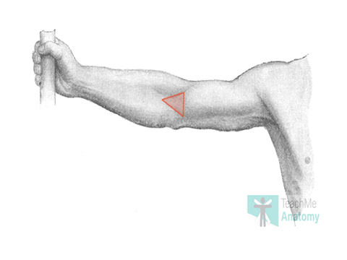

Slide 15
Borders
The cubital fossa is triangular in shape and consists of three borders, a roof, and a floor:
Lateral border – medial border of the brachioradialis muscle.
Medial border – lateral border of the pronator teres muscle.
Superior border – horizontal line drawn between the epicondyles of the humerus.
Roof – bicipital aponeurosis, fascia, subcutaneous fat and skin.

Slide 16
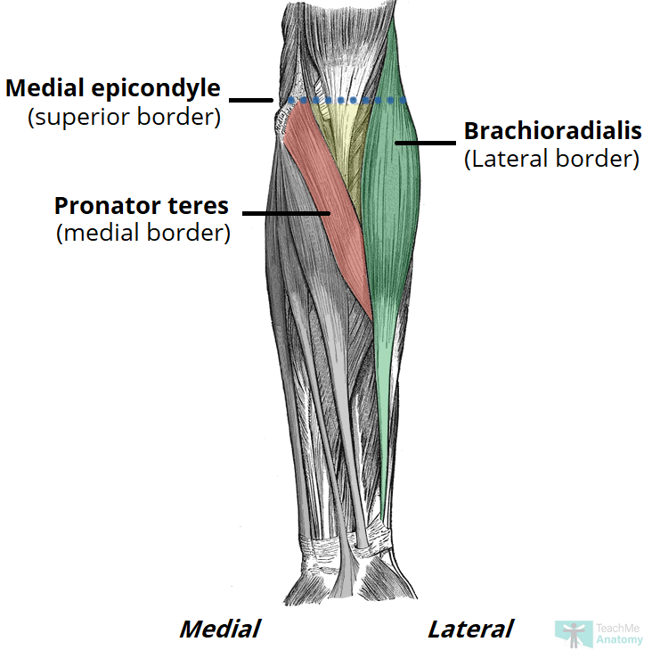

Slide 17
Contents
The cubital fossa is a passageway for structures to pass between the upper arm and forearm.
Its contents are (lateral to medial):
Radial nerve – travels along the lateral border of the cubital fossa and divides into superficial and deep branches.
It has a motor and sensory function in the posterior forearm and hand.
Biceps tendon – passes centrally through the cubital fossa and attaches the radial tuberosity (immediately distal to the radial neck).
It gives rise to the bicipital aponeurosis which contributes to the roof of the cubital fossa.
Brachial artery – bifurcates into the radial and ulnar arteries at the apex of the cubital fossa.
The brachial pulse can be felt in the cubital fossa by palpating medial to the biceps tendon

Slide 18
Median nerve-travels medially through the cubital fossa, exiting by passing between the two heads of the pronator teres.
It has a motor and sensory function in the anterior forearm and hand.
The roof of the cubital fossa also contains several superficial veins. Notably, the median cubital vein, which connects the basilic and cephalic veins and can be accessed easily – a common site for venepuncture.

Slide 19
Contents of cubital fossa

Slide 20
Ulnar tunnel
The ulnar (cubital) tunnel is a fibro-osseous space located on the posteromedial aspect of the elbow.
It transmits the ulnar nerve from the arm into the forearm.

Slide 22
Borders
The ulnar tunnel is oval shaped with medial and lateral walls, a floor, and a roof:
Medial wall – medial epicondyle of the humerus.
Lateral wall – olecranon of the ulna.
Floor – elbow joint capsule and medial collateral ligament of the elbow.
Roof – ligament spanning between the medial epicondyle and olecranon
The ligament forming the roof of the cubital tunnel is also known as the cubital tunnel retinaculum or the arcuate ligament of Osbourne. It is a band of fascia which runs between the ulnar and humeral heads of the flexor carpi ulnaris.

Slide 23
Contents
The ulnar tunnel transmits the ulnar nerve – a major peripheral nerve of the upper limb. After passing through this space, the ulnar nerve travels between the two heads of the flexor carpi ulnaris and continues into the forearm and hand.

Slide 24
Carpal tunnel
The carpal tunnel is a narrow passageway found on the anterior portion of the wrist.
It serves as the entrance to the palm for several tendons and the median nerve.
Borders
The carpal tunnel is formed by two layers: a deep carpal arch and a superficial flexor retinaculum. The deep carpal arch forms a concave surface, which is converted into a tunnel by the overlying flexor retinaculum (transverse carpal ligament).

Slide 25
Carpal Arch
Concave on the palmar side, forming the base and sides of the carpal tunnel.
Formed laterally by the scaphoid and trapezium tubercles
Formed medially by the hook of the hamate and the pisiform
Flexor Retinaculum
Thick connective tissue which forms the roof of the carpal tunnel.
Turns the carpal arch into the carpal tunnel by bridging the space between the medial and lateral parts of the arch.

Slide 26
Spans between the hook of hamate and pisiform (medially) to the scaphoid and trapezium (laterally).
To find where the carpal tunnel begins on yourself, locate your distal wrist crease, which aligns with the entrance of the carpal tunnel.

Slide 27
Transverse section of carpal tunnel

Slide 28
Contents
The carpal tunnel contains a total of 9 tendons, surrounded by synovial sheaths, and the median nerve. The palmar cutaneous branch of the median nerve is given off prior to the carpal tunnel, travelling superficially to the flexor retinaculum.
Tendons
The tendon of flexor pollicis longus
Four tendons of flexor digitorum profundus
Four tendons of flexor digitorum superficialis

Slide 29
The 8 tendons of the flexor digitorum profundus and flexor digitorum superficialis are surrounded by a single synovial sheath. The tendon of flexor pollicis longus is surrounded by its own synovial sheath. These sheaths allow free movement of the tendons.
Sometimes you may hear that the carpal tunnel contains another tendon, the flexor carpi radialis tendon, but this is located within the flexor retinaculum and not within the carpal tunnel itself

Slide 30
Muscular and tendinous components of carpal tunnel

Slide 31
Median Nerve
Once it passes through the carpal tunnel, the median nerve divides into 2 branches: the recurrent branch and palmar digital nerves.
The palmar digital nerves give sensory innervation to the palmar skin and dorsal nail beds of the lateral three and a half digits. They also provide motor innervation to the lateral two lumbricals. The recurrent branch supplies the thenar muscle group.

Slide 32
The Extensor Tendon Compartments of the Wrist
the extensor tendon compartments of the wrist are six tunnels which transmit the long extensor tendons from the forearm into the hand
They are located on the posterior aspect of the wrist. Each tunnel is lined internally by a synovial sheath and separated from one another by fibrous septa

Slide 33
Extensor tendon compartments

Slide 34
Compartment 1
The first extensor compartment is located on the lateral (radial) aspect of the wrist. It transmits two tendons:
Extensor pollicis brevis
Abductor pollicis longus
These tendons form the lateral border of the anatomical snuffbox.

Slide 35
Compartment 2
The second extensor compartment contains the tendons of the extensor carpi radialis longus and extensor carpi radialis brevis.
This compartment is separated from compartment 3 by Lister’s tubercle – a bony prominence of the distal aspect of the radius.
Compartment 3
Compartment three conducts the extensor pollicis longus tendon – this forms the medial border of the anatomical snuffbox.

Slide 36
Compartment 4
The 4th extensor compartment of the wrist transmits the tendons of the extensor digitorum and extensor indicis.
Compartment 5
Compartment five contains the extensor digiti minimi tendon, which travels into the little finger.
Compartment 6
The sixth compartment is the located on the medial (ulnar) aspect of the wrist. It conducts the tendon of the extensor carpi ulnaris.

Slide 38
Anatomical snuffbox
The anatomical snuffbox (also known as the radial fossa), is a triangular depression found on the lateral aspect of the dorsum of the hand.
It is located at the level of the carpal bones, and best seen when the thumb is extended.
In the past, this depression was used to hold snuff (ground tobacco) before inhaling via the nose – hence it was given the name ‘snuffbox’.

Slide 40
Borders
As the snuffbox is triangularly shaped, it has three borders, a floor, and a roof:
Ulnar (medial) border: Tendon of the extensor pollicis longus.
Radial (lateral) border: Tendons of the extensor pollicis brevis and abductor pollicis longus.
Proximal border: Styloid process of the radius.
Floor: Carpal bones; scaphoid and trapezium.
Roof: Skin.

Slide 41
The tendinous border of anatomical snuff box

Slide 42
Contents
The main contents of the anatomical snuffbox are the radial artery, a branch of the radial nerve, and the cephalic vein:
Radial artery – crosses the floor of the anatomical snuffbox, then turns medially and travels between the heads of the adductor pollicis muscle.
The radial pulse can be palpated in some individuals by placing two fingers on the proximal portion of the anatomical snuffbox.

Slide 43
Superficial branch of the radial nerve – found in the skin and subcutaneous tissue of the anatomical snuffbox. It innervates the dorsal surface of the lateral three and half digits, and the associated area on the back of the hand.
Cephalic vein – arises from the dorsal venous network of the hand and crosses the anatomical snuffbox to travel up the anterolateral aspect of the forearm.

Slide 44
The ulnar (Guyon’s) canal
is a fibro-osseous tunnel located at the level of the palm.
It transmits the ulnar neurovascular bundle from the forearm into the hand
Borders
The ulnar canal is approximately 4cm in length.
It extends from the proximal aspect of the pisiform bone to the origin of the hypothenar muscles at the hook of hamate.

Slide 45
Its borders consist of:
Medial (ulnar) – pisiform, pisohamate ligament and abductor digiti minimi.
Lateral (radial) – hook of hamate.
Roof – palmar carpal ligament.
Floor – flexor retinaculum and hypothenar muscles.

Slide 46
The borders of ulnar canal

Slide 47
Contents
The ulnar canal conveys the ulnar neurovascular bundle into the hand:
Ulnar nerve – bifurcates within the canal into superficial (sensory) and deep (motor) branches.
Ulnar artery – located on the radial aspect of the ulnar nerve. It gives rise to a deep palmar branch and continues laterally across the palm as the superficial palmar arch.
Venae comitantes of ulnar artery (refers to a vein that is usually paired, with both veins lying on the sides of an artery.
Lymphatic vessels

