Slide 1
Anatomy and Physiology of the ear
Dr Sitima Michael
ENT, Head and Neck Surgeon
Nakuru

Slide 2
Major Divisions of the Ear
Peripheral Mechanism
Central Mechanism
Outer Ear | Middle Ear | Inner Ear | VIII Cranial Nerve | Brain

Slide 3
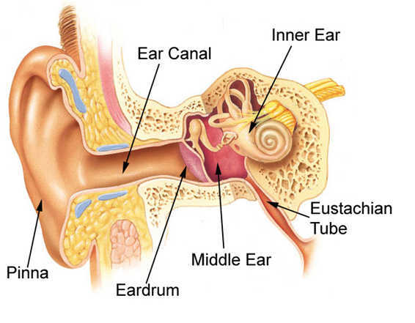

Slide 4
The Outer Ear Consists of:
The Pinna - cartilaginous, highly variable in appearance, some landmarks.
External Auditory Canal (or external auditory meatus) - 2.5 cm tube.

Slide 5
External Auditory Canal
lateral portion-cartilage
medial portion-osseous
lined with epidermal (skin) tissue
hairs in lateral part
cerumen (ear wax) secreted in lateral part.

Slide 6
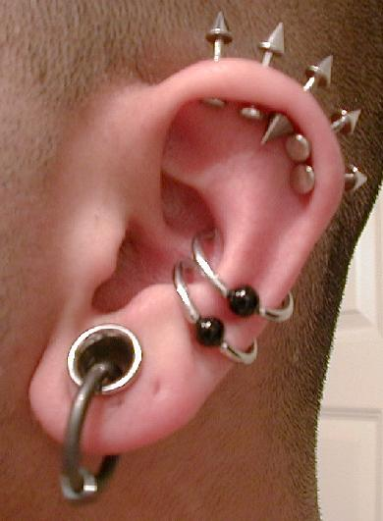
Outer Ear Functions
Amplification - increases sounds between 2000 and 4000 Hz by 10 to 15 dB
-- because of the resonance of
Concha -- 5000 Hz
E.A.Canal -- 2500 Hz
Protection
-- medial displacement of ear drum
-- curvature of canal
-- hairs
-- cerumen
-- skin migration
Localization
-- The ability to identify the location of a sound source
Sensation ?

Slide 7
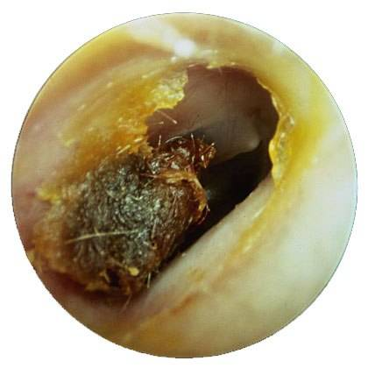
Cerumen
The purpose of wax:
Repel water
Trap dust, sand particles, micro-organisms, and other debris
Moisturize epithelium in ear canal
Odor discourages insects
Antibiotic, antiviral, antifungal properties
Cleanse ear canal

Slide 8
The Middle Ear: A cleft within the temporal bone
Lining is mucous membrane
Tympanic Membrane separates it from EAC
Eustachian tube connects it to nasopharynx
Also Connected to Mastoid Air Cells

Slide 9
1- Malleus
2- Incus
3- Stapes
4- Tympanic Membrane (Eardrum)
5- Round Window
6- Eustachian Tube

Slide 10
Function of Middle Ear
Conduction
Conduct sound from the outer ear to the inner ear
Protection
Creates a barrier that protects the middle and inner areas from foreign objects
Middle ear muscles may provide protection from loud sounds
Transducer
Converts acoustic energy to mechanical energy
Converts mechanical energy to hydraulic energy
Amplifier
Transformer action of the middle ear
only about 1/1000 of the acoustic energy in air would be transmitted to the inner-ear fluids (about 30 dB hearing loss)

Slide 11
Middle Ear Functions
Impedance Matching -- amplification of sounds to overcome difference in impedance between the air of EAC and the fluid of the inner ear.
Filtering -- resonant frequency is approximately 1000 Hz, functions as bandpass filter.
Acoustic Reflex -- Contraction of Stapedius muscle in response to loud sounds
Oval Window Isolation-- Sound striking the tympanic membrane is delivered through the ossicular chain to the oval window

Slide 12
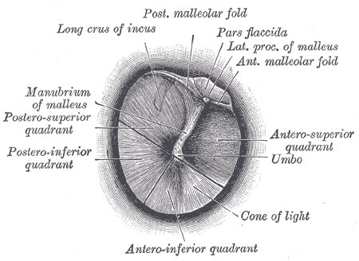
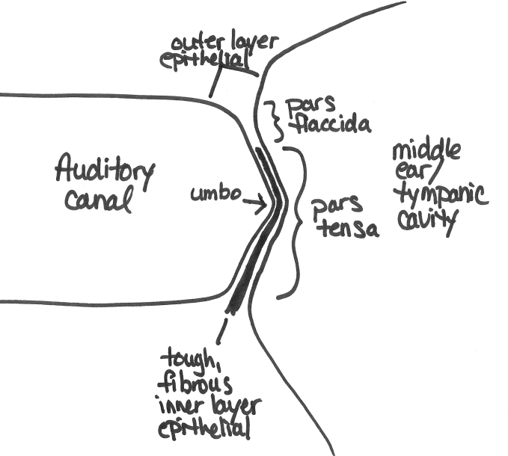
Tympanic Membrane
The eardrum separates the outer ear from the middle ear
Creates a barrier that protects the middle and inner areas from foreign objects
Cone-shaped in appearance
about 17.5 mm in diameter
The eardrum vibrates in response to sound pressure waves.
The membrane movement is incredibly small
as little as one-billionth of a centimeter

Slide 13
Eustachian Tube
The eustachian tube connects the front wall of the middle ear with the nasopharynx
The eustachian tube also operates like a valve, which opens during swallowing and yawning
This equalizes the pressure on either side of the eardrum, which is necessary for optimal hearing.
Without this function, a difference between the static pressure in the middle ear and the outside pressure may develop, causing the eardrum to displace inward or outward
This reduces the efficiency of the middle ear and less acoustic energy will be transmitted to the inner ear.

Slide 14
Transformer/Amplifier
Transform the vibrating motion of the eardrum into motion of the stapes.
The middle ear enhances the transfer of acoustical energy in two ways:
The area of the eardrum is about 17 times larger than the oval window
The effective pressure (force per unit area) is increased by this amount.
The ossicles produce a lever action that further amplifies the pressure
Without the transformer action of middle ear, about 1/1000 of acoustic energy in air transmitted to inner-ear fluids (about 30 dB loss).
Malleus and incus vibrate together, transmitting the sound waves from the eardrum to the footplate of the stapes (this pushes the oval window in and out)(mechanical energy)

Slide 15
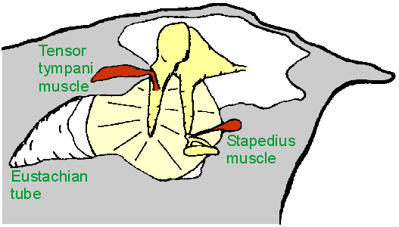
Middle Ear Muscles
Tensor tympani
Attached to malleus
Innervated by V, trigeminal nerve
Stapedius
Attached to stapes
Innervated by VII, facial nerve
Middle Ear Muscle Function:
Help maintain ossicles in proper position
Protect inner ear from excessive sound levels
When ear exposed to sound levels above 70 dB, the muscles contract, decreasing amount of energy transferred to inner ear
This protective reflex termed "acoustic reflex"

Slide 16
INNER EAR
Two Halves:
Vestibular--transduces motion and pull of gravity
Cochlear--transduces sound energy
(Both use Hair Cells)

Slide 17
Subdivision into spaces containing endolymph (blue), and spaces containing perilymph (red)

Slide 18
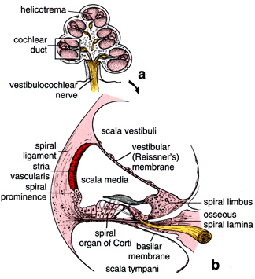
Cochlea
The cochlea resembles a snail shell and spirals for about 2 3/4 turns around a bony column
Within the cochlea are three canals:
Scala Vestibuli
Scala Tympani
Scala Media

Slide 19
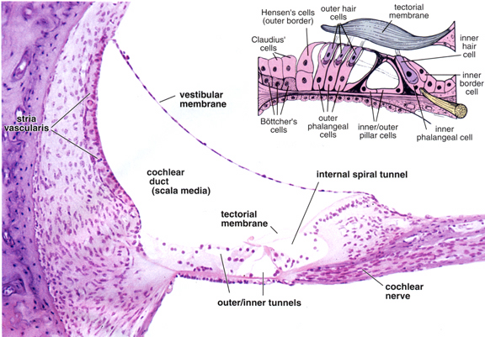
Organ of Corti

Slide 21
Assignments:
Inner vs outer hair cells
Type 1 vs Type 2 hair cells

