Slide 1
HUMAN ANATOMY
INTRODUCTION
HENDRITA MKIMBO

Slide 2
DEFINITION OF TERMS
ANATOMY:
The dissection of the body into parts and giving an accurate description of the parts.
HUMAN ANATOMY:
The study of the structure of the human body and the physical relationships involved between body parts.
2

Slide 3
What prompted the study of human anatomy?
The need to cope with injury, disease and death
The generation of images for aesthetic, magical or religious purposes
A strong element of curiosity about the mysterious nature of human life and its mechanisms.
Introduction to Human Anatomy
3

Slide 4
History
The first recorded school of anatomy was in Alexandria.
The most influential anatomist in the ancient world was Galen who studied anatomy in Alexandria.
Introduction to Human Anatomy
4

Slide 5
Types / divisions of anatomy
Gross Anatomy
Microscopic Anatomy
Developmental Anatomy
Comparative Anatomy
Introduction to Human Anatomy
5

Slide 6
Divisions of Anatomy
Gross Anatomy
Structures that can be seen with the eye
Muscles, bones, various organs
Can be regional or systemic
Microscopic Anatomy
Structures that cannot be seen with the eye
Need to use a microscope (light or electron)
Cytology = study of cells
Histology = study of tissues
Introduction to Human Anatomy
6
Notes:
6

Slide 7
Developmental Anatomy
The study of anatomical changes in a life cycle (infancy to adulthood.)
TYPES OF DEVELOPMENTAL ANATOMY
Embryology:
The study of prenatal development (before birth)
Postnatal development:
The study of structures after birth
Ontogeny:
Total development of an individual
Introduction to Human Anatomy
7

Slide 8
Comparative Anatomy
1.It is the comparison of structures between organisms (similarities and differences)
2. Study of the similarities and differences in the structures of different species
e.g similar bone structures in forelimbs of cats, whales, bats, and humans.
Introduction to Human Anatomy
8

Slide 9
Ways to Study Anatomy
Regional Anatomy – study one region of the body at a time
Systemic Anatomy – study one body system at a time. i.e digestive system.
Introduction to Human Anatomy
9
Notes:
9

Slide 10
Anatomical Organization
Cells-smallest independent unit of life.
Tissues-a group of cells that perform a similar function
Organs-a group of two or more tissues that work together to perform a specific function
Organ Systems-combination of organs that work together to perform a similar function.
Organism-various organs form the entire organisim.
Introduction to Human Anatomy
10
Notes:
10

Slide 11
Organ Systems
Integument
Skeletal
Muscular
Nervous
Endocrine
Cardiovascular
Lymphatic
Respiratory
Digestive
Urinary
Reproductive
Introduction to Human Anatomy
11
Notes:
11

Slide 12
Integumentary System
Components
Skin
Hair, nails
Function
External covering
Protection
Synthesis of Vitamin D
Location of Sense receptors
Introduction to Human Anatomy
12

Slide 13
Skeletal System
Components
Bones
Joints and adjacent cartilages
Function
Support
Protection
Movement
Blood cell production (red bone marrow)
Mineral storage (calcium and phosphorus)
Introduction to Human Anatomy
13

Slide 14
Muscular System
Components
Skeletal Muscles
Associated Connective Tissues (tendons)
Function
Locomotion
Manipulation of the environment
Facial expression (communication)
Maintain posture
Produce heat
Introduction to Human Anatomy
14

Slide 15
Circulatory System
Components
Cardiovascular System
Lymphatic System
Function
Transportation of materials
Within the body
To and from internal and external environments
Introduction to Human Anatomy
15

Slide 16
Cardiovascular System
Components
Heart
Vessels
Function
Transportation of blood
Blood contains O₂ and CO_{2,} nutrients, wastes, etc.
Blood composed of plasma and cells
Introduction to Human Anatomy
16

Slide 17
Lymphatic System
Components
Lymphatic Organs (spleen, lymph nodes, thymus, etc.)
Lymphatic Vessels
Function
Transportation of lymph
Lymph is derived from tissue fluid
Introduction to Human Anatomy
17

Slide 18
Immune System
Components
Immune Organs (red bone marrow, thymus, etc.)
White blood cells (lymphocytes, macrophages, etc.)
Function
Defense (Immune response)
Introduction to Human Anatomy
18

Slide 19
Nervous System
Components
Brain, Spinal cord (CNS)
Nerves (PNS), sense receptors
Function
Control system (fast, “hard wired”)
Response to external and internal environments
Introduction to Human Anatomy
19

Slide 20
Endocrine System
Components
Glands that secrete hormones
E.g. pituitary, pancreas, thyroid
Function
Control system (slow, “chemical”)
Regulates processes such as growth, reproduction and nutrient use
Introduction to Human Anatomy
20

Slide 21
Respiratory System
Components
Lungs
Tubing ( trachea, bronchus, etc.)
Larynx (vocal cords)
Function
Exchange of respiratory gases (O₂ and CO₂)
Between blood and atmosphere
Voice production
Introduction to Human Anatomy
21

Slide 22
Digestive System
Components
Alimentary canal (mouth, pharynx, esophagus, stomach, small intestine, large intestine)
Accessory structures(liver, salivary glands, etc.)
Function
Break down food into small, absorbable pieces
Absorption of nutrients between blood and lumen
Eliminate waste
Introduction to Human Anatomy
22

Slide 23
Urinary System
Components
Kidneys, Ureters, Urinary bladder, Urethra
Function
Eliminate waste (nitrogen) from blood
Between blood and external environment
Regulates water, electrolytes, acid/base
Introduction to Human Anatomy
23

Slide 24
Reproductive System
Components
Male Reproductive System
Female Reproductive System
Function
Perpetuation of the species
Hormones influence structure and function
Introduction to Human Anatomy
24

Slide 25
ANATOMICAL TERMINOLOGY
Definitions
Introduction to Human Anatomy
25

Slide 26
Anatomical position
All anatomical descriptions are expressed in relation to the anatomical position.
The anatomical position refers to a person as if he were standing erect, with:
Head, eyes, and toes directed anteriorly (forward)
Upper limbs by the sides with the palms facing anteriorly
Lower limbs together with the feet directed anteriorly
* the body is upright, facing forwards (anteriorly), with the palms also anterior.
Introduction to Human Anatomy
26

Slide 27
Anatomical Planes
A plane is an imaginary surface that slices the body into specific sections.
Anatomical descriptions are based on four anatomical planes that pass through the body in the anatomical position.
There are many sagittal, frontal, and transverse planes but there is only one median plane.
The main use of anatomical planes is to describe sections and images of the body.
Introduction to Human Anatomy
27

Slide 28
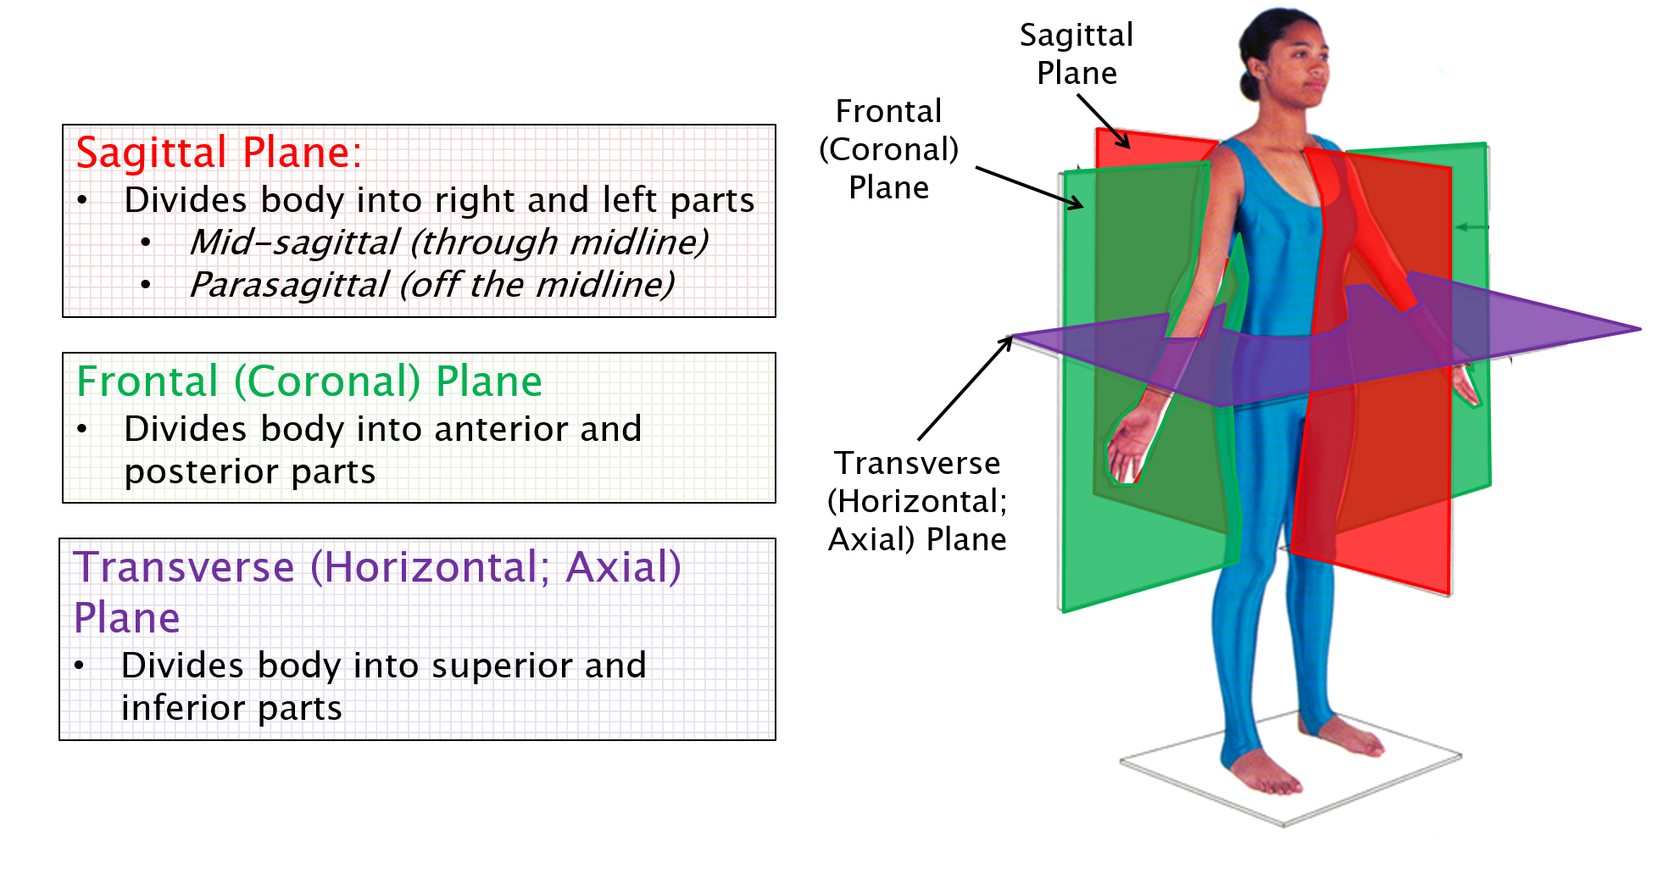
Introduction to Human Anatomy
28

Slide 29
Median plane
Also called median sagittal plane
It is the vertical plane passing longitudinally through the center of the body – dividing it into right and left halves.
Introduction to Human Anatomy
29

Slide 30
Sagittal planes
Are vertical planes passing through the body parallel to the median plane.
A point of reference indicating its position is usually indicated e.g. sagittal plane through the midpoint of the clavicle.
Introduction to Human Anatomy
30

Slide 31
Frontal planes (Coronal planes)
Are vertical planes passing through the body at right angles to the median plane, dividing it into anterior (front) and posterior (back) portions.
Introduction to Human Anatomy
31

Slide 32
Horizontal planes (transverse planes)
Are planes passing through the body at right angles to the median and frontal planes.
A horizontal plane divides the body into upper and lower parts.
A reference point indicating its level, e.g. a horizontal plane through the umbilicus, is usually given.
Also referred to as transaxial planes or simply axial planes by radiologists.
Introduction to Human Anatomy
32

Slide 33
Terms of relationship and comparison
Superior (cranial) – Nearer to head
Inferior (caudal) – Nearer to feet
Anterior (ventral) – Nearer to front
Posterior (dorsal) – nearer to back
Medial – Nearer to median plane
Lateral – Farther from median plane
Proximal – Nearer to trunk or point of origin (e.g. of a limb)
Distal – farther from trunk or point of origin (e.g. of a limb)
Introduction to Human Anatomy
33

Slide 34
Terms of relationship and comparison
Superficial – nearer to or on surface
Deep – farther from surface
Dorsum – the superior or dorsal surface of hand or foot
Palm – the flat of the hand exclusive of the thumb and fingers
Sole – the inferior aspect or bottom of the foot
Introduction to Human Anatomy
34

Slide 35
Terms of relationship and comparison…
Combined terms
Describe intermediate positional arrangements. E.g.
Inferomedial – nearer to the feet and closer to the median plane
Superolateral – nearer to the head and farther from the median plane
Posterolateral
Anterosuperior , etc.
Introduction to Human Anatomy
35

Slide 36
Terms of laterality
Paired structures having right and left members such as the kidneys are bilateral
Those occurring on one side only are unilateral.
Ipsilateral means occurring on the same side of the body. E.g. the right thumb and right great toe are ipsilateral.
Contralateral - occurring on the opposite side of the body.
Introduction to Human Anatomy
36

Slide 37
Terms of movement
These describe movements of the limbs and other parts of the body.
Movements take place at joints. The movements are described as pairs of opposites.
Flexion – bending of a part or decreasing the angle between body parts
Extension – straightening a part or increasing the angle between body parts.
Abduction – moving away from the median plane of the body in the frontal plane.
Adduction – moving toward the median plane of the body in the coronal plane.
Introduction to Human Anatomy
37

Slide 38
Terms of movement
Rotation – moving a part of the body around its long axis
Medial rotation turns the anterior surface medially
Lateral rotation turns the anterior surface laterally
Circumduction – the circular movement of the limbs, or parts of them, combining in sequence the movements of flexion, extension, abduction, and adduction.
Introduction to Human Anatomy
38

Slide 39
Terms of movement
Pronation – a medial rotation of the forearm and hand so that the palm faces posteriorly.
Supination – a lateral rotation of the forearm and hand so that the palm faces anteriorly, as in the anatomical position.
Eversion – turning sole of foot outward
Inversion – turning sole of foot inward
Introduction to Human Anatomy
39

Slide 40
Terms of movement
Protrusion (protraction) – to move anteriorly e.g. of jaw.
Retrusion (retraction) – to move [the jaw] posteriorly.
Elevation raises or moves a part superiorly
Depression lowers or moves a part inferiorly.
Introduction to Human Anatomy
40

Slide 41
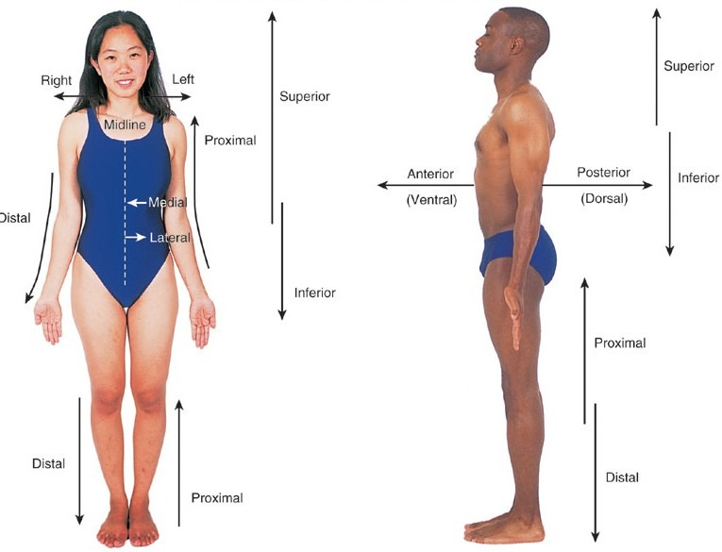
Introduction to Human Anatomy
41

Slide 42
Thank you

