Slide 1
HUMAN ANATOMY
Introduction
By P.J. Okoth

Slide 2
INTRODUCTION
The human body is a complex and intricate piece of engineering in which every structure plays a precise role.
There are approximately 200 bones, 650 muscles, 79 organs, and enough blood vessels to circle the Earth twice!
First, what is anatomy and where did it all begin?

Slide 3
Introduction
The term 'anatomy' derives from ancient Greek meaning ‘dissection’ or 'to dissect’ and involves the study of the structure of the human body.

Slide 4
Definition
Anatomy is the dissection or the separation of the body into its parts, and giving an accurate description of the parts.
It is the study of the structure of the human body and the physical relationships involved between body parts.

Slide 5
Historical background
This 2000 year old scientific discipline sprung to life in Ancient Egypt and was increasingly developed across the ages by anatomy heavyweights like Galen, Leonardo da Vinci, Vesalius, and many others.
Most terms of anatomy are of Greek or Latin derivation.

Slide 6
History
What prompted the study of human anatomy?
The need to cope with injury, disease and death
The generation of images for aesthetic, magical or religious purposes
A strong element of curiosity about the mysterious nature of human life and its mechanisms.

Slide 7
History
The first recorded school of anatomy was in Alexandria (from about 300BC to the 2nd century AD) where the renowned anatomical teachers Herophilus and Erasistratus dissected the human body and described many of its structures.

Slide 8
History…
The most influential anatomist in the ancient world was Galen (approx. 130-200AD), a physician and prolific writer who studied anatomy in Alexandria.
Many terms used in anatomy have roots in Galen’s work.
The foundation stone of modern anatomy is the work of Andreas Vasalius: De Fabrica Corporis Humani, published in 1543.
Prolific = producing many works

Slide 9
History …
Vesalius was born in Brussels into a family of physicians.
He received his early medical training at the University of Paris and completed his studies at the University of Padua in Italy, where he began teaching surgery and anatomy immediately after graduation.
At Padua, Vesalius participated in human dissections and initiated the use of live models to determine surface landmarks for internal structures.
By the time he was 28 years old, he had already completed the masterpiece of his life, De Fabrica Corporis Humani, in which the various body systems and individual organs are beautifully illustrated and described.

Slide 10
Types / divisions of anatomy
Gross Anatomy
Microscopic Anatomy
Developmental Anatomy
Comparative Anatomy

Slide 11
Divisions of Anatomy
Gross Anatomy
Structures that can be seen with the eye
Muscles, bones, various organs
Can be regional or systemic
Microscopic Anatomy
Structures that cannot be seen with the eye
Need to use a microscope
Cytology = study of cells
Histology = study of tissues

Slide 12
Developmental Anatomy
Definition:
The study of anatomical changes in a life cycle
Kinds:
Embryology:
The study of prenatal development
Postnatal development:
The study of structures after birth
Ontogeny:
Total development of an individual

Slide 13
Comparative Anatomy
Definition:
Comparison of structures between organisms
Kinds:
Vertebrate:
Comparison of structures among the vertebrate classes
Phylogeny:
The study of phyla, and their relationships

Slide 14
Ways to Study Anatomy
Regional Anatomy – study one region of the body at a time and learn everything about the region
Systemic Anatomy – study one body system at a time. This is the approach we will use in this course

Slide 15
Anatomical Terminology
Definitions

Slide 16
Anatomical position
All anatomical descriptions are expressed in relation to the anatomical position.
The anatomical position refers to a person as if he were standing erect, with:
Head, eyes, and toes directed anteriorly (forward)
Upper limbs by the sides with the palms facing anteriorly
Lower limbs together with the feet directed anteriorly
* the body is upright, facing forwards (anteriorly), with the palms also anterior.

Slide 17
Anatomical Planes
A plane is an imaginary surface that slices the body into specific sections.
Anatomical descriptions are based on four anatomical planes that pass through the body in the anatomical position.
There are many sagittal, frontal, and transverse planes but there is only one median plane.
The main use of anatomical planes is to describe sections and images of the body.

Slide 18
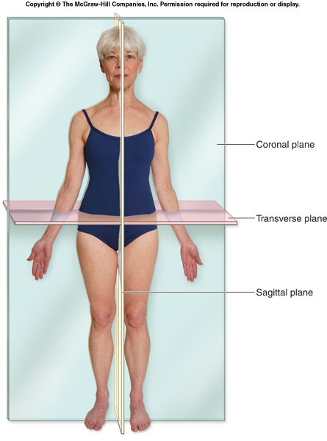

Slide 19
Median plane
Also called median sagittal plane
It is the vertical plane passing longitudinally through the center of the body – dividing it into right and left halves.
It is the sagittal plane through the midline of the body.

Slide 20
Sagittal planes
Are vertical planes running from front to back, dividing the body or any of its parts into right and left sides.
They are vertical planes passing through the body parallel to the median plane.
A point of reference indicating its position is usually indicated e.g. sagittal plane through the midpoint of the clavicle.

Slide 21
Frontal planes (Coronal planes)
Are vertical planes passing through the body at right angles to the median plane, dividing it into anterior (front) and posterior (back) portions.
A coronal or frontal plane is a vertical plane running from side to side; dividing the body or any of its parts into anterior and posterior portions.

Slide 22
Horizontal planes (transverse planes)
Are planes passing through the body at right angles to the median and frontal planes.
A horizontal plane divides the body into upper and lower parts.
A reference point indicating its level, e.g. a horizontal plane through the umbilicus, is usually given.
Also referred to as transaxial planes or simply axial planes by radiologists.

Slide 23
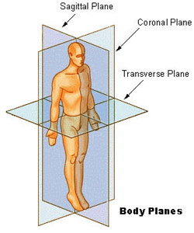

Slide 24
Thank you
The end!

