Slide 1
Anorectal Abscess
An anorectal abscess is caused by obstruction of an anal gland, resulting in retrograde infection.
Many of these abscesses result in fistulas

Slide 2
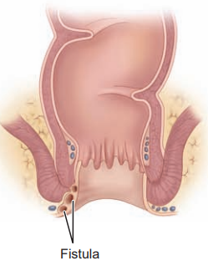

Slide 3
Causes
Sexually transmitted infections
Blocked anal glands
immunosuppressive conditions-- AIDS
Fistula Anal fissure (ulcer)
Internal hemorrhoid or External hemorrhoid. are particularly susceptible to these infections.
Colitis
Inflammatory bowel disease such as Crohn's disease or ulcerative colitis
Diabetes
Diverticulitis
Pelvic inflammatory disease
anal sex
Use of medications such as prednisone

Slide 4
Symptoms
foul smelling pus at rectum
pain
swelling,
redness
and tenderness
severe lower abdominal pain
fever.

Slide 5
Management
sitz baths
analgesics.
Surgery--- treatment to incision and drainage the abscess is the treatment of choice.
When a deeper infection exists with the possibility of a fistula, the fistulous tract must be excised.
The wound may be packed with an absorptive dressing (eg, calcium alginate or hydrofiber) and allowed to heal by granulation.

