Slide 1
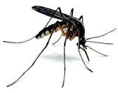
Anti-malarial drugs
Prof. Anuradha Nischal

Slide 2
Drugs used for
prophylaxis
treatment
and
prevention of relapse of malaria

Slide 3
Malaria
Most important parasitic disease of humans, causing hundreds of millions of illnesses and probably over a million deaths each year.

Slide 4
Causative agent
Plasmodium
4 species
P. vivax (tertian)
P. falciparum (tertian)
P. ovale (tertian)
P. malariae(quartian)

Slide 5
Life-cycle of Plasmodium

Slide 6
Malaria is transmitted by the bite of infected female anopheles mosquitoes.
During feeding, mosquitoes inject sporozoites, which circulate to the liver, and rapidly infect hepatocytes, causing asymptomatic liver infection (hepatic phase)(absent in falciparum; malariae)
Merozoites released from the liver, rapidly infect erythrocytes to begin the asexual erythrocytic stage of infection that is responsible for human disease
Multiple rounds of erythrocytic development, with production of merozoites that invade additional erythrocytes, lead to large numbers of circulating parasites and clinical illness

Slide 7
Release of merozoites subsequent to rupture of erythrocytes causes the clinical attack of malaria.
Some erythrocytic parasites also develop into sexual gametocytes, which are infectious to mosquitoes, allowing completion of the life cycle and infection of others
In P vivax and P ovale parasites also form dormant liver hypnozoites, which are not killed by most drugs, allowing subsequent relapses of illness after initial elimination of erythrocytic infections

Slide 8
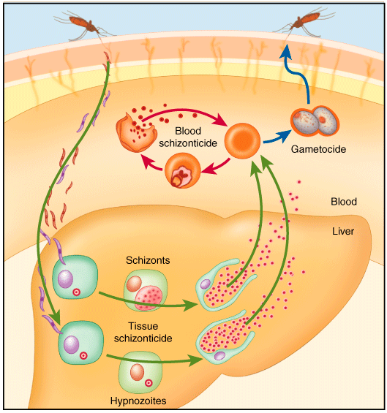

Slide 9
Malaria Transmission Cycle
Exo-erythrocytic (hepatic) Cycle: Sporozoites infect liver cells and develop into schizonts, which release merozoites into the blood
Sporozoires injected into human host during blood meal
Parasites mature in mosquito midgut and migrate to salivary glands
MOSQUITO
HUMAN
Dormant liver stages (hypnozoites) of P. vivax and P. ovale
Erythrocytic Cycle: Merozoites infect red blood cells to form schizonts
Parasite undergoes sexual reproduction in the mosquito
Some merozoites differentiate into male or female gametocyctes

Slide 10
Signs and symptoms
Initial manifestation of malaria are non-specific and resembles to flu like symptoms.
The presentation includes headache, fever, shivering, arthralgia, myalgia.
The paroxysm which includes fever spikes, chills and rigors are classical for malaria

Slide 11
The typical paroxysmal attack comprises of three distinct stages:
a) Cold stage- The onset is with lassitude, headache, nausea and chilly sensation followed by rigors. The stage lasts for ¼ - 1 hour
b) Hot stage- The patient feels burning hot, the skin is hot and dry to touch. Headache is intense. Pulse rate is high. The stage lasts for 2-6 hours
c) Sweating stage- Fever comes down with profuse sweating. The pulse rate gets slower, patient feels relieved. The stage lasts 2-4 hours

Slide 12
These paroxysms have different frequencies in different species of malarial parasites
In P. vivax and P. ovale after every 2 days- Tertian fever
In P. malariae after every 3 days- Quartan fever
While in P. falciparum it recurs in every 36-48 hours
These paroxysmal attacks coincide with the release of successive broods of merozites into the blood stream.

Slide 13
Relapse Vs Recrudesence
Depending upon the cause , recurrence can be classified either as recrudescence or relapse
Recrudescence is when symptoms return after a symptoms free period. It is due to parasites surviving in the blood as a result of inadequate or ineffective treatment.
Relapse is when symptoms reappear after the parasites have been eliminated from blood but persist as dormant hypnozites in liver cells.
Relapse is common in P.ovale and P.vivax infection
Recrudescence is commonly seen in P.falciparum

Slide 14
Classification
4-Aminoquinolines Chloroquine Amodiaquine
2) Quinoline methanol Mefloquine
3) Cinchona alkaloid Quinine
Quinidine
4) Biguanides Proguanil (Chloroguanide)

Slide 15
Diaminopyrimidines Pyrimethamine
8-Aminoquinoline Primaquine
Tafenoquine
Sulfonamides & sulfone Sulfadoxine Sulfamethopyrazine Dapsone
Antibiotics Tetracyclins
Doxycycline

Slide 16
Sesquiterpine lactones Artesunate Artemether Arteether
Amino alcohols Halofantrine Lumefantrine
Naphthyridine Pyronaridine
Naphthoquinone Atovaquone

Slide 17
Tissue schizonticides
That eliminate pre erythrocytic/exo-erythrocytic stages in liver
Erythrocytic schizonticides
act on erythrocytic parasites
Gametocides
kill gametocytes in blood and prevent transmission to mosquitoes

Slide 18
Tissue schizonticides
Primaquine: 15 mg/kg/day X 2 weeks(hypno)
Proguanil
Doxycycline
Gametocides
Primaquine
gametocidal for all species.
45 mg single dose
Immediately after clinical cure
Cuts down transmission to mosquito

Slide 19
Clinical cure
Terminate the episode of malarial fever
Radical cure
eliminate both hepatic and erythrocytic stages
Causal prophylaxis
Suppressive propylaxis

Slide 20
Clinical Cure
Erythrocytic schizonticide is used to terminate the episode of malarial fever
High efficacy
Low efficacy

Slide 21
Low efficacy
High efficacy
Artemesinin
Chloroquine
Amodiaquine
Quinine
Mefloquine
Halofantrine
Lumifantrine
Atovaquone
Proguanil
Pyrimethamine
Sulfonamides
Tetracyclins
Clindamycin

Slide 22
Radical cure
Eliminates both hepatic and erythrocytic stages
Vivax & ovale
Erythrocytic schizonticide + Tissue schizonticide
CQ + primaquine

Slide 23
Chloroquine resistance
Quinine + Doxycycline/clindamycin
+ Primaquine
Artemesinin based combination therapy
+ Primaquine

Slide 24
Causal prophylaxis
Pre-erythrocytic phase which is the cause of malarial infection and clinical attacks is the target for this purpose
Primaquine is the causal prophylactic for all species of malaria

Slide 25
Supressive prophylaxis
Schizonticides which suppress the erythrocytic phase and thus attacks of malarial fever can be used as prophylactics
Clinical disease does not appear

Slide 26
Supressive prophylaxis
CQ: NOT used in INDIA
Mefloquine
Doxycycline

Slide 27
Supressive prophylaxis
Mefloquine
250 mg weekly
Starting week before travel & taken till 4 weeks after return from endemic area for CQ resistant P. falciparum

Slide 28
Supressive prophylaxis
Doxycycline
100 mg daily
Starting day before travel & taken till 4 weeks after return from endemic area for CQ resistant P. falciparum
CI in pregnant women & children <8years of age

Slide 29
Supressive prophylaxis
Pregnancy
One dose each in second & third trimester
1 month gap
Pyrimethamine(75 mg)+ sulphadoxine(1500mg)
In areas with high P.f endemicity

Slide 30
Goal
To prevent and treat clinical attack of malaria.
To completely eradicate the parasite from the patient's body.
To reduce the human reservoir of infection - cut down transmission to mosquito.

Slide 31
CHLOROQUINE
Rapidly acting erythrocytic schizontocide against all species of plasmodia including the senstive strains of P. falciparum
Controls most clinical attacks in 1-2 days with disappearance of parasites from peripheral blood in 1-3 days.
No effect on Pre-erythrocytic and exo-erythrocytic phases of the parasite does not prevent relapses in vivax and ovale malaria. Only for clinical cure.

Slide 32
Mechanism of action:
It is actively concentrated by sensitive intra-erythrocytic plasmodia by accumulating in the acidic vesicles of the parasite and weakly basic nature it raises the vesicular pH and thereby interferes with degradation of haemoglobin by parasitic lysosomes
Polymerization of toxic haeme to nontoxic parasite pigment hemozoin is inhibited by formation of chloroquine-heme complex

Slide 33
Haeme itself or its complex with chloroquine then damages the plasmodial membranes. Clumping of pigment and changes in parasite membranes follow: death
Other related anti-malarials like amodiaquine quinine, mefloquine, lumefantrine act in an analogous manner

Slide 34
Resistance
Reduced uptake and transport of chloroquine to food vacuole of plasmodium.

Slide 35
Pharmacokinetics
Oral
Widely distributed & concentrated in tissues
like liver, spleen, kidney, lungs (several hundred-fold), skin, leucocytes and some other tissues
Its selective accumulation in retina is responsible for the ocular toxicity seen with prolonged use

Slide 36
metabolized by liver
excreted in urine.
The early plasma t1/2 varies from 3-10 days. Because of tight tissue binding, small amounts persist in the body for longer time.

Slide 37
Adverse Effects
GI intolerance
Nausea, vomiting, abdominal pain, headache, anorexia, malaise, and urticaria are common. Dosing after meals may reduce some adverse effects.
The long-term administration of high doses of chloroquine for rheumatologic diseases can result in loss of vision due to retinal damage.
Corneal deposits may occur affect vision: reversible

Slide 38
Contraindications & Cautions
Chloroquine can ppt attacks of seizures, psoriasis
or porphyria
Cautious use
Liver damage
Severe GI, neurological, retinal & haematological
diseases
Safe in pregnancy and for young children

Slide 39
Other actions
E. histolytica & Giardia lambia
Anti-inflammatory
Local irritant
Local anaesthetic (on injection)
Weak smooth muscle relaxant
Anti-histaminic
Anti-arrythmic properties

Slide 40
Therapeutic Uses
Chloroquine is the preferred drug for clinical cure of
Vivax
Ovale
malariae
+ some sensitive falciparum strains
Causes rapid clearance of fever & Parasitaemia

Slide 41
Extraintestinal amoebiasis/Hepatic amoebiasis/Amoebic Liver Abscess
Due to high liver concentrations, it may be used for ameobic abscesses that fail initial therapy with metronidazole.
Rheumatoid arthritis
Other uses:
Discoid lupus erythematosus
Lepra reaction
Photogenic reactions
Infectious mononucleosis

Slide 42
Resistance
Resistance to chloroquine is now very common among strains of P falciparum and uncommon but increasing for P vivax.
ACT
first line for plasmodium falciparum cases countrywide.

Slide 43
Oral
Chloroquine phosphate: (250 mg = 150 mg base)
Vivax & Ovale:
6oo mg base ; followed after 6-8 hrs by 300 mg; then 300mg daily for two days
i.m local tissue toxicity
i.v no indication
Large intramuscular injections or rapid intravenous infusions of chloroquine hydrochloride can result in severe hypotension, arrythmias & seizures. Not recommended.

Slide 44
Amodiaquine
Identical to chloroquine:
mech
resistance
uses & adverse effects
less bitter
faster acting than chloroquine.
Widely used; reduced cost, safety & activity against chloroquine resistant P. falciparum

Slide 45
Reports of toxicities, including agranulocytosis, and hepatotoxicity (on long term administration), have limited the use of the drug for prophylaxis(Long term).
Not seen with short term use (25-35mg/kg over 3 days) for clinical cure.

Slide 46
Can be used for clinical cure of falciparum malaria with or without CQ resistance
X used for prophylaxis
Combined formulation with artesunate has been recently approved for use in uncomplicated falciparum malaria irrespective of CQ resistance status
preferred in african countries

Slide 47
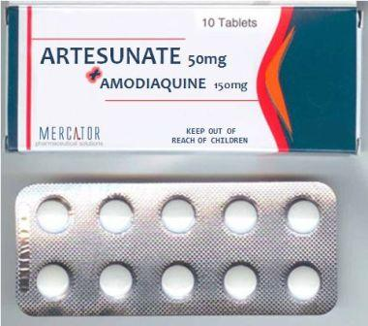

Slide 48
PRIMAQUINE
8-aminoquinoline
Poor erythrocytic schizontocide
not useful for acute attack
Highly active against gametocytes and hypnozoites
Notes:
weak action on P. vivax,
but blood forms of P. falciparum are totally insensitive

Slide 49
Primary indication Radical cure of relapsing (vivax) malaria & ovale
15 mg/kg/day X 2 weeks(hypnozoites)
+
CQ/ another blood schizonticide to eliminate the erythrocytic phase
Gametocidal for all species of plasmodia. Cuts transmission to mosquitoes.

Slide 50
Chloroquine Sensitive Falciparum Malaria:
Cq + Primaquine
A single 45 mg dose (As gametocidal) of primaquine is given with the curative dose of chloroquine to kill the gametes and cut down transmission to mosquito.

Slide 51
Adverse effects
Nausea, headache, epigastric pain
And abdominal cramps occasionally
Toxicity Dose related haemolysis, meth-haemoglobinaemia, tachypnoea and cyanosis; due to the oxidant property of primaquine.
Those with G-6-PD deficiency are highly sensitive and haemolytic anaemia can occur even with 15-30 mg/day.

Slide 52
Tafenoquine
New
Long acting
Erythrocytic schizonticide
Developed as single dose anti-relapse drug for vivax malaria

Slide 53
Mefloquine
Chemically related to quinine
Fast acting Erythrocytic schizonticidal
Hepatic stage ×
Gametocyte stage ×
Mechanism same as chloroquine
Active against chloroquine sensitive as well resistant P.vivax and falciparum

Slide 54
Single dose: 15mg/kg controls fever & eliminates circulating parasites(both P. vivax & pf)
Well absorbed orally, absorption enhances by food
Not used parentally
Excreted in bile and urine

Slide 55
Therapeutic Uses
Mefloquine is effective therapy for many chloroquine resistant strains of P falciparum
Chemoprophylactic drug for most malaria-endemic regions with chloroquine-resistant strains
Sporadic resistance to mefloquine has been reported from many areas

Slide 56
Current recommendation
Shd be used in combination with artesunate as ACT to prevent MQ-resistance for
Uncomplicated falciparum malaria
CQ resistant &
CQ + sulfa-pyrimethamine resistant cases

Slide 57
Prophylaxis
5 mg/kg per week started 1-2 weeks before travel to areas with multidrug resistance
250 mg weekly
Available as 250 mg tablet
Travelers to areas with multidrug resistance
Not in residents of endemic areas

Slide 58
Interactions:
Halofantrine/quinidine/quinine/Cq
given to patients who have received mefloquine causes QTc lengthening---cardiac arrests are reported.
These drugs should not be administered if MQ has been given less than 12 hrs earlier.

Slide 59
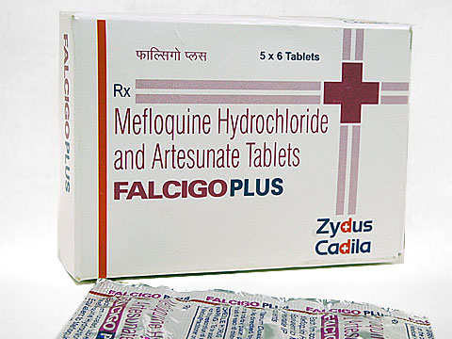

Slide 60
Piperaquine
Cq congener; Mech same as cq
High efficacy, erythrocytic schizonticide, with prolonged action, onset is slow
Effective in both CQ sensitive and CQ resistant P. falciparum malaria
Used in combination with DHA for resistant falciparum malaria
FDCs Arterolane + piperaquine
Dihydroartemesinin + piperaquine

Slide 61
Quinine
Cinchona bark; SA
Erythrocytic schizontocide for all species of plasmodia
Pre-erythrocytic stages X
Gametocidal against P. vivax & P. malariae
+ Primaquine for vivax malaria
Less effective and more toxic than chloroquine

Slide 62
Chloroquine preferred over quinine
Resurgence: Most chloroquine and multidrug-resistant strains of P. falciparum still respond to it
Though effective in terminating an acute attack of falciparum malaria, it may not prevent recrudescence indicating incomplete clearance of the parasites
Doxycycline/clindamycin is mostly added to it for complete parasite clearance.

Slide 63
Mechanism of Action:
Same as chloroquine
It is a weak base: gets concentrated in the acidic food vacuoles of sensitive plasmodia
inhibits polymerization of haeme to hemozoin
free haeme increases(toxic)
or haeme-quinine complex damages parasite membranes and kills it

Slide 64
After oral administration, quinine is rapidly absorbed, reaches peak plasma levels in 1–3 hours, and is widely distributed in body tissues.
The use of a loading dose in severe malaria allows the achievement of peak levels within a few hours.

Slide 65
Other Pharmacological actions
Intensely bitter and irritant.
Orally it causes nausea, vomiting, epigastric discomfort.
Injections can cause pain and local necrosis in the muscle and thrombosis in the vein.
Cardiodepressant
Anti-arrythmic

Slide 66
Higher dose/rapid i.v.
Hypotension & Hypoglycemia; CV collapse
Hemolysis in G6PD patient
Hypersentivity reaction

Slide 67
Cinchonism occurs when plasma concentration is more than 30-60µmol/L.
C/B headache, dizziness, tinnitus(ringing sound in ear), nausea, flushing and visual disturbances which are blurred vision, photophobia, diplopia, night blindness, altered colour perception , reduced visual field, optic atrophy ( due to constriction of retinal blood vessels) and even blindness

Slide 68
auditory (tinitus,deafness and vertigo ) disturbances due to involvement of the 8th nerve , vomiting, diarrhea and abdominal pain. Auditory and visual disturbances are possibly due to direct neurotoxicity.

Slide 69
Cinchonism may be:
Idiosyncratic: may occur after singles dose and usually mild type.
Dose dependent: occur after large single oral dose or fast i.v. administration or prolonged use of therapeutic dose

Slide 70
Therapeutic Uses
Resistant falciparum malaria second line(1st : ACT)
7 day
Quinine + doxy/clindamycin regimen
Quinine: 600 mg 8 hrly x 7 days
Doxy: 100 mg daily x 7 days
Clinda: 600 mg 12 hrly x 7 days

Slide 71
Complicated and severe malaria including cerebral malaria Quinine (i.v.) has been used as the drug of choice for cerebral malaria and other forms of complicated malaria
20mg/kg(loading dose) diluted in 5 % dextrose saline and infused i.v over 4 hrs.
Switch oral:10 mg /kg 8 hrly to complete a 7 day course
Currently artemisin compounds are preferred and used by parental route

Slide 72
BIGUANIDES
Proguani (Chloroguanide) : slow-acting erythrocytic schizontocide,also inhibits the preerythrocytic stage of
P.F alciparum. Do not kill gametocytes but inhibit their development in the mosquito.
Mechanism of action :
It is cyclized in the body to cycloguanil which inhibits plasmodial DHFRase in preference to the mammalian enzyme.
Resistance: due to mutational changes in the plasmodial DHFRase enzyme.
Current use of proguanil is restricted to prophylaxis of malaria in combination with chloroquine in areas of low level chloroquine resistance among P. falciparum. Safe during during pregnancy.

Slide 73
PYRIMETHAMINE
Inhibitor of plasmodial DHFRase.
Selective anti-malarial action depends on high affinity for plasmodial enzyme.
In contrast to trimethoprim, it has very poor action on bacterial DHFRase.
Pyrimethamine is a slowly acting erythrocytic schizontocide, but does not eliminate the pre-erythrocytic phase of P. falciparum

Slide 74
If used alone, resistance develops rather rapidly by mutation in the DHFRase enzyme of the parasite
used only in combination with a sulfonamide (S/P) or dapsone
Addition of sulfonamide, retards the development of resistance

Slide 75
SULFONAMIDE-PYRTMETHAMINE(S/P) COMBINATION
Supra-additive synergistic combination due to sequential block
Clinical curative, particularly for P.falciparum.
Efficacy against P. vivax is rather low.

Slide 76
As clinical curative:
Sulfadoxine 1500 mg + pyrimethamine 75 mg
(3 tab) single dose
Children
9-14 yr 2 tab
4-8 yr 1 tab
1-4 yr ½ tab

Slide 77
Adverse effects/ why single dose?????
Exfoliative dermatitis, Stevens johnson syndrome, etc. due to the sulfonamide. Therefore, use is restricted to single dose treatment of uncomplicated chloroquine-resistant falciparum malaria, or in patients intolerant to chloroquine.
The major importance of this combination is due to its efficacy against chloroquine-resistant P. falciparum.
Compliance is good due to single dose therapy and few acute side effects.

Slide 78
FDC
Artesunate - sulfadoxine+pyrimethamine
First line drug for uncomplicated falciparum malaria under the “National anti-malaria drug policy” of India.
Replaced chloroquine throughout the country.

Slide 79
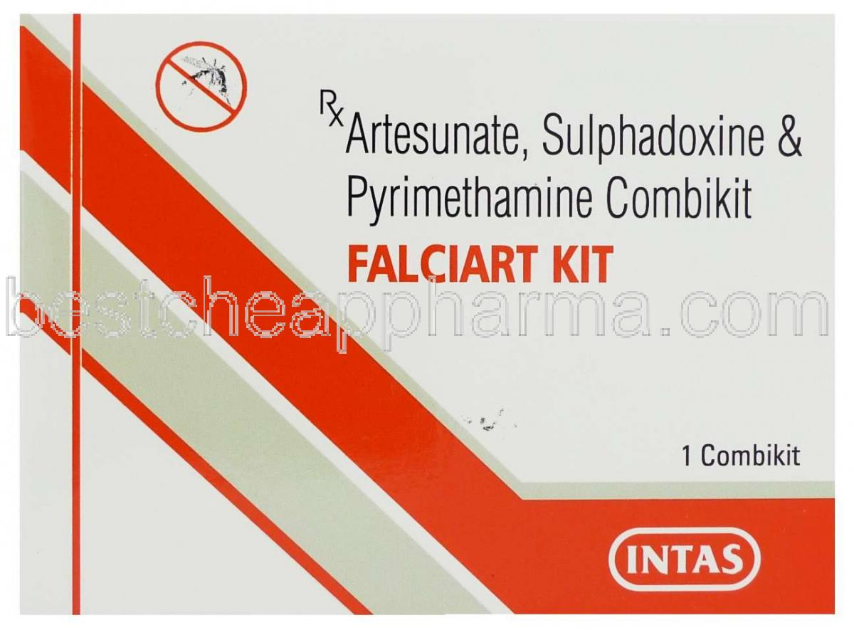

Slide 80
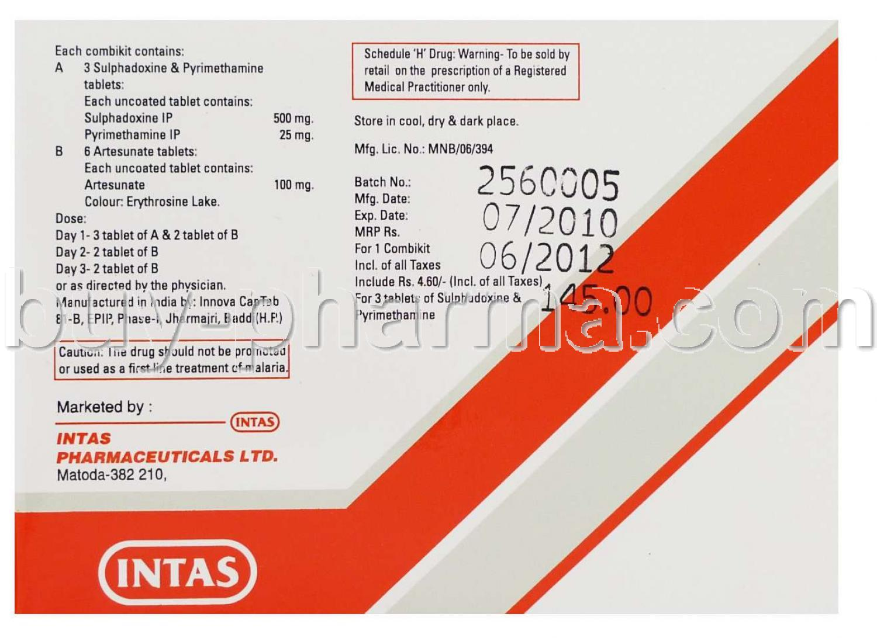

Slide 81
Tetracycline and doxycycline
Weak erythrocytic schizonticidal
All plasmodial species: Cq, MQ, S/P resistant P. falciparum
Never used alone
Combination with quinine for treatment of CQ resistant falciparum & vivax malaria

Slide 82
Artemesinin
Potent and rapid erythrocytic schizonticide
Quick defervescense and parasitemia clearance(<48 hr)
Quinghaosu; Artemesia annua
It is active against P. falciparum resistant to all other anti-malarial drugs as well as sensitive strains of other malarial species

Slide 83
In the erythrocytic schizogony cycle of the malarial parasite, artemisinins exert action on ring forms to early schizonts; thus have the broadest time window of antimalarial action.
X kill hypnozoites so for vivax malaria primaquine is to be added
Lethal to early stage of malarial gametes

Slide 84
Artemesinin
Poorly soluble in water & oil
Derivatives
Artemether: soluble in oil; oral; i.m
Artesunate: water soluble; oral; i.m + i.v
Active metabolite generated in the body DHA is also used orally
Arte-ether (injectable; i.m in oil) was produced in India
Arterolane : totally synthetic has been developed here
Collectively k/a Artemesinins

Slide 85
Duration of action: short
Recrudescence rate is high
When used alone in short courses
Used only in combination
Artemisinin Based Combination Therapy

Slide 86
Artemisinin Based Combination Therapy
Most important consideration ---- Elimination t1/2
Effective concentrations in blood must be maintained for at least 3-4 asexual cycles of the parasite, i.e. 6-8 days, to exhaust the parasite burden.
Therefore, short t1/2 drugs given for 7 days
longer acting drugs given for 1-3 days
Risk of de facto monotherapy --- Therefore choose a short t1/2 drug that reduces the parasite load rapidly and drastically such as artemisinin compounds.

Slide 87
Artesunate-sulfadoxine + Pyrimethamine
First line drug for uncomplicated falciparum malaria.

Slide 88
Artesunate-mefloquine
Highly effective and well tolerated in uncomplicated falciparum malaria

Slide 89
Artemether-lumefantrine
Both protect each other from plasmodial
resistance
High clinical efficacy
Active even in multidrug resistant Plasmodium
falciparum areas
Artemether – Quickly reduces parasite biomass
and resolves symptoms
Lumefantrine – Prevents recrudescence
Gametocyte population is checked

Slide 90
Artesunate-amodiaquine
First line therapy of uncomplicated falciparum malaria in many African countries

Slide 91
Dihydroartemisinin-piperaquine
Piperaquine with DHA in a dose ratio of 8:1
>98% response rate in uncomplicated falciparum malaria in India
Likely to be approved soon
Safe combination
Well tolerated even by children

Slide 92
Arterolane-piperaquine
Arterolane acts rapidly at all stages of asexual schizogony of malarial parasite including multidrug resistant Plasmodium falciparum but has no effect on hepatic stages
Arterolane accumulates in the food vacuole of the parasite, and thus differs from other artemisinins.
For vivax : ACT + primaquine

Slide 93
Artesunate-pyronaridine
Dose ratio is 1:3
>95% cure rate
Well tolerated
Not yet approved in India

Slide 94
Artesunate
Its sodium salt is water-soluble and is administered by oral, i m or i v. Routes.
After oral ingestion, absorption is incomplete but fast, reaching peak in <60 min.
Prodrug: It is rapidly converted to the active metabolite dihydroartemisinin (DHA) with a t1/2 of 30-60 min. The t1/2 of DHA is 2-4 hours.
After repeated dosing, artesunate causes autoinduction of its own metabolism

Slide 95
Artemether
It is lipid-soluble and is administered orally or i.m., but not i.v.
Oral absorption is slower taking 24 hours, but is enhanced by food.
Prodrug: It undergoes substantial first pass metabolism and is converted to DHA. Extensive metabolism by CYP3A4 yields a variable 1/2 of 3-10 hours.

Slide 96
Arteether
This compound developed in India has been released for institutional use only, for i.m administration in complicated/cerebral malaria. Because of its longer elimination t1/2 (23 hours), it is effective in a 3 day schedule with a recrudescence rate of 57%.
Dose: 1,50 mg i m daily for 3 days in adults.

Slide 97
FM during Pregnancy
Serious
Prompt treatment
Quinine + Clindamycin (7d)
300mg tds x 7days+ 300mg tds/qid x 7 days
All trimesters; especially first
ACT (3d) is better tolerated three day regimen
But: second & third trimesters

Slide 98
Severe & complicated falciparum malaria
Malaria+ 1/more of the following
Hyperparasitaemia
Hyperpyrexia
Fluid & electrolyte imbalance
Acidosis
Hypoglycaemia
Prostration
CV Collapse
Jaundice
Severe anaemia
Spontaneous bleeding
Pulmonary edema
Haemoglobinuria
Black water fever
Renal failure
Cerebral malaria

Slide 99
Parenteral drugs have to be used
Oral on improvement
I.m. artemesinins are preferred
i.v artesunate (NVBDCP)
Quinine replaced: used only when artemesinins cannot be used Pregnancy: 1st trimester

Slide 100
Summary
Uncomplicated malaria
Viva/Ovale/Malariae
CQ + Primaquine (hypnozoites)
Quinine + Doxy/Clinda + Primaquine (2nd line)
Or,
ACT + Primaquine

Slide 101
Falciparum
Cq Sensitive FM
CQ + Primaquine(G)
Cq Resistant FM
Artesunate + SP
Artesunate + Mefloquine
Artemether + Lumefantrine
Arterolane + Piperaquine
Quinine + Doxy/Clinda

Slide 102
Uncomplicated & Severe Falciparum malaria
Artesunate
Artemether
Arteether
Quinine

Slide 103
Thank You

Slide 104
PHARMACOKINETICS OF CHLOROQUINE

Slide 105
Chloroquine is well absorbed on oral administration from GIT while absorption from i.m or s.c route is rapid.
After absorption it is widely distributed and gets concentrated in various tissues like spleen, kidney, lungs and melanin containing cells.
Its apparent volume of distribution is 13000 litres
Its t1/2 gets prolonged upto 214 hours

Slide 106
Due to wide distribution in various tissues and extensive binding and long plasma half life the high initial dose or loading dose is required so as to achieve the therapeutic concentration in plasma and early steady state concentration.
60% of drug is plasma protein bound
During metabolism it gets converted to desethylchloroquine and bisdesethylchloroquine by cytochrome P- 450 in liver.
The systemic elimination of chloroquine is 50% and the remaining 50% is elminated by renal route.

Slide 107
When chloroquine is administered by the parentral route, its entry is rapid and removal is slow and this may lead to toxic concentration which may prove fatal. Therefore to prevent this problem whenever chloroquine has to be administered by parentral route it sholud be given as :
i.v route- slow infusion; s.c / i.m – small divided doses

Slide 108
Oral route is safer as the absorption and distribution correlates closely.
The peak plasma concentration is achieved in 3-5 hours after oral administration.

Slide 109
PHARMACOKINECTICS
unnati

Slide 110
Chloroquine is well absorbed on oral administration from GIT and absorption on i.m. or s.c. administration is rapid .
Chloroquine after absorption is widely distributed and concentration in various tissues like liver, spleen, kidney, lung and melanin. Distribution also occur in brain and spinal cord
Thus , it has large apparent volume of distribution which is about 13000 liters in an adult.

Slide 111
Chloroquine T1/2 is also prolonged about 214 h. Due to wide distribution in various tissues and extensive binding and long plasma half life the high initial dose or loading dose is required so as to achieve the therapeutic concentration in plasma and early steady state concentration.

Slide 112
About 60% of the drug is bound to plasma proteins .
During metabolism chloroquine is converted into two active metabolites which are desethylchoroquine and bisdesethylchoroquine by cytochrome P-450 in liver .
The systemic elimination of chloroquine is about 50% and remaining amount is eliminated by the renal route . By renal route 50% of chloroquine is excreted unchanged while 25% as metabolite and remaining in unchanged form .

Slide 113
when chloroquine is administered by the parenteral route, its entry is rapid and removal is slow and this may lead to toxic concentration which may prove fatal. Therefore , to prevent this problem whenever chloroquine has to be administered by parenteral route it should be given as follows.
I.V route – slow infusion ;
S.C/ I.M – small divided doses.

Slide 114
Oral route is safer as the absorption and distribution correlated closely. The peak concentration is achieved in 3-5 hours after oral administration ..
As the concentration of drug falls the elimination becomes slower and the half life is increased from few days to few weeks. The terminal half life is about 30-60 hours.

