Slide 1
Antihistamines
By Silas Mkombe

Slide 2
Objectives
At the end of the lesson the learner should be able to:
Define antihistamines?
Identify causes allergies and what are they, what is histamine?
Explain history of antihistamines
Describe Classification of antihistamines
Understand future of antihistamines and allergy treatment in general

Slide 3
WHAT IS AN ANTIHISTAMINE?
A drug that reduces or eliminates the effects mediated by the chemical histamine
Histamine is released by your body during an allergic reaction and acts on a specific histamine receptor
True antihistamines are only the agents that produce a therapeutic effect that is mediated by negative modulation of histamine receptors (other agents may have antihistaminergic action but are not true antihistamines)
The term antihistamine only refers to H₁ receptor antagonists(actually inverse agonists)
Antihistamines compete with histamine for binding sites at the receptors. Antihistamine cannot remove the histamine if it is already bound

Slide 4
WHAT ARE ALLERGIES?
Allergies are caused by a hypersensitivity reaction of the antibody class IgE (which are located on mast cells in the tissues and basophils in the blood)
When an allergen is encountered, it binds to IgE, which excessively activates the mast cells or basophils, leading them to release massive amounts of histamines.
These histamines lead to inflammatory responses ranging from runny nose to anaphylactic shock
If both parents have allergies, you have a 70% of having them, if only one parent does, you have a 48% chance (American Academy of Asthma, Allergies and Immunology, Spring 2003).

Slide 5
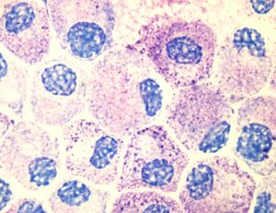
ALLERGIES
Structure of Histamine
When it is released, histamine causes inflammation by increasing vasodilation, capillary permeability, causing smooth muscle contraction, mucus secretion, and parasympathetic nerve stimulation
Mast Cells
Histamine is distributed in Mast Cells in all peripheral tissues of the body and basophils, which circulate in the blood

Slide 6
THE DIFFERENT HISTAMINE RECEPTORS
 | Location | Type of receptor | Effect | Treatment
H1 | Throughout the body, specifically in smooth muscles, on vascular endothelial cells, in the heart and the CNS | G-protein coupled, linked to intercellular Gq, which activates phospholipase C | Mediate an increase in vascular permeability at sites of inflammation induced by histamine | Allergies, nausea, sleep disorders
H2 | In more specific locations in the body mainly in gastric parietal cells, a low level can be found in vascular smooth muscle, neutrophils, CNS, heart, uterus | G-protein coupled, linked to intercellular Gs | Increases the release of gastric acid | Stomach ulcers
H3 | Found mostly in the CNS, with a high level in the thalamus, caudate nucleus and cortex, also a low level detected in small intestine, testis and prostate. | G-protein coupled, possibly linked to intercellular Gi | Neural presynaptic receptor, may function to release histamine | Unknown
H4 | They were recently discovered in 2000. They are widely expressed in components of the immune system such as the spleen, thymus and leukocytes. | Unknown, most likely also G-protein coupled | Unknown | In addition to benefiting allergic conditions, research in the h4 receptor may lead to the treatment of autoimmune diseases. (rheumatoid arthritis and IBS)

Slide 7
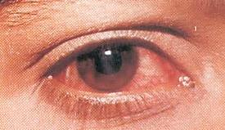
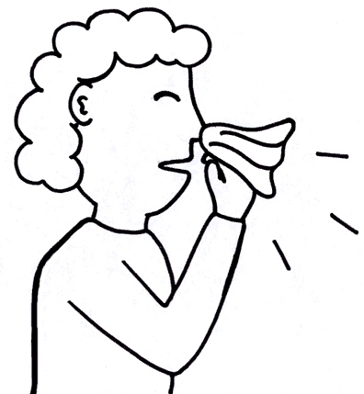
CLINICAL USES OF ANTIHISTAMINES
Allergic rhinitis (common cold)
Allergic conjunctivitis (pink eye)
Allergic dermatological conditions
Urticaria (hives)
Angioedema (swelling of the skin)
Puritus (atopic dermatitis, insect bites)
Anaphylactic reactions (severe allergies)
Nausea and vomiting (first generation H₁-antihistamines)
Sedation (first generation H₁-antihistamines)

Slide 8
ADVERSE SIDE EFFECTS
Associated with the first generation H₁-antihistamines and due to their lack of selectivity for the H₁ receptor and anti-cholinergic activity. Side effects are due to CNS depression:
Sedation
Dizziness
Tinnitus (ringing in the ear)
Blurred vision
Euphoria
Uncoordination
Anxiety
Insomnia
Tremor
Nausea/vomitting
Dry mouth/dry cough
Newer second generation H1-antihistamines are more selective for the peripheral histamine receptors and have far less side effects (drowsiness, fatigue, headache, nausea and dry mouth)
Notes:
Can also infrequently cause: urinary retention, palpitations, hypotension, headache, hallucinations, psychosis
The reasons for these side effects is the lack of selectivity of the H1-antihistamines. These drugs in addition to being H1-receptor inverse agonists, they are muscarinic acetycholine receptor antagonists (anticholinergic agents), and may also have action at alpha-adrenergic receptors and 5-HT receptors

Slide 9
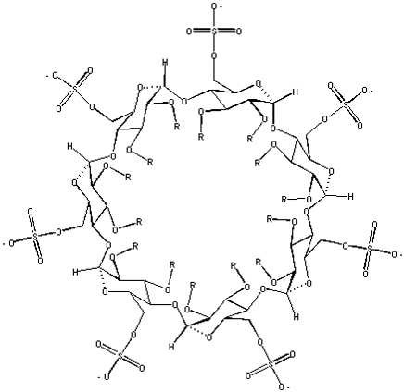
FIRST ANTIHISTAMINE
Piperoxan
Discovered in 1933 by Jeff Forneau and Daniel Bovent while developing a guinea pig animal model of anaphylaxis
They received the Nobel Prize in 1957

Slide 10
CLASSES OF FIRST GENERATION H₁ RECEPTOR ANTAGONIST ANTIHISTAMINES
Ethylenediamines
Ethanolamines
Alkylamines
Piperazines
Tricyclics

Slide 11
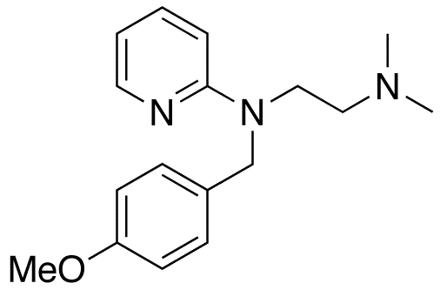
ETHYLENEDIAMINES
These were the first group of clinically effective H₁-antihistamines
Mepyramine (Pyrilamine)

Slide 12
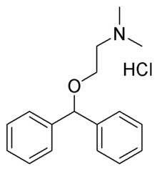
ETHANOLAMINES
This class has significant anticholinergic side effects and sedation, however reduced the gastroinestnal side effects
Diphenhydramine (Benedryl)
Oldest and most effective antihistamine on the market
Available over the counter
Because it induces sedation, it’s used in nonprescription sleep aids such as Tylenol PM
Also inhibits the reuptake of serotonin, which led to the search for viable antidepressants with similar structures (prozac)
Notes:
The anticholinergic side effects may include: motor impairment, dry mouth/throat, flushed skin, rapid or irregular heart beat, blurred vision, sensitivity to light, pupil dilation, urinary retention, constipation, difficulty concintrating, short term memory loss, visual disturbances, hallucinations, confusion, erectile dysfunction, and delirium

Slide 13
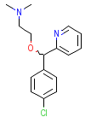
ETHANOLAMINES
Carbinoxamine(Clistine)
Doxylamine succinate
Is used to treat Hay fever and is especially popular to children due its its mild taste
After 21 reported deaths in children under 2, its now only marketed to children above 3 (FDA, June 2006)
2nd in effectiveness of anti-allergy activity only to Benadryl
Potent anti-cholinergic effects

Slide 14
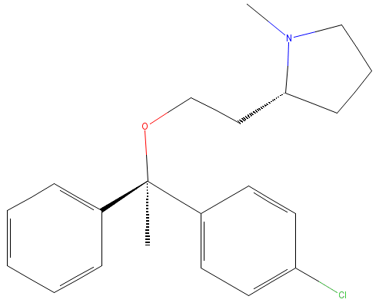
ETHANOLAMINES
Clemastine (Tavist)
Dimenhydrinate (Dramamine)
Exhibits fewer side effects than most antihistamines
Widely used as an antiprurtic (stops itching)
Anti-emetic (anti nausea)
Also causes strong sedation
Readily crosses the BBB
Notes:
Dramamine is actually a combination of two drugs: diphenhydramine (Benadryl) and 8-chlorotheophillinate (similar to caffeine and is a mild CNS stimulator)
They thought that adding the 8-chlorotheophillinate would counteract the affects of the diphenhydramine, however that is not that case and sedation still occurs

Slide 15
ALKYLAMINES
Isomerism is an important factor in this class of drugs, which is due to the positioning and fit of the molecules in the H1-receptor binding site
These drugs have fewer sedative and GI adverse effects, but a greater incidence of CNS stimulation
These drugs lack the “spacer molecule” (which is usually a nitrogen or oxygen) between the two aromatic rings and at least one of the rings has nitrogen included in the aromatic system

Slide 16
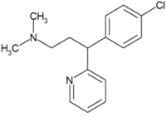
AKYLAMINES
Chlorphenamine
Brompheniramine (Dimetapp)
Originally used to prevent allergic conditions
Shown to have antidepressant properties and inhibit the reuptake of serotonin
The first SSRI was made as a derivative of chlorphenamine
Available over the counter
Used to treat the common cold by relieving runny nose, itchy, watery eyes and sneezing

Slide 17
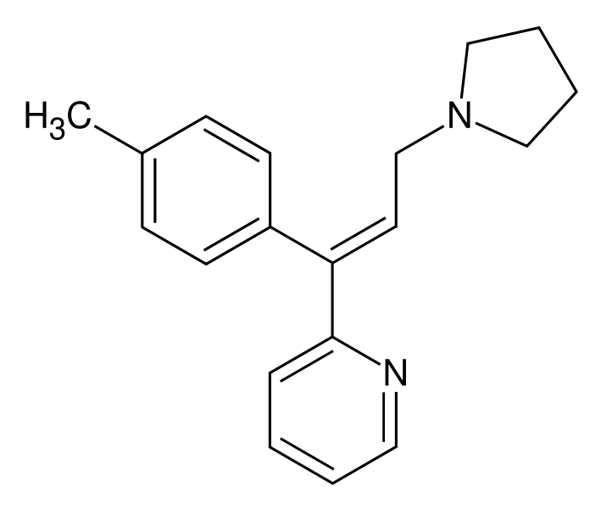
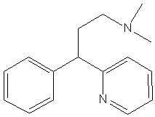
AKYLAMINES
Triprolidine hydrochloride
Pheniramine (Avil)
Used to alleviate the symptoms associated with allergies
Can be combined with other cold medicine to relieve “flu-like” symptoms
Used most often to treat hay fever or urticaria (hives)
Antihistamine component of Visine-A

Slide 18
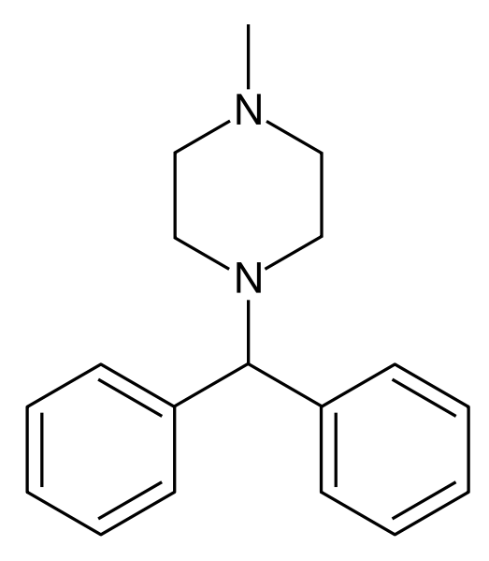
PIPERAZINES
Structurally related to the ethylenediamines and the ethanolamines and thus produce significant anti-cholinergic effects
Used most often to treat motion sickness, vertigo, nausea and vomiting
Cyclizine
Used to treat the symptoms associated with motion sickness, vertigo and post-op following administration of general anaesthesia and opiods
Mechanism of inhibiting motion sickness is not well understood, but it may act on the labyrinthine apparatus and the chemoreceptor trigger zone (area of the brain which receives input and induces vomiting)

Slide 19
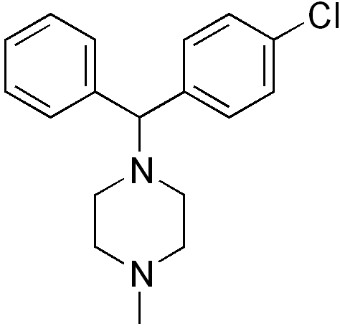
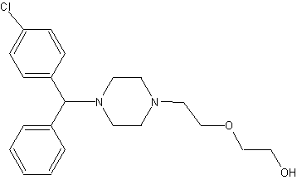
PIPERAZINES
Chlorcyclizine
Hydroxyzine
In addition to treating itches and irritations, its an anitemetic, a weak analgesic and an anxiolytic (treat anxiety)
This drug is used to treat motion sickness

Slide 20
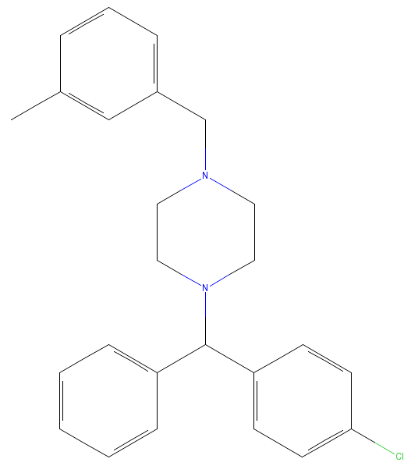
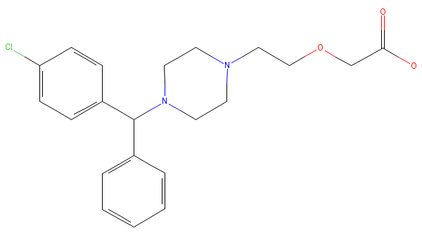
PIPERAZINES
Meclizine
Cetirizine (Zyrtec)
It is most commonly used to inhibit nausea and vomiting as well as vertigo, however it does cause drowsiness
This drug treats indoor and outdoor allergies and is safe to use in children as young as 2

Slide 21
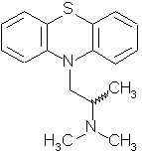
TRICYCLICS
These drugs are structurally related to tricyclic antidepressants, which explains why they have cholinergic side effects
Promethazine (Phenegran)
This drug has extremely strong anticholinergic and sedative effects
It was originally used as an antipsychotic, however now it is most commonly used as a sedative or antinausea drug (also severe morning sickness) and requires a prescription

Slide 22
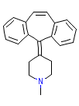
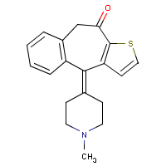
TRICYCLICS
Cyproheptadine
Ketotifen (Zaditor)
This drug both an antihistamine and an antiserotonergic agent
It is a 5-HT2 receptor antagonist and also blocks calcium channels
Used to treat hay fever and also to stimulate appetite in people with anorexia
It is also rarely used to treat SSRI induced sexual dysfunction and also Cushing’s Syndrome (high level of cortisol in the blood) and migraine headaches
This drug is available in two forms: an ophthalmic form used to treat allergic conjunctivitis or itchy red eyes and an oral form used to prevent asthma attacks
It has several adverse side effects including drowsiness, weight gain, dry mouth, irritability and increased nosebleeds

Slide 23
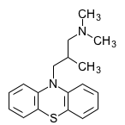
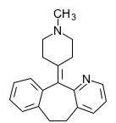
TRICYCLICS
Alimemazine (Vallergan)
Azatadine
(Optimine or Trinalin)
This drug is used to treat itchiness and hives that results from allergies
Since it causes drowsiness, it is useful for rashes that itch worse at night time
It is also used to sedate young children before operations
This drug is used to treat symptoms of allergies and the common cold such as sneezing, runny nose, itchy watery eyes, itching, hives and rashes

Slide 24
SECOND GENERATION H₁-RECEPTOR ANTAGONISTS
These are the newer drugs and they are much more selective for the peripheral H1-receptors involved in allergies as opposed to the H1-receptors in the CNS
Therefore, these drugs provide the same relief with many fewer adverse side effects
The structure of these drugs varies and there are no common structural features associated with them
They are however bulkier and less lipophilic than the first generation drugs, therefore they do not cross the BBB as readily
Recent studies have also showed that these drugs also have anti-inflammatory activity and therefore, would be helpful in the management of inflammation in allergic airways disease (Devalia and Davies).

Slide 25
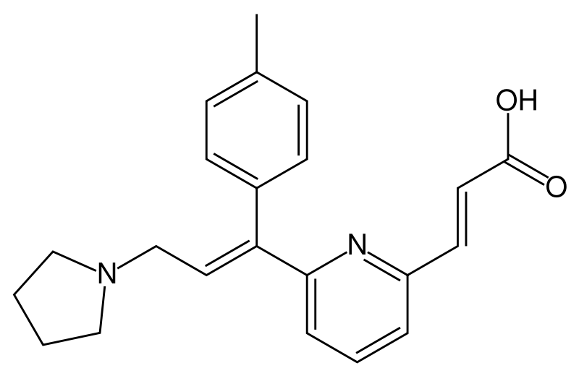
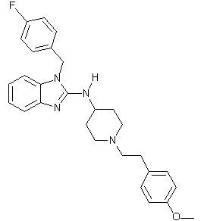
SECOND GENERATION H₁-RECEPTOR ANTAGONISTS
Acrivastine (Semprex-D)
Astemizole (Hismantol)
This drug has a long duration of action
It suppresses the formation of edema and puritus
It doesn’t cross the BBB
It has been taken off the market in most countries because of adverse interactions with erythromycin and grapefruit juice
This drug relieves itchy rashes and hives
It is non-sedating because it does not cross the BBB

Slide 26
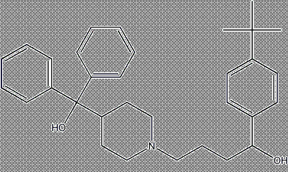
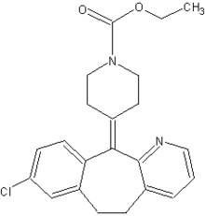
SECOND GENERATION H₁-RECEPTOR ANTAGONISTS
Loratadine (Claritin)
Terfenadine (Seldane)
It is the only drug of its class available over the counter
It has long lasting effects and does not cause drowsiness because it does not cross the BBB
It was formerly used to treat allergic conditions
In the 1990’s it was removed from the market due to the increased risk of cardiac arrythmias

Slide 27
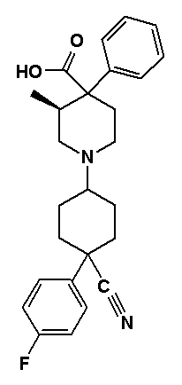
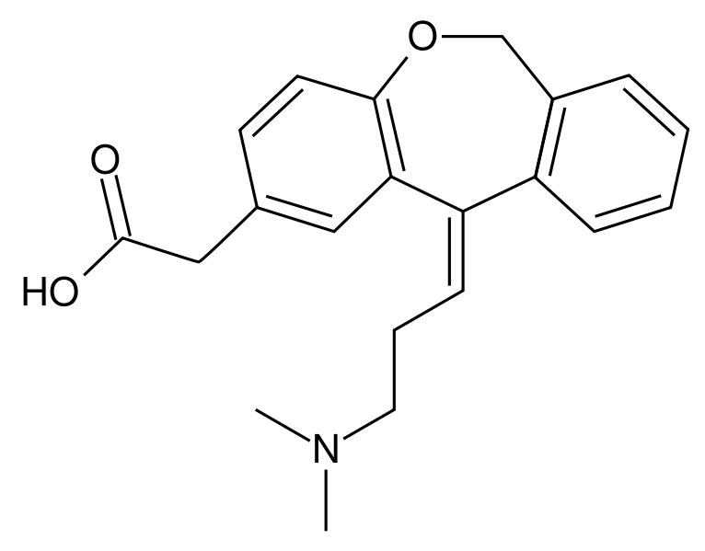
SECOND GENERATION H₁-RECEPTOR ANTAGONISTS
Azelastine
(Astelin or Optivar)
Levocabastine
(Livostin)
Olopatadine
(Patanol)
It is a mast cell stablilizer
Available as a nasal spray (Astelin) or eye drops for pink eye (Optivar)
Both of these drugs are used as eye drops to treat allergic conjunctivitis

Slide 28
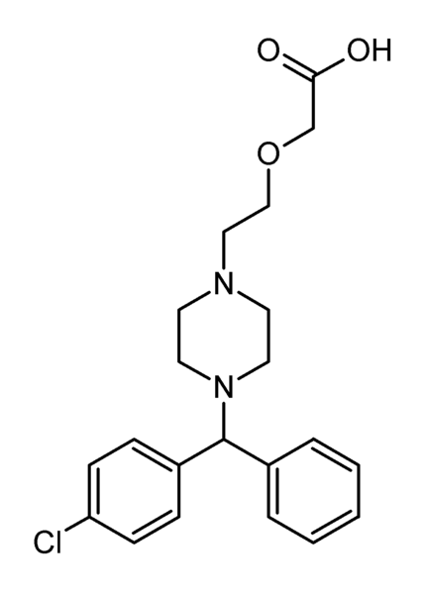
THIRD GENERATION H₁-RECEPTOR ANTAGONISTS
These drugs are derived from second generation antihistamines
They are either the active enantiomer or metabolite of the second generation drug designed to have increased efficacy and fewer side effects
Levocetirizine (Zyzal)
This drug is the active enantiomer of cetirizine and is believed to be more effective and have fewer adverse side effects.
Also it is not metabolized and is likely to be safer than other drugs due to a lack of possible drug interactions (Tillement).
It does not cross the BBB and does not cause significant drowsiness
It has been shown to reduce asthma attacks by 70% in children

Slide 29
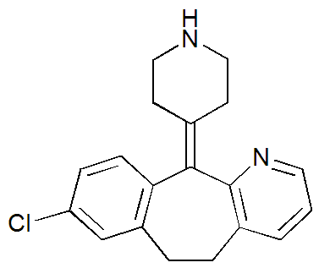
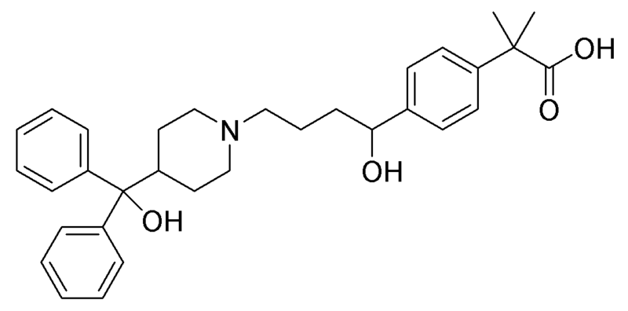
THIRD GENERATION H₁-RECEPTOR ANTAGONISTS
Deslortadine (Clarinex)
Fexofenadine (Allegra)
It was developed as an alternative to Terfenadine
Fexofenadine was proven to be more effective and safe
It is the active metabolite of Lortadine
Even though it is thought to be more effective, there is no concrete evidence to prove this

Slide 30
THE FUTURE OF ANTIHISTAMINES
The anti-inflammatory activity of second generation antihistamines, about which little is known, will continue to be researched and possibly lead to an effective alternative to corticosteriods in the treatment of allergic airways conditions.
The action of the H4 receptor will also continue to be researched and will possibly lead to effective treatment of autoimmune dieseases.
Creating antihistamines with higher selectivity and less adverse side effects will continue to be the goal

