Slide 1
Antiparasitic Agents - Antimalarial Agents
Kumuti Jacob – Lecturer
Clinical Medicine – Sept. 2020 Class
Year I Semester I

Slide 2
Antiparasitic Agents
Anti-parasitic Agents include:
  Antiprotozoal agents
    Antimalarial agents
    Antiamoebic agents
    Antileishmania agents
    Antitrypanosoma agents
  Antihelmintic agents

Slide 3
    Antimalarial agents
Learning outcome
By the end of this lesson, you should be able to:
  Outline goals of antimalarial agents
  Demonstrate understanding of the Life-cycle of Plasmodium
  Describe Classification of Antimalarial Agents
  Discuss Treatment of malaria in Kenya

Slide 4
I. Antimalarial Agents
Introduction
  Malaria is one of the leading causes of morbidity and mortality, particularly in children under five years of age in Kenya.
  Plasmodium falciparum is the commonest cause of malaria.
  Interventions to control malaria in Kenya have been integrated and include:
    Provision of prompt and effective treatment or malaria case management.

Slide 5
  2. Vector control using long lasting insecticidal nets, indoor residual spraying and other integrated vector management strategies
  3. Prevention and treatment of malaria in pregnancy and
  4. Epidemic preparedness and response

Slide 6
Four species of plasmodium cause human malaria:
  Plasmodium falciparum which is responsible for nearly all serious complications and deaths.
  Plasmodium vivax
  Plasmodium malariae
  Plasmodium ovale
Transmitted by the female Anopheles mosquito
Antimalarials act at different stages in life cycle

Slide 7
Goals of antimalarial agents
  To prevent and treat clinical attack of malaria.
  To completely eradicate the parasite from the patient's body.
  To reduce the human reservoir of infection - cut down transmission to mosquito.

Slide 8
Life-cycle of Plasmodium
Malaria is transmitted by the bite of infected female anopheles mosquitoes.
During feeding, mosquitoes inject sporozoites, which circulate to the liver, and rapidly infect hepatocytes, causing asymptomatic liver infection (hepatic phase)(absent in falciparum; malariae)
Merozoites released from the liver, rapidly infect erythrocytes to begin the asexual erythrocytic stage of infection that is responsible for human disease
Multiple rounds of erythrocytic development, with production of merozoites that invade additional erythrocytes, lead to large numbers of circulating parasites and clinical illness

Slide 9
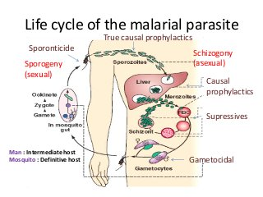

Slide 10
Release of merozoites subsequent to rupture of erythrocytes causes the clinical attack of malaria.
Some erythrocytic parasites also develop into sexual gametocytes, which are infectious to mosquitoes, allowing completion of the life cycle and infection of others
In P vivax and P ovale parasites also form dormant liver hypnozoites, which are not killed by most drugs, allowing subsequent relapses of illness after initial elimination of erythrocytic infections

Slide 11
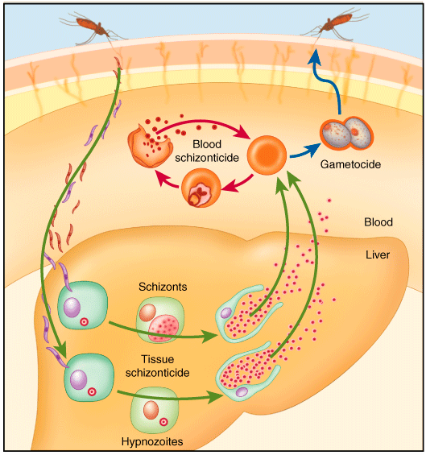

Slide 12
Malaria Transmission Cycle
Exo-erythrocytic (hepatic) Cycle: Sporozoites infect liver cells and develop into schizonts, which release merozoites into the blood
Sporozoires injected into human host during blood meal
Parasites mature in mosquito midgut and migrate to salivary glands
MOSQUITO
HUMAN
Dormant liver stages (hypnozoites) of P. vivax and P. ovale
Erythrocytic Cycle: Merozoites infect red blood cells to form schizonts
Parasite undergoes sexual reproduction in the mosquito
Some merozoites differentiate into male or female gametocyctes

Slide 13
Classification of Antimalarial Agents
Anti malarial drugs may be classified based on mechanism of action, therapeutic uses and chemistry.
A. Classification Based on Mechanism of Action
1. Causal prophylactics
  - Are drugs that kill the pre-erythrocytic forms of the parasite
    Pyrimethamine
    Primaquine
    Proguanil

Slide 14
2. Clinical curatives – Are blood schizontocides
  Chloroquine
  Amodiaquine
  Quinine
  Mefloquine
  Pyrimethamine
  Lumefantrine
  Artemisinin

Slide 15
3. Radical curtives - Eliminate both hepatic and erythrocytic stages
  Are tissue schizontocides for p. Vivax & p. Ovale
  Primaquine
4. Gametocidal drugs (drugs that kill gametes and prevent spread of disease in mosquito)
a. For p. Vivax: chloroquine, quinine
b. For p. Falciparum: Primaquine
5. Sporontocides: Are drugs that inhibit the life cycle of malarial parasite in mosquitoes)
  Primaquine
  Chloroguanide

Slide 16
B. Classification Based on Chemistry
4-Aminoquinolines
  Chloroquine
  Amodiaquine
8-Aminoquinoline
  Primaquine
4-Quinoline- Methanol
  Mefloquine

Slide 17
Quinoline-containing Cinchona Alkaloids
  Quinine
  Quinidine
Diaminopyrimidine
  Pyrimethamine
Sulfonamides/Sulfone
  Sulfadoxine
  Sulfalene
  Dapsone

Slide 18
Sesquiterpene-Lactone
  Qinghaosu (Artemisinin)
  Arte-Ether
  Artemether –longer acting
Amino alcohols
  Halofantrine
  Lumefantrine
Antibiotics (Tetracyclines)
  Tetracycline
  Doxycycline
  Minocycline

Slide 19
Biguanides
  Proguanil
  Chlorproguanil
  Cycloguanil
Hydroxy-naphthoquinone
  Atovaquone

Slide 20
Clinical Cure
Erythrocytic schizonticide is used to terminate the episode of malarial fever
These agents exist in two forms:
  High efficacy agents
  Low efficacy agents

Slide 21
Low efficacy
High efficacy
Artemesinin
Chloroquine
Amodiaquine
Quinine
Mefloquine
Halofantrine
Lumifantrine
Atovaquone
Proguanil
Pyrimethamine
Sulfonamides
Tetracyclins
Clindamycin

Slide 22
Radical cure
Eliminates both hepatic and erythrocytic stages:
Both for Vivax & ovale
Erythrocytic schizonticide + Tissue schizonticide
Treatment: CQ/ AL + primaquine

Slide 23
For Chloroquine resistance
Treat with:
  Quinine + Doxycycline/clindamycin + Primaquine
  Artemesinin based combination therapy + Primaquine

Slide 24
Causal prophylaxis
Pre-erythrocytic phase which is the cause of malarial infection and clinical attacks is the target for this purpose
Primaquine is the causal prophylactic for all species of malaria

Slide 25
Supressive prophylaxis
Schizonticides which suppress the erythrocytic phase and thus attacks of malarial fever can be used as prophylactics
Clinical disease does not appear
Uese:
  Mefloquine
  Doxycycline

Slide 26
Mefloquine
  250 mg weekly
  Starting week before travel & taken till 4 weeks after return from endemic area for CQ resistant P. falciparum
Doxycycline
  100 mg daily
  Starting day before travel & taken till 4 weeks after return from endemic area for CQ resistant P. falciparum
  C/I in pregnant women & children <8years of age

Slide 27
Pregnancy
  One dose each in second & third trimester
  1 month gap
  Pyrimethamine(75 mg)+ sulphadoxine(1500mg)
  In areas with high P.f endemicity

Slide 28
PRIMAQUINE
8-aminoquinoline
Poor erythrocytic schizontocide
It’s not useful for acute attacks of malaria
Highly active against gametocytes and hypnozoites
Notes:
weak action on P. vivax,
but blood forms of P. falciparum are totally insensitive

Slide 29
Primary indication
  Radical cure of relapsing malaria (vivax) & ovale
  15 mg/kg/day X 2 weeks(hypnozoites)
  +
  CQ/ another blood schizonticide to eliminate the erythrocytic phase
  Gametocidal for all species of plasmodia. Cuts transmission to mosquitoes.

Slide 30
Chloroquine Sensitive Falciparum Malaria:
  CQ + Primaquine
  A single 45 mg dose (As gametocidal) of primaquine is given with the curative dose of chloroquine to kill the gametes and cut down transmission to mosquito.

Slide 31
Adverse effects
  Nausea, headache, epigastric pain
  And abdominal cramps occasionally
Toxicity
  Dose related haemolysis, meth-haemoglobinaemia, tachypnoea and cyanosis; due to the oxidant property of primaquine.
  Those with G-6-PD deficiency are highly sensitive and haemolytic anaemia can occur even with 15-30 mg/day.

Slide 32
Mefloquine
Chemically related to quinine
Fast acting Erythrocytic schizonticidal
Hepatic stage: Not effective
Gametocyte stage: Not effective
Mechanism same as chloroquine
Active against chloroquine sensitive as well resistant P.vivax and falciparum

Slide 33
Single dose: 15mg/kg controls fever & eliminates circulating parasites(both P. vivax & pf)
Well absorbed orally, absorption enhances by food
Not used parentally
Excreted in bile and urine

Slide 34
Therapeutic Uses
Mefloquine is effective therapy for many chloroquine resistant strains of P falciparum
Chemoprophylactic drug for most malaria-endemic regions with chloroquine-resistant strains
Sporadic resistance to mefloquine has been reported from many areas

Slide 35
Current recommendation
  Should be used in combination with artesunate as ACT to prevent Mefloquin-resistance for:
    Uncomplicated falciparum malaria
    CQ resistant &
    CQ + sulfa-pyrimethamine resistant cases

Slide 36
Prophylaxis
  5 mg/kg per week started 1-2 weeks before travel to areas with multidrug resistance
  250 mg weekly
  Available as 250 mg tablet
  Travelers to areas with multidrug resistance
  Not in residents of endemic areas

Slide 37
Interactions:
  Halofantrine/quinidine/quinine/Cq
  - Given to patients who have received mefloquine causes QTc lengthening---cardiac arrests are reported.
  These drugs should not be administered if MQ(mefloquin) has been given less than 12 hrs earlier.

Slide 38
Piperaquine
Cq congener; Mech. same as CQ.
High efficacy, erythrocytic schizonticide, with prolonged action, onset is slow
Effective in both CQ sensitive and CQ resistant P. falciparum malaria
Used in combination with DHA for resistant falciparum malaria
FDCs
  Arterolane + piperaquine
  Dihydroartemesinin + piperaquine

Slide 39
Quinine
Cinchona bark; SA
Erythrocytic schizontocide for all species of plasmodia
  Pre-erythrocytic stages: Not effective
  Gametocidal against P. vivax & P. malariae
  Given + Primaquine for vivax malaria
Less effective and more toxic than chloroquine

Slide 40
Chloroquine preferred over quinine
Resurgence:
  Most chloroquine and multidrug-resistant strains of P. falciparum still respond to it
  Though effective in terminating an acute attack of falciparum malaria, it may not prevent recrudescence indicating incomplete clearance of the parasites
  Doxycycline/clindamycin is mostly added to it for complete parasite clearance.

Slide 41
Mechanism of Action:
Same as chloroquine
It is a weak base: gets concentrated in the acidic food vacuoles of sensitive plasmodia
Inhibits polymerization of haeme to hemozoin
Free haeme increases(toxic) or haeme-quinine complex damages parasite membranes and kills it

Slide 42
After oral administration, quinine is rapidly absorbed, reaches peak plasma levels in 1–3 hours, and is widely distributed in body tissues.
The use of a loading dose in severe malaria allows the achievement of peak levels within a few hours

Slide 43
Therapeutic Uses
Resistant falciparum malaria
second line(1st : ACT)
7 day Quinine + doxy/clindamycin regimen
  Quinine: 600 mg 8 hrly x 7 days
  Doxy: 100 mg daily x 7 days
  Clinda: 600 mg 12 hrly x 7 days

Slide 44
Complicated and severe malaria including cerebral malaria
  Quinine (i.v.) has been used as the drug of choice for cerebral malaria and other forms of complicated malaria
  20mg/kg(loading dose) diluted in 5 % dextrose saline and infused i.v over 4 hrs. Then, Switch oral:10 mg /kg 8 hrly to complete a 7 day course
  Currently artemisin compounds are preferred and
  used by parental route

Slide 45
Adverse effects and other uses
  Intensely bitter and irritant.
  Orally it causes nausea, vomiting, epigastric discomfort.
  Injections can cause pain and local necrosis in the muscle and thrombosis in the vein.
  Cardiodepressant
  Anti-arrythmic

Slide 46
Higher dose/rapid i.v.
Hypotension & Hypoglycemia; CV collapse
Hemolysis in G6PD patient
Hypersentivity reaction

Slide 47
Cinchonism occurs when plasma concentration is more than 30-60µmol/L.
C/P: headache, dizziness, tinnitus (ringing sound in ear), nausea, flushing and visual disturbances which are blurred vision, photophobia, diplopia, night blindness, altered colour perception , reduced visual field, optic atrophy ( due to constriction of retinal blood vessels) and even blindness

Slide 48
Auditory (tinitus,deafness and vertigo ) disturbances is due to involvement of the 8th nerve , vomiting, diarrhea and abdominal pain.
Auditory and visual disturbances are possibly due to direct neurotoxicity.

Slide 49
Cinchonism may be:
  Idiosyncratic: may occur after singles dose and usually mild type.
  Dose dependent: occur after large single oral dose,
  or fast i.v. administration,
  or prolonged use of therapeutic dose.

Slide 50
BIGUANIDES
Proguani (Chloroguanide) : slow-acting erythrocytic schizontocide,also inhibits the preerythrocytic stage of
P.F alciparum. Do not kill gametocytes but inhibit their development in the mosquito.
Mechanism of action :
  It is cyclized in the body to cycloguanil which inhibits plasmodial DHFRase in preference to the mammalian enzyme.

Slide 51
Resistance: due to mutational changes in the plasmodial DHFRase enzyme.
Current use of proguanil is restricted to prophylaxis of malaria in combination with chloroquine in areas of low level chloroquine resistance among P. falciparum.
It is Safe during during pregnancy.

Slide 52
PYRIMETHAMINE
Inhibitor of plasmodial DHFRase.
Selective anti-malarial action depends on high affinity for plasmodial enzyme.
In contrast to trimethoprim, it has very poor action on bacterial DHFRase.
Pyrimethamine is a slowly acting erythrocytic schizontocide, but does not eliminate the pre-erythrocytic phase of P. falciparum

Slide 53
If used alone, resistance develops rather rapidly by mutation in the DHFRase enzyme of the parasite
Used only in combination with a sulfonamide (S/P) or dapsone
Addition of sulfonamide, retards the development of resistance

Slide 54
SULFONAMIDE-PYRTMETHAMINE(S/P) COMBINATION
  Supra-additive synergistic combination due to sequential block
  Clinical curative, particularly for P.falciparum.
  Efficacy against P. vivax is rather low.

Slide 55
As clinical curative:
  Sulfadoxine 1500 mg + pyrimethamine 75 mg (3 tab) single dose
  Children
      9-14 yr 2 tab
      4-8 yr 1 tab
      1-4 yr ½ tab

Slide 56
Adverse effects
Exfoliative dermatitis, Stevens johnson syndrome, etc. due to the sulfonamide.
Therefore, use is restricted to single dose treatment of uncomplicated chloroquine-resistant falciparum malaria, or in patients intolerant to chloroquine.
The major importance of this combination used to be its efficacy against chloroquine-resistant P. falciparum.
Compliance is good due to single dose therapy and few acute side effects.

Slide 57
Tetracycline and doxycycline
  Weak erythrocytic schizonticidal
  All plasmodial species: CQ, MQ, S/P resistant P. falciparum
  Never used alone
  Combination with quinine for treatment of CQ resistant falciparum & vivax malaria

Slide 58
Artemesinin
  Potent and rapid erythrocytic schizonticide
  Quick defervescense and parasitemia clearance(<48 hr)
  Quinghaosu; Artemesia annua
  It is active against P. falciparum resistant to all other anti-malarial drugs as well as sensitive strains of other malarial species

Slide 59
  In the erythrocytic schizogony cycle of the malarial parasite, artemisinins exert action on ring forms to early schizonts; thus have the broadest time window of antimalarial action.
  Does not kill hypnozoites, so for vivax malaria primaquine is to be added
  Lethal to early stage of malarial gametes

Slide 60
Poorly soluble in water & oil
Derivatives
  Artemether: soluble in oil; oral; i.m
  Artesunate: water soluble; oral; i.m + i.v
  Active metabolite generated in the body DHA is also used orally
  Arte-ether (injectable; i.m in oil) was produced in India
  Arterolane : totally synthetic has been developed here
  Collectively known as Artemesinins

Slide 61
  Duration of action: short
  Recrudescence rate is high
  When used alone in short courses
  Used only in combination

Slide 62
Artemisinin Based Combination Therapy
Most important consideration ---- Elimination t1/2
Effective concentrations in blood must be maintained for at least 3-4 asexual cycles of the parasite, i.e. 6-8 days, to exhaust the parasite burden.
Therefore, short t1/2 drugs given for 7 days
longer acting drugs given for 1-3 days
Risk of de facto monotherapy --- Therefore choose a short t1/2 drug that reduces the parasite load rapidly and drastically such as artemisinin compounds.

Slide 63
Artemether-lumefantrine
Both protect each other from plasmodial
resistance
High clinical efficacy
Active even in multidrug resistant Plasmodium
falciparum areas
Artemether – Quickly reduces parasite biomass
and resolves symptoms
Lumefantrine – Prevents recrudescence
Gametocyte population is checked
First line therapy of uncomplicated falciparum malaria in kenya

Slide 64
Artesunate-sulfadoxine + Pyrimethamine
  May be used as First line drug for uncomplicated falciparum malaria.
Artesunate-mefloquine
  Highly effective and well tolerated in uncomplicated falciparum malaria
Artesunate-amodiaquine
  First line therapy of uncomplicated falciparum malaria in many other African countries

Slide 65
Artesunate
Its sodium salt is water-soluble and is administered by oral, i m or i v. Routes.
After oral ingestion, absorption is incomplete but fast, reaching peak in <60 min.
Prodrug: It is rapidly converted to the active metabolite dihydroartemisinin (DHA) with a t1/2 of 30-60 min. The t1/2 of DHA is 2-4 hours.
After repeated dosing, artesunate causes autoinduction of its own metabolism

Slide 66
Artemether
It is lipid-soluble and is administered orally or i.m., but not i.v.
Oral absorption is slower taking 24 hours, but is enhanced by food.
Prodrug: It undergoes substantial first pass metabolism and is converted to DHA. Extensive metabolism by CYP3A4 yields a variable 1/2 of 3-10 hours.

Slide 67
Arteether
This compound developed in India has been released for institutional use only, for i.m administration in complicated/cerebral malaria.
Because of its longer elimination t1/2 (23 hours), it is effective in a 3 day schedule with a recrudescence rate of 57%.
Dose: 1,50 mg i m daily for 3 days in adults.

Slide 68
Treatment of uncomplicated falciparum malaria
First line treatment in all age groups
The recommended first line treatment is Artemether-lumefantrine (AL) currently available as a co-formulated regular or child friendly dispersible tablet containing 20 mg of artemether and 120 mg of lumefantrine.
This is administered as a 6-dose regimen given over three days

Slide 69
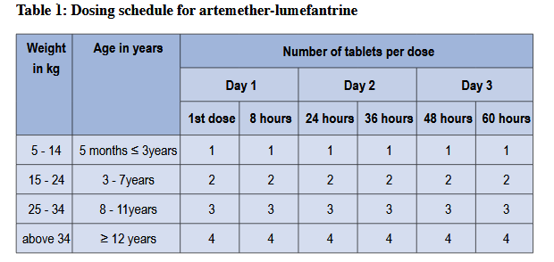

Slide 70
Second line treatment in all age groups
The recommended second line treatment for uncomplicated malaria in Kenya is Dihydroartemisinin-piperaquine (DHA-PPQ).
This is currently available as a fixed-dose combination with adult tablets containing 40 mg of dihydroartemisinin and 320 mg of piperaquine and paediatric tablets containing 20mg dihydroartemisinin and 160mg of piperaquine.
These are administered once daily for three days

Slide 71
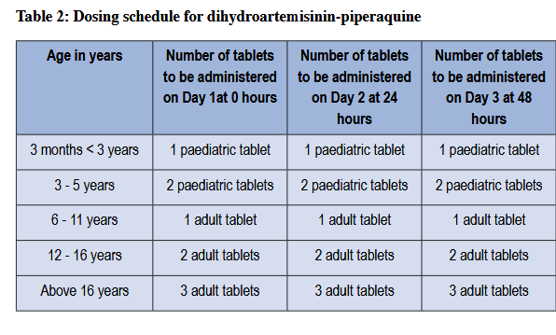

Slide 72
Treatment of uncomplicated vivax malaria
Confirmed lab diagnosis of P. vivax malaria is done before commencing treatment.
P. vivax has both blood and liver stages.
The recommended treatment for vivax malaria is AL and primaquine
Primaquine dose ranges between 0.25 and 0.5mg/kg/day once a day for 14 days

Slide 73
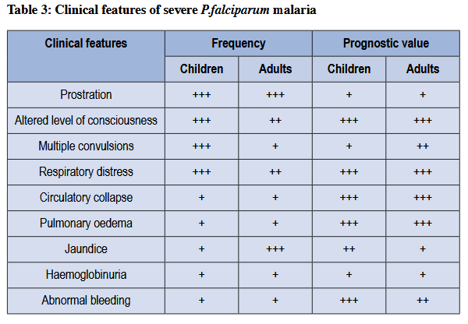
Clinical features of severe falciparum malaria

Slide 74
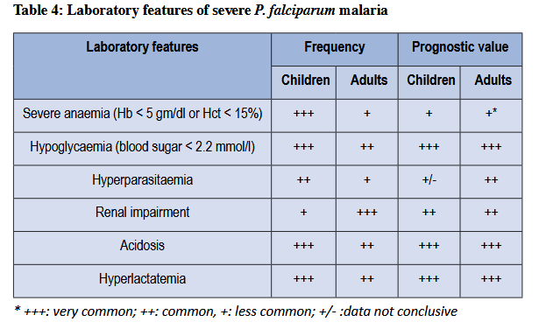

Slide 75
Treatment of severe malaria
  The recommended treatments for severe malaria are parenteral quinine or parenteral artemisinins (artesunate or artemether).
  The preferred route of administration is the intravenous route.
  However the intramuscular route can be used as an alternative where intravenous route is not feasible.

