Slide 1
Antiparasitic agents
Antileishmanial drugs
Antitrypanosomols

Slide 2
Introduction
Leishmaniasis is a parasitic disease caused by the Leishmania parasite.
This parasite typically lives in infected sand flies.
Leishmaniasis spread from a bite of an infected sand fly belongs to genus Phlebotomus.
Visceral leishmaniasis is endemic in semi-arid and arid areas of Rift Valley, Eastern and North Eastern regions of Kenya.
The most important transmission foci remain Baringo, Isiolo, Marsabit, Pokot, Turkana and Wajir counties

Slide 3
TYPES
1. Cutaneous leishmaniasis
It produced by Leishmania tropica which is characterized by a skin lesion
More common
2. Mucocutaneous leishmania:
It produces by Leishmania braziliensis characterized by lesion near mucosal membranes.
Less common
3.Visceral leishmania: ( kala-azar)
It produces by Leishmania Donovani.
Symptoms include fever, enlargement of spleen and liver, weakness and progressive emaciation, anaemia
More serious and fatal.

Slide 4
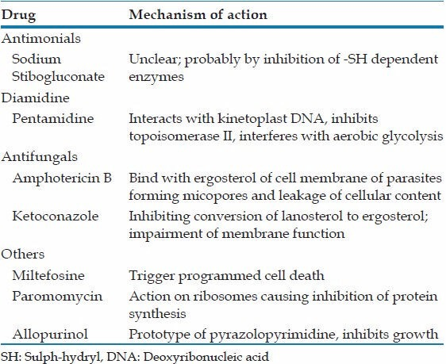
Classification of antileishmanial drugs

Slide 6
Sodium stibogluconate is an organic antimony derivative.
Its mechanism is unclear but it may act by binding to thiol groups in the parasite and inhibiting the formation of high-energy phosphates (ATP) and guanosine triphosphate (GTP)
Pharmacokinetics
Sodium stibogluconate must be given parenterally, either by intramuscular injection or by slow intravenous infusion
It is eliminated by the kidneys
Has a half-life of 6 hours.

Slide 7
Indications
1.Primary visceral leishmaniasis- DOC
A. Combination therapy- 1st line
sodium stibogluconate (pentavalent antimonials)/SSG at 20 mg/kg per day intramuscularly or intravenously plus paromomycin 15 mg per kg body weight per day intramuscularly) for 17 days.
B. Monotherapy treatment Sodium stibogluconate (SSG) as a monotherapy where paromomycin is not available or is contraindicated (hearing impairment or concomitant renal disease). –
- SSG 20 mg/kg per day intramuscularly or intravenously for 30 days

Slide 8
Side effects of pentavalent antimonials - SSG
Pentavalent antimonials require monitoring of safety as toxicity and side-effects may occur, especially with longer treatment duration.
These include
nausea
anorexia
arthralgia /myalgia
pain at the injection site
ECG changes
raised liver enzymes
raised pancreatic enzymes
severe vomiting
Sudden death may occur due to cardiac arrhythmia
intra-cerebral bleeding
anaemia associated heart failure and renal toxicity

Slide 9
Paramomycin (aminosidine)
Paromomycin is a non absorbable aminoglycoside agent that acts like other aminoglycosides by binding to the 30S ribosomal RNA and inhibiting protein synthesis.
It is administered orally or parenterally
Paromomycin is excreted by the kidneys unchanged and is eliminated fastest of all antileishmanial drugs.

Slide 10
Indications
active as a luminal agent for E. histolytica,but not against the extraluminal forms
leishmaniasis
Tapeworm infections in human
giardiasis during pregnancy.
used to treat cryptosporidiosis in a limited number of people
when combined with azithromycin, appears to impact malabsorption and diarrhea in patients with AIDS

Slide 11
Common side-effects of paromomycin /aminosidine
Injection site pain,
Elevated liver enzymes( aspartate aminotransferase (AST) and alanine aminotransferase (ALT)
pyrexia,
Hearing changes( abnormal audiogram).
-These effects are usually mild to moderate and transient or reversible at the end of treatment.

Slide 13
Liposomal amphotericin B (AmBisome)
Used as 2nd line treatment
AmBisome comes in vials of 50 mg and needs to be reconstituted and diluted in 5% dextrose and given over a period of 30–60 minutes as an intravenous infusion.
The recommended dose in Kenya is:
3–5mg/kg body weight per daily dose by infusion given over 6–10 days up to a total dose of 30 mg/kg.
AmBisome should be stored at 2–8 °C and should not be frozen.
It should also be protected from exposure to light.
The reconstituted AmBisome may be stored for 15–24 hours at 2–8 °C before use.

Slide 14
Liposomal amphotericin B is the first-line treatment for the following conditions:
pregnant women
lack of response or relapses after SSG-PM or SSG therapies
severely ill patients
children less than 2 years old and adults older than 45 years
Leishmania-HIV coinfected patients
contraindication to SSG or Paramomycin treatment

Slide 15
Side-effects of AmBisome
Are rare but the patient may have:
fever and chills
low backache if the infusion is given too fast.
Anaphylactic reactions have also been observed in some patients.
Hypokalaemia - corrected using potassium chloride
NB/ Amphotericin B deoxycholate has been used in the past for treatment of visceral leishmaniasis. However, due to its side-effects, it has been replaced by safer liposomal formulations.

Slide 16
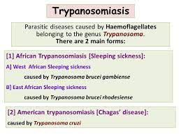
Antitrypanosomals Introduction

Slide 17
African Trypanosomiasis, also known as “sleeping sickness”, is caused by microscopic parasites of the species Trypanosoma brucei.
It is transmitted by the tsetse fly (Glossina species), which is found only in sub-Saharan Africa.
Two morphologically indistinguishable subspecies of the parasite cause distinct disease patterns in humans:

Slide 19
T. b. gambiense causes a slowly progressing African trypanosomiasis in western and central Africa
T. b. rhodesiense causes a more acute African trypanosomiasis in eastern and southern Africa
In Kenya, the disease is caused by Trypanosoma brucei rhodesiense and occurs in the western part of the country
Tsetse flies are found in woodland and savannah areas mainly in national parks and game reserves and they bite during daylight hours.

Slide 20
Clinical presentation
Occurs in two stages:
First stage- the trypanosomes multiply in subcutaneous tissues, blood and lymph.
This is also called haemo-lymphatic stage . It entails:-
bouts of fever
headaches,
enlarged lymph nodes
joint pains
itching

Slide 21
Second stage - the parasites cross the blood-brain barrier to infect the central nervous system.
This is known as the neurological or meningo-encephalic stage.
Signs and symptoms of the disease include:-
changes of behavior
Confusion
sensory disturbances
poor coordination
Disturbance of the sleep cycle, which gives the disease its name, is an important feature.
Without treatment, sleeping sickness is considered fatal although cases of healthy carriers have been reported.

Slide 22
Antitrypanosomal drugs- classification

Slide 26
Pentamidine has been used since 1940 as an alternative to suramin for the early hemolymphatic stage of disease caused by Trypanosoma brucei (especially T brucei gambiense).
The drug can also be used with suramin. Pentamidine should not be used to treat late trypanosomiasis with central nervous system involvement.
A number of dosing regimens have been described, generally providing 2–4 mg/kg daily or on alternate days for a total of 10–15 doses.
Pentamidine has also been used for chemoprophylaxis against African trypanosomiasis, with dosing of 4 mg/kg every 3–6 months

Slide 31
Melarsoprol remains the most active trypanocidal drug available.
Clinically, even patients with advanced sleeping sickness will feel better within 1 week of initiation of melarsoprol therapy.
However, the important determinant of efficacy in trypanosomiasis treatment is the proportion of patients who relapse during follow-up.

Slide 34
Nifurtimox, a nitrofuran derivative, trypanocidal activity was empirically discovered and since 1967
It has been used for the treatment of Chagas disease caused by Trypanosoma cruzi in Latin America.
The mode of action of nifurtimox is not clearly known but may be related to the generation of reactive oxygen species which damage cellular components such as DNA, membrane lipids and proteins.
More recently, nifurtimox has been evaluated together with eflornithine as combination therapy for treatment of late-stage T. b. gambiense sleeping sickness

