Slide 1
ANTIVIRAL/ANTIRETROVIRAL
PHARMACOLOGY
BY
N. KING’ORI

Slide 2
HIV VIRUS
A retrovirus from the Lentivirus family.
Genetic material consists of a single-stranded ribonucleic acid (RNA)
Viral particle is spherical in shape with a diameter of 80-100 nanometers (nm).

Slide 3
The Biology Of The Human Immunodeficiency Virus
Basic Virology:
There are two types of HIV.
HIV – 1
  Is found worldwide
  Is the main cause of the worldwide pandemic
HIV – 2
  Is mainly found in West Africa, Mozambique and Angola.
  Causes a similar illness to HIV – 1
  Less efficiently transmissible rarely causing vertical transmission
  Less aggressive with slower disease progression

Slide 4
HIV 1 Subtypes

Slide 5
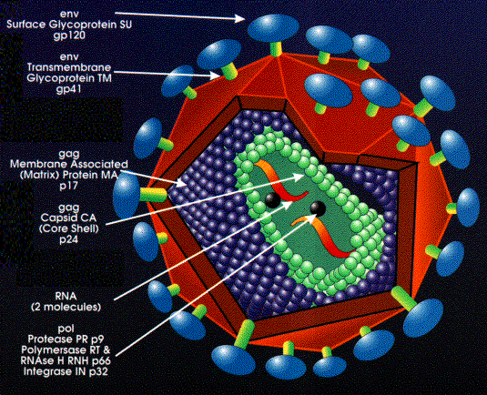
Structure Of Human Immunodeficiency Virus

Slide 6
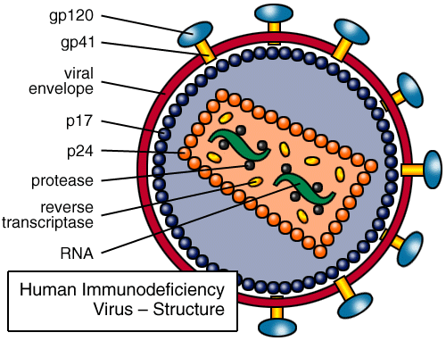
Structure Of Human Immunodeficiency Virus
Has an outer double lipid membrane, (derived from the host membrane).
The lipid membrane is lined by a matrix protein.
The lipid membrane is studded with the surface glycoprotein (gp) 120 and the transmembrane gp 41 protein.
These glycoprotein spikes surround the cone-shaped protein core.

Slide 7
HIV Structure
The core (capsid) is made up of several proteins:-
HIV Glycoproteins
The gp120 and gp41 mediate the entry of virus into the host cells.
P₂₄ the main protein
Within the capsid are
  two identical single strands of RNA (the viral genetic material).
  viral enzymes

Slide 8
HIV Structure
Viral Enzymes
Most important: Reverse Transcriptase (RT), Protease and Integrase.
RT converts viral single-stranded RNA into a double stranded deoxyribonucleic acid (DNA).
DNA is incorporated into host nucleus as the proviral DNA.
Integrase facilitates integration of the DNA into the host’s chromosomal DNA.
Protease enzyme splits generated macro-proteins into smaller viral proteins (core, envelope & regulatory proteins and enzymes) which go into forming new viral particles.
Notes:
It is necessary for a double stranded DNA chain to be formed so that it can be integrated into the double stranded host DNA. This step is catalyzed by RT which also acts as a DNA polymerase. This is essential for the integration process since the host DNA is a double stranded structure. In this way the virus establishes an infection that is not eradicable unless the host cell dies

Slide 9
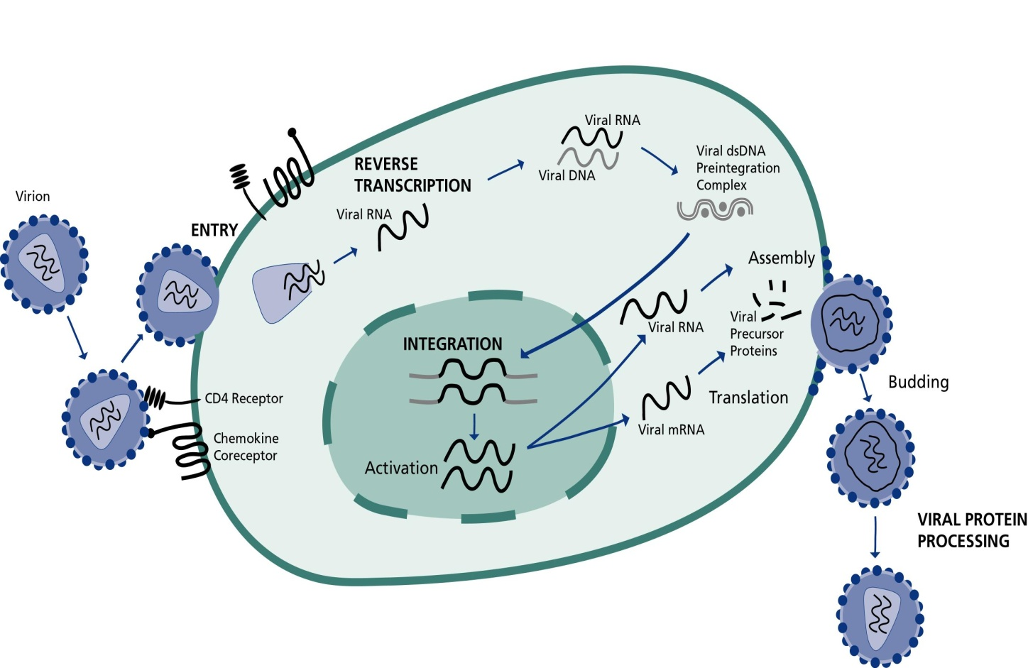
HIV Life Cycle
Binding, Fusion and Entry
Transcription
Integration & Replication
Budding
Maturation

Slide 10

HIV LIFE CYCLE: Enzymes
Transcription:
  Activation of host cell results in transcription of viral DNA into mRNA.
  mRNA translated into viral precursor proteins
Assembly & Budding
Viral precursor proteins processed by protease enzyme into usable forms
  Proteins assembled with RNA to form viral particles which then bud
Fusion & entry
Reverse Transcription
  The viral enzyme reverse transcriptase converts the single stranded viral RNA into double strand DNA
Integration:
  The viral enzyme integrase inserts the viral DNA (viral genetic material) into the host DNA.
Notes:
Activation of the host cells results in the transcription of viral DNA into messenger RNA (mRNA), which is then translated into viral proteins. The new viral RNA forms the genetic material of the next generation of viruses. The viral RNA and viral proteins assemble at the cell membrane into a new virus. Amongst the viral proteins is HIV protease, which is required to process other HIV proteins into their functional forms. The viral RNA and viral proteins assemble at the cell membrane into a new virus. Following assembly at the cell surface, the virus then buds forth from the cell and is released to infect another cell. CD4 cells are destroyed in this process

Slide 11
HIV Entry Mechanism
HIV
2. Co-receptor
interaction
HIV
HIV
gp41
3a. Anchorage
gp120
HIV
1. CD4
Attachment
CXCR4
CCR5
CD4
gp41
Cell
3c. Fusion
Complete
HIV
3b. coil-coil
interaction
HIV
Notes:
The virus binds to the CD4 receptor on the cell’s membrane.
Interactions with co-receptors (CCR5 or CXCR4)take place- Individuals who have mutations of CCR5 are very resistant to HIV
Leading to anchorage of the virus
Then fusion of the virus with the membrane
When fusion is complete, the virus enters the cell.

Slide 12
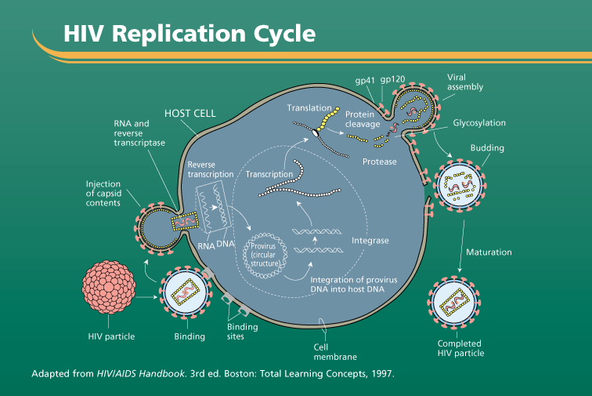
Notes:
The virus binds to the CD4 receptor on the cell’s membrane.
Interactions with co-receptors (CCR5 or CXCR4)take place- Individuals who have mutations of CCR5 are very resistant to HIV
Leading to anchorage of the virus
Then fusion of the virus with the membrane
When fusion is complete, the virus enters the cell.

Slide 13
Targets of ARV Drugs
gp41
gp120
Viral
assembly
CD4 Cell
HOST CELL
Translation
Protein
RNA s
cleavage
NRTI’s & NNRTI’s/ NtRTIs (e.g. AZT)2
e
Budding
Reverse
Protease
transcription
Transcription
Injection
Protease inhibitors (e.g. Kaletra) 3
of
contents
Entry/Fusion inhibitors work here 1
RNA
DNA
Provirus
Integrase
(circular
Maturation
structure)
Integration of provirus
DNA into host DNA
HIV Particle
Binding
HIV particle
sites
Completed
Cell
HIV particle
membrane
Notes:
The viral lifecycle is important when talking about drugs to fight HIV
New drugs under development target different parts of the Lifecycle
Fusion: Fusion Inhibitors – Enfuvirtide (Fuzeon)
Reverse Transcriptase: Is targeted by three drug classes the NNRTI, the NRTI, the nucleotide RTI (We will talk about extensively later)
Viral Integrase
Viral Regulatory Proteins
Viral Protease: Is targeted by Protease Inhibitors (We will talk about these extensively later)
HIV proteins
Made as “polyproteins”
Multiple proteins attached to each other
Must be cleaved to form functional proteins
Protease cleaves polyproteinsFusion inhibitor already in use, T20 (Enfuvirtide), effective. Currently used mainly in salvage therapy; needs to be given SC
Other entry inhibitors in development include the chemokine co-receptor inhibitors, CD4 receptors and other fusion inhibitors
NRTI drugs prevent viral DNA production by incorporating themselves into the newly forming DNA.
NNRTI drugs attach themselves to the viral enzyme reverse transcriptase, blocking its mechanism and making it unable to produce viral DNA
To make the virus infectious it is essential that new viral proteins are cut and structured correctly. Protease inhibitors work by blocking the site where the cutting takes place, preventing the new virus from maturing and infecting any other cells.

Slide 14
Classes of Anti Retro Virals
Reverse transcriptase (RT) inhibitors
  Nucleoside RT inhibitors (NRTI)
  Non-nucleoside RT inhibitors (NNRTI)
  Nucleotide RT inhibitors (NtNRI)
Protease inhibitors (PI)
Entry Inhibitors
  Attachment inhibitors
  Chemokine receptor antagonists
  Fusion inhibitors
Integrase inhibitors

Slide 15
Antiretroviral Agents
NRTI Nucleoside Reverse Transcriptase Inhibitor
  Zidovudine (AZT,ZDV Ritrovir)
  Didanosine (ddI Videx)
  Zalcitabine (ddC)
  Stavudine (d4T Zerit )
  Lamivudine (3TC Epivir)
  Abacavir (ABC Ziagen)
  Emtricitabine (FTC)
Nucleotide analogues
  Tenofovir (TDF, Viread)

Slide 16
Antiretroviral Agents
NNRTI Non-Nucleoside Reverse Transcriptase Inhibitor
  Nevirapine (NVP- Viramune)
  Delavirdine (DLV)
  Efavirenz (EFV- Stocrin, sustiva )

Slide 17
Antiretroviral Agents
Protease Inhibitors Protease Inhibitors
  Saquinavir (SQV)
  Ritonavir (RTV)
  Indinavir (IDV)
  Nelfinavir (NFV)
  Amprenavir (APV)
  Lopinavir/ ritonavir (LPV/r Kaletra, Aluvia)
  Atazanavir (ATZ)
  Darunavir(DRV)
Fusion inhibitors
  Enfuvirtide (T-20)
  Entry inhibitors
  -Maraviroc
  Vicroviroc
Integrase inhibitors
  Raltegravir
  Dalutegravir

Slide 18
Some ARVs as Fixed drug combinations (FDCs)
AZT + 3TC
TDF+3TC
AZT + 3TC + NVP
TDF+ 3TC + EFV
TDF + FTC + EFV
TDF + FTC
ABC + 3TC
TDF + 3TC + DTG

Slide 19
Considerations while initiating ART
Develop a treatment partnership with your patient.
Focus on your patient’s concerns and priorities.
Use the 5 A’s:Assess, Advise, Agree, Assist, Arrange.
Educate patient on disease and support patient self-management.
Organize proactive follow-up.
Involve peer educators and support staff in your health facility.
Link the patient to community-based resources and support.
Use written information—registers, Treatment Plan, treatment cards and written information for patients—to document, monitor, and remind.
Work as a clinical team.
Assure continuity of care.

Slide 20
Principles of ART
Antiretroviral treatment is part of the comprehensive care of HIV infection
Treatment should be planned and started in good time
Regular follow up and monitoring is essential
Treatment should be stopped/changed when necessary
The choice of drugs should take into account
  Efficacy
  Tolerability
  Dose Schedule
  Affordability and availability

Slide 21
Principles of ART cont’d
ARV drugs are associated with adverse events and drug-drug interactions
Adherence is key to successful treatment
Treatment may fail despite patient’s and carer’s best efforts
There should be commitment to continued support of patient (and family)

Slide 22
Characteristics of good HAART
Potent: should bring down viral load to an undetectable level within 3-4 months of therapy
Acceptable regimen to maximize adherence
- simple
- tolerable side effects
- patient commitment for life-long therapy
Reasonable options for future therapy
Affordable and sustainable

Slide 23
AIM OF ART
Improve symptom free longevity by maximal, sustainable & durable suppression of viral replication
(<50 copies/ml)
Currently HAART does not cure HIV but halts viral replication, thus prevent further disease progression and immune system damage

Slide 24
HISTORY OF ART
1980 - 1987 – No therapy
1987 - 1994 – Mono therapy
1994 - 1999 – Combination therapy (HAART)
1999 - 2002 – Complicated therapy
2002 - 2005 - Simplified therapy

Slide 25
Goals of ART
Improved quality of life/increased longevity
Reduction of HIV related morbidity and mortality
Restoration and preservation of immune function
Maximal suppression of HIV replication

Slide 26
Suppression of HIV Replication
ARVs must be taken in combination of at least 3 drugs
Strict adherence to treatment is of the utmost importance
  <95% adherence allows the rapid development of viral resistance
  Poor adherers do badly
    Fail treatment much earlier

Slide 27
Immune Reconstitution
ART prevents CD4 destruction by HIV
CD4 cell count can recover
Improved function of CD4 cells
CD4 cells are central to the immune system
  So there is improved overall function of the immune system
  It takes from 6 to 8 weeks for this to become evident clinically

Slide 28
Reduction of HIV related morbidity and mortality and Improvement of QOL
Decreased hospitalizations
Decreased risk of illnesses
Increased general well-being
Reversal of weight loss
Ability to return to work

Slide 29
HAART INITIATION
All clients who test positive for HIV should be initiated on HAART irrespective of CD4 count and WHO staging after a successful testing and counselling
All pregnant mothers who test positive should be initiated on HAART irrespective of CD4 or WHO status

Slide 30
HAART INITIATION(first line) DEC 2020
Age/Weight Preferred Regimen
Birth – 4 weeks AZT + 3TC + RAL or NVP
< 20 kg (above 4 weeks) ABC + 3TC + LPV/r
20 kg – <35 kg ABC + 3TC + DTG
≥ 35 kg TDF + 3TC + DTG
HIV EXPOSED INFANT
AZT/NVP for six weeks
NVP for six months or up to one week prior to ceasastion of breastfeeding

Slide 31
HAART INITIATION
Infants who initiate ART at less than 4 weeks of age should be initiated on AZT+3TC+RAL. If RAL is not immediately available at the facility, then use NVP instead.
Once the infant is 4 weeks old, change their regimen to ABC+3TC+ LPV/r 2. DTG 50mg OD to be used for all children ≥20kgs and above. For all the other molecules doses, refer to the dosing chart in the National ART Guidelines 2018

Slide 32
HAART IN SPECIAL CIRCUMSTANCES
POST EXPOSURE PROPHYLAXIS(PEP) PEP should be offered as soon as possible (< 72 hours) after high risk exposure .The recommended ARV agents for PEP are
ADULT >35 kg (TDF/3TC/DTG)
20 - <35kg (ABC/3TC/DTG)
< 20 kg (ABC/3TC/LPV/r)
Pre exposure prophylaxis(PrEP) Oral PrEP should be offered to HIV negative individuals at substantial ongoing risk of HIV infection (including the seronegative partner in a discordant relationship, MSM,FSW, PWID)
TDF/FTC
TDF/3TC

Slide 33
PEP/PrEP
Prep does not eliminate the risk of HIV infection and it does not prevent STIs or unintended pregnancies
PrEP should only be offered after assessment to establish eligibility, readiness for effective use, required follow-up (including HIV testing every 3 months) and absence of contraindications to TDF and/or FTC

Slide 34
HBV/HIV and HCV/HIV Co-infection
All HIV positive adolescents and adults should be screened for HBV infection, using serum HBsAg, as part of initial evaluation; children who did not complete routine childhood immunizations should also be screened for HBV
PLHIV without evidence of hepatitis B infection (HBsAg negative) should be vaccinated against hepatitis B.
The recommended first-line ART for adults with HIV/HBV co-infection is TDF + 3TC + DTG ( superboost DTG 50 mg )
HCV serology should be offered to individuals at risk of HCV infection
Direct acting antiviral therapies (DAAs) for treatment of HCV have simplified the management of HIV/HCV co-infection

Slide 35
Interpreting Viral load results and defining treatment failure
The goal of ART is to achieve sustained viral suppression defined as below Lower Detection Limit(LDL).
Less than 400 copies/ml are currently considered <LDL(February 2019, VL cut off circular)
Persistent low-level viremia (PLLV) is defined as viral load copies between 400-999 copies/ml on two consecutive measures. These patients are at increased risk of progression to treatment failure, development of ARV resistance and death and therefore require a similar case management approach as patients with VL ≥ 1,000 copies/ml

Slide 36
TREATMENT MONITORING
Adherence assessment on every visit
Viral load monitoring every 6 months
Treatment failure assessment
ADULTS
Clinical failure
Pt. Deteriorating, new/ recurrent significant stage III / IV O.I or malignancy
Immunological failure
*CD4 count NOT > 100cells/mm³ after 12 months of effective HAART treatment.
*CD4 count drop > 30% from peak value while on HAART.
*CD4 count drop to /below baseline level.

Slide 37
Virological confirmation of TF
*viral load > 1000 copies/ml 2 results 3 months apart
CHILDREN
Clinical failure
Pt. Deteriorating, new/ recurrent significant stage III / IV O.I or malignancy
* Growth failure despite adequate nutrition
* Delayed, stagnation or regressed developmental milestones
* Lack of clinical improvement from baseline on presentation to care

Slide 38
Three Main Reasons for Altering a Patient’s Regimen
1. Drug Toxicity or Intolerance
  Single drug substitutions appropriate
2. Drug Interactions
  Single drug substitutions appropriate
3. Treatment Failure
  Entire regimen must be changed

Slide 39
General Principles for Identification and Management of ADRs
At every clinic visit the patient on ART should be monitored clinically for toxicities using appropriate history (history of symptoms that suggest toxicity) and physical examination (relevant signs). Targeted laboratory assessment may be used to confirm specific toxicities.
Evaluate concurrent medications and establish whether the toxicity is attributable to an ARV drug (or drugs), or to a non-ARV medication taken at the same time. Consider other disease processes (e.g. concurrent infectious processes or IRIS)
3. All toxicities should be graded. Manage the adverse event according to severity

Slide 40
Drug Toxicity and Intolerance
Two Broad Groups of Side-effects:
1. Common “Mild”
2. Rare and Dangerous
Common mild side effects
Nausea
Vomiting
Lethargy
Headaches
Dizzyness
“Flu” symptoms
Mild rash
NB
Patients should “expect” them
Usually improve within 1-2 months
Rarely necessary to change/stop regime

Slide 41
Rare, potentially serious SE’s
Severe rash/SJ Syndrome
Hepatotoxicity
Peripheral Neuropathy
Haematotoxicity
Pancreatitis
Lactic Acidosis

Slide 42
General guide to estimate the severity of grade
Mild Grade 1 | Moderate Grade 2 | Severe Grade 3 | Potentially life threatening Grade 4
Symptoms causing no or minimal interference with usual social and functional activities | Symptoms causing greater than minimal interference with usual social and functional activities | Symptoms causing inability to perform usual social and functional activities | Symptoms causing inability to perform basic self-care OR medical or operative intervention indicated to prevent permanent impairment, persistent disability or death

Slide 43
Management of Adverse Drug Effects
Try and establish the ARV drug responsible for the adverse effect
Consider duration of ARV use, other disease processes, other treatments (including self administered)
If it is necessary to stop ART, discontinue all ARV drugs simultaneously*
Grade 1 or 2 reactions: continue ART under observation.
  Single drug substitution may be necessary
Grade 3 or 4- Stop ART, manage Adverse Event and re-introduce ART.
Notes:
* In NNRTI containing regimens stopping all 3 drugs at once may allow for development of drug resistance. It is therefore recommended that the NRTI backbone should be continued for 2 weeks if possible to reduce the likelihood of NNRTI resistance developing. See Guidelines to ARV Treatment
Minimizing Adverse Events
Appropriate drug and regimen selection
Dose titration
Monitoring and reassuring for effects that are transient
Appropriate timing of administration
Pharmacological interventions
Withdrawal of the offending drug(s)

Slide 44
ARV Drug Class Adverse Effects(summary)
NRTIs
Peripheral neuropathy
Pancreatitis
Lipoatrophy
Hepatitis
Lactic acidosis
Mitochondrial toxicity
PIs
Lipodystrophy
GI Intolerance
Hyperglycaemia
Lipid abnormalities
Common Adverse Effects
Peripheral Neuropathy – d4T,ddI
Hematotoxicity - AZT
Hepatotoxicity - NVP
Diarrhea – NFV
Skin rash – NVP
Lipodystrophy – PIs, NRTIs
CNS disturbance – EFV
Hypersensitivity – ABC
Hyperlipidemia-PIs, d4T
NNRTIs
Rash
Fever
Nausea
Diarrhea
Hepatoxicity
Notes:
The extent of inhibition of mitochondrial DNA polymerase gamma is as follows d4T>Zalcitabine (ddC) > Didanosine ( ddI) > Lamivudine (3TC) > Zidovudine (ZDV) > Abacavir (ABC).
Generally adverse events are less common in children compared to adults
Hyperbilirubinemia, haematuria and nephrolithiasis with Indivanir is more pronounced in children
There is high risk of hepatoxicity with ZDV in children below 5 years.
Asymptomatic retinal pigmentation with ddI is more likely in children.
Be on the look out for diarrhea with NFV and manage the same.
The most common adverse events are graded ( see attached table) with suggestions of interventions at each level of grading.

Slide 45
Nucleoside Reverse Transcriptase Inhibitors
Mechanism of action
NRTIs interrupt the HIV replication cycle via competitive inhibition of HIV reverse transcriptase and termination of the DNA chain.
Reverse transcriptase is an HIV-specific DNA polymerase that allows HIV RNA to be transcribed into single-strand and ultimately double-strand proviral DNA and incorporated into the host-cell genome.
Proviral DNA chain elongation is necessary before genome incorporation can occur and is accomplished by the addition of purine and pyrimidine nucleosides to the 3’ end of the growing chain.

Slide 46
NRTIs
NRTIs are structurally similar to the DNA nucleoside bases and become incorporated into the proviral DNA chain, resulting in termination of proviral DNA formation Tenofovir, lamivudine, and emtricitabine exhibit activity against hepatitis B virus (HBV) in addition to HIV and are frequently incorporated into antiretroviral regimens for patients with HIV and HBV coinfection.

Slide 47
Resistance
Resistance to NRTIs occurs by one of two mechanisms: (1) impaired incorporation into the proviral DNA chain or (2) removal from the proviral DNA chain.
Mutations typically occur gradually, with accumulation of several mutations required before clinically significantly resistance develops.
An exception is the M184V mutation, which confers high-level resistance to lamivudine and emtricitabine in a single step. Mutations that selectively impair incorporation into the proviral DNA chain include M184V, Q151M, and K65R

Slide 48
Pharmacokinetics
NRTIs are prodrugs and must undergo phosphorylation by intracellular kinases to exert their activity. Collectively, the oral bioavailability of NRTIs ranges from 25%-93%, with tenofovir and didanosine on the lower end of the spectrum. Food does not significantly affect absorption of any of the NRTIs except didanosine, which must be taken on an empty stomach to achieve optimal absorption and drug levels.
Although serum half-lives of NRTIs are relatively short, intracellular drug levels are the best indicator for drug activity and determine the dose administered for each NRTI.
Most NRTIs are renally eliminated and require dosage adjustments in patients with renal insufficiency; the exception is abacavir, which is given at the normal dose regardless of creatinine clearance.

Slide 49
NRTIs are not metabolized by the cytochrome P450 system; therefore, minimal drug-drug interactions occur. Interactions that have been found to be clinically significant involve didanosine.
When given in combination with tenofovir, didanosine levels are higher than expected, and lower doses must be given to avoid potentially serious adverse effects.
A similar scenario has been demonstrated when didanosine is combined with ribavirin in the treatment of patients with HIV and hepatitis C virus (HCV) coinfection. This combination should be avoided

Slide 50
Adverse events
Adverse effects of the NRTI class include mitochondrial toxicities (e.g., lactic acidosis, pancreatitis, peripheral neuropathy, hepatic steatosis, lipoatrophy).
Mitochondrial toxicities are due to NRTI binding to human mitochondrial DNA polymerase-γ enzyme, impairing cellular respiration.
Under these conditions, normal aerobic metabolism shifts to an anaerobic process, resulting in the above manifestations.

Slide 51
NRTIs adverse effects
Peripheral neuropathy
Pancreatitis
Lipoatrophy
Hepatitis
Lactic acidosis
Mitochondrial toxicity

Slide 52
Zidovudine(AZT)
Bone marrow suppression (anaemia, neutropaenia).
Dose related,synergistic toxicity with other drugs such as TMP-SMX,ganciclovir, etc.
Headache, nausea,vomiting & myopathy, nail changes
Hepatotoxicity, fever, rash---rare

Slide 53
Stavudine (d4t)
Toxicities:
Peripheral neuropathy - higher incidence & more severe when used with ddI (Didanosine) or ddC (Zalcitabine)
Elevated liver enzymes
Increased incidence of pancreatitis when used with ddl + hydroxyurea & fatal lactic acidosis as described earlier
Lipodystrophy - some association of fat redistribution syndrome & hyperlipidaemia with d4T

Slide 54
Didanosine (ddI)
Toxicities: Diarrhoea (16%), pancreatitis(4-7%), peripheral neuropathy(9-15%)
Recent reports of increased incidence of pancreatitis & liver toxicities when used with d4T + hydroxyurea
5/1/2001 warning - 3 cases of fatal lactic acidosis +/- pancreatitis in HIV pregnant women receiving ddI + d4T
Drug interactions:
ddI may interfere absorption of drugs that require gastric acidity (e.g itraconazole, ketoconazole, dapsone)
Ca++ and Mg++ salts in ddI formulation - may chelate drugs such as tetracyclines & quinolones
EC formulation - eliminates these drug interactions
ddI + oral ganciclovir - ddI AUC increased by 100%

Slide 55
Abacavir (ABC)
Hypersensitivity reaction -Mostly occurring within 6 weeks of initiation of treatment
Signs & Symptoms (At least 2 of the following)
High fever, skin rash, malaise, fatigue, nausea, vomiting, diarrhoea, myalgia, arhralgia, respiratory symptoms
Assessment: can be difficult, but should attempt to rule out concomitant illnesses

Slide 56
NNRTIs
Mechanism of action
HIV reverse transcriptase is a heterodimer composed of 2 subunits (p66 and p51).
NNRTIs bind the p66 subunit at a hydrophobic pocket distant from the active site of the enzyme. This noncompetitive binding induces a conformational change in the enzyme that alters the active site and limits its activity.
Etravirine differs from first-generation NNRTIs in its ability to bind at this site despite the presence of some mutations that limit the efficacy of first-generation agents. It is a highly flexible molecule that is able to rotate within the binding site to allow multiple binding conformations.

Slide 57
Resistance
Mutations within the reverse transcriptase gene domain alter the ability of the NNRTIs to bind the enzyme.
First-generation NNRTIs have a low genetic barrier to resistance, whereby a single mutation in the binding site can decrease the ability of the drug to bind, significantly diminishing activity.
First-generation NNRTI resistance has been associated with mutations at multiple codons; however, the presence of either a K103N or Y181C mutation is sufficient to cause clinical failure of delavirdine, efavirenz, and nevirapine.

Slide 58
Pharmacokinetics
NNRTIs display considerable interindividual variability in their pharmacokinetic properties. All currently approved NNRTIs utilize the cytochrome P450 system for metabolism and exert varying induction and inhibition effects on specific isoenzymes (e.g., CYP3A4, CYP2C9). This results in a significant potential for drug-drug interactions

Slide 59
Adverse events
Rash, which is the most common adverse effect associated with all NNRTIs, usually develops within the first few weeks of therapy and resolves with continued treatment.
All NNRTIs except etravirine have the ability to cause some degree of hepatotoxicity. Delavirdine and efavirenz can increase transaminase levels, while nevirapine can cause severe toxicity, including hepatic necrosis in patients with CD4 counts that exceed 250 cells/µL.

Slide 60
Nevirapine (NVP)
Hepatotoxicity-Increasing reports or serious, even life-threatening hepatic necrosis. 12 fold greater risk in women (CD4 >250, pregnancy)
2/3 occurred with 1st 12 weeks of treatment.
Clinical presentation: fatigue, malaise, anorexia, nausea, with or without elevated transminases.
Symptoms progressed to jaundice, hepatomegaly, high transaminases leading to hepatic failure in few days.

Slide 61
Efavirenz (EFV)
Averse effects
Reported in > 50% of patients
Occurs after 1st few doses
Usually resolves or stabilizes within first few weeks
Symptoms: Drowsiness, dizziness, dysphoria, insomnia, somnolence, abnormal dreams, altered concentration & attention span, acute psychosis, depression
Taking at bedtime may reduce symptoms
Some evidence of benefit of using drug level to predict CNS toxicities

